Slide 1
ASMX servisi i Windows Communication Foundation

Slide 2
Sadržaj
XML za komunikaciju aplikacija
ASMX model - pregled
Windows Communication Foundation - pregled

Slide 3




Od objekata do servisa
Object-Oriented
Polymorphism
Encapsulation
Subclassing
1980s
Component-Based
Interface-based
Dynamic Loading
Runtime Metadata
1990s
Service-Oriented
Message-based
Schema+Contract
Binding via Policy
2000s

Slide 4
Prisjetimo se: XML, SOAP, WSDL

Slide 5
Definicija
Simple Object Access Protocol je W3C XML bazirani komunikacijski protokol za razmjenu poruka između aplikacija.
SOAP dokument = XML dokument
Preuzima i sve prednosti XML standarda
platformska neovisnost
jezična neovisnost
korištenje Interneta za transport
proširivost
otvoreni standard

Slide 6
SOAP u akciji
Potreba za komunikacijom između različitih aplikacija
Aplikacije nisu unutar granica nekog IT sistema
Udaljene aplikacije dostupne Internet protokolima
Kreiranje poruka primjeri: SOAP request :: SOAP response

Slide 7
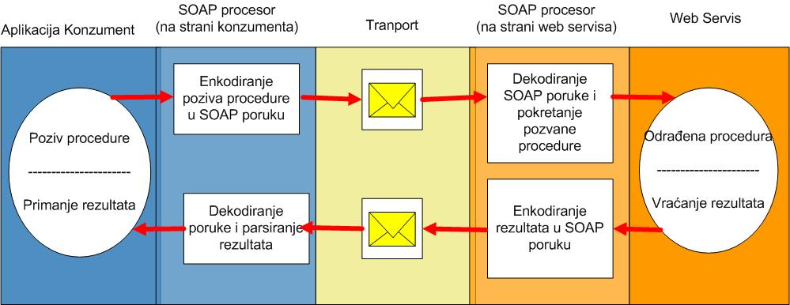
SOAP procesor
SOAP poruka dolazi na web server u HTTP paketu
Na osnovu podataka u HTTP paketu koji označuju da se prenosi SOAP poruka, ovi paketi se predaju aplikativnim modulima za rad sa SOAP dokumentima

Slide 8
WSDL dokument
XML opis web servisa
Svi podaci potrebni za obavljanje komunikacije između web servisa i konzumenta
Code first / contract first

Slide 9
ASMX model

Slide 10
ASMX – vezano uz ASP.NET/IIS

Slide 11
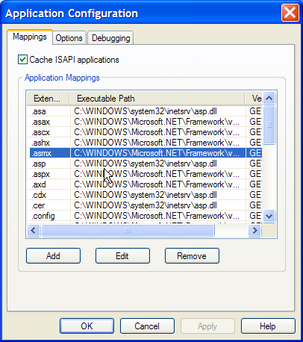
ASMX – vezano uz ASP.NET/IIS

Slide 12
ASMX web servis – krajnja točka
.asmx – krajnja točka web servisa
<%@ WebService class="TVZ.XML.MeteoInfo" %>
Deklaracija – “ja sam web servis”
Class – a svoj funkcionalni dio držim u klasi TVZ...

Slide 13
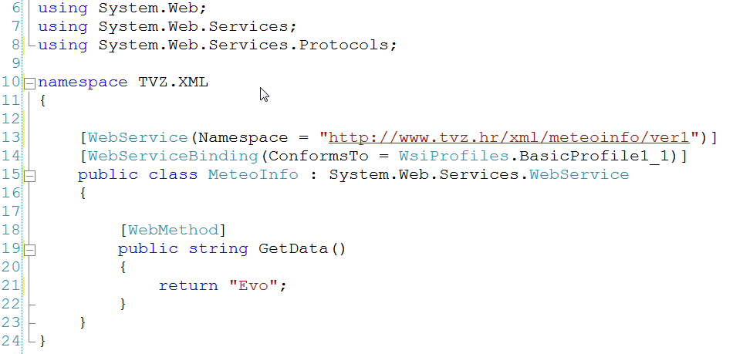
ASMX web servis - klasa
System.Web.Services.WebService
Dodatna označavanja atributima [imeatributa]

Slide 14
ASMX - WSDL
?wsdl
Autogenerirani WSDL dokument
Potreban konzumentu za komunikaciju sa web servisom
Ne postoji “ugrađeni” alat za contract-first razvoj
Open source rješenje – WSCF 5.1 – Web Services Contract First tool

Slide 15
ASMX – dodatni alati
Wsdl.exe
Autogenerirani web site za testiranje web servisa (HTTP POST test)
Ugasiti obavezno kada se krene u produkciju
Kroz web.config konfiguracijsku datoteku (add,remove)
<webServices>
<protocols>
<add name="HttpSoap" />
<add name="HttpPost" />
<add name="HttpGet" />
<add name="Documentation" />
</protocols>
</webServices>

Slide 16
ASMX – problemi
Rad sa dodatnim standardima (WS-security, WS-routing) težak
WS Enhacements 2.0 i 3.0

Slide 17
DEMO
MeteoInfo ASMX web servis

Slide 18
Windows Communication Foundation

Slide 19

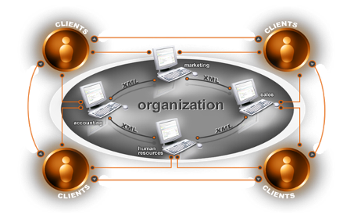
Zašto WCF Potreba za kvalitetnijim i jednostavnijim načinima razvoja distribuiranih aplikacija
Razvoj povezanih sustava još uvijek skup i težak za održavanje
Različiti programski modeli za različite zadatke
Potreba za sigurnosnim mehanizmima i sigurnom razmjenom
Interoperabilnost sa drugim platformama
Servisno orijentirani programski model

Slide 20
Što sve WCF zamjenjuje/objedinjuje
ASMX
WSE
.NET Remoting
COM+ (Enterprise Services)
MSMQ

Slide 21
ASMX i WCF usporedba http://www.microsoft.com/net/wcf/champ/

Slide 22

ASMX Web Servisi

Slide 23

WCF web servisi – ima li razlike

Slide 24
WCF – OSNOVNI PRINCIPI

Slide 25




Servis i konzument
Konzument
Servis
Poruka
Poruka

Slide 26

Krajnje točke - endpoint
Konzument
Servis
Endpoint
Endpoint
Poruka
Endpoint

Slide 27







Address, Binding, Contract
Konzument
Servis
Endpoints
Endpoint
C
B
A
C
B
A
Poruka
C
B
A
Address
Binding
Contract
(Gdje)
(Kako)
(Što)

Slide 28

WCF Arhitektura: Messaging Runtime
Servis
Contract
and Behaviors
Konzument
Dispatcher
Protokoli
Protokoli
Binding
Enkoder
Enkoder
Transport
Transport
Address

Slide 29





WCF globalno
Application
…
Error Behavior
Metadata Behavior
Instance Behavior
Service Model
Throttling Behavior
Transaction Behavior
Type Integ.
Behavior
Concurrency Behavior
Messaging
…
Secure
Channel
Reliable
Channel
Text/XML
Encoder
…
HTTP
Channel
TCP
Channel
Queue
Channel
Binary
Encoder
WAS
ASP.NET
WPF
WinForm
NT Service
COM+
Hosting
Environments

Slide 30
UGOVORI - contracts
Što

Slide 31
Tri tipa ugovora servis, podaci, poruka
Service Contract
Defines Operations, Behaviors and Communication Shape
Data Contract
Defines Schema and Versioning Strategies
Message Contract
Allows defining application-specific headers and unwrapped body content
Što servis radi
Koji i kakvi podaci se razmjenjuju
Kontrola nad izgledom SOAP poruka

Slide 32
Načini komunikacije
One Way
Konzument
Servis
Request-Reply
Duplex (Dual)
One Way:
Pošalji i zaboravi
Request-Reply
Pošalji upit i čekaj na odgovor
Duplex
Primi odgovor “kasnije” na drugom kanaliu (callback-style)

Slide 33
Windows communication foundation
Creating a wcf service
Ivan cesar, polytechnic zagreb

Slide 34
Creating a wcf service in VS2015
Create a new WCF project or add service to an existing project
Create services and operations
Create objects used for data transfer
Configure web service
Publish a WCF application

Slide 35
Creating a wcf service in VS2015
If we are creating a new WCF app, we can choose project type WCF service application
Generally, it is better to separate WCF project from core project, such as web site or web app
Improved horizontal scaling and load balancing
Visual Studio automatically creates a simple demo service which can be used instantly
Notes:
Present a DEMO here – just creating a web service and run it in vs2015

Slide 36
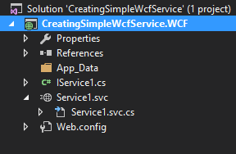
Creating a wcf service in VS2015
File *.svc serves as a markup file which only denotes which class will be used for our service
File I*.cs is an interface which describes our service
File *.svc.cs is a code-behind class which is implementation of our service, implements previously mentioned interface

Slide 37
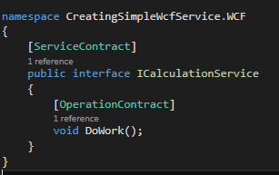
Creating a wcf service in VS2015
ICalculationService is an interface
Interface is a set of functionalities a class must implement
In WCF context, it is a service contract with defined operations
Annotations [ServiceContract] and [OperationContract]
Notes:
At this point, we will delete Service1, and instead demonstrate how to add new service, we will call it CalculationService.
Each method which will be exposed through our web service must be denoted with [OperationContract] attribute
We can have more methods which will not be exposed

Slide 38
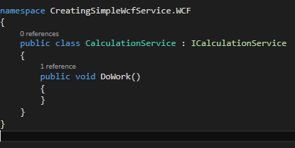
Creating a wcf service in VS2015
CalculationService is a class which implements ICalculationService
Contains the logic of a service
Notes:
Here we will run the project, and see how services are exposed if they are annotated, or not if they are not annotated.
Also, we will show WCF test client, and how WCF app looks in a web browser

Slide 39
Creating a wcf service in VS2015
[ServiceContract] annotation can be further configured
CallbackContract – used to notify calling service in duplex mode
ConfigurationName – link service specification in XML config file
Name, Namespace – controls naming when creating WSDL document
ProtectionLevel – we can ensure that caller satisfies minimum protection requirements (sign, encrypt)
SessionMode – enable or disable session
Notes:
Describe briefly WSDL document and show it on our web service
Also show how to add servicecontract annotations to a web service (ie., name and namespace)

Slide 40
Creating a wcf service in VS2015
[OperationContract] annotation can be further configured
Contains similar set of options as ServiceContract

Slide 41
Creating a wcf service in VS2015
Service behavior can be customized
Define the concurrency mode (single or multiple)
Define the instance context mode (per call, per session, singleton)
Transaction options (isolation level, timeouts, …)
Operation behavior can be customized
Recycling options
Transaction scope and flow
These settings affect performance and processing
Notes:
Describe how asp.net handles requests with regard to concurrency and instance conext
Briefly mention transaction isolation levels

Slide 42
Data transfer objects
Services rarely return simple types (int, string, …)
Services can accept complex parameters and return complex objects
Method 1 (recommended): annotations with [DataContract] and [DataMember]
Method 2: annotations with [Serializable]
Notes:
Demonstrate adding ComplexNumber class
Do not annotate at first
Annotate with Serializable
Annotate with DataContract and DataMember
Show difference by launching WCF test tool and browser.

Slide 43
configuration
Modify web.config or app.config file
XML file with detailed service configuration
Service can be configured on two places
In code, using attributes and annotations
In config file, using XML
Which one is better?
Possibly the hardest part
Fine tuning the service performance and behavior

Slide 44
configuration
Service behavior
Endpoint behaviors (credentials, discovery, serialization, …)
Service behaviors (credentials, metadata, throttling, auditing, …)
Bindings
httpBinding, wsHttpBinding, customBinding, …
Service settings
Endpoint (address, behavior, binding)
Routing
Protocol mapping

Slide 45
bindings
BasicHttpBinding
Easy to setup, no need for a server certificate
Does not provide security by default
SOAP version 1.1
WsHttpBinding
Harder to setup, requires server certificate
Provides security by default
SOAP version 1.2
Supports WS-* standards
Transactions, reliable messaging, etc…
Notes:
We will show config differences between ws http binding and http binding

Slide 46
WCF – authentication and security
Nearly every application requires some sort of authentication and authorization, and security protocols
In WCF, security is most commonly ensured in two ways:
Transport security – using SSL
Message security – by encrypting each message
Every binding type except basicHttpBinding require server certificate to verify identity
Notes:
We will show config differences between ws http binding and http binding

Slide 47
WCF – authentication and security
If basicHttpBinding is used, it is recommended to use at least SSL
Otherwise, sensitive data is sent as plain text, visible to anyone ‘sniffing around’
Possible to authenticate with username/password
Idea: By sending username and password as parameters in each request
NOT AN OPTION – data is sent as plain text
Notes:
We will show config differences between ws http binding and http binding

Slide 48
WCF – authentication and security
If wsHttpBinding is used, it is possible to authenticate and secure communication on several ways
Username and password
Windows identity
Certificate (client and server)
Notes:
We will show config differences between ws http binding and http binding

Slide 49
PUBLIshing wcf application
General rules apply as for publishing „regular” ASP.NET application
WCF app is deployed to IIS
Possible differences between production environment and development environment
It is common to use continuos integration systems
Pull code from source control system
Run tests
Deploy to production server
Cloud environments such as Azure, AWS, …

Slide 50
Windows communication foundation
CONSUMING a wcf service
Ivan cesar, polytechnic zagreb

Slide 51
Consuming wcf service
WCF service is based on SOAP protocol
can be consumed by any form of application running on any form of platform or system, with the condition of supporting SOAP
Exposes WSDL document describing all necessary settings of the service
We will be using .NET in the following demonstrations since interoperability is maximized

Slide 52
Consuming wcf service
Step 1: Locate web service
Usually, by locating WSDL document for the service
Step 2: Generate classes
Generate data transfer classes
Generace client classes to connect to service
Step 3: Configure endpoints
Step 4: Use service

Slide 53
Consuming wcf service
Web service is added as service reference in VS
VS generates all required classes automatically
Generated classes can be seen in object browser of a service reference
Most important class is on with the suffix ‘…Client’
It encapsulates all the methods exposed via web service
Notes:
At this point we will create a winforms app and add service reference

Slide 54
Consuming wcf service
Web service methods are called same as other C# methods
Message processing and communication is hidden
Large amount of classes used in communication implement various interfaces
Nearly all segments of WCF mechanism can be extended and customized

Slide 55
Consuming wcf service
WCF supports fault processing
An exception can occur on server while processing the request
Exception is propagated as FaultException
An exception can occur while establishing connection to server
Exception can be of various types
Client app should take care of error handling
Mostly these exceptions are configuration exceptions

Slide 56
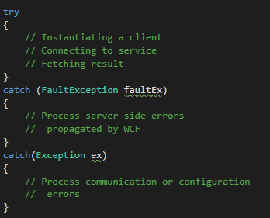
Consuming wcf service
All service calls should be contained inside try-catch block
Error can happen in many segments
Communication
Configuration
While processing on server
Notes:
Here we will demonstrate exception handling and exception propagation, also some configuration errors (for instance, missing certificate for wsHttpBinding)

Slide 57
Consuming wcf service
Generaly, WCF services should be thaught of as ‘stateless’, ie., each request is independent
Sometimes services should maintain state
Services can implement session state
Similar to ASP.NET session

Slide 58
Consuming wcf service
Most common architecture is client (WinForms, WPF) + WCF web service
Goal: make client responsive while fetching the data from web service
Web service calls are rarely instantaneous
Obvious solution: multithreading
Notes:
Present simple WinForms client calling a web service method
Thread.Sleep(…) in web service, demonstrate unresponsiveness

Slide 59
C# Task architecture
C# introduces async methods and Task architecture to simplify multithreading
Combination of async – await
Task class and Task<T> class
Task.Wait
Task.WhenAll
…

Slide 60
C# Task architecture
Important in scenarios when certain thread is ‘blocking’ in one way or another
WinForms or WPF app – UI thread
ASP.NET – limited number of worker threads
Thread invokes a Task on (other) thread, and resumes after task is completed
Thread is returned to thread pool while task is awaited

Slide 61
C# Task architecture
C# allows methods to be marked as async
These methods must return either:
Task – used for methods which do not return result, but can be awaited
Task<Tresult> - used for methods who do return result, can be awaited
void – method which is async/void cannot be awaited, but some tasks inside can be awaited
Designed for event handlers
Notes:
At this point, several simple examples will be introduced. Also, WinFOrms app calling a long-running web service will be modified to asynchronous programming architecture

Slide 62
C# task architecture
async method
await
Long running method, IO operation (awaitable)
returns to caller
Some other code…
At this point, thread can be used for other things (UI thread, or ASP.NET worker thread)

Slide 63
Wcf - recapitulation
Basic concepts of WCF were presented
Basic principles of creating a WCF service were explained
Consuming WCF service was demonstrated
async methods and Task architecture was briefly introduced

Slide 64
SERVICE CONTRACT
Što servis radi?

Slide 65
Service Contract
using System.ServiceModel;
[ServiceContract]
public interface ICalculate
{
[OperationContract]
double Add( double a, double b);
[OperationContract]
double Subtract( double a, double b);
}
Notes:
Note that boundaries are explicit. WCF will only publish methods that are decorated as part of the service.
Note that this can be declared inline on a class instance as well. This does not require that the end user declare the service contract via an interface.

Slide 66
Service Contract: OneWay
[ServiceContract]
public interface IOneWayCalculator
{
[OperationContract(IsOneWay=true)]
void StoreProblem (ComplexProblem p);
}

Slide 67
Service Contract: Duplex Asymmetric
[ServiceContract(Session=true,
CallbackContract=typeof(ICalculatorResults)]
public interface ICalculatorProblems
{
[OperationContract(IsOneWay=true)]
void SolveProblem (ComplexProblem p);
}
public interface ICalculatorResults
{
[OperationContract(IsOneWay=true)]
void Results(ComplexProblem p);
}

Slide 68
DATA CONTRACTS
Koji podaci, tipovi podataka će se razmjenjivati?

Slide 69
Data Contract
[DataContract]
public class ComplexNumber
{
[DataMember] public double Real = 0.0D; [DataMember] public double Imaginary = 0.0D;
public ComplexNumber(double r, double i) { this.Real = r; this.Imaginary = i; }
}
Notes:
The operations of the contracts shown in the previous code examples accept only simple types as parameters and the return values are also simple types.
If you are dealing with parameter lists of that sort, it is likely that you will—for the most part—ignore the fact that the data you are exchanging between services is serialized from its in-memory object representation into an XML information set and subsequently encoded for the wire transfer (and vice versa, of course).
If you are dealing with predefined WSDL documents or if you want to use complex types as arguments, you need to give a little more consideration to the "data contract", however.
While a service contract defines the shape and rules for interfaces (portTypes), along with their associated messages and operations, the data contract defines the shape and rules for the data that is exchanged through operation's input and output messages.
The split between the data contract and the service contract is important.
Service contracts typically define a logically and semantically related set of operations grouped on an interface and are about how a service behaves.
The data contract defined information items that you flow across service boundaries and that are handled with additional logic on the provider and consumer side. If you were looking at it from a (English language) grammar perspective, you could consider operations to be the predicates and the data that flows are the objects, while the caller is the subject. Subjects can do a lot with objects. Every "do" is an operation.

Slide 70
Message contracts
Mapiranje između nativnog tipa u SOAP omotnicu

Slide 71
Message Contract
[MessageContract]
public class ComplexProblem
{
[MessageHeader] public string operation;
[MessageBody] public ComplexNumber n1;
[MessageBody] public ComplexNumber n2;
[MessageBody] public ComplexNumber solution;
// Constructors…
}

Slide 72
Bindings
Načini povezivanja

Slide 73
Povezivanje – binding elementi
Binding
HTTP
Text
Security
Reliability
TX
Transport
Encoders
Protocol
TCP
HTTP
Text
Security
Reliability
MSMQ
IPC
Binary
TX
.NET
Custom
Custom
Custom

Slide 74
Standardni načini povezivanja
Binding | Interop | Security | Session | TX | Duplex
BasicHttpBinding | BP 1.1 | N, T | N | N | n/a
WSHttpBinding | WS | M, T, X | N, T, RS | N, Yes | n/a
WSDualHttpBinding | WS | M | RS | N, Yes | Yes
WSFederationBinding | Federation | M | N, RS | N, Yes | No
NetTcpBinding | .NET | T, M | T ,RS | N, Yes | Yes
NetNamedPipeBinding | .NET | T | T, N | N, Yes | Yes
NetPeerTcpBinding | Peer | T | N | N | Yes
NetMsmqBinding | .NET | T, M, X | N | N, Yes | No
MsmqIntegrationBinding | MSMQ | T | N | N, Yes | n/a
N = None | T = Transport | M = Message | B = Both | RS = Reliable Sessions

Slide 75
DEMO - BINDINGS

Slide 76
Sigurnost Security
Claims based end-to-end security
Secure end-to-end message exchanges
Secure access to resources
Record resource access requests
X509, Username/Password, Kerberos, SAML, custom credentials
Message security
Confidentiality and integrity
Transport or message level
Access to resources
Authentication and authorization
Notes:
Speaker Notes
WCF security secures message exchanges, secures access to resources, and records requests for resources. Security is focused on the support and use of credentials. Credentials consist of claims, issuer, proof of possession.
Confidentiality is ensured by encryption using the recipients credentials, integrity is ensured by signing messages using the senders credentials.
WCF is secure by default (with the exception of the basicHttpBinding).
By default, WCF supports X509 certificates and Username/password, as well as Kerb and SAML tokens. Of course, custom tokens can be written and plugged into WCF as well, and WCF also supports anonymous access if the service chooses to.
Access to resources – authentication and autorization consistent with .NET FX AuthZ processes. Supports integration authentication or control via separate access lists. Acces

Slide 77




Bindings & Behaviors: Security
Client
Service
A
B
C
C
B
A
A
B
C
Be
A
B
C
Be
Bindings Insert Claims in Messages
Behaviors Implement Security Gates

Slide 78
Feature Overview Reliability and Transactions
End-to-end Reliable messaging
In-order guarantees
Exactly once guarantees
Transport-Independent Sessions
Integration with ASP.NET Sessions in IIS-Hosted compatibility mode
Transactions
Guaranteed atomic success or failure across services
Notes:
Speaker Notes
When we talk about reliable messaging (RM), we’re talking about a guarantee that a message actually gets from one service to another (retrying on failed attempts until success). WCF supports two RM guarantees: in-order and exactly once (similar to MSMQ and MQSeries guarantees). “In order” guarantees ensure that messages received are done so in the order in which they are sent. Exactly once guarantees ensure that each message is received only once. There are also two modes for doing RM: an express lightweight mode in which messages are not stored to disk before sending; and a transacted mode in which messages are durably stored to disk before sending. In the case of machine failure, express mode services would lose any messages in the buffer at the time of failure.
When you truly need classic, atomic two-phase commit across two services, WCF also supports transactions. This provides the ability to flow a transaction across service boundaries, for and all participants to enlist in the transaction, vote on the outcome, and succeed or fail together atomically.
It’s also important to point out that security, RM, and transaction support are all configured by default to communicate using Web Services specification-compliant protocols (WS-Security, WS-ReliableMessaging, WS-AtomicTransaction, etc). This provides a new level of integration between services built on our platform and built on other vendor's platforms (WebSphere, etc).
Transition to next slide:
Now that we’ve discussed a broad range of WCF-supported features, let’s look at how WCF services are hosted and activated…

Slide 79
Bindings & Behaviors: Transactions
Client
Service
A
B
C
C
B
A
A
B
C
Be
A
B
C
Be
Bindings Flow Transactions
Behaviors AutoEnlist and AutoComplete

Slide 80
Bindings & Behaviors: Reliable Sessions
Client
Service
A
B
C
C
B
A
A
B
C
A
B
C
Bindings provide Session and Guarantees

Slide 81
Podešavanja kroz kod ili deklarativno Code vs. Config

Slide 82
Definiranje krajnje točke
<?xml version="1.0" encoding="utf-8" ?>
<configuration xmlns="http://schemas.microsoft.com/.NetConfiguration/v2.0">
<system.serviceModel>
<services>
<service serviceType="CalculatorService">
<endpoint address="Calculator"
bindingSectionName="basicProfileBinding"
contractType="ICalculator" />
</service>
</services>
</system.serviceModel>
</configuration>

Slide 83
Konfiguriranje načina povezivanja
<endpoint address="Calculator" bindingSectionName="basicProfileBinding" bindingConfiguration="Binding1" contractType="ICalculator" />
<bindings> <basicProfileBinding> <binding configurationName="Binding1" hostnameComparisonMode="StrongWildcard" transferTimeout="00:10:00" maxMessageSize="65536" messageEncoding="Text" textEncoding="utf-8" </binding> </basicProfileBinding> </bindings>

Slide 84
Custom Bindings
<bindings>
<customBinding>
<binding configurationName="Binding1">
<reliableSession bufferedMessagesQuota="32" inactivityTimeout="00:10:00" maxRetryCount="8" ordered="true" />
<httpsTransport manualAddressing="false" maxMessageSize="65536" hostnameComparisonMode="StrongWildcard"/>
<textMessageEncoding maxReadPoolSize="64" maxWritePoolSize="16" messageVersion="Default" encoding="utf-8" />
</binding>
</customBinding>
</bindings>

Slide 85
DEMO

Slide 86
WCF Podsjetnik
Application
…
Error Behavior
Metadata Behavior
Instance Behavior
Service Model
Throttling Behavior
Transaction Behavior
Type Integ.
Behavior
Concurrency Behavior
Messaging
…
Secure
Channel
Reliable
Channel
Text/XML
Encoder
…
HTTP
Channel
TCP
Channel
Queue
Channel
Binary
Encoder
WAS
ASP.NET
WPF
WinForm
NT Service
COM+
Hosting
Environments

Slide 87
WCF –osnovni i dodatni alati
SVCUtil.exe (service model ⬅ ➔ metadata)
SVCConfigEditor.exe - WCF Service Configuration Editor
SVCTraceViewer.exe – Service Trace Viewer
WCFTestClient.exe – WCF Test Client
WCF Service Auto Host
....
WSCF Blue – Web Services Contract First za WCF
Web Service Software Factory: Modeling Edition

Slide 88
WCF Sažetak
WCF – sadašnjost i budućnost programiranja distribuiranih povezanih apliakcija
Kombinacija najboljih MS tehnologija za distribuirane aplikacije
WS-* standardi za interoperabilnost i .NET za performanse i integracije u postojeća rješenja

