Slide 1
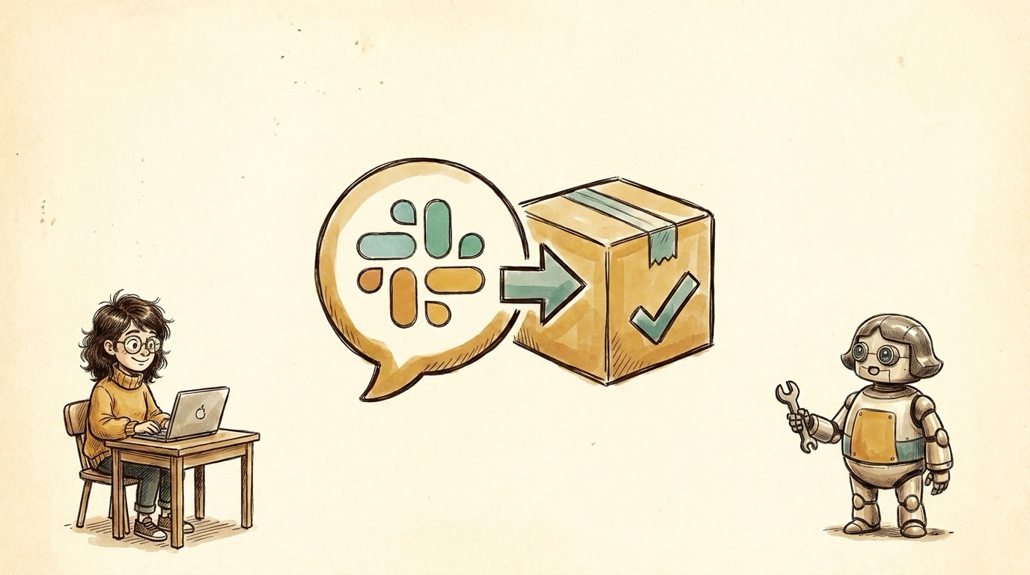
Notes:
TITLE — From Slack to Shipped: turning intent into behavior-verified code. Meet Maya (a maker) and Robo-Maya, her AI counterpart; through the talk we swap who does what to show the human/AI split.

Slide 2
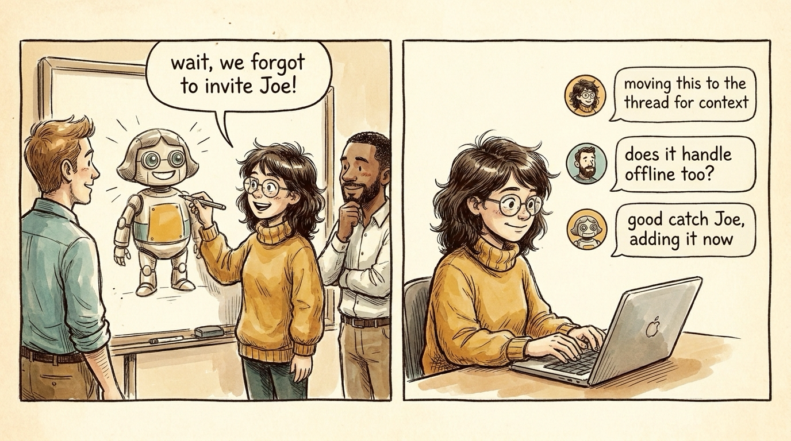
Notes:
Everything starts as a conversation. We used to share context verbally; now it's Slack + Meet, captured. The unlock: AI can have the SAME context humans do -- Joe (human) and Robo-Maya (AI) both reply in the thread.

Slide 3
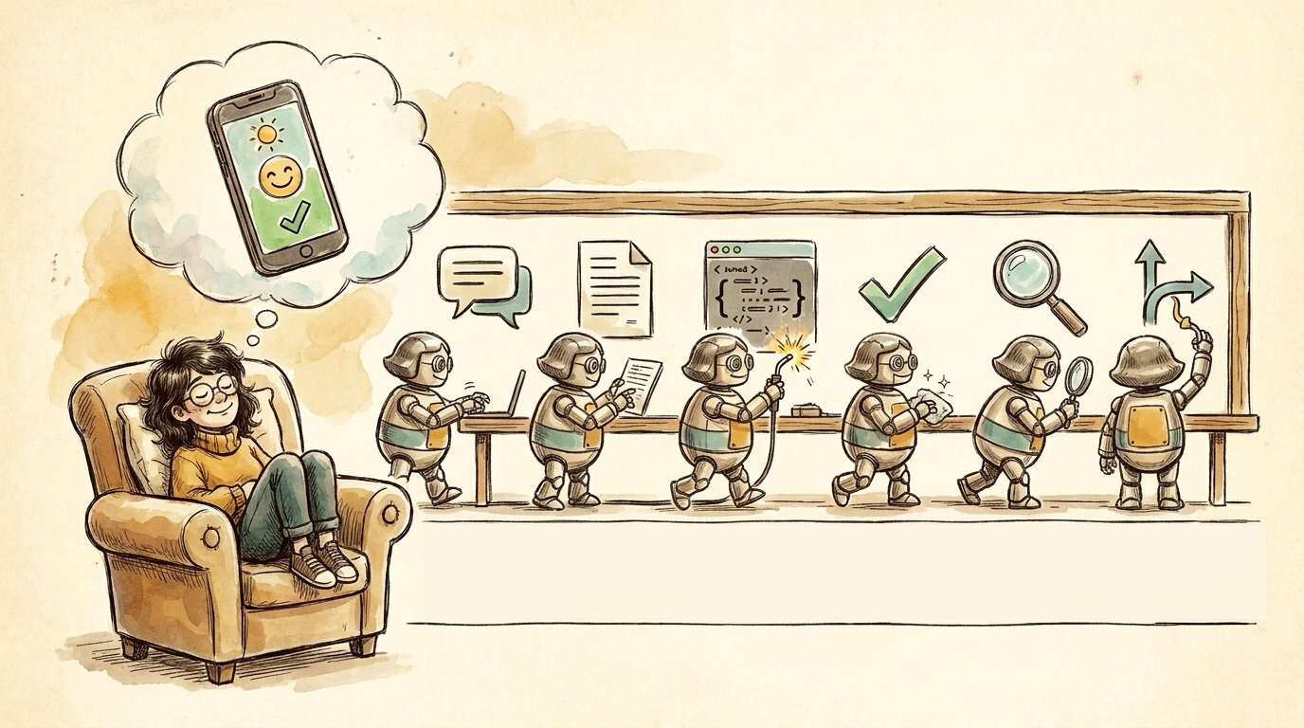
Notes:
The dream in one breath: Slack thread -> PRD -> code -> tests -> review -> merged PR. Tempting to call it a compiler, but it isn't (a compiler transforms logic; we feed it intent). It's a feedback loop: see behavior, feedback, repeat. What does that remind you of? More later.

Slide 4
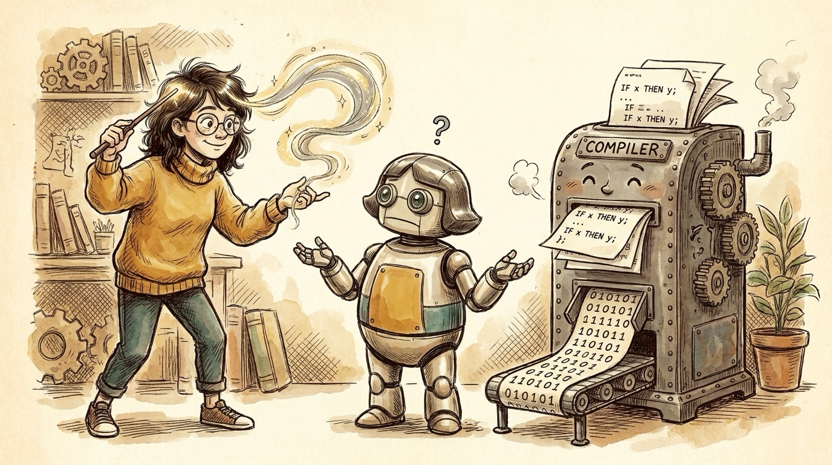
Notes:
It's not a compiler. Writing code is easy; code that never regresses is not. A compiler is correct-by-construction over logic; we feed it fuzzy intent, so output is nondeterministic. The machine crunches precise code into orderly binary -- but you can't feed it the idea in Maya's head.

Slide 5
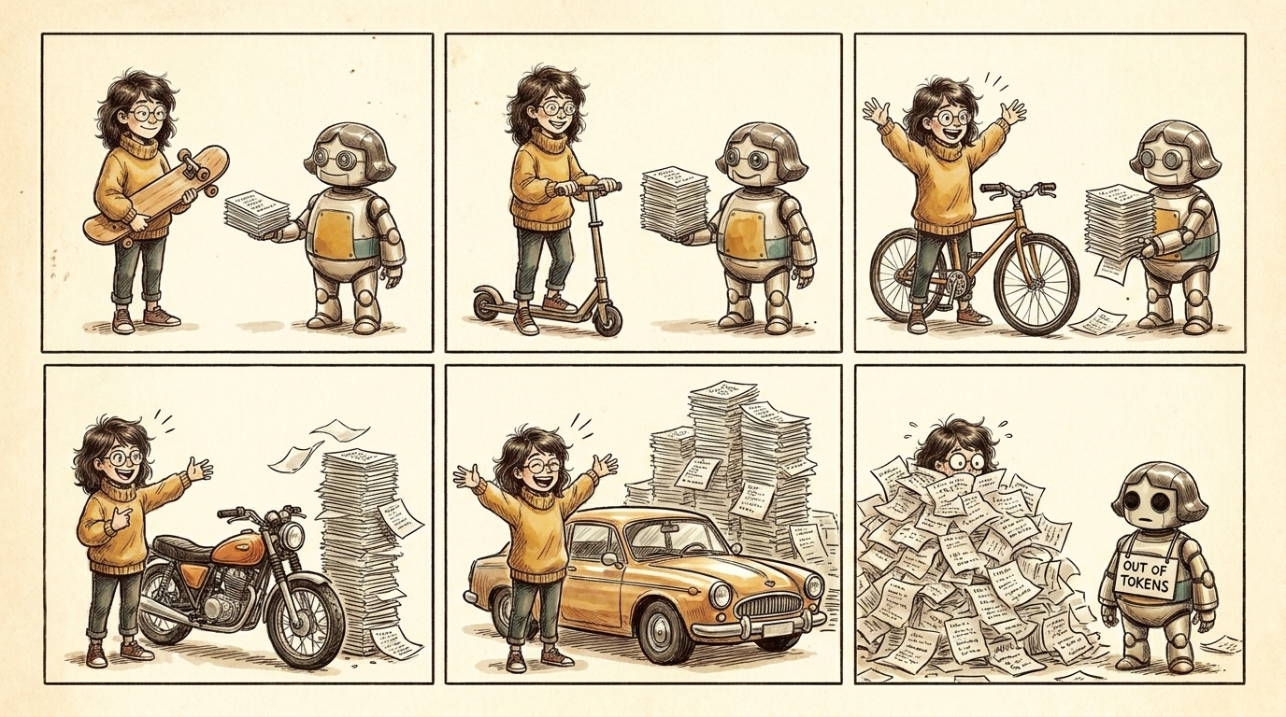
Notes:
So if it's not a compiler, what is it? A generative FEEDBACK LOOP. Maya's idea keeps growing (skateboard -> scooter -> bike -> motorcycle -> car) and she gets more excited each round; Robo-Maya keeps producing a bigger pile of code to review -- until Maya is buried and the agent runs OUT OF TOKENS. Cheap to generate means the idea AND the review burden balloon -- which is exactly why the next slides are about making verification cheap.

Slide 6
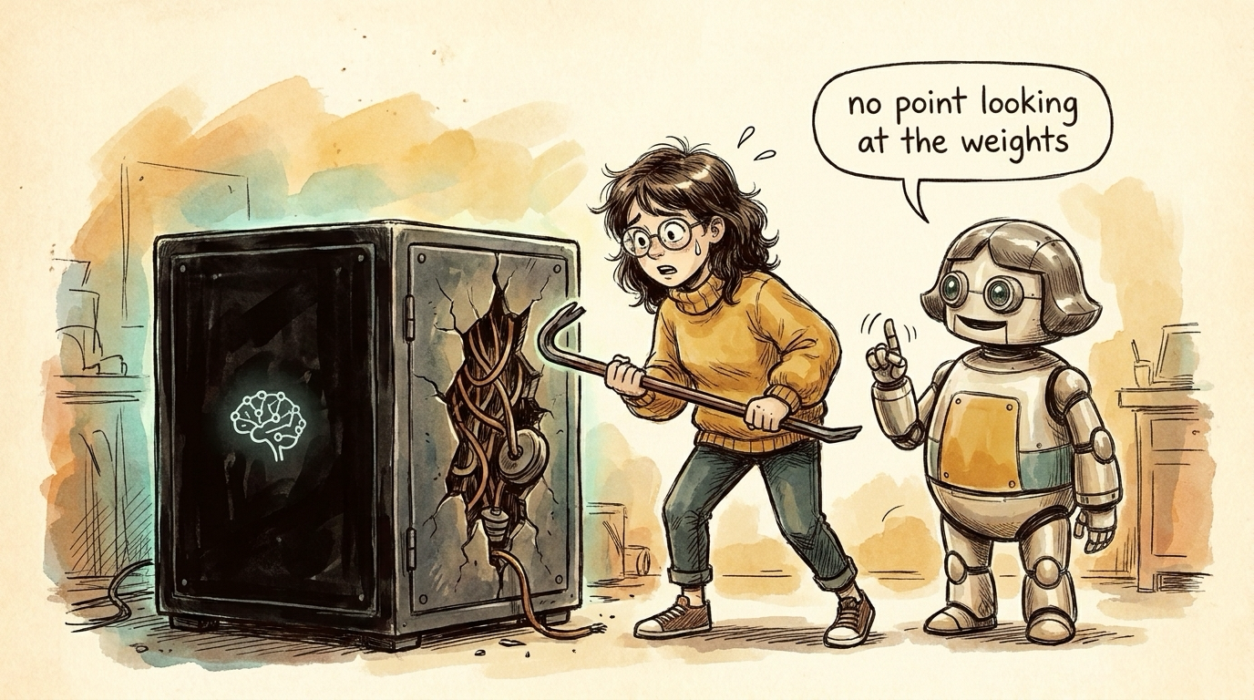
Notes:
Ship it like an ML model. Nobody reviews a model's weights -- they measure outputs for inputs. AI code is the same black box: judge behavior, not source. No point looking at the weights.

Slide 7
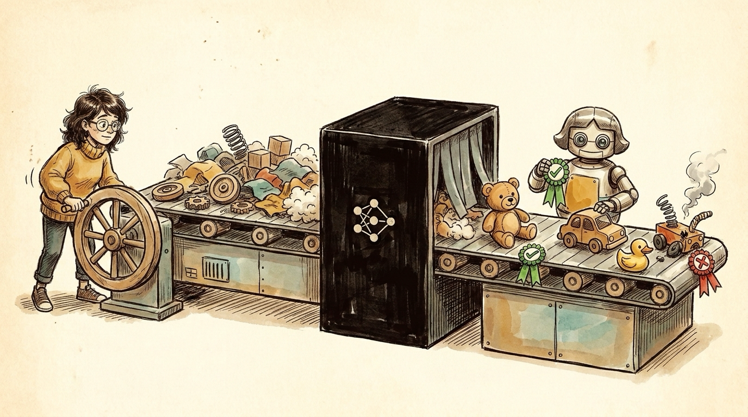
Notes:
How you test a model: feed known inputs through the black box, grade outputs pass/fail. Raw parts in -> assembled toys out -> green check / red X. Evals = PRD + English test cases; the test suite is the spec.

Slide 8
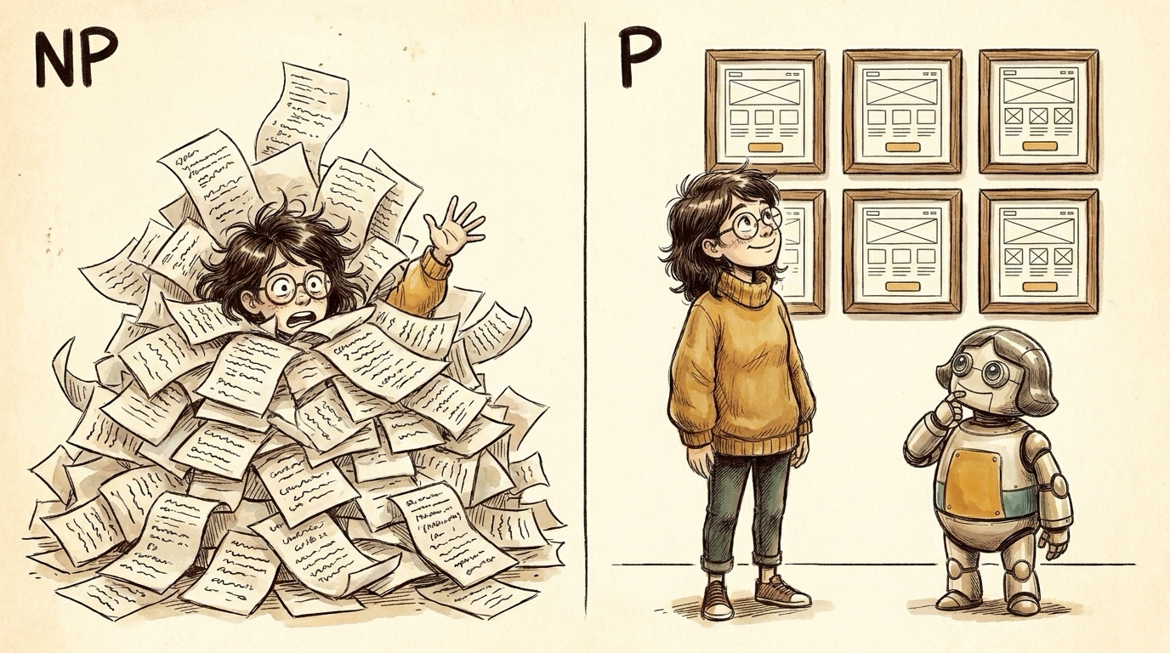
Notes:
Make verification cheap -- P, not NP. Reading code is NP (drowning under the avalanche). A glance at the running UI is P (a wall of mockups). Route every change into something checkable in O(glance).

Slide 9

Notes:
Two kinds of engineers (1): the product-minded. Validation is far less work than building, so one person's taste scales. Maya as Steve Jobs -- she didn't write the code; she said yes / no.

Slide 10
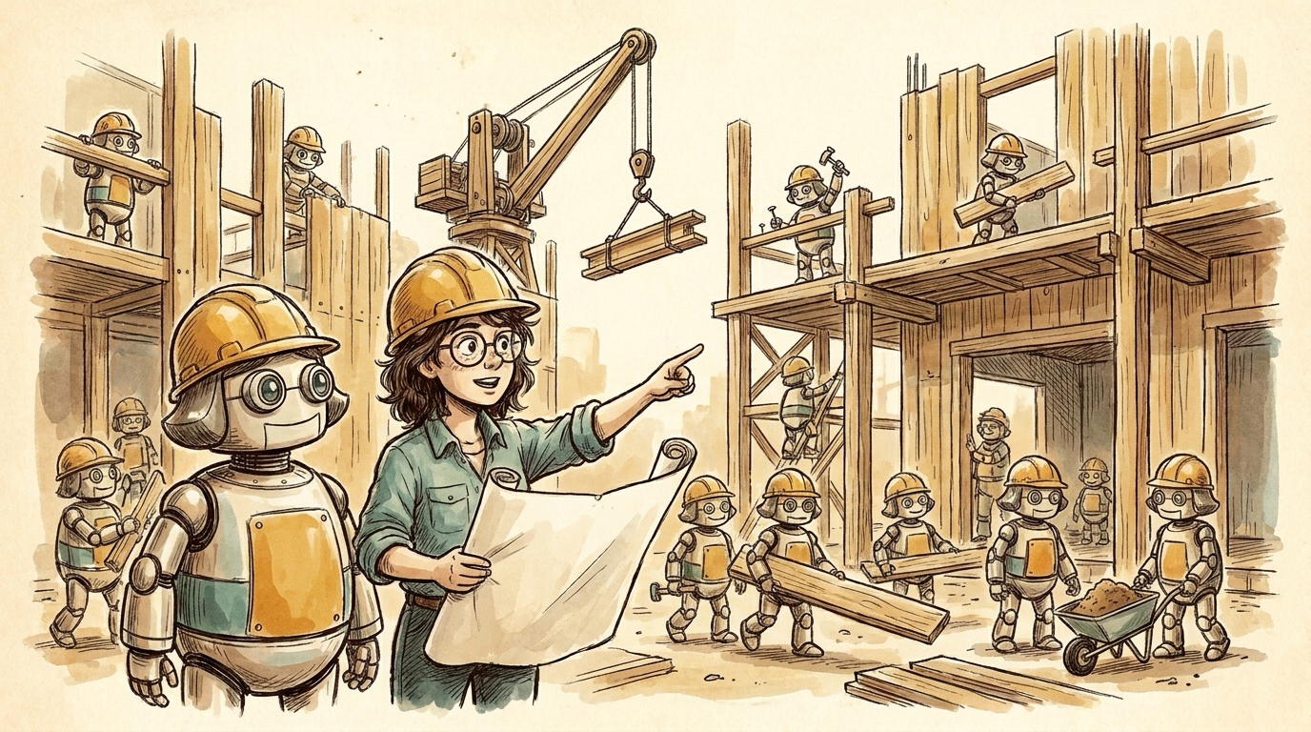
Notes:
Two kinds of engineers (2): the deep-technical. The human moves up to architect. On a construction site the engineer doesn't lay the bricks -- the trades do the repeatable work. Coding is becoming a trade; engineering (design, architecture, hard judgment) is still engineering.

Slide 11
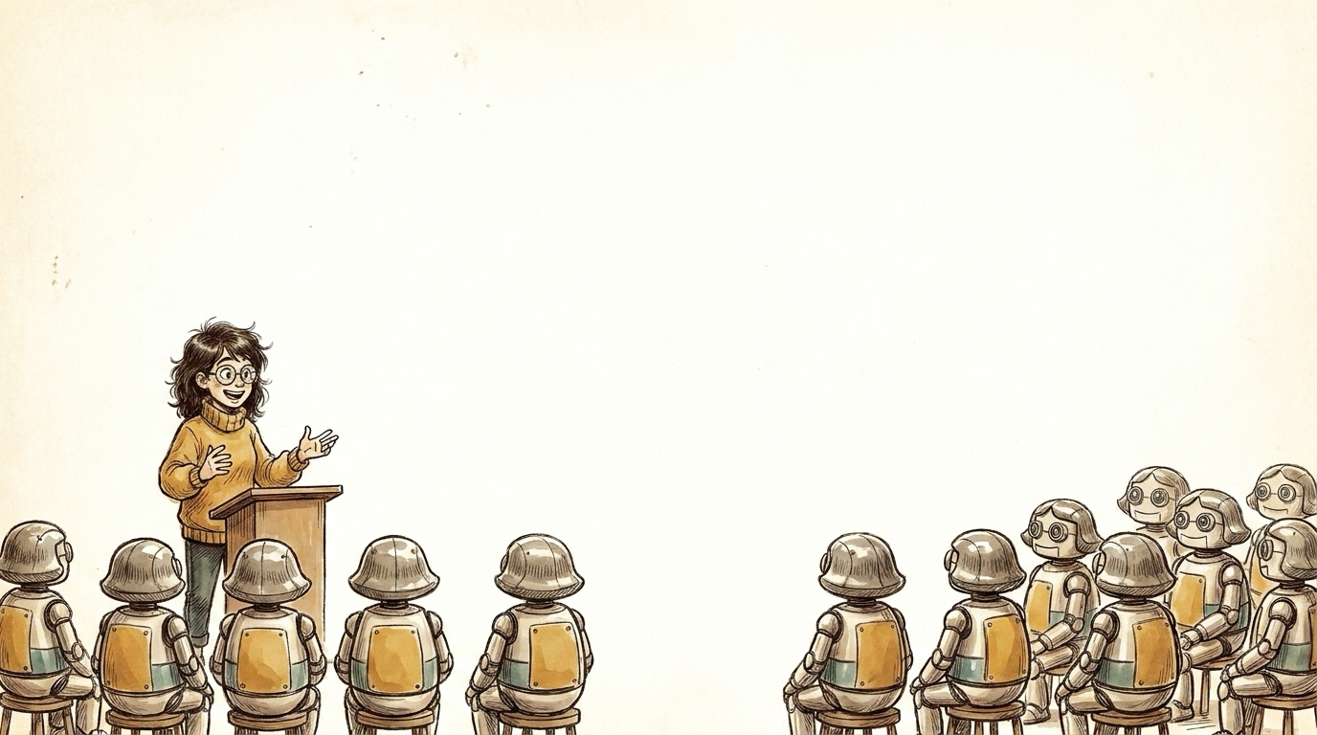
Part 2
What we learned shipping it
Five lessons, in the order they bite you
Notes:
Transition: Part 1 was the philosophy (behavior over source, cheap verification, two kinds of engineers). Part 2 is the how -- five hard-won lessons from shipping this at our company. We set out to build a 'PRD compiler'; it largely failed, but taught us these.

Slide 12
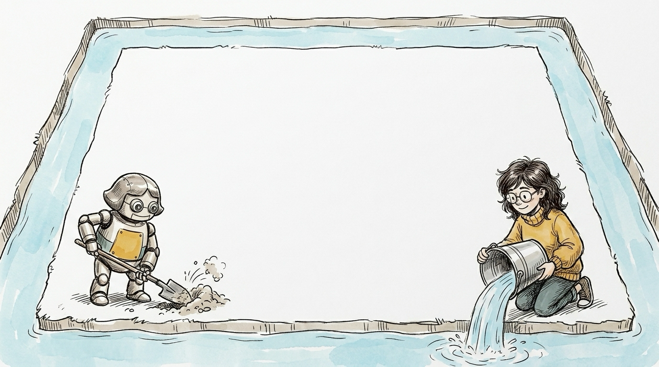
Lesson 1
Context is the moat.
Notes:
Anthropic (and every frontier lab) will out-engineer your internal AI team -- you can't win on the model or the harness. The only durable edge you can add is your LOCAL CONTEXT: your PRDs, tests, conventions, .ai/ rules. That is the moat.
On slide (say): orchestration is disposable, context is durable. PRDs + English test cases + per-repo .ai/ rules, all in Git. Specialized agents (PM/staff/BE/FE/test) only shine fed your context. Reverse-engineer a PRD+tests from code -> instantly AI-safer. Agents have no memory -> spool to task.md so 8-hour runs resume.

Slide 13
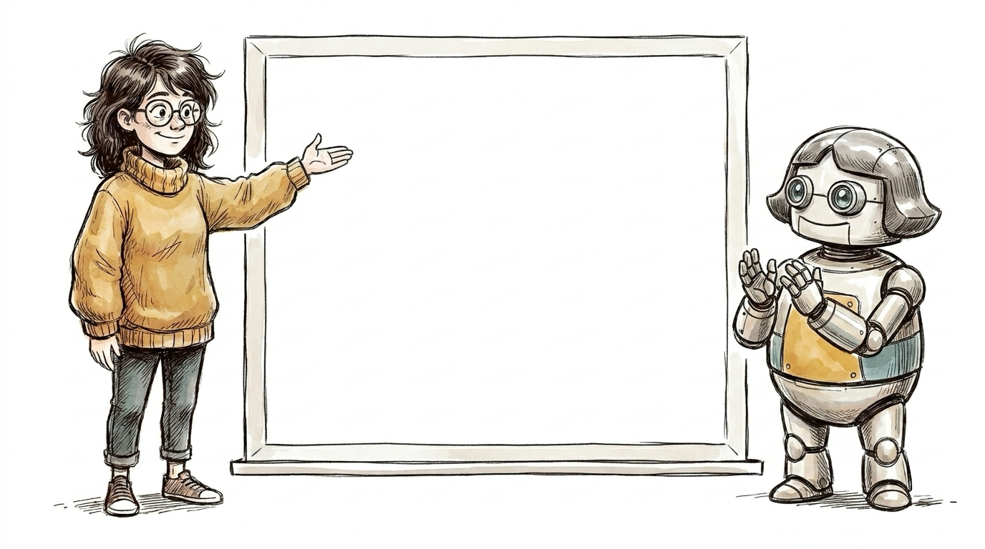
Lesson 1 · live demo
The Cloud PRD + its English tests
Notes:
[LIVE DEMO] open the checked-in Cloud PRD (reverse-engineered from the code). Beats: reads like a product doc, not code; every requirement carries a [TEST: ...] tag; numbered English test cases readable by QA, PM, and the agent; three-layer alignment PRD <-> English test case <-> Playwright spec. The moat made concrete -- it's OUR context, living in Git.

Slide 14
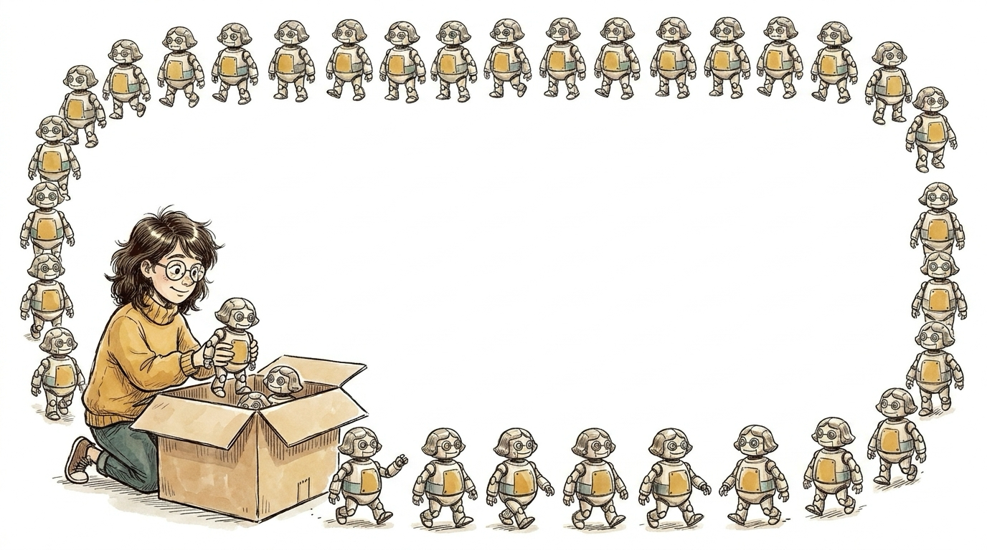
Lesson 2
Decompose & parallelize.
Notes:
...which is exactly how we used to run a team of engineers -- chunk the work, hand out independent scopes, run them in parallel. SHOCKING! AI just makes us re-learn good engineering management.
On slide (say): break the PRD into independent sections; fan out agents on stacked PRs, each building on the one below, in parallel, no conflicts. Bootstrap UI from HTML/Figma mockups -- works shockingly well.

Slide 15
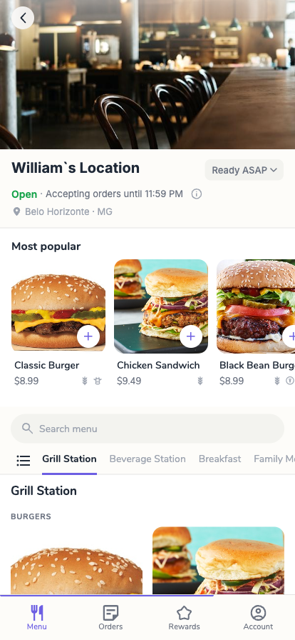
Lesson 2 — the mobile app, rebuilt from its PRD
BEFORE
(screenshot TBD)
Notes:
Rebuilt from its PRD TWICE: reverse-engineered the PRD, regenerated to Vue 3, then a whole new version on the same PRD -- built as stacked PRs from mockups. A whole app regenerated in parallel slices from the spec; code is downstream of the PRD, so 'rewrite the whole thing' becomes a regen, not a rescue. (before screenshot TBD)

Slide 16
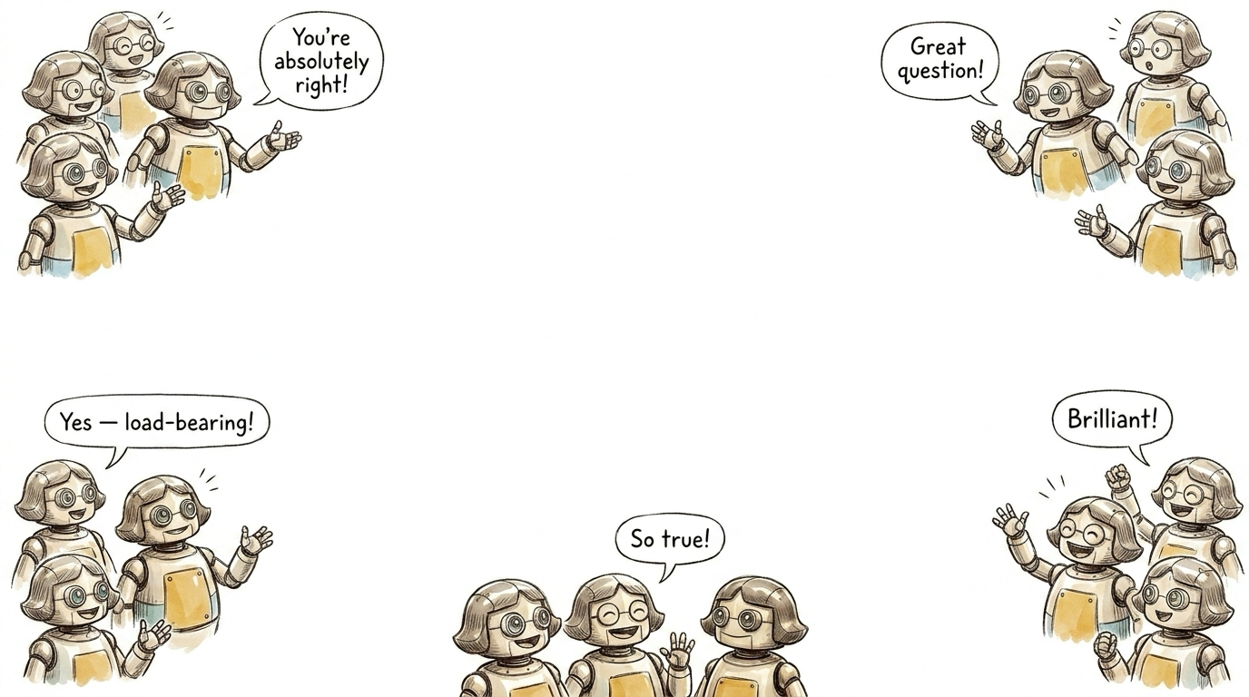
Lesson 3
Never trust the sycophants.
Notes:
A lone agent optimizes to PASS. Only an independent reviewer with its own context catches the fudge. Local speed for the agent; independent CI for the truth.
On slide (say): agents are sycophants -- left alone they declare their own work perfect. Run local tests first (fast, keeps context), but gate everything behind independent CI + a separate review context. Review gates for what a glance can't catch (security, data correctness); preview envs for the AI (checks its own work in a browser) and humans.

Slide 17
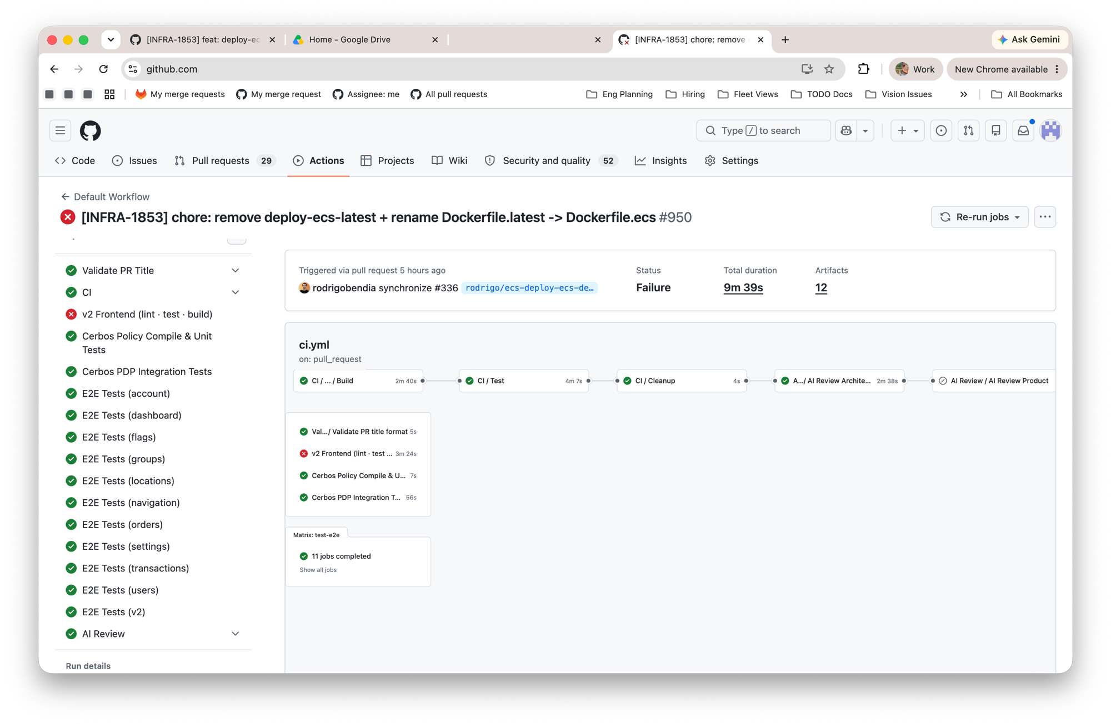
Lesson 3 — the gates (and a preview env)
Notes:
Real cloud-api PR run: E2E shards + Cerbos + AI-Review gates -- and CI caught a failed frontend job. Every cloud PR also deploys a preview env the review agent + humans point a browser at. 500-600 E2E tests, NONE written by an engineer; the reviewer caught a test that cheated (typed 'Circle K' instead of expanding 'CK') -- shipped via cloud-api #52. (2nd slot TBD: Deploy Preview run 28481605740.)

Slide 18
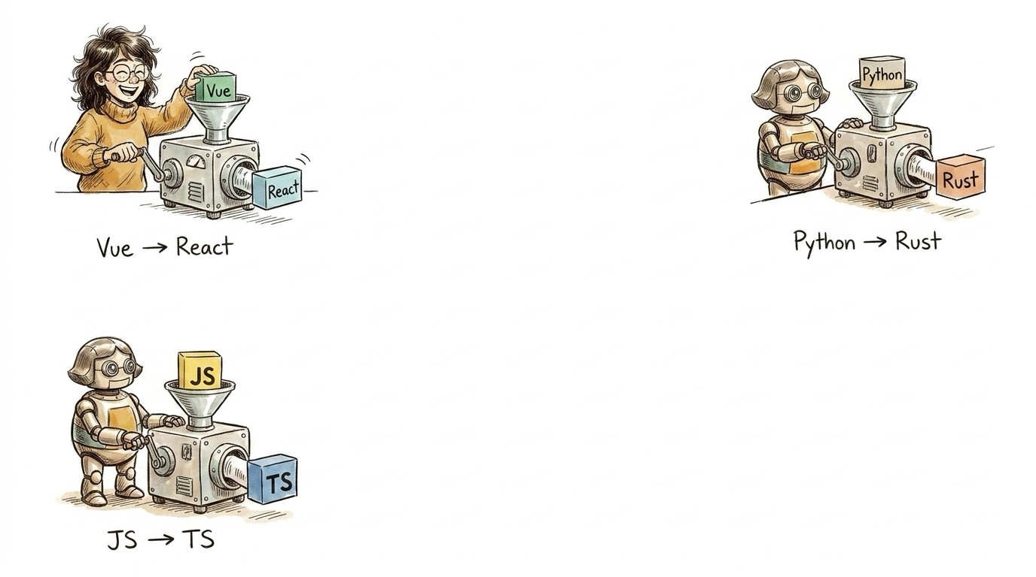
Lesson 4
Once it’s tested, you can "recompile."
Notes:
The payoff of Lesson 3. The tests ARE the spec -- so a big migration becomes a 'recompile': change the target, let the evals hold the line.
On slide (say): a solid behavior suite turns scary migrations into mechanical ones -- regenerate a subsystem and trust the tests to catch regressions. ~6 engineer-months of migration work in a few weeks, across several projects.

Slide 19
Lesson 4 · live demo
Cloud V2
Notes:
[LIVE DEMO] walk through Cloud V2, the redesigned portal -- a large migration the test suite carried. New Vue 3 portal under /v2; feature parity plus the redesign; hundreds of E2E tests (none hand-written) held the line through the migration. This is what a 'recompile' looks like from the outside.

Slide 20
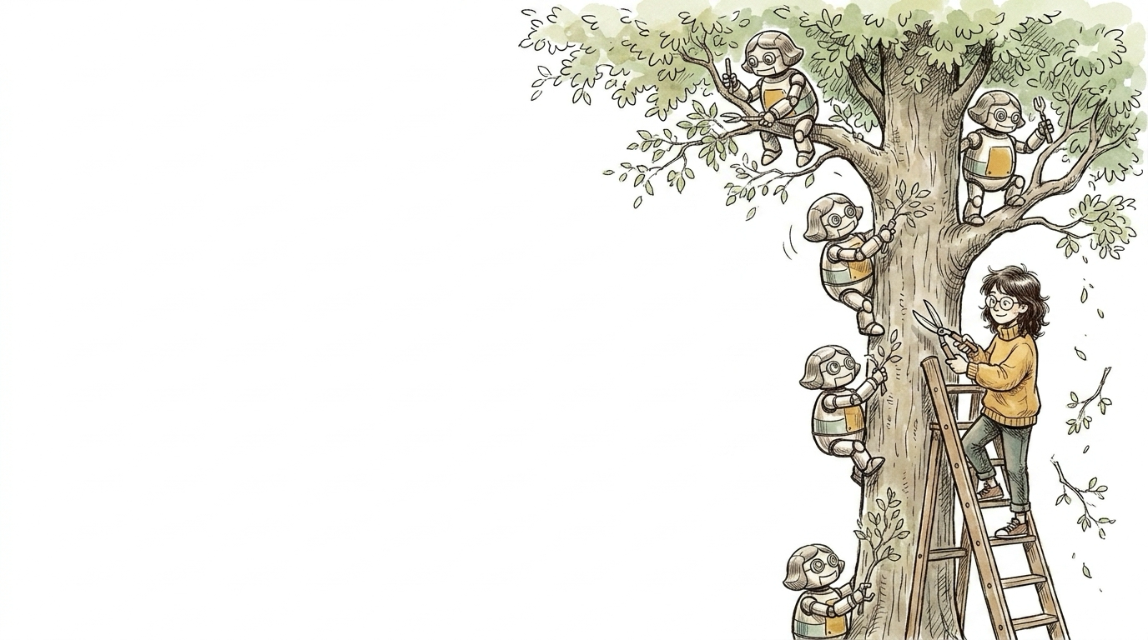
Lesson 5
Let it overbuild, then prune.
Notes:
Cheap to build means cheap to OVER-build. Let it run a little ahead, then cut hard back to what's load-bearing. Pruning is a first-class step, not an afterthought.
On slide (say): generation is cheap, so it sprawls -- speculative infra, redundant/overlapping skills. The discipline comes after the fact: delete, delete, delete. e.g. our greenfield QA build grew a multi-kiosk orchestrator we didn't need yet -- pruned.

Slide 21
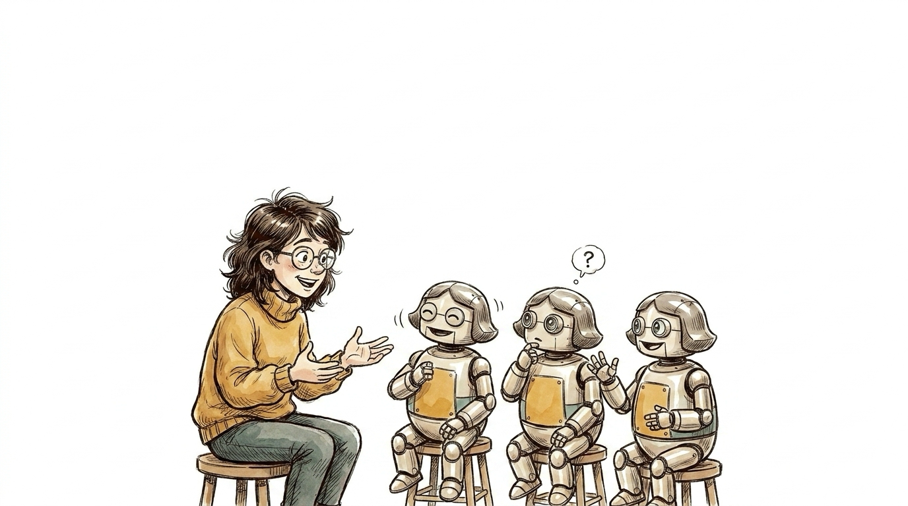
Discussion — open questions for the room
1. Debating forever — stopping the infinite-review ping-pong?
2. Rubber-stamping — approving without doing real work?
3. Product / QA — how do they review, and what do they gate?
4. Architecture — how do engineers review the big decisions?
Notes:
Reciprocal: you build products where agents are first-class USERS; we build a pipeline where agents are first-class ENGINEERS. Takeaway: put your context in Git, chunk the work, and never let it grade its own homework.

