Slide 2
Southbound Solution for Transport (ITS-N)
Transport New
GATEWAY
MQTT over TCP
GATEWAY
UDP Gateway
Message Broker (RabbitMQ)
MQTT-SN over UDP
In-vehicle
AGGREGATOR
AGGREGATOR
UDP Client
Control
Message Broker (MQtt)
UI
UI
OpenCV
Common Lib
Common Lib
Common Lib
Common Lib
Modelo .java/.xml
Sensor Related Code
Sensor Related Code
Sensor Related Code
Sensor Related Code
Sensors

Slide 3

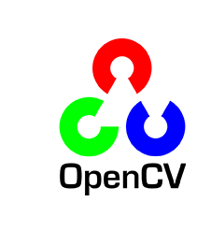


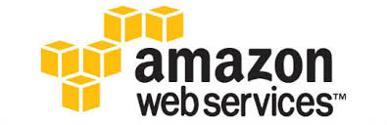

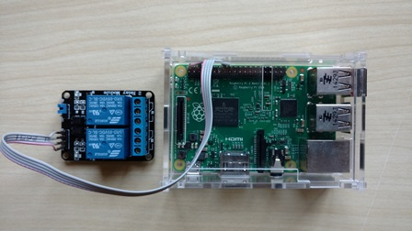
Arquitetura - comunicação
Unidade Argos
MQTT/TCP
MQTT/TCP
MQTT Client
Broker
MQTT Client
Notes:
WebSocket is a protocol providing full-duplex communication channels over a single TCP connection. (IETF as RFC 6455)

Slide 4
Arquitetura - comunicação
Broker
MQTT/TCP
Target
Argos
Argos
Argos
Subjects
Subjects
Argos
Subjects
Subjects
Notes:
WebSocket is a protocol providing full-duplex communication channels over a single TCP connection. (IETF as RFC 6455)

