Slide 2






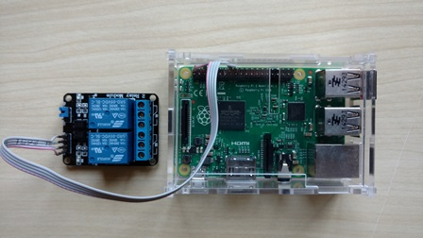
Arquitetura - comunicação
Unidade Argos
MQTT/TCP
MQTT/TCP
MQTT Client
Broker
MQTT Client
Notes:
WebSocket is a protocol providing full-duplex communication channels over a single TCP connection. (IETF as RFC 6455)

Slide 3
Arquitetura - comunicação
Broker
MQTT/TCP
Target
Argos
Argos
Argos
Subjects
Subjects
Argos
Subjects
Subjects
Notes:
WebSocket is a protocol providing full-duplex communication channels over a single TCP connection. (IETF as RFC 6455)

