Slide 2






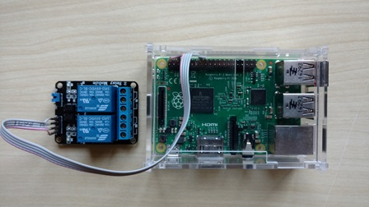
Broker
Unidade Argos
MQTT/TCP
MQTT/TCP
MQTT Client
MQTT Client
Controle Central
Notes:
WebSocket is a protocol providing full-duplex communication channels over a single TCP connection. (IETF as RFC 6455)

Slide 3
Broker
MQTT/TCP
Target
Controle Central
Argos
Argos
Argos
Subjects
Subjects
Argos
Subjects
Subjects
Notes:
WebSocket is a protocol providing full-duplex communication channels over a single TCP connection. (IETF as RFC 6455)

Slide 4
Região_1
Zona_2
Zona_1
Argos_1
Argos_2
Argos_3

