Slide 1
PresentationFramework
PresentationCore
Common Language Runtime (.NET)
Kod zarządzany
Kod natywny
MIL
Kodeki
User32
DirectX

Slide 2
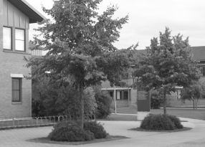



L(x,y,0)
L(x,y,1)
L(x,y,4)
L(x,y,16)

