Slide 1
Fixing the mess of healthcare with blockchain
Vidushi Savant, MD
Psychiatrist, Faculty Stanford
Cofounder Savant care

Slide 2

Goals
This is a an open discussion. Feel free to ask questions.
We would love some:

Slide 3
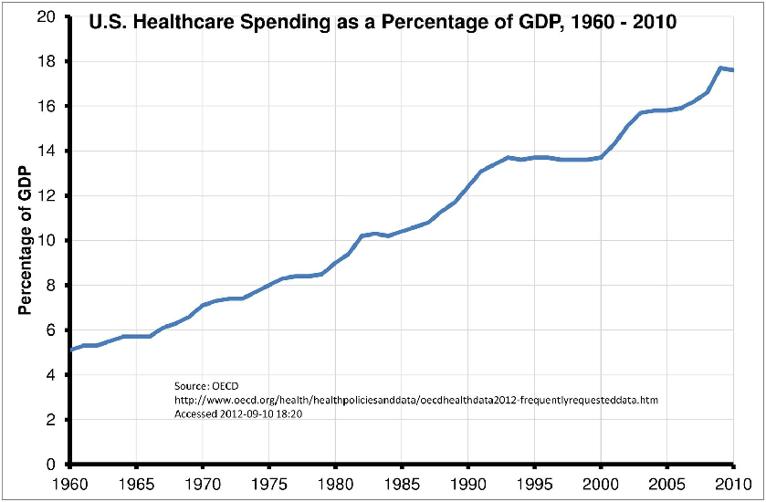
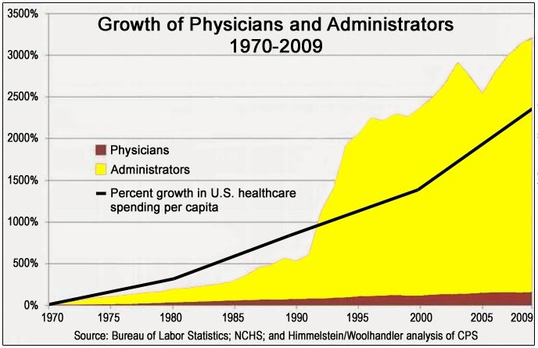
How bad is it?
Increasing %age of GDP
Admin costs increasing as a %age of total medical cost

Slide 4
Why did we end up here?
Custody
Fragmentation

Slide 5
What happens when you don't have custody of your health data and it is fragmented.
Duplication
Centralization
Siloed
Demand side
Supply side

Slide 6
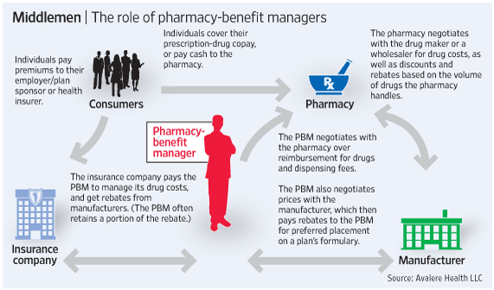
Gatekeepers/entrenched interests of your medical data have no incentive to innovate
Hospitals
Private practices
Labs
Pharmacies
(CVS/Walgreen/RiteAid)
Health insurance
company
Pharmacy benefit manager
(To reduce influence case has
to be made to employers)
Surescripts
Drug manufacturer

Slide 7
What happens when you get custody of your data?

Slide 8



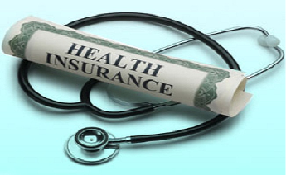

No more duplicate tests
Better diagnosis
More personal health care
Reduce admin costs
Lower prescription costs
Old:
Surescripts: Centralized trust provider
PBM: Market aggregators
New:
Healthchain: trust provider
PBM: Risk pooling
Lower health insurance costs
Eliminate claim filling industry
Better research
Realize the value of your
medical data

Slide 9
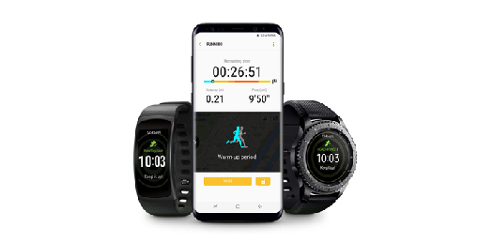
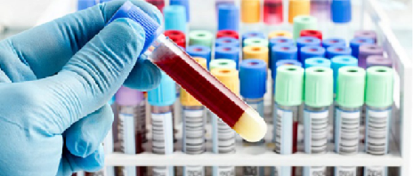
A decentralized industry data bus
Health chain protocol
Permission less innovation
Will allow innovation/apps

Slide 10
Where else has this been tried?
Austria - ELGA
        GOVT MANDATED
Google health
        Shut down in 2011
        HARD / IMPOSSIBLE? TO TRUST
VA’s blue button
        No industry adoption. Low customer adoption: I need to backup my
        data and figure out how to share.
Microsoft health vault
        I cannot trust Microsoft with my health data.

Slide 11
What is different this time?
Block chain guarantees immutability of medical data
IPFS allows decentralized storage of petabytes of medical data
Tokens enable a business model, without having to data mine/advertise.
Client side private key generation from password solve UX problem of PKI

Slide 12
Centralization vs decentralization
Decentralization benefits
  — Cost of storage will be lower.
  — Easier scalability.
  — Lower latency
  — I finally don't worry about my medical data being data mined.
  — Don’t have to trust an organization staying in business or their business model.
Larger impact in developing countries compared to developed countries.

Slide 13
Blockchain vs No-blockchain
Immutability of medical data.
Ordering guaranteed by blockchain is important.
Blockchain enables a token based business model

Slide 14
Tokenization vs no tokenization
Tokens enable creating the network effect. Allow to take on the entrenched interests.
Maybe just maybe tokens will allow to break through the inertia.
Tokens have value if they are backed by real business.
What is the real business here?
— Protocol development and exchanging data between health chain entities.

Slide 15
CHALLENGES
Getting the early adapters to jumpstart the network effect.
Get machine parsable data and not just PDFs: PDFs would just result in doctors drowning in data.
The current players are not going to give in easy.
  Prescriptions can only be sent to patient or pharmacy.
  Once data is in paper format it becomes high cost.
Pharmacies still cannot lower the price because the price is determined by the PBM.
PBM can remove a pharmacy from the list of authorized pharmacies.
  Can we get them to send electronic prescription to the patient health chain a/c?
Cash market is 5% for pharmacy. Most cash market is low cost drugs.
Co-pay is higher than the cost: In 2% cases, usually happens for generics.

Slide 16
Breaking the inertia
Give tokens to early adapters
Deliver pharmacy savings.
Retail pharmacy avg. margin is 12%
Most profit is being captured by PBM’s
Lab results - time series graphs.
Build HL7 interface for data import and export
Share wearable data with your doctor.
Create research market place for medical data
Create correct api’s to enable app eco-system.

Slide 17
When would I know that we have succeeded
When my patient tells me “send my prescription to health chain”
When my patient tells me, Hey doc !! You can get my medical history on health chain
Next time instead of ordering an expensive test I can get my patients previous test results from health chain
I get a flier in the mail offering me lower health insurance rates.
My next prescription is being filled by a pharmacy in Sacramento since they bid and I accepted their bid for the lowest cost next day delivery. (What about antibiotics/pain meds/ refrigerated stuff / controlled substances)
The year I earn $100 from offering my de-identified medical data to health researchers.
For my research study on “melatonin usage in delirium” I can find 1000 patients matching criteria without waiting for 6+ months.

Slide 18
For comments / suggestions
vsavant@stanford.edu

