Slide 1
First Grade
Word List #1
Words any first grader should be able to read in a minute.
www.iMustRead.com

Slide 2
HOW TO USE THIS LIST
Set a timer of 1 minute.
Ask the kid to read out each word loud.
All words should be randomly read accurately in 1 minute.
Repeat daily if inaccurate or slow.
Print badge & ask the kid to write name on it.
Move to next list.

Slide 3
the

Slide 4
of

Slide 5
and

Slide 6
a

Slide 7
to

Slide 8
in

Slide 9
is

Slide 10
you

Slide 11
that

Slide 12
it

Slide 13
he

Slide 14
was

Slide 15
for

Slide 16
on

Slide 17
are

Slide 18
as

Slide 19
with

Slide 20
his

Slide 21
they

Slide 22
at

Slide 23
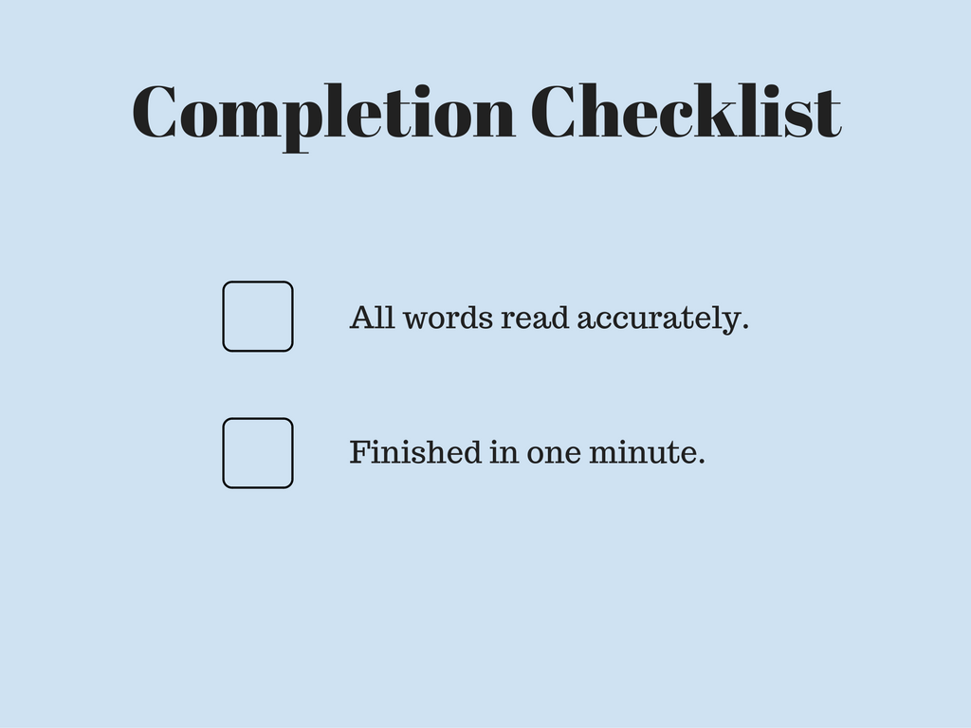

Slide 24


Slide 25
Thanks
Visit our website for more word lists and printables.
iMustRead.com

