Slide 1
A study on the strategies of road and railway development in Uzbekistan
Ergashev Shakhzod, Yong-Seok CHOI
Sunchon National University

Slide 2
The structure of the work
Chapter 1: Intruduction
Chapter 2: DESIGN and IMPLEMENTATION
Chapter 3: PERFORMANCE ASSESSMENT
Chapter 4: OTHER ASSESSMENTS
Chapter 5: Conclusion

Slide 3
Chapter 1. Introduction
The Asian Development Bank's (ADB) funding for two linked rail projects in Uzbekistan is evaluated in this report: the Railway Rehabilitation Project 1 and the Railway Modernization Project 2. The two projects were chosen for review by the ADB's Independent Evaluation Department (IED) as part of the organization's country assistance program evaluation in 2010–2011. The two rail projects are the only two finished projects in the transportation sector 3 and are among the nine completed projects that were eligible for review (Shukhratjon Khurramov 2019).

Slide 4
1.1 Evaluation Purpose and Process
The Railway Rehabilitation Project 1
The Railway Rehabilitation Project (first project) received funding from the ADB in 1998.
The first project might be regarded phase one of the rehabilitation and reform project.
Railway Modernization Project 2
Railway Rehabilitation Project (second project) received funding in 2000.
the second project could be considered phase two, building on the first project's lessons.

Slide 5
1.2 Transport communications of the republic of Uzbekistan
Uzbekistan has been recognized as the state situated on the Great Silk Road, which connects the West with the East.
The national program for 1995-2010 was created to strengthen the Republic of Uzbekistan's position in Central Asia by improving different sectors and economic connections with neighboring countries.
Uzbekistan has made a significant contribution to the updating and launching of new international highways in this region.
The construction and completion of this line had a significant influence in the growth of the country.
The distance between freight and passenger traffic was reduced to 170 kilometers, and the travel duration was reduced to 7 hours.

Slide 6
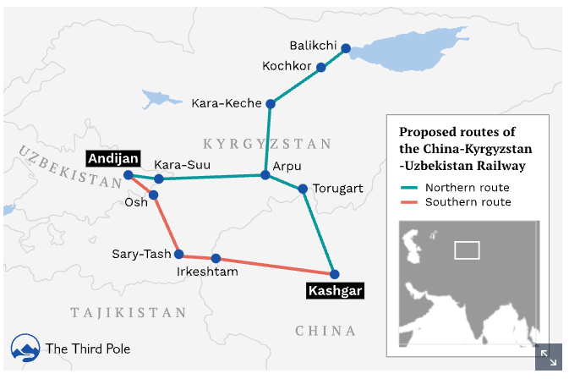
1.3 Development strategy
JSC "Uzbekistan temir yullari" has been a key structure-forming link in the creation and growth of the economy of the Republic of Uzbekistan for more than 20 years, from its inception on November 7, 1994.
Formation of freight and passenger traffics, cost-cutting on railroad operations, and railway service safety are all done in close collaboration with foreign partners, in accordance with international agreements.

Slide 7
Chapter 2. DESIGN and IMPLEMENTATION
In its first country programming visit to Uzbekistan in 1996, the ADB offered a loan for the first railway project. The Government asked ADB to be the main development partner in railroads as a consequence of the mission, and ADB made the initial move in coordinating with other development partners in the sector. Each project was created with the support of a project preparation technical assistance team (PPTA). The PPTA for the first project was authorized by the ADB in early 1997, and for the second project in 1999. The second PPTA assessed the first railway project's development and the ADTA study that accompanied it, and suggested additional physical investments and changes (John C. K. Daly. 2020).

Slide 8
2.1 Formulation
The International Monetary Fund (IMF) warned the government against this approach, and the Stand-By Arrangement with Uzbekistan was discontinued in December 1996.
UTY was quite pleased with the initial project's design and the contributions of the first PPTA.
The efforts of the Asian Development Bank (ADB) to organize funding for the project and other railway projects were praised by UTY.
The TOR gave the consultants little time to do further work after receiving feedback, and also gave ADB and UTY no recourse if the final report was inadequate.

Slide 9
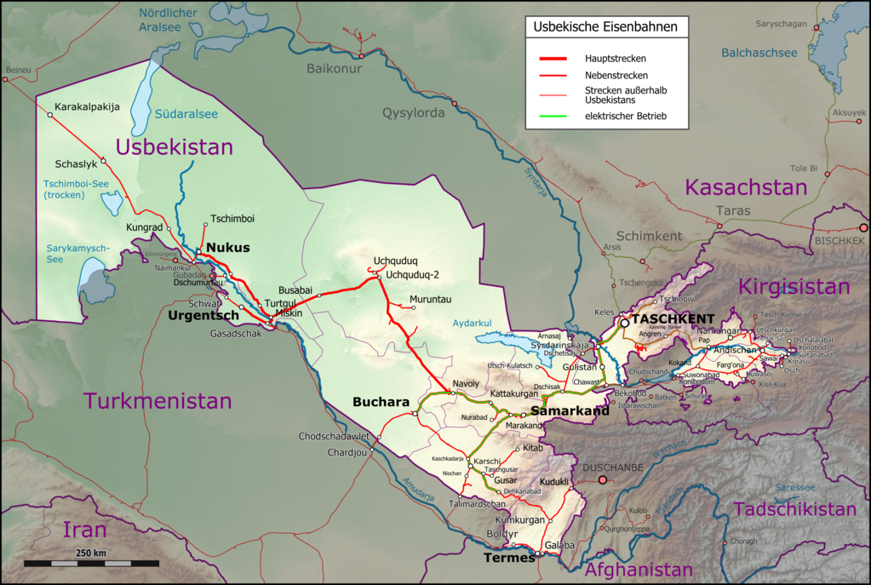
2.2 Inland Transport Mode: Railways
The 1,520 mm Russian-gauge railway network has a total length of 6,020 km5, with 3,645 km of major railway lines. Railways account for 90 percent of the country's overall cargo transportation.
. Uzbekistan has the largest railway density (the length of railway infrastructure in meters per 1,000 people) in Central Asia, one of the highest in the CIS, and is close to Portugal and Turkey.

Slide 10
Chapter 3. PERFORMANCE ASSESSMENT
The first project is extremely relevant, effective, efficient, and likely sustainable, as measured by the PCR's ratings; the project is overall successful, as measured by the PCR. The second project is rated as relevant, effective, efficient, and likely sustainable, deviating only from the second PCR in that the extremely relevant is downgraded to relevant; the project is overall successful, as was the PCR.

Slide 11
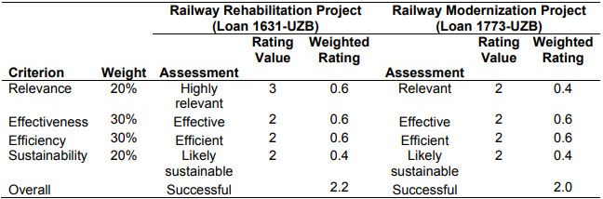
3.1 Overall Assessment

Slide 12
3.2 Relevance
Physical investments (track restoration, maintenance equipment, computer systems, and telecommunications equipment) are extremely important in each project. The first project's UTY reforms (downsizing, restructuring, and privatization) are relevant; the second project's reforms are only partially relevant.
According to UTY, the changes are one of the government's main objectives. The reforms' applicability is restricted by the government's UTY reform program's ambiguity, as well as one of the reform components of the second project, the SBF.
After the government's attitude on privatization shifted, ADB did not modify its reform agenda and continued to advocate for the same changes for UTY.

Slide 13
3.3 Effectiveness
The evaluation assigns a score to each project based on its ability to produce results. Based on the evaluation's study of track quality and observation of train speeds, the physical investments are successful.
The average speed between Tashkent and Samarkand, as well as Samarkand and Bukhara, was 80 kilometers per hour, exceeding the DMF's passenger rail speed objective.
The only metric by which UTY achieved substantial gain was the number of employees. UTY considerably reduced worker numbers, however several operating performance measures were partially reliant on personnel numbers, therefore UTY fulfilled objectives for those indicators in part due to efforts in reducing workforce.
Real per capita GDP increased by a low of 4.4 percent (2002) and a maximum of 11 percent from 1999 to 2009. (2007). As a result, the initiatives were successful in averting a slowdown in Uzbekistan's economic growth and development.

Slide 14
3.4 Efficiency
The evaluation assessed resource efficiency based on the economic internal rate of return (EIRR) and process efficiency. The first project's investments are rated as efficient, with an expected EIRR of 38.7%, and the second project's investments are rated as efficient, with an EIRR of 17%.
The recalculated EIRR for the first project is 38.7%, which is much higher than the 14.3% in the PCR and the 17% anticipated during assessment, but lower than the 45.6 percent estimated in the first PPTA.
The assessment team noticed the significantly higher cost in conversations with UTY and recommended to UTY that ADB's procurement restrictions precluded UTY from choosing the lowest-cost alternative.

Slide 15
3.5 Sustainability
The evaluation examined and observed UTY's maintenance processes, as well as taking measurements of the repaired track's condition. UTY's Railway Section Offices are in charge of 75 to 110 kilometers of single- or double-track railways, and they do daily maintenance, lifting repairs, and medium repairs.
The first project's FIRR is 29.9%, which is much higher than UTY's weighted average cost of capital of 4.0 percent, the 4.5 percent FIRR in the first PCR, the 12.7 percent estimated during assessment, and the 11.7 percent estimated in the PPTA.
The second project's FIRR is 7.4 percent, which is higher than UTY's weighted average cost of capital of 4.3 percent. The recalculated FIRR for the evaluation is somewhat higher than the 7.3 percent in the second PCR, but lower than the 8.7% estimated at appraisal and the 9.4% estimated in the PPTA.

Slide 16
Chapter 4. OTHER ASSESSMENTS
Each project's reforms and related TAs had a substantial influence on UTY, since they aided in its downsizing and reorganization. UTY had 45,220 workers in 1999, soon after ADB granted the first loan. UTY has reduced its workforce by a third, to 30,875, by 2009. Many of UTY's schools, housing, and medical facilities were devolved, with just those that were plausibly important remaining. UTY executives stated that they were initially averse to devolving auxiliary functions, but now see them as constructive improvements that they completely embrace.

Slide 17
4.1 Impact on Institutions
UTY discovered the potential of several railway fasteners during track repair. Through a small modification in scope, the first project funded research to assist UTY in reviewing and selecting a different technology, the flexible fastener.
UTY became the primary contractor for an ADB-financed railway project in Afghanistan, partly as a result of its performance with the two projects. The initiatives aided in the development of skills, allowing UTY to function on a global scale.
In Uzbekistan, the fiber optic communications network constructed in the second project was the second of its kind. That subproject provided technical expertise to UTY, which was then passed on to others.

Slide 18
4.2 Socioeconomic Impact
The project will “facilitate pro-poor economic growth via technological upgrades and restructuring efforts to increase railway transport operating efficiency,” according to the second RRP.
The project reduced the travel time between Tashkent and Gulistan by roughly 35 minutes each way, from 1.8 to 1.25 hours. Changes in travel time are insufficient to materially influence job possibilities in Tashkent for those living in Gulistan; a 35-minute reduction in commute time would benefit commuters but would not be crucial in a person's decision to work in Tashkent.
The most frequent reason for taking the train rather than driving was comfort, which was cited by 73 percent of passengers; just 28% claimed that the train was faster.
The flexible fasteners required sleepers that were different from those previously made and utilized in Uzbekistan, therefore UTY advertised for sleepers from across the world.

Slide 19
4.3 Performance of the Asian Development Bank and the Borrower
The flexible fasteners necessitated sleepers that were not previously made or utilized in Uzbekistan, therefore UTY advertised for sleepers from throughout the world.
The government was enthusiastic about the projects, actively participating in the ADB's maiden programming mission and providing the necessary finance and other resources throughout project development and execution.
The government made a concerted effort to execute all covenants, including those it did not initially support; UTY even implemented the SBF despite the central bank's judgment that the fund did not comply with the financial sector's regulatory framework. During the implementation of either loan, no incidents of possible corruption were reported to the ADB's Office of Anticorruption and Integrity.

Slide 20
Chapter 5. Conclusion
Since ancient times, Uzbekistan has been recognized as the state situated on the Great Silk Road, which connects the West with the East.
The national program for 1995-2010 was created to strengthen the Republic of Uzbekistan's position in Central Asia by improving different sectors and economic connections with neighboring countries.
The evaluation examined and observed UTY's maintenance processes, as well as taking measurements of the repaired track's condition.
Every element of ADB's engagement in the project, including its timeliness, the quality of employees allocated to the project, and assistance for project design and implementation, was rated as satisfactory or excellent by UTY.

