Slide 1
Human resources slide 1
Comparative and Integrative Analysis of QIIME2, MicrobiomeAnalyst 2.0, and NF-Core ampliseq 2.14.0 Pipelines with Microbial–Clinical Associations in a Fermented Yogurt Intervention for Type 2 Diabetes
Andrew Reid, Asylzhan Almukhamet, Kevin Frank, Masroor Rashid, Ryan Ma

Slide 2
Human resources slide 3
QIIME2
MicrobiomeAnalyst 2.0
NF-Core Ampliseq 2.14.0
Processes raw FASTQ data from start to finish.
Performs quality control, denoising (DADA2/Deblur), feature table creation, and taxonomy assignment.
Includes alpha/beta diversity, phylogenetics, and visualizations.
Strong provenance tracking ensures full reproducibility.
Works with processed feature tables + metadata (not raw FASTQ).
Provides filtering, normalization, and extensive statistical analysis tools.
Offers differential abundance, biomarker discovery (LEfSe), and functional predictions.
Easy-to-use web interface for fast visualization and figure generation.
Fully automated Nextflow pipeline for raw amplicon data.
Performs QC, primer trimming, DADA2 denoising, clustering, and taxonomy.
Uses containerized, version-controlled software for maximum reproducibility.
Ideal for HPC clusters, multi-center studies, and standardized workflows.
Notes:
For this project we used three pipelines: QIIME2, NF-Core Ampliseq, and MicrobiomeAnalyst.
QIIME2 and NF-Core handle the main bioinformatic processing—things like denoising, quality filtering, and taxonomy assignment. MicrobiomeAnalyst is used for visualization and statistical interpretation.
Together, these pipelines let us compare how different tools process the same dataset and whether they produce consistent biological conclusions.

Slide 3
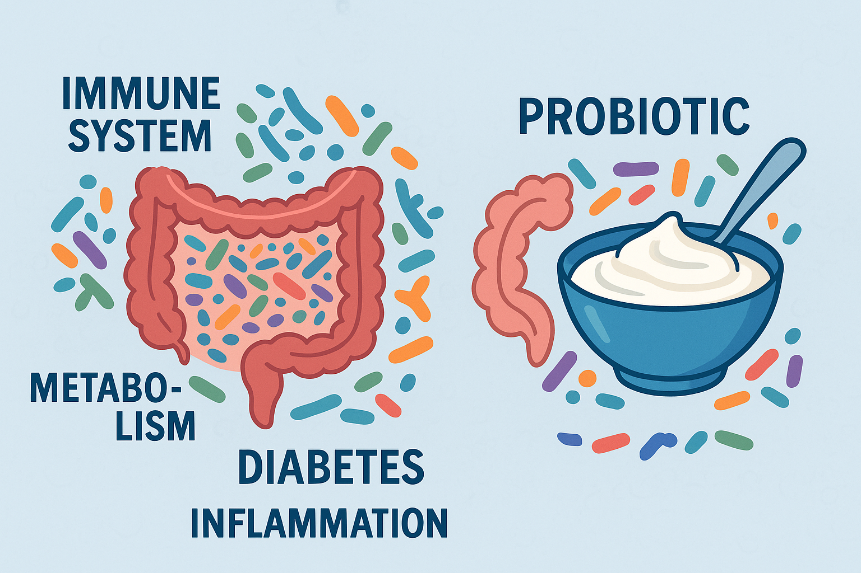
Background
Type 2 diabetes is linked to altered gut microbiota and metabolic markers.
Medical nutrition therapy improves glucose, HbA1c, weight, lipids, and blood pressure
Bifidobacterium animalis subsp. lactis B420 is a common probiotic in fermented dairy.
B420 has been linked to better weight regulation and lower blood glucose in early studies.
Our yogurt trial includes three groups: no yogurt, regular yogurt, and B420-fortified yogurt.

Slide 4
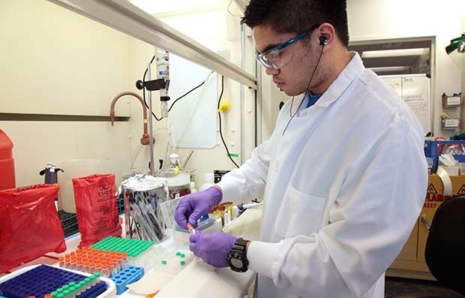
Purpose
Use pipeline comparisons to improve microbiome research design, reporting, and reproducibility.
Provide stronger evidence for or against yogurt and probiotic yogurt as tools in medical nutrition therapy for type 2 diabetes.
•dietitians match specific yogurt products or probiotic strains to patients based on microbial and clinical responses.
Support development of microbiome-informed dietary guidelines and future clinical trials that target metabolic health.
Notes:
We wanted to look at the biological effect of the intervention and the analytical consistency of different bioinformatics tools

Slide 5
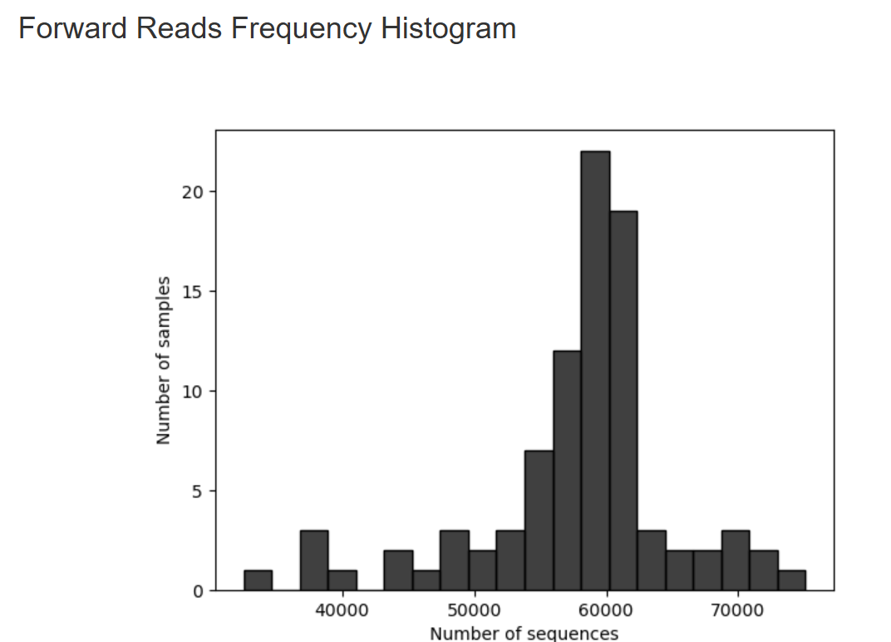
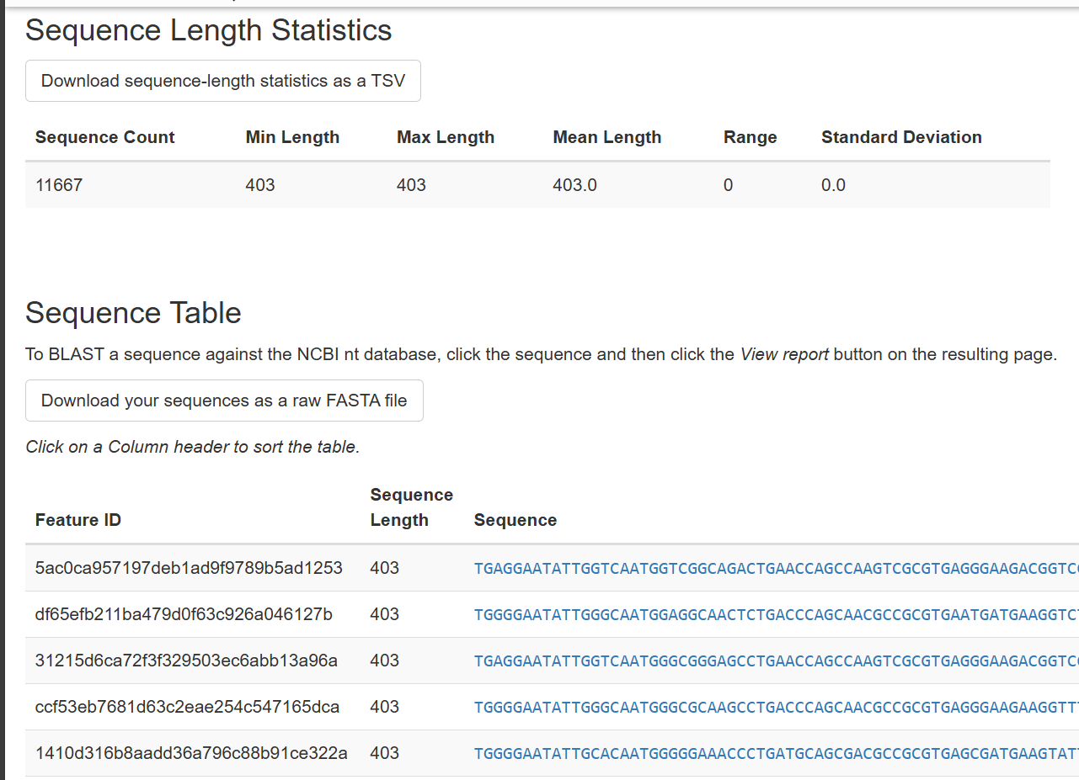
Human resources slide 8
Qiime Overview
Started with Demultiplexed data and created visualization
Most reads around 60000
Dada2 for denoising and filtering to remove sequence errors
Visualization file showing % that passed input filter
Mapping of feature IDs to sequences
Generation of phylogenetic tree
Compute default Alpha and Beta metrics
Converted to MicroBiome Analyst
Takes hours to run (~3 hours)
Memory errors generating phylogenetic tree

Slide 6
Diversity Metrics
Alpha Diversity
Beta Diversity
Shannon diversity matrix (community richness, high score -> high diversity)
Faiths phylogenetic diversity (a qualitative measure of community richness that incorporates phylogenetic relationships between the features)
Observed Features (qualitative community richness)
Evenness (measure of community evenness)
Jaccard Distance (qualitative measure of community dissimilarity)
Bray-Curtis Distance (quantitative measure of community dissimilarity)
Unweighted and Weighted Unifrac Distance (community dissimilarity with phylogenetic relationships)

Slide 7
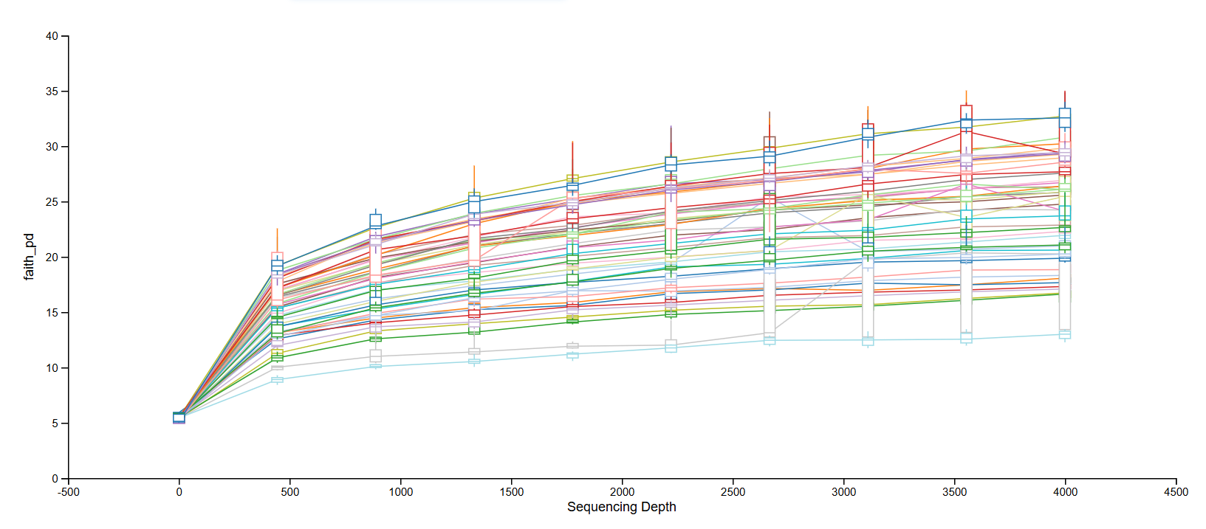
Alpha Rarefaction

Slide 8
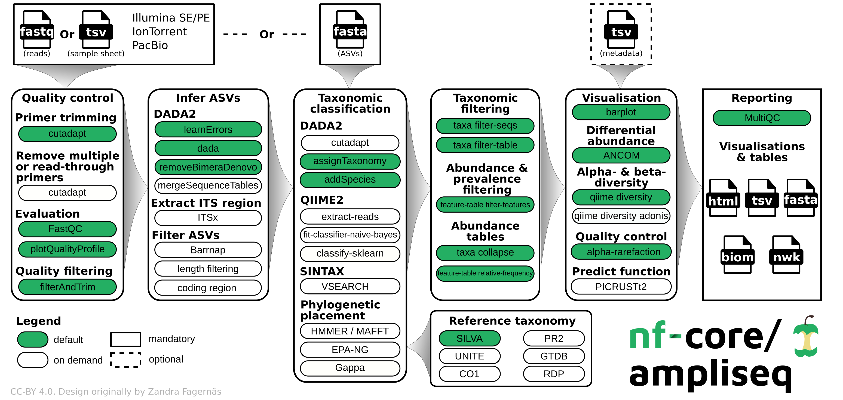
NFCore Ampliseq
Used NFCore to run through the dataset
Provides a convenient way to run multiple analysis software within a singlepackage
Within NFCore, Ampliseq was used to run the analysis
Used to run on amplicons
Example packages used in the pipeline include:
QIIME2
DADA2
MultiQC
Etc.

Slide 9

Setting Up Environment
Approach not the best because a docker would have been better
Worked using conda within Piccotte
Easiest to setup and run based on personal skill
Download the nf-core package from bioconda
Specific Configurations
Older version of python and conda used (python 3.11 conda 25.1.1.0)
Assumed that current conda version doesn't have bash function that iscompatible with current nf-core version

Slide 10
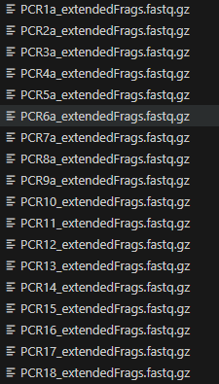
Configuring Dataset
Ran the diet data
PCR[#].extendedFrags.fastq.gz
File title specification that needs to be achieved for dataset
No periods until the file type extension
Anything before an underscore must have a unique PCR string
Reformat the file title to be compatible with nf-core syntax
For single digit files --> PCR[#]a_extendedFrags.fastq.gz
For double digit files --> PCR[#]_extendedFrags.fastq.gz
After formatting, nf-core/ampliseq could be run

Slide 11
MicrobiomeAnalyst 2.0 Overview
Web-based platform for marker-gene microbiome analysis
Accepts ASV/OTU tables + taxonomy + metadata
Provides quality filtering, normalization, and statistical testing
Offers rich visualization (bars, heatmaps, PCA/PCoA, heat trees)
Includes diversity analysis, differential abundance, biomarker discovery
Efficient for nutrition/clinical microbiome datasets
Notes:
MicrobiomeAnalyst 2.0 is a web-based analysis and visualization platform designed for amplicon microbiome data, including 16S rRNA datasets like ours.
For our project, MicrobiomeAnalyst was especially valuable because it provides standardized workflows for filtering, normalization, taxonomic profiling, and diversity analysis. Since our upstream ASV table and taxonomy came from NF-Core ampliseq, we used MicrobiomeAnalyst as our main tool for downstream interpretation and visualization

Slide 12
MicrobiomeAnalyst 2.0 Setup
Input files used: → ASV table from NF-Core → SILVA taxonomy file from NF-Core → Cleaned metadata file
Notes:
Although we performed preprocessing in QIIME2, our abundance and taxonomy inputs came from NF-Core ampliseq. NF-Core’s workflow uses DADA2 denoising, Cutadapt trimming, and SILVA 138.2 for taxonomic assignment. The advantage of using the NF-Core outputs is that the ASV table and taxonomy file were already clean and consistently formatted.
These files were loaded into MicrobiomeAnalyst along with our manually cleaned metadata sheet. Once sample names were aligned and blank rows removed, MicrobiomeAnalyst accepted the dataset and allowed us to run filtering, normalization, diversity metrics, and taxonomic profiling.

Slide 13
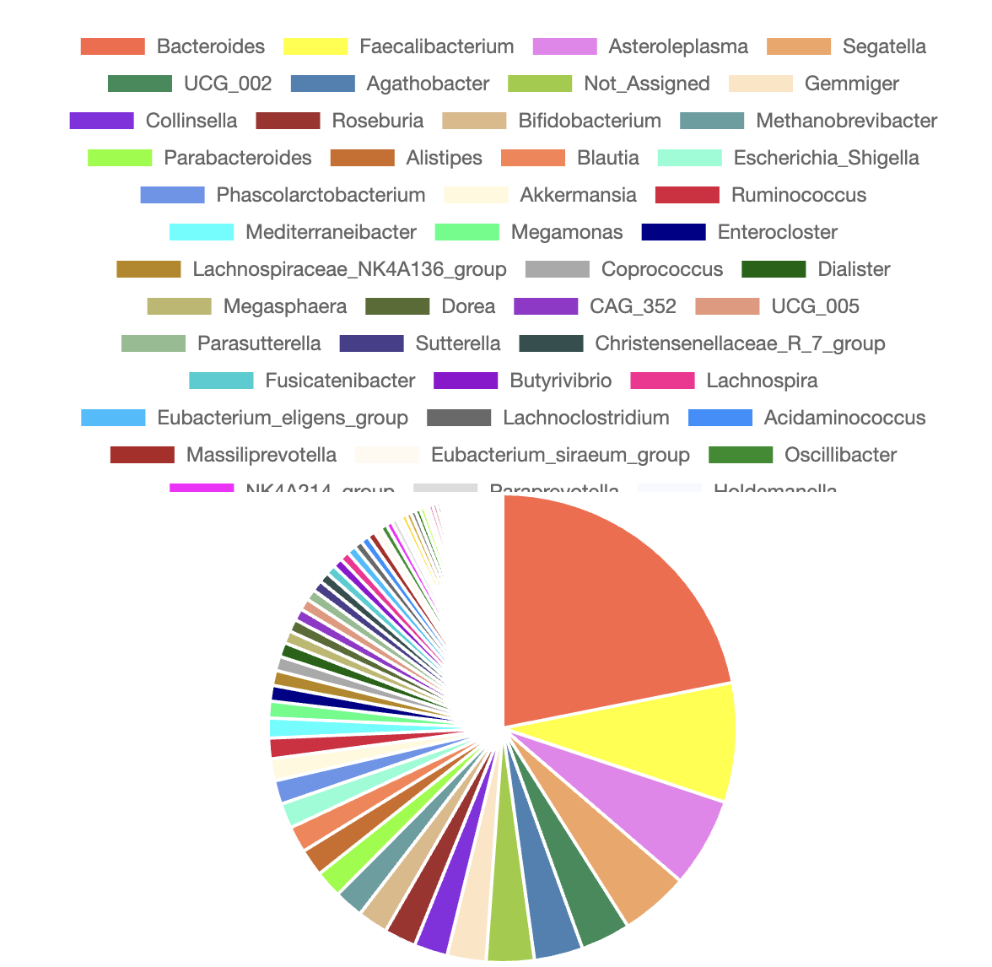
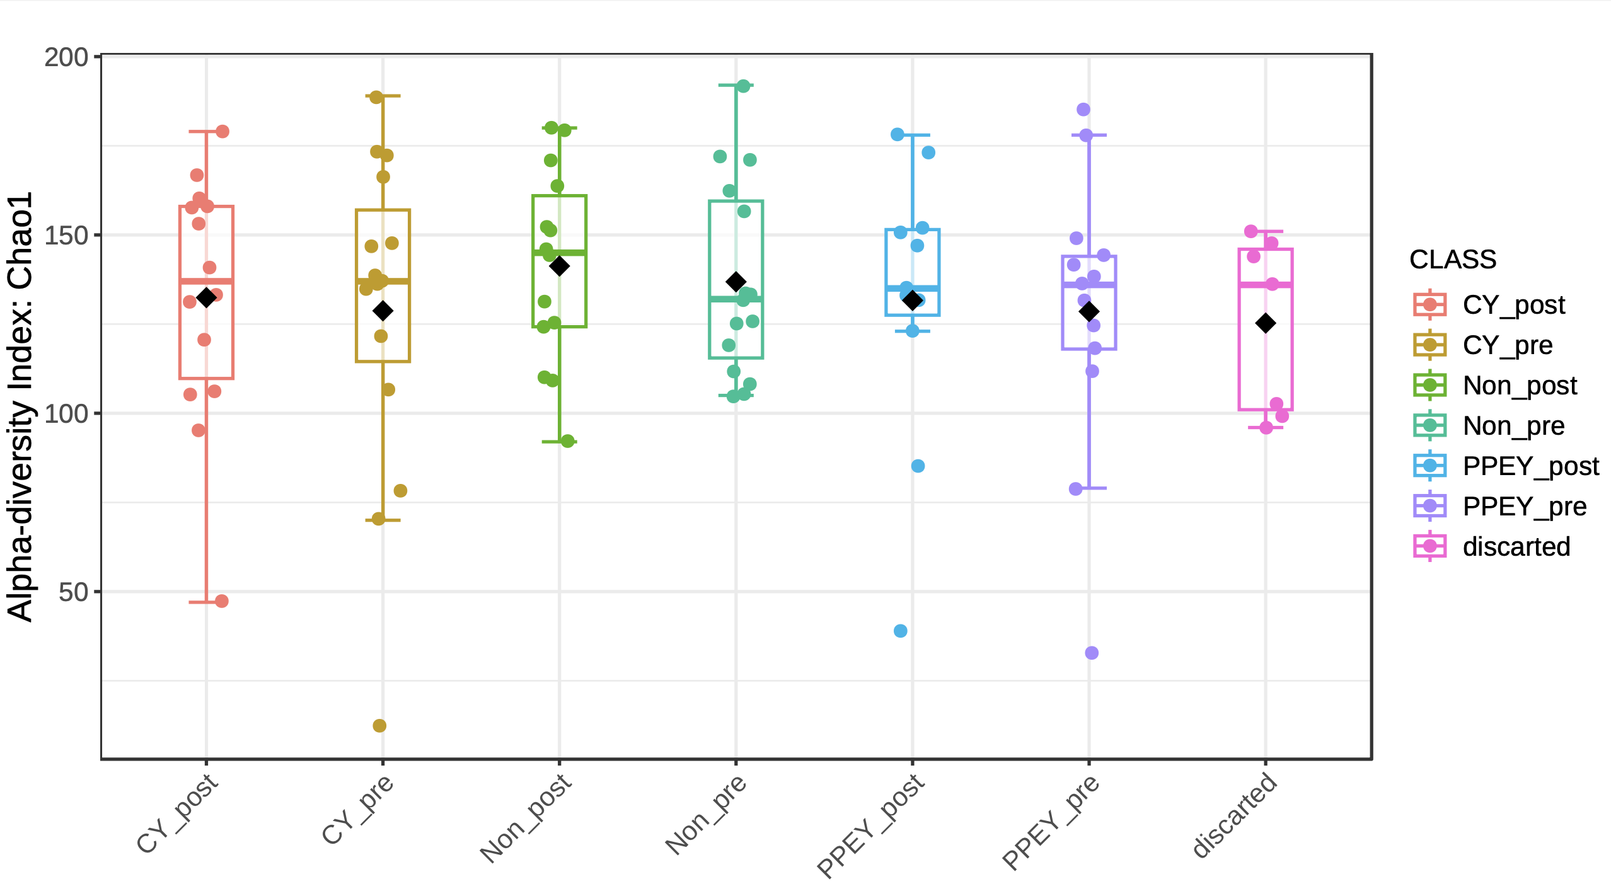
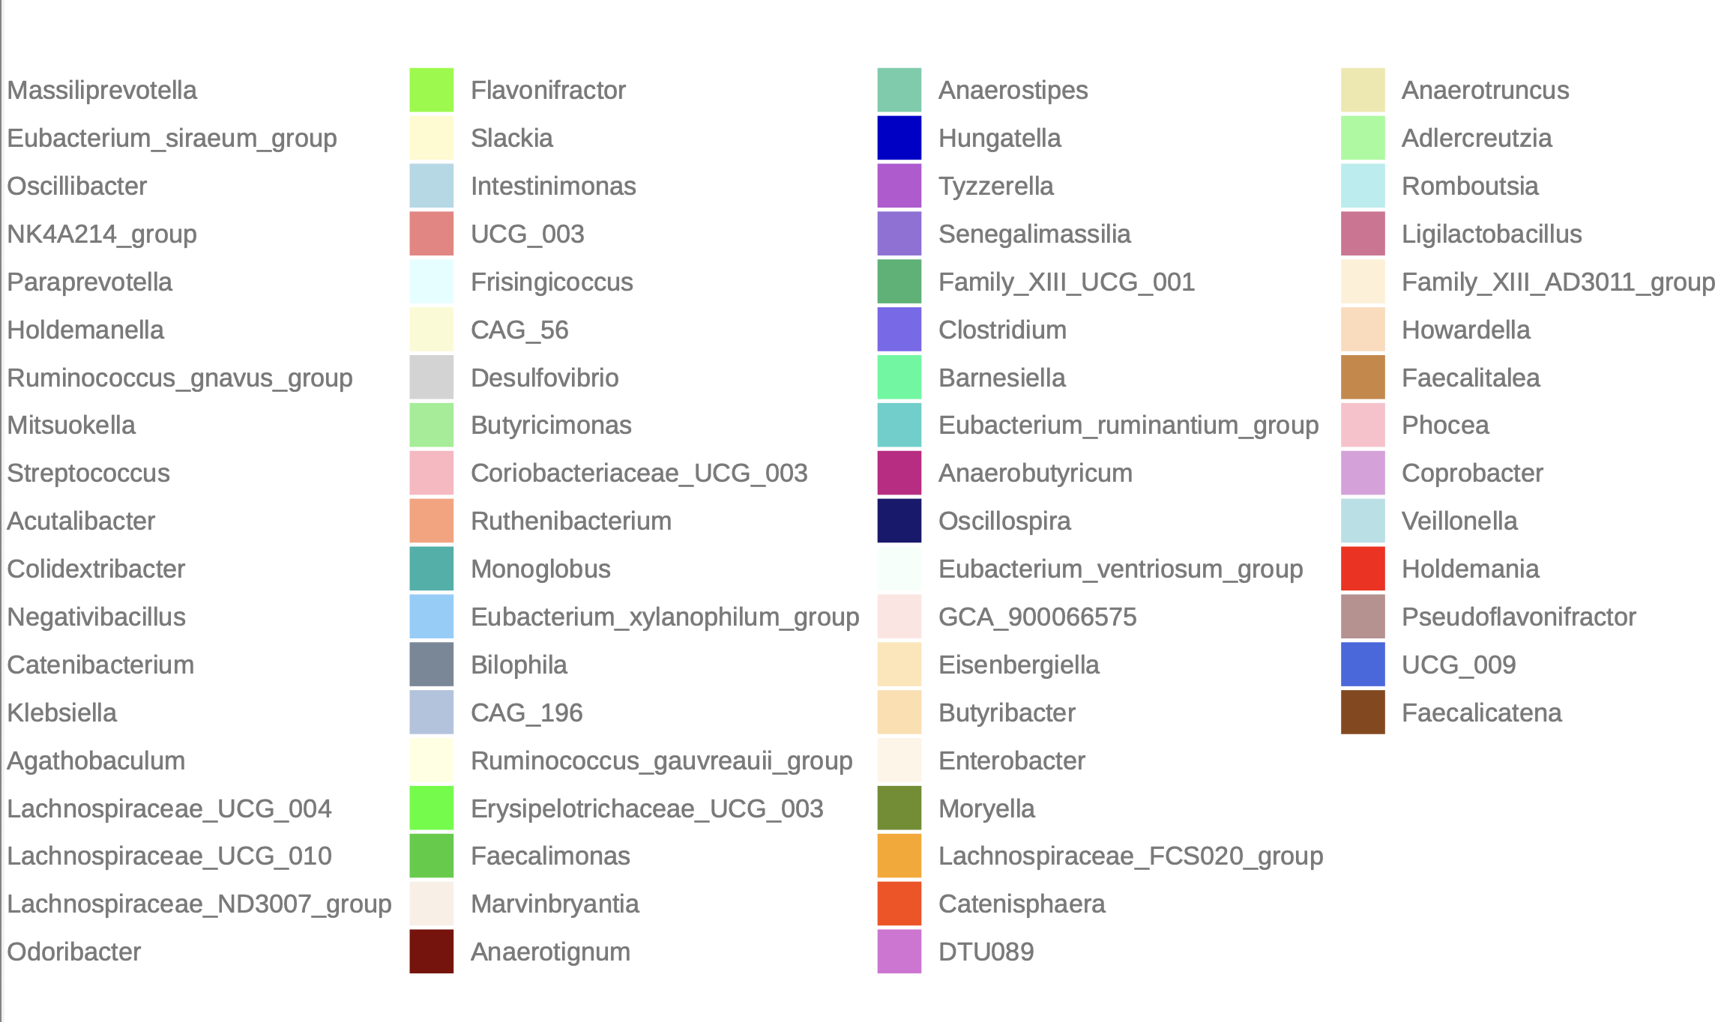
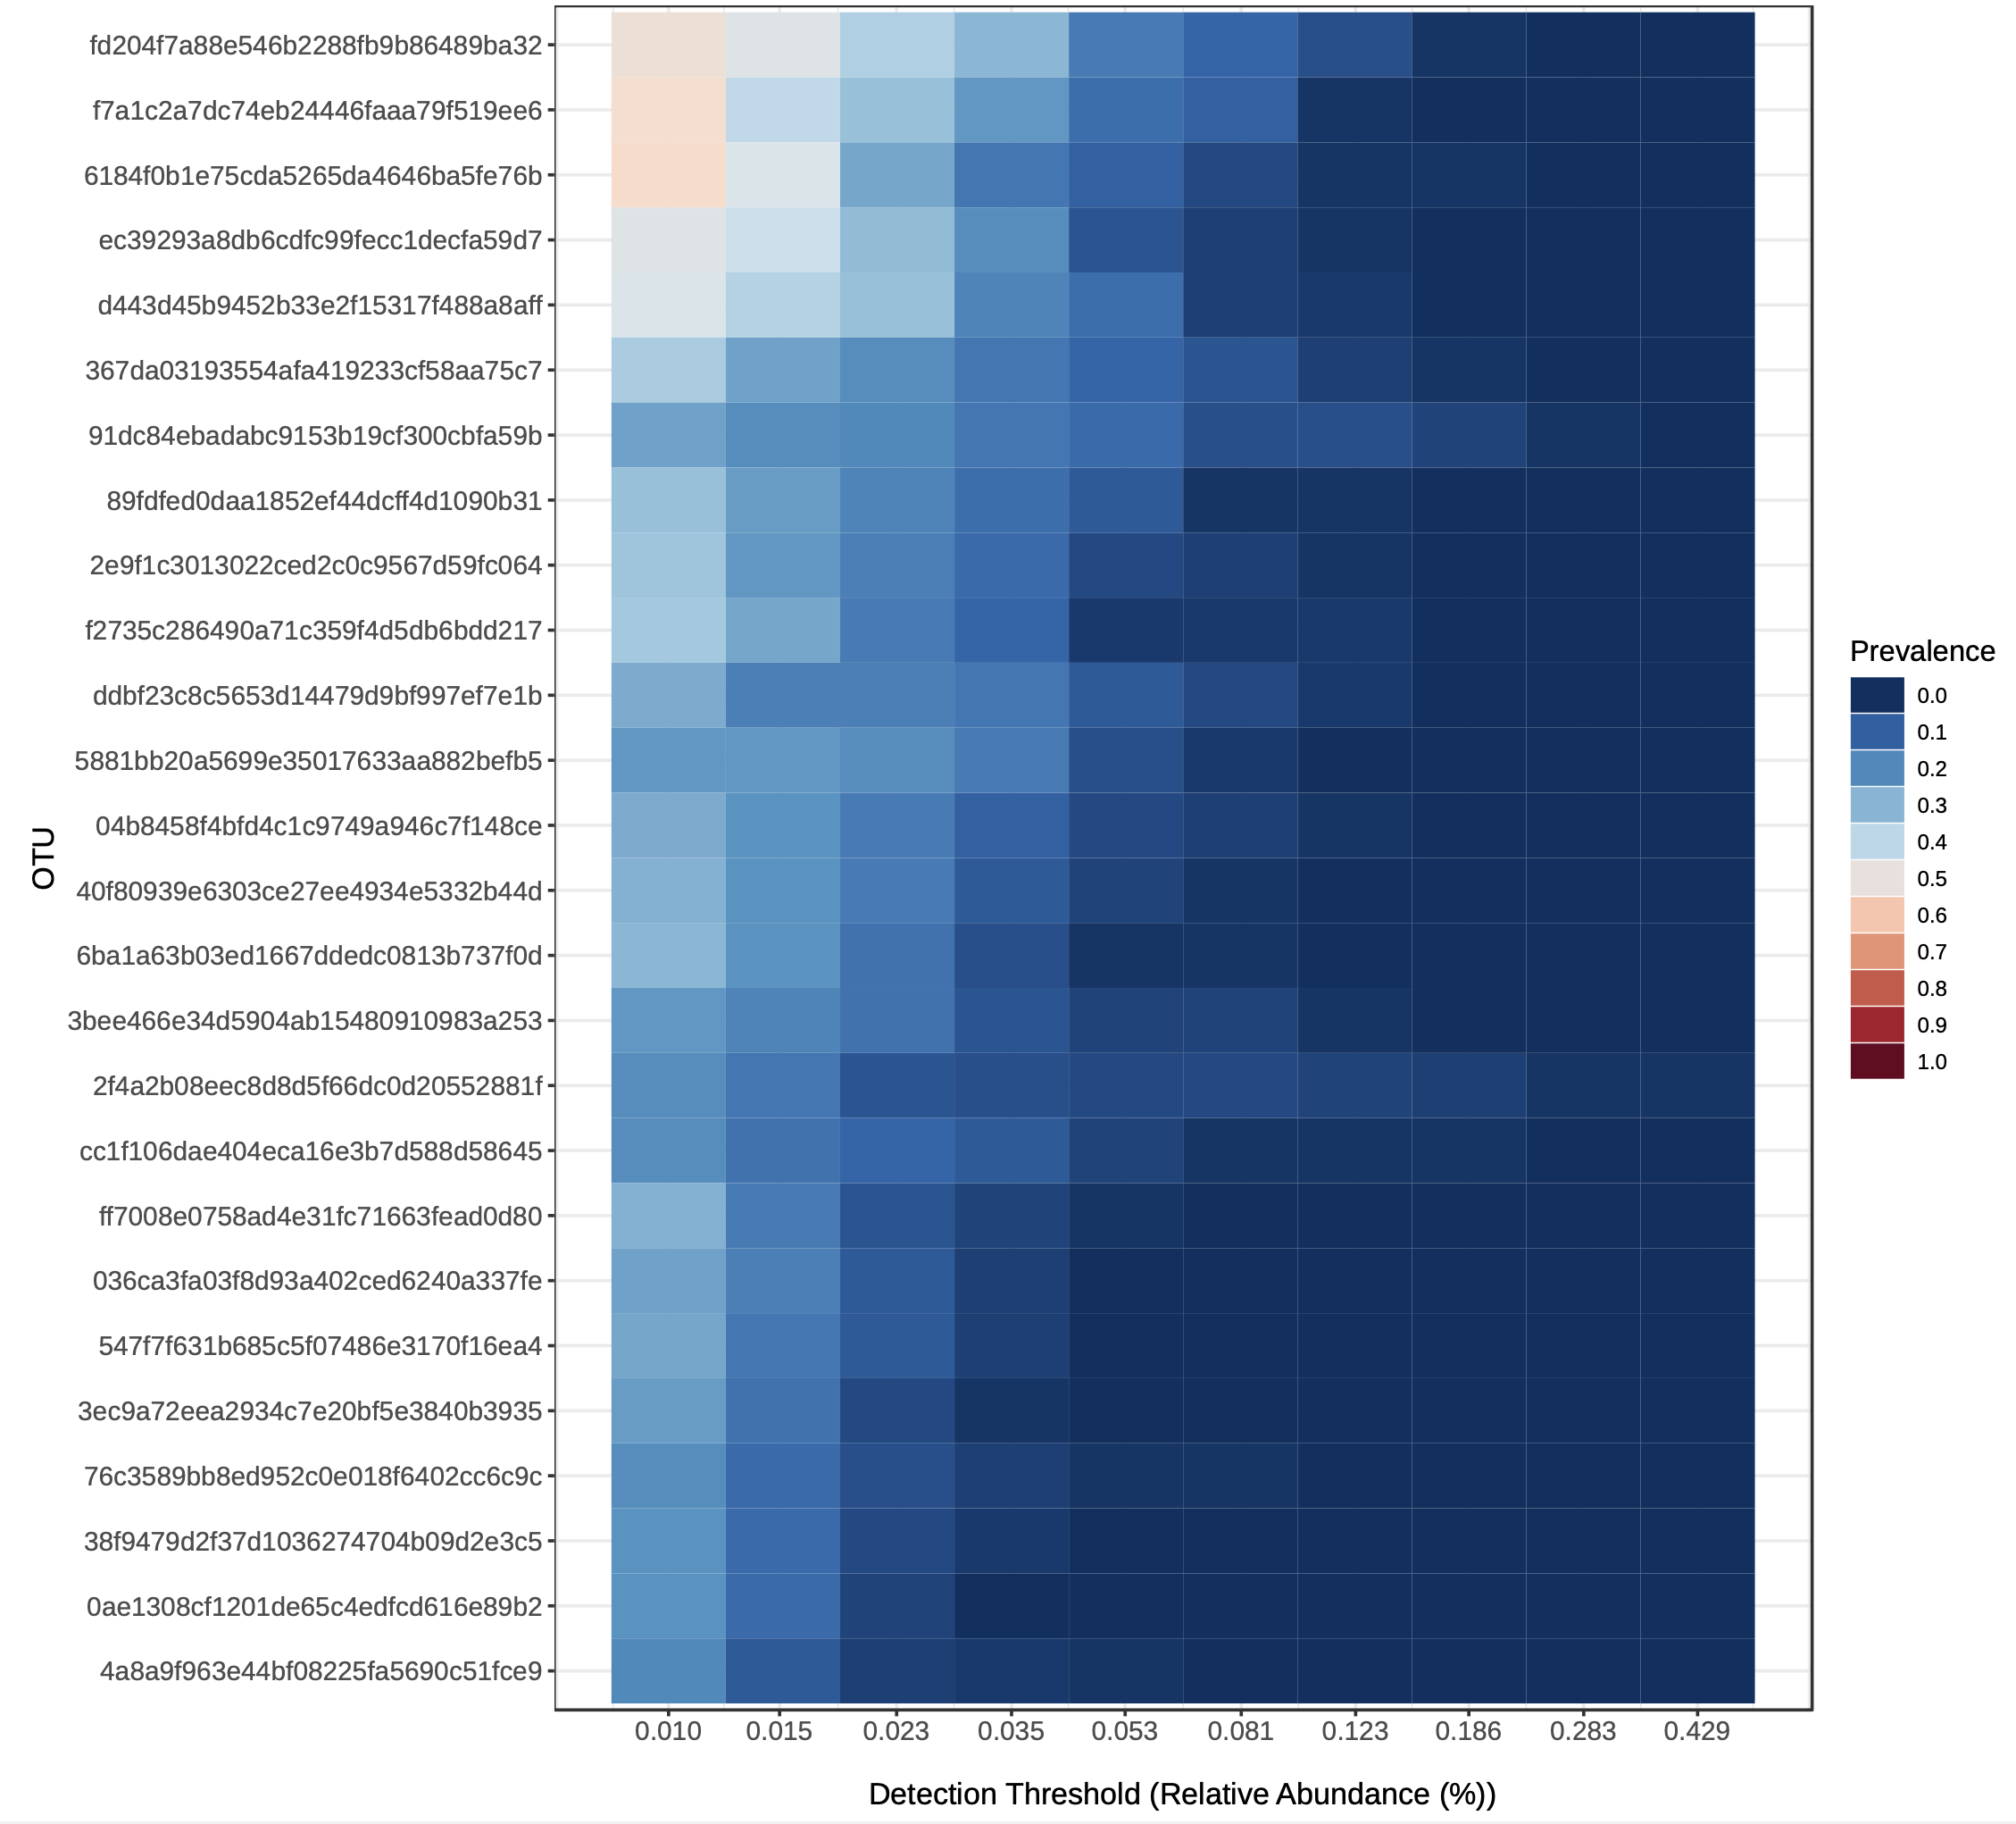
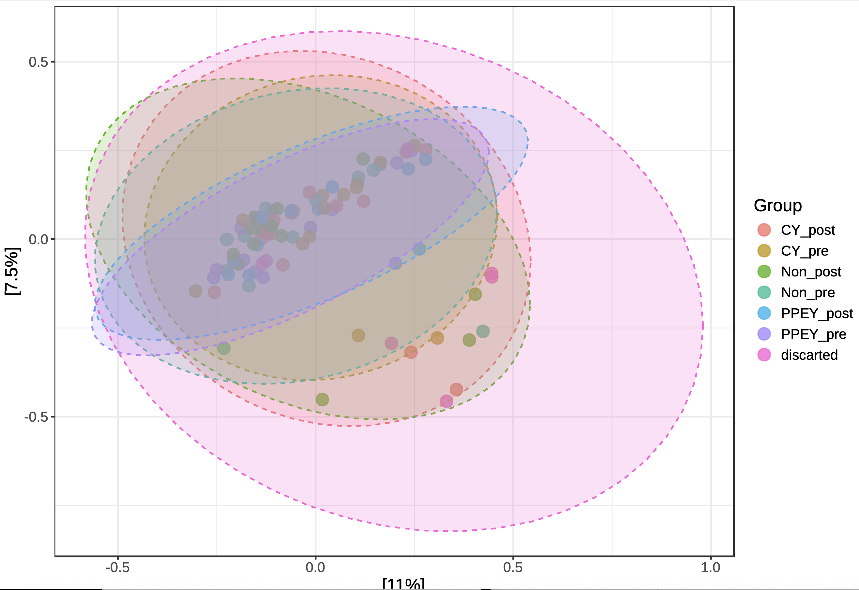
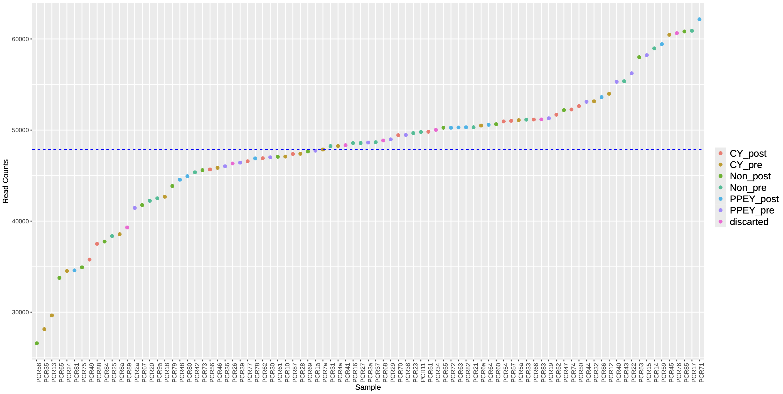
MicrobiomeAnalyst 2.0 Outputs from NF-Core
Notes:
Abundance profiling (stacked bar plots at phylum, genus, species levels)
Alpha diversity (Chao1, Shannon, with Welch ANOVA)
Beta diversity (Bray–Curtis PCoA + PERMANOVA)
Heat trees (group comparisons across taxa)
Core microbiome (prevalence and abundance thresholds)

Slide 14
Statistics*
Part 1 - Exploratory
Part 2 – Model building
Generated alpha & beta diversity metrics
Histograms & boxplots
Rarefaction
Correlation
Canonical correspondence analysis
ANOVA
Generalized Linear Models
(Multiple Linear Regression)
Notes:
Alpha diversity metrics are used to quantify the diversity within a sample, considering factors like the # of species (richness) and relative abundances (evenness).
Beta diversity metrics quantify the differences in microbial composition between samples by calculating a dissimilarity or distance matrix.
Rarefaction is a technique to assess expected species richness. It allows the calculation of species richness for a given number of individual samples, based on the construction of rarefaction curves.
Correlation measures the relationship between two variables, indicating how they move together, with values between –1 and +1.
CCA is a multivariate stat technique to analyze the relationship between a set of species and a set of environmental variables.

Slide 15
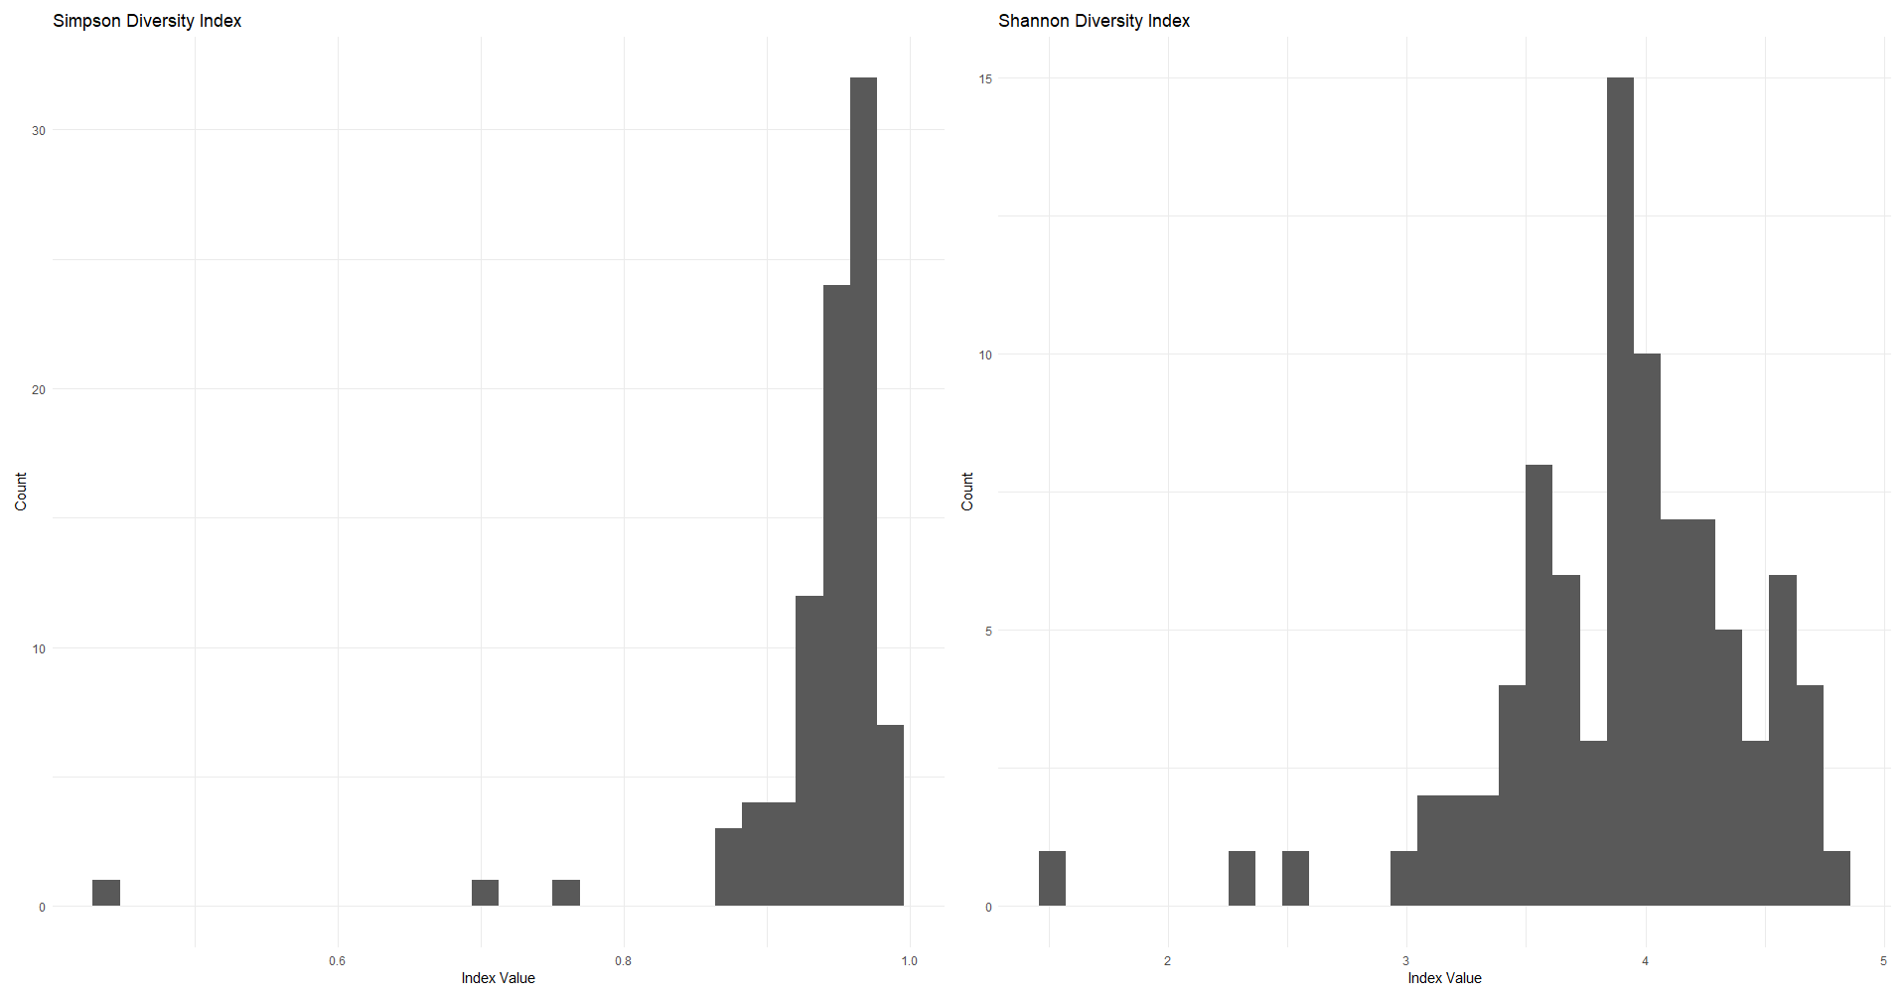
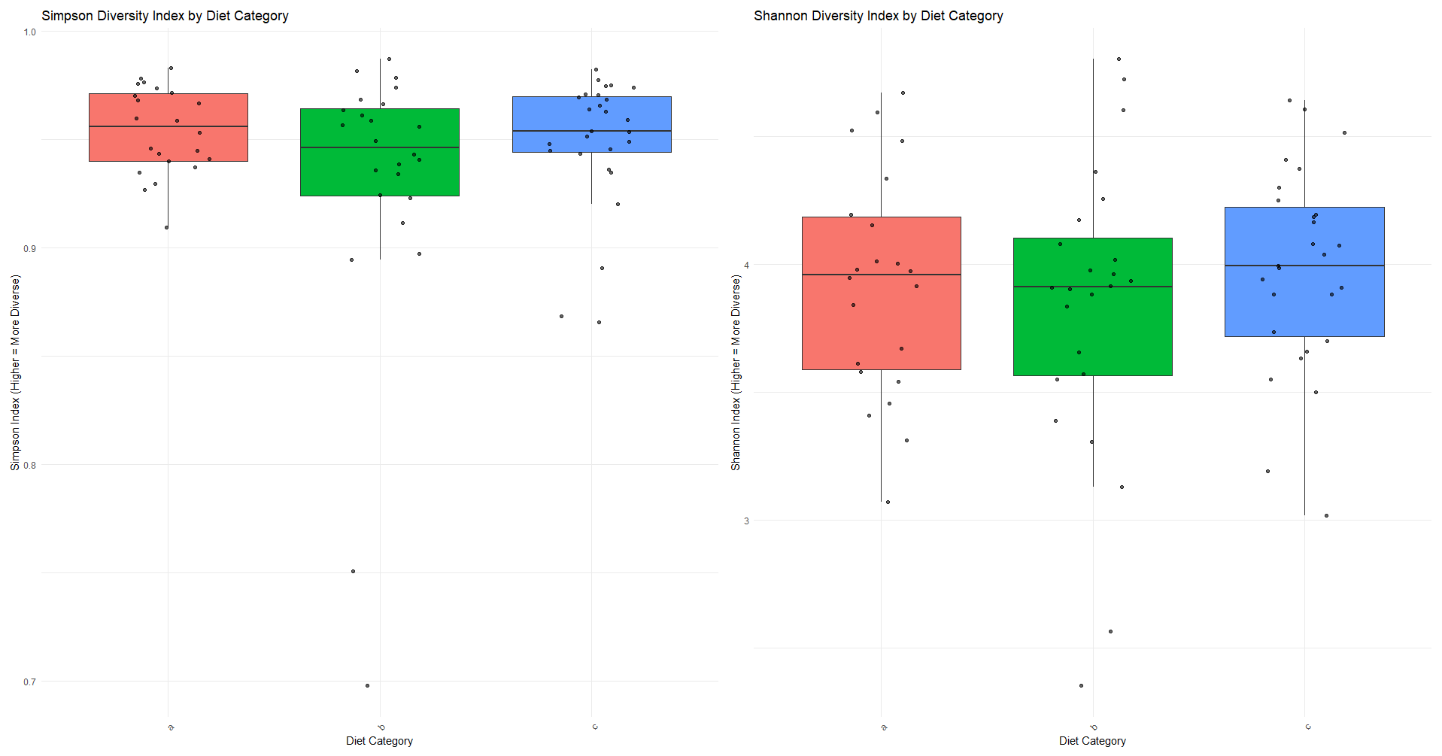
Alpha diversity indices
Notes:
Simpson's index measures the probability that 2 individuals randomly selected from a sample belong to the same species. A higher index indicates lower diversity.
Shannon's index incorporates both # of species and relative abundances. A higher index value indicates greater diversity, which means there are more species and more evenly distributed.
Histograms show the overall distribution: high diversity with a few outliers
Boxplots compare effect of the different diet categories on microbial diversity
A – probiotic, b – control, C – no yogurt

Slide 16
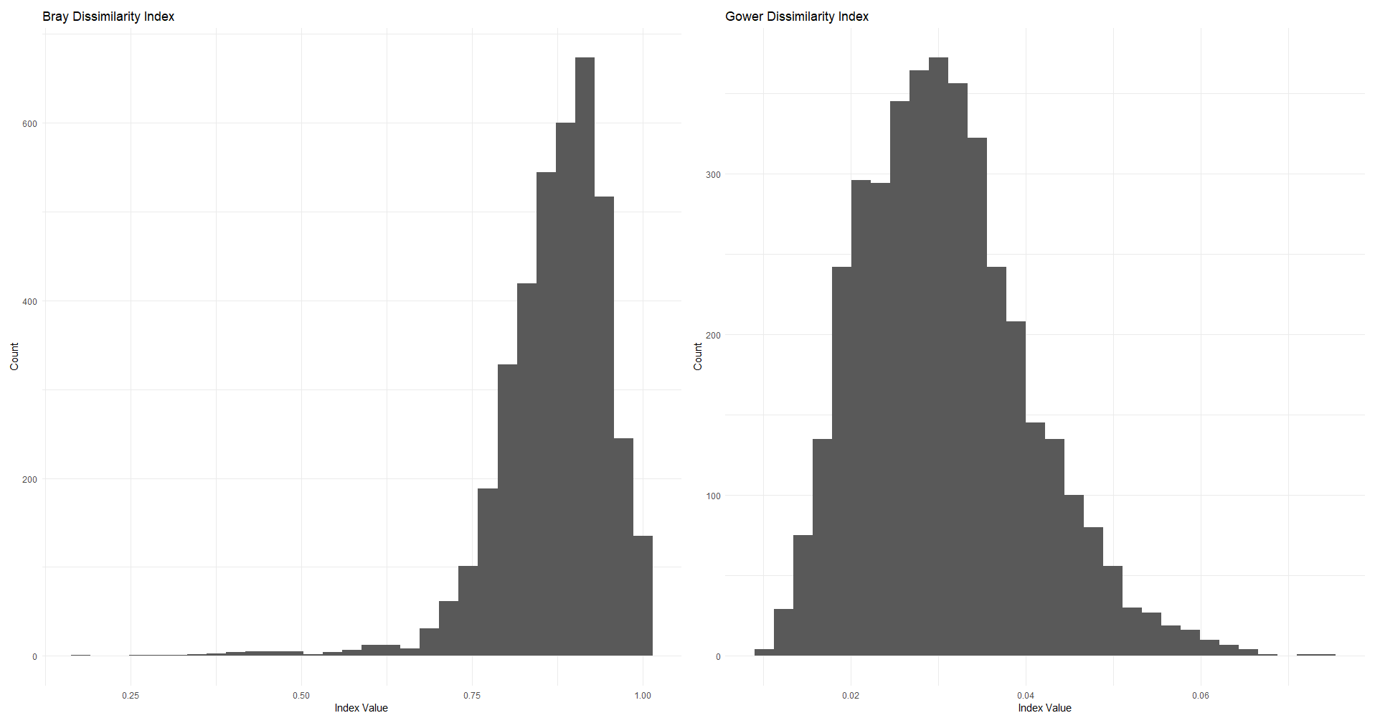
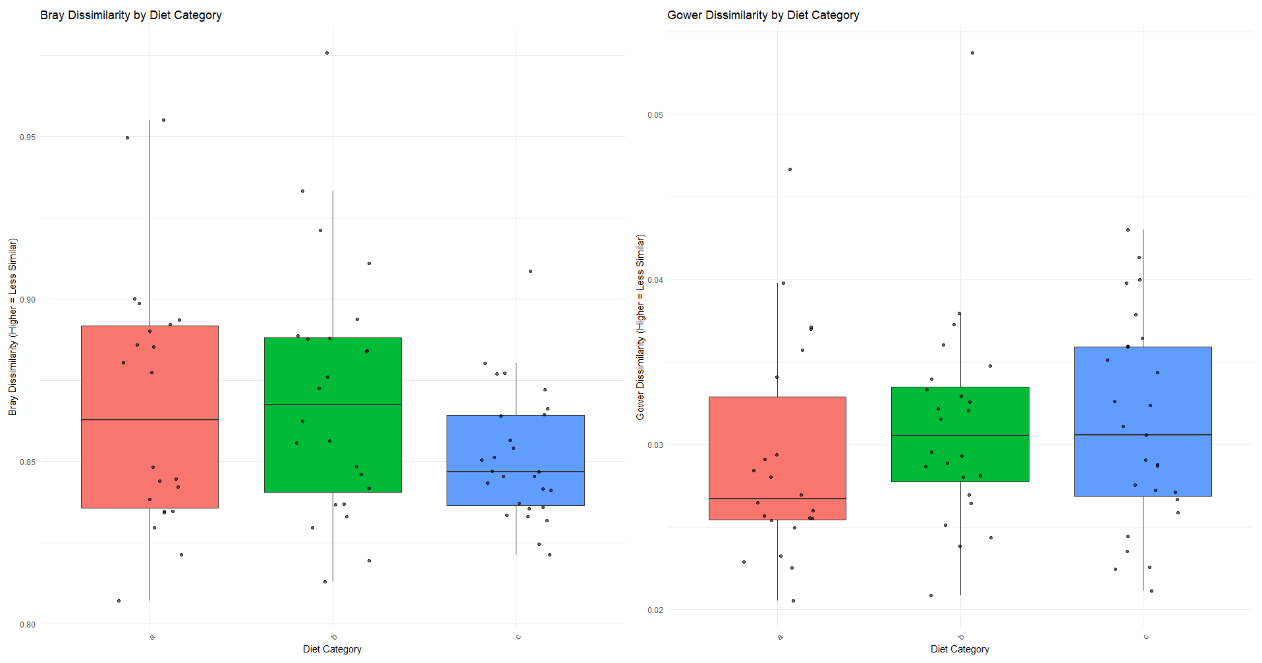
Beta diversity indices
Notes:
Dissimilarity analysis is a good way to explore variability in community composition.
Bray dissimilarity index – quantify the difference between 2 samples based on the abundance of species and other entities. 0: samples identical in species composition and abundance. 1: samples share no species in common
Gower dissimilarity index is used to measure the difference between 2 samples, especially those with a mix of numerical and categorical variables. 0: identical, 1: maximally different
A – probiotic, b – control, C – no yogurt

Slide 17
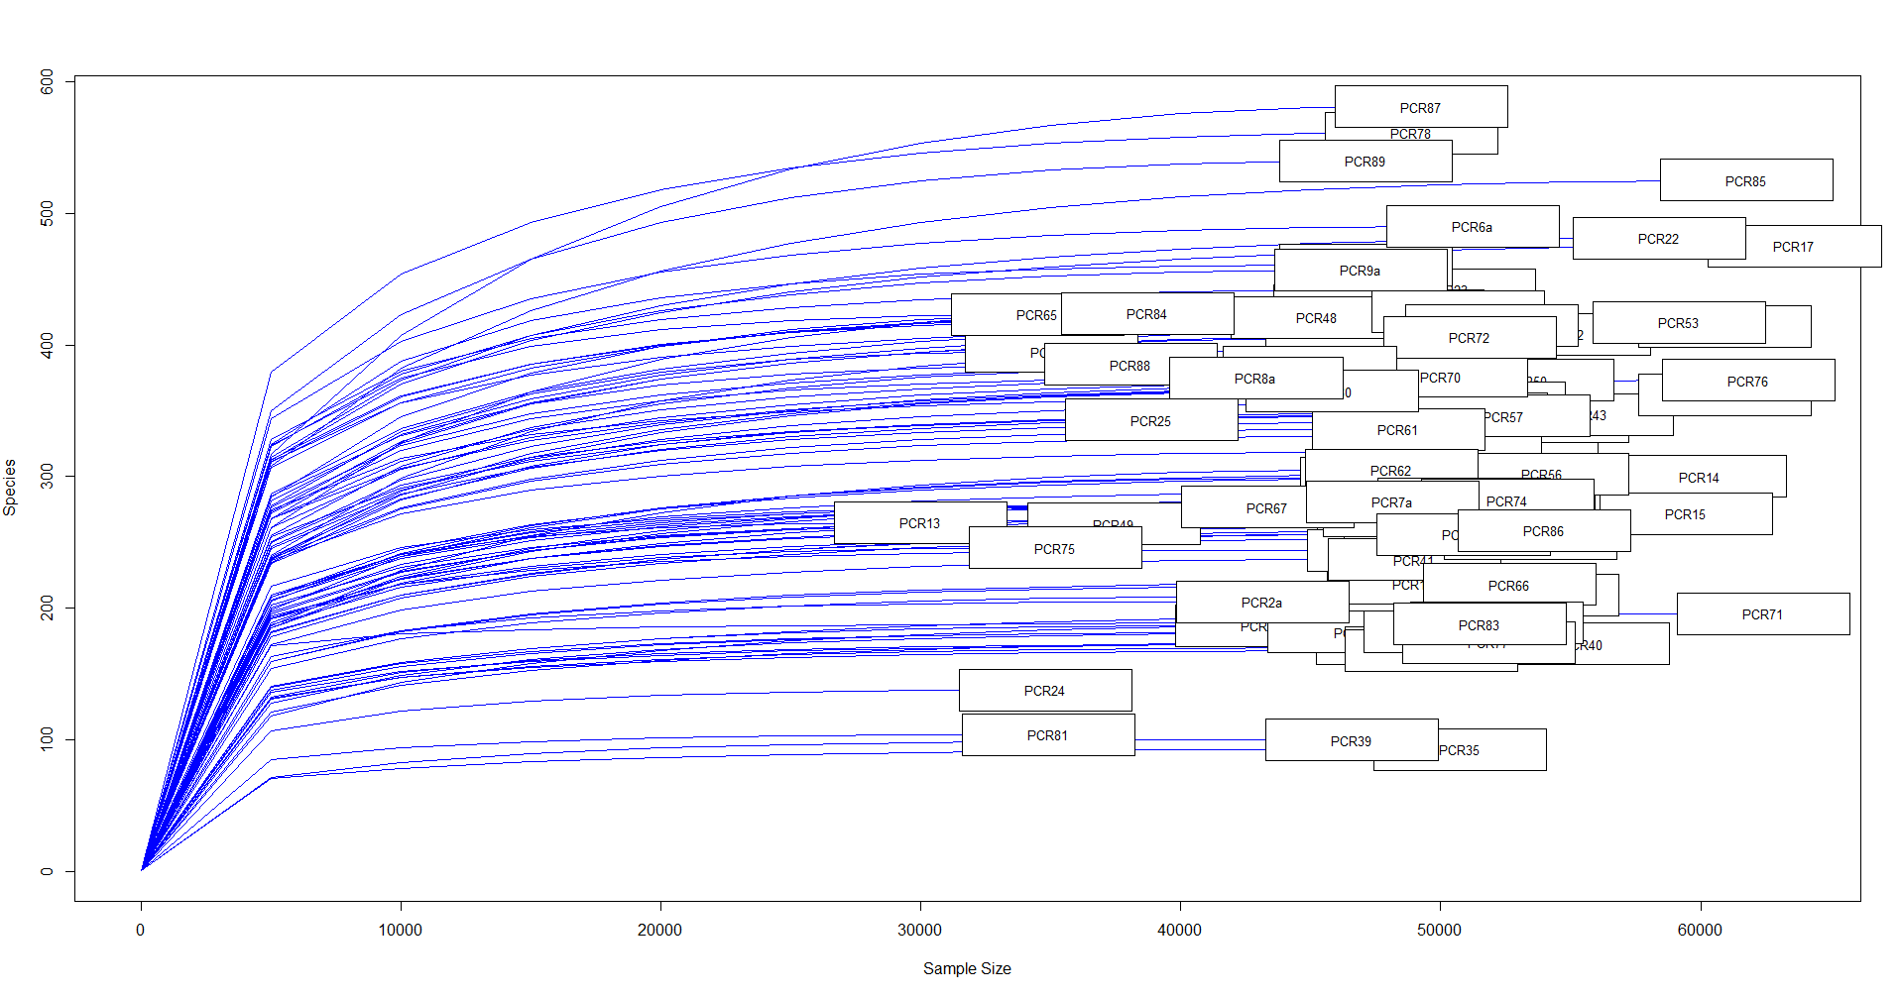
Rarefation
Notes:
Rarefaction curves generally grow rapidly at first, as the most common species are found, but the curves plateau as only the rarest species remain to be sampled.
Confirms alpha diversity
Sequences between to plateau after 30K. Different heights represent a high richness

Slide 18
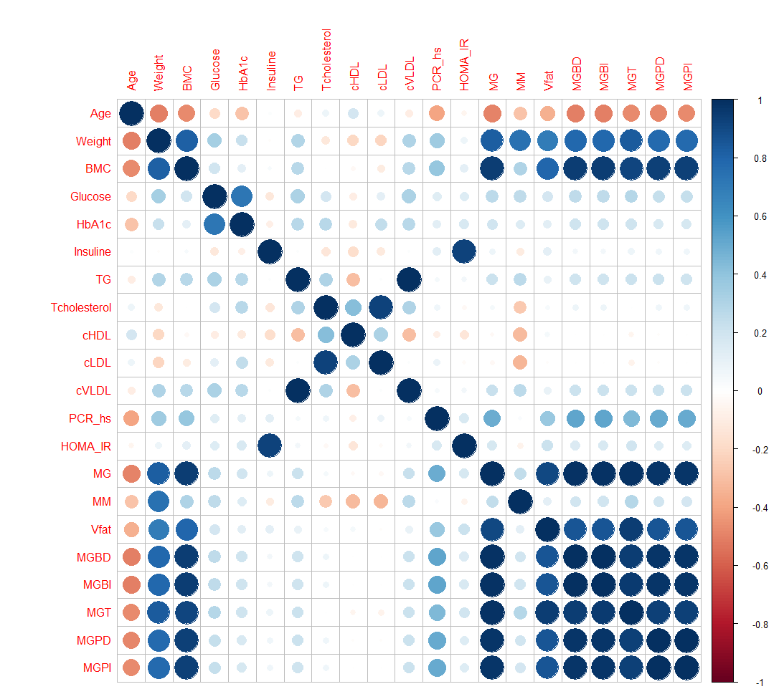
Correlation
Relationship between 2 variables
Notes:
Multicollinearity is when 2+ independent variables in a regression model are highly correlated, making it difficult to determine the individual effect of each variable on the dependent variable.

Slide 19
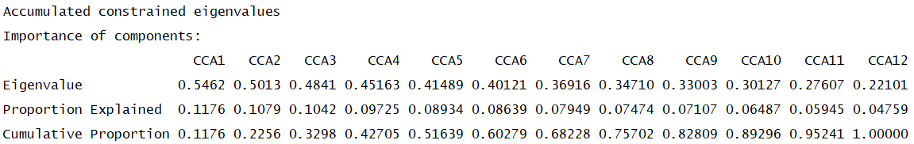
Canonical Correspondence Analysis
Partitioning of scaled Chi-square:
Inertia Proportion
Total 13.862 1.000
Constrained 4.644 0.335
Unconstrained 9.218 0.665
Notes:
Global Model Fit - how much of total variation in microbial community the clinical variables explain
Constrained inertia - portion of microbial variation explained by clinical variables
how the explained variation (the 33.5%) is distributed across the canonical axes – clinical variables not really influential
CCA1 and CCA2 together capture about 22.6% of the total constrained variance, first two axes represent a significant portion of the relationship (look at biplot visualization)

Slide 20
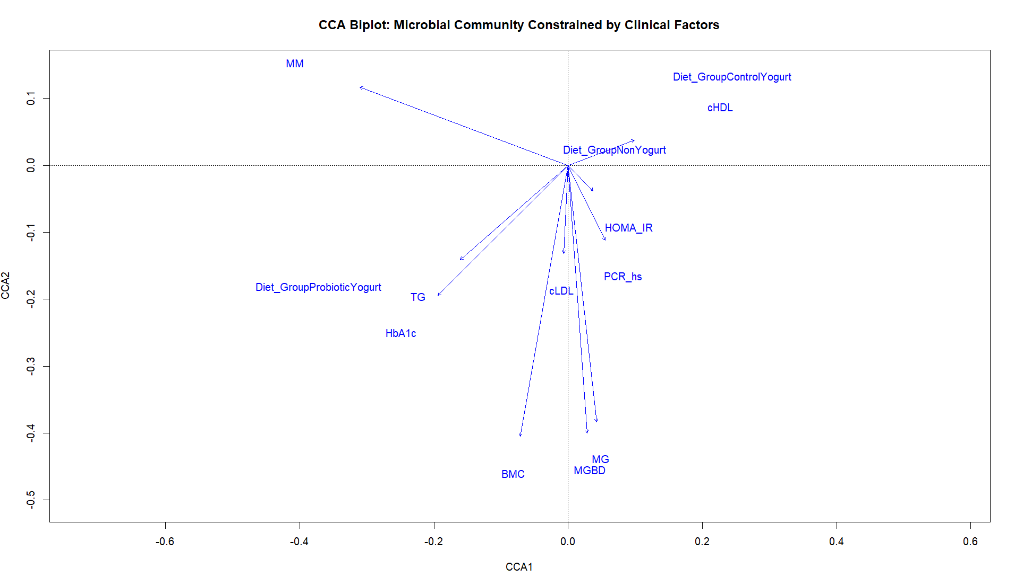
CCA cont.
Notes:
CCA1 & CC2 explain majority of variation in species distribution based on clinical gradients

Slide 21
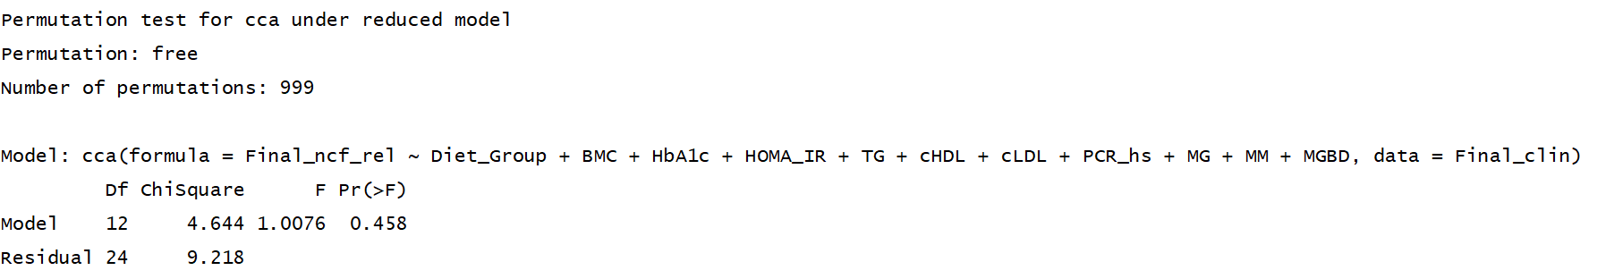
Overall model significance
Notes:
Since p = 0.458 is much greater than the standard level of 0.05, the overall null hypothesis cannot be rejected. The entire set of clinical and experimental predictors (accounting for 33.5% of variance) does not have a statistically significant effect on the microbial community structure.
CCA summary showed that model explained 33.5% of the variance, this p-value indicates that this 33.5% could plausibly have occurred by random chance.

Slide 22
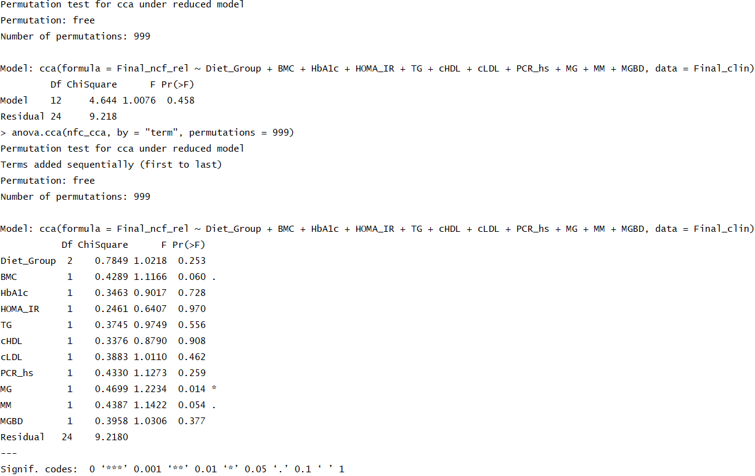
Individual term significance

Slide 23
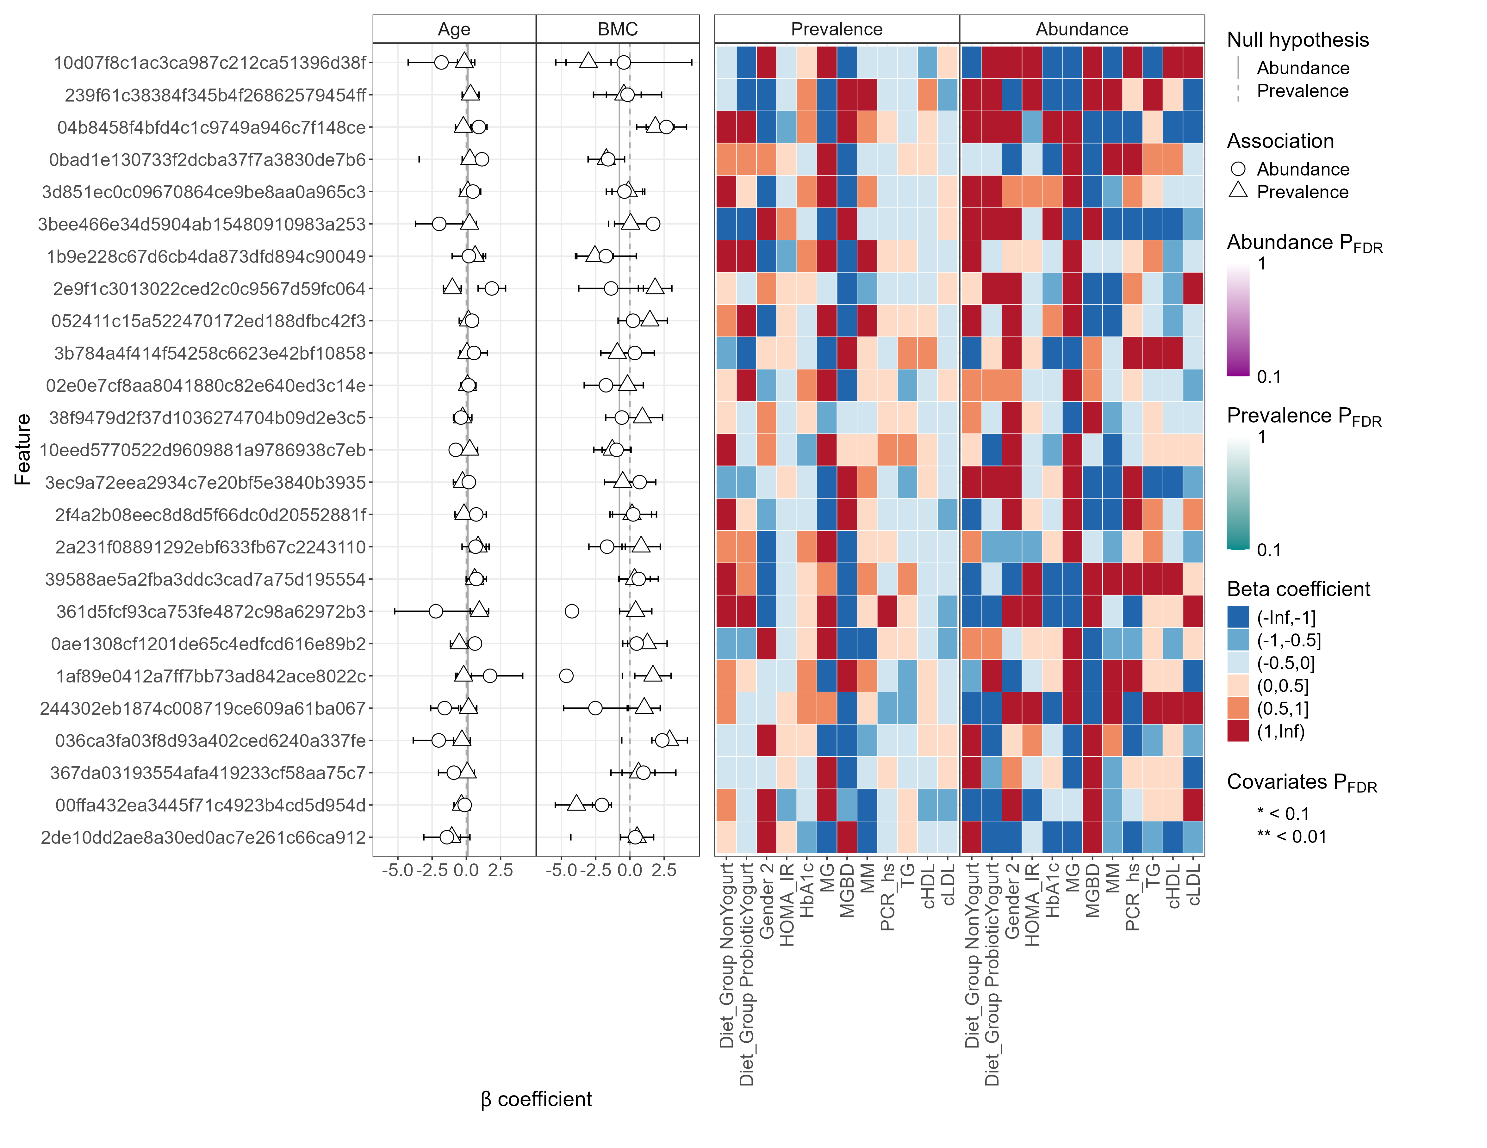
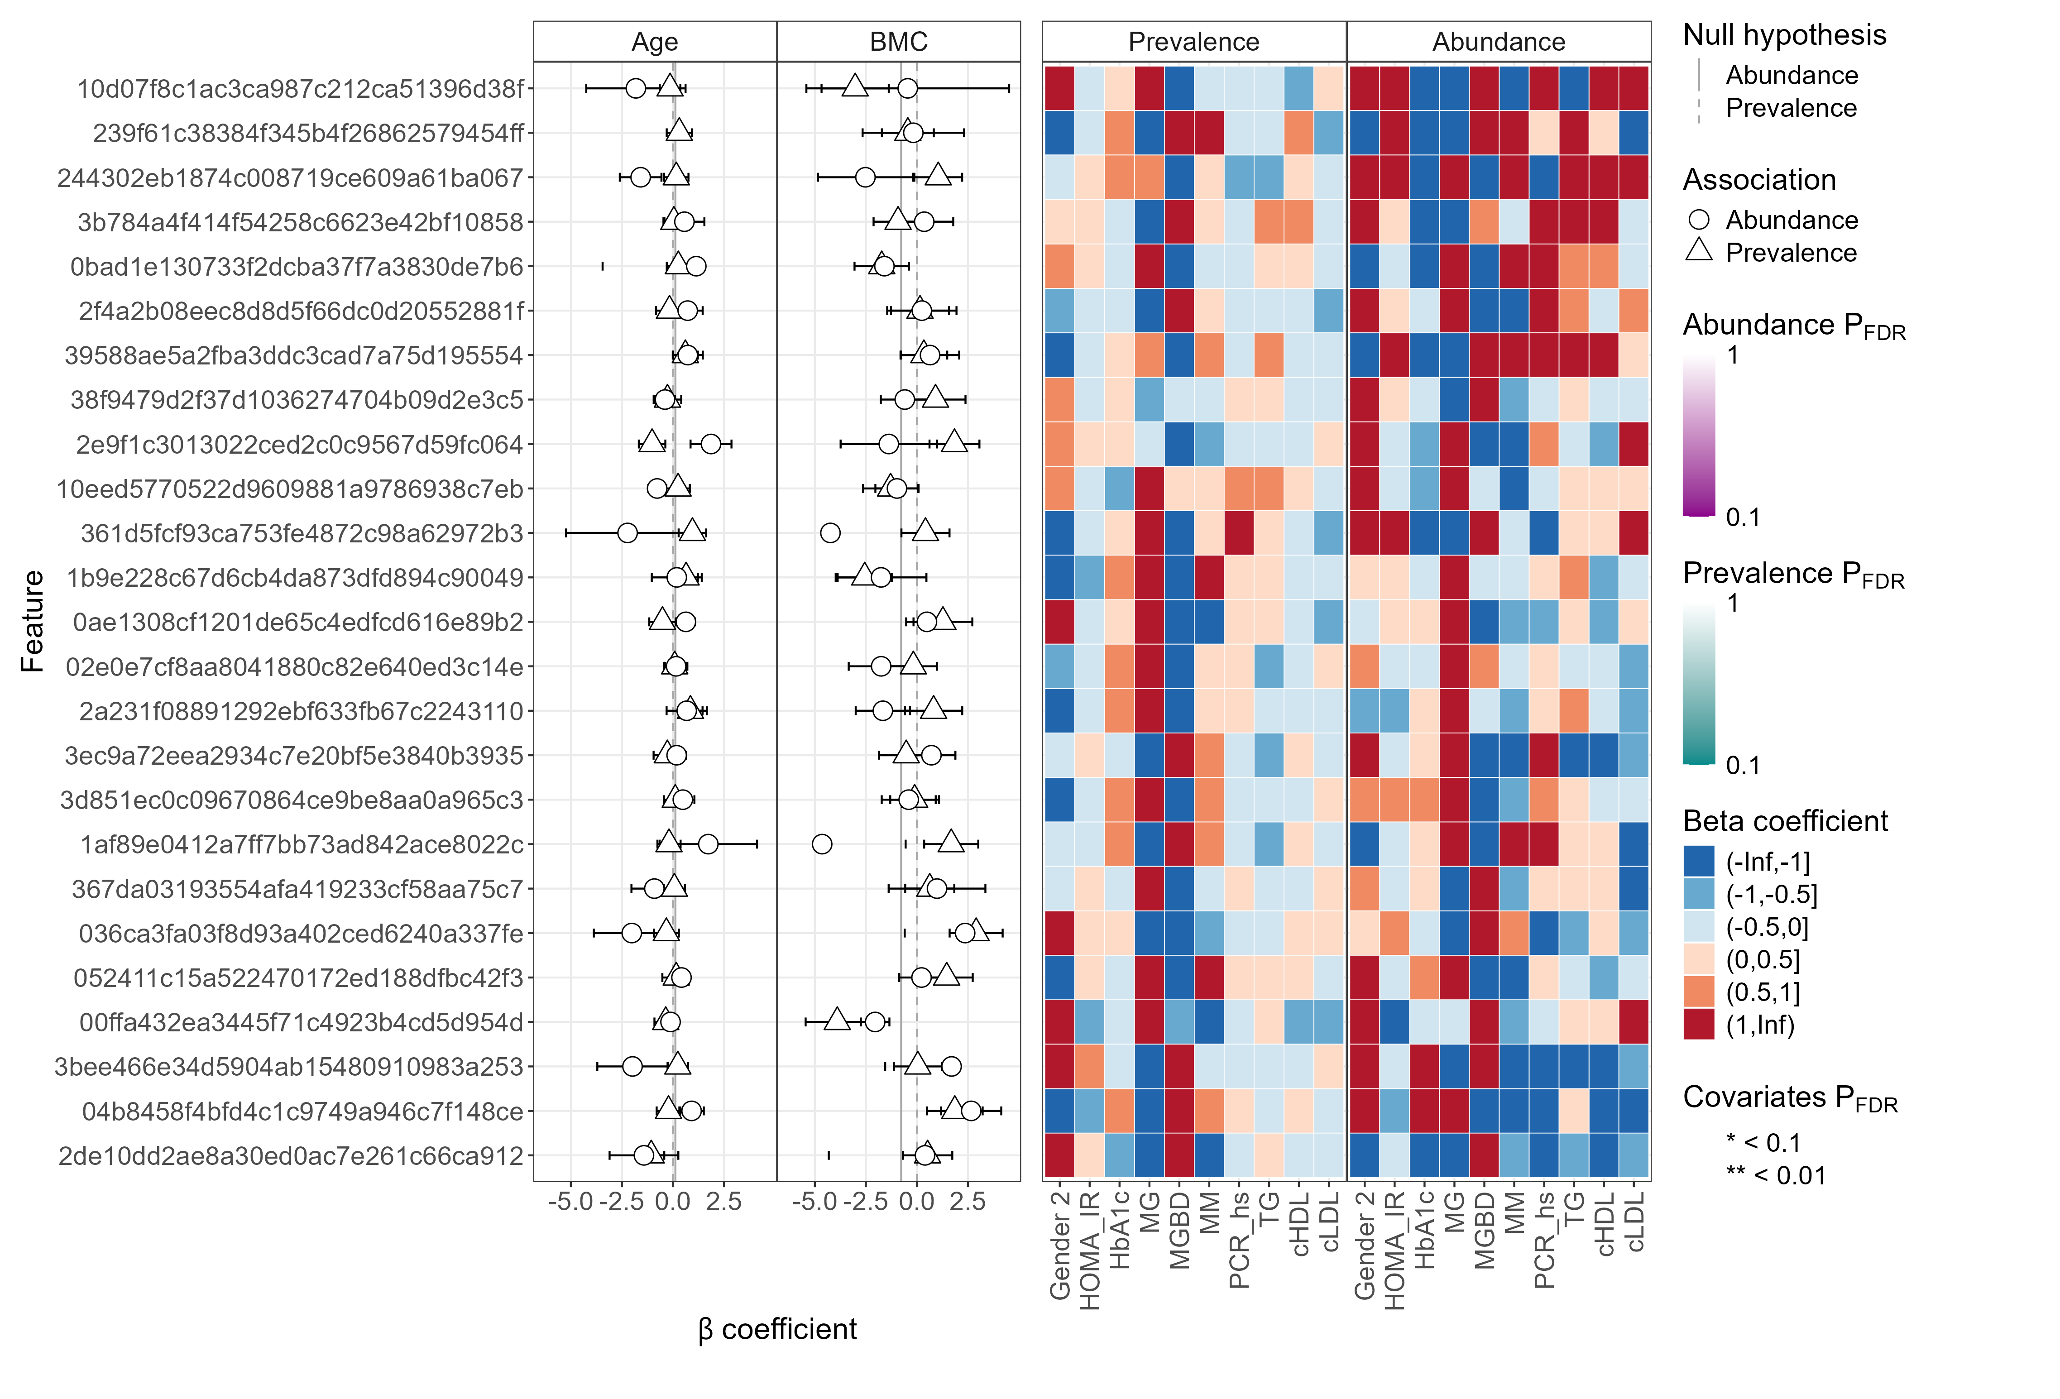
Maaslin3 summaries
General model
Yogurt groups
Notes:
A – probiotic, b – control, C – no yogurt
If the horizontal line (confidence interval) doesnt cross the vertical dashed line at zero, the association is statistically significant. A positive coefficient means the feature's abundance increases with the covariate, and a negative coefficient means it decreases.
Comprehensive heatmap showing the significance and direction of association for all features and all covariates.

Slide 24
Human resources slide 10
Thank You

