Slide 1
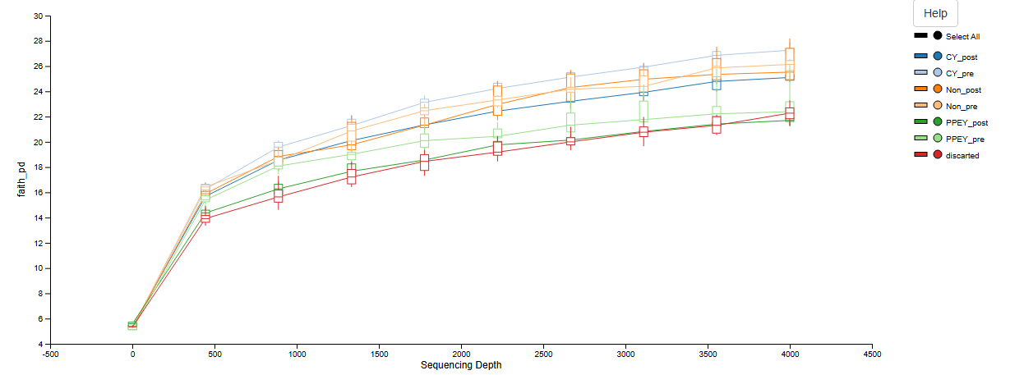
Notes:
Figure 1. Alpha rarefaction plot by group from QIIME2

Slide 2
A
B
C
D
Notes:
Figure 2: Alpha diversity metrics from MicrobiomeAnalyst2.0. A) Chao1 plot, B) Chao1 boxplot, C) Shannon plot, D) Shannon boxplot

Slide 3
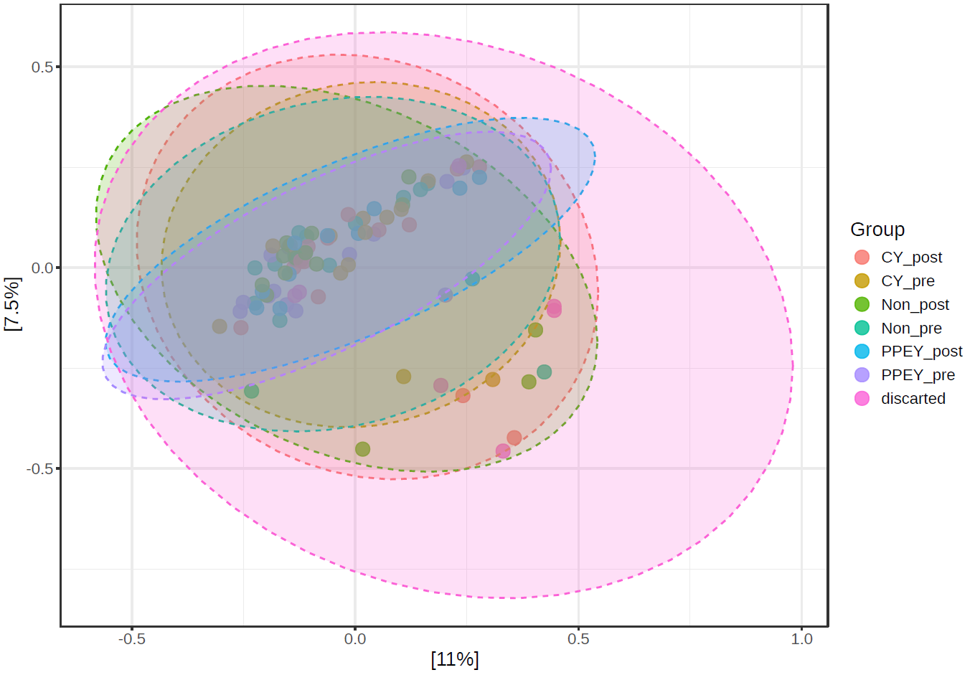
Notes:
Figure 3. Principal Coordinates Analysis plot

Slide 4
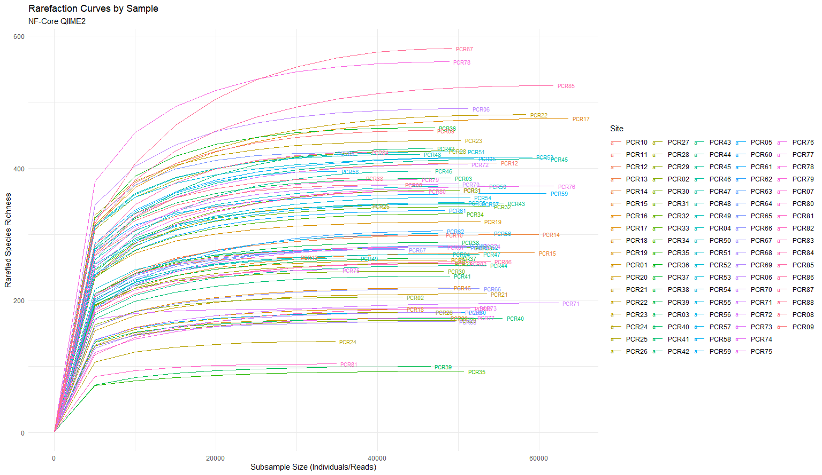
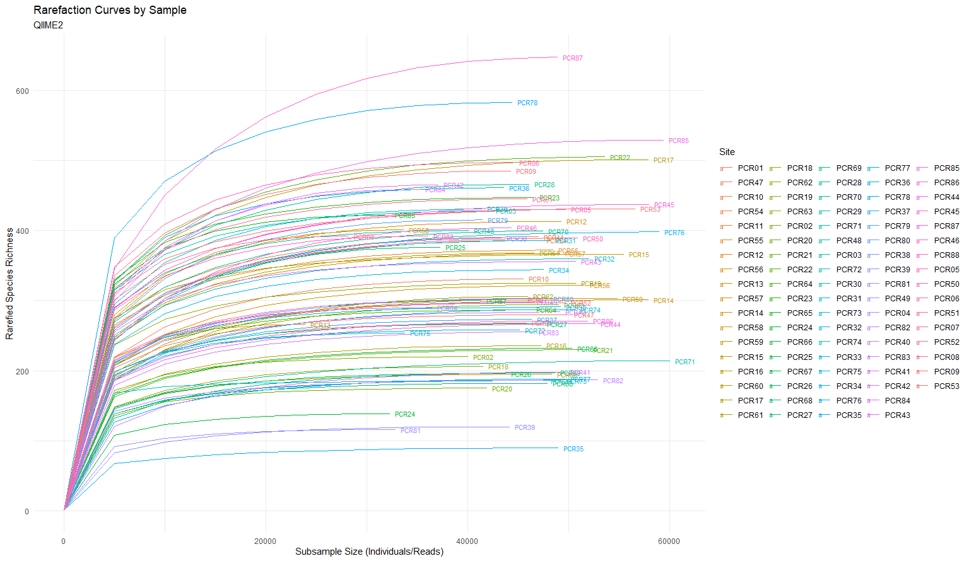
A
B
Notes:
Figure 4. A) Rarefaction Curves by Sample (NF-Core QIIME2 Pipeline), B) Rarefaction Curves by Sample (QIIME2 Pipeline)

Slide 5
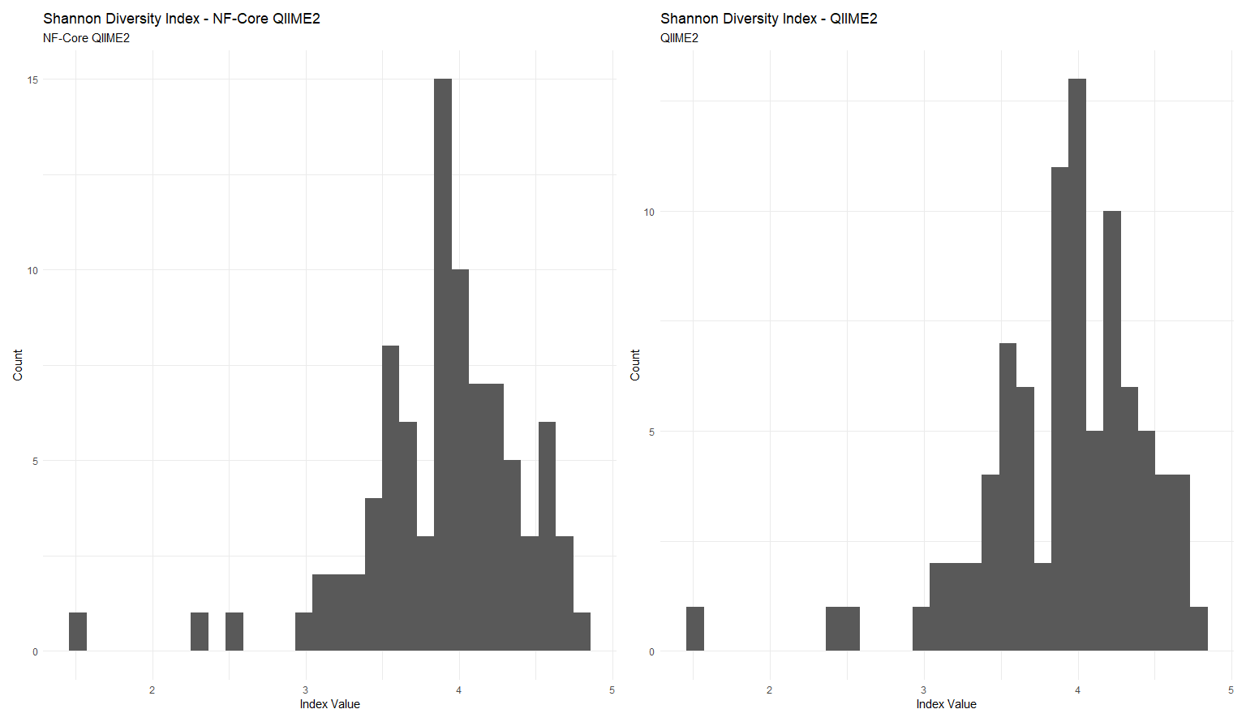
Notes:
Figure 5. Shannon diversity index histograms. A) NF-Core, B) QIIME2

Slide 6
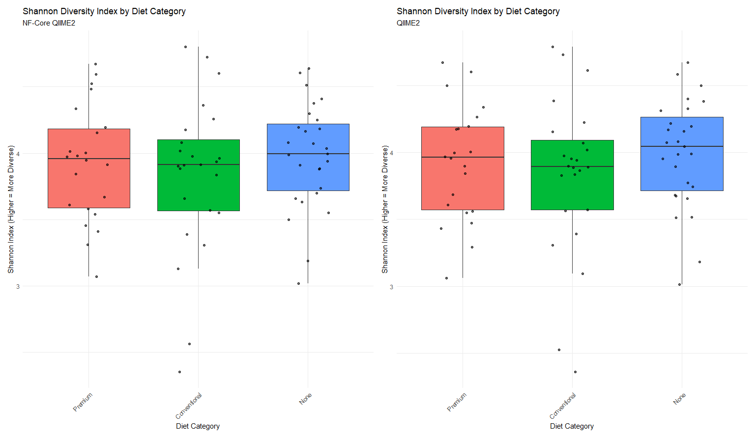
Notes:
Figure 6. Shannon diversity index boxplots. A) NF-Core, B) QIIME2

Slide 7
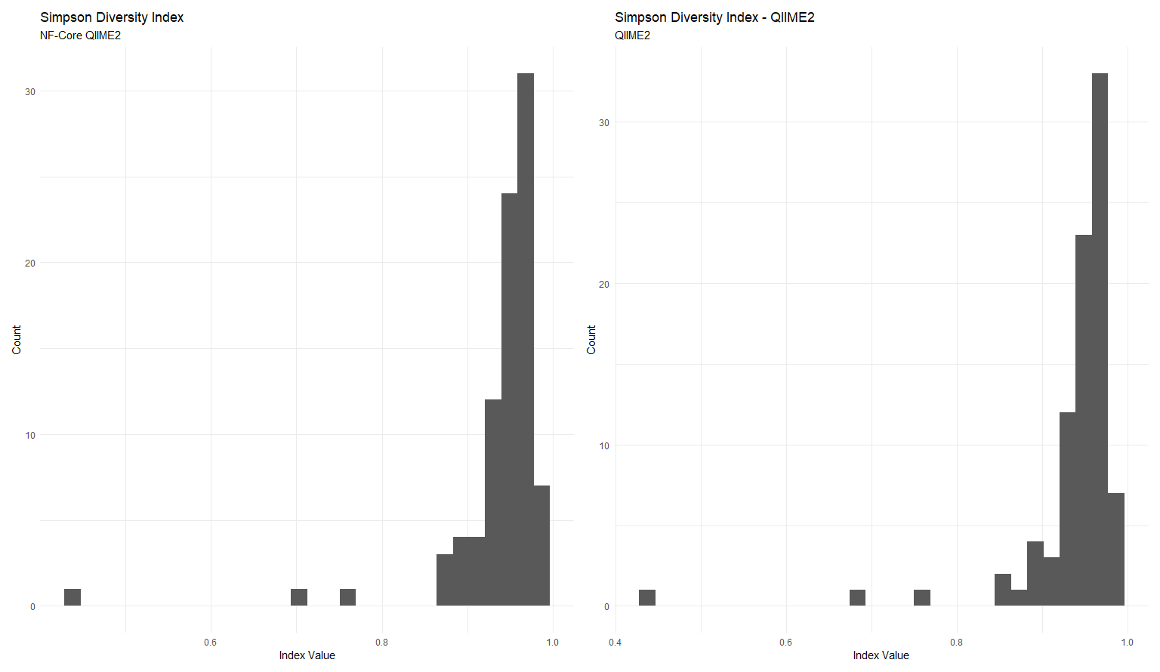
Notes:
Figure 7. Simpson diversity index histograms. A) NF-Core, B) QIIME2

Slide 8
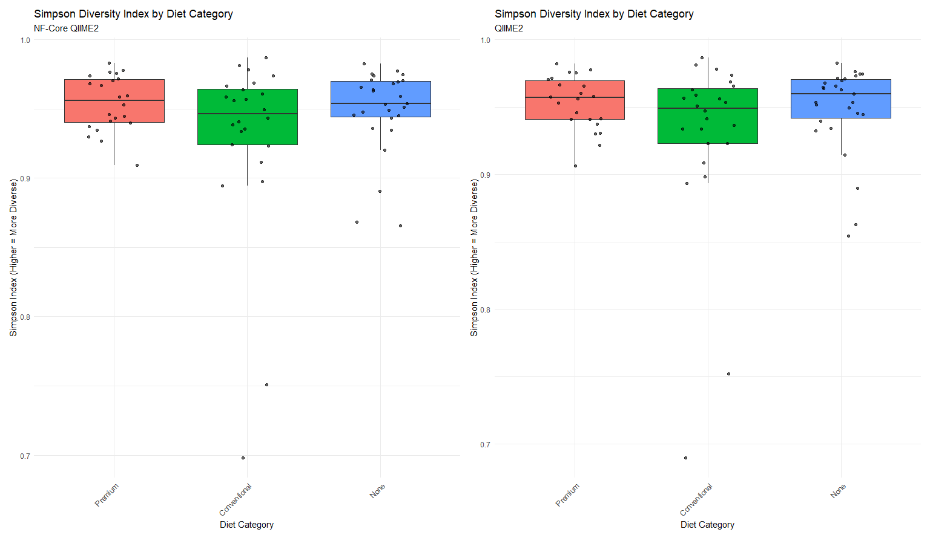
Notes:
Figure 8. Simpson diversity index boxplots. A) NF-Core, B) QIIME2

Slide 9
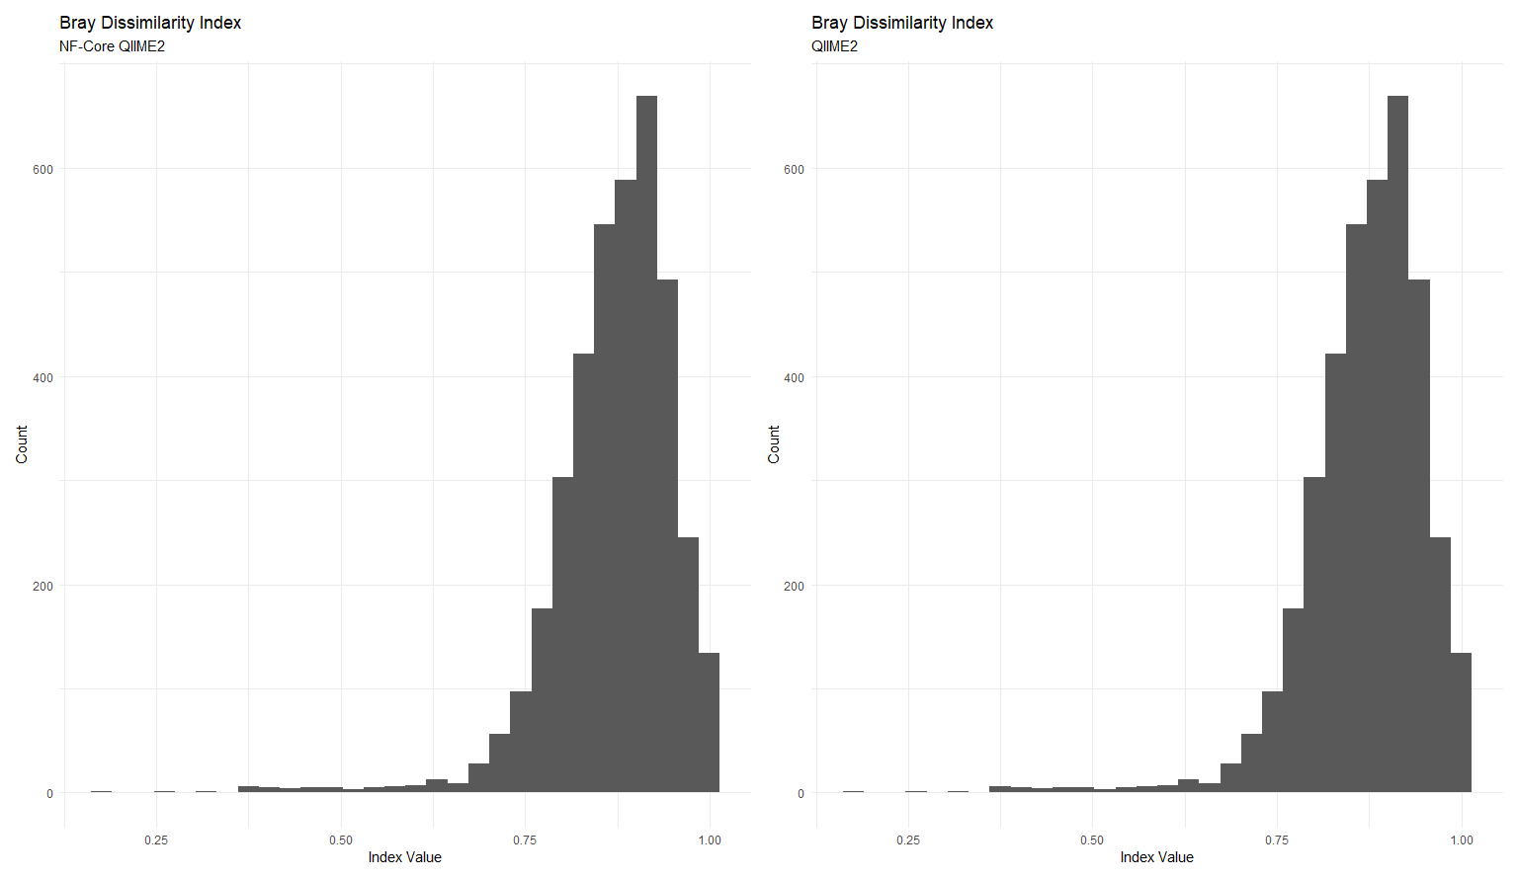
Notes:
Figure 9. Bray Dissimilarity Index histograms. A) NF-Core, B) QIIME2

Slide 10
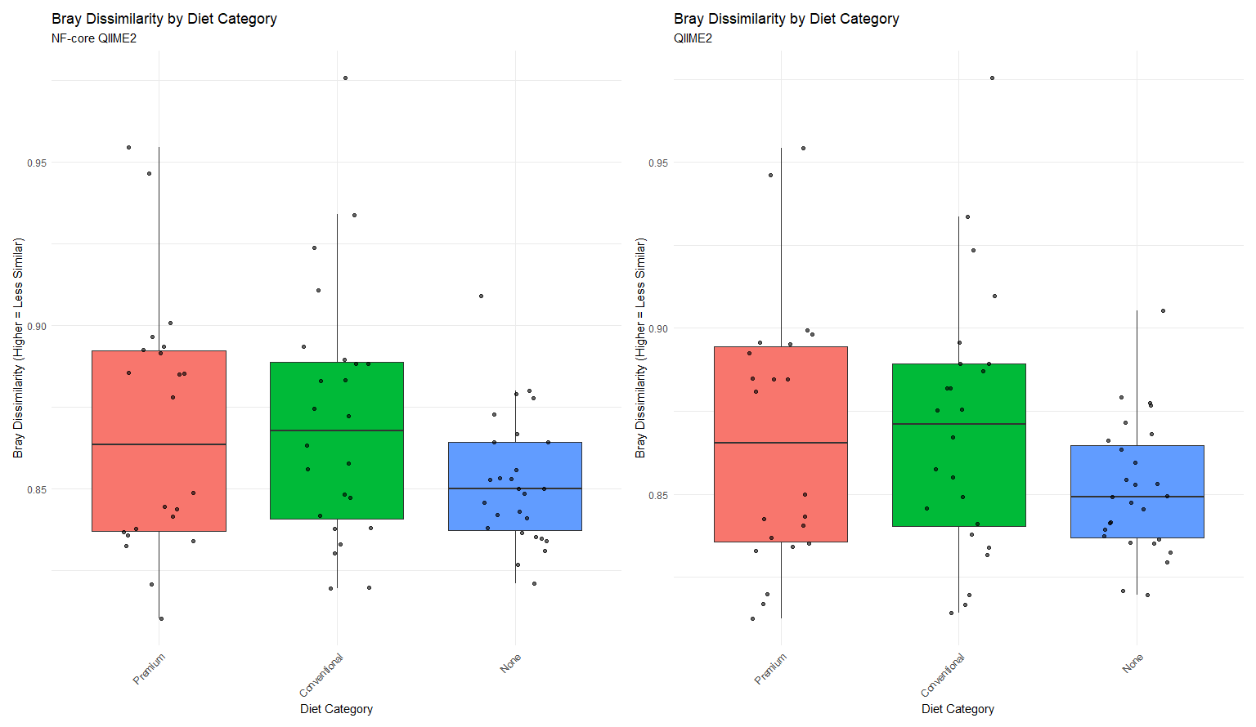
Notes:
Figure 10. Bray Dissimilarity Index boxplots. A) NF-Core, B) QIIME2

Slide 11
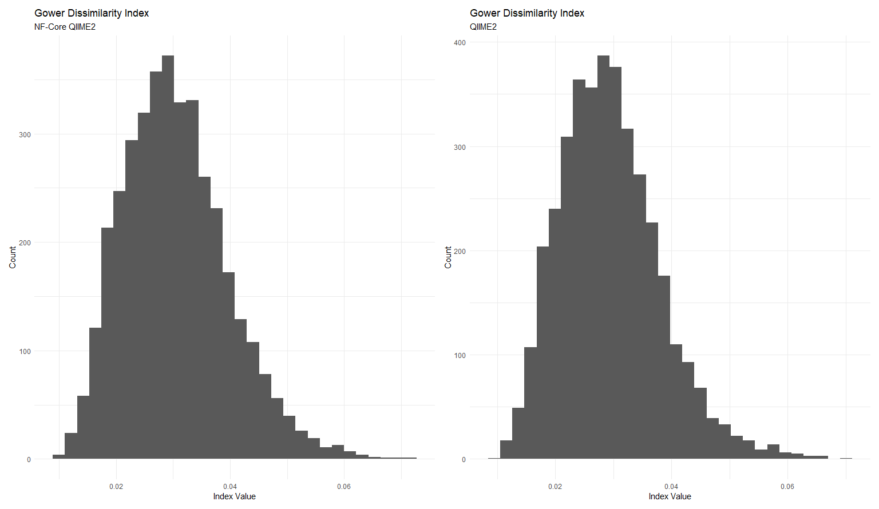
Notes:
Figure 10. Gower Dissimilarity Index histograms. A) NF-Core, B) QIIME2

Slide 12
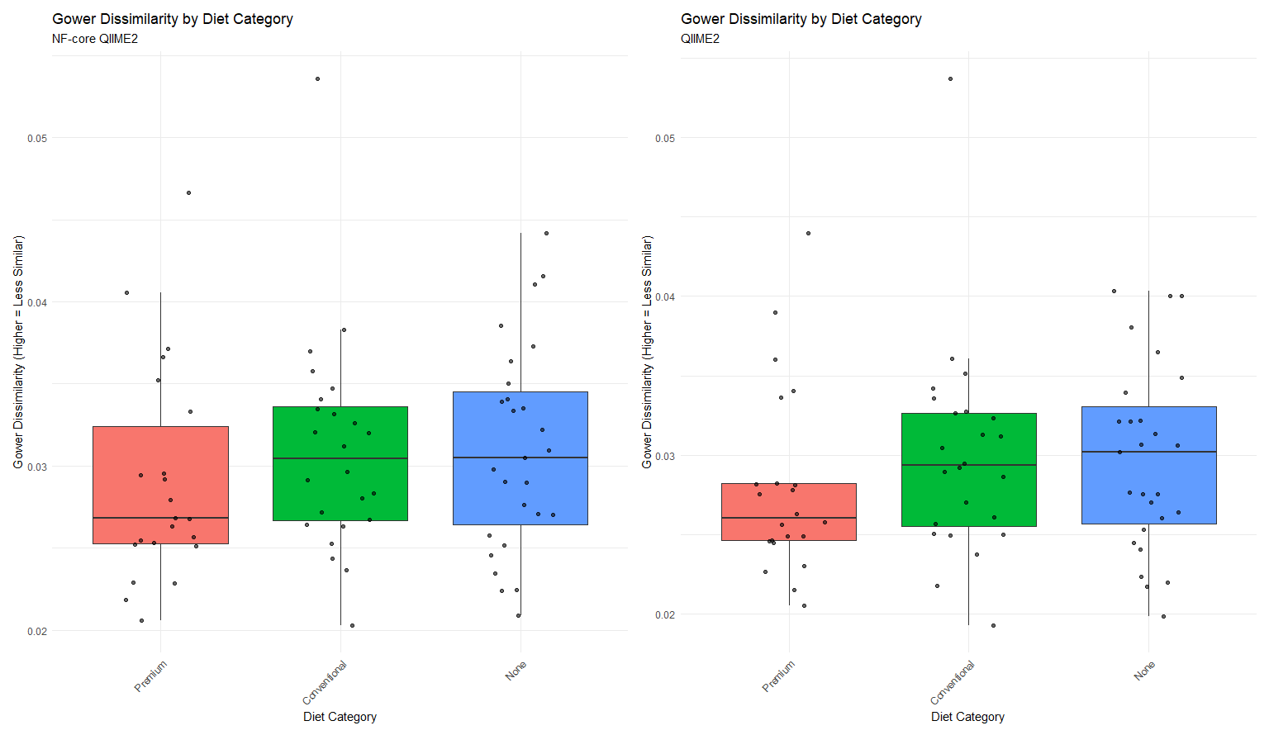
Notes:
Figure 12. Gower Dissimilarity Index boxplots. A) NF-Core, B) QIIME2

Slide 13
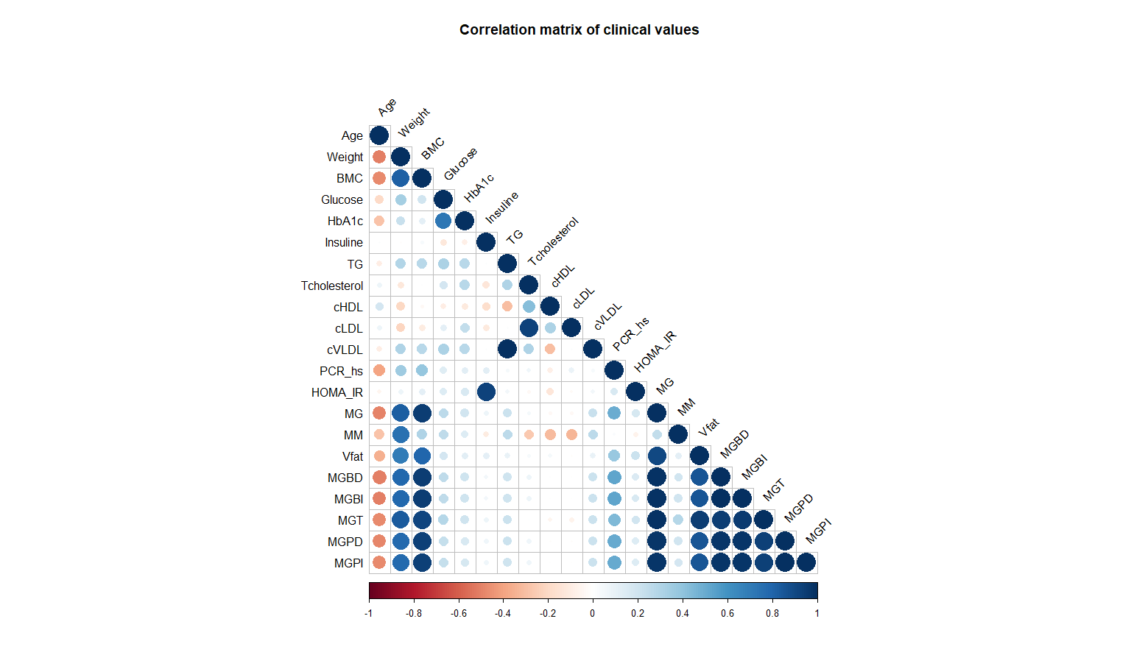
Notes:
Figure 13. Correlation matrix of clinical values

Slide 14
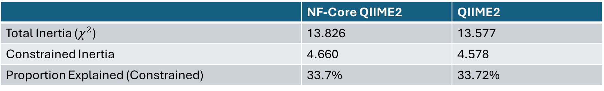
 | NF-Core QIIME2 | QIIME2
Total Inertia ($χ^{2}$) | 13.826 | 13.577
Constrained Inertia | 4.660 | 4.578
Proportion Explained (Constrained) | 33.7% | 33.72%
Notes:
Table 1. Comparison of Canonical Correspondence Analysis Model Statstics and

Slide 15
Axis | NF-Core Eigenvalue | QIIME2 Eigenvalue
CCA1 | 0.5535 | 0.5283
CCA2 | 0.5089 | 0.5024
Notes:
Table 2: Eigenvalues and Cumulative Proportion of Constrained Variance Explained by Canonical Axes (CCA1–CCA12)

Slide 16
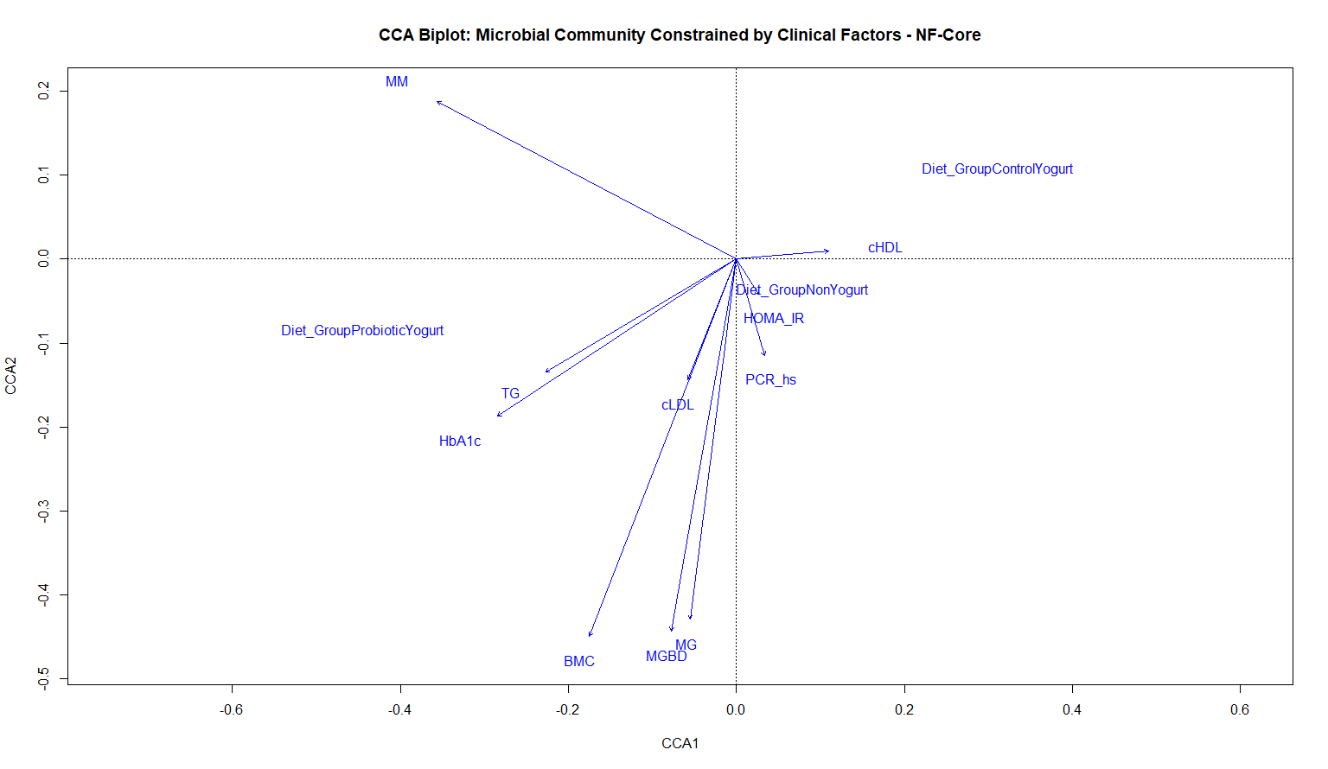
Notes:
Figure 14. Canonical Correspondence Analysis (CCA) Biplot of Microbial Community Constrained by Clinical Factors (NF-Core QIIME2)

Slide 17
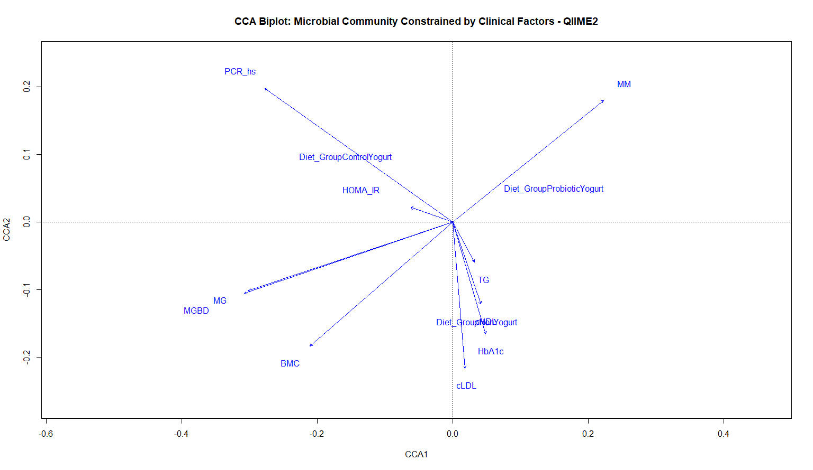
Notes:
Figure 15. Canonical Correspondence Analysis (CCA) Biplot of Microbial Community Constrained by Clinical Factors (QIIME2)

