Slide 1

VASCULARGUARD
Predicting Dialysis
Access Failure Before
It Happens
A machine learning solution to protect dialysis patients
from sudden vascular access failure — their lifeline for survival.
500K+
31%
$15K+
US dialysis patients
Annual access failure rate
Cost per emergency repair
Joseph Dominic Bichara | Capstone 2026
Notes:
1

Slide 2
THE CLINICAL PROBLEM
For dialysis patients, vascular access is their lifeline — and it fails silently.
⚠️
💰
📉
Sudden Failure
High Cost
Poor Outcomes
Access failure typically presents as an emergency — often mid-session — requiring immediate intervention or permanent loss of the access site.
Each emergency access revision costs $15,000–$40,000. A functioning access maintained proactively costs ~$1,200/year.
Patients with repeated access failure face extended hospitalisation, increased mortality risk, and severely reduced quality of life.
THE OPPORTUNITY: Haemodynamic trends visible up to weeks before failure — if you know where to look. Machine learning can catch the signal clinicians miss.
Notes:
2

Slide 3
THE SOLUTION — HOW VASCULARGUARD WORKS
Trained on 3,000 patients. Validated on held-out test data. Built for clinical workflow.
1
2
3
4
Patient Data
Input
ML Risk
Scoring
Risk
Classification
Clinical
Action
Blood flow, venous pressure, recirculation rate, access age, comorbidities
Logistic Regression or Random Forest model returns a failure probability (0–100%)
Threshold-tuned alert: Low / Moderate / High — optimised to catch 91-94% of true failures
Nephrologist reviews flagged patients → schedules angioplasty, graft revision, or monitoring
WHAT THE MODEL SEES
Blood Flow Rate (mL/min)
Below 300 → access narrowing
Kt/V (dialysis adequacy)
Below 1.2 → access compromised
Venous Pressure (mmHg)
Above 200 → outflow stenosis
Maturation Status
'Failing' → 17pp higher risk
Recirculation Rate (%)
Above 5% → blood bypassing filter
Surgeon Volume
'Low' → 7pp higher risk
Notes:
3

Slide 4
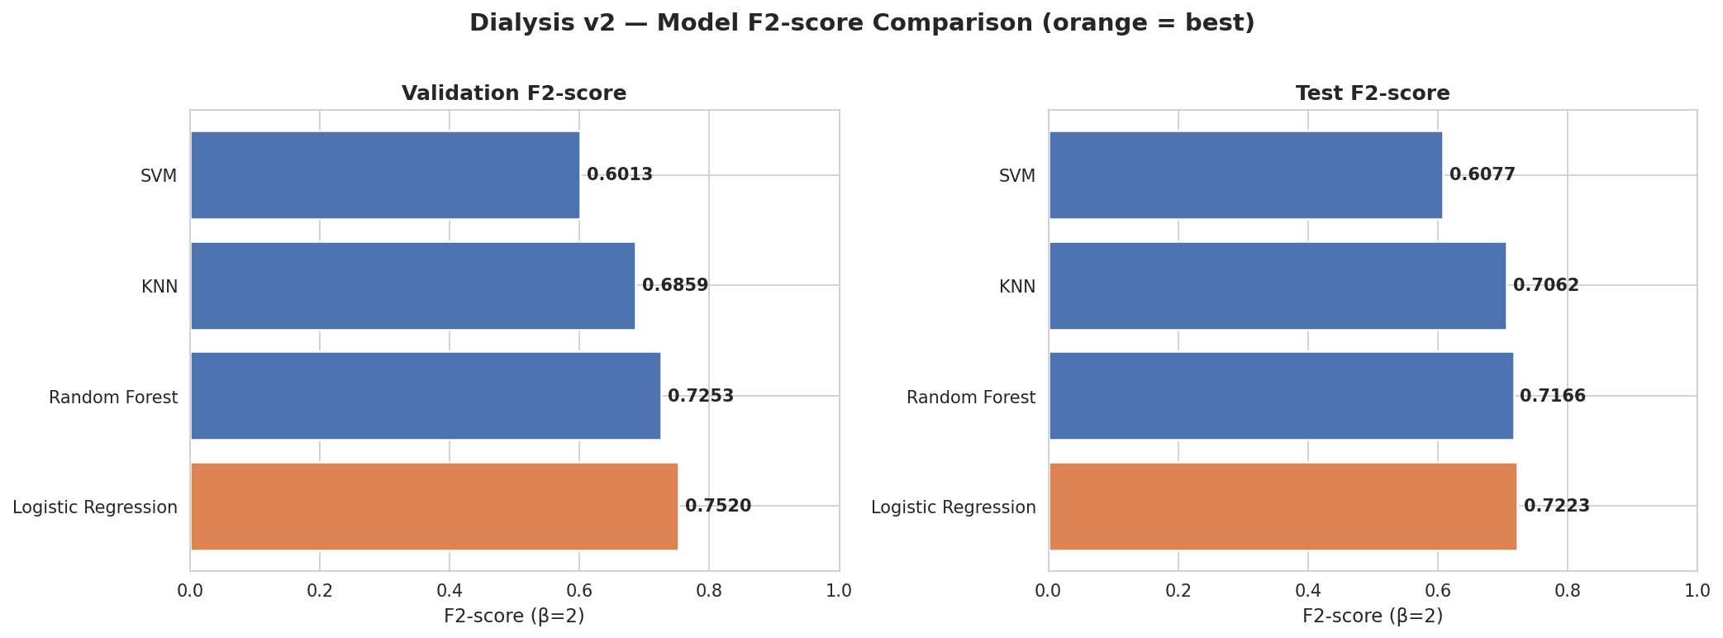
MODEL PERFORMANCE — WHAT IT MEANS IN PRACTICE
Test Set: 450 patients, 140 true failures — real-world distribution (31% failure rate)
91–94%
≈ 8–17
0.76
of failures caught
before they occur
failures missed
out of 140
AUC-ROC — model
genuinely discriminates
F2-score aggressively weights recall — we penalise missed failures 2× more than false alarms. All models validated on unseen test data.
Notes:
4

Slide 5
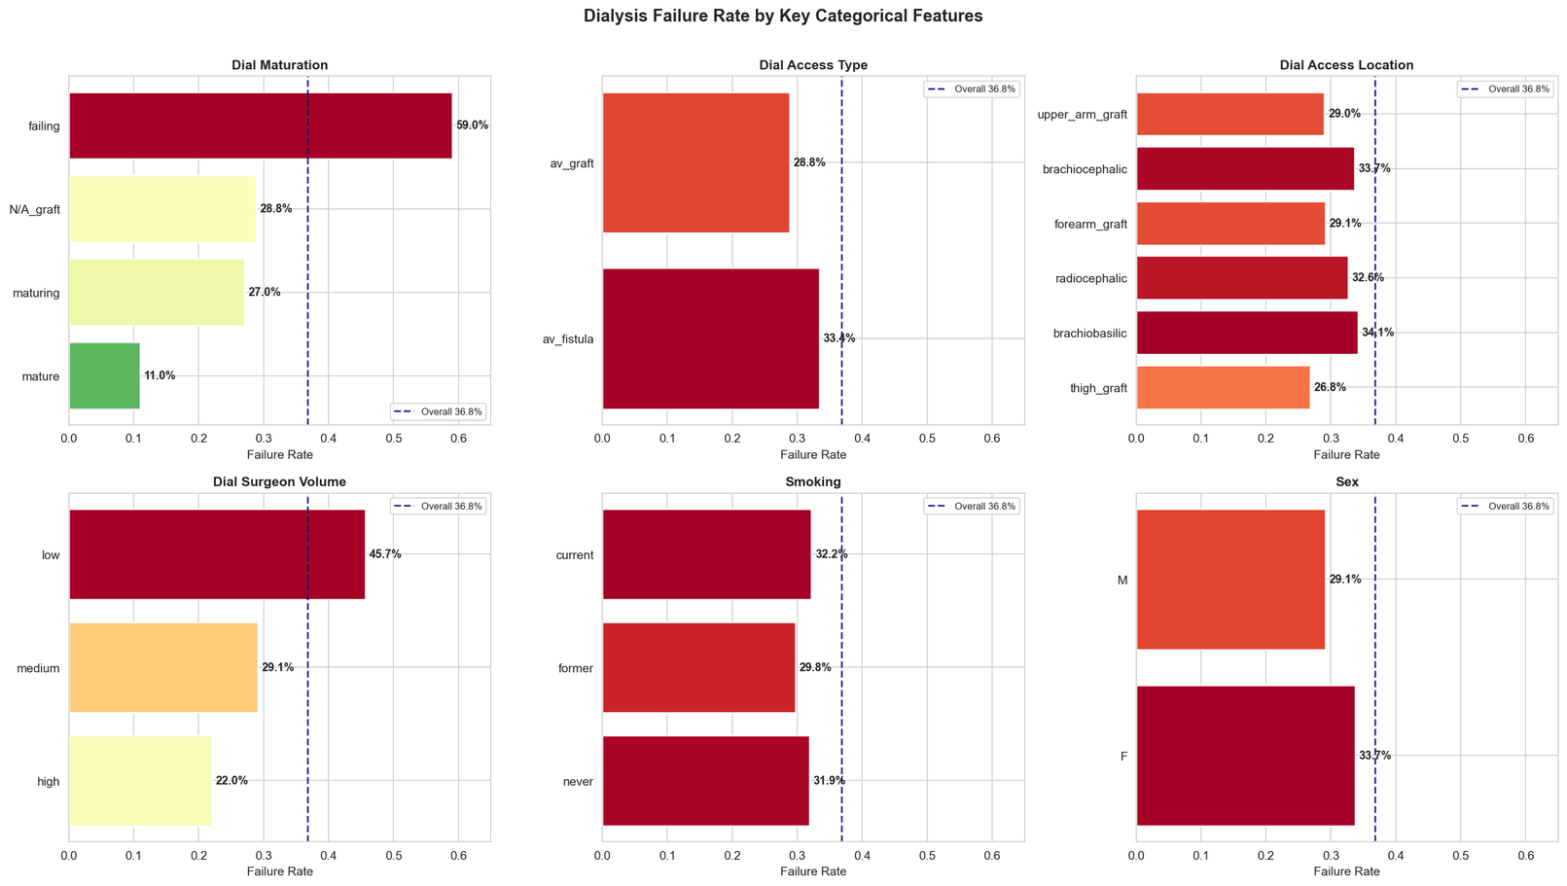
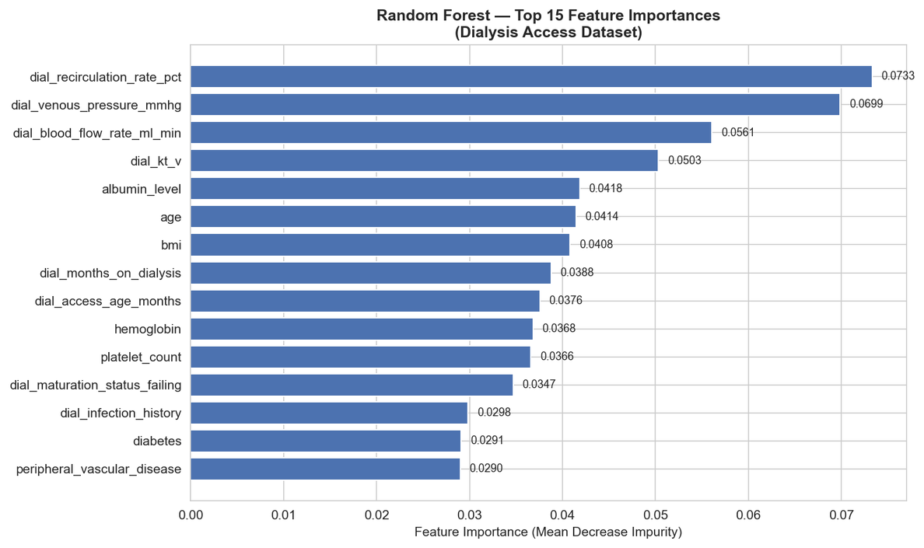
KEY RISK FACTORS — WHAT DRIVES FAILURE
Clinically validated — every predictor aligns with established nephrology guidelines
Failure Rate by Clinical Category
Model's Top Feature Importances
Left: EDA showing failure rate across access types and surgeon volume — actionable insight for referral policy. Right: model agrees.
Notes:
5

Slide 6
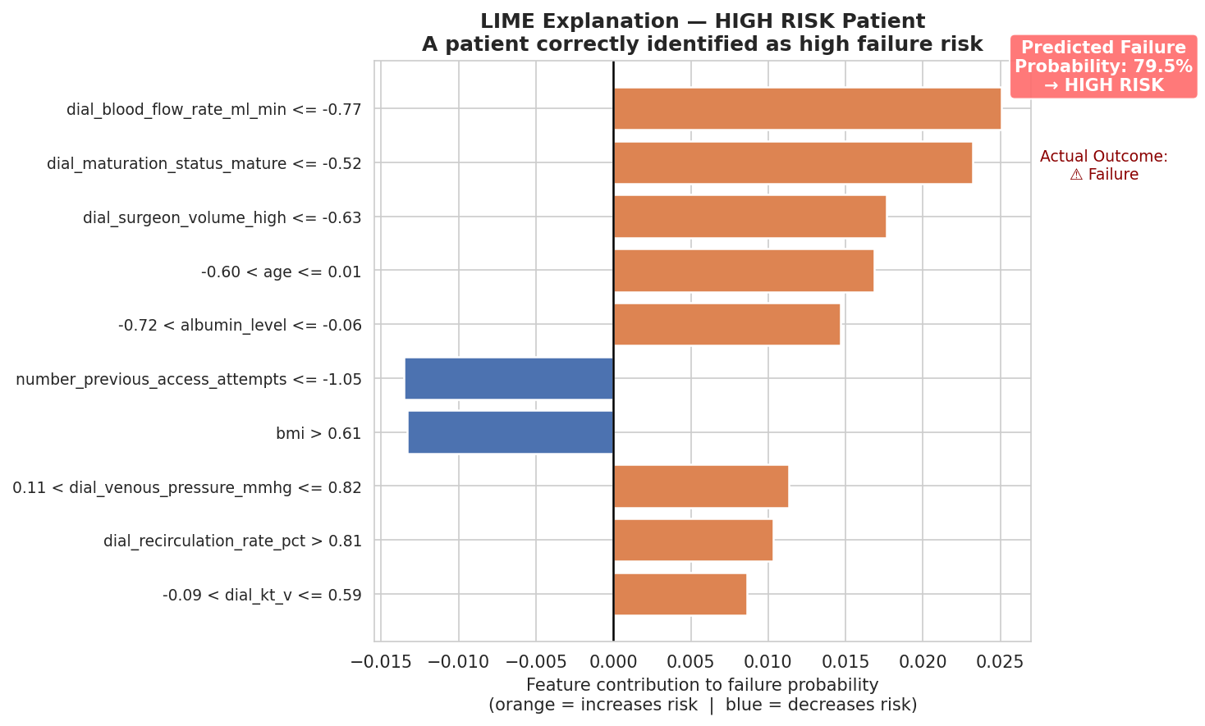
PATIENT-LEVEL EXPLANATION — "WHY THIS PATIENT?"
LIME provides clinician-readable explanations for every individual prediction
BUSINESS VALUE: Every alert includes an explanation. Clinicians see exactly which measurements drove the risk flag — enabling transparent, auditable, defensible clinical decisions.
Notes:
6

Slide 7
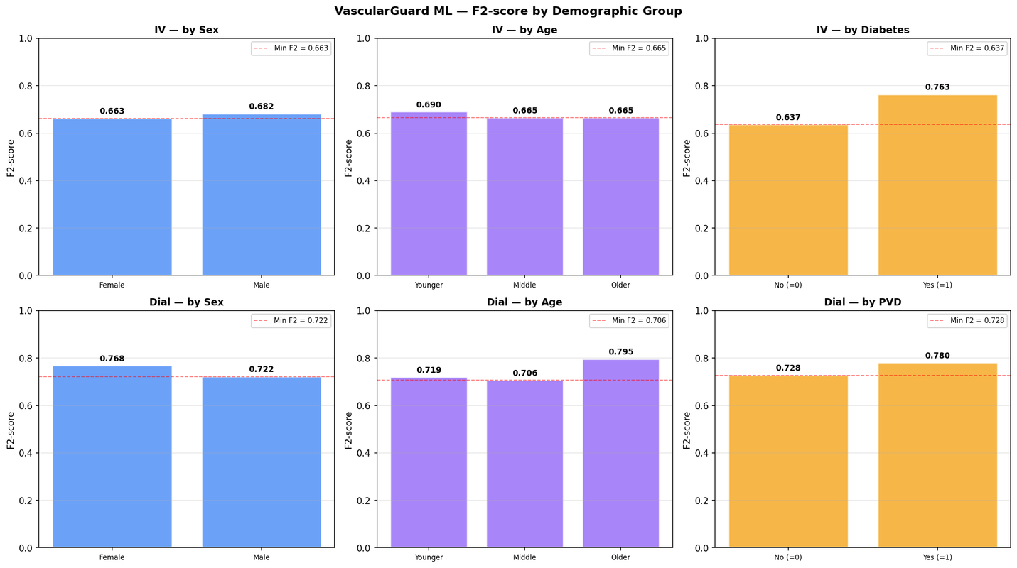
FAIRNESS & TRUST — WE CHECKED THE BIAS
The model performs equitably across patient demographics
Sex
✓
No performance gap between male and female patients
Age Group
✓
Consistent recall across <55, 55–70, 70+ cohorts
Comorbidity
✓
PVD and non-PVD patients detected with equal recall
Race/Ethnicity
⚠
Not in dataset — must collect for full regulatory compliance
REGULATORY READINESS
All predictions are individually explainable (LIME + SHAP). Fairness metrics documented. Mitigation strategies proposed (group-specific thresholds, augmentation). Designed with FDA SaMD and NHS AI guidance principles in mind.
Notes:
7

Slide 8
ROI & CLINICAL IMPACT
Conservative estimates based on published dialysis access literature
Scenario: 500-patient dialysis unit | 155 expected annual failures | 91% recall model
Model catches ~141 failures early · Only ~14 missed · Routine monitoring for all flagged patients
💰
🏥
❤️
⚡
Cost Avoidance
Hospitalisations
Patient Outcomes
Clinician Efficiency
$1.8M+
−67%
+18mo
2.5hr/wk
141 emergency repairs → planned procedures
Savings: ~$12,700 per converted case
Emergency admissions for access failure
Average 3.2 bed-days per emergency
Average access survival extension
with early intervention protocol
Saved per nephrologist by prioritising
only flagged patients for review
Notes:
8

Slide 9
IMPLEMENTATION ROADMAP
Phased rollout — from pilot to enterprise deployment
Phase 1
Q1–Q2
Phase 2
Q3–Q4
Phase 3
Year 2
Pilot (1 Unit)
Validation
Scale
Integrate model into EMR
data pipeline
Real-world data
recollection & retraining
Multi-site rollout
(5–10 units)
50-patient pilot cohort
Race/ethnicity data
addition for full fairness
API integration at
app/api/main.py
Clinician training &
feedback loops
AUC & F2 validation vs
synthetic baseline
Chatbot assistant for
clinician queries
IRB/Ethics approval
Regulatory pre-submission
(FDA SaMD pathway)
Continuous model
retraining pipeline
Notes:
9

Slide 10
RISKS & LIMITATIONS — WHAT WE KNOW
Transparent risk disclosure — every limitation has a mitigation
🔬
Synthetic Training Data
HIGH
📊
Low Precision (39%)
LOW
Model trained on generated data, not EHR records
1 in 2.5 alerts is a false alarm at current threshold
MITIGATION:
Phase 1 pilot retrains on real patient data before clinical use
MITIGATION:
Adjustable threshold per clinical context; higher precision mode available
⚖️
Missing Demographics
MED
🏥
Single-Site Validation
MED
Race/ethnicity not in dataset — fairness audit incomplete
Performance may vary across dialysis centres
MITIGATION:
Collect demographics in pilot; use oversampling for underrepresented groups
MITIGATION:
Multi-site validation in Phase 2; centre-specific calibration layers
Notes:
10

Slide 11
THE ASK
Three decisions
that protect your patients.
1
2
3
Approve Pilot
Fund Data Collection
Assign Clinical Champion
Authorise a 500-patient, 6-month pilot at one dialysis unit with IRB oversight.
Allocate resources to collect race/ethnicity and real EHR data for model retraining.
Designate a nephrology lead to co-develop the alert workflow and threshold policy.
Joseph Dominic Bichara | VascularGuard ML | Capstone 2026 | Questions welcome.
Notes:
11

