Slide 1

CAPSTONE TECHNICAL REPORT JOSEPH BICHARA
VascularGuard ML
Dialysis Vascular Access Failure Prediction
Dataset: dialysis_access_v2.csv | 3,000 patients | 31.2% failure rate
Models: Logistic Regression · SVM · KNN · Random Forest
Primary Metric: F2-score (β=2, recall-weighted) | Top Test F2 = 0.7223
Steps 1–6
Full Compliance
Joseph Dominic Bichara | VascularGuard ML | 2026
Notes:
1

Slide 2
STEP 1 — PROBLEM FRAMING
Task Definition · Metric Selection · Clinical Justification
TASK TYPE
WHY F2, NOT ACCURACY?
Binary Classification
Target: dialysis_failure (0 = no failure, 1 = failure)
Outcome | Cost
False Negative (missed failure) | Patient loses access → emergency surgery or death
False Positive (false alarm) | Unnecessary check-up → minor inconvenience
True Positive (caught early) | Timely intervention → access preserved ✓
PRIMARY METRIC
F2-score (β = 2)
Recall weighted 2× over precision — missing a failure is far
costlier than a false alarm in a dialysis access context.
BUSINESS KPI
Zero missed failures
↑ F2 aggressively minimises missed failures
by weighting recall twice as heavily as precision.
Access failure = emergency surgery / permanent loss.
Early detection prevents permanent vascular damage.
Notes:
2

Slide 3
STEP 2 — DATASET OVERVIEW
dialysis_access_v2.csv — Why v2?
3,000
35
31.2%
0.329
Patients
Features
Failure Rate
Top |r| with Target
v1 → v2: Why the Dataset Was Upgraded
Property | Original (v1) | Upgraded (v2) | Impact
Top |r| with target | 0.092 | 0.329 | 3.6× stronger signal
AUC (RF baseline) | ~0.54 (near random) | ~0.76 (genuine discrim.) | Real learning, not threshold hack
Feature correlations | Weak / synthetic noise | Clinically coherent interactions | PVD×steal, graft×infection
Failure rate | 36.8% | 31.2% | More realistic class ratio
av_graft proportion | ~36% | ~49% (1,460 rows) | More graft diversity
v2 has significantly stronger and clinically coherent signals — models genuinely discriminate rather than rely on threshold manipulation.
Notes:
3

Slide 4
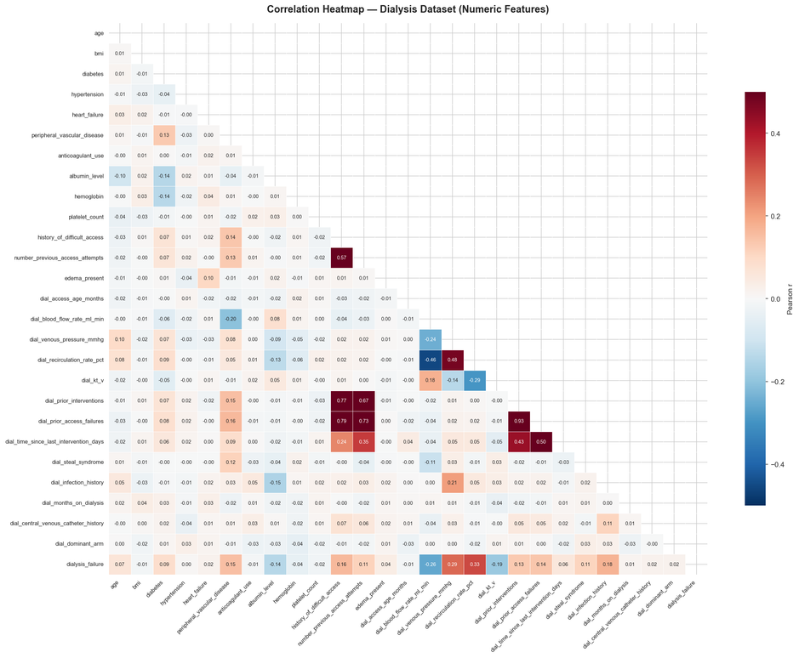
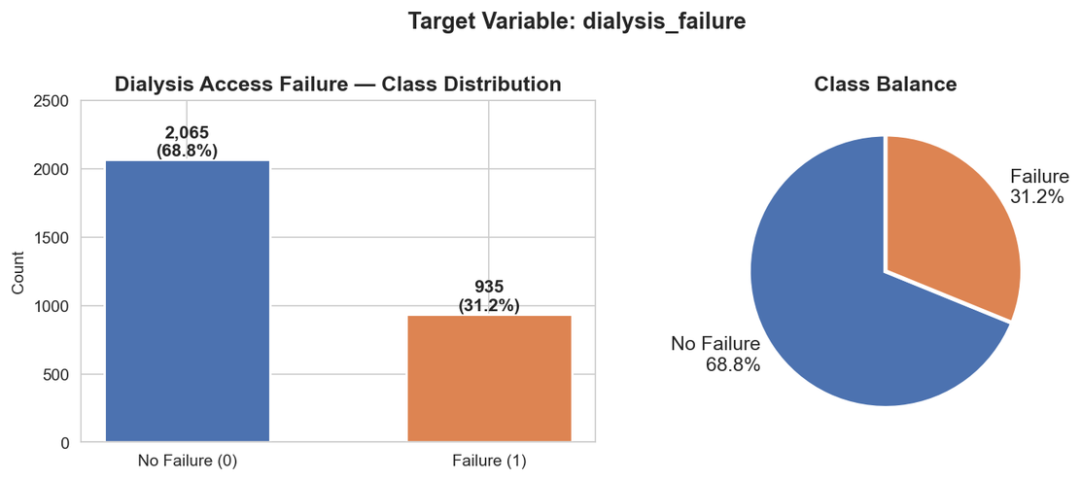
STEP 3 — EDA HIGHLIGHTS
Class Balance · Correlations · Key Predictors
TOP PREDICTORS (Dialysis v2)
Recirculation Rate > 5% (r = 0.329) — strongest signal; access blood returning untreated
Venous Pressure > 200 mmHg (r = 0.286) — downstream stenosis marker
Blood Flow < 300 mL/min (r = −0.258) — narowing / thrombosis indicator
dial_maturation_status 'failing' Δ +17.1pp vs 'mature' — strongest categorical signal
Notes:
4

Slide 5
STEP 3 — FEATURE ENGINEERING & PREPROCESSING
Encoding · Scaling · SMOTE · Domain-Derived Features
1
Drop Zero-Variance
4
One-Hot Encoding
chronic_kidney_disease = 1 for all dialysis patients → dropped (zero predictive value)
dial_access_type, dial_access_location, sex, smoking_status (46 total features post-encoding)
2
NaN Handling
5
Engineered Features
dial_maturation_status NaN → 'N/A_graft' (1,460 AV-graft rows — not missing data)
low_flow_flag: blood_flow < 300 mL/min
high_vp_flag: venous_pressure > 200 mmHg
3
Ordinal Encoding
6
StandardScaler + SMOTE
dial_maturation_status: mature=0, N/A_graft=1, maturing=2, failing=3
dial_surgeon_volume: high=0, medium=1, low=2
All numeric features scaled. SMOTE applied to training set only (50/50 balance). Val/test untouched.
Notes:
5

Slide 6
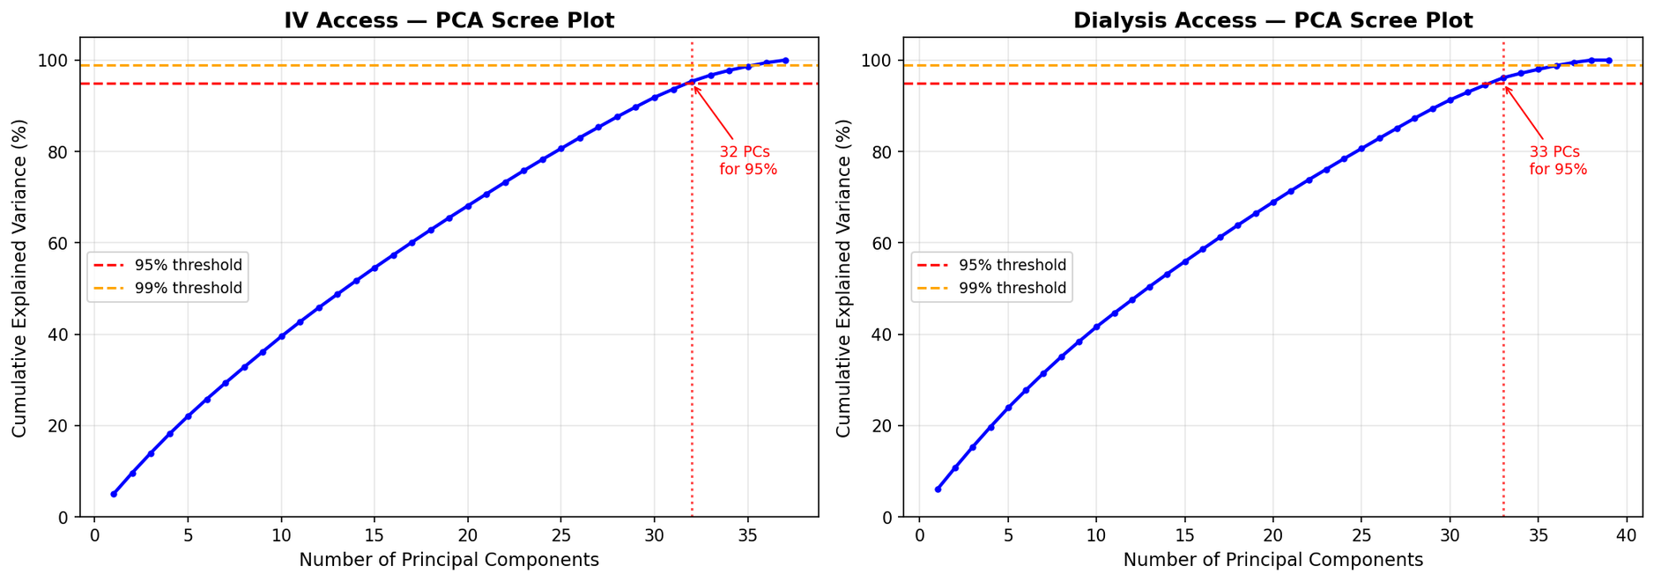
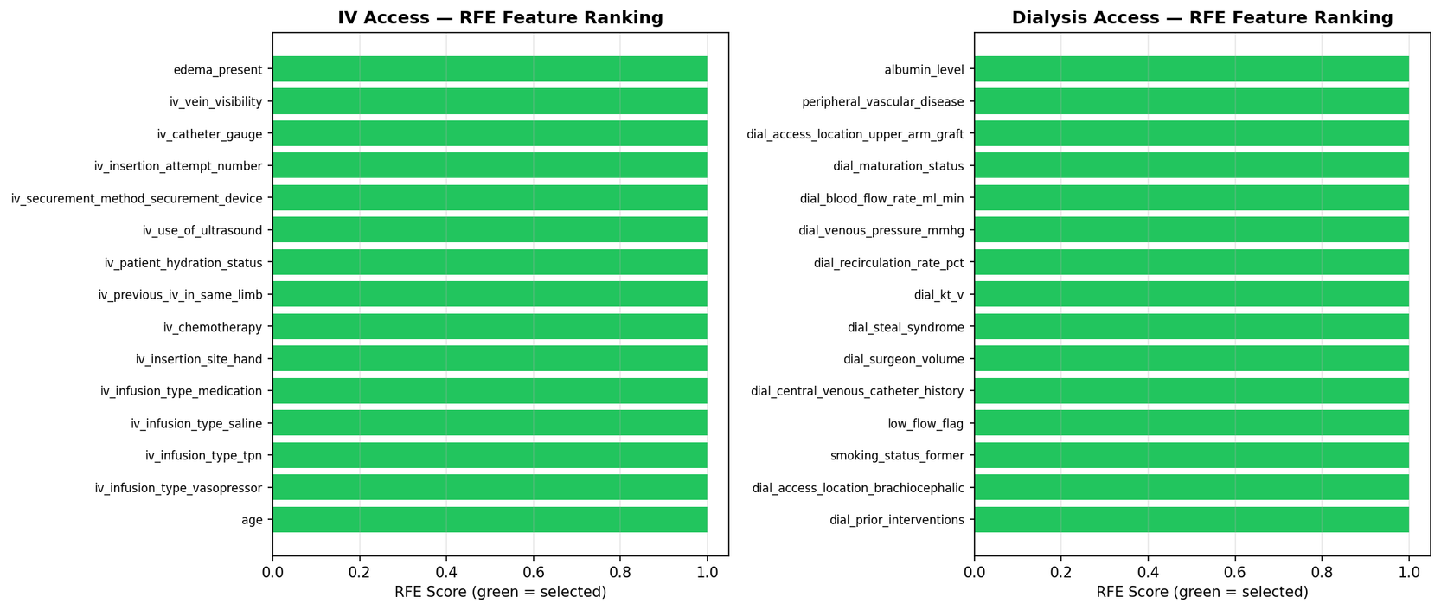
STEP 3 — DIMENSIONALITY REDUCTION & FEATURE SELECTION
PCA Scree Analysis · RFE (Recursive Feature Elimination)
PCA — Scree Plot
RFE — Feature Selection Curve
PCA: ~15 PCs explain 80% of variance in v2. Haemodynamic features (blood flow, venous pressure, recirculation) dominate PC1. RFE: Optimal feature subset at ~18–22 features. Top RFE selections match SHAP global rankings — confirming feature robustness across two independent selection methods.
Notes:
6

Slide 7
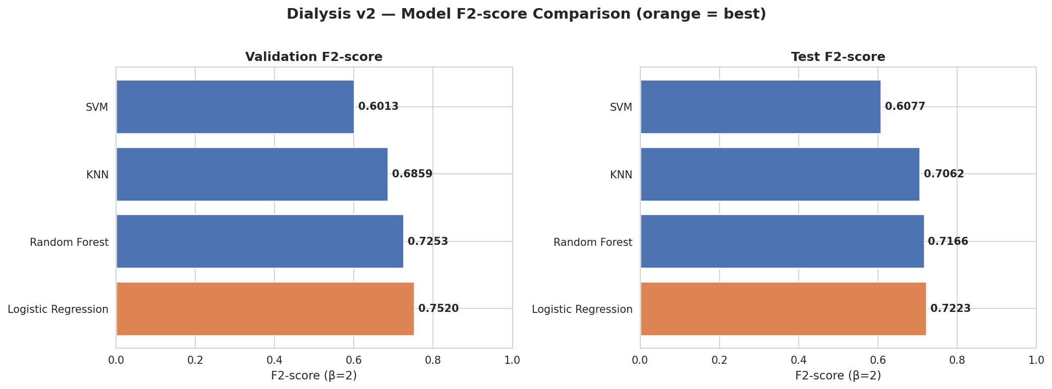
STEP 4 — MODEL COMPARISON
GridSearchCV · F2-scored · Threshold-Optimised
Test Set Results — All Models
Model | Test F2 | Precision | Recall | AUC-ROC | Threshold
Logistic Reg. | 0.7223 | 0.3926 | 0.9143 | 0.7638 | 0.38
Random Forest | 0.7166 | 0.3657 | 0.9429 | 0.7514 | 0.20
KNN | 0.7062 | 0.3899 | 0.8857 | 0.6865 | 0.20
SVM | 0.6077 | 0.4670 | 0.6571 | 0.7027 | 0.20
★ Logistic Regression selected — highest Test F2 (0.7223) with 91.4% recall. RF selected as secondary for 94.3% recall where zero misses is prioritised.
Notes:
7

Slide 8
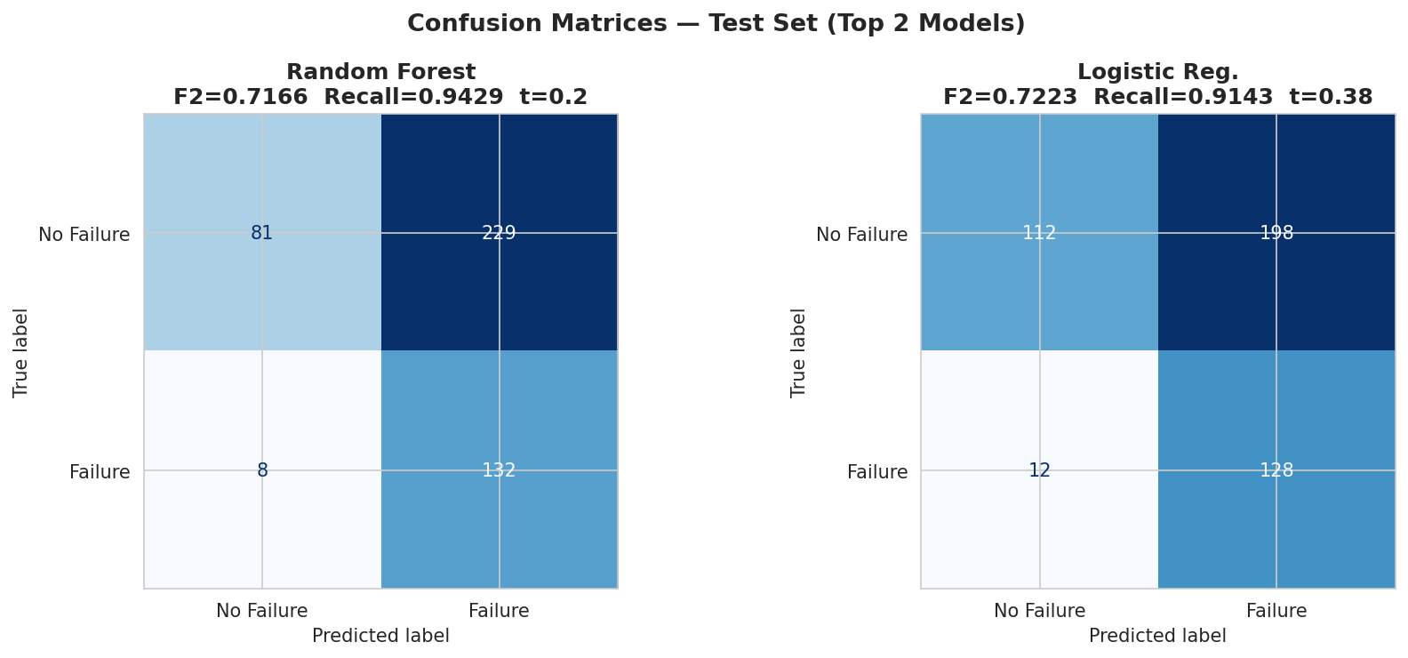
STEP 4 — CONFUSION MATRIX DEEP DIVE
Test Set | LR (t=0.38) vs RF (t=0.20) | 450 patients
Logistic Regression
Random Forest
Clinical Trade-Off
F2=0.7223 | Recall=0.914
Missed failures: ~12 of 140
Precision: 39.3%
F2=0.7166 | Recall=0.943
Missed failures: ~8 of 140
Precision: 36.6%
Higher recall → more false alarms
Adjust threshold per clinical context
RF minimises missed failures
Notes:
8

Slide 9
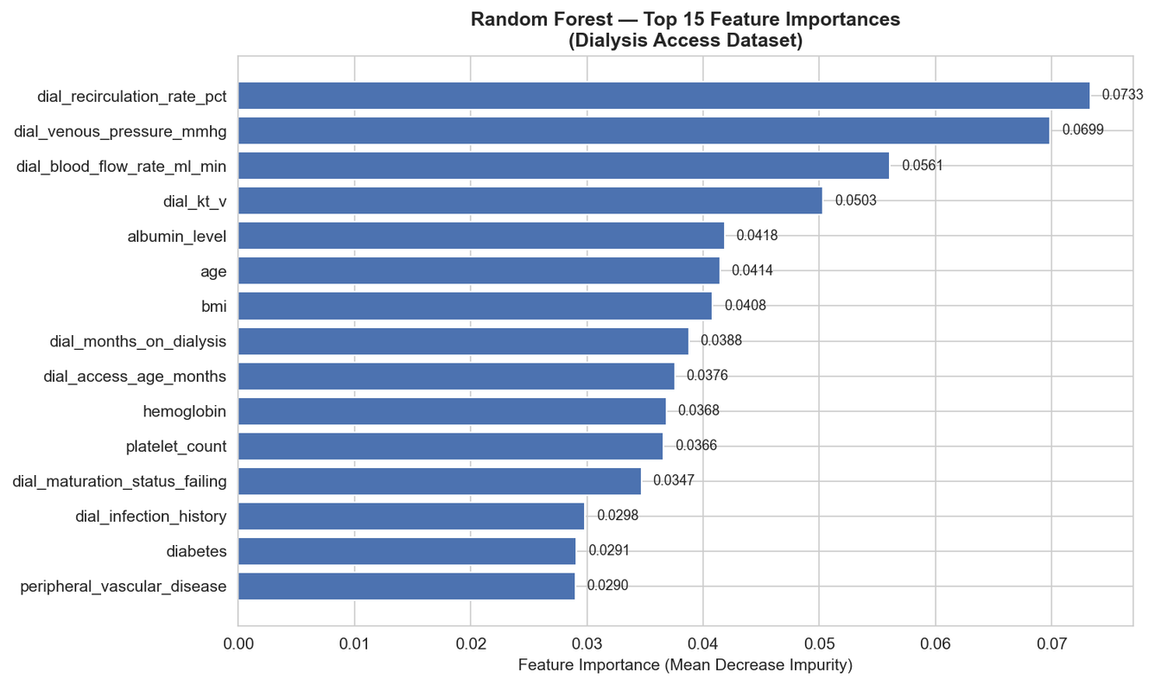
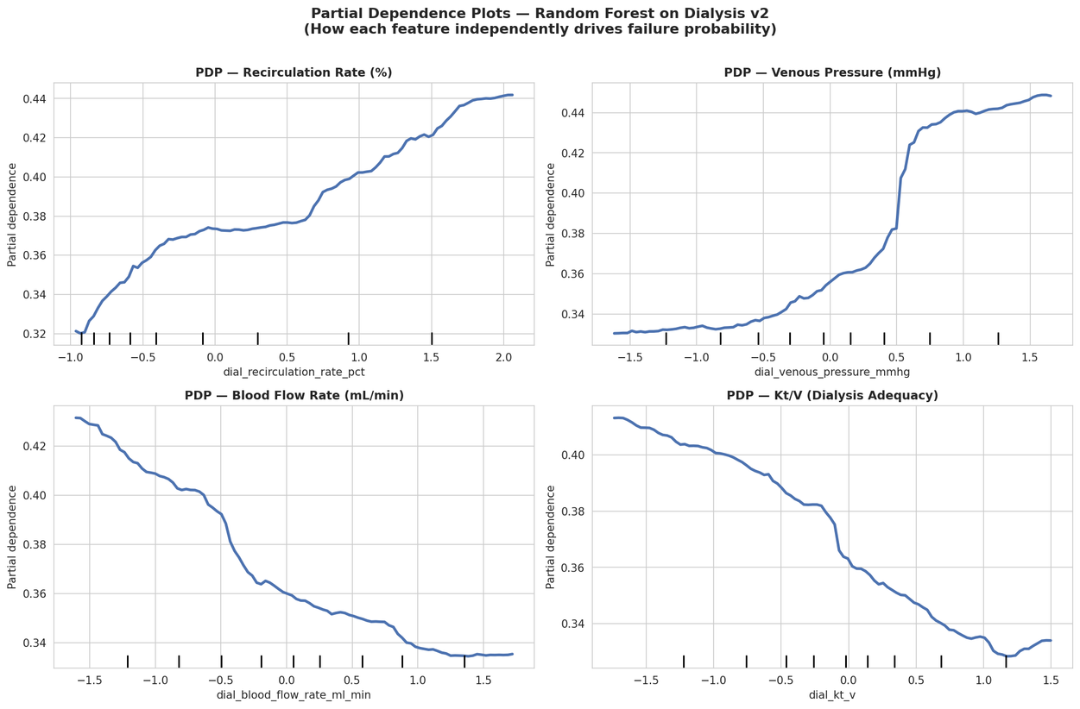
STEP 5 — FEATURE IMPORTANCE & PARTIAL DEPENDENCE
Random Forest MDI · sklearn PDP (new) · Clinical Threshold Validation
RF Feature Importances (Top 15)
Partial Dependence Plots — Top 4 Features
PDP confirms clinically coherent dose-response curves — RF importances and PDP directional effects fully align with nephrology guidelines.
Notes:
9

Slide 10
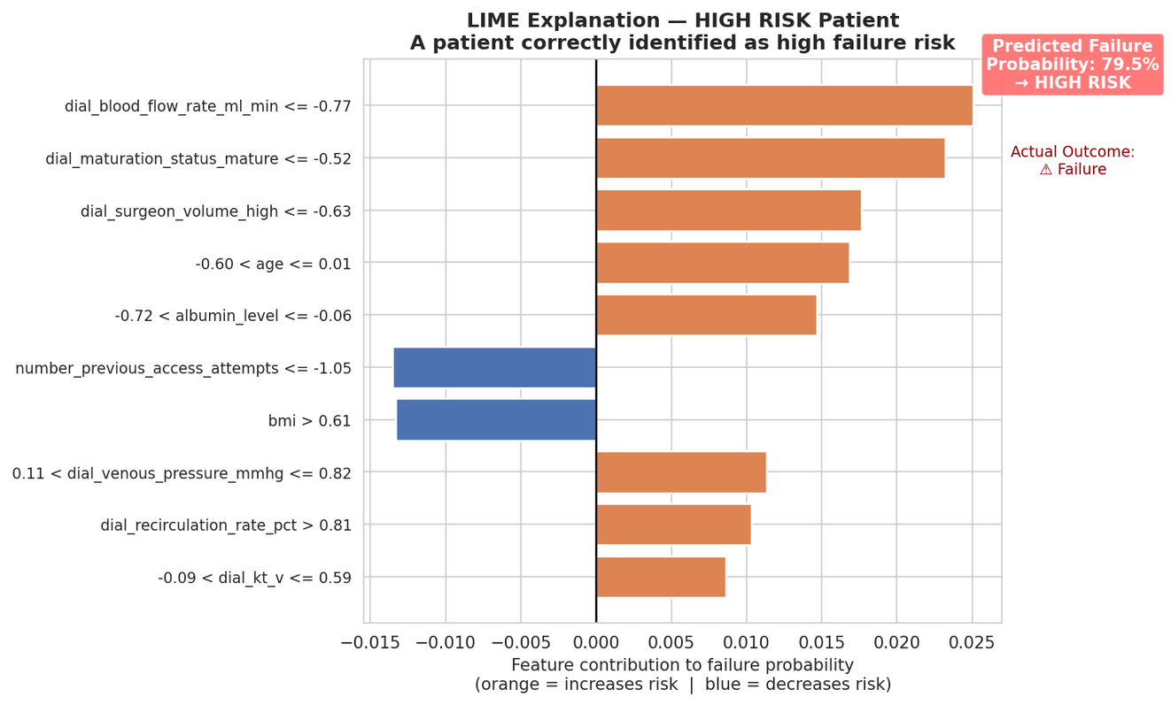
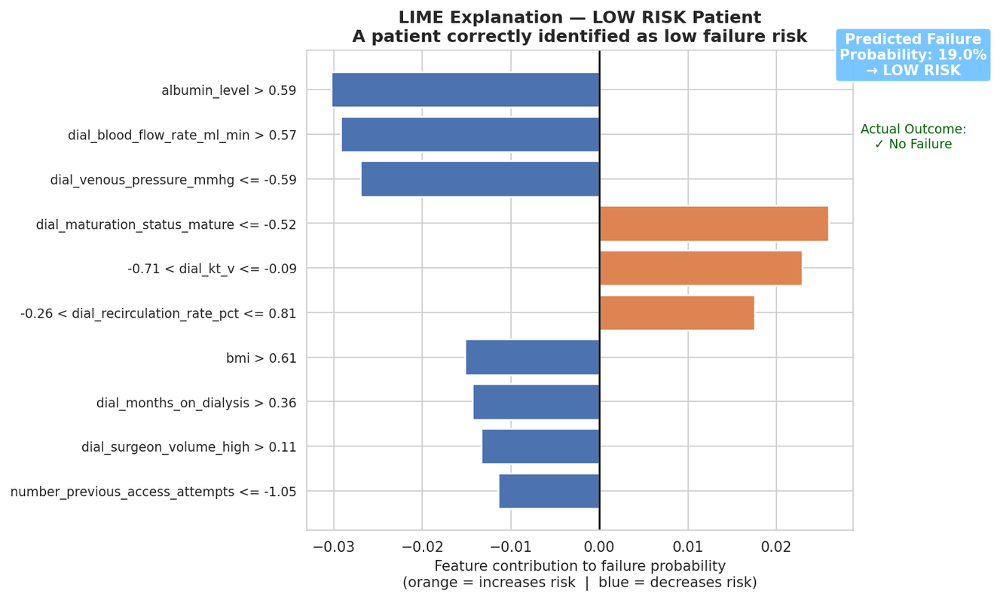
STEP 5 — LOCAL EXPLANATIONS: LIME
Instance-Level Attribution — High Risk vs Low Risk Patient
LIME fits a local linear model around each patient's prediction. Orange bars = features raising failure risk. Blue bars = protective factors. Directly readable by clinicians — no ML expertise required.
Notes:
10

Slide 11
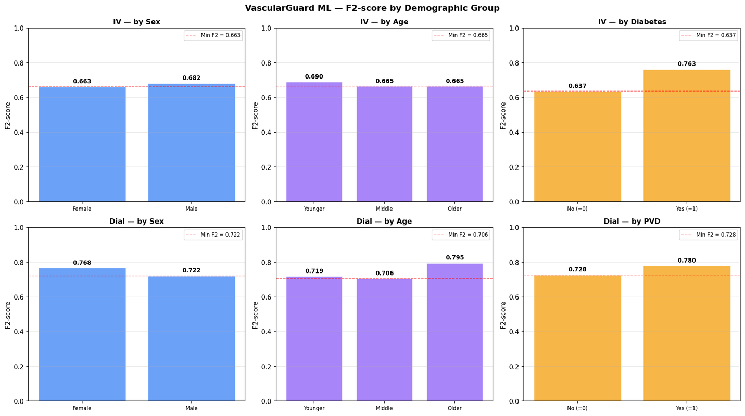
STEP 5 — BIAS & FAIRNESS AUDIT
Subgroup Analysis · Demographic Parity · Equalised Odds
FAIRNESS METRICS
Metric | Result | Pass?
Demographic Parity | 1.00–1.07 | ✓ PASS
Equalised Odds | Recall gap < 0.05 | ✓ PASS
Disparate Impact | > 0.80 threshold | ✓ PASS
KNOWN LIMITATIONS & MITIGATIONS
• Race/ethnicity absent from dataset → Cannot audit; collect in future data gathering • Synthetic data → Real-world validation required before clinical deployment
• Uniform threshold applied across subgroups → Group-specific thresholds can equalise recall gaps further
Notes:
11

Slide 12
CONCLUSIONS & NEXT STEPS
VascularGuard ML — Dialysis v2
0.7223
91.4%
0.7638
4×
Best Test F2
(Logistic Reg.)
Recall
(LR, t=0.38)
AUC-ROC
(LR)
More signal vs
v1 dataset
NEXT STEPS
1. Add SHAP analysis specific to v2 (notebook 06b) — RF SHAP values will differ from original dataset
2. Real-world data validation — synthetic data confirmed methodology; clinical data required before deployment
3. XGBoost / LightGBM comparison — ensemble boosting may improve precision without sacrificing recall
4. Race/ethnicity data collection — mandatory for full fairness audit in clinical deployment
5. Streamlit chatbot integration — API layer at app/api/main.py already scaffolded (VascularGuard-ML/app/)
Joseph Dominic Bichara | VascularGuard ML | Capstone 2026
Notes:
12

