Slide 1

Enviromental Ethics
Dr. Naresh Kumar
Department of Chemistry
B. N. Mandal University, Madhepura

Slide 2
What is Environmental Ethics?
The moral relationship of human beings to and the value and moral status of the environment and its non human content.
Study of the ethical basis of environment or discussion of the ethical basis of environmental protection.

Slide 3
Why we need to study Environmental Ethics?
To overcome the following questions:
What are the environmental damages caused by the current generation?
What acts must be given to slow such damages?

Slide 4
Environmental Damage
Pollution:
Air pollution
Water pollution
Land pollution/Soil pollution
2. Resource depletion:
Depletion of Species & Habits
Depletion of Fossil fuels, etc.

Slide 5
Environmental Ethics Principles
We should have profound respect for nature/natural resources.
We must maintain a harmonious relation with other natural species.Everyone should take responsibility for this bad impact on nature.
Local & indigenous environmental knowledge should be respected by all human being.
We must plan for the long term plan for non-human being.

Slide 6
The Ethical Values for Pollution Control
We should recognized our moral duty to protect the welfare not only human beings, but also of other non-human beings of our system.
Usefulness of non-human being for human being.
Humans have no rights to reduce this richness & diversity to satisfy even their vital needs.
The ideological changes is appreciating for life quality.

Slide 7
Ethical values to conserve damaged resources
Proper utilisation of resources i.e. the people should maintain the ecological balance.
We should adopt voluntary measures to conserve the resources by different awareness program.
If we are to preserve enough scarce resources, so that future generation can maintain their quality of life at a satisfactory level.

Slide 8
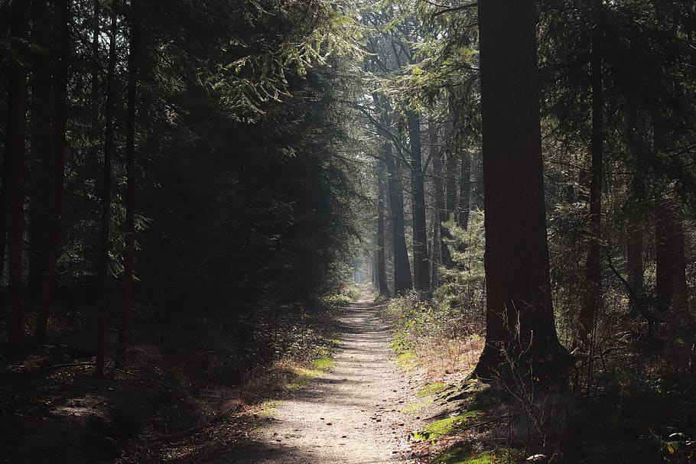
Environmental Ethics

Slide 9
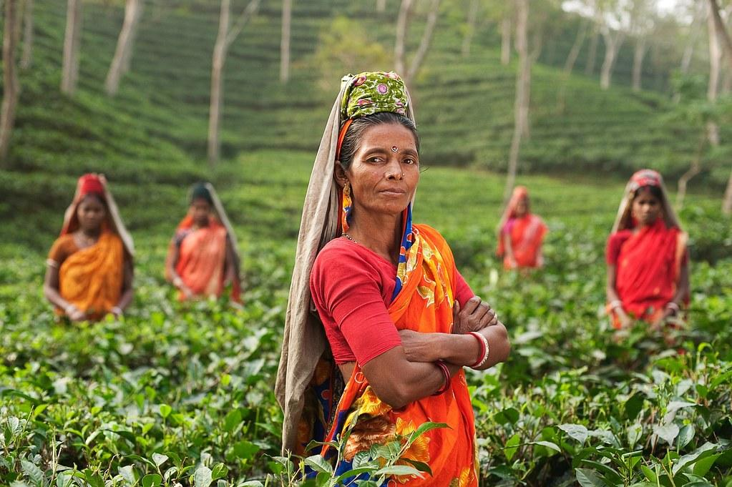
Definitions
Moral Agents:
Those who have the freedom and rational capacity to be responsible for choices
Those capable of moral reflection and decision. Eg. adult humans of sound mind.
Infants and mentally infirm adults are NOT moral agents.

Slide 10
Definitions
Moral Standing:
If you have moral standing:
Your continued existence or welfare is valuable in itself (intrinsic value)
Your interests and well- being must be weighed when deciding what is permissible to do.
Eg. Humans of all kind
Babies, children, adults, old people, women, different races, different cultures

Slide 11
Definitions
Moral duties:
That which is owed by moral agents to those with moral standing.
Example: It is wrong to kill our children because we have a moral duty toward them

Slide 12
Philosophical Issue
Who or what has moral standing, and why?
Does the environment have moral standing?
Must look at criteria for moral standing
What moral duty do we (moral agents) have toward those with moral standing?
Different ethical positions suggest different moral duties.

Slide 13
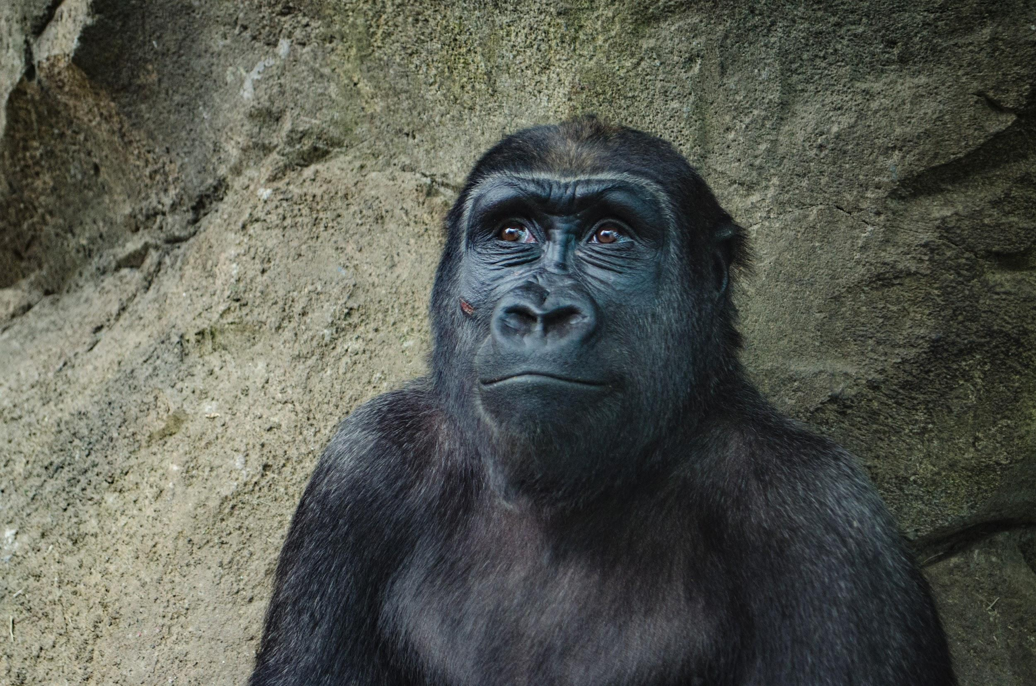
Ideas on Criteria for Moral Standing
The ability to feel pain
Therefore extend moral standing to animals

Slide 14
Ideas on Criteria for Moral Standing
Being alive
- Therefore extend moral standing to animals and plants:
- All living things.
Being part of nature
- Therefore extend moral standing to the earth ecosystems.
- Rocks, rivers, plants, animals, the entire natural world.

Slide 15
Various worldviews & Ethical perspectives
Philosophy
Anthropocentric
Stewardship
Biocentric
Ecocentric
Ecofeminism

Slide 16
Anthropocentrism
We can best protect nature by looking out for human needs.
Eg. Ducks Unlimited preserves wetlands
Eg. Saving the rainforests will provide O₂ and medicines for humans.
Problem:
Would you blow up the world if you were the last human?

Slide 17
Stewardship
MAN AS STEWARD - A sense of responsibility to manage and care for the environment.
Stewardship = Moral Responsibility
Moral responsibility is nothing more than our capacity to be human and being able to take care of everything around us.

Slide 18
Stewardship
Four Criteria of Moral Responsibility
The person has knowledge of the consequences of the act.
The person has the capacity to do the act.
The person has the choice to do it.

Slide 19
Man has moral responsibility towards nature
We know that we can cause permanent damage to natural landscapes, resources and ecosystems
We know that we can cause them.
We know how we can prevent or remedy them.

Slide 20
Biocentric
Life-centered morality
▫ All and only living beings, specifically individual organisms have intrinsic value and moral standing.
▫ Humans are not superior to other life forms nor privileged, and must respect the inherent worth of every organism
▫ Humans should minimize harm and interference with nature: eat vegetarian since less land needs to be cultivated.

Slide 21
Ecocentric Holism
Ecosystem centered morality
Non-individuals (the earth as an interconnected ecosystem, species, natural processes) have moral standing or intrinsic value and are deserving of respect.
Individuals must be concerned about the whole community of life/nature.
Humans should strive to preserve ecological balance and stability.

Slide 22
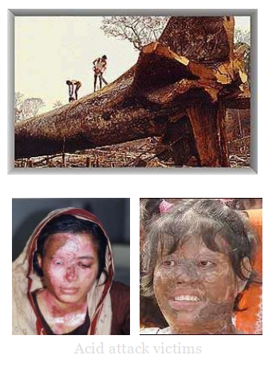
Eco-feminism
Rejects Patriarchal Dualisms
The domination of nature by men is wrong is similar to and related to the domination of women by men.
Must break the pattern of "power over" relationships will benefit both women and the natural world.

Slide 23
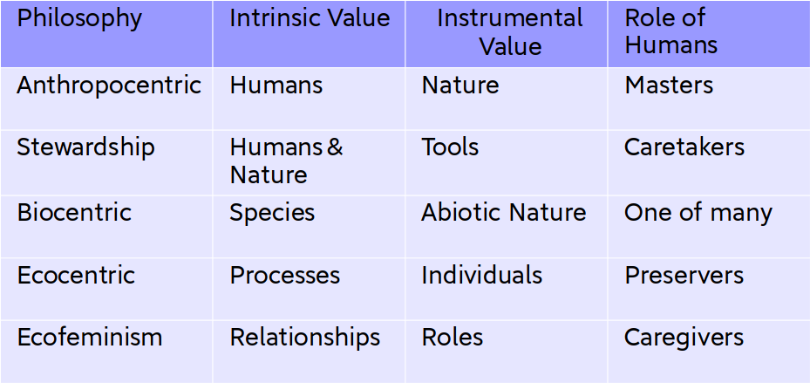
Various worldviews & Ethical Perspectives

Slide 24
"The care of the Earth is our most ancient and most worthy, and after all our most pleasing responsibility. To cherish what remains of it and to foster its renewal is
our only hope." - Wendell Berry
Knowing all these exacts a moral obligation to act with care, foresight, forbearance and constraint.

