Slide 1
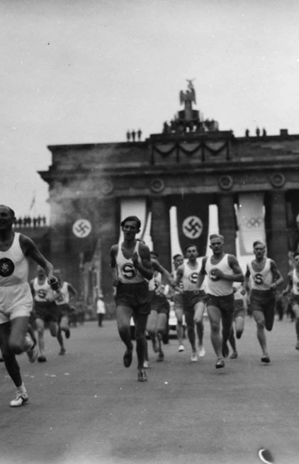
OLYMPIC Games vs WARS
Who Run THE WORLD ETL PROJECT

Slide 2

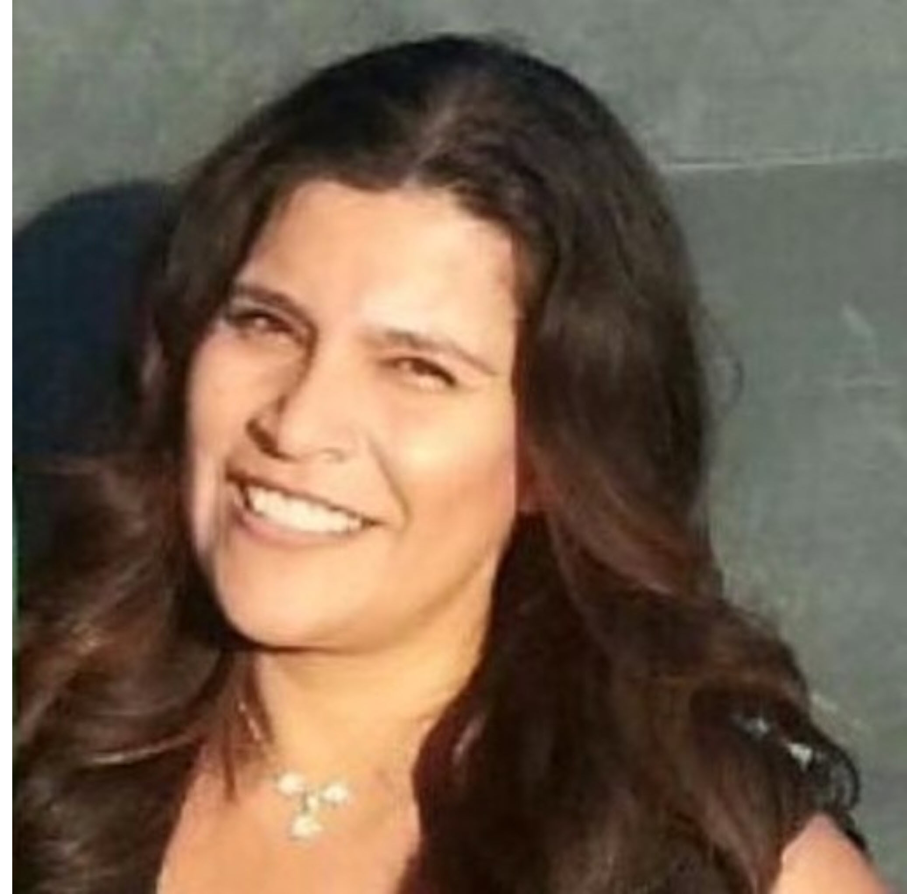

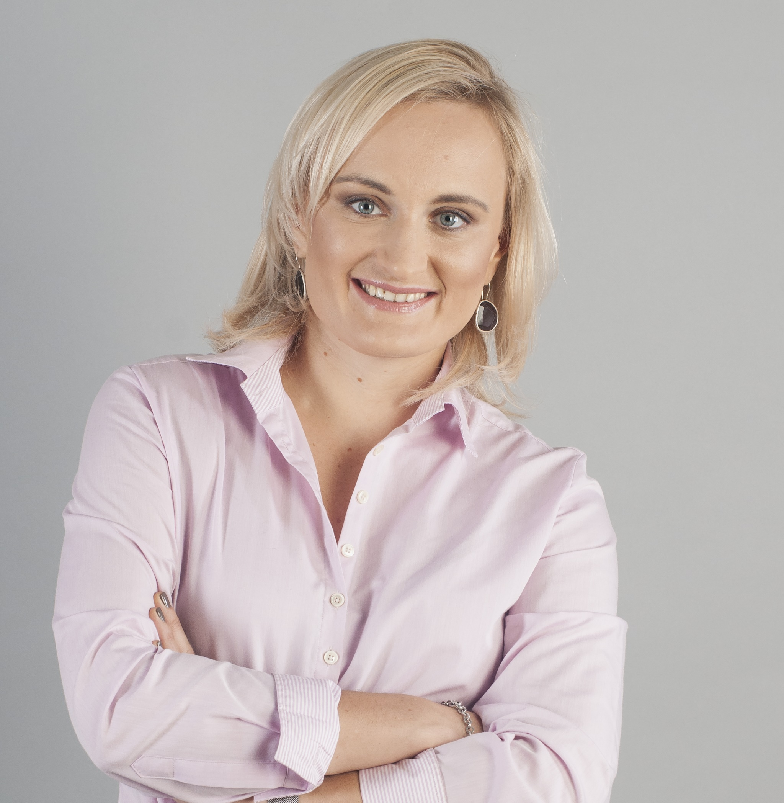
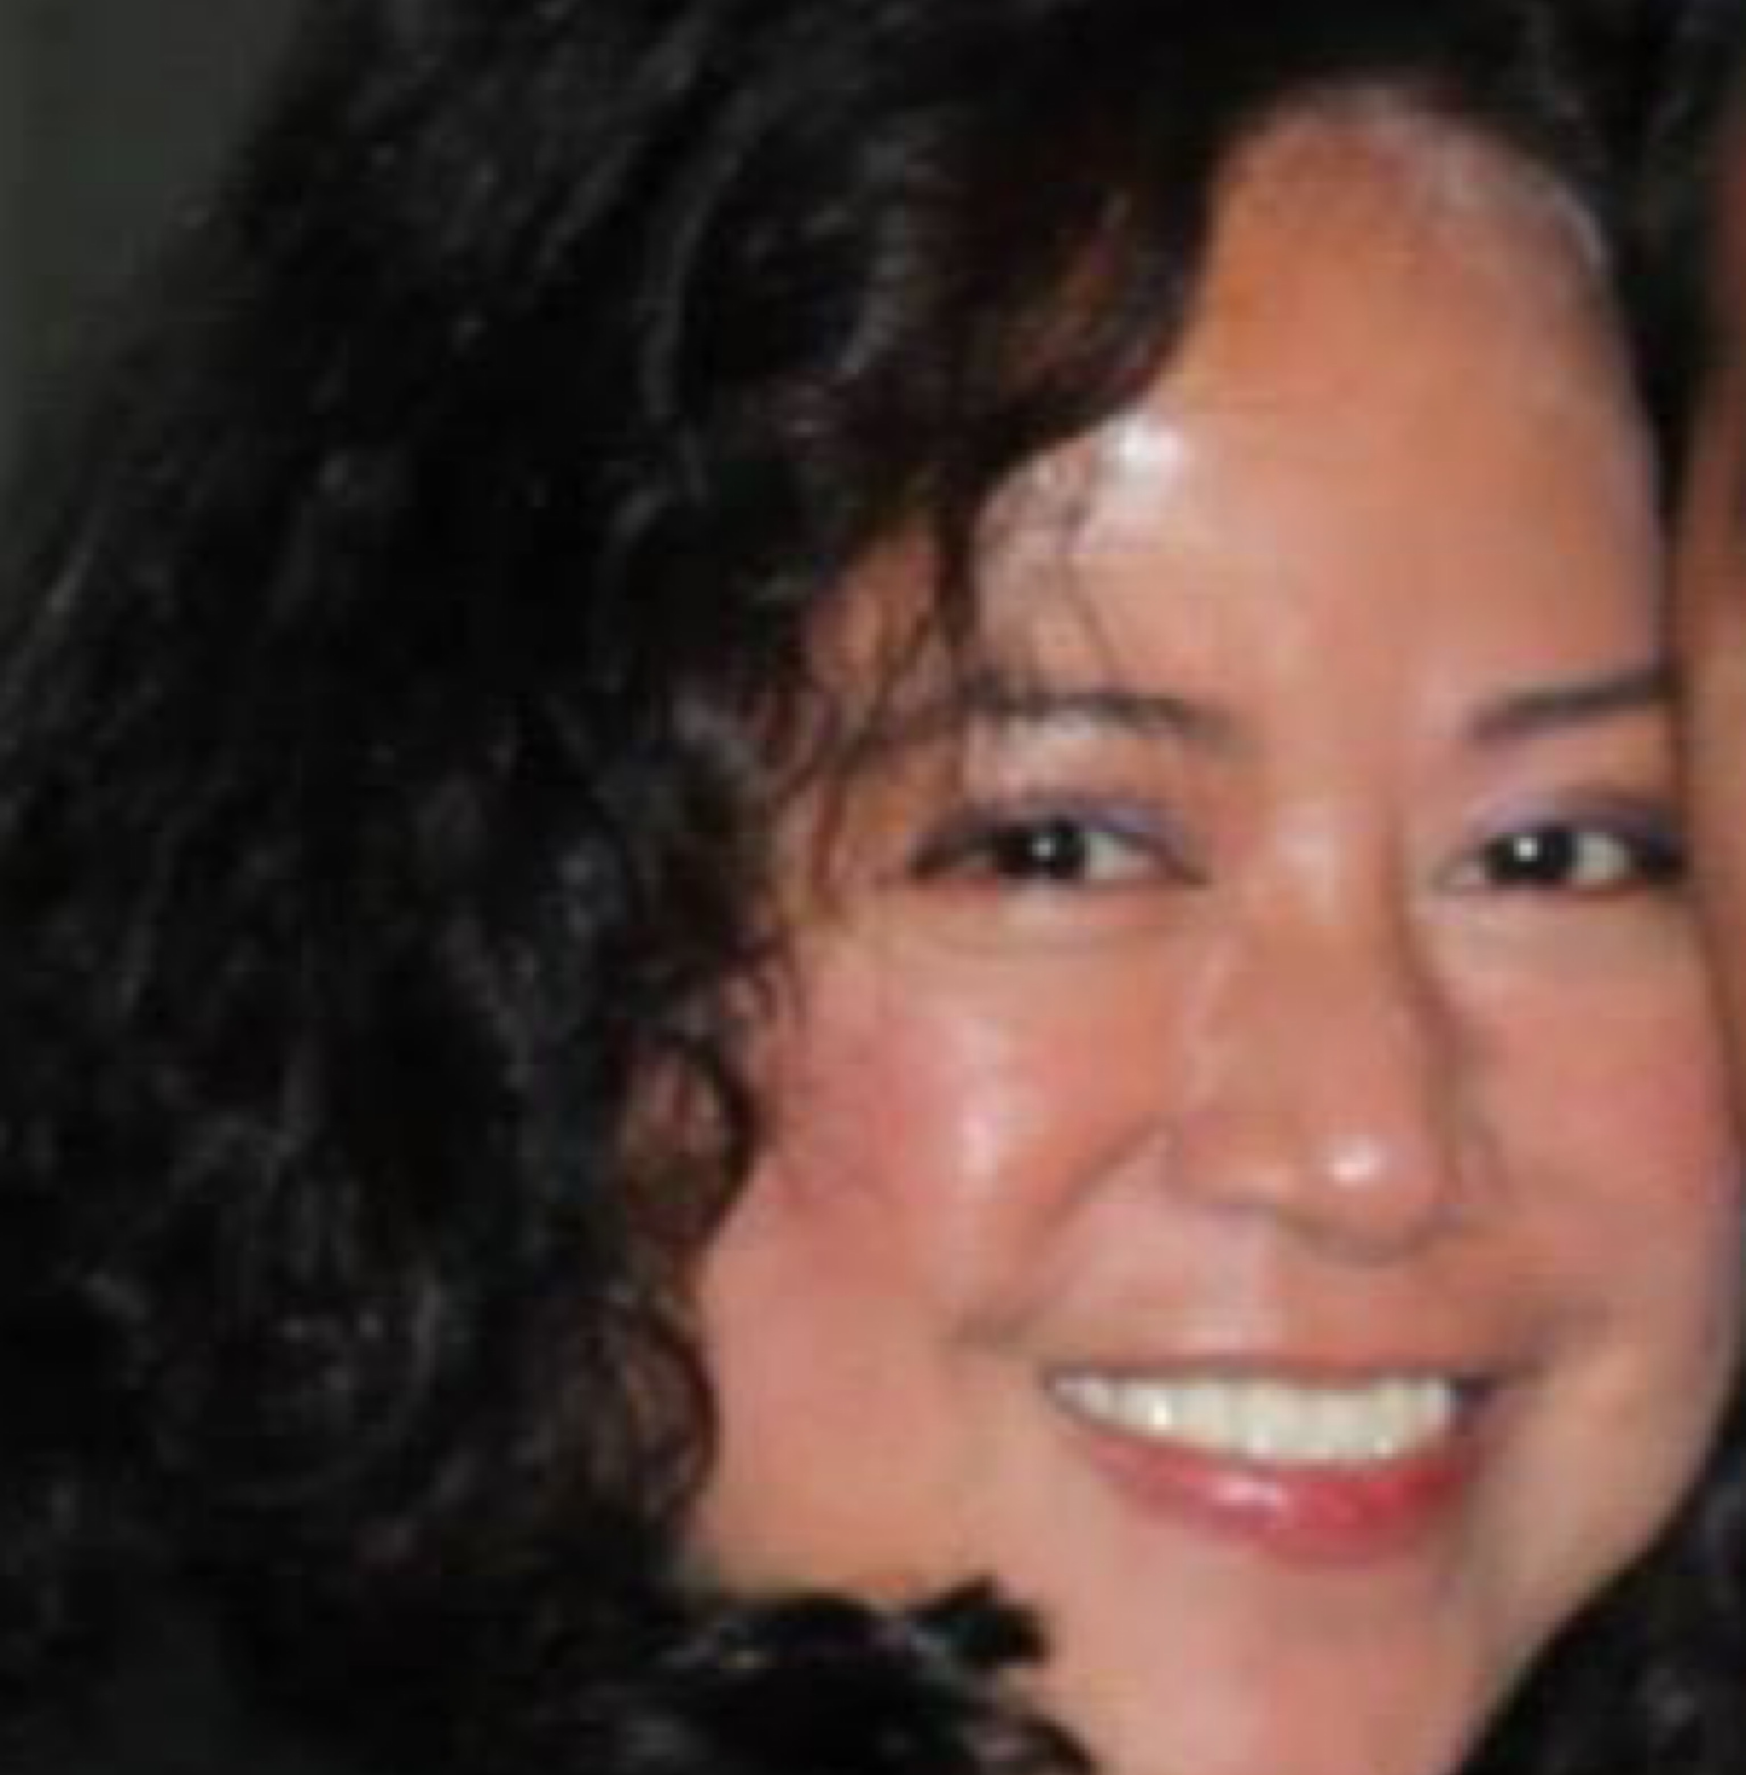

Team
Ana Davalos
Diana Chacon
Evgeniya Grigoreva
Frances Gliane
Mary Basco

Slide 3
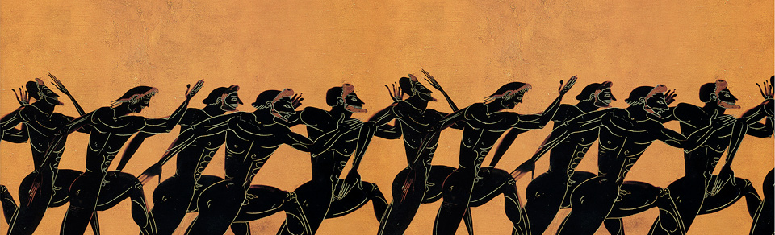
Did Countries-Olympic Medalists participate in a war While Olympics took place?
Who RUN THE WORLD. ETL PROJECT

Slide 4
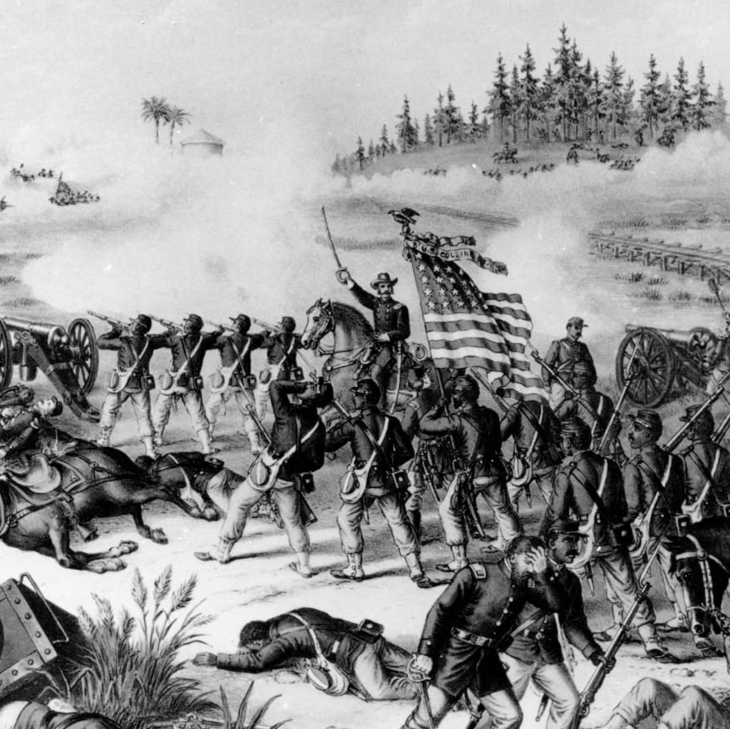
Finding Data
1. Olympic Sports and Medals, 1896-2014
Which countries and athletes have won the most medals at the Olympic games?
https://www.kaggle.com/the-guardian/olympic-games
2. Correlates of War: Interstate Wars
Countries, dates, and fatalities of all wars between 1816 and 2007
https://www.kaggle.com/umichigan/interstate-wars
Who RUN THE WORLD. ETL PROJECT

Slide 5
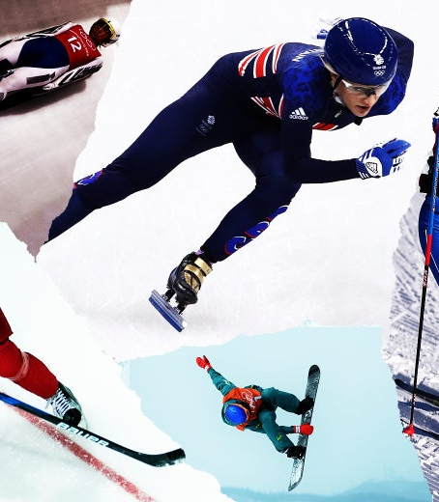
Data Cleanup & Analysis. OLYMPICS Part
Reading 3 CSVs: Winter games, Summer games, Dictionary
Concatenating Olympics data into one Dataframe in ascending order
Column names unification Country → Code, adding column Country
Grouping by year and finding out unique countries per this year
Exporting to CSV
Who RUN THE WORLD. ETL PROJECT

Slide 6
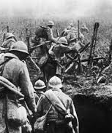
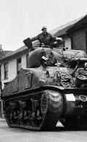
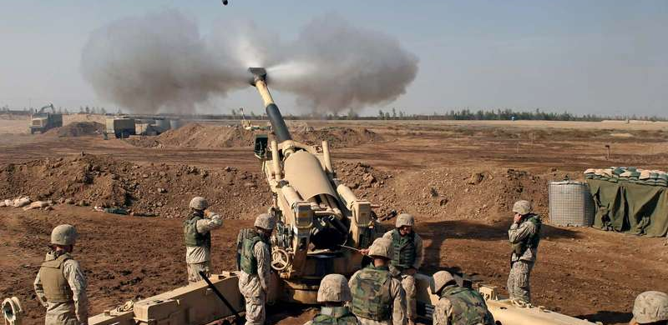
Data Cleanup & Analysis. WARS Part
Reading 3 CSVs: Extrawars, Intrawars, Interwars
Cleaning data
Concatenating data into one dataframe
Exporting to CSV
Who RUN THE WORLD. ETL PROJECT

Slide 7



Loading to FINAL DATABASE
Relational Database Postgres (pgAdmin4)
Preparing data for loading into a relational database Postgres (pgAdmin 4)
Loading into a relational database Postgres (pgAdmin 4)
Aggregating data from two cleaned CSV:
Olympics data
Wars data
Tables:
Olympics
Wars
Who RUN THE WORLD. ETL PROJECT

Slide 8
DATABASE Analysis. TABLES
РАЗДЕЛ 01 | РАЗДЕЛ 02 | РАЗДЕЛ 03 | РАЗДЕЛ 04 | РАЗДЕЛ 05
Элемент 01 | Текст | Текст | Текст | Текст
Элемент 02 | Текст | Текст | Текст | Текст
Элемент 03 | Текст | Текст | Текст | Текст
Элемент 04 | Текст | Текст | Текст | Текст
Элемент 05 | Текст | Текст | Текст | Текст
Элемент 06 | Текст | Текст | Текст | Текст
Элемент 07 | Текст | Текст | Текст | Текст
Элемент 08 | Текст | Текст | Текст | Текст
ИТОГО | Текст | Текст | Текст | Текст
WHO RUN THE WORLD. ETL PROJECT

Slide 9
DATABASE Analysis
WHO RUN THE WORLD. ETL PROJECT

Slide 10
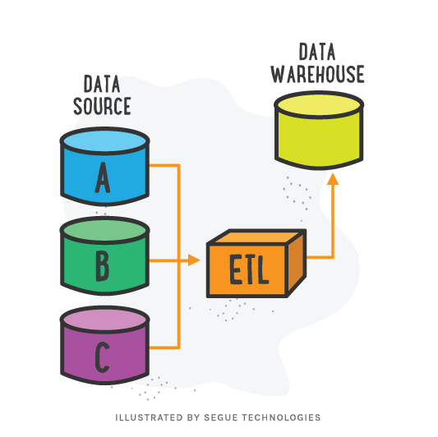
Conclusion
…
Who RUN THE WORLD. ETL PROJECT

Slide 11
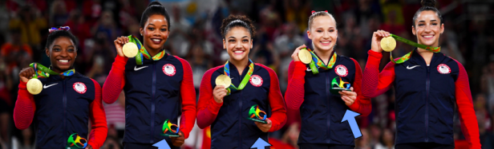
Questions?
Check our GITHUB repository for results
https://github.com/doccoteam/WhoRunTheWorld_ETL_Project
WHO RUN THE WORLD. ETL PROJECT

