Slide 1

UBER & LYFT CAB PRICES Prediction in the Boston Area
Who Run The World Project Team

Slide 2
RIDESHARE PREDICTIONS ON weather, time of day
Cheaper rides = More savings!
Creating a model that predicts the price of rides based on the weather patterns, timing information, distance, level of service
Reducing the time and effort needed to ascertain the cheaper ride

Slide 3


Reducing the time and effort needed to ascertain the cheaper ride
Life is like riding in a taxi. Whether you are going anywhere or not, the meter keeps ticking.

Slide 4
PREDICTIVE EXPERIMENT

Slide 5




PREDICTIVE EXPERIMENT. MILESTONES
FLASK ML
HTML UI
PREDICTION WITH USER DATA
MICROSOFT AZURE MACHING LEARNING STUDIO
Decision Forest Regression
Bayesian Linear Regression
Boosted Decision Tree Linear Regression
Multiclass Decision Jungle
MODEL TRAINING + EVALUATION
TABLEAU
DATA VISUALIZATION & UNDERSTANDING
SOURCE DATASET. INPUTS
KAGGLE Dataset: “https://www.kaggle.com/ravi72munde/uber-lyft-cab-prices”
Weather Dataset
JUPYTER: Data Merging + Cleaning

Slide 6
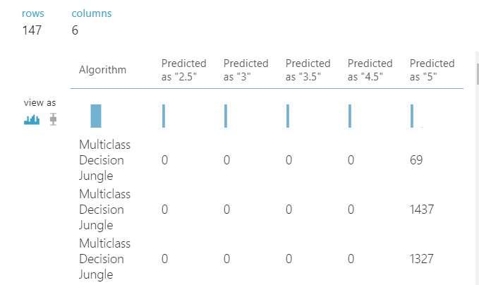
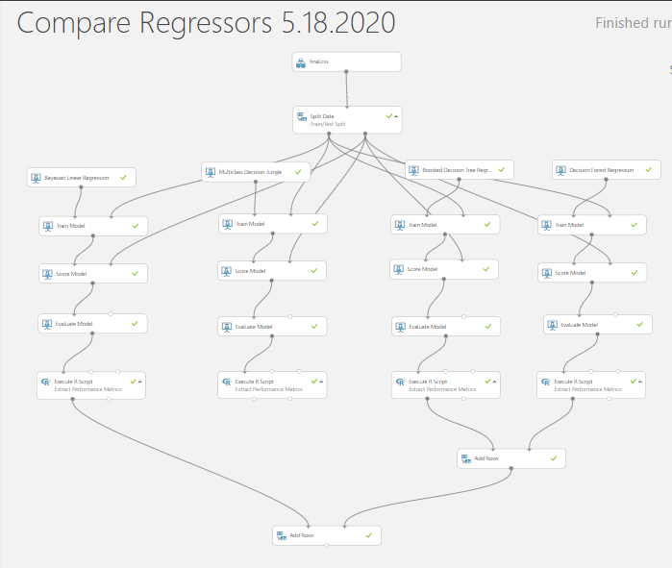
Comparison of Different Regression models
Creating different regression models, selecting one with the lowest R mean² error
Decision Forest Regression
Bayesian Linear Regression
Boosted Decision Tree Linear Regression
Multiclass Decision Jungle

Slide 7
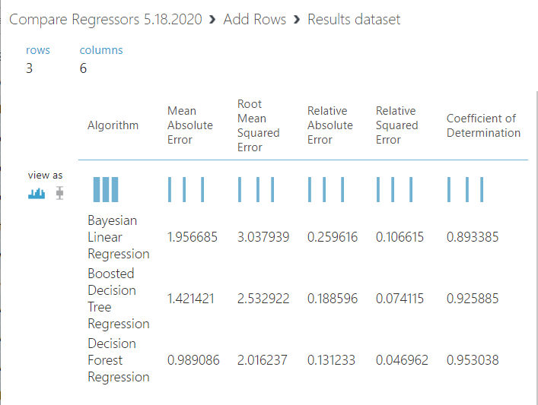
Comparison of Different Regression models
Results dataset

Slide 8
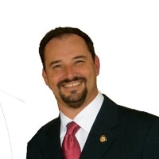







WHO RUN THE WORLD TEAM
Ana Davalos
Paula Urteaga
Frances Gliane
Evgeniya Grigoreva
ANTHONY TAYLOR
Lead & Mentor
ADVISOR:
Kevin Nguyen
ADVISOR:
Mark Flynn

Slide 9

“BABY, IT’s cold outside. Let’s take a cab!”
PREDICTION EXPERIMENT BASED ON:
WEATHER CONDITIONS
Temperature
Rain
DISTANCE
TIME OF DAY
DAY OF THE WEEK
CAB TYPE
Uber / Lyft
LEVEL OF SERVICE

Slide 10



It’s SHOW TIME!

Slide 11
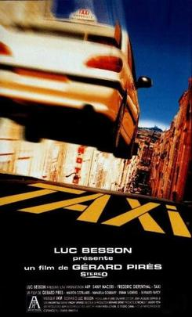
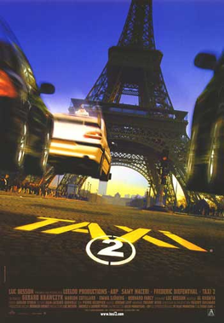
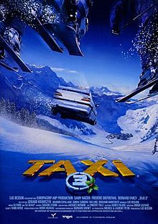
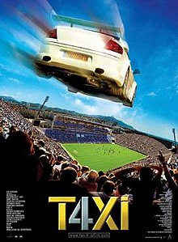

QUESTIONS?
Check our GITHUB repository for results:
https://github.com/eugeniagr/WhoRunTheWorld_TaxisProject

