Slide 1

UBER & LYFT CAB PRICES Prediction in the Boston Area
Who Run The World Project Team

Slide 2








WHO RUN THE WORLD TEAM
Ana Davalos
Paula Urteaga
Frances Gliane
Evgeniya Grigoreva
ANTHONY TAYLOR
Lead & Mentor
ADVISOR:
Kevin Nguyen
ADVISOR:
Mark Flynn

Slide 3


Reducing the time and effort needed to ascertain the cheaper ride
Life is like riding in a taxi. Whether you are going anywhere or not, the meter keeps ticking.

Slide 4
RIDESHARE PREDICTIONS ON weather, time of day
Cheaper rides = More savings!
Creating a model that predicts the price of rides based on the weather patterns, timing information, distance, level of service
Reducing the time and effort needed to ascertain the cheaper ride

Slide 5




PREDICTIVE EXPERIMENT. MILESTONES
FLASK ML
HTML UI
PREDICTION WITH USER DATA
MODEL TRAINING + EVALUATION
MICROSOFT AZURE MACHING LEARNING STUDIO
Decision Forest Regression
Bayesian Linear Regression
Boosted Decision Tree Linear Regression
Multiclass Decision Jungle
TABLEAU
DATA VISUALIZATION & UNDERSTANDING
SOURCE DATASET. INPUTS
KAGGLE Dataset: https://www.kaggle.com/ravi72munde/uber-lyft-cab-prices
cab_rides.csv - up to 1M records!
weather.csv
JUPYTER: Data Merging + Cleaning

Slide 6
PREDICTIVE EXPERIMENT

Slide 7

“BABY, IT’s cold outside. Let’s take a cab!”
PREDICTION EXPERIMENT BASED ON:
WEATHER CONDITIONS
Temperature
Rain
DISTANCE
TIME OF DAY
DAY OF THE WEEK
CAB TYPE
Uber / Lyft
LEVEL OF SERVICE

Slide 8
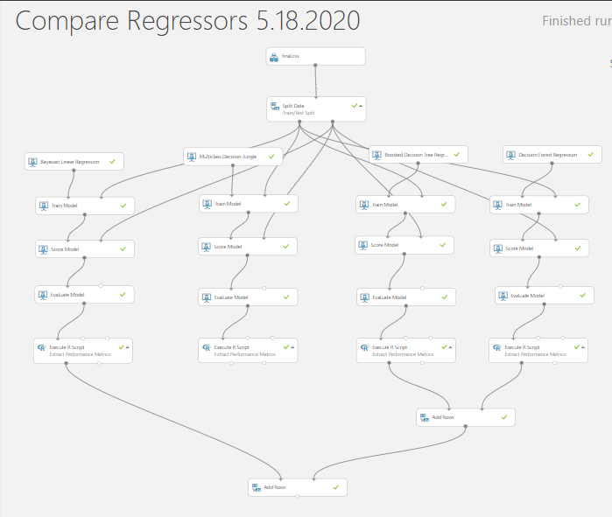
Comparison of Different Regression models
Creating different regression models, selecting one with the lowest R mean² error
Decision Forest Regression
Bayesian Linear Regression
Boosted Decision Tree Linear Regression
Multiclass Decision Jungle

Slide 9
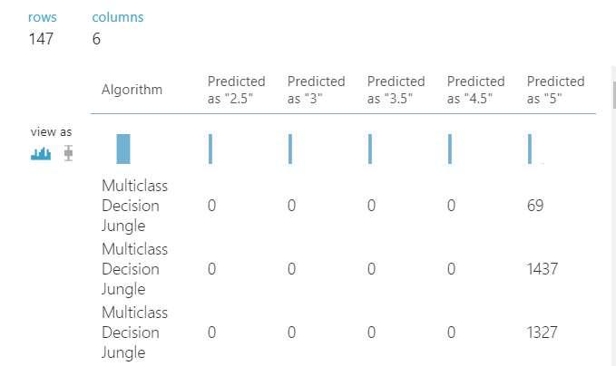
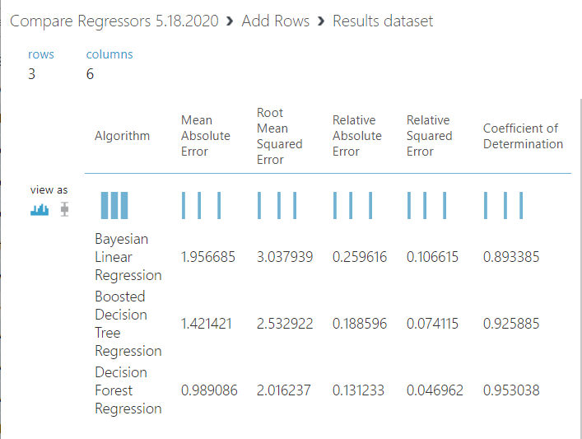
Comparison of Different Regression models
Results dataset

Slide 10



It’s SHOW TIME!

Slide 11





QUESTIONS?
Check our GITHUB repository for results:
https://github.com/eugeniagr/WhoRunTheWorld_TaxisProject
&
Tableau Public for our coolest visuals:
https://public.tableau.com/views/CabPrice_Prediction/Story1?:display_count=y&publish=yes&:origin=viz_share_link

