Slide 1

UBER & LYFT CAB PRICES Prediction in the Boston Area
Who Run The World Project Team

Slide 2
RIDESHARE PREDICTIONS ON weather, time of day
Cheaper rides = More savings!
Creating a model that predicts the price of rides based on the weather patterns and timing information
Reducing the time and effort needed to ascertain the cheaper ride.

Slide 3


Reducing the time and effort needed to ascertain the cheaper ride
Life is like riding in a taxi. Whether you are going anywhere or not, the meter keeps ticking.

Slide 4
PREDICTIVE EXPERIMENT

Slide 5




PREDICTIVE EXPERIMENT. MILESTONES
FLASK ML
PREDICTION WITH USER DATA
MICROSOFT AZURE MACHING LEARNING STUDIO
Decision Forest Regression
MODEL TRAINING + EVALUATION
TABLEAU
DATA VISUALIZATION & UNDERSTANDING
KAGGLE Dataset: “https://www.kaggle.com/ravi72munde/uber-lyft-cab-prices”
Weather Dataset
JUPYTER: Data Merging + Cleaning
SOURCE DATASET. INPUTS

Slide 6
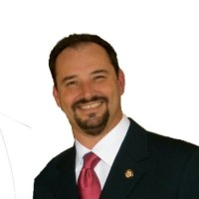
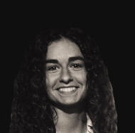






WHO RUN THE WORLD TEAM
Ana Davalos
Paula Urteaga
Frances Gliane
Evgeniya Grigoreva
ANTHONY TAYLOR
Lead & Mentor
ADVISOR:
Kevin Nguyen
ADVISOR:
Mark Flynn

Slide 7

“BABY IT’s cold outside. Let’s take a cab!”
PREDICTION EXPERIMENT BASED ON:
WEATHER CONDITIONS
Temperature
Rain
DISTANCE
TIME OF DAY
CAB TYPE
Uber / Lyft
LEVEL OF SERVICE

Slide 8



It’s SHOW TIME!

Slide 9
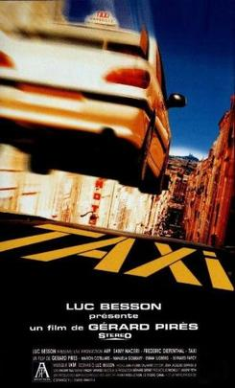
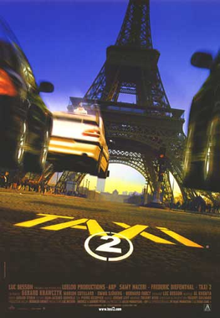
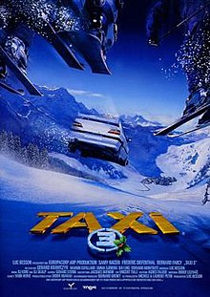
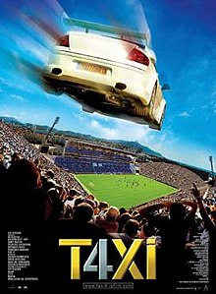

QUESTIONS?
Check our GITHUB repository for results:
https://github.com/eugeniagr/WhoRunTheWorld_TaxisProject

