Slide 1


Maciej Lasyk
OWASP Poland, 2013-10-17

Slide 2
Recruitment process @OWASP?
Because this system is web application (partially)
Because we based (100%) on FOSS (open-source)
Because security matters
Because OWASP people cares about security and can affect recruitment processes (hopefully) ;)

Slide 3

Recruitment
Lot of recruitment agencies / services
Huge number of potential candidates
Whole team is involved in recruitment
Candidate evaluation takes really lot of time

Slide 4

SysAdmin / Operations
He is sysop, developer, QA and network specialist
Also great for performance tuning
Responsible for critical data (all data)
Easy handles moving UPSes between racks ;)
Anytime day / night understands what you’re talking to him
Everything he does respects high security standards
Loves playing games (do you know sysop that doesn’t play)? ;)

Slide 5
Let’s play then
Any idea? Not Quake / Diablo / Warcraft ;)
pythonchallenge.com, wechall.net – CTFs are great!
trueability.com – event for sysops
So maybe CTF / challenge?
Such system would have to fulfill some requirements:
  Optimization of recruitment process time
  Minimisation of the risk of rejecting good candidate
  Draw attention as very interesting (you like mindfscks?)

Slide 6
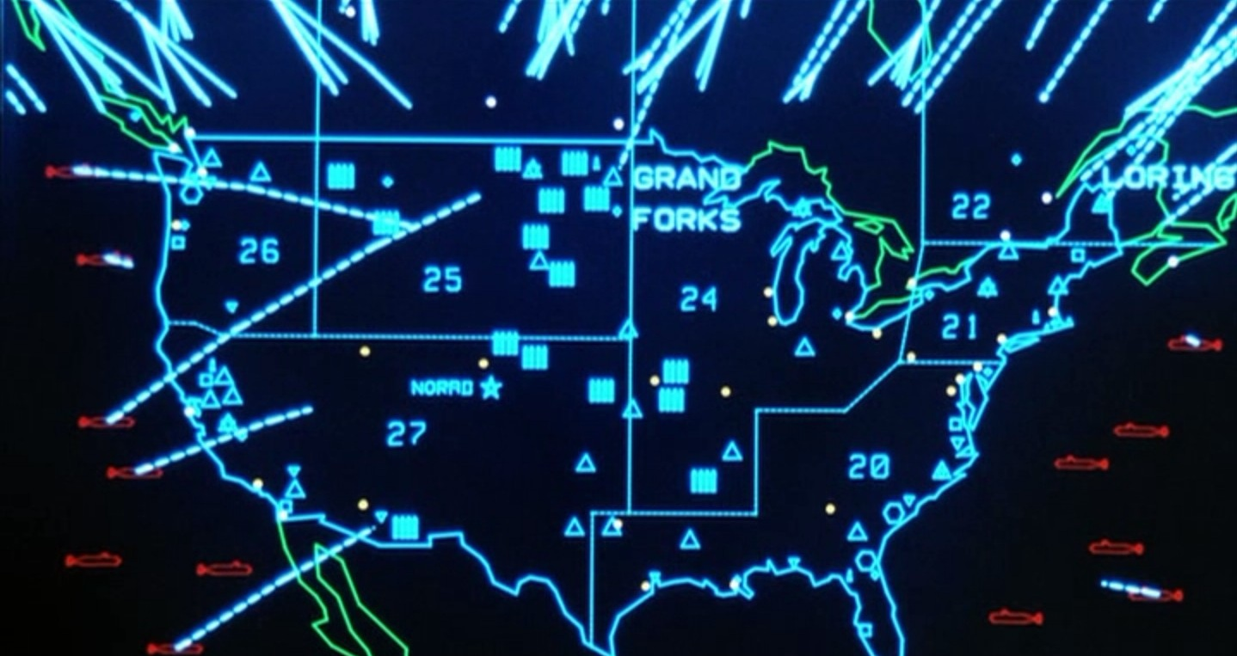
Let's start the ball rolling
Application
Problem: huge candidates number (>100)
Stage 1 – simple task
Target: reject not suitable cands (>80% rejections!)
Stage 2 – call/social.eng.
Target: recognition, manipulation
Stage 3 – challenge
Global Thermonuclear War ;)

Slide 7
Stage 1 – telnet / SMTP
RFC-821/1869:
HELO/EHLO ??.....??
GPG us ur CV using
http://..../gpg.asc
Lack of GPG knowledge :(
RTFM!

Slide 8
Stage 1 – telnet / SMTP
RFC-821/1869:
HELO/EHLO my.hostname
1 trap – not server’s hostname
but client’s (90% catched)
GPG us ur CV using
http://..../gpg.asc
Lack of GPG knowledge :(
RTFM!

Slide 9

Stage 1 – node.js
At the beginning – pure C server. After 3am.. Node.js (simplicity) ;)
What’s wrong with node.js?
  http://seclists.org/bugtraq/ - 0 hits
  http://osvdb.org/ - 2 hits
  http://1337day.com/, http://www.exploit-db.com/ - 1 hit
  https://nodesecurity.io/advisories - 4 hits
Does it mean that node.js is safe & secure?

Slide 10
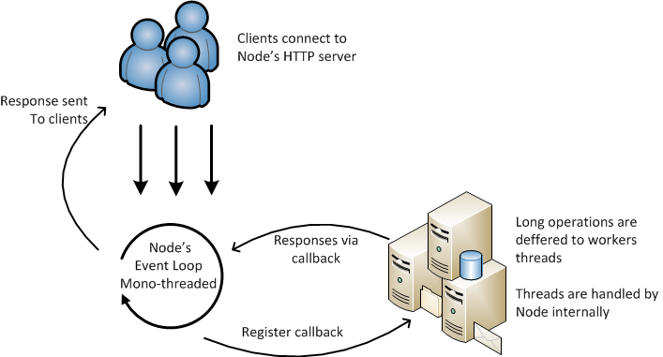
Node.js – how it works?
- Event driven
- Event loop
- Callbacks
- SPA, async, REST, Json
http://magnetik.github.io/

Slide 11
Node.js - threats
............................................________
....................................,.-'"...................``~.,
.............................,.-"..................................."-.,
.........................,/...............................................":,
.....................,?......................................................,
.................../...........................................................,}
................./......................................................,:`^`..}
.............../...................................................,:"........./
..............?.....__.........................................:`.........../
............./__.(....."~-,_..............................,:`........../
.........../(_...."~,_........"~,_....................,:`........_/
..........{.._$;_......"=,_......."-,_.......,.-~-,},.~";/....}
...........((.....*~_......."=-._......";,,./`..../"............../
...,,,___.`~,......"~.,....................`.....}............../
............(....`=-,,.......`........................(......;_,,-"
............/.`~,......`-...................................../
.............`~.*-,.....................................|,./.....,__
,,_..........}.>-._...................................|..............`=~-,
.....`=~-,__......`,.................................
...................`=~-,,.,...............................
................................`:,,...........................`..............__
.....................................`=-,...................,%`>--==``
........................................_..........._,-%.......`
no logging
No error handling - DoS
No configuration – “+” or “-”?
No filters checking user-input
JS: function as a variable
Evil eval(code). Server-side XSS
setInterval(code,2), setTimeout(code,2), str = new Function(code)
Moduły npm – who creates those?

Slide 12
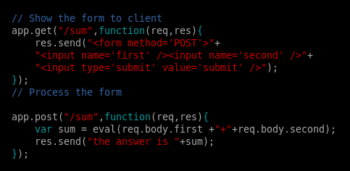
Node.js – evil eval()

Slide 13

Node.js – evil eval()
This way we added new functionality to the server during runtime!
http://node.js/myurl

Slide 14
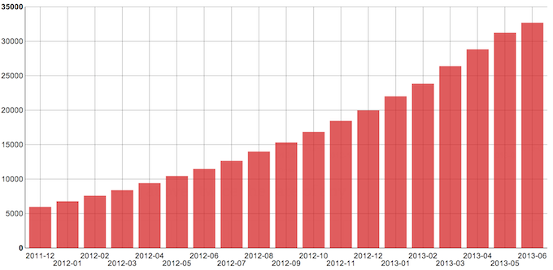
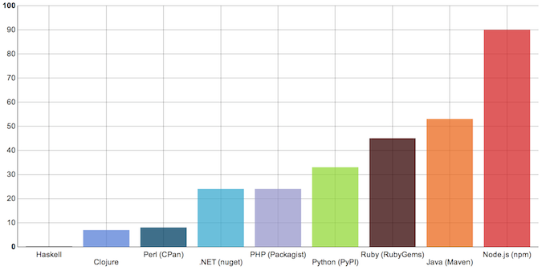
Node.js - npm
https://blog.nodejitsu.com/npm-innovation-through-modularity
Amount of npm
modules in the time
Amount of
npm-mods/day
comparison to
node.js and others

Slide 15
Node.js – how can?
Use frameworks: https://npmjs.org/ - carefully
Npm modules are not validated! Check those: https://nodesecurity.io
Watch module dependencies!
must have: your own error handling & logging
This is server – we need proper server security solutions:
  Monitoring – think how to monitor your app
  Control-groups – set limits for resources
  SELinux sandbox

Slide 16

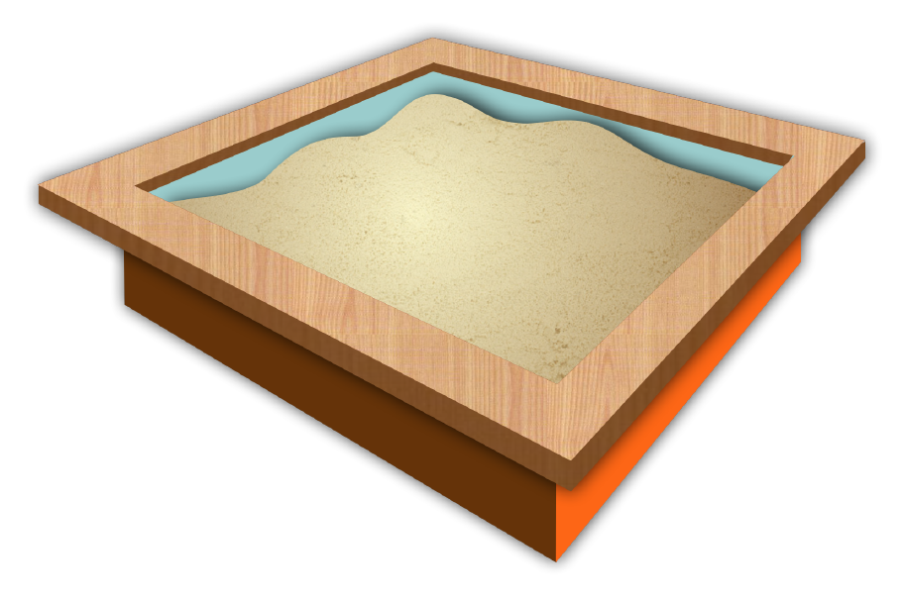

Node.js – SELinux sandbox
'home_dir' and 'tmp_dir'
App can r/w from std(in|out) + only defined FDs
No network access
No access to foreign processes / files
We can easily connect sandbox with cgroups :)
Helpful: semodule -DB (no dontaudit)
grep XXX /var/log/audit/audit.log | audit2allow -M node.sandbox
semodule -i node.sandbox.pp

Slide 17
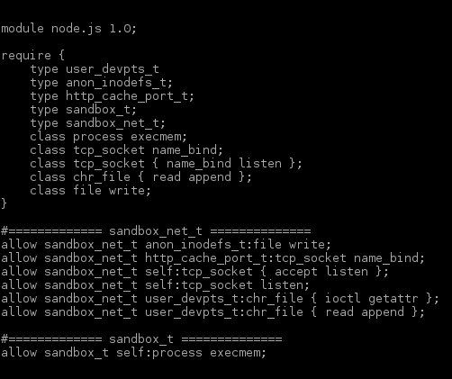
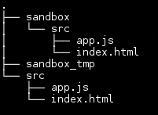
Node.js – SELinux sandbox

Slide 18
Node.js – how can #2
Freeze node.js version per project?
Let’s read & learn:
  https://media.blackhat.com/bh-us-11/Sullivan/BH_US_11_Sullivan_Server_Side_WP.pdf
  http://lab.cs.ttu.ee/dl91
  https://github.com/toolness/security-adventure
Pseudo–configuration – set limits in your code (e.g. POST size)
try...catch ftw
use strict; - helps even with eval case (partially)
Bunyan / dtrace: https://npmjs.org/package/bunyan
node.js OS? Oh and use / build node.js packages (fpm or whatever)

Slide 19
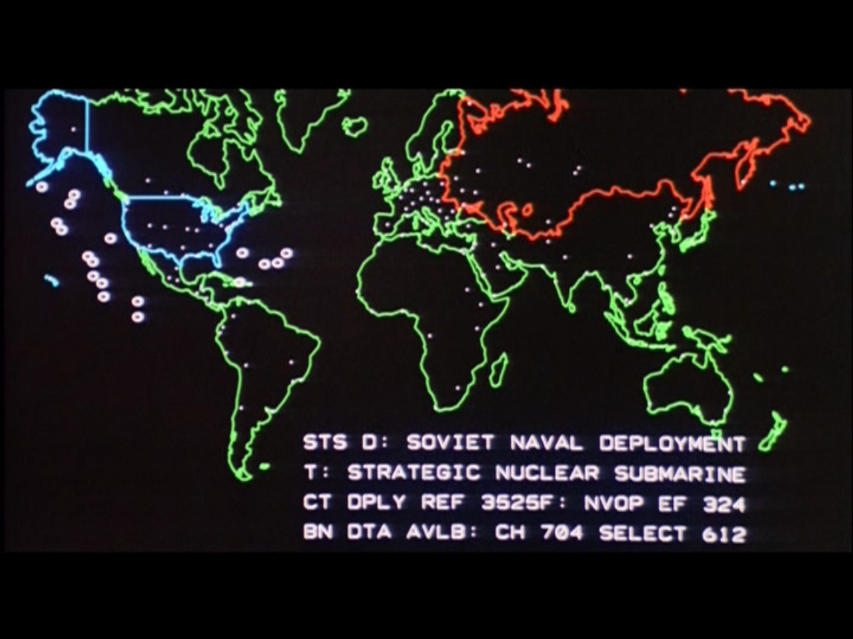
Stage 2 – social engineering
Stage’s target is to verify & check candidate’s security awareness
Christopher Hadnagy – SE framework (2k10):
  http://www.social-engineer.org/framework/Social_Engineering_Framework
Everyone can act as recruiter and call anyone
Building network / connections on Linkedin is very easy
Trust (lingo, easiness in some env: research)
Sysop knows really much about env – he’s good target
So one has to only get sysop’s trust and decrease his carefulness

Slide 20
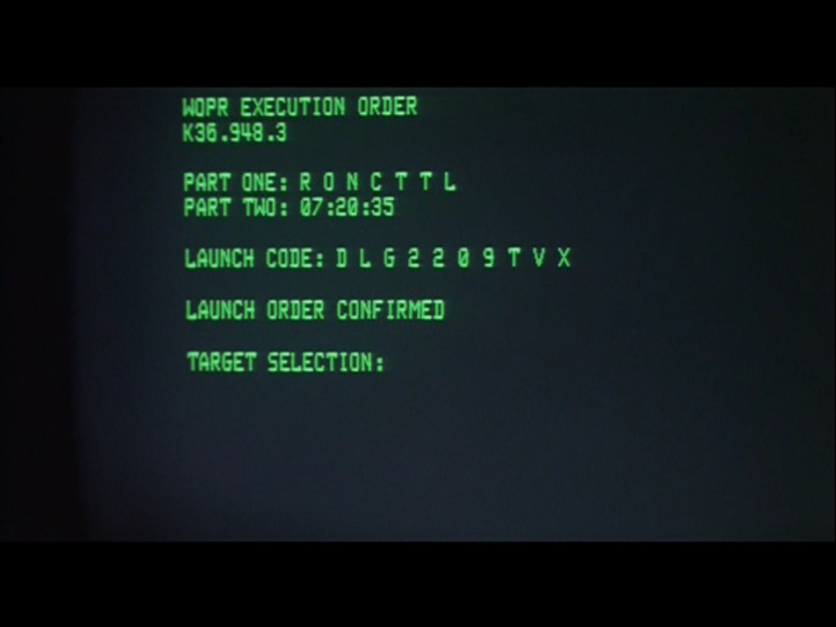

Stage 3 - virtualization
Our needs?
  Boot process supervision
  Console access
  Resource management
  Redundant storage
  Rescue mode for VMs
  Security by default
> AWS
> KVM/libvirt
> XEN/libvirt
> LXC

Slide 21






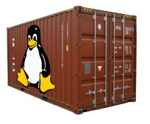
Stage 3 - virtualization
 | boot | console | resources mgmt. | redundant storage | rescue VM | security

Slide 22

Stage 3 - virtualization
VS
Performance XEN/HVM or KVM?

Slide 23

Stage 3 - virtualization
VS
Performance XEN/HVM or KVM?
We had great performance issues with XEN/HVM
The winner is „hat in the red” and its PV
(but with the cgroups help – under heavy load KVM is
not that stable)

Slide 24
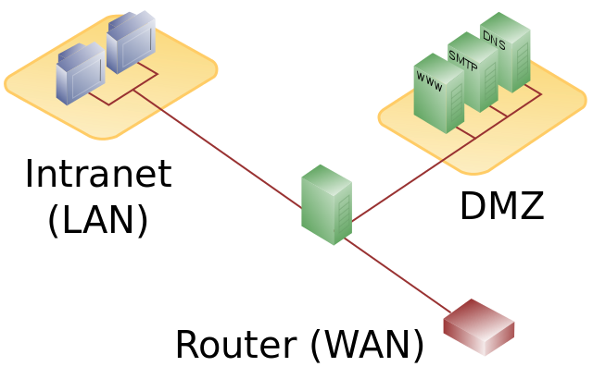
Stage 3 – network security
https://en.wikipedia.org
DMZ (Demilitarized Zone) – logical or physical partition

Slide 25
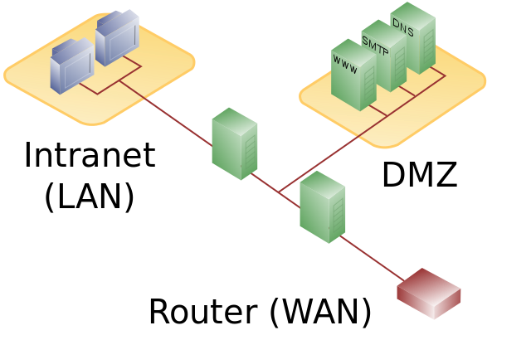
Stage 3 – network security
https://en.wikipedia.org
DMZ (Demilitarized Zone) – logical or physical partition

Slide 26
Stage 3 – network security
Separated, dedicated DMZ (VLAN?) for host
No routing / communication from this DMZ with other segments
Low – cost solutions?
  OpenWRT / DDWRT way || Pure Linux server
  802.1Q – VLANs

Slide 27
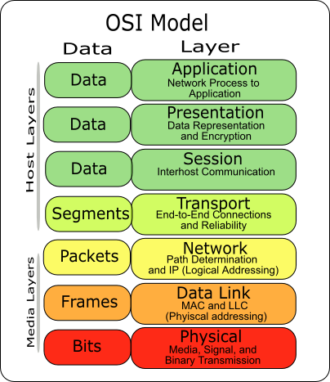
Stage 3 – network security
Network isolation on KVM host:
  Host/network bridge: L2 switch
  netfilter / nwfilter (IBM)
  By default there’s no packets isolation in the bridged network - ebtables null, no filtering
  ebtables – filtering l2– so we gain isolation
  Or virsh nwfilter-list
    allow-arp,dhcp,dhcp-server,clean-traffic, no-arp-ip-spoofing, no-arp-mac-spoofing, no-arp-spoofing, no-ip-multicast, no-ip-spoofing, no-mac-broadcast, no-mac-spoofing, no-other-l2-traffic
  L2 filtering? /proc/sys/net/bridge
https://www.redhat.com/archives/libvir-list/2010-June/msg00762.html
http://pic.dhe.ibm.com/infocenter/lnxinfo/v3r0m0/topic/liaat/liaatsecurity_pdf.pdf

Slide 28
Stage 3 –boot process, VNC
Accessing boot process – VNC
VNC security? SSL? Complications..
Maybe VNC over SSH tunnel?
  Encryption
  No certificates issues
  Every admin can easily use VNC

Slide 29
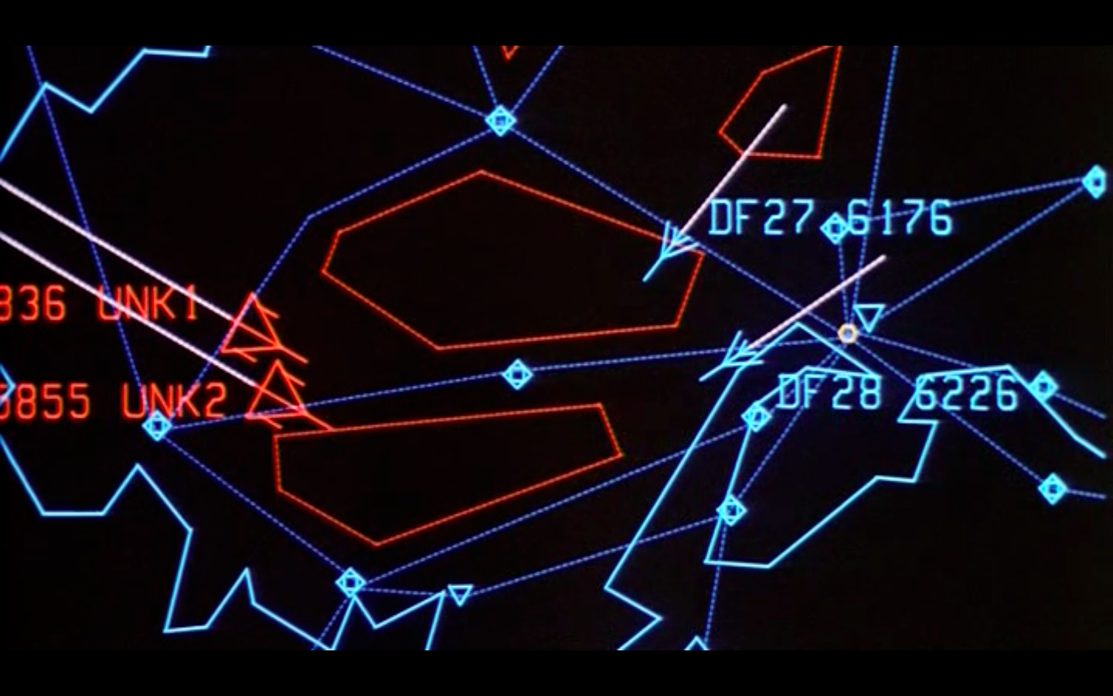

Stage 3 – restricted shells
SSH tunneling requires SSH access (thank You Captain Obvious!)
SSH access is a threat per se
Let’s limit this SSH / shell access – use restricted shells
Restricted shells by. Google ;) =>

Slide 30
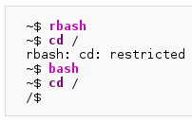

Stage 3 – restricted shells
Restricted shells are threat by default – unless we know how to use those!
Under some circumstances one could escape the rshell:
https://en.wikipedia.org/wiki/Rbash

Slide 31
Stage 3 – restricted shells
Rbash:
  CentOSie / RHEL approved / friendly / legit ;)
  Protects from directory traversal
  Prohibits access to files via direct path
  Prohibits setting PATH or other shell env variables
  No commands output redirection
  PATH=$HOME/bin – and reconsider 2x what to put into this „bin”
https://en.wikipedia.org/wiki/Rbash

Slide 32
Stage 3 – SSH tunnel / VNC
We must go deeper!
VM host
VM-Proxy
rshell / ibsh
ssh tunnel
ssh tunnel
rshell / rbash
Candidate
VNC server
screen / ssh tunnel

Slide 33
Stage 3 – restricted shells
Other restricted shells:
  rssh – allows scp, sftp, rsync
  sudosh - http://sourceforge.net/projects/sudosh
    Allows saving whole user session and replay it
    One can define allowed operations for user
    Little outdated – better use sudosh3
  Ibsh (small, fast, secure): http://sourceforge.net/projects/ibsh/

Slide 34
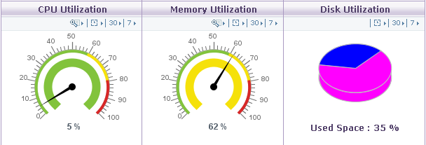
Stage 3 – control groups
resource management in a simple way (ulimits, nice, limits.conf).. but..
Could you set 50 IOPS for defined process?
What about 100Kbp/s limit for particular user?
issues with memory–leaks in Java?

Slide 35
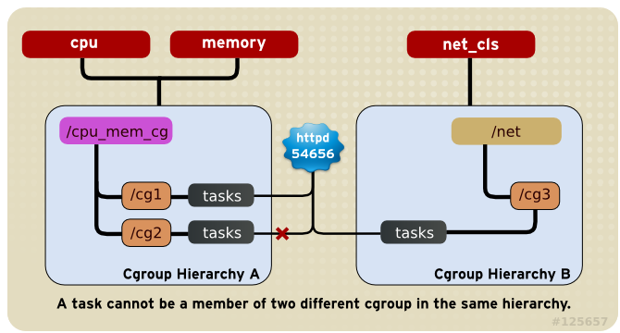
Stage 3 – control groups
https://access.redhat.com/site/documentation/en-US/Red_Hat_Enterprise_Linux/6/html/Resource_Management_Guide/ch01.html
Debian & RHEL friendly
Running apps in cgroup context
Setting cgroup context for process during runtime

Slide 36
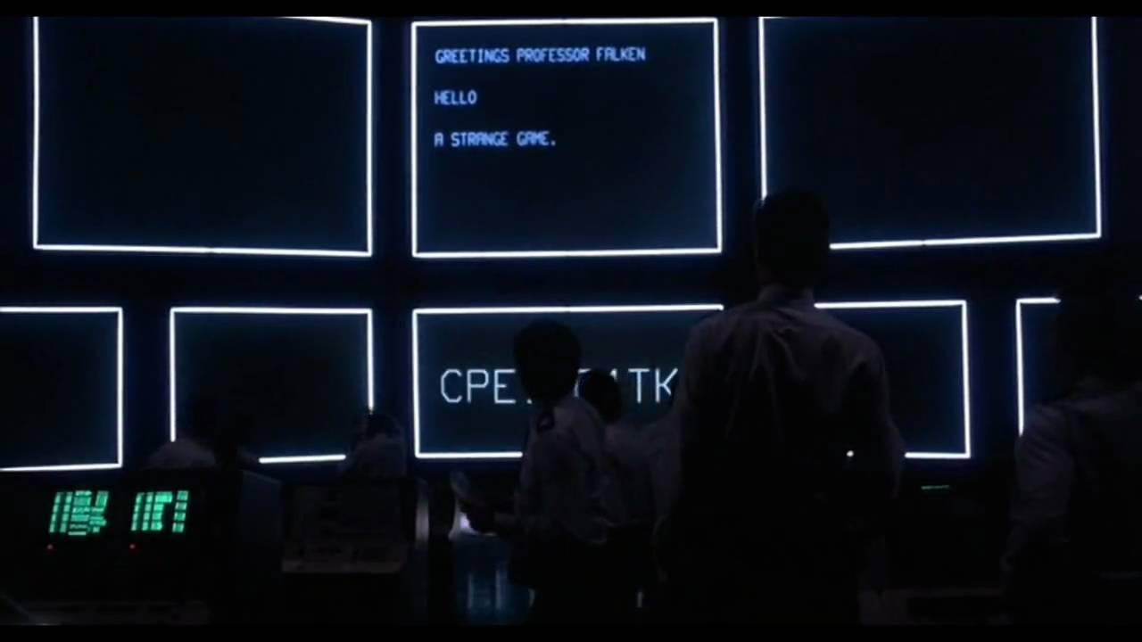
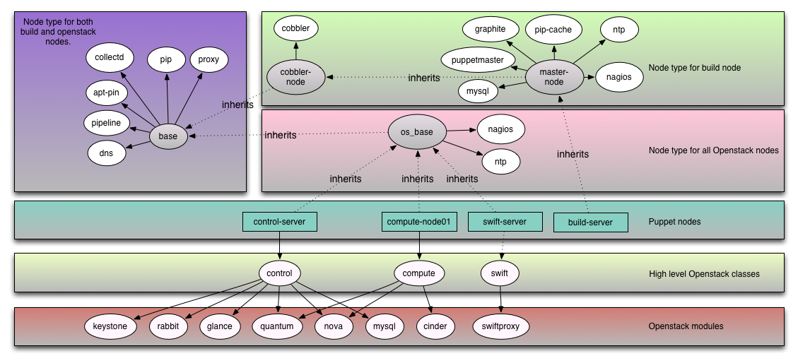
Stage 3 – web application
OpenStack?
„Couple” of compliations ;) “Out of the box” – yup – I’ve heard
about that ;) Could you deploy it in a few hours – securely?

Slide 37
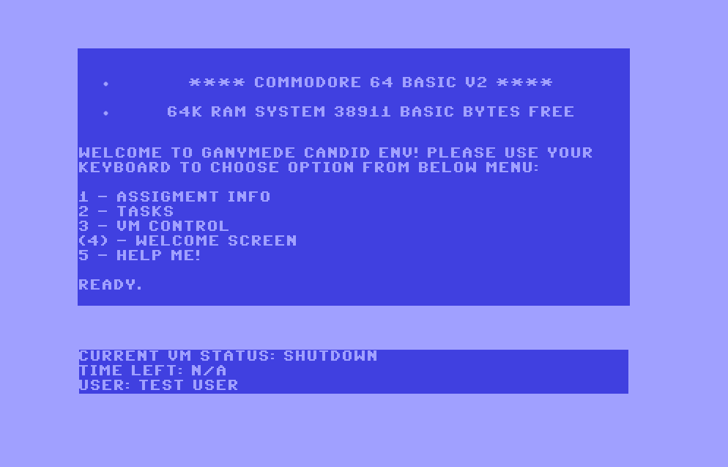
Stage 3 – web application
Commodore OS ???

Slide 38
Stage 3 – web application
Commodore OS Vision FTW!

Slide 39
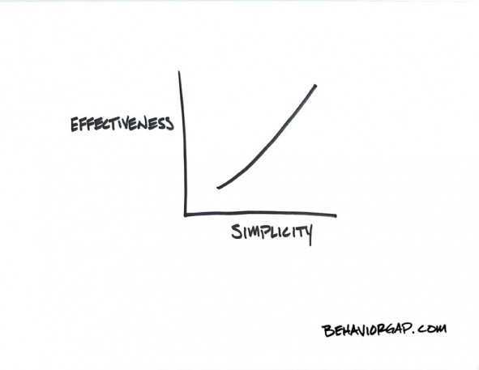
Stage 3 – web application
Apache + mod_security
mod_security + OWASP rules
PHP & Python :)
Simplicity!
VM management with simple daemon + screen:
  while(1) do: manage_VMs();
And this just works!

Slide 40
Stage 3 – recording SSH sessions
We have to record all sessions – also those under „screen”
Real time recording
sudosh3 (sudosh fork) – kinda proxy shell – great ;)
auditd – lov-lewel tool for recording syscalls
Asciinema (ascii.io, Marcin Kulik) – great one, but not for audit purposes
Ttyrec – outdated: http://0xcc.net/ttyrec/index.html.en
Ssh logging patch - outdated: http://www.kdvelectronics.eu/ssh-logging/ssh-logging.html

Slide 41
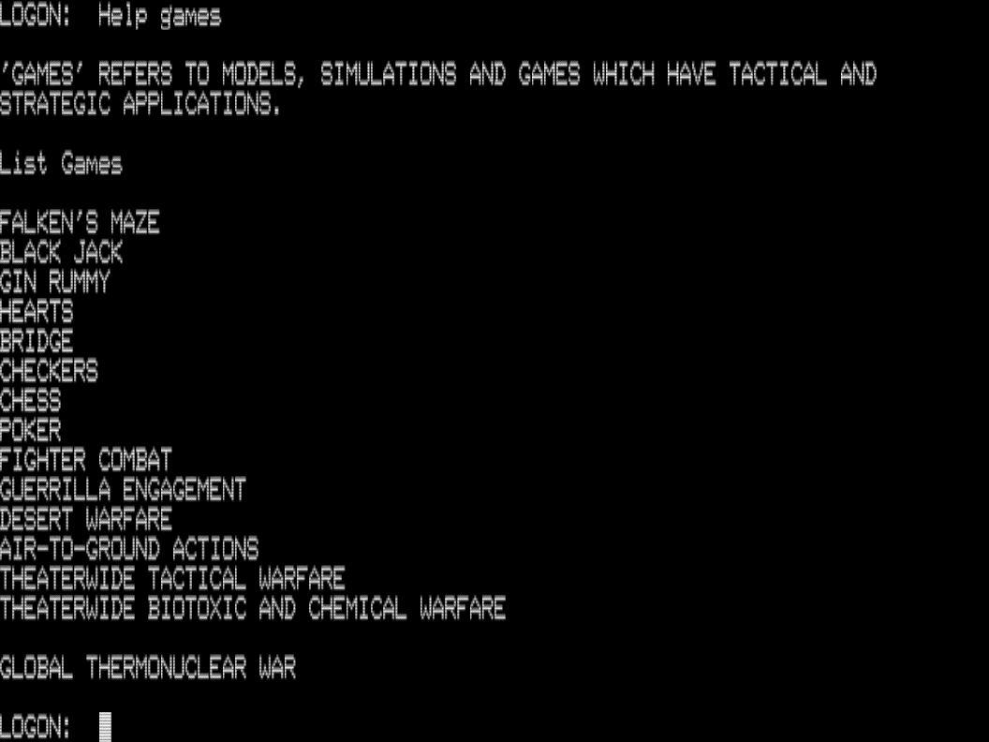

Stage 3 – data security
What if we loose any of the VMs...? Brrr....
Risk assesement – what would be enough for us?
  RAID1 / Mirror – “usually” is enough for a 3 – month time
  Backups – useful ;) RAID / replication are not backups...
  GlusterFS / DRBD – if you have enough resources – try it :)
KVM active host
KVM passive host
LVM
LVM
replication
Gluster brick
Gluster brick

Slide 42
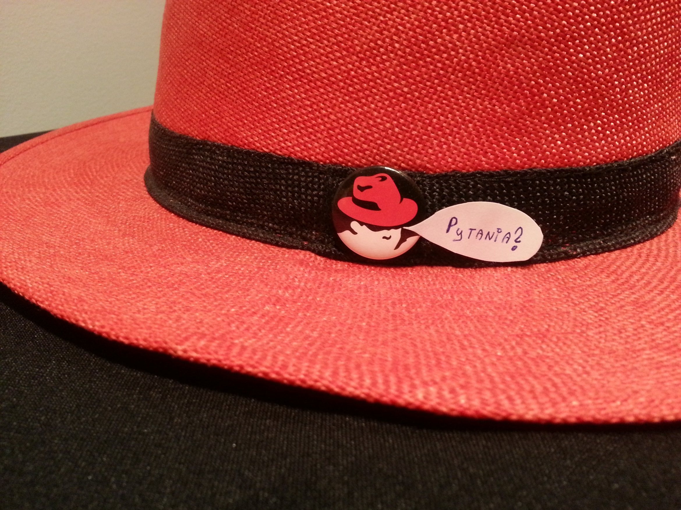
Podsumowanie

Slide 43

Maciej Lasyk
http://maciek.lasyk.info
maciek@lasyk.info
Twitter: @docent_net
OWASP Poland, 2013-10-17

