Slide 1
High Availability Explained
Maciej Lasyk
Kraków, devOPS meetup #2
2014-01-28
Maciej Lasyk, High Availability Explained
1/14

Slide 2

“Anything that can go wrong, will go wrong”
Murphy's law
An electrical explosion and fire Saturday at a Houston data
center operated by The Planet has taken the entire facility offline.
The company claimed power to the facility was interrupted when a
transformer exploded. Official reports that three walls were blown
down causing a fire.
Three walls of the electrical equipment room on the first floor
blew several feet from their original position, and the underground
cabling that powers the first floor of H1 was destroyed.
Maciej Lasyk, High Availability Explained
2/14

Slide 3
High Availability is in the eye of the beholder
CEO: we don't loose sales
Sales: we can extend our offer basing on HA level
Accounts managers: we don't upset our customers (that often)
Developers: we can be proud – our services are working ;)
System engineers: we can sleep well (and fsck, we love to!)
Technical support: no calls? Back to WoW then.. ;)
Maciej Lasyk, High Availability Explained
3/14

Slide 4
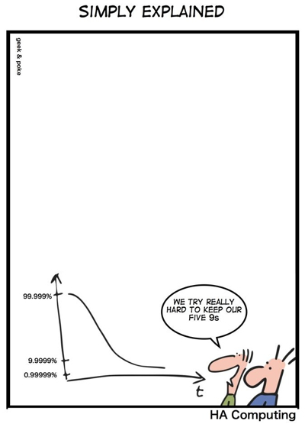
So how many 9's?
Maciej Lasyk, High Availability Explained
4/14

Slide 5
So how many 9's?
Monthly: 1 hour of outage means 100% - 0.13888 ~= 99.86112 of availability
Yearly: 1 hour of outage means 100% - 0.01142 ~= 99.98858 of availability
Availability | Downtime (year) | Downtime (month)
90% (“one nine”) | 36.5 days | 72 hours
95% | 18.25 days | 36 hours
97% | 10.96 days | 21.6 hours
98% | 7.30 days | 14.4 hours
99% (“two nines”) | 3.65 days | 7.2 hours
99.5% | 1.83 days | 3.6 hours
99.8% | 17.52 hours | 86.23 minutes
99.9% (“three nines”) | 4.38 hours | 21.56 minutes
99.99 (“four nines”) | 52.56 minutes | 4.32 minutes
99.999 (“five nines”) | 5.26 minutes | 25.9 seconds
Maciej Lasyk, High Availability Explained
4/14

Slide 6
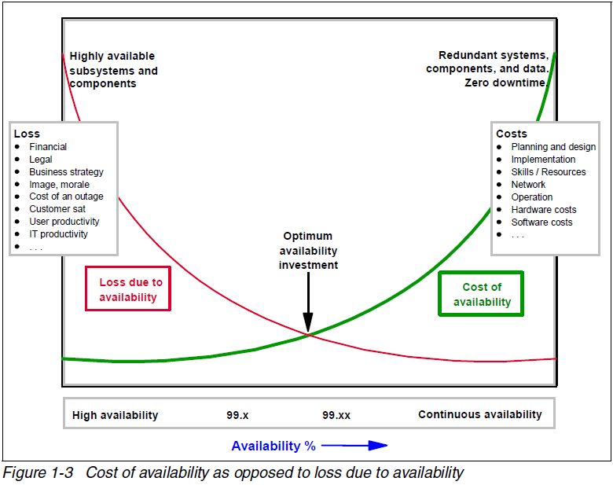
So how many 9's?
https://jazz.net/wiki/bin/view/Deployment/HighAvailability
Maciej Lasyk, High Availability Explained
4/14

Slide 7

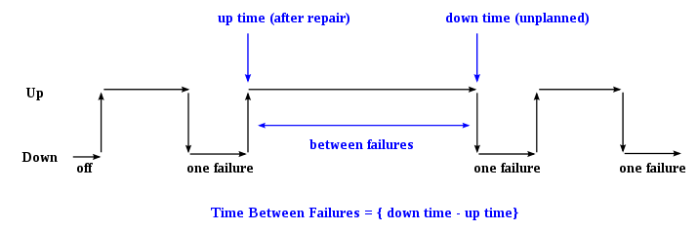
HA terminology
RPO: Recovery Point Objective; how much data can we loose?
RTO: Recovery Time Objective; how long does it take to recover?
MTBF: Mean-Times-Between-Failures; time between failures
(density fnc -> reliability fnc)
https://en.wikipedia.org/wiki/Mean_time_between_failures
Maciej Lasyk, High Availability Explained
5/14

Slide 8
HA terminology
SLA: Service Level Agreement;
formal definitions (customer <-> provider)
OLA: Operational Level Agreement; definitions within organization;
help us keeping provided SLAs
Maciej Lasyk, High Availability Explained
5/14

Slide 9
SLAs..
So what is written in SLAs?
Availability | Downtime (year) | Downtime (month)
90% | 36.5 days | 72 hours
95% | 18.25 days | 36 hours
97% | 10.96 days | 21.6 hours
98% | 7.30 days | 14.4 hours
99% | 3.65 days | 7.2 hours
99.5% (EC2, EBS) | 1.83 days | 3.6 hours
99.8% | 17.52 hours | 86.23 minutes
99.9% (SoftLayer, IBM) | 4.38 hours | 21.56 minutes
99.99 | 52.56 minutes | 4.32 minutes
99.999 | 5.26 minutes | 25.9 seconds
http://aws.amazon.com/ec2/sla/
http://www.softlayer.com/about/service-level-agreement
Maciej Lasyk, High Availability Explained
5/14

Slide 10
SLAs..
Availability mentioned in SLAs are only goals of service provider
Usually when it's not met than company pays off the fees
Maciej Lasyk, High Availability Explained
5/14

Slide 11
How deep is this hole?
app layer (core, db, cache)
data storage
operating system
hardware
networking
location
So we would like to achieve 99,9999% which is about 30s of downtime per year
Maciej Lasyk, High Availability Explained
6/14

Slide 12
How deep is this hole?
app layer (core, db, cache)
data storage
operating system
hardware
networking
location
Even Proof of Concept is very hard to provide: 5s of downtime per layer yearly!
Maciej Lasyk, High Availability Explained
6/14

Slide 13
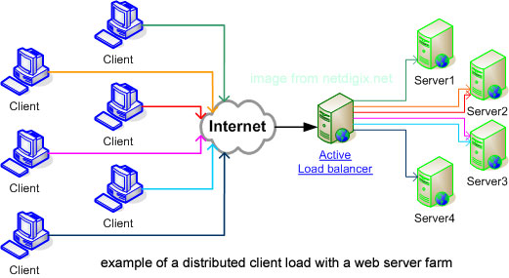
Load-balancing and failover
LB:
http://www.netdigix.com/linux-loadbalancing.php
Maciej Lasyk, High Availability Explained
7/14

Slide 14
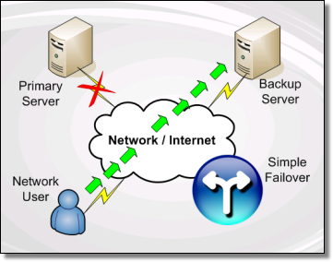
Load-balancing and failover
Failover:
http://www.simplefailover.com/
Maciej Lasyk, High Availability Explained
7/14

Slide 15
LB – 4th layer or 7th?
4th layer:
- high performance
- just do the LB work!
- reliable
- scalable
7th layer:
- low cost
- good for quickfixes / patches
- not that scalable
- low performance
- complex codebase
- custom code for protocols
- cookies? what about memcache..
Maciej Lasyk, High Availability Explained
8/14

Slide 16

Disaster Recovery
Maciej Lasyk, High Availability Explained
9/14

Slide 17
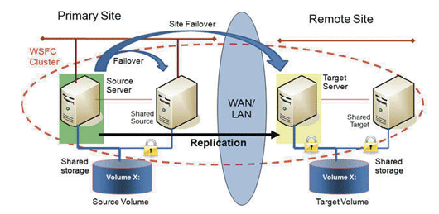
Disaster Recovery
http://disasterrecovery.starwindsoftware.com/planning-disaster-recovery-for-virtualized-environments
Hot site: active synchronization, could be serving services. Cost can be high
Warm site: periodical synchronization, DR tests needed. Low costs
Cold site: Nothing here – just echo and some place to spin services; nightmare
Maciej Lasyk, High Availability Explained
9/14

Slide 18
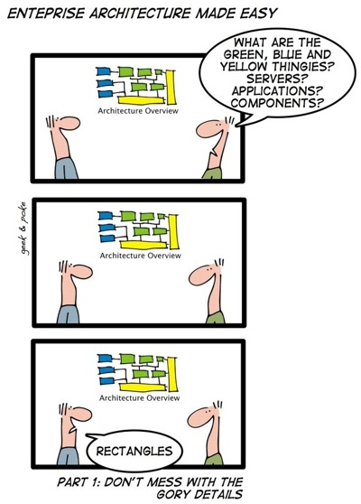
Planning for failure
Maciej Lasyk, High Availability Explained
10/14

Slide 19
Planning for failure
Everything starts here - DNS:
- keep TTLs low (300s). Can't make under 60min? That's bad!
- check SLA of DNS servers (dnsmadeeasy.com history)
- what do you know about DNSes?
- zero downtime here is a must!
- this can be achieved with complicated network abracadabra
- remember what 99.9999% means?
- round robin is a load – balancer but without failover!
- GSLB – killed by OS/browser/srvs cache'ing
(GlobalServerLoadBalancing)
- GlobalIP (SoftLayer etc) – workaround for GSLB via routing
Maciej Lasyk, High Availability Explained
10/14

Slide 20
Planning for failure
E-mail servers:
- it's simple as MX records (delivering)
- it's almost simple as complicated system of SMTP servers (sending)
- it's not that simple when IMAP locking over DFS (reading)
5 gmail-smtp-in.l.google.com.
10 alt1.gmail-smtp-in.l.google.com.
20 alt2.gmail-smtp-in.l.google.com.
30 alt3.gmail-smtp-in.l.google.com.
40 alt4.gmail-smtp-in.l.google.com.
When MXing – watch the spam!
Maciej Lasyk, High Availability Explained
10/14

Slide 21
Planning for failure
WEB servers:
- it's simple as some frontend loadbalancer
- did you really stick user session to particular server? Memcache!
- LB balancing algorithm
- how many Lbs?
- what if LB goes down?
Maciej Lasyk, High Availability Explained
10/14

Slide 22
Planning for failure
DB servers:
- it's.. not that simple
- replication (master – master? App should be aware..)
- replication ring? Complicated, works, but in case of failure...
- let's talk about MySQL:
- NoSPOF solution: MySQL cluster
- MySQL Galera cluster – synch, active-active multi-master
- master – master – simply works
- Failover? Matsunobu Yoshinori mysql-master-ha
- MySQL utilities (http://www.clusterdb.com/mysql/mysql-utilities-webinar-qa-replay-now-available/)
Maciej Lasyk, High Availability Explained
10/14

Slide 23
Planning for failure
Caching servers:
- this is cache for God's sake – why would we use HA here?
- just use proper architecture like... redundancy.
Load – balancers:
- remember about failovering IP addresses!
Storage – DFSes:
- GlusterFS – we'll see it in action in a minute
- NFS? Could be – over some SAN / NAS (high cost solution)
- CephFS – just like GlusterFS – it's great and does the work
- DRBD – lower level, does the work on block – device layer – slow...
Maciej Lasyk, High Availability Explained
10/14

Slide 24
Planning for failure
GlusterFS:
- low cost (could be..)
- distributed volumes
- replicated volumes
- striped volumes
- and...
- distributed – striped volumes
- distributed – replicated volumes
- distributed – striped – replicated volumes
- sound good? :)
Maciej Lasyk, High Availability Explained
10/14

Slide 25
Planning for failure
GlusterFS: replicated volumes vs Geo-replication
- replicated:
- mirrors data
- provides HA
- synch – replication
- Geo-replication:
- mirrors data across geo – distributed clusters
- ensures backing up data for DR
- asynch – replica (periodic checks)
Maciej Lasyk, High Availability Explained
10/14

Slide 26
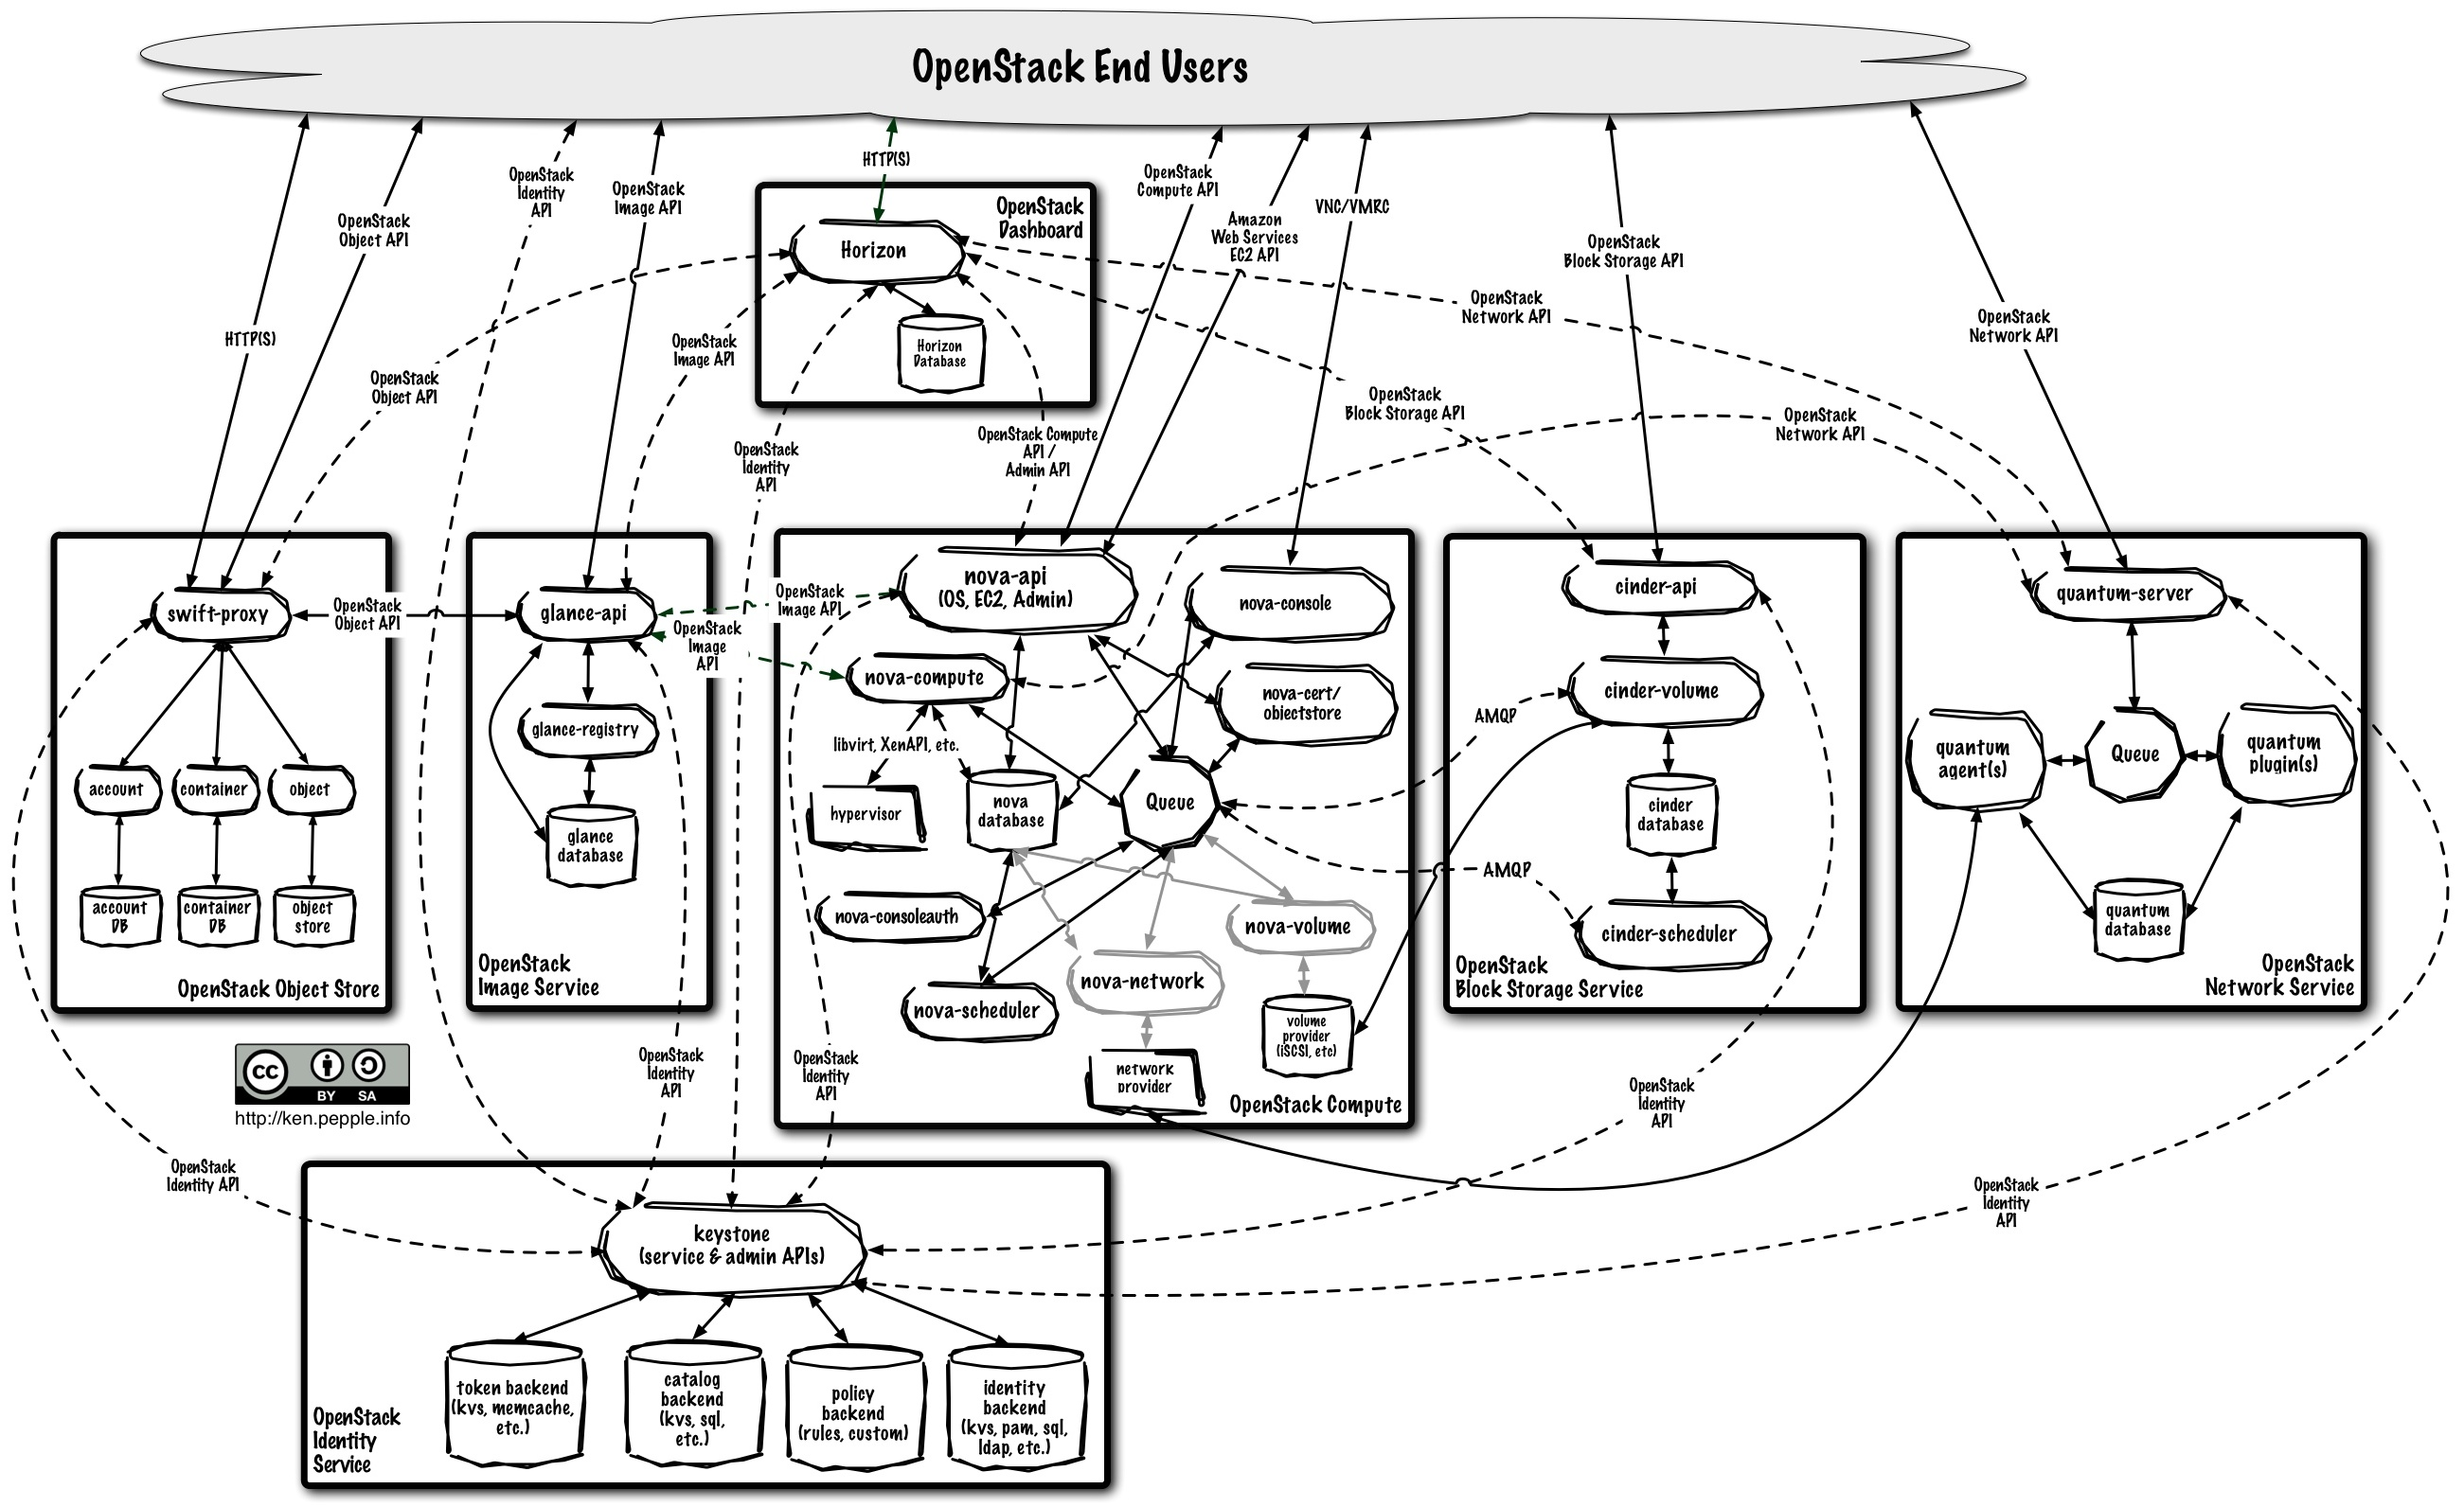
Planning for failure
HA for virtualization solutions?
- it's really complicated, like...
Maciej Lasyk, High Availability Explained
11/14

Slide 27
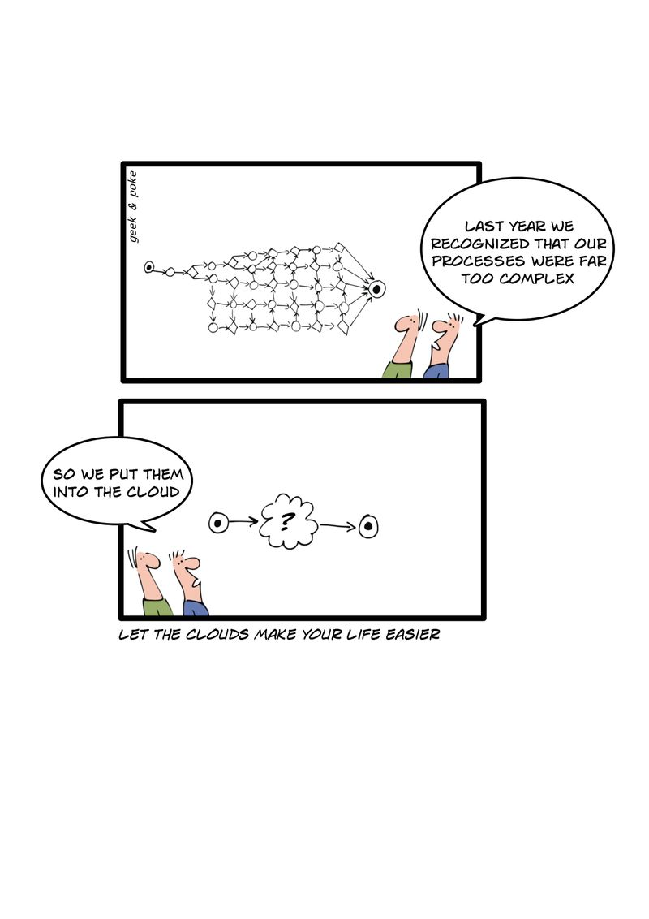

Tools
The most important tool would be the conclusion from the picture below:
Maciej Lasyk, High Availability Explained
12/14

Slide 28
Tools
- DNS: roundrobin, GSLB, low ttls, globalIP
- Load-Balancers (l7, stateless services)): HaProxy, Pound, Nginx
- Failover (statefull services):
- IP: KeepAlived + sysctl
- Managing: pacemaker (manager) + corosync (message'ing)
- (almost) All-In-One: Linux Virtual Server
Maciej Lasyk, High Availability Explained
12/14

Slide 29
Turn on HA thinking!
Main goal of HA? Improve user experience!
- keep the app fully functional
- keep the app resistant and tolerant to faults
- provide method for a successful audit
- sleep well (anyone awake?) ;)
Maciej Lasyk, High Availability Explained
13/14

Slide 30
Thank you :)
High Availability Explained
Maciej Lasyk
Kraków, devOPS meetup #2
2014-01-28
http://maciek.lasyk.info/sysop
maciek@lasyk.info
@docent-net
Maciej Lasyk, High Availability Explained
14/14

