Slide 1
RHEL/Fedora + Docker
Maciej Lasyk
Kraków, devOPS meetup #3
2014-02-26
Maciej Lasyk, RHEL + Docker
1/14

Slide 2
Google + Docker + Fedora?
Maciej Lasyk, RHEL + Docker
2/16

Slide 3
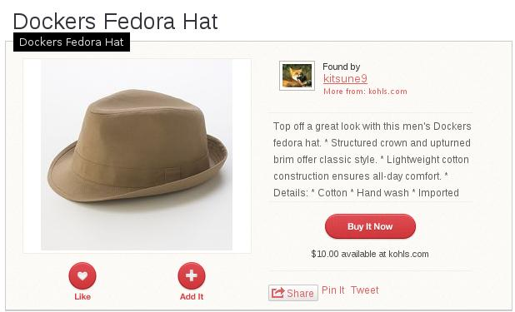
Google + Docker + Fedora?
Maciej Lasyk, RHEL + Docker
2/16

Slide 4
Google + Docker + Fedora?
We won't talk about this :)
Maciej Lasyk, RHEL + Docker
2/16

Slide 5
So.. why Docker?
Maciej Lasyk, RHEL + Docker
3/16

Slide 6
So.. why Docker?
Looking for some dev-env..
Maciej Lasyk, RHEL + Docker
3/16

Slide 7
So.. why Docker?
Looking for some dev-env..
What about XEN/KVM/Virtualbox?
Maciej Lasyk, RHEL + Docker
3/16

Slide 8
So.. why Docker?
Looking for some dev-env..
What about XEN/KVM/Virtualbox?
So if looking for lightweight solution – why not LXC?
Maciej Lasyk, RHEL + Docker
3/16

Slide 9
So.. why Docker?
Looking for some dev-env..
What about XEN/KVM/Virtualbox?
So if looking for lightweight solution – why not LXC?
Answer is simple – LXC is sitting on lower level
And also – it need more sysop work
Docker just works – it's simpler so devs are :)
Read this for more: http://stackoverflow.com/questions/17989306/what-does-docker-add-to-just-plain-lxc
Maciej Lasyk, RHEL + Docker
3/16

Slide 10
So.. why RHEL/Fedora?
Maciej Lasyk, RHEL + Docker
4/16

Slide 11

So.. why RHEL/Fedora?
Maciej Lasyk, RHEL + Docker
4/16

Slide 12
So.. why RHEL/Fedora?
No it's not about flame ;)
Maciej Lasyk, RHEL + Docker
4/16

Slide 13
So.. why RHEL/Fedora?
No it's not about flame ;)
RHEL (CentOS) just does the job like Ubuntu / Debian / Gentoo...
Maciej Lasyk, RHEL + Docker
4/16

Slide 14
So.. why RHEL/Fedora?
No it's not about flame ;)
RHEL (CentOS) just does the job like Ubuntu / Debian / Gentoo...
Oh maybe in a more mature & stable & secure way
Maciej Lasyk, RHEL + Docker
4/16

Slide 15
So.. why RHEL/Fedora?
No it's not about flame ;)
RHEL (CentOS) just does the job like Ubuntu / Debian / Gentoo...
Oh maybe in a more mature & stable & secure way
CVE-2014-0038 & https://github.com/saelo/cve-2014-0038
“Red Hat has previously been paged by its users to enable x32
support in Fedora 18; however, it refused to include it, citing
security concerns.
It affects every user by potentially exposing them to as-yet-
unfound security bugs for zero gain," Red Hat kernel developer
Dave Jones said at the time.
"In addition to this, it increases the potential attack surface for all
users, 99.9 percent of which will never even use this feature unless we
enable it for additional packages."
Maciej Lasyk, RHEL + Docker
4/16

Slide 16
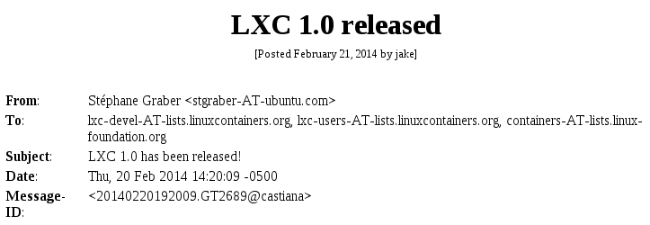
Maciej Lasyk, RHEL + Docker
5/16

Slide 17
Unprivileged containers - we should talk about it @Infosec
More important – ready for production!
Maciej Lasyk, RHEL + Docker
5/16

Slide 18
A little bit of Fedora/RHEL + Docker history
Fedora/RHEL:
first request: 2013-08-23
rls: 2013-11-28/docker-io-0.7.0-6.fc20 (Fedora + EPEL 6)
https://bugzilla.redhat.com/show_bug.cgi?id=1000662
Maciej Lasyk, RHEL + Docker
6/16

Slide 19
A little bit of Fedora/RHEL + Docker history
Fedora/RHEL:
first request: 2013-08-23
rls: 2013-11-28/docker-io-0.7.0-6.fc20 (Fedora + EPEL 6)
https://bugzilla.redhat.com/show_bug.cgi?id=1000662
What had to be done?
AUFS replacement with device-mapper (SELinux)
libvirt-lxc in order to integrate with libvirt
Openshift integration (RHEL PaaS)
http://blog.docker.io/2013/09/red-hat-and-docker-collaborate/
Maciej Lasyk, RHEL + Docker
6/16

Slide 20
Current status of Docker / RHEL / Fedora
Maciej Lasyk, RHEL + Docker
7/16

Slide 21
Current status of Docker / RHEL / Fedora
Fedora 19/20/RawHide + Epel 6:
lxc-0.9.0-2.fc20.x86_64
docker-io-0.8.0-3.fc20.x86_64
https://github.com/dotcloud/docker
v.0.8.1
https://github.com/lxc/lxc
lxc-1.0.0
Maciej Lasyk, RHEL + Docker
7/16

Slide 22
Quickstart
Maciej Lasyk, RHEL + Docker
8/16

Slide 23
Quickstart
if (centos || rhel):
install_epel_repo()
yum -y install docker-io
systemctl enable docker || chkconfig –add docker
systemctl start docker || chkconfig –add docker
docker pull mattdm/fedora
docker run -t -i mattdm/fedora /bin/bash
Maciej Lasyk, RHEL + Docker
8/16

Slide 24
Fedora Dockerfiles
https://git.fedorahosted.org/cgit/dockerfiles.git/tree/
https://github.com/scollier/Fedora-Dockerfiles
What's there?
apache,couchdb,firefox,hadoop,memcached,
mongodb,mysql,nginx,nodejs,postgresql,rabbitmq,
ssh,wordpress
Maciej Lasyk, RHEL + Docker
9/16

Slide 25
Fedora Dockerfiles
https://git.fedorahosted.org/cgit/dockerfiles.git/tree/
https://github.com/scollier/Fedora-Dockerfiles
What's there?
apache,couchdb,firefox,hadoop,memcached,
mongodb,mysql,nginx,nodejs,postgresql,rabbitmq,
ssh,wordpress
Installation:
docker build -rm -t docent/nginx \
git://github.com/scollier/dockerfiles-fedora-nginx.git
or just download Dockerfile and docker build .
Maciej Lasyk, RHEL + Docker
9/16

Slide 26
Fedora Dockerfiles
https://git.fedorahosted.org/cgit/dockerfiles.git/tree/
https://github.com/scollier/Fedora-Dockerfiles
What's there?
apache,couchdb,firefox,hadoop,memcached,
mongodb,mysql,nginx,nodejs,postgresql,rabbitmq,
ssh,wordpress
Installation:
docker build -rm -t docent/nginx \
git://github.com/scollier/dockerfiles-fedora-nginx.git
or just download Dockerfile and docker build .
Trusted builds (index accounts linked with GitHub)
Maciej Lasyk, RHEL + Docker
9/16

Slide 27
Docker / Fedora / JBoss
It's all about Dockerfile...
Maciej Lasyk, RHEL + Docker
10/16

Slide 28
Docker / Fedora / JBoss
It's all about Dockerfile...
FROM mattdm/fedora
RUN yum install -y jboss-as
ENTRYPOINT /usr/share/jboss-as/bin/launch.sh \
standalone standalone.xml 0.0.0.0
Maciej Lasyk, RHEL + Docker
10/16

Slide 29
Docker / Fedora / JBoss
It's all about Dockerfile...
FROM mattdm/fedora
RUN yum install -y jboss-as
ENTRYPOINT /usr/share/jboss-as/bin/launch.sh \
standalone standalone.xml 0.0.0.0
than just:
JBOSS_DOCKER=$(docker build -t my_freakin_jboss .)
docker run -i -t $JBOSS_DOCKER
Maciej Lasyk, RHEL + Docker
10/16

Slide 30

https://asciinema.org/a/7912
Maciej Lasyk, RHEL + Docker
11/16

Slide 31
Internal docker registry / shipyard
So we'd like to host our own registry
https://github.com/dotcloud/docker-registry
yum install docker-registry (epel: 0.6.3, github 0.6.5)
Maciej Lasyk, RHEL + Docker
12/16

Slide 32
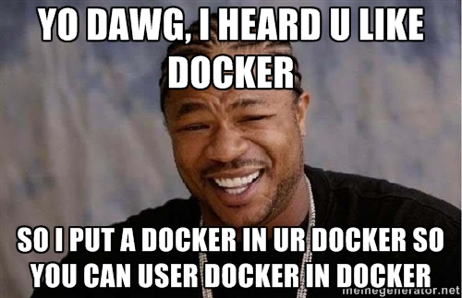
Internal docker registry / shipyard
So we'd like to host our own registry
https://github.com/dotcloud/docker-registry
yum install docker-registry (epel: 0.6.3, github 0.6.5)
or just use this samalba/docker-registry
Maciej Lasyk, RHEL + Docker
12/16

Slide 33
Internal docker registry / shipyard
So we'd like to host our own registry
https://github.com/dotcloud/docker-registry
yum install docker-registry (epel: 0.6.3, github 0.6.5)
or just use this samalba/docker-registry
Collaboration?
docker export internal_registry > internal_registry.tar
gzip internal_registry.tar
mv internal_registry.tar.gz /vagrant
Or simply host it ;)
Maciej Lasyk, RHEL + Docker
12/16

Slide 34
Docker + SELinux
f20 policy: https://git.fedorahosted.org/cgit/selinux-policy.git/tree/docker.te?h=f20-contrib
What's there?
seinfo -t -x | grep docker
sesearch -A -s docker_t (and the rest)
or just unpack docker.pp with semodule_unpackage
Maciej Lasyk, RHEL + Docker
13/16

Slide 35
Docker + SELinux
f20 policy: https://git.fedorahosted.org/cgit/selinux-policy.git/tree/docker.te?h=f20-contrib
What's there?
seinfo -t -x | grep docker
sesearch -A -s docker_t (and the rest)
or just unpack docker.pp with semodule_unpackage
How to use it?
man docker_selinux :)
Maciej Lasyk, RHEL + Docker
13/16

Slide 36
Docker + SELinux
f20 policy: https://git.fedorahosted.org/cgit/selinux-policy.git/tree/docker.te?h=f20-contrib
What's there?
seinfo -t -x | grep docker
sesearch -A -s docker_t (and the rest)
or just unpack docker.pp with semodule_unpackage
How to use it?
man docker_selinux :)
Permissive domains! semanage permissive -a docker_t
It's only in targeted policy (not for MCS)
Maciej Lasyk, RHEL + Docker
13/16

Slide 37

And seriously...
Do you know this guy?
Maciej Lasyk, RHEL + Docker
14/16

Slide 38
And seriously...
Do you know this guy?
So he has something to tell you...
http://www.youtube.com/watch?v=o5snlP8Y5GY
Maciej Lasyk, RHEL + Docker
14/16

Slide 39

Maciej Lasyk, RHEL + Docker
14/16

Slide 40
stopdisablingselinux.com
Maciej Lasyk, RHEL + Docker
15/16

Slide 41
stopdisablingselinux.com
or...
Infosec meetup
Maciej Lasyk, RHEL + Docker
15/16

Slide 42
Thank you :)
RHEL/Fedora + Docker
Maciej Lasyk
Kraków, devOPS meetup #3
2014-02-26
http://maciek.lasyk.info/sysop
maciek@lasyk.info
@docent-net
Maciej Lasyk, RHEL + Docker
16/16

