Slide 1

Stop Disabling SELinux
Maciej Lasyk
Kraków, InfoSec meetup #1
2014-03-12
Maciej Lasyk, Stop Disabling SELinux
1/32
Notes:
test

Slide 2
Does security matter?
Business value and security
Does stock price change after security fail?
Apps or env? Which one should be 'secure'?
Maciej Lasyk, High Availability Explained
2/32
Maciej Lasyk, Stop Disabling SELinux
Notes:
- Czyja praca jest droższa?
- Na jakim etapie rozwoju aplikacji jesteśmy?
- Czy nie łatwiej (i taniej) zastosować rozwiązania po stronie platformy?
- Automatyzacja tworzenia środowisk bardzo ułatwia tworzenie bezpiecznego środowiska
- Ocena ryzyka?

Slide 3

How does security look like?
App
Env
Maciej Lasyk, High Availability Explained
3/32
Maciej Lasyk, Stop Disabling SELinux
Notes:
- scenariusz gdy bezpieczeństwo jest po stronie aplikacji
- czy środowisko faktycznie nie ma znaczenia?
- co wiemy o naszym hostingu?
- czy możemy sobie pozwolić na fakap hostingu?

Slide 4

How does security look like?
Maciej Lasyk, High Availability Explained
4/32
Maciej Lasyk, Stop Disabling SELinux
Notes:
Bezpieczeństwo budujemy warstwowo
Minas Tirith może być nawet naszym AWSem – wtedy koszta TCO wrzucamy w koszta utrzymania serwerów
Jednak co wiemy o sec w hostingu?

Slide 5
How does security look like?
App / DB
Maybe virt-sec?
LSM
OS
Network
Hardware
Security is based on layers!
Maciej Lasyk, High Availability Explained
4/32
Maciej Lasyk, Stop Disabling SELinux
Notes:
To zupełnie tak jak w warstwach OSI
Bezpieczeństwo aplikacji powinno być rozpatrywane krok po kroku na każdej warstwie tworząc zestawienie zagrożeń, ich prawdopodobieństw oraz sensowności wdrożenia

Slide 6

How does security look like?
WOW :)
Such security..
Very fortress!!1
Maciej Lasyk, High Availability Explained
5/32
Maciej Lasyk, Stop Disabling SELinux
Notes:
Osadzenie aplikacji w chmurze może wyglądać w ten sposób właśnie – trzeba uważać na złudność, bo nie wszystko musi być przemyślane
Jednak pamiętajmy o wektorach ataku nie przemyślanych w tym zestawieniu
Nadal trzeba przemyśleć sec na każdej wartswie

Slide 7
SELinux – what?
Think about it as an internal firewall
Guarding procs, files, users
Users don't manage security, admin does
Maciej Lasyk, High Availability Explained
6/32
Maciej Lasyk, Stop Disabling SELinux
Notes:
To jest właśnie MAC (Mandatory Access Control) – jest globalna polityka stworzona przez administratora bezpieczeństwa

Slide 8
SELinux – short history recap
- 2000: NSA, GPL
- 2001: Linux Kernel Summit, NSA vs Linus, LSM announced
(SELinux, Apparmor, Smack, and TOMOYO Linux)
- 2003: Merge with mainline Kernel 2.6.0-test3
- RHEL4
- Ubuntu LTS 8.04 Hardy Heron & rest (even Novell)
Maciej Lasyk, High Availability Explained
7/32
Maciej Lasyk, Stop Disabling SELinux

Slide 9
SELinux – use cases
- hosting multiple services on one box / vps
- virtualization host (imagine containers)
- libvirt-sandbox FTW!
- any apps that are not secure or sec – aware
- SELinux sandbox
- root access for anyone :)
- DBAs, devs - whatever :)
- try it yourself: http://www.coker.com.au/selinux/play.html
- Gentoo Hardened: https://wiki.gentoo.org/wiki/Project:Hardened
- Desktops (yes!)
Maciej Lasyk, High Availability Explained
8/32
Maciej Lasyk, Stop Disabling SELinux

Slide 10
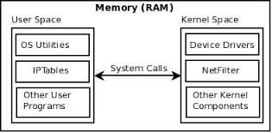
SELinux – how it works?
syscalls work like interfaces for accessing some resources
Maciej Lasyk, High Availability Explained
9/32
Maciej Lasyk, Stop Disabling SELinux
Notes:
Aplikacja działa w wydzielonym bloku pamięci virtualnej
Aplikacja może się komunikować z inną np. Za pomocą pamięci współdzielonej
Jednak jedyny sposób na dostanie się do kernel-space'a i zapytanie o zasoby zewnętrzne -> syscall
Syscall nie jest funkcją per-se; to raczej procedura, która wykonuje po drodze wiele sprawdzeń

Slide 11
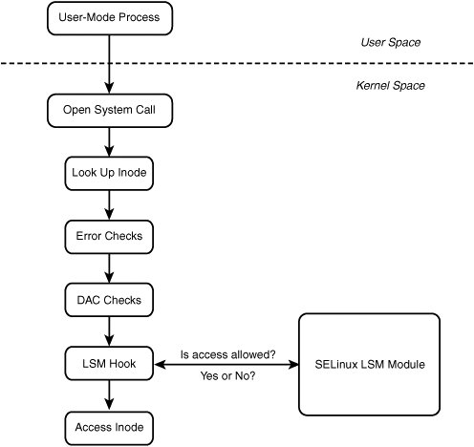
SELinux – how it works?
Maciej Lasyk, High Availability Explained
10/32
Maciej Lasyk, Stop Disabling SELinux

Slide 12
SELinux – how it works?
MAC
upstream kernel has been fixed to report
check for mmap_zero for MAC AFTER DAC
(2014-03-05, http://danwalsh.livejournal.com/69035.html)
DAC
Maciej Lasyk, High Availability Explained
11/32
Maciej Lasyk, Stop Disabling SELinux

Slide 13
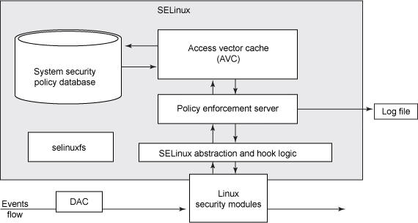
SELinux – how it works?
Maciej Lasyk, High Availability Explained
12/32
Maciej Lasyk, Stop Disabling SELinux

Slide 14
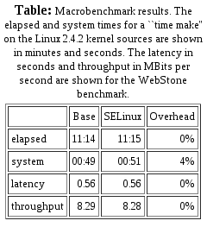
SELinux – performance
- http://www.nsa.gov/research/_files/selinux/papers/freenix01/node18.shtml#sec:perf:macro
avcstat
uptime: 10h
hit ratio: 99.94%!
(57mln of lookups)
Just test it yourself: git://git.selinuxproject.org/~serge/selinux-testsuite
Maciej Lasyk, High Availability Explained
13/32
Maciej Lasyk, Stop Disabling SELinux
Notes:
Stop reading tests – just test it yourself, because every env, every policy works different
AVC means cache! It's really fast though it has some restrictions

Slide 15
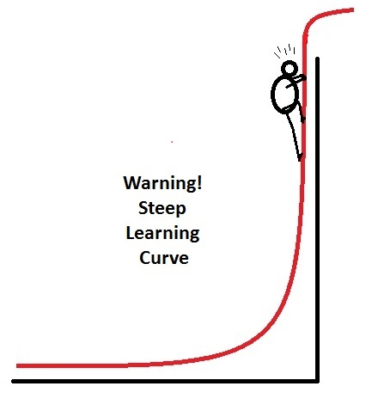
SELinux – learning curve
Maciej Lasyk, High Availability Explained
14/32
Maciej Lasyk, Stop Disabling SELinux
Notes:
Just sit and learn. Profit for many years

Slide 16
SELinux – installation
apt-get install selinux-basics selinux-policy-default auditd
Gentoo is.. like always – little complicated..
emerge hardened-sources
EC2? yum install libselinux* selinux-policy* policycoreutils
RHEL / CentOS / Fedora is rdy
11/32
Maciej Lasyk, High Availability Explained
15/32
Maciej Lasyk, Stop Disabling SELinux

Slide 17
SELinux – need assistance?
- IRC: freenode, #selinux
- Mailing list: selinux@lists.fedoraproject.org
- URLs:
- http://stopdisablingselinux.com/
- http://www.nsa.gov/research/selinux/faqs.shtml
- https://fedoraproject.org/wiki/SELinux
- Books?
- SELinux System Administration, Sven Vermeulen,
2013, ISBN-10: 1783283173 ($15)
- SELinux by Example: Using Security Enhanced Linux,
Frank Mayer, Karl MacMillan,
David Caplan, 2006,
ISBN-10: 0131963694
Maciej Lasyk, High Availability Explained
16/32
Maciej Lasyk, Stop Disabling SELinux

Slide 18

SELinux and Android
- from 4.3 – permissive
- from 4.4 enforcing
- Will help us with BYOD :)
- No setuid/setgid programs (4.3)
http://selinuxproject.org/page/SEAndroid
http://source.android.com/devices/tech/security/se-linux.html
Maciej Lasyk, High Availability Explained
17/32
Maciej Lasyk, Stop Disabling SELinux
Notes:
Czym jest permissive a czym enforcing?

Slide 19
libvirt-sandbox!
- Currently RPM based (but could build from sources)
- Sandboxes for LXC / Qemu / KVM
- Rather with systemd
- virt-sandbox -c lxc:/// /bin/sh
- virt-sandbox-service create ... httpd.service myhttpd
- systemctl start myhttpd_sandbox.service
Maciej Lasyk, High Availability Explained
18/32
Maciej Lasyk, Stop Disabling SELinux

Slide 20
libvirt-sandbox!
- The libvirt guest is created when the virt-sandbox command starts
- The libvirt guest is automatically deleted when the virt-sandbox
command completes, or dies from a signal
- The sandboxed command sees a read-only view of the entire host
filesystem
- Specific areas can be made writable by mapping in an alternative
host directory
- There is no network access inside the sandbox by default
- Virtual network interfaces can be associated with libvirt virtual
networks
- The stdin/stdout/stderr file handles of the sandbox command
will be connected to the controlling terminal.
Maciej Lasyk, High Availability Explained
19/32
Maciej Lasyk, Stop Disabling SELinux

Slide 21
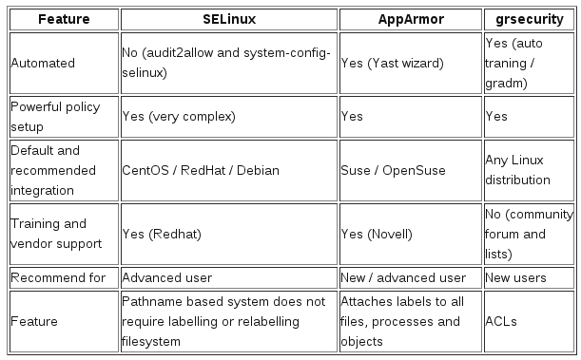
So what about other LSMs?
http://www.cyberciti.biz/tips/selinux-vs-apparmor-vs-grsecurity.html
Maciej Lasyk, High Availability Explained
20/32
Maciej Lasyk, Stop Disabling SELinux
Notes:
Yes, SELinux could work with grSec/PaX – like in Gentoo Hardened

Slide 22
So what about other LSMs?
- AppArmor identifies file system objects by path name
instead of inode
- There is no notion of multi-level security with AppArmor
- AppArmor user rather flat files based configuration
- SELinux supports the concept of a "remote policy server"
- There is no apparmor or grsec in android :)
Maciej Lasyk, High Availability Explained
21/32
Maciej Lasyk, Stop Disabling SELinux

Slide 23
SELinux primer
stopdisablingselinux.com
or
http://opensource.com/business/13/11/selinux-policy-guide
Maciej Lasyk, High Availability Explained
22/32
Maciej Lasyk, Stop Disabling SELinux

Slide 24
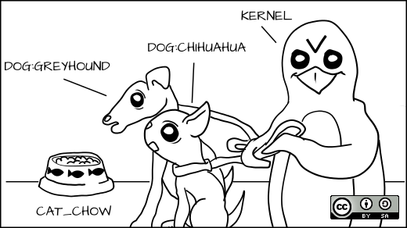
SELinux primer
Everyone gets a label!
Maciej Lasyk, High Availability Explained
23/32
Maciej Lasyk, Stop Disabling SELinux

Slide 25
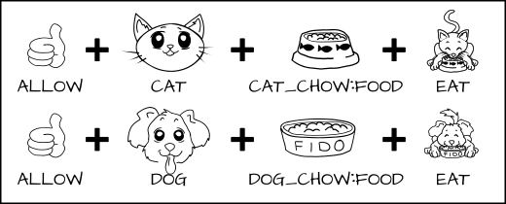
SELinux primer
allow cat cat_chow:food eat;
allow dog dog_chow:food eat;
Maciej Lasyk, High Availability Explained
24/32
Maciej Lasyk, Stop Disabling SELinux

Slide 26
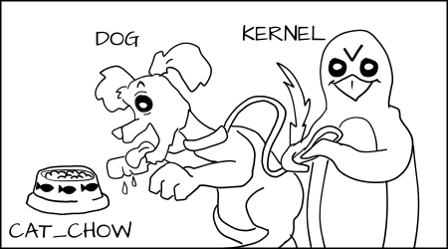
SELinux primer
AVC (Access Vector Cache)
Maciej Lasyk, High Availability Explained
25/32
Maciej Lasyk, Stop Disabling SELinux

Slide 27
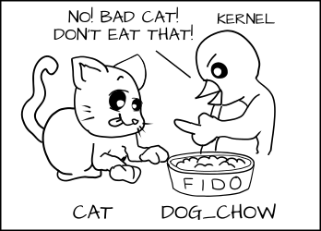
SELinux primer
AVC (Access Vector Cache)
Maciej Lasyk, High Availability Explained
26/32
Maciej Lasyk, Stop Disabling SELinux

Slide 28
SELinux primer
In real world...
process: httpd_t
files under Apache: httpd_sys_content_t
database data: mysqld_data_t
hacked Apache process can not access mysqld files!
Maciej Lasyk, High Availability Explained
27/32
Maciej Lasyk, Stop Disabling SELinux

Slide 29
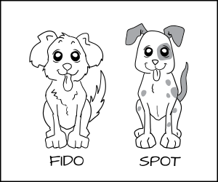

SELinux primer
Can same type of process be confined differently?
Maciej Lasyk, High Availability Explained
28/32
Maciej Lasyk, Stop Disabling SELinux

Slide 30
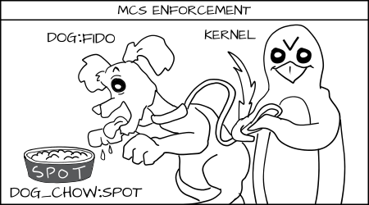
SELinux primer
Yes! With MCS enforcement!
Maciej Lasyk, High Availability Explained
29/32
Maciej Lasyk, Stop Disabling SELinux
Notes:
MCS – Multi Category System
Sensitivity Levels
Categories

Slide 31
SELinux primer
In real world...
2 processes: httpd_t
files under httpd: httpd_sys_content_t
So how to deny files from differ instances of httpd_t?
With MCS labels like s0:c1,c2 ; s0:c3,c4 etc
s0, s1, s2 – sensitivity levels
c1,c2,c3... - categories (up to 255)
Maciej Lasyk, High Availability Explained
30/32
Maciej Lasyk, Stop Disabling SELinux

Slide 32
So remember..
Every time you run setenforce 0, you make Dan Walsh
weep
Dan is a nice guy and he certainly doesn't deserve that.
Maciej Lasyk, High Availability Explained
31/32
Maciej Lasyk, Stop Disabling SELinux

Slide 33
Thank you :)
Stop Disabling SELinux
Maciej Lasyk
Kraków, InfoSec meetup #1
2014-03-12
http://maciek.lasyk.info/sysop
maciek@lasyk.info
@docent-net
Maciej Lasyk, High Availability Explained
32/32

