Slide 1

node.js security
Maciej Lasyk
SEConference
Kraków, 2014-05-09
Maciej Lasyk, node.js security

Slide 2
Sysadmin about node.js security?
- not only sysadmin ;)
- node needs thorough understanding of whole infra
- 14+ years of exp software dev. / sysop
- currently “noding” 4 prv & Fedora
3/25
Maciej Lasyk, Ganglia & Nagios
1/25
Maciej Lasyk, node.js security
Maciej Lasyk, node.js security

Slide 3
JS security recap – evals & co
eval() like fncs takes string argument and
evalute those as source code
3/25
Maciej Lasyk, Ganglia & Nagios
1/25
Maciej Lasyk, node.js security
Maciej Lasyk, node.js security

Slide 4
JS security recap – evals & co
eval() like fncs takes string argument and
evalute those as source code
srsly – who does that?
3/25
Maciej Lasyk, Ganglia & Nagios
1/25
Maciej Lasyk, node.js security
Maciej Lasyk, node.js security

Slide 5
JS security recap – evals & co
var x = req.body.x;
var y = req.body.y;
var sum = eval(a + "+" + b);
3/25
Maciej Lasyk, Ganglia & Nagios
1/25
Maciej Lasyk, node.js security
Maciej Lasyk, node.js security

Slide 6
JS security recap – evals & co
var x = req.body.x;
var y = req.body.y;
var sum = eval(a + "+" + b);
what if attacker fills 'x' with:
some.super.class.wipe.the.database('now');
LOL :)
3/25
Maciej Lasyk, Ganglia & Nagios
1/25
Maciej Lasyk, node.js security
Maciej Lasyk, node.js security

Slide 7
JS security recap – evals & co
not only evals:
setInterval(code,2)
setTimeout(code,2)
str = new Function(code)
Chrome CSP denies those also :)
3/25
Maciej Lasyk, Ganglia & Nagios
1/25
Maciej Lasyk, node.js security
Maciej Lasyk, node.js security

Slide 8
JS security recap – global namespace pollution
- node.js is single threaded
- all variable values are common
- one could thrtically change bhv of others reqs
- watch out for globals then!
3/25
Maciej Lasyk, Ganglia & Nagios
1/25
Maciej Lasyk, node.js security
Maciej Lasyk, node.js security

Slide 9
JS security recap – global namespace pollution
some very awful example:
var auth = false;
app.get('/auth', function(req, res) {
if(legit) { auth = true; res.send("success");
});
app.get('/payments-db', function(req, res) {
if (auth) res.send("legit to see all payments data");
else res.send("not logged in");
})
app.listen(8080);
3/25
Maciej Lasyk, Ganglia & Nagios
1/25
Maciej Lasyk, node.js security
Maciej Lasyk, node.js security

Slide 10
JS security recap – global namespace pollution
So now imagine..
global namespace pollution + evals & co
3/25
Maciej Lasyk, Ganglia & Nagios
1/25
Maciej Lasyk, node.js security
Maciej Lasyk, node.js security

Slide 11

JS security recap – global namespace pollution
So now imagine..
global namespace pollution + evals & co
3/25
Maciej Lasyk, Ganglia & Nagios
1/25
Maciej Lasyk, node.js security
Maciej Lasyk, node.js security

Slide 12
JS security recap – global namespace pollution
So now imagine..
global namespace pollution + evals & co
Watch out who you are hiring
3/25
Maciej Lasyk, Ganglia & Nagios
1/25
Maciej Lasyk, node.js security
Maciej Lasyk, node.js security

Slide 13
JS security recap – strict mode
- let's throw all errors!
- declare variables!
- global namespaces help
3/25
Maciej Lasyk, Ganglia & Nagios
1/25
Maciej Lasyk, node.js security
Maciej Lasyk, node.js security

Slide 14
JS security recap – strict mode
"use strict";
function testFunction(){
var testvar = 4;
return testvar;
}
// This causes a syntax error.
testvar = 5;
3/25
Maciej Lasyk, Ganglia & Nagios
1/25
Maciej Lasyk, node.js security
Maciej Lasyk, node.js security

Slide 15
JS security recap – strict mode
// This causes a syntax error:
"use strict";
testvar = 5;
// This is ok:
"use strict";
var testvar = 0;
testvar = 5;
3/25
Maciej Lasyk, Ganglia & Nagios
1/25
Maciej Lasyk, node.js security
Maciej Lasyk, node.js security

Slide 16
JS security recap – strict mode
- evals & co are not that insecure now
- no access to caller and args props
- enable globally or for some scope
- what about strict mode in 3rd party mods?
3/25
Maciej Lasyk, Ganglia & Nagios
1/25
Maciej Lasyk, node.js security
Maciej Lasyk, node.js security

Slide 17
JS security recap – strict mode
"use strict";
function do_smt() {
do_smt.caller; // no way :)
do_smt.arguments; // no way :)
}
3/25
Maciej Lasyk, Ganglia & Nagios
1/25
Maciej Lasyk, node.js security
Maciej Lasyk, node.js security

Slide 18
JS security recap – strict mode
"use strict";
eval("var smt = 123");
console.log(smt); // sorry – ReferenceError
3/25
Maciej Lasyk, Ganglia & Nagios
1/25
Maciej Lasyk, node.js security
Maciej Lasyk, node.js security

Slide 19
JS security recap – strict mode
"use strict";
eval("var smt = 123");
console.log(smt); // sorry – ReferenceError
But watch out:
"use strict";
var smt = 0;
eval("smt = 123");
console.log(smt); // outputs “123” properly
3/25
Maciej Lasyk, Ganglia & Nagios
1/25
Maciej Lasyk, node.js security
Maciej Lasyk, node.js security

Slide 20
JS security recap – object properties
- writable: RO/RW
- enumerable: no loops enumeration
- configurable: deletion prohibited
- all default set to True so watch out
3/25
Maciej Lasyk, Ganglia & Nagios
1/25
Maciej Lasyk, node.js security
Maciej Lasyk, node.js security

Slide 21
JS security recap – object properties
var obj = {}; obj.prop = "LOL";
// OR:
Object.defineProperty(obj, "prop", {
writable: true,
enumerable: true,
configurable: true,
value: "LOL"
})
3/25
Maciej Lasyk, Ganglia & Nagios
1/25
Maciej Lasyk, node.js security
Maciej Lasyk, node.js security

Slide 22
JS security recap – object properties
// RO & immutable property def:
var obj = {};
Object.defineProperty(obj, "prop", {
value: "LOL"
});
3/25
Maciej Lasyk, Ganglia & Nagios
1/25
Maciej Lasyk, node.js security
Maciej Lasyk, node.js security

Slide 23
JS security recap – static code analysis
- If not doing it already – just do
- Commit hooks in (D)VCSes
- JSHint / JSLint
- Create policy for static code analysis
- Update & check this policy regularly
3/25
Maciej Lasyk, Ganglia & Nagios
1/25
Maciej Lasyk, node.js security
Maciej Lasyk, node.js security

Slide 24
about node.js: what's up?
- current stable version 0.10.28
- who is using node?
https://github.com/joyent/node/wiki/Projects,-Applications,-and-Companies-Using-Node
- Operating Node.js in production/Bryan Cantrill (Joyent)
- Bill Scott,“Clash of the Titans: Kraken | Node.js @ paypal”
3/25
Maciej Lasyk, Ganglia & Nagios
1/25
Maciej Lasyk, node.js security

Slide 25
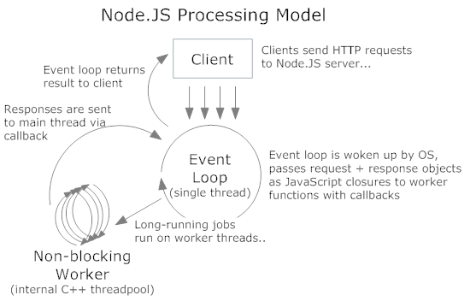
about node.js: model
3/25
Maciej Lasyk, Ganglia & Nagios
1/25
Maciej Lasyk, node.js security
Maciej Lasyk, node.js security

Slide 26
about node.js: concurrency
- node.js is single threaded (let's say)
- multi – core? child processes (cluster.fork)
- Linux containers ftw!
3/25
Maciej Lasyk, Ganglia & Nagios
1/25
Maciej Lasyk, node.js security
Maciej Lasyk, node.js security

Slide 27
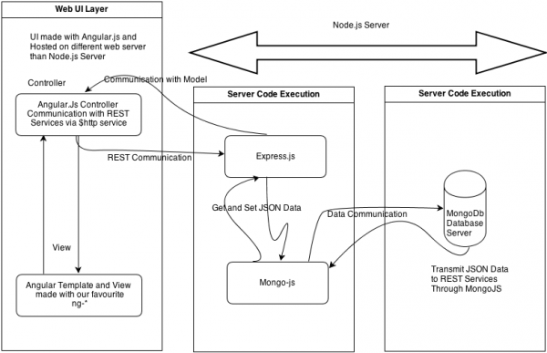
about node.js: SPA
(thx Sekurak.pl for this image)
3/25
Maciej Lasyk, Ganglia & Nagios
1/25
Maciej Lasyk, node.js security
Maciej Lasyk, node.js security

Slide 28
node.js sec: exploits anyone?
- http://seclists.org/bugtraq – 0 hits
- http://osvdb.org – 2 hits
- http://1337day.com, http://www.exploitdb.com – 1 hit
- http://nodesecurity.io/advisories – 4 hits
3/25
Maciej Lasyk, Ganglia & Nagios
1/25
Maciej Lasyk, node.js security
Maciej Lasyk, node.js security

Slide 29

node.js sec: exploits anyone?
- http://seclists.org/bugtraq – 0 hits
- http://osvdb.org – 2 hits
- http://1337day.com, http://www.exploitdb.com – 1 hit
- http://nodesecurity.io/advisories – 4 hits
Such security big?
3/25
Maciej Lasyk, Ganglia & Nagios
1/25
Maciej Lasyk, node.js security
Maciej Lasyk, node.js security

Slide 30
node.js sec: exploits anyone?
- http://seclists.org/bugtraq – 0 hits
- http://osvdb.org – 2 hits
- http://1337day.com, http://www.exploitdb.com – 1 hit
- http://nodesecurity.io/advisories – 4 hits
Such security big?
not exactly
3/25
Maciej Lasyk, Ganglia & Nagios
1/25
Maciej Lasyk, node.js security
Maciej Lasyk, node.js security

Slide 31
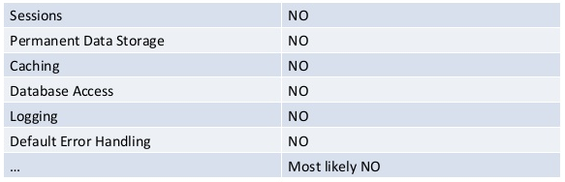
node.js sec: what's wrong?
node.js security is a blank page
http://www.slideshare.net/ASF-WS/asfws-2012-nodejs-security-old-vulnerabilities-in-new-dresses-par-sven-vetsch
3/25
Maciej Lasyk, Ganglia & Nagios
1/25
Maciej Lasyk, node.js security
Maciej Lasyk, node.js security

Slide 32

node.js sec: how does sec look like?
3/25
Maciej Lasyk, Ganglia & Nagios
1/25
Maciej Lasyk, node.js security
Maciej Lasyk, node.js security

Slide 33


node.js sec: how does sec look like?
WOW :)
Such security..
Very fortress!!1
3/25
Maciej Lasyk, Ganglia & Nagios
1/25
Maciej Lasyk, node.js security
Maciej Lasyk, node.js security

Slide 34
node.js sec: exceptions / callbacks
callbacks Error object – remember to handle those
var fs = require("fs");
fs.readFile("/some/file", "utf8", function (err, contents) {
// err will be null if no error occured
// ... otherwise there will be info about error
});
forget about handling and die debugging
3/25
Maciej Lasyk, Ganglia & Nagios
1/25
Maciej Lasyk, node.js security
Maciej Lasyk, node.js security

Slide 35
node.js sec: exceptions / eventemitter
EventEmitter: emitting events 4 async actions
var http = require("http");
http.get("http://nodejs.org/", function (res) {
res.on("data", function (chunk) {
do_something_with_chunk;
});
res.on("error", function (err) {
// listener handling error
});
});
Attach listeners to errors events or
welcome unhandled exception!
3/25
Maciej Lasyk, Ganglia & Nagios
1/25
Maciej Lasyk, node.js security
Maciej Lasyk, node.js security

Slide 36
node.js sec: uncaught exceptions
- by default node.js will print stack trace and terminate thread
- EventEmitter / process / uncaughtException
// it looks like this by default:
process.on("uncaughtException", function (err) {
console.error(err);
console.trace();
process.exit();
});
3/25
Maciej Lasyk, Ganglia & Nagios
1/25
Maciej Lasyk, node.js security
Maciej Lasyk, node.js security

Slide 37
node.js sec: uncaught exceptions
- by default node.js will print stack trace and terminate thread
- EventEmitter / process / uncaughtException
// it looks like this by default:
process.on("uncaughtException", function (err) {
console.error(err);
console.trace();
process.exit();
});
So do you really want to comment out the 'process.exit()' line?
3/25
Maciej Lasyk, Ganglia & Nagios
1/25
Maciej Lasyk, node.js security
Maciej Lasyk, node.js security

Slide 38
node.js sec: clusters
scaling within multi-core envs
var cluster = require('cluster');
var http = require('http');
var numCPUs = require('os').cpus().length;
if (cluster.isMaster) {
for (var i = 0; i < numCPUs; i++) {
cluster.fork();
}
cluster.on('exit', function(worker, code, signal) {
console.log(worker.process.pid + ' died');
});
} else {
http.createServer(function(req, res) {
res.writeHead(200);
res.end("hello world\n");
}).listen(8000);
}
3/25
Maciej Lasyk, Ganglia & Nagios
1/25
Maciej Lasyk, node.js security
Maciej Lasyk, node.js security

Slide 39
node.js sec: domains
Handling multiple different IO operations as a single group
// don't do that:
var d = require('domain').create();
d.on('error', function(er) {
console.log('error, but oh well', er.message);
});
d.run(function() {
require('http').createServer(function(req, res) {
handleRequest(req, res);
}).listen(PORT);
});
3/25
Maciej Lasyk, Ganglia & Nagios
1/25
Maciej Lasyk, node.js security
Maciej Lasyk, node.js security

Slide 40
node.js sec: domains
Rather use cluster & forks and exit gently..:
create_cluster;
fork_workers;
if(worker){
var domain = require('domain');
var server = require('http').createServer(function(req, res) {
var d = domain.create();
d.on('error', function(er) {
console.error('error', er.stack);
try {
// set timeout timer
// update master && print err msg
// close server
} catch (er2) { console.error('Error 500!', er2.stack); }
}
3/25
Maciej Lasyk, Ganglia & Nagios
1/25
Maciej Lasyk, node.js security
Maciej Lasyk, node.js security

Slide 41
node.js sec: domains
Using Express take look at that:
https://github.com/brianc/node-domain-middleware
Assigning each Express request to a separate domain?
3/25
Maciej Lasyk, Ganglia & Nagios
1/25
Maciej Lasyk, node.js security
Maciej Lasyk, node.js security

Slide 42
node.js sec: npm modules
- npm install (-g)
- who creates modules?
- who verifies those?
- how to update?
- semantic versioning in package.json
- "connect":"~1.8.7" -> 1.8.7 - 1.9
3/25
Maciej Lasyk, Ganglia & Nagios
1/25
Maciej Lasyk, node.js security
Maciej Lasyk, node.js security

Slide 43
node.js sec: npm modules
--ignore-scripts
stop preinstall/prepublish scripts
- mods auditing: https://nodesecurity.io/
3/25
Maciej Lasyk, Ganglia & Nagios
1/25
Maciej Lasyk, node.js security
Maciej Lasyk, node.js security

Slide 44
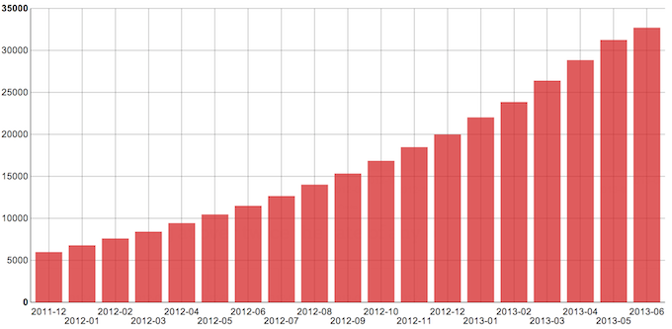
node.js sec: npm modules
The scale of npm modules
3/25
Maciej Lasyk, Ganglia & Nagios
1/25
Maciej Lasyk, node.js security
Maciej Lasyk, node.js security

Slide 45
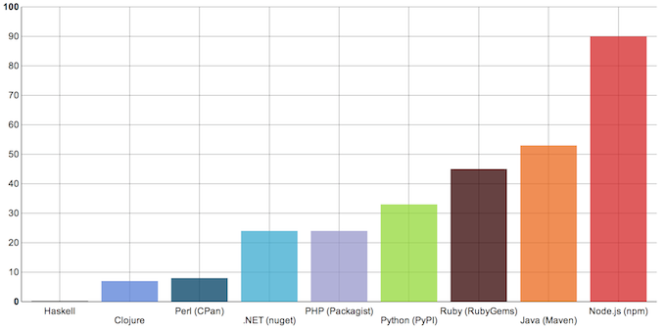
node.js sec: npm modules
Comparison to other langs (mods/day):
3/25
Maciej Lasyk, Ganglia & Nagios
1/25
Maciej Lasyk, node.js security
Maciej Lasyk, node.js security

Slide 46
node.js sec: npm modules
Remember:
- use strict?
- static analysis?
- does include some test suite?
- what is the dependency tree?
3/25
Maciej Lasyk, Ganglia & Nagios
1/25
Maciej Lasyk, node.js security
Maciej Lasyk, node.js security

Slide 47
node.js.express: connect / express
Express – web dev framework
Built on top of connect
3/25
Maciej Lasyk, Ganglia & Nagios
1/25
Maciej Lasyk, node.js security
Maciej Lasyk, node.js security

Slide 48
node.js.express: auth.basic_auth
var express = require('express'),
app = express();
app.use(express.basicAuth("user", "pwd"));
app.get("/", function (req, res) {
res.send('Hello World');
});
app.listen(8080);
Plain text and simple auth issues
3/25
Maciej Lasyk, Ganglia & Nagios
1/25
Maciej Lasyk, node.js security
Maciej Lasyk, node.js security

Slide 49
node.js.express: auth.basic_auth
var users = {
admin: "admin123",
user: "user456"
};
app.use(express.basicAuth(function (user, pass) {
return users.hasOwnProperty(user) && users[user] === pass;
}));
3/25
Maciej Lasyk, Ganglia & Nagios
1/25
Maciej Lasyk, node.js security
Maciej Lasyk, node.js security

Slide 50
node.js.express: auth.SSL
var express = require('express'), routes = require('./routes'), fs = require('fs')
var opts = {
key: fs.readFileSync('ssl/server/keys/server.key'),
cert: fs.readFileSync('ssl/server/certificates/server.crt'),
ca: fs.readFileSync('ssl/ca/ca.crt'),
crl: fs.readFileSync('ssl/ca/ca.crl'),
requestCert: true,
rejectUnauthorized: true
passphrase: "pwd" // <<<< really here?
};
var app = module.exports = express.createServer(opts);
app.configure(function(){
app.set('views', __dirname + '/views');
...
});
app.get('/', routes.index);
app.listen(8443);
3/25
Maciej Lasyk, Ganglia & Nagios
1/25
Maciej Lasyk, node.js security
Maciej Lasyk, node.js security

Slide 51
node.js.express: passport.js
- provides API for authentication and authorization
- authentication:
- LocalStrategy
- OpenIDStrategy
- OAuth / FacebookStrategy
3/25
Maciej Lasyk, Ganglia & Nagios
1/25
Maciej Lasyk, node.js security
Maciej Lasyk, node.js security

Slide 52
node.js.express: authorization
var users = [
{ id: 1, name: "user1", role: "admin" },
{ id: 2, name: "user2", role: "common" },
];
function loadUser(req, res, next) {
req.userData = users[req.params.user];
return next();
}
function requireRole(role) {
return function (req, res, next) {
if (req.user.role === role) {
return next();
} else {
return next(new Error("Unauthorized"));
}
};}
3/25
Maciej Lasyk, Ganglia & Nagios
1/25
Maciej Lasyk, node.js security
Maciej Lasyk, node.js security

Slide 53
node.js.express: authorization
app.get("/users/:user", loadUser, function (req, res) {
res.send(req.user.name);
});
app.del("/users/:user", requireRole("admin"), loadUser, function (req,res) {
res.send("User deleted");
});
3/25
Maciej Lasyk, Ganglia & Nagios
1/25
Maciej Lasyk, node.js security
Maciej Lasyk, node.js security

Slide 54
node.js.express: logging
OWASP will tell you what should be logged :)
https://www.owasp.org/index.php/Logging_Cheat_Sheet
- authentication & authorisation
- session management
- errors & weirdo events
- events (startups, shutdowns, slowdowns etc)
- high risk functionalities (payments, privileges, admins)
3/25
Maciej Lasyk, Ganglia & Nagios
1/25
Maciej Lasyk, node.js security
Maciej Lasyk, node.js security

Slide 55
node.js.express: logging
Try Winston module (Github -> flatiron/winston)
- logging to console
- logging to file
- sending logs over HTTP
- CouchDB, Redis, MongoDB, Riak etc
3/25
Maciej Lasyk, Ganglia & Nagios
1/25
Maciej Lasyk, node.js security
Maciej Lasyk, node.js security

Slide 56
node.js.express: logging
var winston = require('winston');
var logger = new (winston.Logger)({
transports: [
new (winston.transports.Console)(),
new (winston.transports.File)({
filename: 'application.log' })
]
});
3/25
Maciej Lasyk, Ganglia & Nagios
1/25
Maciej Lasyk, node.js security
Maciej Lasyk, node.js security

Slide 57
node.js.express: sessions
var express = require('express');
var app = express();
var RedisStore = require('connect-redis')(express);
app.use(express.cookieParser());
app.use(express.session({
store: new RedisStore({
host: '127.0.0.2',
port: 6379,
db: 3,
pass: 'pwd'
}),
secret: 'this-is-very-secret'
}));
app.get('/somewhere', function(req, res) {
res.send('In the middle of nowhere');
});
app.listen(process.env.PORT || 8080);
3/25
Maciej Lasyk, Ganglia & Nagios
1/25
Maciej Lasyk, node.js security
Maciej Lasyk, node.js security

Slide 58
node.js.express: sessions
app.use(express.session({
secret: “very-secret”,
key: “sessionId”,
cookie: {
httpOnly: true,
secure: true
}
}));
3/25
Maciej Lasyk, Ganglia & Nagios
1/25
Maciej Lasyk, node.js security
Maciej Lasyk, node.js security

Slide 59
node.js.CSI: CSRF
var express = require("express"),
app = express();
app.use(express.cookieParser());
app.use(express.bodyParser());
app.use(express.session({ secret: "very-secret" }));
app.use(express.csrf());
3/25
Maciej Lasyk, Ganglia & Nagios
1/25
Maciej Lasyk, node.js security
Maciej Lasyk, node.js security

Slide 60
node.js.CSI: CSRF
app.get("/valid", function (req, res) {
<input type="hidden" name="_csrf" value="+req.CsrfToken()+">
res.send(output);
});
app.get("/invalid", function (req, res) {
no_csrf_token_field
res.send(output);
});
Express CSRF ignores CSRF on HTTP, GET, OPTIONS, HEAD reqs
3/25
Maciej Lasyk, Ganglia & Nagios
1/25
Maciej Lasyk, node.js security
Maciej Lasyk, node.js security

Slide 61
node.js.CSI: input.validation
var express = require("express"),
app = module.exports = express();
app.use(express.bodyParser());
app.use(require("express-validator")());
app.get("/", function (req, res) {
res.sendfile(__dirname + "/tpls/validate.html");
});
app.post("/", function (req, res, next) {
// validation
req.checkBody("name").notEmpty().is(/\w+/);
// filtering
req.sanitize("name").trim();
...
}
3/25
Maciej Lasyk, Ganglia & Nagios
1/25
Maciej Lasyk, node.js security
Maciej Lasyk, node.js security

Slide 62
node.js.CSI: XSS
- XSS allows to access cookies, session tokens etc
- or even redirect user to malicious sites
- Myth: frameworks / tpls does the anti-XSS job
- always encode untrusted data for correct context
- OWASP ESAPI
3/25
Maciej Lasyk, Ganglia & Nagios
1/25
Maciej Lasyk, node.js security
Maciej Lasyk, node.js security

Slide 63
node.js.CSI: DoS
- Error handling
- Use streams / chunking
- Use monitoring
- Use domains / clusters
- Don't be afraid of SlowLoris :)
3/25
Maciej Lasyk, Ganglia & Nagios
1/25
Maciej Lasyk, node.js security
Maciej Lasyk, node.js security

Slide 64
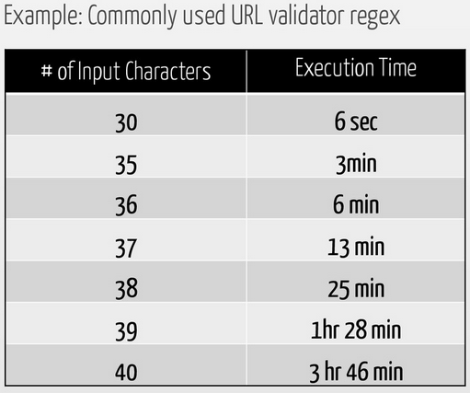
node.js.CSI: ReDoS
- Regex could take exponential execution time
- Is regex executed in the event loop thread?
- Regex and user input?
https://speakerdeck.com/ckarande/top-overlooked-security-threats-to-node-dot-js-web-applications
3/25
Maciej Lasyk, Ganglia & Nagios
1/25
Maciej Lasyk, node.js security
Maciej Lasyk, node.js security

Slide 65
node.js.CSI: HPP
HTTP Parameter Pollution
// POST firstName=John&firstName=John
req.body.color
//=> [“John”, “John”]
3/25
Maciej Lasyk, Ganglia & Nagios
1/25
Maciej Lasyk, node.js security
Maciej Lasyk, node.js security

Slide 66
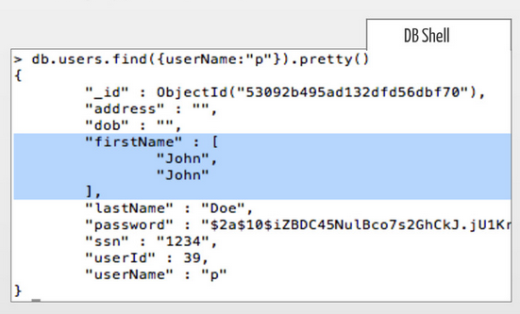
node.js.CSI: HPP
Modify app behavior:
3/25
Maciej Lasyk, Ganglia & Nagios
1/25
Maciej Lasyk, node.js security
Maciej Lasyk, node.js security

Slide 67
node.js.CSI: HPP
- TypeErrors, uncaught errs->DoS,
- Check the expected type in the input validation
- Input fuzzing / test suites
- try/catch, domains, clusters
3/25
Maciej Lasyk, Ganglia & Nagios
1/25
Maciej Lasyk, node.js security
Maciej Lasyk, node.js security

Slide 68
node.js.CSI: HTTP_headers.CSP
Content Security Policy
Content-Security-Policy:
script-src 'self';
frame-src 'none';
object-src 'none';
report-uri /my_csp_report_parser;
3/25
Maciej Lasyk, Ganglia & Nagios
1/25
Maciej Lasyk, node.js security
Maciej Lasyk, node.js security

Slide 69
node.js.CSI: HTTP_headers.CSP
Content Security Policy
Content-Security-Policy:
script-src 'self';
frame-src 'none';
object-src 'none';
report-uri /my_csp_report_parser;
app.use(helmet.csp.policy({
defaultPolicy: {
"script-src": [ "'self'" ],
"img-src": [ "'self'", "http://example.com/" ]
}
}));
3/25
Maciej Lasyk, Ganglia & Nagios
1/25
Maciej Lasyk, node.js security
Maciej Lasyk, node.js security

Slide 70
node.js.CSI: HTTP_headers.HSTS
HTTP Strict Transport Security
app.use(helmet.hsts(X, true));
Strict-Transport-Security: max-age=X; includeSubdomains
Requires HTTPS also on subdomains,
respects configuration for X seconds
3/25
Maciej Lasyk, Ganglia & Nagios
1/25
Maciej Lasyk, node.js security
Maciej Lasyk, node.js security

Slide 71
node.js.CSI: HTTP_headers.X-Frame-Options
X-Frame-Options: DENY
helmet.xframe('sameorigin');
helmet.xframe('allow-from', 'http://example.com');
3/25
Maciej Lasyk, Ganglia & Nagios
1/25
Maciej Lasyk, node.js security
Maciej Lasyk, node.js security

Slide 72
node.js.CSI: HTTP_headers.others
- X-Content-Type-Options
- Cache-Control
- X-Powered-By
X-Content-Type-Options: nosniff
app.use(helmet.contentTypeOptions());
app.use(helmet.cacheControl());
app.disable(“x-powered-by”);
3/25
Maciej Lasyk, Ganglia & Nagios
1/25
Maciej Lasyk, node.js security
Maciej Lasyk, node.js security

Slide 73
node.js.CSI: request_size
Just set limits
use streams instead of buffering
And request size:
app.use(express.limit("5mb"));
3/25
Maciej Lasyk, Ganglia & Nagios
1/25
Maciej Lasyk, node.js security
Maciej Lasyk, node.js security

Slide 74
node.js.CSI: environment.monitoring
- is app functional? :)
- is app overloaded?
- app should provide monitoring interface
- how many errors caught?
- are forks alive and OK?
3/25
Maciej Lasyk, Ganglia & Nagios
1/25
Maciej Lasyk, node.js security
Maciej Lasyk, node.js security

Slide 75
node.js.CSI: environment.resources
- node.js will eat ;)
- use control groups || containers
- monitor resources usage
3/25
Maciej Lasyk, Ganglia & Nagios
1/25
Maciej Lasyk, node.js security
Maciej Lasyk, node.js security

Slide 76
node.js.CSI: environment.sandboxing
- running node.js within shared env?
- selinux sandbox?
- libvirt sandbox?
- LXC / Docker?
3/25
Maciej Lasyk, Ganglia & Nagios
1/25
Maciej Lasyk, node.js security
Maciej Lasyk, node.js security

Slide 77
node.js.CSI: environment.ACLs
Just...
3/25
Maciej Lasyk, Ganglia & Nagios
1/25
Maciej Lasyk, node.js security

Slide 78
node.js.CSI: environment.ACLs
Just...
Don't run as `root`!!!
3/25
Maciej Lasyk, Ganglia & Nagios
1/25
Maciej Lasyk, node.js security
Maciej Lasyk, node.js security

Slide 79
node.js.CSI: environment.ACLs
Just...
Don't run as `root`!!!
And also maybe behind some LB?
3/25
Maciej Lasyk, Ganglia & Nagios
1/25
Maciej Lasyk, node.js security
Maciej Lasyk, node.js security

Slide 80
node.js.CSI: environment.tracing_execution
- SmartOS / Joyent: debugging
- Bunyan / Dtrace
- strace of course...
3/25
Maciej Lasyk, Ganglia & Nagios
1/25
Maciej Lasyk, node.js security
Maciej Lasyk, node.js security

Slide 81
node.js.testing: testing
- maybe some interface for white-box pentests?
- unit-testing 4 the sake!
- OWASP Zed Attack Proxy
3/25
Maciej Lasyk, Ganglia & Nagios
1/25
Maciej Lasyk, node.js security
Maciej Lasyk, node.js security

Slide 82
So what else?
sockets.io
node-webkit
3/25
Maciej Lasyk, Ganglia & Nagios
1/25
Maciej Lasyk, node.js security
Maciej Lasyk, node.js security

Slide 83
node.js.learning
- Node Security Book
- OWASP Node Goat (top10)
- nodesecurity.io (Twitter, RSS)
3/25
Maciej Lasyk, Ganglia & Nagios
1/25
Maciej Lasyk, node.js security
Maciej Lasyk, node.js security

Slide 84
node.js.hiring?
- does this guy contribute?
- NoSQL somehow?
- not only HTTP: socket.io?
- DevOps & infra?
- Security? :)
3/25
Maciej Lasyk, Ganglia & Nagios
1/25
Maciej Lasyk, node.js security
Maciej Lasyk, node.js security

Slide 85

Infosec && meet.js meetups
Maciej Lasyk, node.js security
1/25
Maciej Lasyk, node.js security

Slide 86
Thank you :)
node.js security
Maciej Lasyk
SEConference
Kraków, 2014-05-09
http://maciek.lasyk.info/sysop
maciek@lasyk.info
@docent-net
Maciej Lasyk, node.js security
1/25
Maciej Lasyk, node.js security

