Slide 1


Orchestrating Docker containers at scale
Maciej Lasyk
12 Sesja Linuksowa
Wrocław 2015-04-18

Slide 2

Join Fedora Infrastructure!
- learn Ansible
- learn Docker with Fedora Dockerfiles
http://fedoraproject.org/en/join-fedora

Slide 3
Quick survey
How many of you...
Knows what Docker is?
Played with Docker?
Runs it on production?
Notes:
- knows vagrant?
- knows differences between hyplev2 hyplev1 and containers?
- czy quick sort jest szybszy od heap sorta (kopcowanie)?

Slide 4
Quick survey
How many of you...
Knows what Docker is?
Played with Docker?
Runs it on production?
Notes:
- knows vagrant?
- knows differences between hyplev2 hyplev1 and containers?
- czy quick sort jest szybszy od heap sorta (kopcowanie)?

Slide 5
Quick survey
How many of you...
Knows what Docker is?
Played with Docker?
Runs it on production?
Notes:
- knows vagrant?
- knows differences between hyplev2 hyplev1 and containers?
- czy quick sort jest szybszy od heap sorta (kopcowanie)?

Slide 6
Quick survey
How many of you...
Knows what Docker is?
Played with Docker?
Runs it on production?
Notes:
- knows vagrant?
- knows differences between hyplev2 hyplev1 and containers?
- czy quick sort jest szybszy od heap sorta (kopcowanie)?

Slide 7
Why use Docker?
With Docker we can solve many problems
→ “it works on my machine”
→ reducing build & deploy time
→ Infrastructure configuration spaghetti – automation!
→ Libs dependency hell
→ Cost control and granularity

Slide 8
Why use Docker?
With Docker we can solve many problems
→ “it works on my machine”
→ reducing build & deploy time
→ Infrastructure configuration spaghetti – automation!
→ Libs dependency hell
→ Cost control and granularity

Slide 9
Why use Docker?
With Docker we can solve many problems
→ “it works on my machine”
→ reducing build & deploy time
→ Infrastructure configuration spaghetti – automation!
→ Libs dependency hell
→ Cost control and granularity

Slide 10
Why use Docker?
With Docker we can solve many problems
→ “it works on my machine”
→ reducing build & deploy time
→ Infrastructure configuration spaghetti – automation!
→ Libs dependency hell
→ Cost control and granularity

Slide 11
Why use Docker?
With Docker we can solve many problems
→ “it works on my machine”
→ reducing build & deploy time
→ Infrastructure configuration spaghetti – automation!
→ Libs dependency hell
→ Cost control and granularity

Slide 12
Why use Docker?
With Docker we can solve many problems
→ “it works on my machine”
→ reducing build & deploy time
→ Infrastructure configuration spaghetti – automation!
→ Libs dependency hell
→ Cost control and granularity

Slide 13

Docker – what is it?

Slide 14
“automates the deployment of any
application as a lightweight, portable,
self-sufficient container
that will run virtually anywhere”

Slide 15
Java’s promise: Write Once. Run Anywhere.

Slide 16

Java’s promise: Write Once. Run Anywhere.
Even on Windows now!
https://blog.docker.com/2014/10/docker-microsoft-partner-distributed-applications/

Slide 17
Is Docker is lightweight?
10/64

Slide 18
Is Docker is lightweight?
======================================================
Package Arch Version Repository Size
======================================================
Installing:
docker-io x86_64 1.3.0-1.fc20 updates 4.3 M

Slide 19
Is Docker is lightweight?
======================================================
Package Arch Version Repository Size
======================================================
Installing:
docker-io x86_64 1.3.0-1.fc20 updates 4.3 M
======================================================
Package Arch Version Repository Size
======================================================
Installing:
docker-io x86_64 1.5.0-2.fc21 updates 26 M

Slide 20

http://sattia.blogspot.com/2014/05/docker-lightweight-linux-containers-for.html

Slide 21

Docker – how it works?
http://blog.docker.com/2014/03/docker-0-9-introducing-execution-drivers-and-libcontainer/

Slide 22
Docker – how it works?
→ LXC & libcontainer
→ control groups
→ kernel namespaces
→ layered filesystem
→ no more AUFS (perf sucks)
→ devmapper thin provisioning & loopback mounts
→ OverlayFS!

Slide 23
Docker – how it works?
→ LXC & libcontainer
→ control groups
→ kernel namespaces
→ layered filesystem
→ no more AUFS (perf sucks)
→ devmapper thin provisioning & loopback mounts
→ OverlayFS!

Slide 24
Docker – how it works?
→ LXC & libcontainer
→ control groups
→ kernel namespaces
→ layered filesystem
→ no more AUFS (perf sucks)
→ devmapper thin provisioning & loopback mounts
→ OverlayFS!

Slide 25
Docker – how it works?
→ LXC & libcontainer
→ control groups
→ kernel namespaces
→ layered filesystem
→ no more AUFS (perf sucks)
→ devmapper thin provisioning & loopback mounts
→ OverlayFS!

Slide 26
Docker – how it works?
→ LXC & libcontainer
→ control groups
→ kernel namespaces
→ layered filesystem
→ no more AUFS (perf sucks)
→ devmapper thin provisioning & loopback mounts
→ OverlayFS!

Slide 27
Docker – how it works?
→ LXC & libcontainer
→ control groups
→ kernel namespaces
→ layered filesystem
→ no more AUFS (perf sucks)
→ devmapper thin provisioning & loopback mounts
→ OverlayFS!

Slide 28
Docker – how it works?
→ LXC & libcontainer
→ control groups
→ kernel namespaces
→ layered filesystem
→ no more AUFS (perf sucks)
→ devmapper thin provisioning & loopback mounts
→ OverlayFS!

Slide 29
control groups (cgroups)
Control Groups provide a mechanism for
aggregating/partitioning sets of tasks, and
all their future children, into hierarchical groups
with specialized behavior

Slide 30
control groups (cgroups)
→grouping processes
→allocating resources to particular groups
→memory
→network
→CPU
→storage bandwidth (I/O throttling)
→device whitelisting

Slide 31
control groups (cgroups)
→grouping processes
→allocating resources to particular groups
→memory
→network
→CPU
→storage bandwidth (I/O throttling)
→device whitelisting

Slide 32
control groups (cgroups)
→grouping processes
→allocating resources to particular groups
→memory
→network
→CPU
→storage bandwidth (I/O throttling)
→device whitelisting

Slide 33
control groups (cgroups)
→grouping processes
→allocating resources to particular groups
→memory
→network
→CPU
→storage bandwidth (I/O throttling)
→device whitelisting

Slide 34
control groups (cgroups)
→grouping processes
→allocating resources to particular groups
→memory
→network
→CPU
→storage bandwidth (I/O throttling)
→device whitelisting

Slide 35
control groups (cgroups)
→grouping processes
→allocating resources to particular groups
→memory
→network
→CPU
→storage bandwidth (I/O throttling)
→device whitelisting

Slide 36
control groups (cgroups)
→grouping processes
→allocating resources to particular groups
→memory
→network
→CPU
→storage bandwidth (I/O throttling)
→device whitelisting

Slide 37
control groups (cgroups)
little demo?
Notes:
ps -o cgroup
cat /proc/self/cgroup
cgcreate -t docent:docent -g cpu:/test-subgroup1
cgset -r cpuset.cpus=0 test-subgroup1
cgexec -g cpu:-subgroup1 /bin/bash
cgdelete -g cpu:/test-subgroup1
ps -o cgroup
cat /proc/self/cgroup
Cd /sys/fs/cgroup/memory
Ls
Mkdir test1 && cd test1 && ls
Cat memory.iimit_in_bytes
echo 104857600 > memory.limit_in_bytes
Cat memory.limit_in_bytes && Cat memory.oom_control
Echo $$ >> tasks
Vim ~/mem-hog.c && ~/mem-hog
Echo 1 > memory.oom_control
~/mem-hog I na drugiej konsoli cat memory.oom_control
Echo 0 > memory.oom_control

Slide 38
Kernel Namespaces
Providing a unique views of the system for processes.
→ PID – PIDs isolation
→ NET – network isolation (via virt-ifaces; demo)
→ IPC – won't use this
→ MNT – chroot like; deals w/mountpoints
→ UTS – deals w/hostname
Notes:
PID: pid 1, main view different PIDs
NET: own routing table, iptables rules and chains

Slide 39
Kernel Namespaces
Providing a unique views of the system for processes.
→ PID – PIDs isolation
→ NET – network isolation (via virt-ifaces; demo)
→ IPC – won't use this
→ MNT – chroot like; deals w/mountpoints
→ UTS – deals w/hostname
Notes:
PID: pid 1, main view different PIDs
NET: own routing table, iptables rules and chains

Slide 40
Kernel Namespaces
Providing a unique views of the system for processes.
→ PID – PIDs isolation
→ NET – network isolation (via virt-ifaces; demo)
→ IPC – won't use this
→ MNT – chroot like; deals w/mountpoints
→ UTS – deals w/hostname
Notes:
PID: pid 1, main view different PIDs
NET: own routing table, iptables rules and chains

Slide 41
Kernel Namespaces
Providing a unique views of the system for processes.
→ PID – PIDs isolation
→ NET – network isolation (via virt-ifaces; demo)
→ IPC – won't use this
→ MNT – chroot like; deals w/mountpoints
→ UTS – deals w/hostname
Notes:
PID: pid 1, main view different PIDs
NET: own routing table, iptables rules and chains

Slide 42
Kernel Namespaces
Providing a unique views of the system for processes.
→ PID – PIDs isolation
→ NET – network isolation (via virt-ifaces; demo)
→ IPC – won't use this
→ MNT – chroot like; deals w/mountpoints
→ UTS – deals w/hostname
Notes:
PID: pid 1, main view different PIDs
NET: own routing table, iptables rules and chains

Slide 43
Kernel Namespaces
Providing a unique views of the system for processes.
→ PID – PIDs isolation
→ NET – network isolation (via virt-ifaces; demo)
→ IPC – won't use this
→ MNT – chroot like; deals w/mountpoints
→ UTS – deals w/hostname
Notes:
PID: pid 1, main view different PIDs
NET: own routing table, iptables rules and chains

Slide 44
Kernel Namespaces
little demo?
Notes:
ip netns list
ip netns add green
ip link add veth0 type veth peer name veth1
ip link list
ip link set veth1 netns green
ip netns exec green ip link list
ip netns exec green ip addr add 10.11.12.13/24 dev veth1
ip netns exec green ip a

Slide 45
OverlayFS
→ hell fast (you'll see)
→ page cache sharing
→ finally in upstream kernel (in rhel from 7.2)
→ finally supported by docker (-s overlay)
→ SELinux not there yet (but will be)

Slide 46
OverlayFS
→ hell fast (you'll see)
→ page cache sharing
→ finally in upstream kernel (in rhel from 7.2)
→ finally supported by docker (-s overlay)
→ SELinux not there yet (but will be)

Slide 47
OverlayFS
→ hell fast (you'll see)
→ page cache sharing
→ finally in upstream kernel (in rhel from 7.2)
→ finally supported by docker (-s overlay)
→ SELinux not there yet (but will be)

Slide 48
OverlayFS
→ hell fast (you'll see)
→ page cache sharing
→ finally in upstream kernel (in rhel from 7.2)
→ finally supported by docker (-s overlay)
→ SELinux not there yet (but will be)

Slide 49
OverlayFS
→ hell fast (you'll see)
→ page cache sharing
→ finally in upstream kernel (in rhel from 7.2)
→ finally supported by docker (-s overlay)
→ SELinux not there yet (but will be)

Slide 50
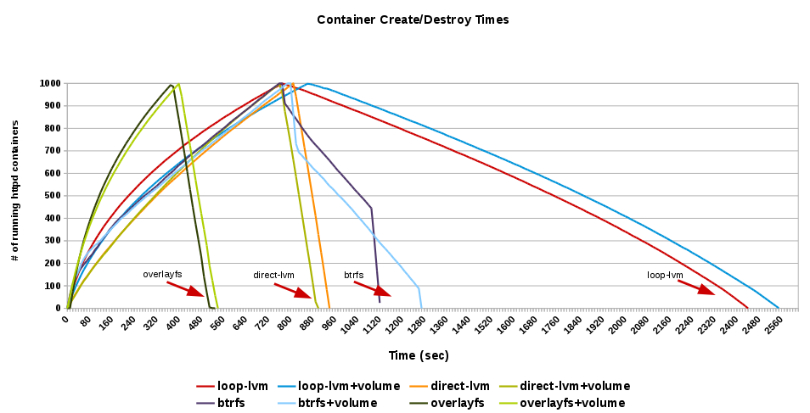
OverlayFS
http://developerblog.redhat.com/2014/09/30/overview-storage-scalability-docker/

Slide 51
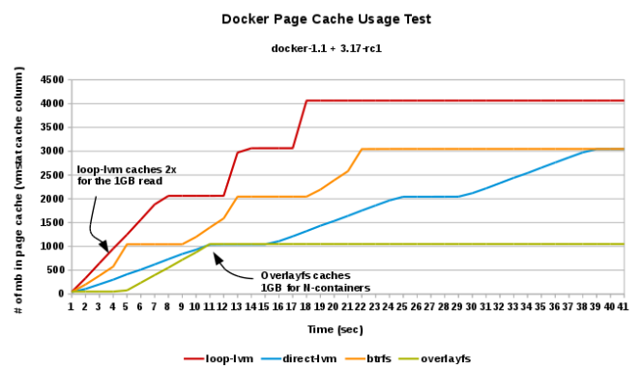
OverlayFS
http://developerblog.redhat.com/2014/09/30/overview-storage-scalability-docker/
Notes:
Odcyzt tego samego pliku z 3 różnych kontenerów z 4 różnych storage'ów

Slide 52
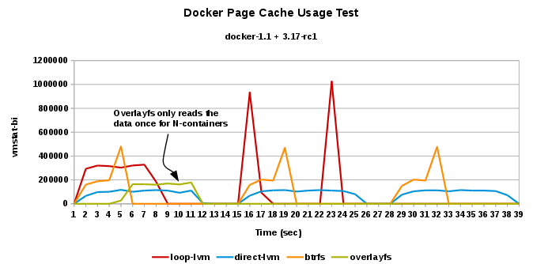
OverlayFS
http://developerblog.redhat.com/2014/09/30/overview-storage-scalability-docker/
Notes:
Ilość odycztanych danych z blk/pamięci w celu odczytania tego samego pliku z 3 różnych kontenerów w 4 rodzajach storage

Slide 53
OverlayFS
little demo?
Notes:
ip netns list
ip netns add green
ip link add veth0 type veth peer name veth1
ip link list
ip link set veth1 netns green
ip netns exec green ip link list
ip netns exec green ip addr add 10.11.12.13/24 dev veth1
ip netns exec green ip a

Slide 54
Linux containers equation
Linux Containers = namespaces + cgroups + storage
Notes:
systemctl status docker -l
cd /etc/sysconfig
ls docker*
vim docker-storage
restart...

Slide 55
Docker – concepts
Images
→ read only
→ act as templates
Dockerfile
→ like a makefile
→ commands order & cache'ing
→ extends the base image
→ results in a new image
Containers: instances running apps

Slide 56
Docker – concepts
Images
→ read only
→ act as templates
Dockerfile
→ like a makefile
→ commands order & cache'ing
→ extends the base image
→ results in a new image
Containers: instances running apps

Slide 57
Docker – concepts
Images
→ read only
→ act as templates
Dockerfile
→ like a makefile
→ commands order & cache'ing
→ extends the base image
→ results in a new image
Containers: instances running apps

Slide 58
Docker – concepts
dockerfile + base image = docker container

Slide 59
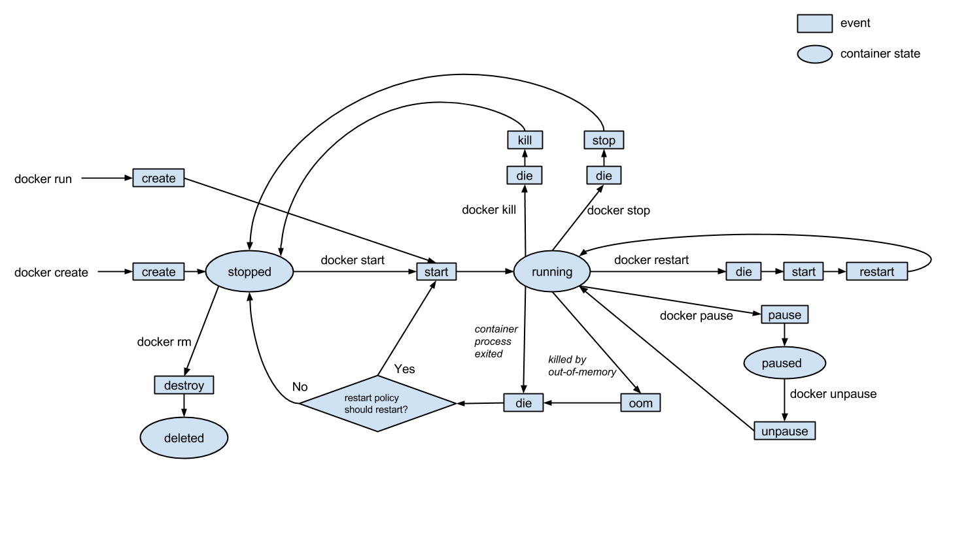
Docker – events
http://gliderlabs.com/blog/2015/04/14/docker-events-explained/

Slide 60
Dockerfile
FROM fedora
MAINTAINER scollier <scollier@redhat.com>
RUN yum -y update && yum clean all
RUN yum -y install nginx && yum clean all
RUN echo "daemon off;" >> /etc/nginx/nginx.conf
RUN echo "nginx on Fedora" > /srv/www/index.html
EXPOSE 80
CMD [ "/usr/sbin/nginx" ]

Slide 61

Docker – registry
http://osv.io/blog/blog/2014/06/19/containers-hypervisors-part-2/

Slide 62
Docker – registry
→ git like semantics
→ pull, push, commit
→ private and public registry
→ https://github.com/dotcloud/docker-registry
→ yum install docker-registry
$ docker pull
$ docker push
$ docker commit

Slide 63

Docker – images hierarchy
http://blog.octo.com/en/docker-registry-first-steps/

Slide 64
Docker – images hierarchy
base image
-> child image
-> grandchild image

Slide 65
Docker – images hierarchy
base image
-> child image
-> grandchild image
Git’s promise: Tiny footprint with
lightning fast performance

Slide 66
Docker – security
→ Isolation via kernel namespaces
→ Each container gets own network stack
→ Control groups for resources limiting
→ Additional layer of security: SELinux / AppArmor / GRSEC
f20 policy: https://git.fedorahosted.org/cgit/selinux-policy.git/tree/docker.te?h=f20-contrib
What's there?
seinfo -t -x | grep docker
sesearch -A -s docker_t (and the rest)
or just unpack docker.pp with semodule_unpackage

Slide 67
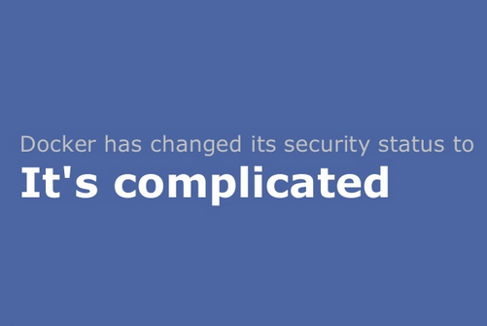
Docker – security
http://www.projectatomic.io/blog/2014/08/is-it-safe-a-look-at-docker-and-security-from-linuxcon/

Slide 68

Docker – security

Slide 69

Docker – use cases
CI Stack
http://sattia.blogspot.com/2014/05/docker-lightweight-linux-containers-for.html

Slide 70
Docker – use cases
→ Continuous Integration
→ local dev
→ with Docker it's easy to standardize envs
→ deployment (rolling updates (e.g. w/Ansible))
→ testing
→ unit testing of any commit on dedicated env
→ don't worry about cleaning up after testing
→ paralleled tests across any machines

Slide 71
Docker – use cases
→ version control system for apps
→ microservices
→ Docker embraces granularity
→ Services can be deployed independently and faster
→ paralleled tests across any machines
→ continuous delivery
→ PaaS

Slide 72
Docker – history
→ 2013-01: dotCloud worked on own PaaS (Python based)
→ 2013-03: Docker went public (AUFS, LXC)
→ middle 2013: Red Hat joined, devmapper, SELinux
→ late 2013: removed LXC, rewritten in Go
→ 2014-02: stable 1.0

Slide 73
Docker – history
→ 2013-01: dotCloud worked on own PaaS (Python based)
→ 2013-03: Docker went public (AUFS, LXC)
→ middle 2013: Red Hat joined, devmapper, SELinux
→ late 2013: removed LXC, rewritten in Go
→ 2014-02: stable 1.0

Slide 74
Docker – history
→ 2013-01: dotCloud worked on own PaaS (Python based)
→ 2013-03: Docker went public (AUFS, LXC)
→ middle 2013: Red Hat joined, devmapper, SELinux
→ late 2013: removed LXC, rewritten in Go
→ 2014-02: stable 1.0

Slide 75
Docker – history
→ 2013-01: dotCloud worked on own PaaS (Python based)
→ 2013-03: Docker went public (AUFS, LXC)
→ middle 2013: Red Hat joined, devmapper, SELinux
→ late 2013: removed LXC, rewritten in Go
→ 2014-02: stable 1.0

Slide 76
Docker – history
→ 2013-01: dotCloud worked on own PaaS (Python based)
→ 2013-03: Docker went public (AUFS, LXC)
→ middle 2013: Red Hat joined, devmapper, SELinux
→ late 2013: removed LXC, rewritten in Go
→ 2014-02: stable 1.0

Slide 77
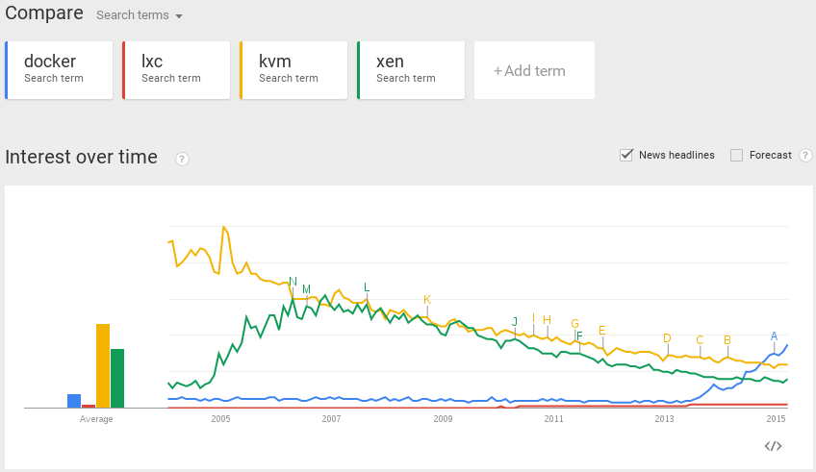
Docker – popularity

Slide 78
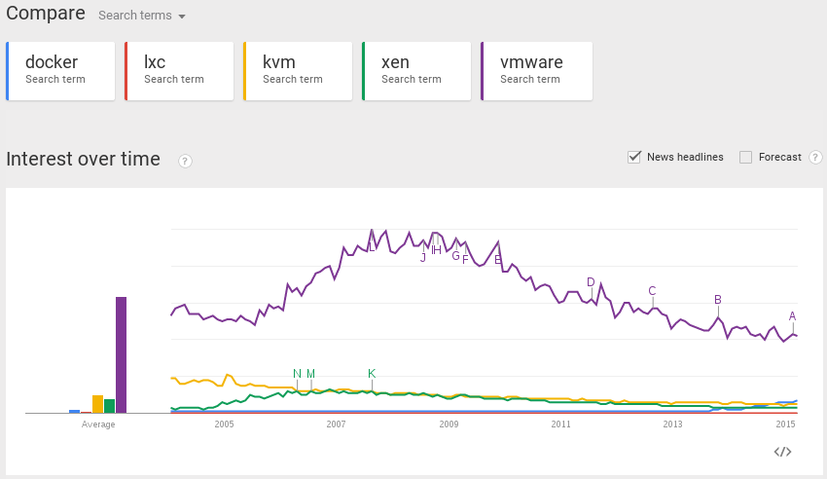
Docker – popularity

Slide 79

Orchestration at scale w/Docker

Slide 80
Orchestration at scale w/Docker
This might be a little problem

Slide 81

Orchestration at scale w/Docker
This might be a little problem

Slide 82

Orchestration at scale w/Docker

Slide 83

http://www.cloudssky.com/en/blog/Docker-Is-Not-Enough

Slide 84

To Paas or not to PaaS?

Slide 85
To Paas or not to PaaS?
→ you think PaaS will solve your problems?
→ it will rather clone them :)
→ installing PaaS might be easy
→ operating PaaS will be tough
→ so is operating your apps tough enough to move?
→ private PaaS or not?
→ is your app ready for PaaS?
→ Rainbow and Unicorn Piss:
http://blog.lusis.org/blog/2014/06/14/paas-for-realists/

Slide 86
To Paas or not to PaaS?
→ you think PaaS will solve your problems?
→ it will rather clone them :)
→ installing PaaS might be easy
→ operating PaaS will be tough
→ so is operating your apps tough enough to move?
→ private PaaS or not?
→ is your app ready for PaaS?
→ Rainbow and Unicorn Piss:
http://blog.lusis.org/blog/2014/06/14/paas-for-realists/

Slide 87
To Paas or not to PaaS?
→ you think PaaS will solve your problems?
→ it will rather clone them :)
→ installing PaaS might be easy
→ operating PaaS will be tough
→ so is operating your apps tough enough to move?
→ private PaaS or not?
→ is your app ready for PaaS?
→ Rainbow and Unicorn Piss:
http://blog.lusis.org/blog/2014/06/14/paas-for-realists/

Slide 88
To Paas or not to PaaS?
→ you think PaaS will solve your problems?
→ it will rather clone them :)
→ installing PaaS might be easy
→ operating PaaS will be tough
→ so is operating your apps tough enough to move?
→ private PaaS or not?
→ is your app ready for PaaS?
→ Rainbow and Unicorn Piss:
http://blog.lusis.org/blog/2014/06/14/paas-for-realists/

Slide 89
To Paas or not to PaaS?
→ you think PaaS will solve your problems?
→ it will rather clone them :)
→ installing PaaS might be easy
→ operating PaaS will be tough
→ so is operating your apps tough enough to move?
→ private PaaS or not?
→ is your app ready for PaaS?
→ Rainbow and Unicorn Piss:
http://blog.lusis.org/blog/2014/06/14/paas-for-realists/

Slide 90
To Paas or not to PaaS?
→ you think PaaS will solve your problems?
→ it will rather clone them :)
→ installing PaaS might be easy
→ operating PaaS will be tough
→ so is operating your apps tough enough to move?
→ private PaaS or not?
→ is your app ready for PaaS?
→ Rainbow and Unicorn Piss:
http://blog.lusis.org/blog/2014/06/14/paas-for-realists/

Slide 91
To Paas or not to PaaS?
→ you think PaaS will solve your problems?
→ it will rather clone them :)
→ installing PaaS might be easy
→ operating PaaS will be tough
→ so is operating your apps tough enough to move?
→ private PaaS or not?
→ is your app ready for PaaS?
→ Rainbow and Unicorn Piss:
http://blog.lusis.org/blog/2014/06/14/paas-for-realists/

Slide 92
To Paas or not to PaaS?
→ you think PaaS will solve your problems?
→ it will rather clone them :)
→ installing PaaS might be easy
→ operating PaaS will be tough
→ so is operating your apps tough enough to move?
→ private PaaS or not?
→ is your app ready for PaaS?
→ Rainbow and Unicorn Piss:
http://blog.lusis.org/blog/2014/06/14/paas-for-realists/

Slide 93
To Paas or not to PaaS?
→ flynn.io
- Open source PaaS (Go)
- Uses Docker to manage containers
- Ops should be a product team, not consultants
- under development
- Git push deployment
- https://flynn.io
→ dokku
- The smallest PaaS implementation you've ever seen
- Docker powered mini-Heroku
- Less than 100 lines of Bash
- Git push deployment
- https://github.com/progrium/dokku
→ deis.io
- Open source PaaS (Python)
- Git push deployment
- On top of CoreOS w/ Docker
- http://deis.io/
Don't forget maestro-ng!
https://github.com/signalfuse/maestro-ng

Slide 94
To Paas or not to PaaS?
→ flynn.io
- Open source PaaS (Go)
- Uses Docker to manage containers
- Ops should be a product team, not consultants
- under development
- Git push deployment
- https://flynn.io
→ dokku
- The smallest PaaS implementation you've ever seen
- Docker powered mini-Heroku
- Less than 100 lines of Bash
- Git push deployment
- https://github.com/progrium/dokku
→ deis.io
- Open source PaaS (Python)
- Git push deployment
- On top of CoreOS w/ Docker
- http://deis.io/
Don't forget maestro-ng!
https://github.com/signalfuse/maestro-ng

Slide 95
To Paas or not to PaaS?
→ flynn.io
- Open source PaaS (Go)
- Uses Docker to manage containers
- Ops should be a product team, not consultants
- under development
- Git push deployment
- https://flynn.io
→ dokku
- The smallest PaaS implementation you've ever seen
- Docker powered mini-Heroku
- Less than 100 lines of Bash
- Git push deployment
- https://github.com/progrium/dokku
→ deis.io
- Open source PaaS (Python)
- Git push deployment
- On top of CoreOS w/ Docker
- http://deis.io/
Don't forget maestro-ng!
https://github.com/signalfuse/maestro-ng

Slide 96
To Paas or not to PaaS?
→ flynn.io
- Open source PaaS (Go)
- Uses Docker to manage containers
- Ops should be a product team, not consultants
- under development
- Git push deployment
- https://flynn.io
→ dokku
- The smallest PaaS implementation you've ever seen
- Docker powered mini-Heroku
- Less than 100 lines of Bash
- Git push deployment
- https://github.com/progrium/dokku
→ deis.io
- Open source PaaS (Python)
- Git push deployment
- On top of CoreOS w/ Docker
- http://deis.io/
Don't forget maestro-ng!
https://github.com/signalfuse/maestro-ng

Slide 97

To Paas or not to PaaS?
Remember, that PaaS might fail; plan & test for disaster !
Notes:
Chaos monkey!

Slide 98
Docker & CLI
$ docker run -t -i fedora /bin/bash
> yum -y update
> yum -y install nginx
$ docker commit 73fa45674fd fedora-nginx
$ docker run -d -p 80:80 fedora-nginx

Slide 99
Docker & CLI
Or via Dockerfile:
---
FROM fedora
MAINTAINER scollier <scollier@redhat.com>
RUN yum -y update
RUN yum -y install nginx
EXPOSE 80
CMD [ "/usr/sbin/nginx" ]
---
$ docker build -t fedora –-rm .
$ docker run --name=nginx fedora

Slide 100

FIG?
- http://www.fig.sh?

Slide 101
Actually: Docker-Compose
- http://docs.docker.com/compose/
- for single host env

Slide 102
Docker-Compose
- http://docs.docker.com/compose/
- for single host env
FROM python:2.7
ENV PYTHONUNBUFFERED 1
RUN mkdir /code
WORKDIR /code
ADD requirements.txt /code/
RUN pip install -r requirements.txt
ADD . /code/

Slide 103
Docker-Compose
db:
image: postgres
web:
build: .
command: python manage.py runserver 0.0.0.0:8000
volumes:
- /srv/app/code:/code
ports:
- "8000:8000"
links:
- db

Slide 104
Docker-Compose
$ alias fig='docker-compose'
$ fig run web django-admin.py startproject figexample .
$ fig up
Management during runtime?
$ fig run web python manage.py syncdb

Slide 105
Docker & Ansible
Ansible + Docker
&
Docker + Ansible

Slide 106
Docker & Ansible
Ansible docker core module:
http://docs.ansible.com/docker_module.html
- hosts: web
sudo: yes
tasks:
- name: run tomcat servers
docker: >
image=centos
command="service tomcat6 start"
ports=8080
count=5
memory_limit=128MB
link=mysql
expose=8080
registry=...
volume=...

Slide 107
Docker & Ansible
Building image with Ansible:
FROM ansible/centos7-ansible:stable
ADD ansible /srv/example
WORKDIR /srv/example
RUN ansible-playbook web.yml -c local
EXPOSE 80
CMD ["/usr/sbin/nginx"]

Slide 108
Docker & Ansible
Building image with Ansible:
FROM ansible/centos7-ansible:stable
ADD ansible /srv/example
WORKDIR /srv/example
RUN ansible-playbook web.yml -c local
EXPOSE 80
CMD ["/usr/sbin/nginx"]
ansible/web.yml:
- name: Install webserver
hosts: localhost
tasks:
- yum: pkg=nginx state=latest
- shell: echo "ansible" > /usr/share/nginx/html/index.html

Slide 109
Docker & Ansible
Yet another demo?
Notes:
cd ~/Dropbox/private/Prezentacje/atmosphere-shuttle-2-2015/dockerfiles
Pokazać dockerfile I web.yml
docker build --rm -t fedora-ansible-docker-nginx .
docker create --name docker-ansible-test -p 127.0.0.1:83:80 -t fedora-ansible-docker-nginx
Docekr ps -a && docker start ABC

Slide 110
CoreOS
→ Designed for massive server deployments
→ Support Docker container out of the box
→ It's a Chrome OS fork
→ Consists of couple of components:
→ SystemD – not just a init system ;)
→ Fleet – cluster level manager & scheduler
→ etcd – light & distributed key / value store
→ Docker – the only packaging method in CoreOS

Slide 111

CoreOS

Slide 112
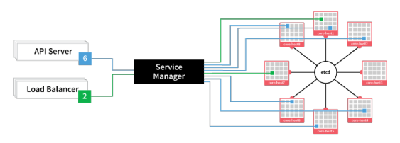
CoreOS
Fleet – cluster level manager & scheduler
https://coreos.com/using-coreos/clustering/

Slide 113
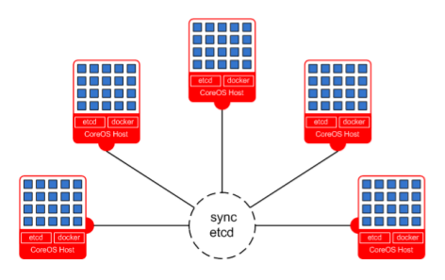
CoreOS
etcd – light & distributed key / value store
(used for configuration store)
https://coreos.com/docs/#cluster-management

Slide 114
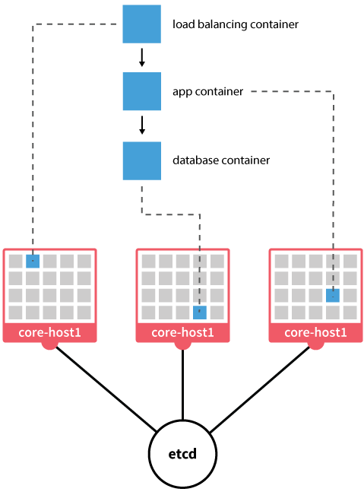
CoreOS
Docker – the only
packaging method
in CoreOS

Slide 115
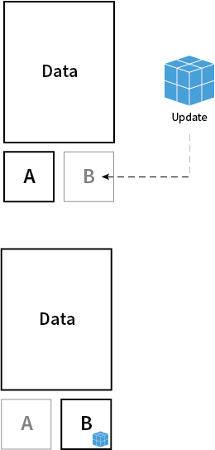
CoreOS
Full Control Over Updates:
- active–passive (dual) partitioning
- update all-packages-at-once
- safe rollback
- no more partially upgraded state
- reboot to get upgraded

Slide 116
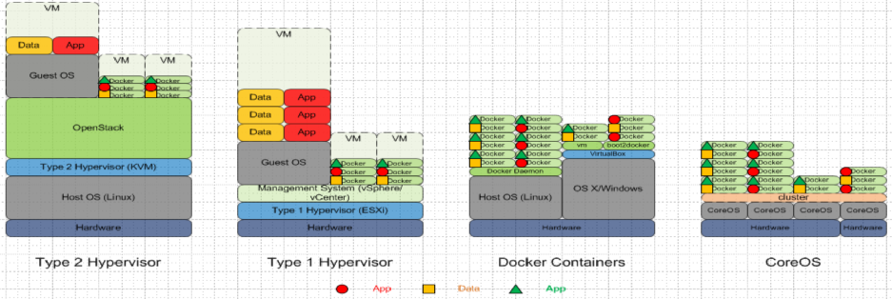
CoreOS

Slide 117
CoreOS
Cluster management with Fleet & SystemD
[Unit]
Description=My Service
After=docker.service
[Service]
TimeoutStartSec=0
ExecStartPre=-/usr/bin/docker kill hello
ExecStartPre=-/usr/bin/docker rm hello
ExecStartPre=/usr/bin/docker pull busybox
ExecStart=/usr/bin/docker run --name hello busybox /bin/sh -c
"while true; do echo Hello World; sleep 1; done"
ExecStop=/usr/bin/docker stop hello

Slide 118
CoreOS
Cluster management with Fleet & SystemD
$ fleetctl load hello.service
Unit hello.service loaded on 8145ebb7.../10.10.1.3
$ fleetctl start hello.service
Unit hello.service launched on 8145ebb7.../10.10.1.3
$ fleetctl list-machines
MACHINE IP METADATA
148a18ff-6e95-4cd8-92da-c9de9bb90d5a 10.10.1.1 -
491586a6-508f-4583-a71d-bfc4d146e996 10.10.1.2 -
c9de9451-6a6f-1d80-b7e6-46e996bfc4d1 10.10.1.3 -
$ fleetctl list-units
UNIT MACHINE ACTIVE SUB
hello.service c9de9451.../10.10.1.3 active running

Slide 119
CoreOS
- scheduler
- HA
- dependencies
https://coreos.com/docs/launching-containers/launching/launching-containers-fleet/

Slide 120
Kubernetes
- https://github.com/GoogleCloudPlatform/kubernetes
- Advanced cluster manager (more than 1k hosts is a fit)
- Architecture:
- master
- minion
- pod
- replication controller
- label

Slide 121

Kubernetes

Slide 122

Kubernetes

Slide 123
SmartStack
- automated service discovery and registration framework
- ideal for SOA architectures
- ideal for continuous integration & delivery
- solves “works on my machine” problem

Slide 124
SmartStack
- automated service discovery and registration framework
- ideal for SOA architectures
- ideal for continuous integration & delivery
- solves “works on my machine” problem
haproxy + nerve + synapse + zookeper = smartstack

Slide 125
SmartStack
Synapse
→ discovery service (via zookeeper or etcd)
→ installed on every node
→ writes haproxy configuration
→ application doesn't have to be aware of this
→ works same on bare / VM / docker
→ https://github.com/airbnb/nerve

Slide 126

SmartStack

Slide 127
SmartStack
Nerve
→ health checks (pluggable)
→ register service info to zookeper (or etcd)
→ https://github.com/airbnb/synapse

Slide 128

SmartStack

Slide 129

SmartStack

Slide 130
SmartStack
Smartstack + Docker = <3

Slide 131
SmartStack
Smartstack + Docker = <3
but also remember about Consul
(come to #dockerkrk 2 meetup!)

Slide 132
Summary
Wanna learn Docker?
http://dockerbook.com/

Slide 133
Summary

Slide 134

Freenode #docker
#KrkDocker meetups (http://www.meetup.com/Docker-Krakow-Poland/)
https://github.com/docker/docker

Slide 135
sources?
→ docker.io documentation
→ dockerbook.com
→ slideshare!
→ zounds of blogposts (urls provided)
→ and some experience ;)

Slide 136
Thank you :)
Orchestrating Docker containers at scale
Maciej Lasyk
12 Sesja Linuksowa
2015-04-18, Wrocław
http://maciej.lasyk.info
maciej@lasyk.info
@docent-net

