Slide 1

Continuous Security in DevOps
Maciej Lasyk
4developers – Warsaw
2015-04-20

Slide 2

Join Fedora Infrastructure!
→ learn Ansible
→ join the security team!
→ use Fedora Security Lab (spin)
http://fedoraproject.org/en/join-fedora

Slide 3
Agenda?
→ DevOps indoctrination
→ technical infrastructure stuff
→ continuous delivery considerations
→ finally infosec tools & automation
→ working demo (hopefully) ;)
Notes:
- na początek trochę laia wody – ale istotnego
- Potem bardziej technicznie

Slide 4
Agenda?
→ DevOps indoctrination
→ technical infrastructure stuff
→ continuous delivery considerations
→ finally infosec tools & automation
→ working demo (hopefully) ;)
Notes:
- na początek trochę laia wody – ale istotnego
- Potem bardziej technicznie

Slide 5
Agenda?
→ DevOps indoctrination
→ technical infrastructure stuff
→ continuous delivery considerations
→ finally infosec tools & automation
→ working demo (hopefully) ;)
Notes:
- na początek trochę laia wody – ale istotnego
- Potem bardziej technicznie

Slide 6
Agenda?
→ DevOps indoctrination
→ technical infrastructure stuff
→ continuous delivery considerations
→ finally infosec tools & automation
→ working demo (hopefully) ;)
Notes:
- na początek trochę laia wody – ale istotnego
- Potem bardziej technicznie

Slide 7
Agenda?
→ DevOps indoctrination
→ technical infrastructure stuff
→ continuous delivery considerations
→ finally infosec tools & automation
→ working demo (hopefully) ;)
Notes:
- na początek trochę laia wody – ale istotnego
- Potem bardziej technicznie

Slide 8
I'm not a security expert but an engineer
passionate about security & quality

Slide 9
“The only thing more dangerous than a developer is a
developer conspiring with Security. The two working
together gives means, motive and opportunity.”
“The Phoenix Project”
by Gene Kim, Kevin Behr and George Spafford

Slide 10

General security rule in IT: security is based on layers
App / DB
Containers
VMs
OS
Network
Hardware

Slide 11
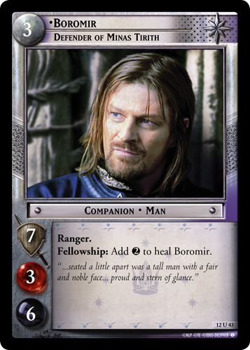
General security rule in IT: security is based on layers
Notes:
Jeden sam infosec to nieskalowalne
I nie zadziała

Slide 12
DevOps Anti-Types & patterns
This is a copy/paste from http://blog.matthewskelton.net/
w/my comments included and InfoSec layer added
Great job Matthew! Thanks!

Slide 13
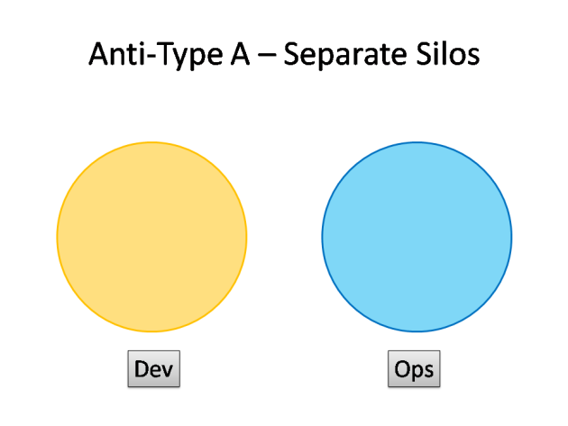
DevOps Anti-Types
http://blog.matthewskelton.net/2013/10/22/what-team-structure-is-right-for-devops-to-flourish/

Slide 14
DevOps Anti-Types
InfoSec
http://blog.matthewskelton.net/2013/10/22/what-team-structure-is-right-for-devops-to-flourish/

Slide 15
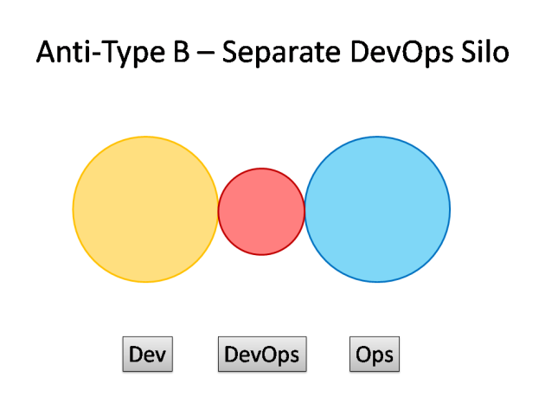
DevOps Anti-Types
InfoSec
http://blog.matthewskelton.net/2013/10/22/what-team-structure-is-right-for-devops-to-flourish/

Slide 16
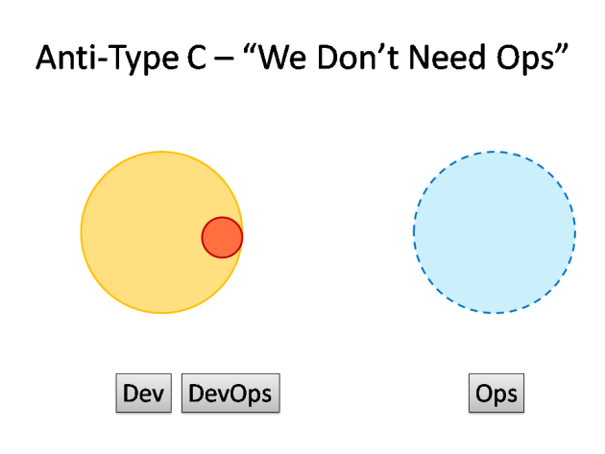
DevOps Anti-Types
http://blog.matthewskelton.net/2013/10/22/what-team-structure-is-right-for-devops-to-flourish/

Slide 17
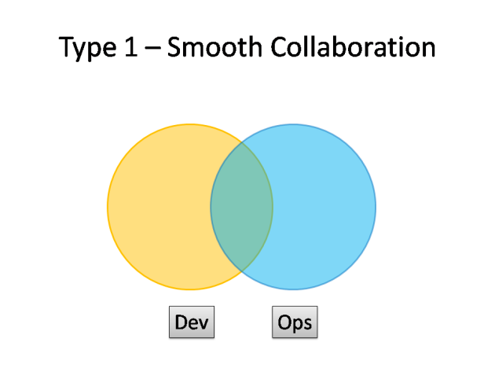
DevOps Patterns
http://blog.matthewskelton.net/2013/10/22/what-team-structure-is-right-for-devops-to-flourish/

Slide 18
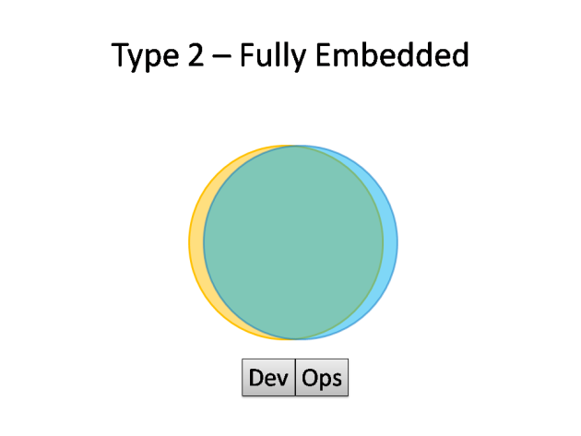
DevOps Patterns
InfoSec
http://blog.matthewskelton.net/2013/10/22/what-team-structure-is-right-for-devops-to-flourish/

Slide 19
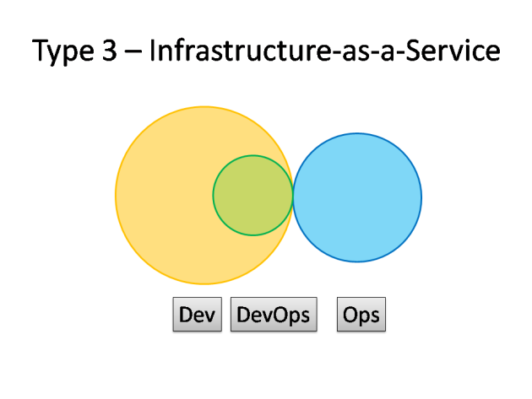
DevOps Patterns
http://blog.matthewskelton.net/2013/10/22/what-team-structure-is-right-for-devops-to-flourish/
Notes:
W firmach, gdzie klasyczne IT pozostanie, lub nie zmieni sie w krótkim czasie
DevOps jest częścią DEV (np. Jako wirtualny team) I służy jako bariera translacyjna z IaaS – zespołem infra

Slide 20
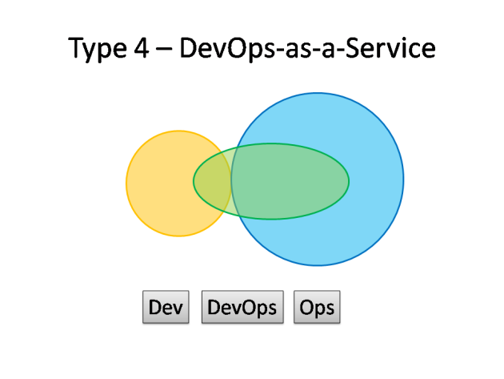
DevOps Patterns
http://blog.matthewskelton.net/2013/10/22/what-team-structure-is-right-for-devops-to-flourish/

Slide 21
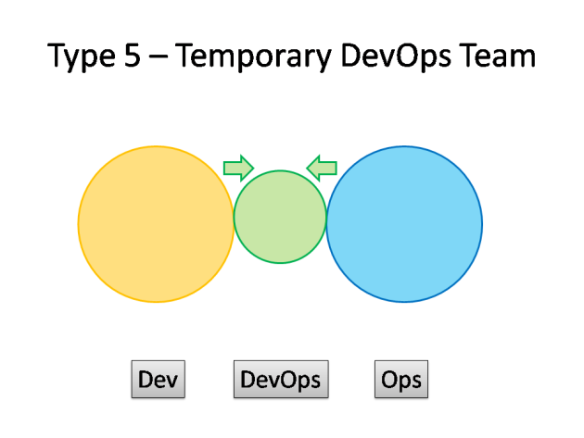
DevOps Patterns
InfoSec
http://blog.matthewskelton.net/2013/10/22/what-team-structure-is-right-for-devops-to-flourish/

Slide 22
Deciding about InfoSec strategy w/devops remember:
→ security ninjas (just like admins) are expensive and rare
→ virtual teams might cut this problem
→ wandering experts

Slide 23
Deciding about InfoSec strategy w/devops remember:
→ security ninjas (just like admins) are expensive and rare
→ virtual teams might cut this problem
→ wandering experts

Slide 24
Deciding about InfoSec strategy w/devops remember:
→ security ninjas (just like admins) are expensive and rare
→ virtual teams might cut this problem
→ wandering experts

Slide 25
DevOPS ?== CAMS
(culture, automation, measurement, sharing)

Slide 26
DevOPS !== CAMS
DevOPS === people!

Slide 27
culture
automation
People
measurement
sharing

Slide 28
General security rule in IT: security is based on layers
App / DB
Containers
VMs
OS
Network
Hardware

Slide 29

General security rule in IT: security is based on layers

Slide 30
C for Culture
A for Automation
M for Monitoring
S for Sharing
Notes:
Tutaj info o historii devopsów – począwszy od 1 – osobowej instytycji

Slide 31
→ focus on delivery
→ close collaboration
→ lightweight environment and components
→ lightweight processes
Notes:
Tutaj info o historii devopsów – począwszy od 1 – osobowej instytycji

Slide 32
→ focus on delivery
→ close collaboration
→ lightweight environment and components
→ lightweight processes
Notes:
Tutaj info o historii devopsów – począwszy od 1 – osobowej instytycji

Slide 33
→ focus on delivery
→ close collaboration
→ lightweight environment and components
→ lightweight processes
Notes:
Tutaj info o historii devopsów – począwszy od 1 – osobowej instytycji

Slide 34
→ focus on delivery
→ close collaboration
→ lightweight environment and components
→ lightweight processes
Notes:
Tutaj info o historii devopsów – począwszy od 1 – osobowej instytycji

Slide 35
cultural change
modification of a society through innovation, invention, discovery, or contact with other societies

Slide 36
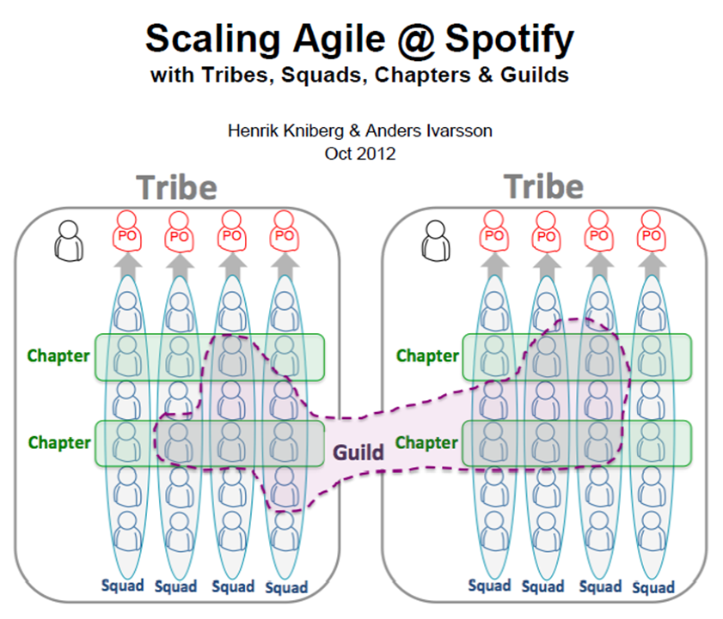

Slide 37
C for Culture
A for Automation
M for Monitoring
S for Sharing
Notes:
Tutaj info o historii devopsów – począwszy od 1 – osobowej instytycji

Slide 38

→ repeatable tasks leads to automation

Slide 39
→ repeatable tasks leads to automation
→ automation leads to consistency

Slide 40
→ repeatable tasks leads to automation
→ automation leads to consistency
→ consistency reduces errors

Slide 41
→ repeatable tasks leads to automation
→ automation leads to consistency
→ consistency reduces errors
→ reducing errors leads to stable environment

Slide 42
→ repeatable tasks leads to automation
→ automation leads to consistency
→ consistency reduces errors
→ reducing errors leads to stable environment
→ stable environment leads to less unplanned work

Slide 43
→ repeatable tasks leads to automation
→ automation leads to consistency
→ consistency reduces errors
→ reducing errors leads to stable environment
→ stable environment leads to less unplanned work
→ less unplanned work leads to focus on delivery

Slide 44

→ flat learning curve
→ doesn't required additional resources
→ fit for maintenance jobs / procedures
→ great for any containers as non-daemon
→ might be easily adopted as universal language
→ ansible-galaxy

Slide 45
/
inventory
srv_group1
srv_group2
group_vars/
srv_group1
srv_group2
host_vars/
server1
server2
roles/
webserver/
monitoring/
app1/
app2/
security/
portscan/
master.yml

Slide 46
/
inventory
srv_group1
srv_group2
group_vars/
srv_group1
srv_group2
host_vars/
server1
server2
roles/
webserver/
monitoring/
app1/
app2/
security/
portscan/
master.yml

Slide 47
/
inventory
srv_group1
srv_group2
group_vars/
srv_group1
srv_group2
host_vars/
server1
server2
roles/
webserver/
monitoring/
app1/
app2/
security/
portscan/
master.yml

Slide 48
/
inventory
srv_group1
srv_group2
group_vars/
srv_group1
srv_group2
host_vars/
server1
server2
roles/
webserver/
monitoring/
app1/
app2/
security/
portscan/
master.yml

Slide 49
/
inventory
srv_group1
srv_group2
group_vars/
srv_group1
srv_group2
host_vars/
server1
server2
roles/
webserver/
monitoring/
app1/
app2/
security/
portscan/
master.yml

Slide 50
/
inventory
srv_group1
srv_group2
group_vars/
srv_group1
srv_group2
host_vars/
server1
server2
roles/
webserver/
monitoring/
app1/
app2/
security/
portscan/
master.yml

Slide 51
/
inventory
srv_group1
srv_group2
group_vars/
srv_group1
srv_group2
host_vars/
server1
server2
roles/
webserver/
monitoring/
app1/
app2/
security/
portscan/
master.yml
ansible-playbook master.yml \
–tags app2,portscan

Slide 52
- name: run portscan
shell: /usr/bin/nmap -sS -p- > wide_scan_results
# vars in e.g. group_vars
ports:
tcp:
- 80
- 443
--exclude-ports=”{{ ports.tcp | join(",") }}”
async, pool, fire & forget
- name: Parse results
shell: python parse.py {{ ports.tcp }}
register: parse_results
- name: Notify
- shell: echo “{{ parse_results.stdout }}” | mail -s “results” a@b.com
- when: "'error_placeholder' in parse_results.stdout"

Slide 53
- name: run portscan
shell: /usr/bin/nmap -sS -p- > wide_scan_results
# vars in e.g. group_vars
ports:
tcp:
- 80
- 443
--exclude-ports=”{{ ports.tcp | join(",") }}”
async, pool, fire & forget
- name: Parse results
shell: python parse.py {{ ports.tcp }}
register: parse_results
- name: Notify
- shell: echo “{{ parse_results.stdout }}” | mail -s “results” a@b.com
- when: "'error_placeholder' in parse_results.stdout"

Slide 54
- name: run portscan
shell: /usr/bin/nmap -sS -p- > wide_scan_results
# vars in e.g. group_vars
ports:
tcp:
- 80
- 443
--exclude-ports=”{{ ports.tcp | join(",") }}”
async, pool, fire & forget
- name: Parse results
shell: python parse.py {{ ports.tcp }}
register: parse_results
- name: Notify
- shell: echo “{{ parse_results.stdout }}” | mail -s “results” a@b.com
- when: "'error_placeholder' in parse_results.stdout"

Slide 55
- name: run portscan
shell: /usr/bin/nmap -sS -p- > wide_scan_results
# vars in e.g. group_vars
ports:
tcp:
- 80
- 443
--exclude-ports=”{{ ports.tcp | join(",") }}”
async, pool, fire & forget
- name: Parse results
shell: python parse.py {{ ports.tcp }}
register: parse_results
- name: Notify
- shell: echo “{{ parse_results.stdout }}” | mail -s “results” a@b.com
- when: "'error_placeholder' in parse_results.stdout"

Slide 56
- name: run portscan
shell: /usr/bin/nmap -sS -p- > wide_scan_results
# vars in e.g. group_vars
ports:
tcp:
- 80
- 443
--exclude-ports=”{{ ports.tcp | join(",") }}”
async, pool, fire & forget
- name: Parse results
shell: python parse.py {{ ports.tcp }}
register: parse_results
- name: Notify
- shell: echo “{{ parse_results.stdout }}” | mail -s “results” a@b.com
- when: "'error_placeholder' in parse_results.stdout"

Slide 57
C for Culture
A for Automation
M for Monitoring
S for Sharing
Notes:
Tutaj info o historii devopsów – począwszy od 1 – osobowej instytycji

Slide 58
→ Visualization – graph everything (or make it possible)
→ Same monitoring interfaces for all
→ Logfiles lines number (e.g. audit.log) as a metric
→ False negs / pos number as a metric

Slide 59
C for Culture
A for Automation
M for Monitoring
S for Sharing
Notes:
Tutaj info o historii devopsów – począwszy od 1 – osobowej instytycji

Slide 60
It's simple as: stop hiding security incidents reports in the
locked drawer
Let other learn: think continuous improvement!
Share the knowledge about mistakes

Slide 61
DEV
INTEGRATION
TEST
PROD

Slide 62
Delivery Pipeline!
DEV
INTEGRATION
TEST
PROD

Slide 63
Delivery Pipeline!
DEV
INTEGRATION
TEST
PROD
Feedback loop!

Slide 64
Delivery Pipeline!
DEV
INTEGRATION
TEST
PROD
→ QA
→ Performance
→ Security
Feedback loop!

Slide 65
Delivery Pipeline!
DEV
INTEGRATION
TEST
containers
PROD
→ QA
→ Performance
→ Security
Feedback loop!
Experimentation gives you improvements!
Continuous security scanning

Slide 66
Let's wrap this up
→ security is about providing quality – it must be the part of delivery
→ including security in CD is a business decission; involve business in devops!
→ security doesn't have to slow the CD pipeline

Slide 67
Let's wrap this up
→ security is about providing quality – it must be the part of delivery
→ including security in CD is a business decision; involve business in devops!
→ security doesn't have to slow the CD pipeline

Slide 68
Let's wrap this up
→ security is about providing quality – it must be the part of delivery
→ including security in CD is a business decission; involve business in devops!
→ security doesn't have to slow the CD pipeline

Slide 69
Deep dive into technical infra
(briefly, more in my arch presentation today)
Linux Containers

Slide 70
why InfoSec should bother about infra?
→ because infra is a code
→ because infra might be a tool
Notes:
LENNART case!

Slide 71
control groups (cgroups)
→grouping processes
→allocating resources to particular groups
→memory
→network
→CPU
→storage bandwidth (I/O throttling)
→device whitelisting

Slide 72
Kernel Namespaces
Providing a unique views of the system for processes.
→ PID – PIDs isolation
→ NET – network isolation (via virt-ifaces; demo @arch)
→ IPC – won't use this
→ MNT – chroot like; deals w/mountpoints
→ UTS – deals w/hostname
Notes:
PID: pid 1, main view different PIDs
NET: own routing table, iptables rules and chains

Slide 73
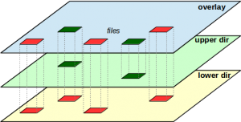
Layered filesystems
→ OS installation
→ libraries
→ application
→ apps updates
We ship this as one package – container
It has to be lightweight!
http://www.blaess.fr/christophe/2014/12/14/le-systeme-overlayfs-de-linux-3-18/

Slide 74
Docker in a nutshell – installing WP in seconds demo
Notes:
Docker search wordpress
Docker pull tutum/wordpress
docker run -d --name wordpress-tutum -p 80:80 tutum/wordpress
Docker exec -it ID bash

Slide 75
Docker in a nutshell – installing WP in seconds demo
remember #DockerKrk & infosec & devops meetups
http://www.meetup.com/Docker-Krakow-Poland/
http://www.meetup.com/Krakow-DevOps/
http://www.meetup.com/Infosec-Krakow/
Notes:
Docker search wordpress
Docker pull tutum/wordpress
docker run -d --name wordpress-tutum -p 80:80 tutum/wordpress
Docker exec -it ID bash

Slide 76
It doesn't have to be docker
LXC, LXD, systemd-nspawn etc
Just make sure it does its job
Notes:
Docker search wordpress
Docker pull tutum/wordpress
docker run -d --name wordpress-tutum -p 80:80 tutum/wordpress
Docker exec -it ID bash

Slide 77
Summing this up – learn how to use containers
so you can focus on InfoSec work not on infrastructure
mojo
You'll see how this repays :)

Slide 78
Tools overview

Slide 79
GAUNTLT - http://gauntlt.org/
→ Hooks for sectools (nmap, sslyze, sqlmap)
→ Output formatting (json and others)
→ see yourself (demo)
Notes:
Man gauntlt
gauntlt nmap/tcp_ping_ports.attack

Slide 80
nikto - https://www.cirt.net/Nikto2
→ webapp sec scanner
→ customizable reports (templates)
→ logging to metasploit
→ save full requests for positive tests
→ ...
→ see yourself (demo)
Notes:
perl nikto.pl -h http://127.0.0.1:80 -output outout_scan -Format CSV

Slide 81
nikto - https://www.cirt.net/Nikto2
And docker maybe? (demo)
https://registry.hub.docker.com/u/activeshadow/nikto/dockerfile/
Remember to verify those images..
Notes:
Docker images
Docker ps
Docker inspect ID | grep 172
docker run -it 04f9a805f8c9 nikto -h http://172.17.0.10:80

Slide 82
nikto - https://www.cirt.net/Nikto2
FROM debian:jessie
RUN apt-get update && apt-get install -y libtimedate-perl libnet-ssleay-perl \
&& rm -rf /var/lib/apt/lists/*
ADD https://cirt.net/nikto/nikto-2.1.5.tar.gz /root/
WORKDIR /opt
RUN tar xzf /root/nikto-2.1.5.tar.gz && rm /root/nikto-2.1.5.tar.gz \
&& echo "EXECDIR=/opt/nikto-2.1.5" >> nikto-2.1.5/nikto.conf \
&& ln -s /opt/nikto-2.1.5/nikto.conf /etc/nikto.conf \
&& chmod +x nikto-2.1.5/nikto.pl && ln -s /opt/nikto-2.1.5/nikto.pl /usr/local/bin/nikto \
&& nikto -update
WORKDIR /root
CMD ["nikto"]
Notes:
perl nikto.pl -h http://127.0.0.1:80

Slide 83
wapiti - http://wapiti.sourceforge.net/
→ webapp sec scanner
→ rich vulns detection (see docs)
→ JSON reports (and some other formats)
→ suspend / resume attack
→ modular
→ ...
→ see yourself (demo)
Notes:
python bin/wapiti http://127.0.0.1:80 --format json

Slide 84
skipfish - https://code.google.com/p/skipfish
→ webapp sec scanner
→ high performance
→ easy to use
→ rich vulns detection (see docs)
→ ...
→ see yourself (demo)
Notes:
./skipfish -u -o output_dir2 -S dictionaries/minimal.wl -W new_dict.wl http://127.0.0.1:80

Slide 85
mittn - https://github.com/F-Secure/mittn
→ high level testing suite
→ alternative for Gauntlt
→ no required low-level knowledge about tools
→ Python / Behave (BDD)
→ automated web scanning w/Burp (BSPAS)
→ tls w/sslyze
→ HTTP api fuzzing w/Radamsa
Notes:
Burp suite professional active scanner

Slide 86
OWASP + DevOps (by Mateusz Olejarka)
https://www.owasp.org/images/d/df/Owasp_plus_devops.pptx
→ OWASP dependency check
→ OWASP dependency track
→ OWASP ESAPI
→ OWASP AppSensor
→ OWASP Zed Attack Proxy
→ O-Saft
Notes:
Dependency check – libs dependencies do znanych podatności
Dependency track – bza danyc tychze bibliotek I podatnosci
Appsensor – wbudowywanie aplikacje detekcji zachowan na podstawie wykonywanych akcji
-osaft – sslyze ;)

Slide 87
How to deal with false negs / pos?
→ actually human analysis is always required
→ before “feedback loop” check yourself if it's red
→ mark, hide, automate

Slide 88
Demo
→ install docker
→ install jenkins
→ install owasp-zap container
→ install wordpress container
→ configure scan job
→ run it
→ try w/docker inside docker:
http://www.jayway.com/2015/03/14/docker-in-docker-with-jenkins-and-supervisord/
Notes:
Docker search / pull jenkins
Docker search owasp
docker run -u zap -i owasp/zap2docker-stable zapr --debug --summary http://172.17.0.10:80

Slide 89
Looking for a job?
Information Security Manager
Catch me: maciek@lasyk.info

Slide 90
Continuous Security in DevOps
Maciej Lasyk
@docent-net
http://maciej.lasyk.info
4developers – Warsaw
2015-04-20

