Slide 1

Under the dome
(of failure driven pipeline)
Maciej Lasyk
4developers – Warsaw
2015-04-20

Slide 2

Join Fedora Infrastructure!
- learn Ansible
- learn Docker with Fedora Dockerfiles
http://fedoraproject.org/en/join-fedora

Slide 3
Agenda?
Don't run away ;)
Notes:
- na początek trochę laia wody – ale istotnego
- Potem bardziej technicznie

Slide 4
[…]
Situations like this only reinforce my deep suspicion of
developers: They're often carelessly breaking things and
then disappearing, leaving Operations to clean up the
Mess.
[…]
“The Phoenix Project”
by Gene Kim, Kevin Behr and George Spafford
Notes:
- na początek trochę laia wody – ale istotnego
- Potem bardziej technicznie

Slide 5

Notes:
- na początek trochę laia wody – ale istotnego
- Potem bardziej technicznie

Slide 6

Notes:
- na początek trochę laia wody – ale istotnego
- Potem bardziej technicznie

Slide 7


Slide 8
Conway's law (1968)
organizations which design systems ... are constrained to produce designs which are copies of the communication structures of these organizations
http://en.wikipedia.org/wiki/Conway%27s_law

Slide 9
Ruth Malan (2008)
if the architecture of the system and the architecture of the organization are at odds, the architecture of the organization wins.
The organizational divides are going to drive the true seams in the system.
http://traceinthesand.com/blog/2008/02/13/conways-law/

Slide 10
Yup, you're gut is telling truth...

Slide 11
Yup, you're gut is telling truth...
This will be another devops indoctrination

Slide 12
Yup, you're gut is telling truth...
This will be another devops indoctrination
What did you expect? ;)

Slide 13
Yup, you're gut is telling truth...
This will be another devops indoctrination
What did you expect? ;)
This presentation includes gentle product placement

Slide 14


Yup, you're gut is telling truth...
This will be another devops indoctrination
What did you expect? ;)
This presentation includes gentle product placement

Slide 15
DevOps Anti-Types & patterns
This is a copy/paste from http://blog.matthewskelton.net/
w/my comments included
Great job Matthew! Thanks!

Slide 16
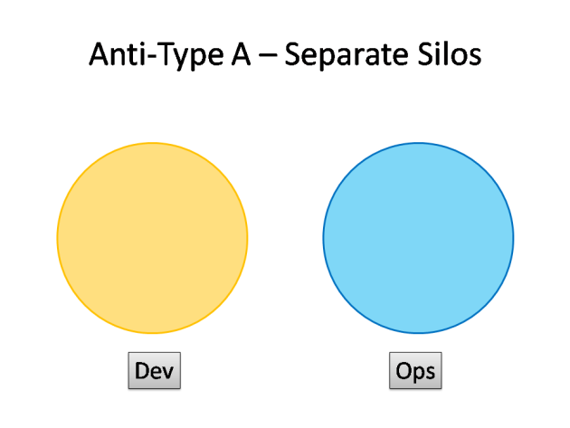
DevOps Anti-Types
http://blog.matthewskelton.net/2013/10/22/what-team-structure-is-right-for-devops-to-flourish/

Slide 17
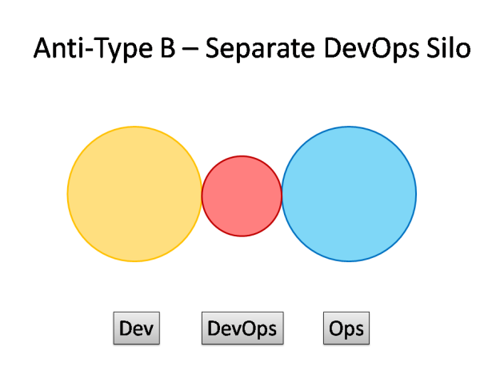
DevOps Anti-Types
http://blog.matthewskelton.net/2013/10/22/what-team-structure-is-right-for-devops-to-flourish/

Slide 18
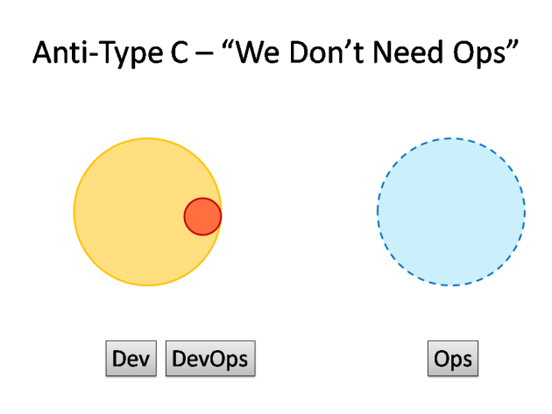
DevOps Anti-Types
http://blog.matthewskelton.net/2013/10/22/what-team-structure-is-right-for-devops-to-flourish/

Slide 19
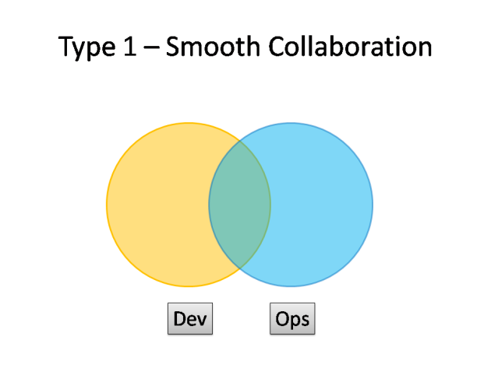
DevOps Patterns
http://blog.matthewskelton.net/2013/10/22/what-team-structure-is-right-for-devops-to-flourish/

Slide 20
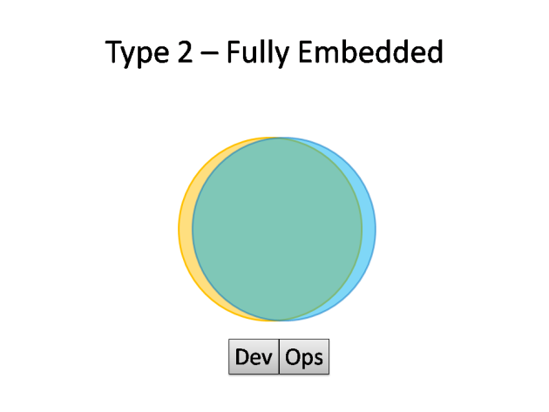
DevOps Patterns
http://blog.matthewskelton.net/2013/10/22/what-team-structure-is-right-for-devops-to-flourish/

Slide 21
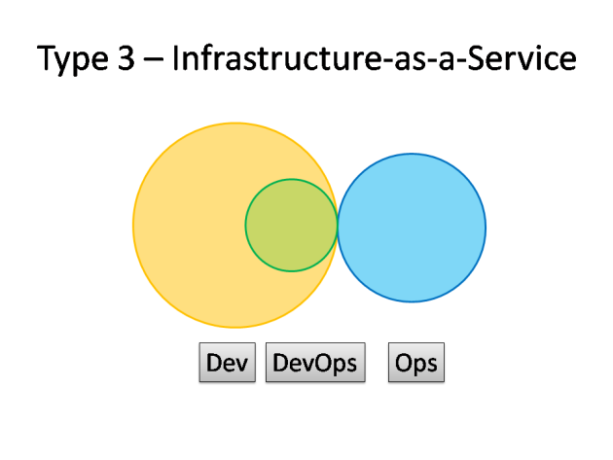
DevOps Patterns
http://blog.matthewskelton.net/2013/10/22/what-team-structure-is-right-for-devops-to-flourish/

Slide 22
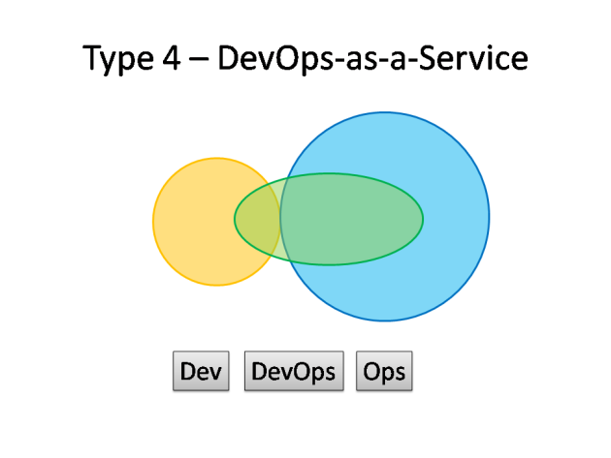
DevOps Patterns
http://blog.matthewskelton.net/2013/10/22/what-team-structure-is-right-for-devops-to-flourish/

Slide 23
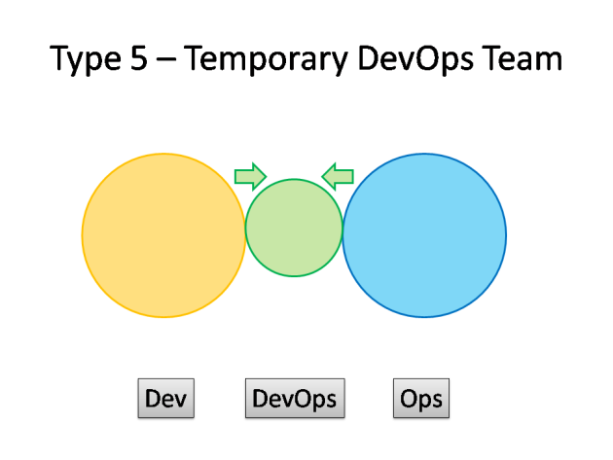
DevOps Patterns
http://blog.matthewskelton.net/2013/10/22/what-team-structure-is-right-for-devops-to-flourish/

Slide 24
Ok let's CAMS

Slide 25
DevOPS ?== CAMS
(culture, automation, measurement, sharing)

Slide 26
DevOPS !== CAMS
DevOPS === people!

Slide 27
culture
automation
People
measurement
sharing

Slide 28
C for Culture
A for Automation
M for Monitoring
S for Sharing
Notes:
Tutaj info o historii devopsów – począwszy od 1 – osobowej instytycji

Slide 29

Notes:
Tutaj info o historii devopsów – począwszy od 1 – osobowej instytycji

Slide 30

Notes:
Tutaj info o historii devopsów – począwszy od 1 – osobowej instytycji

Slide 31
Is there a need for change?
“agile” and “cloud”:
→ focus on delivery
→ close collaboration
→ lightweight environment and components
Notes:
Tutaj info o historii devopsów – począwszy od 1 – osobowej instytycji

Slide 32
cultural change
modification of a society through innovation, invention, discovery, or contact with other societies

Slide 33
Dead sea effect
→ most talented evaporates
→ the residue
→ maintenance experts & bus factor == 1
http://brucefwebster.com/2008/04/11/the-wetware-crisis-the-dead-sea-effect/

Slide 34
→ talk. often. and get along
→ take responsibility - from beginning to the end
→ continuous improvement. seriously
→ be brave. don't be silent
→ it's better to be unpolite l/German than polite l/Englishman

Slide 35
GTD? (getting things done)

Slide 36
GTD? (getting things done)
JFDI? (just fuckin' do it)

Slide 37
GTD? (getting things done)
JFDI? (just fuckin' do it)
MFBT? (move fast, break things)

Slide 38
GTD + JFDI + MFBT = FCH

Slide 39
GTD + JFDI + MFBT = FCH
(Fuckin' Customer Happy)

Slide 40
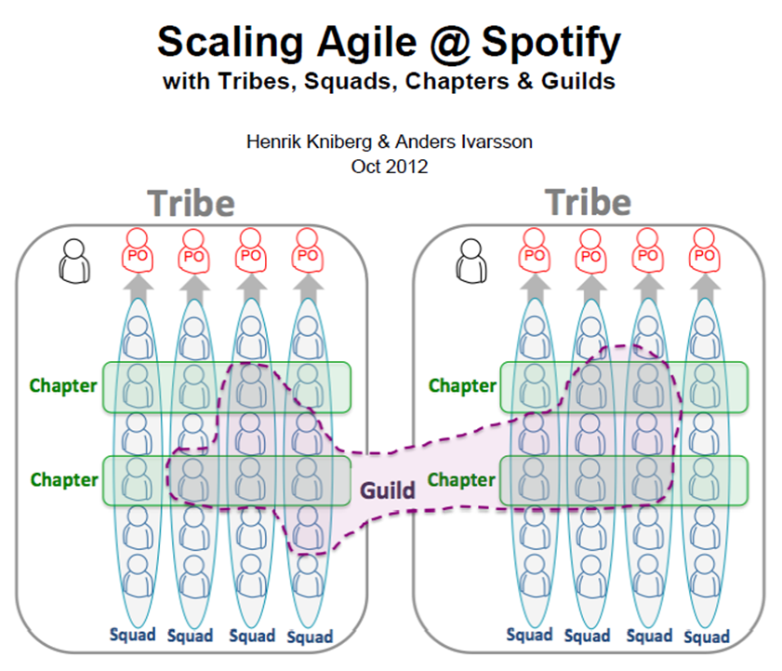

Slide 41
C for Culture
A for Automation
M for Monitoring
S for Sharing
Notes:
Tutaj info o historii devopsów – począwszy od 1 – osobowej instytycji

Slide 42
Automation is big for most sysadmins. We’re inherently lazy, so the idea of pushing a button and making programs work for us? Appealing.
Standalone Sysadmin
http://www.standalone-sysadmin.com/blog/2011/04/view-from-the-other-side/

Slide 43
→ it has to be simple
→ don't reinvent the wheel. don't fabric
→ automate from very beginning

Slide 44

→ repeatable tasks leads to automation

Slide 45
→ repeatable tasks leads to automation
→ automation leads to consistency

Slide 46
→ repeatable tasks leads to automation
→ automation leads to consistency
→ consistency reduces errors

Slide 47
→ repeatable tasks leads to automation
→ automation leads to consistency
→ consistency reduces errors
→ reducing errors leads to stable environment

Slide 48
→ repeatable tasks leads to automation
→ automation leads to consistency
→ consistency reduces errors
→ reducing errors leads to stable environment
→ stable environment leads to less unplanned work

Slide 49
→ repeatable tasks leads to automation
→ automation leads to consistency
→ consistency reduces errors
→ reducing errors leads to stable environment
→ stable environment leads to less unplanned work
→ less unplanned work leads to focus on delivery

Slide 50
Remember?
http://blog.matthewskelton.net/2013/10/22/what-team-structure-is-right-for-devops-to-flourish/

Slide 51
Short story of Anti-Type C
“we don't need ops”
# it's madness with paths for different users and such option as:
# sudo su
# sudo -i
# su -
# su
# that is why we add variables to two places
ENVIRONMENT_FILE = '/etc/environment'
PROFILE_FILE = '/etc/profile'
INITIAL_PATH = '/usr/local/bin:/usr/bin:/bin'
# due to sudo issues (resetting PATH by /etc/sudoers)
# we have to add PATH to /root/.profile as well

Slide 52
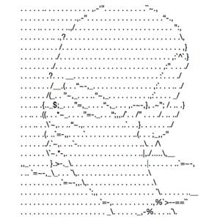
Short story of Anti-Type C
“we don't need ops”
# it's madness with paths for different users and such option as:
# sudo su
# sudo -i
# su -
# su
# that is why we add variables to two places
ENVIRONMENT_FILE = '/etc/environment'
PROFILE_FILE = '/etc/profile'
INITIAL_PATH = '/usr/local/bin:/usr/bin:/bin'
# due to sudo issues (resetting PATH by /etc/sudoers)
# we have to add PATH to /root/.profile as well

Slide 53
Short story of Anti-Type C
“we don't need ops”
Shells:
→ login
→ non-login
→ interactive
→ non – interactive

Slide 54
Short story of Anti-Type C
“we don't need ops”
Shells:
→ login
→ non-login
→ interactive
→ non – interactive
→ su
→ sudo su: interactive, non-login, .bashrc
→ sudo su -: interactive, login, /etc/profile;/root/.profile;/root/.bashrc
→ sudo -i: interactive, login, /root/.profile;/root/.bashrc;/root/.login
→ sudo /bin/bash: interactive, non-login, ~/.bashrc
→ sudo -s: reads $SHELL and executes it

Slide 55
Short story of Anti-Type C
“we don't need ops”
Shells:
→ login
→ non-login
→ interactive
→ non – interactive
→ su
→ sudo su: interactive, non-login, .bashrc
→ sudo su -: interactive, login, /etc/profile;/root/.profile;/root/.bashrc
→ sudo -i: interactive, login, /root/.profile;/root/.bashrc;/root/.login
→ sudo /bin/bash: interactive, non-login, ~/.bashrc
→ sudo -s: reads $SHELL and executes it

Slide 56
Short story of Anti-Type C
“we don't need ops”
Shells:
→ login
→ non-login
→ interactive
→ non – interactive
→ su
→ sudo su: interactive, non-login, .bashrc
→ sudo su -: interactive, login, /etc/profile;/root/.profile;/root/.bashrc
→ sudo -i: interactive, login, /root/.profile;/root/.bashrc;/root/.login
→ sudo /bin/bash: interactive, non-login, ~/.bashrc
→ sudo -s: reads $SHELL and executes it

Slide 57
Short story of Anti-Type C
“we don't need ops”
Shells:
→ login
→ non-login
→ interactive
→ non – interactive
→ su
→ sudo su: interactive, non-login, .bashrc
→ sudo su -: interactive, login, /etc/profile;/root/.profile;/root/.bashrc
→ sudo -i: interactive, login, /root/.profile;/root/.bashrc;/root/.login
→ sudo /bin/bash: interactive, non-login, ~/.bashrc
→ sudo -s: reads $SHELL and executes it

Slide 58
Short story of Anti-Type C
“we don't need ops”
Shells:
→ login
→ non-login
→ interactive
→ non – interactive
→ su
→ sudo su: interactive, non-login, .bashrc
→ sudo su -: interactive, login, /etc/profile;/root/.profile;/root/.bashrc
→ sudo -i: interactive, login, /root/.profile;/root/.bashrc;/root/.login
→ sudo /bin/bash: interactive, non-login, ~/.bashrc
→ sudo -s: reads $SHELL and executes it

Slide 59
Short story of Anti-Type C
“we don't need ops”
Shells:
→ login
→ non-login
→ interactive
→ non – interactive
→ su
→ sudo su: interactive, non-login, .bashrc
→ sudo su -: interactive, login, /etc/profile;/root/.profile;/root/.bashrc
→ sudo -i: interactive, login, /root/.profile;/root/.bashrc;/root/.login
→ sudo /bin/bash: interactive, non-login, ~/.bashrc
→ sudo -s: reads $SHELL and executes it

Slide 60
def is_ubuntu():
return run("uname -a | grep Ubuntu | wc -l") == "1"
def install_apache_fix():
if is_ubuntu():
if exists("/lib/x86_64-linux-gnu/libssl.so.0.9.8"):
print "libssl.so.0.9.8 already installed - SKIPPING"
else:
sudo("apt-get -y install libssl0.9.8")
else:
#Debian
if exists("/usr/lib/libssl.so.0.9.8"):
print "libssl.so.0.9.8 already installed - SKIPPING"
else:
#download if necessary
url = "http://.../libssl0.9.8_0.9.8o-squeeze14_amd64.deb"
if download.sync_opt_download(_download_libssl_lock, url, store_file_path):
sudo('chmod ug+x %s' % store_file_path)
sudo("dpkg -i %s" % store_file_path)

Slide 61
def is_ubuntu():
return run("uname -a | grep Ubuntu | wc -l") == "1" /etc/issue maybe?
def install_apache_fix():
if is_ubuntu():
if exists("/lib/x86_64-linux-gnu/libssl.so.0.9.8"):
print "libssl.so.0.9.8 already installed - SKIPPING"
else:
sudo("apt-get -y install libssl0.9.8")
else:
#Debian
if exists("/usr/lib/libssl.so.0.9.8"):
print "libssl.so.0.9.8 already installed - SKIPPING"
else:
#download if necessary
url = "http://.../libssl0.9.8_0.9.8o-squeeze14_amd64.deb"
if download.sync_opt_download(_download_libssl_lock, url, store_file_path):
sudo('chmod ug+x %s' % store_file_path)
sudo("dpkg -i %s" % store_file_path)

Slide 62
def is_ubuntu():
return run("uname -a | grep Ubuntu | wc -l") == "1"
def install_apache_fix():
if is_ubuntu():
if exists("/lib/x86_64-linux-gnu/libssl.so.0.9.8"):
print "libssl.so.0.9.8 already installed - SKIPPING"
else:
sudo("apt-get -y install libssl0.9.8")
else:
#Debian
if exists("/usr/lib/libssl.so.0.9.8"):
print "libssl.so.0.9.8 already installed - SKIPPING"
else:
#download if necessary
url = "http://.../libssl0.9.8_0.9.8o-squeeze14_amd64.deb"
if download.sync_opt_download(_download_libssl_lock, url, store_file_path):
sudo('chmod ug+x %s' % store_file_path)
sudo("dpkg -i %s" % store_file_path)

Slide 63
def is_ubuntu():
return run("uname -a | grep Ubuntu | wc -l") == "1"
def install_apache_fix():
if is_ubuntu():
if exists("/lib/x86_64-linux-gnu/libssl.so.0.9.8"): ldconfig maybe?
print "libssl.so.0.9.8 already installed - SKIPPING"
else:
sudo("apt-get -y install libssl0.9.8")
else:
#Debian
if exists("/usr/lib/libssl.so.0.9.8"):
print "libssl.so.0.9.8 already installed - SKIPPING"
else:
#download if necessary
url = "http://.../libssl0.9.8_0.9.8o-squeeze14_amd64.deb"
if download.sync_opt_download(_download_libssl_lock, url, store_file_path):
sudo('chmod ug+x %s' % store_file_path)
sudo("dpkg -i %s" % store_file_path)

Slide 64
def is_ubuntu():
return run("uname -a | grep Ubuntu | wc -l") == "1"
def install_apache_fix():
if is_ubuntu():
if exists("/lib/x86_64-linux-gnu/libssl.so.0.9.8"):
print "libssl.so.0.9.8 already installed - SKIPPING"
else:
sudo("apt-get -y install libssl0.9.8")
else:
#Debian
if exists("/usr/lib/libssl.so.0.9.8"):
print "libssl.so.0.9.8 already installed - SKIPPING"
else:
#download if necessary
url = "http://.../libssl0.9.8_0.9.8o-squeeze14_amd64.deb"
if download.sync_opt_download(_download_libssl_lock, url, store_file_path):
sudo('chmod ug+x %s' % store_file_path)
sudo("dpkg -i %s" % store_file_path)

Slide 65
def is_ubuntu():
return run("uname -a | grep Ubuntu | wc -l") == "1"
def install_apache_fix():
if is_ubuntu():
if exists("/lib/x86_64-linux-gnu/libssl.so.0.9.8"):
print "libssl.so.0.9.8 already installed - SKIPPING"
else:
sudo("apt-get -y install libssl0.9.8")
else:
#Debian What about RHEL, Fedora, Slackware, Gentoo?
if exists("/usr/lib/libssl.so.0.9.8"):
print "libssl.so.0.9.8 already installed - SKIPPING"
else:
#downl. if necessary So whole this is for particular distro version?
url = "http://.../libssl0.9.8_0.9.8o-squeeze14_amd64.deb"
if download.sync_opt_download(_download_libssl_lock, url, store_file_path):
sudo('chmod ug+x %s' % store_file_path)
sudo("dpkg -i %s" % store_file_path)

Slide 66
def is_ubuntu():
return run("uname -a | grep Ubuntu | wc -l") == "1"
def install_apache_fix():
if is_ubuntu():
if exists("/lib/x86_64-linux-gnu/libssl.so.0.9.8"):
print "libssl.so.0.9.8 already installed - SKIPPING"
else:
sudo("apt-get -y install libssl0.9.8")
else:
#Debian
if exists("/usr/lib/libssl.so.0.9.8"):
print "libssl.so.0.9.8 already installed - SKIPPING"
else:
#downl. if necessary
url = "http://libssl0.9.8_0.9.8o-squeeze14_amd64.deb"
if download.sync_opt_download(_download_libssl_lock, url, store_file_path):
sudo('chmod ug+x %s' % store_file_path)
sudo("dpkg -i %s" % store_file_path)

Slide 67
def is_ubuntu():
return run("uname -a | grep Ubuntu | wc -l") == "1"
def install_apache_fix():
if is_ubuntu():
if exists("/lib/x86_64-linux-gnu/libssl.so.0.9.8"):
print "libssl.so.0.9.8 already installed - SKIPPING"
else:
sudo("apt-get -y install libssl0.9.8")
else:
#Debian
if exists("/usr/lib/libssl.so.0.9.8"):
print "libssl.so.0.9.8 already installed - SKIPPING"
else:
#downl. if necessary
url = "http://libssl0.9.8_0.9.8o-squeeze14_amd64.deb"
if download.sync_opt_download(_download_libssl_lock, url, store_file_path):
sudo('chmod ug+x %s' % store_file_path) # declarative madness
sudo("dpkg -i %s" % store_file_path)

Slide 68
Imperativeness vs declarativeness

Slide 69
Imperativeness vs declarativeness
def configure(dst_dir, config_properties, installer_file):
_copy_conf_file(dst_dir, properties)
def _copy_conf_file(dst_dir, properties):
sudo("cp %s %s" % (srcConfigPath, targetConfigPath))
change_directory_owner(targetConfigPath)
sudo('chmod ug+x %s' % store_file_path)
- name: configure this
hosts: all
tasks:
- name: copy conf file
file: >
src={{ some_source }}
dest={{ some_destination }}
perms=0750

Slide 70
Imperativeness vs declarativeness
def configure(dst_dir, config_properties, installer_file):
_copy_conf_file(dst_dir, properties)
def _copy_conf_file(dst_dir, properties):
sudo("cp %s %s" % (srcConfigPath, targetConfigPath))
change_directory_owner(targetConfigPath)
sudo('chmod ug+x %s' % store_file_path)
- name: configure this
hosts: all
tasks:
- name: copy conf file
file: >
src={{ some_source }}
dest={{ some_destination }}
perms=0750

Slide 71


Slide 72
→ flat learning curve

Slide 73
→ flat learning curve
→ doesn't required additional resources

Slide 74
→ flat learning curve
→ doesn't required additional resources
→ fit for maintenance jobs / procedures

Slide 75
→ flat learning curve
→ doesn't required additional resources
→ fit for maintenance jobs / procedures
→ great for any containers as non-daemon

Slide 76
→ flat learning curve
→ doesn't required additional resources
→ fit for maintenance jobs / procedures
→ great for any containers as non-daemon
→ deals with “deployment specs”

Slide 77
→ flat learning curve
→ doesn't required additional resources
→ fit for maintenance jobs / procedures
→ great for any containers as non-daemon
→ deals with “deployment specs”
→ might be easily adopted as universal language

Slide 78
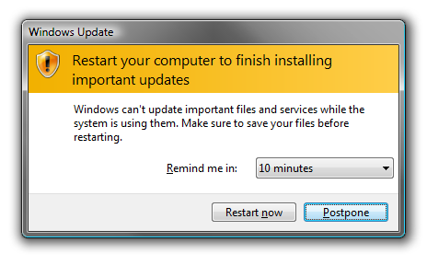

Slide 79
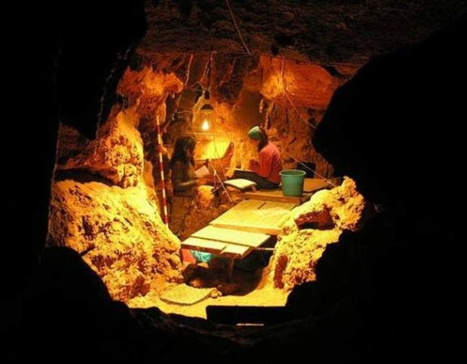
Notes:
W 2010 roku archeolodzy znaleźli w Hiszpanii ślady czegoś, co można uznać za ślady ataku kanibali na rodzinę neandertalczyków. Badacze odgrzebali kości trzech dorosłych mężczyzn oraz kobiet. Wszystkie kości nosiły ślady obgryzania i przeżuwania.

Slide 80
→selinux enforcing i -rw-r--r--. stash stash
unconfined_u:object_r:mysqld_db_t:s0 authorized_keys
→/etc/ssh/sshd_config && /etc/network/interfaces
→ iptables-save nope?
→ broken _netfs ?

Slide 81

Notes:
W 1952 roku w Danii odkryto szczątki około 30-letniego mężczyzny. Człowiek ten umarł na skutek poderżnięcia gardła, aczkolwiek miał również połamaną czaszkę i nogi. Nieznane są jednak okoliczności jego śmierci, nie wiadomo, czy było to morderstwo, czy na przykład obrządek religijny

Slide 82
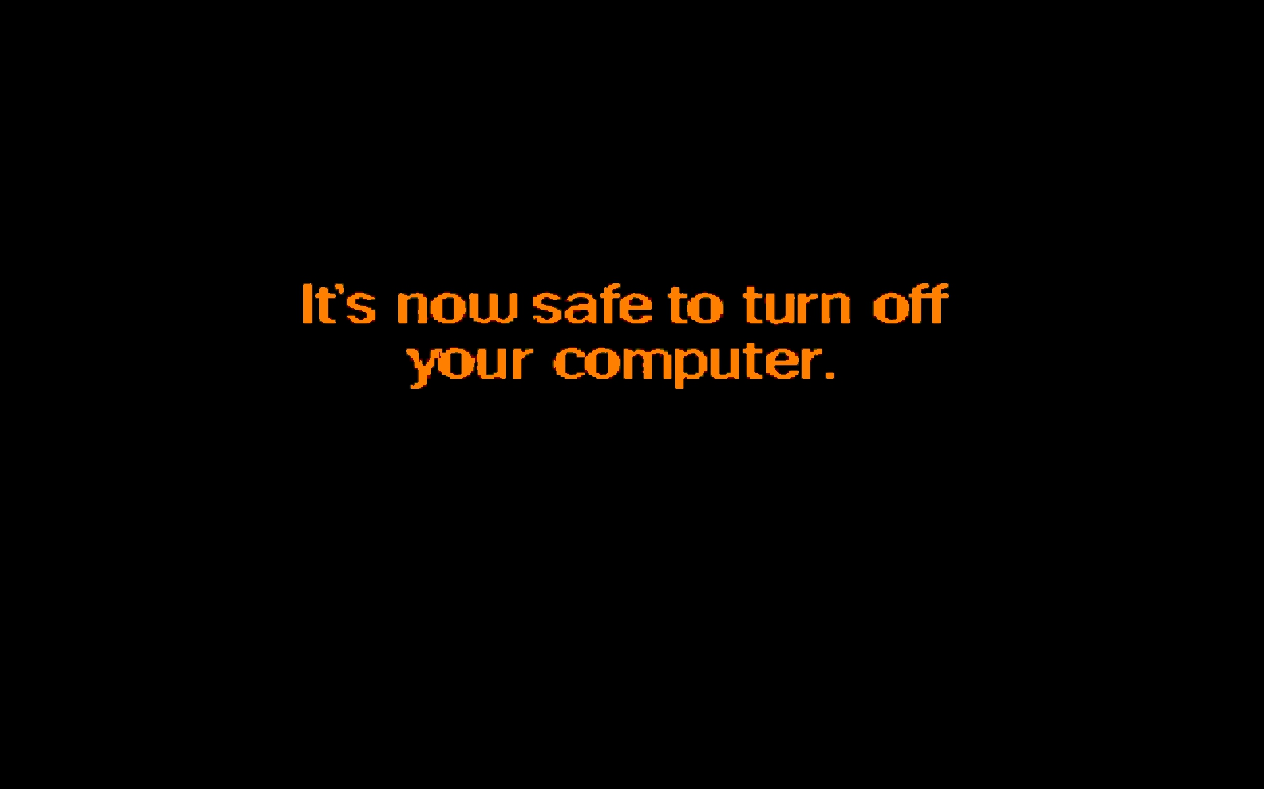

Slide 83
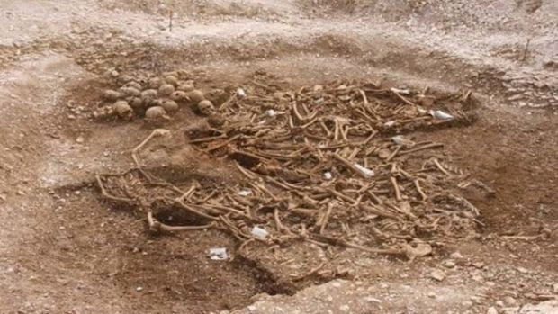
Notes:
Gdy pracownicy kolei kopali rowy pod nową linię kolejową w hrabstwie Dorset w Anglii, dokonali makabrycznego odkrycia. Trafili na zbiorową mogiłę wikingów pozbawionych głów. Początkowo podejrzewano, że miejscowi chłopi mogli dokonać krwawej zemsty na najeźdźcach, ale po dokładniejszych oględzinach okazało się, że cięcia były zbyt czyste i zbyt gładkie. Dodatkowo w przypadku egzekucji cięcia powinny prowadzić od tyłu do przodu, a w tym wypadku było na odwrót. Do dziś nie wiadomo co tu się wydarzyło.

Slide 84
What if...
→ ./configure && make && make install → .zip
→ Dev & Ops have 2 different build & installation methods?
Plz..
→ pkg repos (or Nexus)
→ use fpm for creating pkgs if needed (demo)
Notes:
Make install DESTDIR=../nginx-dest
Fpm -s dir -t rpm -n “nginx-fpm” -C ../nginx-dest
Fpm -s dir -t deb -n “nginx-fpm” -C ../nginx-dest

Slide 85
C for Culture
A for Automation
M for Monitoring
S for Sharing
Notes:
Tutaj info o historii devopsów – począwszy od 1 – osobowej instytycji

Slide 86
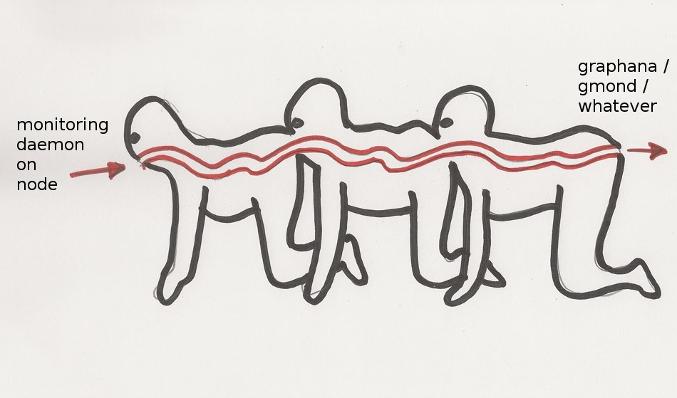

Slide 87
→ make developers create monitoring
→ find yourself between RRD and InfluxDB
→ will product team be able to query your monitoring DB?
→ Etsy case (Ganglia / Graphite)

Slide 88
→ make developers create monitoring
→ find yourself between RRD and InfluxDB
→ will product team be able to query your monitoring DB?
→ Etsy case (Ganglia / Graphite)

Slide 89
→ make developers create monitoring
→ find yourself between RRD and InfluxDB
→ will product team be able to query your monitoring DB?
→ Etsy case (Ganglia / Graphite)

Slide 90
→ make developers create monitoring
→ find yourself between RRD and InfluxDB
→ will product team be able to query your monitoring DB?
→ Etsy case (Ganglia / Graphite)

Slide 91
C for Culture
A for Automation
M for Monitoring
S for Sharing
Notes:
Tutaj info o historii devopsów – począwszy od 1 – osobowej instytycji

Slide 92
→ learn on OPS mistakes
→ Major Incident Reports – source of improvement
→ Learn developers about change management
→ Make CM an easy process. Use simple tools.

Slide 93
→ learn on OPS mistakes
→ Major Incident Reports – source of improvement
→ Learn developers about change management
→ Make CM an easy process. Use simple tools.

Slide 94
→ learn on OPS mistakes
→ Major Incident Reports – source of improvement
→ Learn developers about change management
→ Make CM an easy process. Use simple tools.

Slide 95
→ learn on OPS mistakes
→ Major Incident Reports – source of improvement
→ Learn developers about change management
→ Make CM an easy process. Use simple tools.

Slide 96
Let's arch the infrastructure

Slide 97
Addressing the space
→ VLSM
→ DHCP & DDNS
→ KISS: flat networks!
→ stop /24!

Slide 98
Addressing the space
→ VLSM
→ DHCP & DDNS
→ KISS: flat networks!
→ stop /24!

Slide 99
Addressing the space
→ VLSM
→ DHCP & DDNS
→ KISS: flat networks!
→ stop /24!

Slide 100
Addressing the space
→ VLSM
→ DHCP & DDNS
→ KISS: flat networks!
→ stop /24!

Slide 101
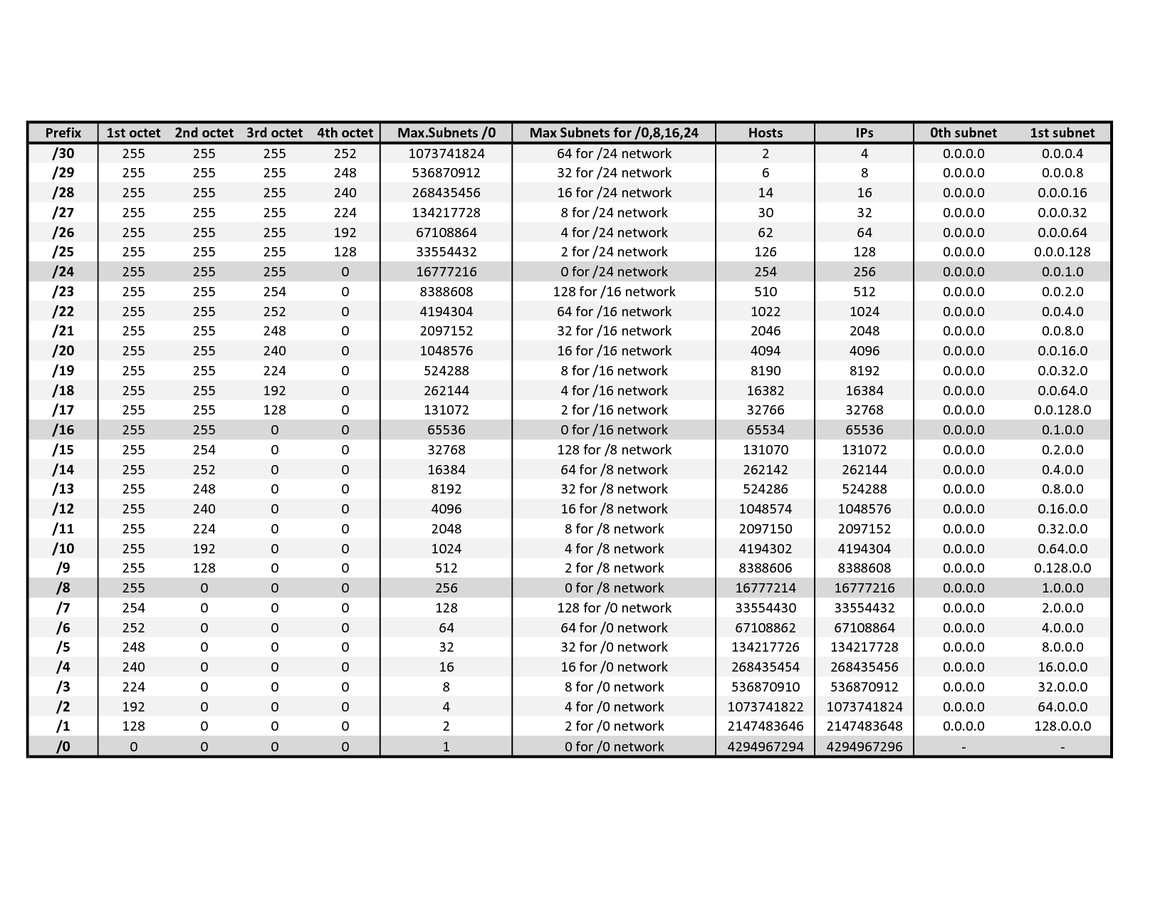

Slide 102
What about DNS?
→ BIND roxx (views etc)
→ KISS: maybe decentralized w/Ansible?

Slide 103
view "internal-view" {
match-clients { internal; };
recursion yes;
zone "lasyk.info" IN {
type master;
file "internal.lasyk.info.conf";
allow-transfer { any; }
};
view "external-view" {
match-clients { any; };
recursion no;
zone "lasyk.info" IN {
type master;
file "external.lasyk.info.conf";
allow-transfer { none; };
};

Slide 104
view "internal-view" {
match-clients { internal; };
recursion yes;
zone "lasyk.info" IN {
type master;
file "internal.lasyk.info.conf";
allow-transfer { any; }
};
view "external-view" {
match-clients { any; };
recursion no;
zone "lasyk.info" IN {
type master;
file "external.lasyk.info.conf";
allow-transfer { none; };
};

Slide 105
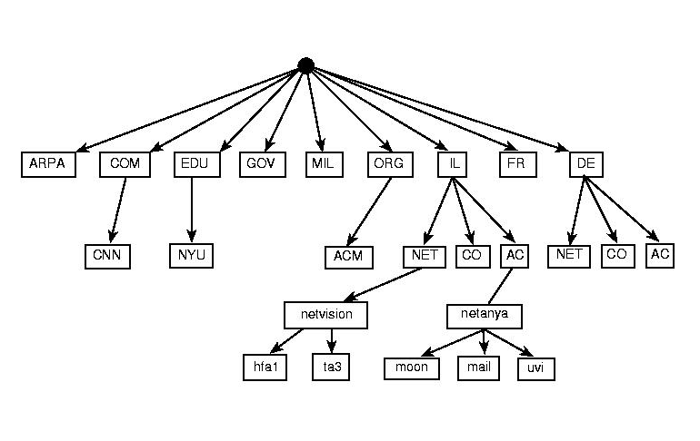

Slide 106
Linux containers equation
Linux Containers = namespaces + cgroups + storage
Notes:
systemctl status docker -l
cd /etc/sysconfig
ls docker*
vim docker-storage
restart...

Slide 107
control groups (cgroups)
Control Groups provide a mechanism for
aggregating/partitioning sets of tasks, and
all their future children, into hierarchical groups
with specialized behavior
Notes:
Google, 2006 (process containers), 2007 published as control groups
Podział procesów na grupy hierarhiczne
Kernel zarządza dostępem do wybrancyh kontrolerów (subsystemów)

Slide 108
control groups (cgroups)
→grouping processes
→allocating resources to particular groups
→memory
→network
→CPU
→storage bandwidth (I/O throttling)
→device whitelisting

Slide 109
control groups (cgroups)
→grouping processes
→allocating resources to particular groups
→memory
→network
→CPU
→storage bandwidth (I/O throttling)
→device whitelisting

Slide 110
control groups (cgroups)
→grouping processes
→allocating resources to particular groups
→memory
→network
→CPU
→storage bandwidth (I/O throttling)
→device whitelisting

Slide 111
control groups (cgroups)
→grouping processes
→allocating resources to particular groups
→memory
→network
→CPU
→storage bandwidth (I/O throttling)
→device whitelisting

Slide 112
control groups (cgroups)
→grouping processes
→allocating resources to particular groups
→memory
→network
→CPU
→storage bandwidth (I/O throttling)
→device whitelisting

Slide 113
control groups (cgroups)
→grouping processes
→allocating resources to particular groups
→memory
→network
→CPU
→storage bandwidth (I/O throttling)
→device whitelisting

Slide 114
control groups (cgroups)
→grouping processes
→allocating resources to particular groups
→memory
→network
→CPU
→storage bandwidth (I/O throttling)
→device whitelisting

Slide 115
control groups (cgroups)
little demo?
Notes:
ps -o cgroup
cat /proc/self/cgroup
cgcreate -t docent:docent -g cpu:/test-subgroup1
cgset -r cpuset.cpus=0 test-subgroup1
cgexec -g cpu:-subgroup1 /bin/bash
cgdelete -g cpu:/test-subgroup1
ps -o cgroup
cat /proc/self/cgroup
Cd /sys/fs/cgroup/memory
Ls
Mkdir test1 && cd test1 && ls
Cat memory.iimit_in_bytes
echo 104857600 > memory.limit_in_bytes
Cat memory.limit_in_bytes && Cat memory.oom_control
Echo $$ >> tasks
Vim ~/mem-hog.c && ~/mem-hog
Echo 1 > memory.oom_control
~/mem-hog I na drugiej konsoli cat memory.oom_control
Echo 0 > memory.oom_control

Slide 116
Kernel Namespaces
Providing a unique views of the system for processes.
→ PID – PIDs isolation
→ NET – network isolation (via virt-ifaces; demo)
→ IPC – won't use this
→ MNT – chroot like; deals w/mountpoints
→ UTS – deals w/hostname
Notes:
PID: pid 1, main view different PIDs
NET: own routing table, iptables rules and chains

Slide 117
Kernel Namespaces
Providing a unique views of the system for processes.
→ PID – PIDs isolation
→ NET – network isolation (via virt-ifaces; demo)
→ IPC – won't use this
→ MNT – chroot like; deals w/mountpoints
→ UTS – deals w/hostname
Notes:
PID: pid 1, main view different PIDs
NET: own routing table, iptables rules and chains

Slide 118
Kernel Namespaces
Providing a unique views of the system for processes.
→ PID – PIDs isolation
→ NET – network isolation (via virt-ifaces; demo)
→ IPC – won't use this
→ MNT – chroot like; deals w/mountpoints
→ UTS – deals w/hostname
Notes:
PID: pid 1, main view different PIDs
NET: own routing table, iptables rules and chains

Slide 119
Kernel Namespaces
Providing a unique views of the system for processes.
→ PID – PIDs isolation
→ NET – network isolation (via virt-ifaces; demo)
→ IPC – won't use this
→ MNT – chroot like; deals w/mountpoints
→ UTS – deals w/hostname
Notes:
PID: pid 1, main view different PIDs
NET: own routing table, iptables rules and chains

Slide 120
Kernel Namespaces
Providing a unique views of the system for processes.
→ PID – PIDs isolation
→ NET – network isolation (via virt-ifaces; demo)
→ IPC – won't use this
→ MNT – chroot like; deals w/mountpoints
→ UTS – deals w/hostname
Notes:
PID: pid 1, main view different PIDs
NET: own routing table, iptables rules and chains

Slide 121
Kernel Namespaces
Providing a unique views of the system for processes.
→ PID – PIDs isolation
→ NET – network isolation (via virt-ifaces; demo)
→ IPC – won't use this
→ MNT – chroot like; deals w/mountpoints
→ UTS – deals w/hostname
Notes:
PID: pid 1, main view different PIDs
NET: own routing table, iptables rules and chains

Slide 122
Kernel Namespaces
Providing a unique views of the system for processes.
→ PID – PIDs isolation
→ NET – network isolation (via virt-ifaces; demo)
→ IPC – won't use this
→ MNT – chroot like; deals w/mountpoints
→ UTS – deals w/hostname
Notes:
PID: pid 1, main view different PIDs
NET: own routing table, iptables rules and chains

Slide 123
Kernel Namespaces
little demo?
Notes:
ip netns list
ip netns add green
ip link add veth0 type veth peer name veth1
ip link list
ip link set veth1 netns green
ip netns exec green ip link list
ip netns exec green ip addr add 10.11.12.13/24 dev veth1
ip netns exec green ip a

Slide 124
OverlayFS
→ hell fast (you'll see)
→ page cache sharing
→ finally in upstream kernel (in rhel from 7.2)
→ finally supported by docker (-s overlay)
→ SELinux not there yet (but will be)

Slide 125
OverlayFS
→ hell fast (you'll see)
→ page cache sharing
→ finally in upstream kernel (in rhel from 7.2)
→ finally supported by docker (-s overlay)
→ SELinux not there yet (but will be)

Slide 126
OverlayFS
→ hell fast (you'll see)
→ page cache sharing
→ finally in upstream kernel (in rhel from 7.2)
→ finally supported by docker (-s overlay)
→ SELinux not there yet (but will be)

Slide 127
OverlayFS
→ hell fast (you'll see)
→ page cache sharing
→ finally in upstream kernel (in rhel from 7.2)
→ finally supported by docker (-s overlay)
→ SELinux not there yet (but will be)

Slide 128
OverlayFS
→ hell fast (you'll see)
→ page cache sharing
→ finally in upstream kernel (in rhel from 7.2)
→ finally supported by docker (-s overlay)
→ SELinux not there yet (but will be)

Slide 129
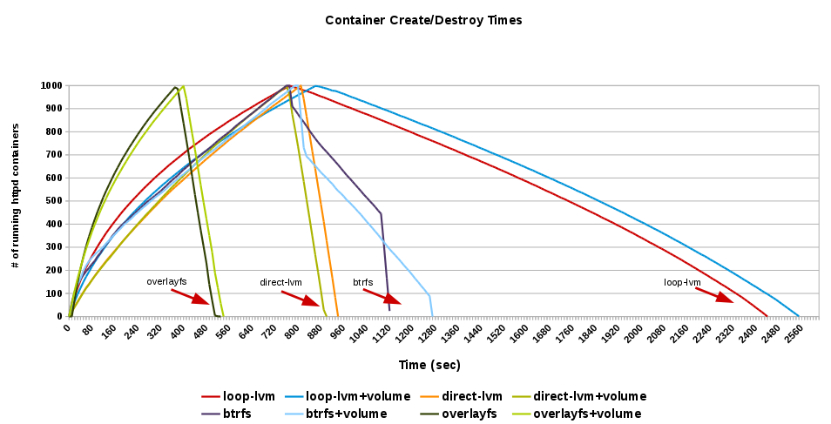
OverlayFS
http://developerblog.redhat.com/2014/09/30/overview-storage-scalability-docker/

Slide 130
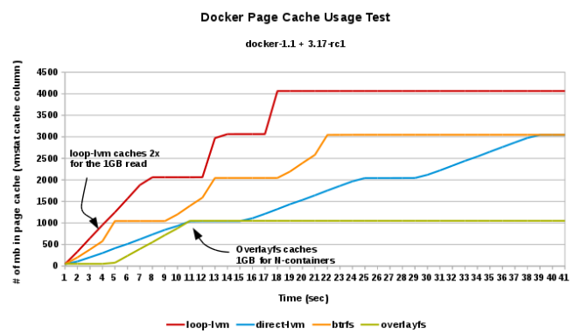
OverlayFS
http://developerblog.redhat.com/2014/09/30/overview-storage-scalability-docker/

Slide 131
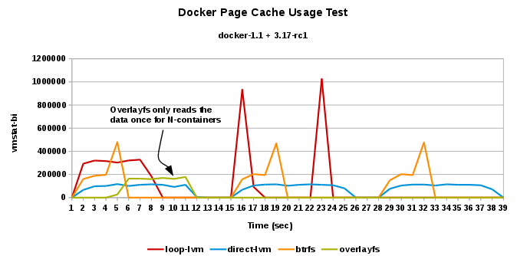
OverlayFS
http://developerblog.redhat.com/2014/09/30/overview-storage-scalability-docker/

Slide 132
Developers' envs?
→ use containers!
→ configure cgroups
→ use LXC / LXC Web Panel
→ use Ansible for spinning up anything!

Slide 133
Developers' envs?
→ use containers!
→ configure cgroups
→ use LXC / LXC Web Panel
→ use Ansible for spinning up anything!

Slide 134
Developers' envs?
→ use containers!
→ configure cgroups
→ use LXC / LXC Web Panel
→ use Ansible for spinning up anything!

Slide 135
Developers' envs?
→ use containers!
→ configure cgroups
→ use LXC / LXC Web Panel
→ use Ansible for spinning up anything!

Slide 136
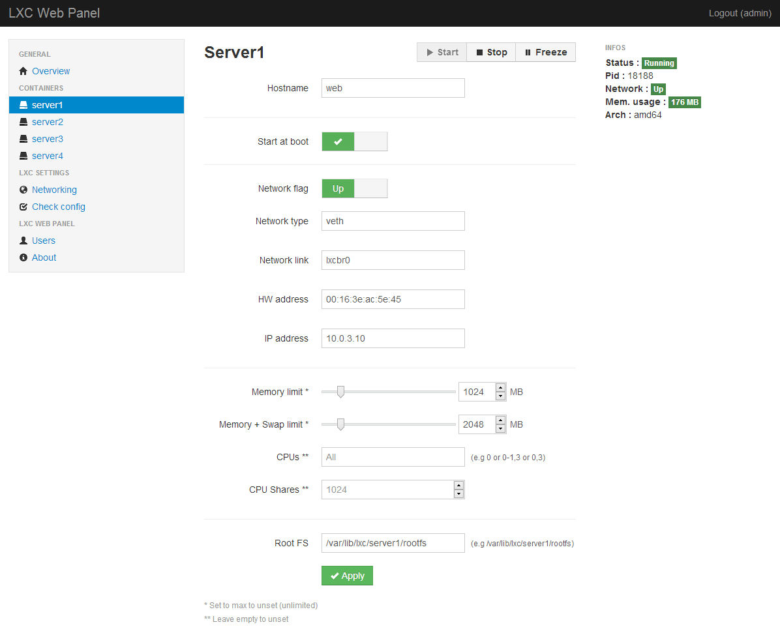

Slide 137
Containers embraces granularity → microservices!

Slide 138
Containers embraces granularity → microservices!
Watch out for microservices architecture, or...

Slide 139
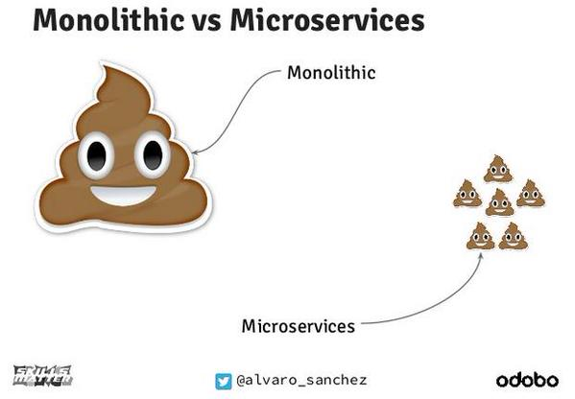
Containers embraces granularity → microservices!
Watch out for microservices architecture, or...

Slide 140
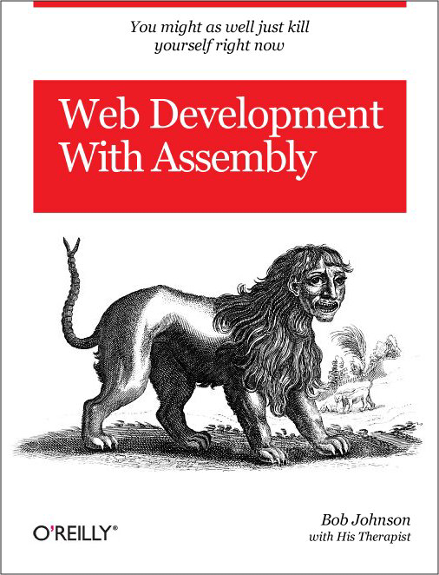

Slide 141
Who knows FHS?

Slide 142
Who knows FHS?
→ 'temp' – what it consist?

Slide 143
Who knows FHS?
→ 'temp' – what it consist?
→ actually: “This Entity Must Persist” ;)

Slide 144
Who knows FHS?
→ 'temp' – what it consist?
→ actually: “This Entity Must Persist” ;)
→ Define your FHS!

Slide 145
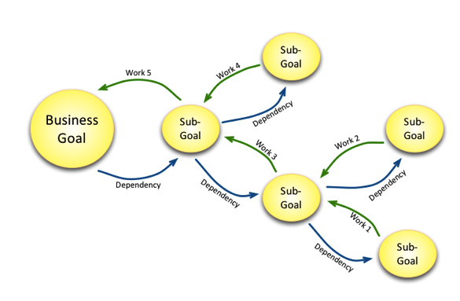
Mikado Method for the win!
→ set a goal
→ experiment
→ visualize
→ rollback

Slide 146
Mikado Method for the win!
→ set a goal
→ experiment
→ visualize
→ rollback

Slide 147
Mikado Method for the win!
→ set a goal
→ experiment
→ visualize
→ rollback

Slide 148
Mikado Method for the win!
→ set a goal
→ experiment
→ visualize
→ rollback

Slide 149
Mikado Method for the win!
→ before any work and rollbacks..
→ remember: monitoring & tests are your friends!
→ think about testing strategy – think heatmaps!

Slide 150
Ansible & infra layers
repo1
Layer 1: bare metal,
Networking
Hypervisor + VM provisioning
Storage
Network interfaces
Storage mounts
repo2
Layer 2: VM
Networking
Container's engine & provisioning
Resources allocation
repo3
Layer 3: container
Application build
Application env
Much simpler w/one, flat network (for small envs)!

Slide 151
Ansible & infra layers
repo1
Layer 1: bare metal,
Networking
Hypervisor + VM provisioning
Storage
Network interfaces
Storage mounts
repo2
repo2
repo2
Layer 2: VM
Layer 2: VM
Networking
Container's engine & provisioning
Networking
Container's engine & provisioning
Resources allocation
repo3
Layer 3: container
Application build
Application env
Much simpler w/one, flat network (for small envs)!

Slide 152
Ansible & infra layers
repo1
Layer 1: bare metal,
Networking
Hypervisor + VM provisioning
Storage
Network interfaces
Storage mounts
Network interfaces
Storage mounts
repo2
repo2
repo2
repo2
Layer 2: VM
Layer 2: VM
Networking
Container's engine & provisioning
Networking
Container's engine & provisioning
Resources allocation
repo3
Layer 3: container
Application build
Application env
Much simpler w/one, flat network (for small envs)!

Slide 153
Ansible & infra layers
repo1
Layer 1: bare metal,
Networking
Hypervisor + VM provisioning
Storage
Network interfaces
Storage mounts
Network interfaces
Storage mounts
repo2
repo2
repo2
repo2
Layer 2: VM
Layer 2: VM
Networking
Container's engine & provisioning
Networking
Container's engine & provisioning
Resources allocation
repo3
repo3
Layer 3: container
Layer 3: container
Application build
Application env
Application build
Application env
Much simpler w/one, flat network (for small envs)!

Slide 154
Ansible & infra layers
repo1
Layer 1: bare metal,
Networking
Hypervisor + VM provisioning
Storage
Network interfaces
Storage mounts
Network interfaces
Storage mounts
repo2
repo2
repo2
repo2
Layer 2: VM
Layer 2: VM
Networking
Container's engine & provisioning
Networking
Container's engine & provisioning
Resources allocation
Resources allocation
repo3
repo3
repo3
Layer 3: container
Layer 3: container
Application build
Application env
Application build
Application env
Much simpler w/one, flat network (for small envs)!

Slide 155
Ansible & infra layers
repo1
Layer 1: bare metal,
Networking
Hypervisor + VM provisioning
Storage
Network interfaces
Storage mounts
repo2
Layer 2: VM
Networking
Container's engine & provisioning
Resources allocation
repo3
Layer 3: container
Application build
Application env
Much simpler w/one, flat network (for small envs)!

Slide 156
SmartStack
→ automated service discovery and registration framework
→ ideal for SOA architectures
→ ideal for continuous integration & delivery
→ solves “works on my machine” problem

Slide 157
SmartStack
→ automated service discovery and registration framework
→ ideal for SOA architectures
→ ideal for continuous integration & delivery
→ solves “works on my machine” problem
haproxy + nerve + synapse + zookeper = smartstack

Slide 158
SmartStack
Synapse
→ discovery service (via zookeeper or etcd)
→ installed on every node
→ writes haproxy configuration
→ application doesn't have to be aware of this
→ works same on bare / VM / docker
→ https://github.com/airbnb/nerve

Slide 159

SmartStack

Slide 160
SmartStack
Nerve
→ health checks (pluggable)
→ register service info to zookeper (or etcd)
→ https://github.com/airbnb/synapse

Slide 161

SmartStack

Slide 162

SmartStack

Slide 163
Smartstack + Docker = <3

Slide 164
Smartstack + Docker = <3
but also remember about Consul
(come to #dockerkrk 2 meetup!)

Slide 165
questions?

Slide 166
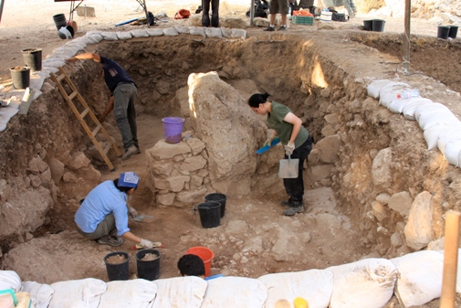
Archaeological workshop

Slide 167
Archaeological workshop
→ nmap, tcpdump, lsof, strace, sysdig, sar
→ cgroups throttling on-the-fly
Do we have time for demo?

Slide 168
Hardware: disks?
→ RAID5 vs RAID10
→ Howto RAID over 1 disk ;)
→ Cheap SSD drives?

Slide 169
Hardware: disks?
→ RAID5 vs RAID10
→ Howto RAID over 1 disk ;)
→ Cheap SSD drives?

Slide 170
Hardware: disks?
→ RAID5 vs RAID10
→ Howto RAID over 1 disk ;)
→ Cheap SSD drives?

Slide 171
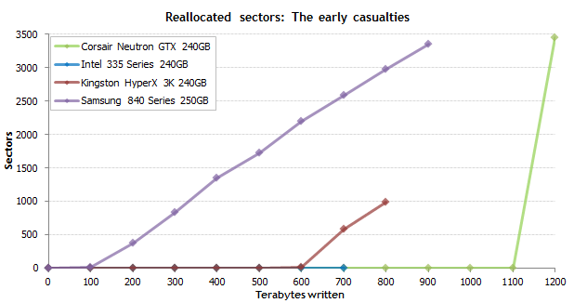
http://techreport.com/review/27909/the-ssd-endurance-experiment-theyre-all-dead

Slide 172
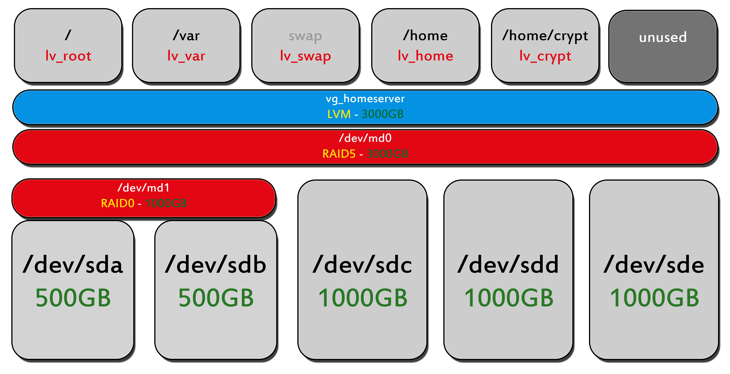
Why use LVM?
→ indexation (capacity, inodes check)
→ capacity planning / iops per mount

Slide 173
Under the dome
(of failure driven pipeline)
Maciej Lasyk
4developers – Warsaw
2015-04-20

