Slide 1

About cultural change w/Devops
Maciej Lasyk
Atmosphere Shuttle #01 – Kraków
2015-03-26

Slide 2
Is there a need for change?
Notes:
Tutaj info o historii devopsów – począwszy od 1 – osobowej instytycji

Slide 3
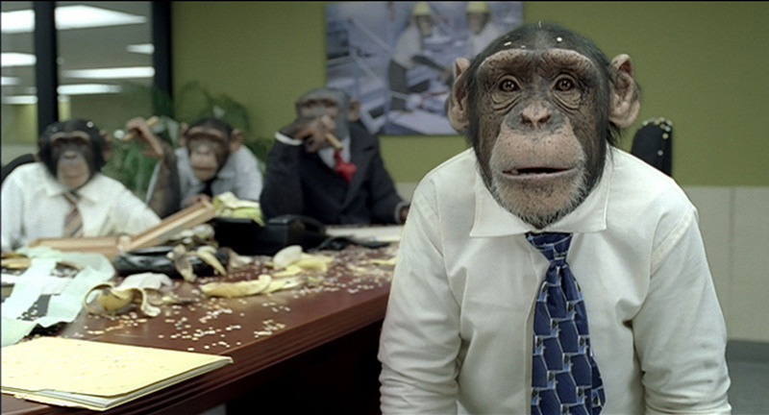
Is there a need for change?
Notes:
Tutaj info o historii devopsów – począwszy od 1 – osobowej instytycji

Slide 4

Is there a need for change?
Notes:
Tutaj info o historii devopsów – począwszy od 1 – osobowej instytycji

Slide 5
Is there a need for change?
“agile” and “cloud”:
→ focus on delivery
→ close collaboration
→ lightweight environment and components
Notes:
Tutaj info o historii devopsów – począwszy od 1 – osobowej instytycji

Slide 6
Conway's law (1968)
organizations which design systems ... are constrained to produce designs which are copies of the communication structures of these organizations
http://en.wikipedia.org/wiki/Conway%27s_law

Slide 7
Ruth Malan (2008)
if the architecture of the system and the architecture of the organization are at odds, the architecture of the organization wins.
The organizational divides are going to drive the true seams in the system.
http://traceinthesand.com/blog/2008/02/13/conways-law/

Slide 8
tightly-coupled vs loosely coupled
lack of face2face embraces modularity

Slide 9
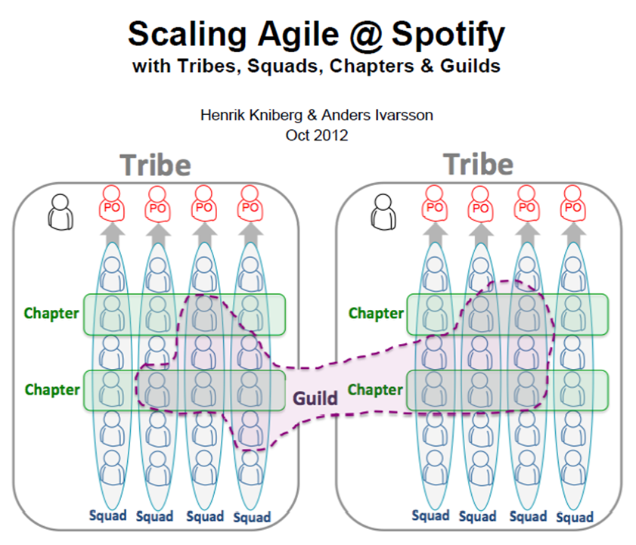

Slide 10
cultural change
modification of a society through innovation, invention, discovery, or contact with other societies

Slide 11
DevOPS ?== CAMS
(culture, automation, measurement, sharing)

Slide 12
DevOPS !== CAMS
DevOPS === people!

Slide 13
culture
automation
People
measurement
sharing

Slide 14
So how do you hire new people?
→ demo days?
→ dedicated HR processes?
→ dedicated HR systems?
→ where do you look for people?

Slide 15
Dead sea effect
→ most talented evaporates
→ the residue
→ maintenance experts & bus factor == 1
http://brucefwebster.com/2008/04/11/the-wetware-crisis-the-dead-sea-effect/

Slide 16
Dead sea effect
→ most talented evaporates
→ the residue
→ maintenance experts & bus factor == 1
there is a solution...
http://brucefwebster.com/2008/04/11/the-wetware-crisis-the-dead-sea-effect/

Slide 17
How do you keep people motivated?

Slide 18
How do you keep people motivated?
The answer is in psychology!
And it lays there since 1954...

Slide 19
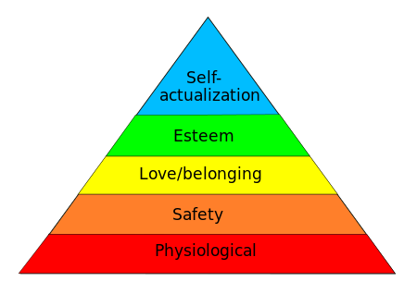
Maslow's hierarchy of needs

Slide 20
Maslow's hierarchy of needs: physiological
Let's say that until it's North Korea than it's ok ;)

Slide 21
Maslow's hierarchy of needs: safety
→ family
→ $$$
→ job security

Slide 22
Maslow's hierarchy of needs: <3 and belonging
→ friendship?
→ is your team your family?
→ do you find yourself in your company?

Slide 23
Maslow's hierarchy of needs: Esteem
→ are you respected?
→ do u need the fame and glory?
→ what about your recognition?

Slide 24
Maslow's hierarchy of needs: self - actualization
→ is your job aligned w/ur interests?
→ do u feel fulfilled?
→ do you find time for self – development?

Slide 25
Maslow's hierarchy of needs

Slide 26
How do you keep good people in company?
people don't leave companies; they leave leaders

Slide 27
How do you keep good people in company?
people don't leave companies; they leave leaders
or just one of the most popular reasons...

Slide 28
most popular reasons.. to leave your company
→ Frustration with the inversion of meritocracy (“organization stupidities”)
→ Simple boredom
→ Perception that current project is futile/destined for failure accompanied by organizational powerlessness to stop it
→ Lack of a mentor or anyone from whom much learning was possible
→ Promotions a matter of time rather than merit
→ No obvious path to advancement
→ Fear of being pigeon-holed into unmarketable technology
→ Red-tape organizational bureaucracy mutes positive impact that anyone can have
→ Lack of creative freedom and creative control (aka “micromanaging”)
http://www.daedtech.com/how-to-keep-your-best-programmers

Slide 29
The real role of 1:1s
→ this is time for your guys
→ this is not a status update
→ make sure you always have time for your guys

Slide 30
Ok let's DEVOPS

Slide 31

Ok let's DEVOPS
(originally: “Before diving into the legacy code” / devopsreactions)

Slide 32
DevOps Anti-Types & patterns
This is a copy/paste from http://blog.matthewskelton.net/ w/my comments included
Great job Matthew! Thanks!

Slide 33
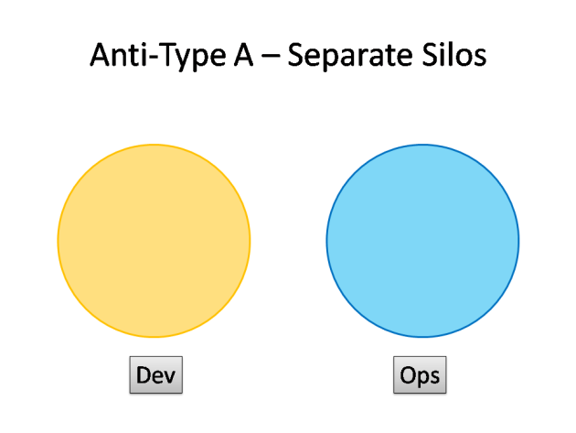
DevOps Anti-Types
http://blog.matthewskelton.net/2013/10/22/what-team-structure-is-right-for-devops-to-flourish/

Slide 34
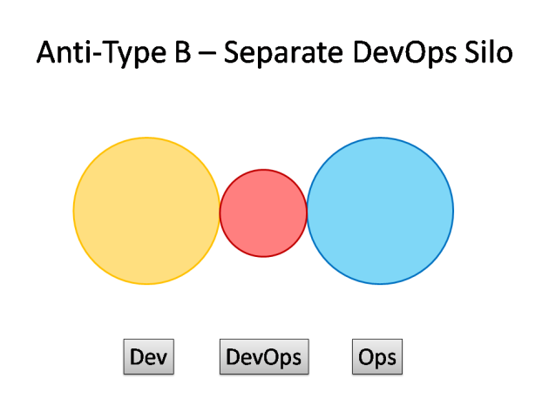
DevOps Anti-Types
http://blog.matthewskelton.net/2013/10/22/what-team-structure-is-right-for-devops-to-flourish/

Slide 35
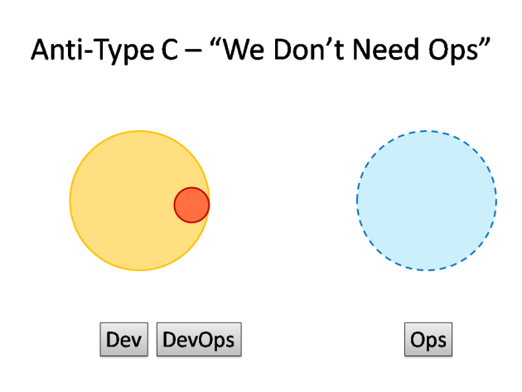
DevOps Anti-Types
http://blog.matthewskelton.net/2013/10/22/what-team-structure-is-right-for-devops-to-flourish/

Slide 36
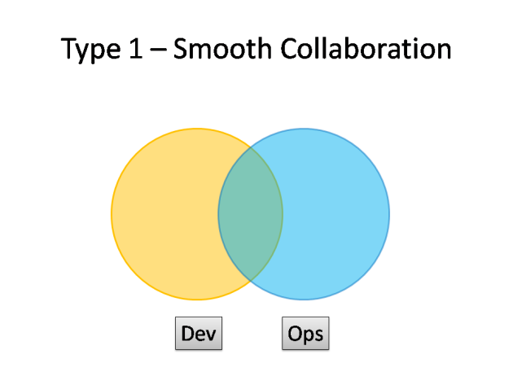
DevOps Patterns
http://blog.matthewskelton.net/2013/10/22/what-team-structure-is-right-for-devops-to-flourish/

Slide 37
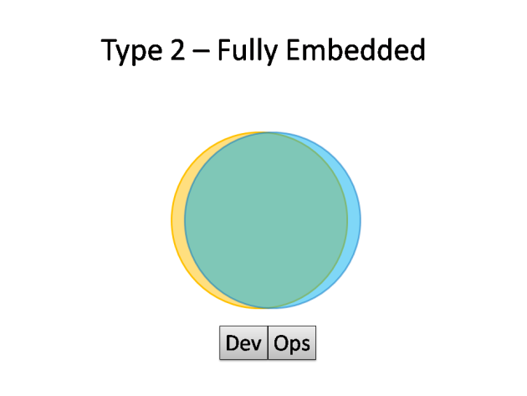
DevOps Patterns
http://blog.matthewskelton.net/2013/10/22/what-team-structure-is-right-for-devops-to-flourish/

Slide 38
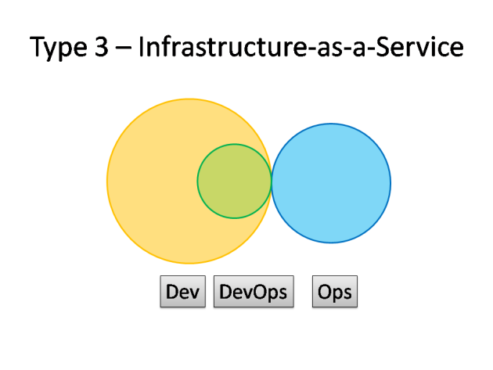
DevOps Patterns
http://blog.matthewskelton.net/2013/10/22/what-team-structure-is-right-for-devops-to-flourish/

Slide 39
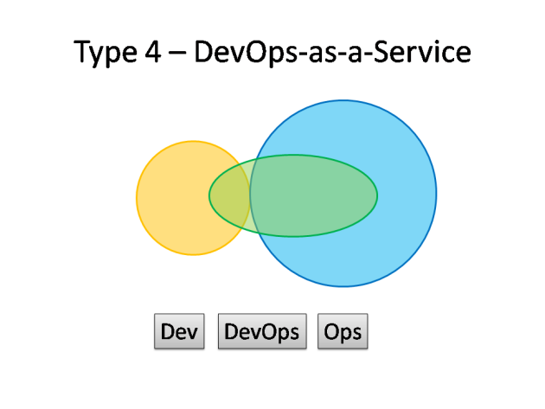
DevOps Patterns
http://blog.matthewskelton.net/2013/10/22/what-team-structure-is-right-for-devops-to-flourish/

Slide 40
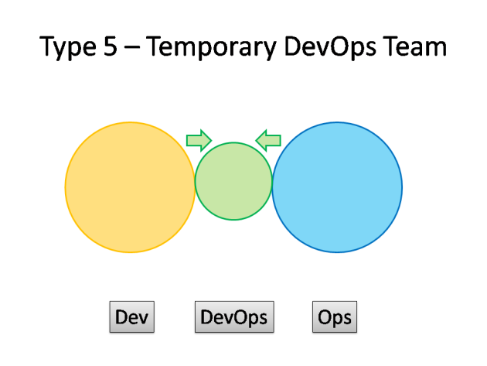
DevOps Patterns
http://blog.matthewskelton.net/2013/10/22/what-team-structure-is-right-for-devops-to-flourish/

Slide 41
Ok let's CAMS

Slide 42
So – what about non – functional reqs?
Do we know who “owns” those?
→ backups
→ monitoring
→ HA
→ scalability
→ security
→ deployment
→ upgradability
→ testability

Slide 43
C for Culture
→ talk. often. and get along
→ take responsibility - from beginning to the end
→ continuous improvement. seriously
→ be brave. don't be silent
→ it's better to be unpolite l/German than polite l/Englishman

Slide 44
A for Automation
→ it has to be simple. Ansible ftw
→ don't reinvent the wheel. don't fabric
→ don't rebuild the world from scratch
→ imperativeness vs declarativeness
→ automate from very beginning. devs - automate

Slide 45
M for Measurement

Slide 46
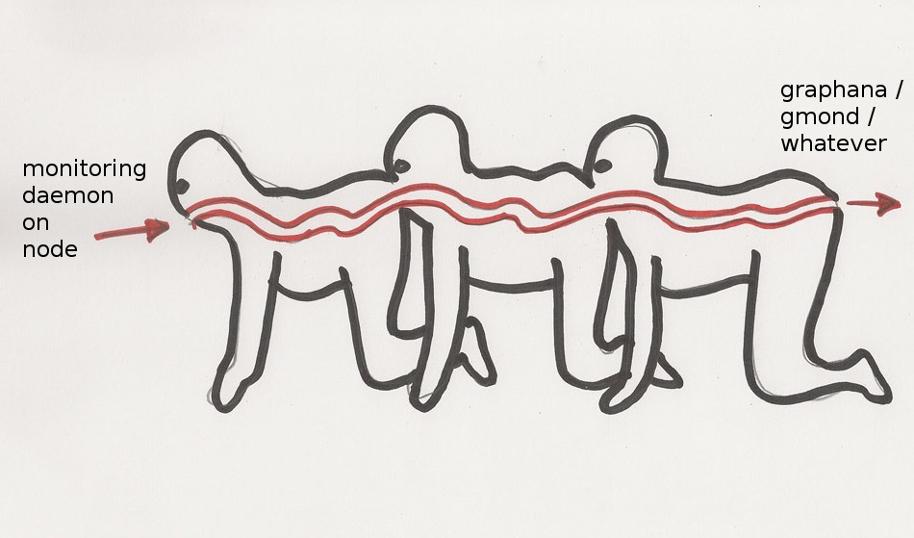
M for Measurement

Slide 47
M for Measurement
→ KISS
→ don't be a hoarder!
→ RRD vs InfluxDB
→ visualize all the things
→ teach teams how to query

Slide 48

S for Sharing

Slide 49
Ah what about archaeology tools?

Slide 50
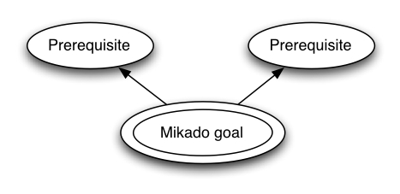
use Mikado!

Slide 51
About cultural change w/Devops
Maciej Lasyk
Atmosphere Shuttle #01 – Kraków
2015-03-26

