Slide 1

Linux containers & Devops
Maciej Lasyk
Atmosphere Shuttle #02 – Wrocław
2015-04-17

Slide 2


Join Fedora Infrastructure!
- learn Ansible
- learn Docker with Fedora Dockerfiles
http://fedoraproject.org/en/join-fedora

Slide 3
Quick survey
How many of you...
Notes:
- knows vagrant?
- knows differences between hyplev2 hyplev1 and containers?
- czy quick sort jest szybszy od heap sorta (kopcowanie)?

Slide 4
Quick survey
How many of you...
→Knows what Docker is?
Notes:
- knows vagrant?
- knows differences between hyplev2 hyplev1 and containers?
- czy quick sort jest szybszy od heap sorta (kopcowanie)?

Slide 5
Quick survey
How many of you...
→Knows what Docker is?
→Played with Docker?
Notes:
- knows vagrant?
- knows differences between hyplev2 hyplev1 and containers?
- czy quick sort jest szybszy od heap sorta (kopcowanie)?

Slide 6
Quick survey
How many of you...
→Knows what Docker is?
→Played with Docker?
→Runs it on production?
Notes:
- knows vagrant?
- knows differences between hyplev2 hyplev1 and containers?
- czy quick sort jest szybszy od heap sorta (kopcowanie)?

Slide 7
Why use Docker?
With Docker we can solve many problems

Slide 8
Why use Docker?
With Docker we can solve many problems
→“it works on my machine”

Slide 9
Why use Docker?
With Docker we can solve many problems
→“it works on my machine”
→reducing build & deploy time

Slide 10
Why use Docker?
With Docker we can solve many problems
→“it works on my machine”
→reducing build & deploy time
→Infrastructure configuration spaghetti – automation!

Slide 11
Why use Docker?
With Docker we can solve many problems
→“it works on my machine”
→reducing build & deploy time
→Infrastructure configuration spaghetti – automation!
→Libs dependency hell

Slide 12
Why use Docker?
With Docker we can solve many problems
→“it works on my machine”
→reducing build & deploy time
→Infrastructure configuration spaghetti – automation!
→Libs dependency hell
→Cost control and granularity

Slide 13

Docker – what is it?

Slide 14
Docker – what is it?
“automates the deployment of any
application as a lightweight, portable,
self-sufficient container
that will run virtually anywhere”

Slide 15
Docker – what is it?
Java’s promise: Write Once. Run Anywhere.

Slide 16

Docker – what is it?
Java’s promise: Write Once. Run Anywhere.
Even on Windows now!
https://blog.docker.com/2014/10/docker-microsoft-partner-distributed-applications/

Slide 17
Docker – what is it?
Is Docker is lightweight?

Slide 18
Docker – what is it?
Is Docker is lightweight?
======================================================
Package Arch Version Repository Size
======================================================
Installing:
docker-io x86_64 1.3.0-1.fc20 updates 4.3 M

Slide 19
Docker – what is it?
Is Docker is lightweight?
======================================================
Package Arch Version Repository Size
======================================================
Installing:
docker-io x86_64 1.3.0-1.fc20 updates 4.3 M
======================================================
Package Arch Version Repository Size
======================================================
Installing:
docker-io x86_64 1.5.0-2.fc21 updates 26 M

Slide 20

Docker – what is it?
http://sattia.blogspot.com/2014/05/docker-lightweight-linux-containers-for.html

Slide 21

Docker – how it works?
http://blog.docker.com/2014/03/docker-0-9-introducing-execution-drivers-and-libcontainer/

Slide 22
Docker – how it works?
→LXC & libcontainer

Slide 23
Docker – how it works?
→LXC & libcontainer
→control groups

Slide 24
Docker – how it works?
→LXC & libcontainer
→control groups
→kernel namespaces

Slide 25
Docker – how it works?
→LXC & libcontainer
→control groups
→kernel namespaces
→layered filesystem
→devmapper thin provisioning & loopback mounts
→no more AUFS (perf sucks)
→OverlayFS!

Slide 26
control groups (cgroups)
Control Groups provide a mechanism for
aggregating/partitioning sets of tasks, and
all their future children, into hierarchical groups
with specialized behavior
Notes:
Google, 2006 (process containers), 2007 published as control groups
Podział procesów na grupy hierarhiczne
Kernel zarządza dostępem do wybrancyh kontrolerów (subsystemów)

Slide 27
control groups (cgroups)
Control Groups provide a mechanism for
aggregating/partitioning sets of tasks, and
all their future children, into hierarchical groups
with specialized behavior
→grouping processes
→allocating resources to particular groups
→memory
→network
→CPU
→storage bandwidth (I/O throttling)
→device whitelisting

Slide 28
control groups (cgroups)
little demo #1
Notes:
ps -o cgroup
cat /proc/self/cgroup
cgcreate -t docent:docent -g cpu:/test-subgroup1
cgset -r cpuset.cpus=0 test-subgroup1
cgexec -g cpu:-subgroup1 /bin/bash
cgdelete -g cpu:/test-subgroup1
ps -o cgroup
cat /proc/self/cgroup
Cd /sys/fs/cgroup/memory
Ls
Mkdir test1 && cd test1 && ls
Cat memory.iimit_in_bytes
echo 104857600 > memory.limit_in_bytes
Cat memory.limit_in_bytes && Cat memory.oom_control
Echo $$ >> tasks
Vim ~/mem-hog.c && ~/mem-hog
Echo 1 > memory.oom_control
~/mem-hog I na drugiej konsoli cat memory.oom_control
Echo 0 > memory.oom_control

Slide 29
Kernel Namespaces
Providing a unique views of the system for processes.

Slide 30
Kernel Namespaces
Providing a unique views of the system for processes.
→ PID – PIDs isolation
Notes:
PID: pid 1, main view different PIDs
NET: own routing table, iptables rules and chains

Slide 31
Kernel Namespaces
Providing a unique views of the system for processes.
→ PID – PIDs isolation
→ NET – network isolation (via virt-ifaces; demo)
Notes:
PID: pid 1, main view different PIDs
NET: own routing table, iptables rules and chains

Slide 32
Kernel Namespaces
Providing a unique views of the system for processes.
→ PID – PIDs isolation
→ NET – network isolation (via virt-ifaces; demo)
→ IPC – won't use this
Notes:
PID: pid 1, main view different PIDs
NET: own routing table, iptables rules and chains

Slide 33
Kernel Namespaces
Providing a unique views of the system for processes.
→ PID – PIDs isolation
→ NET – network isolation (via virt-ifaces; demo)
→ IPC – won't use this
→ MNT – chroot like; deals w/mountpoints
Notes:
PID: pid 1, main view different PIDs
NET: own routing table, iptables rules and chains

Slide 34
Kernel Namespaces
Providing a unique views of the system for processes.
→ PID – PIDs isolation
→ NET – network isolation (via virt-ifaces; demo)
→ IPC – won't use this
→ MNT – chroot like; deals w/mountpoints
→ UTS – deals w/hostname
Notes:
PID: pid 1, main view different PIDs
NET: own routing table, iptables rules and chains

Slide 35
Kernel Namespaces
little demo #2
Notes:
ip netns list
ip netns add green
ip link add veth0 type veth peer name veth1
ip link list
ip link set veth1 netns green
ip netns exec green ip link list
ip netns exec green ip addr add 10.11.12.13/24 dev veth1
ip netns exec green ip a

Slide 36
OverlayFS
+ hell fast (you'll see)

Slide 37
OverlayFS
+ hell fast (you'll see)
+ page cache sharing

Slide 38
OverlayFS
+ hell fast (you'll see)
+ page cache sharing
+ finally in upstream kernel (in rhel from 7.2, 3.18)

Slide 39
OverlayFS
+ hell fast (you'll see)
+ page cache sharing
+ finally in upstream kernel (in rhel from 7.2, 3.18)
+ finally supported by docker (-s overlay)

Slide 40
OverlayFS
+ hell fast (you'll see)
+ page cache sharing
+ finally in upstream kernel (in rhel from 7.2, 3.18)
+ finally supported by docker (-s overlay)
- SELinux not there yet (but will be)

Slide 41
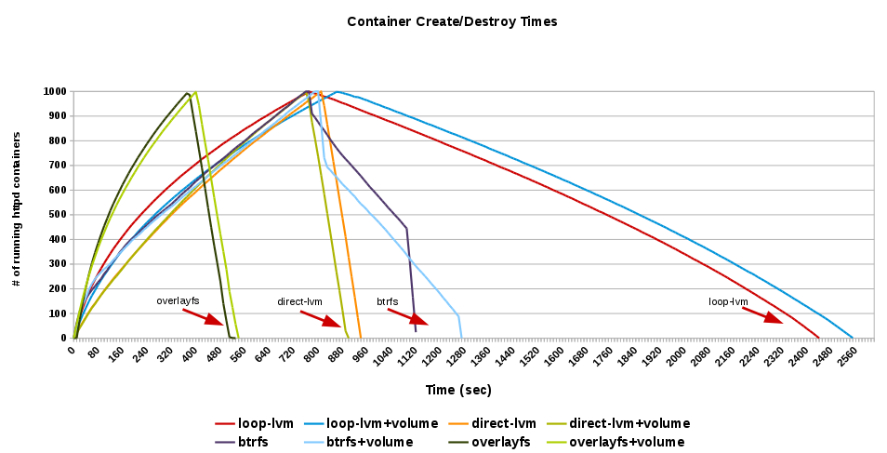
OverlayFS
http://developerblog.redhat.com/2014/09/30/overview-storage-scalability-docker/

Slide 42
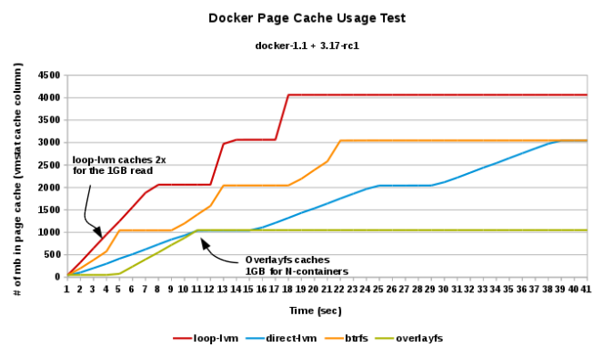
OverlayFS
http://developerblog.redhat.com/2014/09/30/overview-storage-scalability-docker/

Slide 43
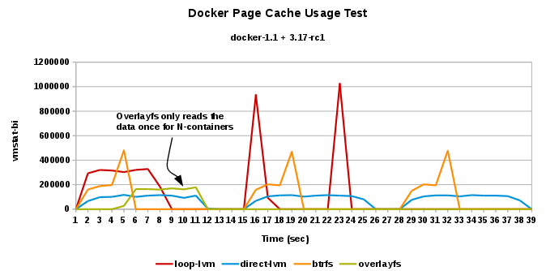
OverlayFS
http://developerblog.redhat.com/2014/09/30/overview-storage-scalability-docker/

Slide 44
OverlayFS
let's demo again
Notes:
systemctl status docker -l
docker info
cd /etc/sysconfig
ls docker*
vim docker-storage
restart...

Slide 45
Linux containers equation
Linux Containers = namespaces + cgroups + storage
Notes:
systemctl status docker -l
cd /etc/sysconfig
ls docker*
vim docker-storage
restart...

Slide 46
Docker – concepts
→ images
→ read only
→ act as templates

Slide 47
Docker – concepts
→ images
→ read only
→ act as templates
→ Dockerfile
→ like a makefile
→ commands order & cache'ing
→ extends the base image
→ results in a new image

Slide 48
Docker – concepts
→ images
→ read only
→ act as templates
→ Dockerfile
→ like a makefile
→ commands order & cache'ing
→ extends the base image
→ results in a new image
→ Containers: instances running apps

Slide 49
Docker – concepts
→ images
→ read only
→ act as templates
→ Dockerfile
→ like a makefile
→ commands order & cache'ing
→ extends the base image
→ results in a new image
→ Containers: instances running apps
dockerfile + base image = docker container

Slide 50
Dockerfile
FROM fedora
MAINTAINER scollier <scollier@redhat.com>
RUN yum -y update && yum clean all
RUN yum -y install nginx && yum clean all
RUN echo "daemon off;" >> /etc/nginx/nginx.conf
RUN echo "nginx on Fedora" > /srv/www/index.html
EXPOSE 80
CMD [ "/usr/sbin/nginx" ]

Slide 51
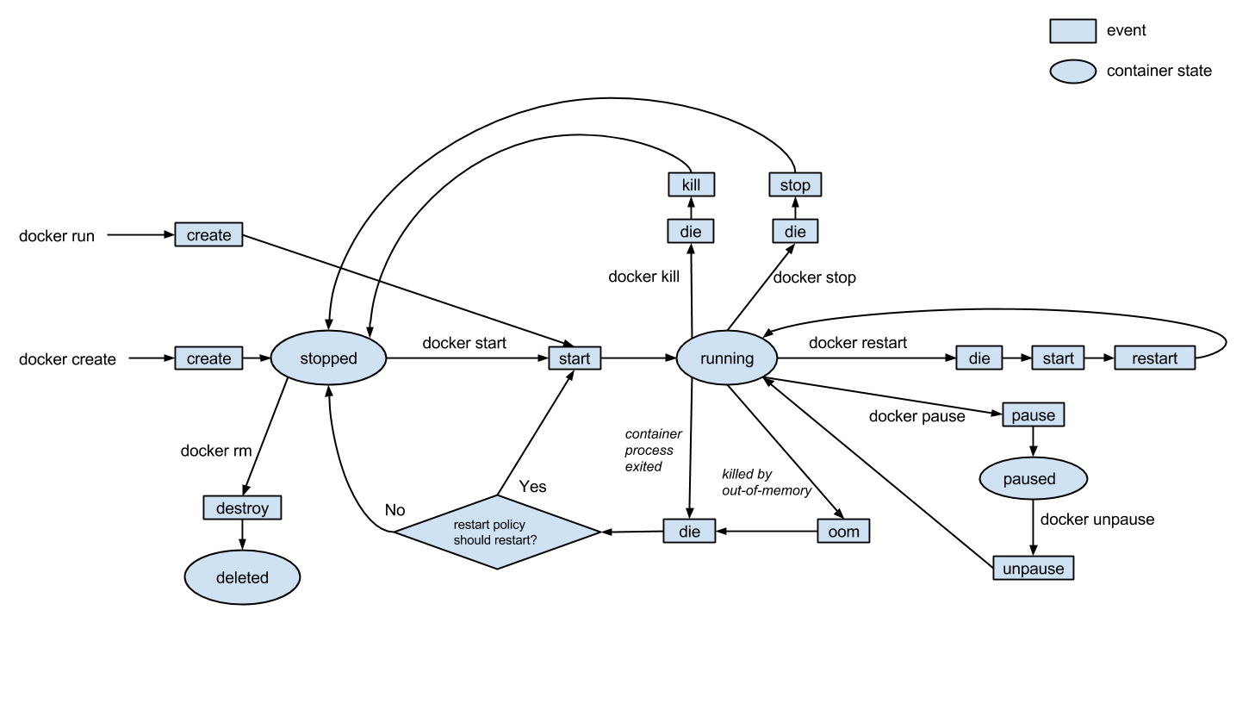
Docker events
http://gliderlabs.com/blog/2015/04/14/docker-events-explained/

Slide 52

Docker – registry
http://osv.io/blog/blog/2014/06/19/containers-hypervisors-part-2/

Slide 53
Docker – registry
→ git like semantics
→ pull, push, commit
→ private and public registry
→ https://github.com/dotcloud/docker-registry
→ yum install docker-registry
$ docker pull
$ docker push
$ docker commit

Slide 54

Docker – images hierarchy
http://blog.octo.com/en/docker-registry-first-steps/

Slide 55
Docker – images hierarchy
base image
-> child image
-> grandchild image

Slide 56
Docker – images hierarchy
base image
-> child image
-> grandchild image
Git’s promise: Tiny footprint with
lightning fast performance

Slide 57
Docker – security
→ Isolation via kernel namespaces
→ Additional layer of security: SELinux / AppArmor / GRSEC
→ Each container gets own network stack
→ control groups for resources limiting
f20 policy: https://git.fedorahosted.org/cgit/selinux-policy.git/tree/docker.te?h=f20-contrib
What's there?
seinfo -t -x | grep docker
sesearch -A -s docker_t (and the rest)
or just unpack docker.pp with semodule_unpackage

Slide 58
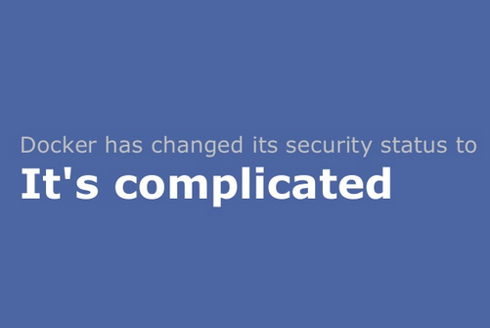
Docker – security
http://www.projectatomic.io/blog/2014/08/is-it-safe-a-look-at-docker-and-security-from-linuxcon/

Slide 59

Docker – security

Slide 60

Docker – use cases
CI Stack
http://sattia.blogspot.com/2014/05/docker-lightweight-linux-containers-for.html

Slide 61
Docker – use cases
Continuous Integration
→ local dev
→ with Docker it's easy to standardize envs
→ deployment
→ rolling updates (e.g. w/Ansible)
→ testing
→ unit testing of any commit on dedicated env
→ don't worry about cleaning up after testing
→ paralleled tests across any machines

Slide 62
Docker – use cases
→ version control system for apps
→ microservices
→ Docker embraces granularity
→ Services can be deployed independently and faster
→ paralleled tests across any machines
→ continuous delivery
→ PaaS

Slide 63

Orchestration at scale w/Docker

Slide 64
Orchestration at scale w/Docker
This might be a little problem

Slide 65

Orchestration at scale w/Docker
This might be a little problem

Slide 66

Orchestration at scale w/Docker

Slide 67

http://www.cloudssky.com/en/blog/Docker-Is-Not-Enough

Slide 68
Ansible + Docker
&
Docker + Ansible

Slide 69
Docker & Ansible
Ansible docker core module:
http://docs.ansible.com/docker_module.html
- hosts: web
sudo: yes
tasks:
- name: run httpd servers
docker: >
image=centos
command="service httpd start"
ports=8080
count=5
memory_limit=32MB
link=mysql
expose=8080
registry=...
volume=...

Slide 70
Docker & Ansible
Building image with Ansible:
FROM ansible/centos7-ansible:stable
ADD ansible /srv/example
WORKDIR /srv/example
RUN ansible-playbook web.yml -c local
EXPOSE 80
CMD ["/usr/sbin/nginx"]

Slide 71
Docker & Ansible
Building image with Ansible:
FROM ansible/centos7-ansible:stable
ADD ansible /srv/example
WORKDIR /srv/example
RUN ansible-playbook web.yml -c local
EXPOSE 80
CMD ["/usr/sbin/nginx"]
ansible/web.yml:
- name: Install webserver
hosts: localhost
tasks:
- yum: pkg=nginx state=latest
- shell: echo "ansible" > /usr/share/nginx/html/index.html

Slide 72
Docker & Ansible
Yet another demo?
Notes:
cd ~/Dropbox/private/Prezentacje/atmosphere-shuttle-2-2015/dockerfiles
Pokazać dockerfile I web.yml
docker build --rm -t fedora-ansible-docker-nginx .
docker create --name docker-ansible-test -p 127.0.0.1:83:80 -t fedora-ansible-docker-nginx
Docekr ps -a && docker start ABC

Slide 73
SmartStack
→ automated service discovery and registration framework
→ ideal for SOA architectures
→ ideal for continuous integration & delivery
→ solves “works on my machine” problem

Slide 74
SmartStack
→ automated service discovery and registration framework
→ ideal for SOA architectures
→ ideal for continuous integration & delivery
→ solves “works on my machine” problem
haproxy + nerve + synapse + zookeper = smartstack

Slide 75
SmartStack
Synapse
→ discovery service (via zookeeper or etcd)
→ installed on every node
→ writes haproxy configuration
→ application doesn't have to be aware of this
→ works same on bare / VM / docker
→ https://github.com/airbnb/nerve

Slide 76

SmartStack

Slide 77
SmartStack
Nerve
→ health checks (pluggable)
→ register service info to zookeper (or etcd)
→ https://github.com/airbnb/synapse

Slide 78

SmartStack

Slide 79

SmartStack

Slide 80
Smartstack + Docker = <3

Slide 81
Smartstack + Docker = <3
but also remember about Consul
(come to #dockerkrk 2 meetup!)

Slide 82
Wanna learn Docker?
http://dockerbook.com/

Slide 83

Freenode #docker
#KrkDocker meetups (http://www.meetup.com/Docker-Krakow-Poland/)
https://github.com/docker/docker

Slide 84
sources?
→ docker.io documentation
→ dockerbook.com
→ slideshare!
→ zounds of blogposts (urls provided)
→ and some experience ;)

Slide 85
Looking for a job?
- Software Engineer (java)
- Information Security Manager
- Product Analyst
Catch me: maciek@lasyk.info

Slide 86
Linux containers & Devops
Maciej Lasyk
Atmosphere Shuttle #02 – Wrocław
2015-04-17

