Slide 1


“Containers do not contain”
(orig. by Dan Walsh)
Maciej Lasyk
Devopsdays Warsaw
2015-11-25
Notes:
test

Slide 2
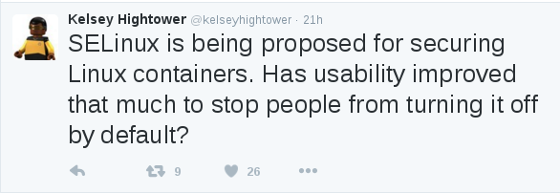

Slide 3


Slide 4


How does security look like?
WOW :)
Such security..
Very fortress!!1
Notes:
Osadzenie aplikacji w chmurze może wyglądać w ten sposób właśnie – trzeba uważać na złudność, bo nie wszystko musi być przemyślane
Jednak pamiętajmy o wektorach ataku nie przemyślanych w tym zestawieniu
Nadal trzeba przemyśleć sec na każdej wartswie

Slide 5

And seriously...
Do you know this guy?

Slide 6
And seriously...
Do you know this guy?
So he has something to tell you...
http://www.youtube.com/watch?v=o5snlP8Y5GY

Slide 7
Linux OS security
DAC (Discretionary access control)
basic ACLs
chmod

Slide 8
Linux OS security – extended ACLs
DAC (Discretionary access control)
setfacl / getfacl

Slide 9
Linux OS security – Linux Security Modules
MAC (Mandatory Access Control)
(LSMs)

Slide 10
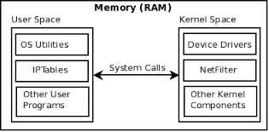
SELinux – how it works?
syscalls work like interfaces for accessing some resources
Notes:
Aplikacja działa w wydzielonym bloku pamięci virtualnej
Aplikacja może się komunikować z inną np. Za pomocą pamięci współdzielonej
Jednak jedyny sposób na dostanie się do kernel-space'a i zapytanie o zasoby zewnętrzne -> syscall
Syscall nie jest funkcją per-se; to raczej procedura, która wykonuje po drodze wiele sprawdzeń

Slide 11
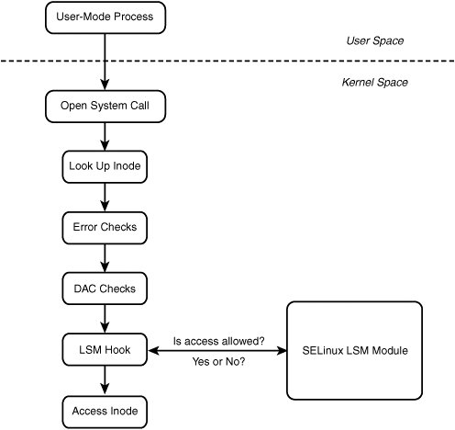
SELinux – how it works?

Slide 12
SELinux – how it works?
MAC
upstream kernel has been fixed to report
check for mmap_zero for MAC AFTER DAC
(2014-03-05, http://danwalsh.livejournal.com/69035.html)
DAC

Slide 13
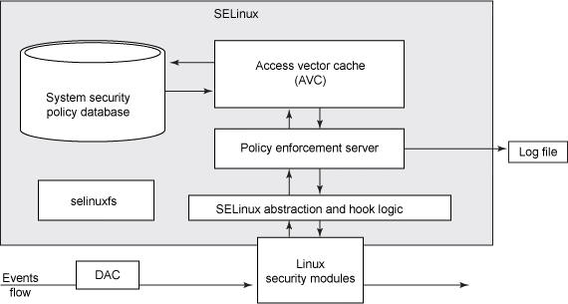
SELinux – how it works?

Slide 14
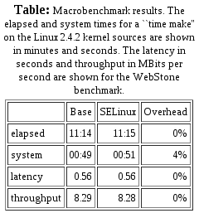
SELinux – performance
- http://www.nsa.gov/research/_files/selinux/papers/freenix01/node18.shtml#sec:perf:macro
Just test it yourself: git://git.selinuxproject.org/~serge/selinux-testsuite
Notes:
Stop reading tests – just test it yourself, because every env, every policy works different
AVC means cache! It's really fast though it has some restrictions
Access Vector Cache

Slide 15
SELinux – performance
- http://www.nsa.gov/research/_files/selinux/papers/freenix01/node18.shtml#sec:perf:macro
avcstat
uptime: 10h
hit ratio: 99.94%!
(57mln of lookups)
Just test it yourself: git://git.selinuxproject.org/~serge/selinux-testsuite
Notes:
Stop reading tests – just test it yourself, because every env, every policy works different
AVC means cache! It's really fast though it has some restrictions

Slide 16
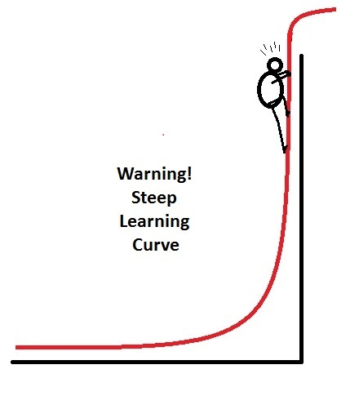
SELinux – learning curve
Notes:
Just sit and learn. Profit for many years

Slide 17
SELinux and...
Notes:
Android!

Slide 18

SELinux and Android
- from 4.3 – permissive
- from 4.4 enforcing
- Will help us with BYOD :)
- No setuid/setgid programs (4.3)
http://selinuxproject.org/page/SEAndroid
http://source.android.com/devices/tech/security/se-linux.html
Notes:
Czym jest permissive a czym enforcing?

Slide 19
SELinux primer
stopdisablingselinux.com
or
http://opensource.com/business/13/11/selinux-policy-guide

Slide 20
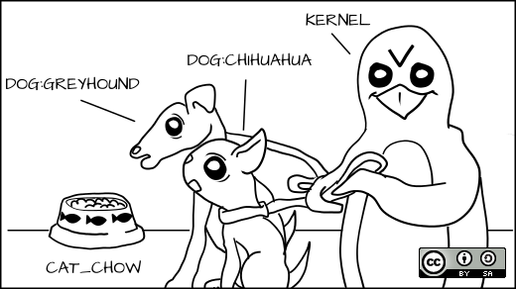
SELinux primer
Everyone gets a label!

Slide 21
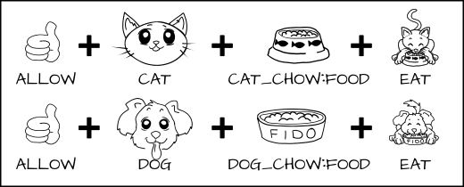
SELinux primer
allow cat cat_chow:food eat;
allow dog dog_chow:food eat;

Slide 22
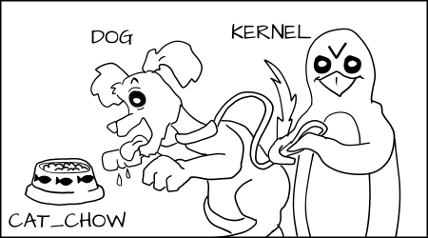
SELinux primer
AVC (Access Vector Cache)

Slide 23
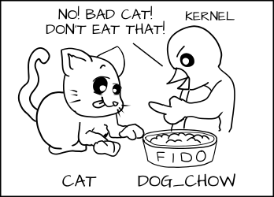
SELinux primer
AVC (Access Vector Cache)

Slide 24
SELinux primer
In real world...
process: httpd_t
files under Apache: httpd_sys_content_t
database data: mysqld_data_t
hacked Apache process can not access mysqld files!

Slide 25
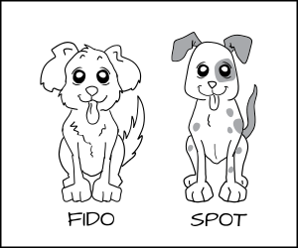
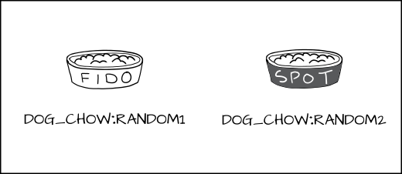
SELinux primer
Can same type of process be confined differently?

Slide 26
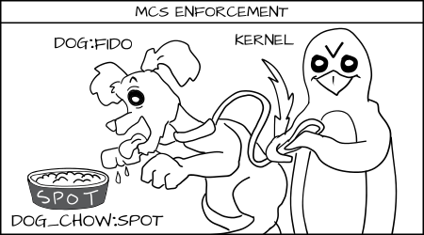
SELinux primer
Yes! With MCS enforcement!
Notes:
MCS – Multi Category System
Sensitivity Levels
Categories

Slide 27
SELinux primer
In real world...
2 processes: httpd_t
files under httpd: httpd_sys_content_t
So how to deny files from differ instances of httpd_t?
With MCS labels like s0:c1,c2 ; s0:c3,c4 etc
s0, s1, s2 – sensitivity levels
c1,c2,c3... - categories (up to 255)

Slide 28
So remember..
Every time you run setenforce 0, you make Dan Walsh
weep
Dan is a nice guy and he certainly doesn't deserve that.

Slide 29
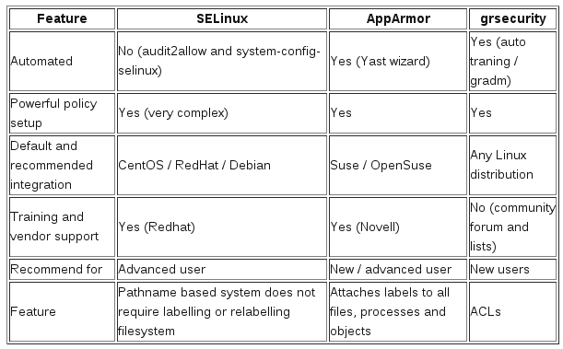
So what about other LSMs?
http://www.cyberciti.biz/tips/selinux-vs-apparmor-vs-grsecurity.html
Notes:
Yes, SELinux could work with grSec/PaX – like in Gentoo Hardened

Slide 30
So what about other LSMs?
- AppArmor identifies file system objects by path name
instead of inode
- There is no notion of multi-level security with AppArmor
- AppArmor user rather flat files based configuration
- SELinux supports the concept of a "remote policy server"
- There is no apparmor or grsec in android :)

Slide 31
Docker + SELinux
f20 policy: https://git.fedorahosted.org/cgit/selinux-policy.git/tree/docker.te?h=f20-contrib
What's there?
seinfo -t -x | grep docker
sesearch -A -s docker_t (and the rest)
or just unpack docker.pp with semodule_unpackage

Slide 32
Docker + SELinux
f20 policy: https://git.fedorahosted.org/cgit/selinux-policy.git/tree/docker.te?h=f20-contrib
What's there?
seinfo -t -x | grep docker
sesearch -A -s docker_t (and the rest)
or just unpack docker.pp with semodule_unpackage
How to use it?
man docker_selinux :)

Slide 33
Docker + SELinux
f20 policy: https://git.fedorahosted.org/cgit/selinux-policy.git/tree/docker.te?h=f20-contrib
What's there?
seinfo -t -x | grep docker
sesearch -A -s docker_t (and the rest)
or just unpack docker.pp with semodule_unpackage
How to use it?
man docker_selinux :)
Permissive domains! semanage permissive -a docker_t
It's only in targeted policy (not for MCS)

Slide 34


Slide 35
stopdisablingselinux.com

Slide 36
stopdisablingselinux.com
or...
Infosec meetup

Slide 37
Thank you :)
“Containers do not contain”
(orig. by Dan Walsh)
http://maciek.lasyk.info/sysop
maciek@lasyk.info
@docent-net

