Slide 1

Docker – kontenery w praktyce
Maciej Lasyk
OpenSourceSummit 2015
Warsaw, 2015-03-24
Maciej Lasyk, Docker containers at scale
1/64

Slide 2

Join Fedora Infrastructure!
- learn Ansible
- learn Docker with Fedora Dockerfiles
http://fedoraproject.org/en/join-fedora
Maciej Lasyk, Docker containers at scale
2/64

Slide 3
Agenda
- Why use Docker?
- Brief history of envs evolution
- Docker – what is it?
- To PaaS or not to PaaS
- Orchestration at scale
Maciej Lasyk, Docker containers at scale
3/64

Slide 4
Quick survey
- How many of you...
Maciej Lasyk, Docker containers at scale
4/64

Slide 5
Quick survey
- How many of you...
- Knows what Docker is?
Maciej Lasyk, Docker containers at scale
4/64

Slide 6
Quick survey
- How many of you...
- Knows what Docker is?
- Played with Docker?
Maciej Lasyk, Docker containers at scale
4/64

Slide 7
Quick survey
- How many of you...
- Knows what Docker is?
- Played with Docker?
- Runs it on production?
Maciej Lasyk, Docker containers at scale
4/64
Notes:
- knows vagrant?
- knows differences between hyplev2 hyplev1 and containers?
- czy quick sort jest szybszy od heap sorta (kopcowanie)?

Slide 8
Why use Docker?
With Docker we can solve many problems
Maciej Lasyk, Docker containers at scale
5/64

Slide 9
Why use Docker?
With Docker we can solve many problems
- “it works on my machine”
Maciej Lasyk, Docker containers at scale
5/64

Slide 10
Why use Docker?
With Docker we can solve many problems
- “it works on my machine”
- reducing build & deploy time
Maciej Lasyk, Docker containers at scale
5/64

Slide 11
Why use Docker?
With Docker we can solve many problems
- “it works on my machine”
- reducing build & deploy time
- Infrastructure configuration spaghetti – automation!
Maciej Lasyk, Docker containers at scale
5/64

Slide 12
Why use Docker?
With Docker we can solve many problems
- “it works on my machine”
- reducing build & deploy time
- Infrastructure configuration spaghetti – automation!
- Libs dependency hell
Maciej Lasyk, Docker containers at scale
5/64

Slide 13
Why use Docker?
With Docker we can solve many problems
- “it works on my machine”
- reducing build & deploy time
- Infrastructure configuration spaghetti – automation!
- Libs dependency hell
- Cost control and granularity
Maciej Lasyk, Docker containers at scale
5/64

Slide 14
A brief story of envs evolution
- classical approach (for & scp/ssh & conf.d)
Maciej Lasyk, Docker containers at scale
6/64

Slide 15
A brief story of envs evolution
- classical approach (for & scp/ssh & conf.d)
- configuration management
Maciej Lasyk, Docker containers at scale
6/64

Slide 16
A brief story of envs evolution
- classical approach (for & scp/ssh & conf.d)
- configuration management
- Bare vs IaaS vs PaaS
Maciej Lasyk, Docker containers at scale
6/64
Notes:
Bare: na pczątku był serwer, potem OS a potem wirtualna maszyna javy żeby to wszystko działało tak samo ;)

Slide 17
A brief story of envs evolution
- classical approach (for & scp/ssh & conf.d)
- configuration management
- Bare vs IaaS vs PaaS
- Continuous Integration
Maciej Lasyk, Docker containers at scale
6/64

Slide 18
A brief story of envs evolution
- classical approach (for & scp/ssh & conf.d)
- configuration management
- Bare vs IaaS vs PaaS
- Continuous Integration
- So when to use Docker?
Maciej Lasyk, Docker containers at scale
6/64

Slide 19

Docker – what is it?
Maciej Lasyk, Docker containers at scale
7/64

Slide 20
Docker – what is it?
“automates the deployment of any
application as a lightweight, portable,
self-sufficient container
that will run virtually anywhere”
Maciej Lasyk, Docker containers at scale
8/64

Slide 21
Docker – what is it?
Java’s promise: Write Once. Run Anywhere.
Maciej Lasyk, Docker containers at scale
9/64

Slide 22

Docker – what is it?
Java’s promise: Write Once. Run Anywhere.
Even on Windows now!
https://blog.docker.com/2014/10/docker-microsoft-partner-distributed-applications/
Maciej Lasyk, Docker containers at scale
9/64

Slide 23
Docker – what is it?
Is Docker is lightweight?
Maciej Lasyk, Docker containers at scale
10/64

Slide 24
Docker – what is it?
Is Docker is lightweight?
======================================================
Package Arch Version Repository Size
======================================================
Installing:
docker-io x86_64 1.3.0-1.fc20 updates 4.3 M
Maciej Lasyk, Docker containers at scale
10/64

Slide 25
Docker – what is it?
Is Docker is lightweight?
======================================================
Package Arch Version Repository Size
======================================================
Installing:
docker-io x86_64 1.3.0-1.fc20 updates 4.3 M
======================================================
Package Arch Version Repository Size
======================================================
Installing:
docker-io x86_64 1.5.0-1.fc21 updates 26 M
Maciej Lasyk, Docker containers at scale
10/64

Slide 26

Docker – what is it?
http://sattia.blogspot.com/2014/05/docker-lightweight-linux-containers-for.html
Maciej Lasyk, Docker containers at scale
11/64

Slide 27

Docker – how it works?
http://blog.docker.com/2014/03/docker-0-9-introducing-execution-drivers-and-libcontainer/
Maciej Lasyk, Docker containers at scale
12/64

Slide 28
Docker – how it works?
- LXC & libcontainer
Maciej Lasyk, Docker containers at scale
13/64

Slide 29
Docker – how it works?
- LXC & libcontainer
- control groups
Maciej Lasyk, Docker containers at scale
13/64

Slide 30
Docker – how it works?
- LXC & libcontainer
- control groups
- kernel namespaces
Maciej Lasyk, Docker containers at scale
13/64

Slide 31
Docker – how it works?
- LXC & libcontainer
- control groups
- kernel namespaces
- layered filesystem
- devmapper thin provisioning & loopback mounts
- no more AUFS prerequisite
- default order: [aufs,btrfs,devmapper,...]
- http://developerblog.redhat.com/2014/09/30/overview-storage-scalability-docker/
Maciej Lasyk, Docker containers at scale
13/64

Slide 32
Docker – concepts
- images
- read only
- act as templates
Maciej Lasyk, Docker containers at scale
14/64

Slide 33
Docker – concepts
- images
- read only
- act as templates
- Dockerfile
- like a makefile
- commands order & cache'ing
- extends the base image
- results in a new image
Maciej Lasyk, Docker containers at scale
14/64

Slide 34
Docker – concepts
- images
- read only
- act as templates
- Dockerfile
- like a makefile
- commands order & cache'ing
- extends the base image
- results in a new image
- Containers: instances running apps
Maciej Lasyk, Docker containers at scale
14/64

Slide 35
Docker – concepts
- images
- read only
- act as templates
- Dockerfile
- like a makefile
- commands order & cache'ing
- extends the base image
- results in a new image
- Containers: instances running apps
dockerfile + base image = docker container
Maciej Lasyk, Docker containers at scale
14/64

Slide 36
Dockerfile
FROM fedora
MAINTAINER scollier <scollier@redhat.com>
RUN yum -y update && yum clean all
RUN yum -y install nginx && yum clean all
RUN echo "daemon off;" >> /etc/nginx/nginx.conf
RUN echo "nginx on Fedora" > /srv/www/index.html
EXPOSE 80
CMD [ "/usr/sbin/nginx" ]
Maciej Lasyk, Docker containers at scale
15/64

Slide 37

Docker – registry
http://osv.io/blog/blog/2014/06/19/containers-hypervisors-part-2/
Maciej Lasyk, Docker containers at scale
16/64

Slide 38
Docker – registry
- git like semantics
- pull, push, commit
- private and public registry
- https://github.com/dotcloud/docker-registry
- yum install docker-registry
$ docker pull
$ docker push
$ docker commit
Maciej Lasyk, Docker containers at scale
17/64

Slide 39

Docker – images hierarchy
http://blog.octo.com/en/docker-registry-first-steps/
Maciej Lasyk, Docker containers at scale
18/64

Slide 40
Docker – images hierarchy
base image
-> child image
-> grandchild image
Maciej Lasyk, Docker containers at scale
19/64

Slide 41
Docker – images hierarchy
base image
-> child image
-> grandchild image
Git’s promise: Tiny footprint with
lightning fast performance
Maciej Lasyk, Docker containers at scale
19/64

Slide 42
Docker – security
- Isolation via kernel namespaces
- Additional layer of security: SELinux / AppArmor / GRSEC
- Each container gets own network stack
- control groups for resources limiting
f20 policy: https://git.fedorahosted.org/cgit/selinux-policy.git/tree/docker.te?h=f20-contrib
What's there?
seinfo -t -x | grep docker
sesearch -A -s docker_t (and the rest)
or just unpack docker.pp with semodule_unpackage
Maciej Lasyk, Docker containers at scale
20/64

Slide 43
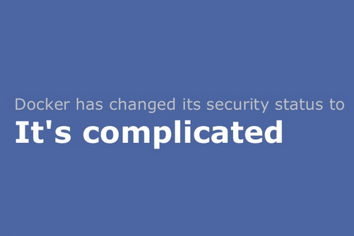
Docker – security
http://www.projectatomic.io/blog/2014/08/is-it-safe-a-look-at-docker-and-security-from-linuxcon/
Maciej Lasyk, Docker containers at scale
20/64

Slide 44

Docker – security
Maciej Lasyk, Docker containers at scale
20/64

Slide 45

Docker – use cases
CI Stack
http://sattia.blogspot.com/2014/05/docker-lightweight-linux-containers-for.html
Maciej Lasyk, Docker containers at scale
21/64

Slide 46
Docker – use cases
Continuous Integration
- local dev
- with Docker it's easy to standardize envs
- deployment
- rolling updates (e.g. w/Ansible)
- testing
- unit testing of any commit on dedicated env
- don't worry about cleaning up after testing
- parrarelized tests across any machines
Maciej Lasyk, Docker containers at scale
22/64

Slide 47
Docker – use cases
- version control system for apps
- microservices
- Docker embraces granularity
- Services can be deployed independently and faster
- paralleled tests across any machines
- continuous delivery
- PaaS
Maciej Lasyk, Docker containers at scale
23/64

Slide 48
Docker – history
- 2013-01: dotCloud worked on own PaaS (Python based)
- 2013-03: Docker went public (AUFS, LXC)
- middle 2013: Red Hat joined, devmapper, SELinux
- late 2013: removed LXC, rewritten in Go
- 2014-02: stable 1.0
Maciej Lasyk, Docker containers at scale
24/64

Slide 49
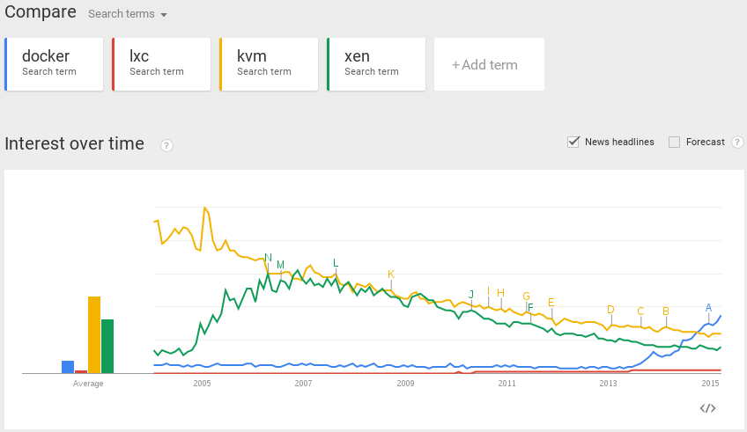
Docker – popularity
Maciej Lasyk, Docker containers at scale
25/64

Slide 50
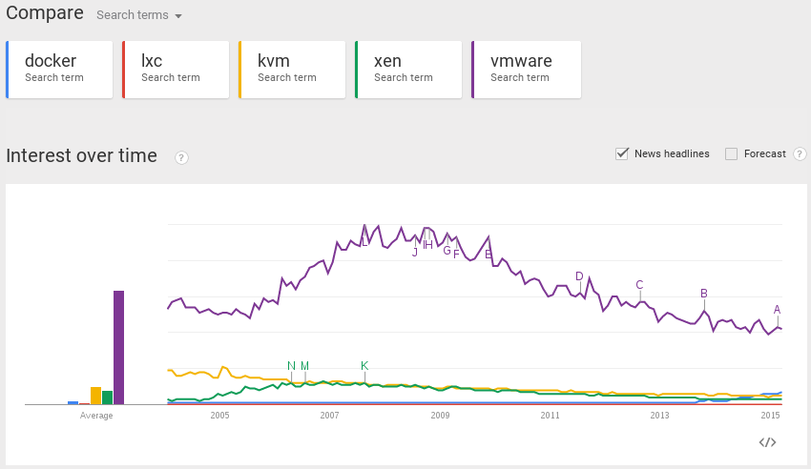
Docker – popularity
Maciej Lasyk, Docker containers at scale
26/64

Slide 51

Orchestration at scale w/Docker
Maciej Lasyk, Docker containers at scale
27/64

Slide 52
Orchestration at scale w/Docker
This might be a little problem
Maciej Lasyk, Docker containers at scale
28/64

Slide 53

Orchestration at scale w/Docker
This might be a little problem
Maciej Lasyk, Docker containers at scale
29/64

Slide 54

Orchestration at scale w/Docker
Maciej Lasyk, Docker containers at scale
30/64

Slide 55

http://www.cloudssky.com/en/blog/Docker-Is-Not-Enough
Maciej Lasyk, Docker containers at scale
31/64

Slide 56

To Paas or not to PaaS?
Maciej Lasyk, Docker containers at scale
32/64

Slide 57
To Paas or not to PaaS?
- you think PaaS will solve your problems?
Maciej Lasyk, Docker containers at scale
33/64

Slide 58
To Paas or not to PaaS?
- you think PaaS will solve your problems?
- it will rather clone them :)
Maciej Lasyk, Docker containers at scale
33/64

Slide 59
To Paas or not to PaaS?
- you think PaaS will solve your problems?
- it will rather clone them :)
- running PaaS might be easy
Maciej Lasyk, Docker containers at scale
33/64

Slide 60
To Paas or not to PaaS?
- you think PaaS will solve your problems?
- it will rather clone them :)
- installing PaaS might be easy
- operating PaaS will be tough
Maciej Lasyk, Docker containers at scale
33/64

Slide 61
To Paas or not to PaaS?
- you think PaaS will solve your problems?
- it will rather clone them :)
- installing PaaS might be easy
- operating PaaS will be tough
- so is operating your apps tough enough to move?
Maciej Lasyk, Docker containers at scale
33/64

Slide 62
To Paas or not to PaaS?
- you think PaaS will solve your problems?
- it will rather clone them :)
- installing PaaS might be easy
- operating PaaS will be tough
- so is operating your apps tough enough to move?
- private PaaS or not?
Maciej Lasyk, Docker containers at scale
33/64

Slide 63
To Paas or not to PaaS?
- you think PaaS will solve your problems?
- it will rather clone them :)
- installing PaaS might be easy
- operating PaaS will be tough
- so is operating your apps tough enough to move?
- private PaaS or not?
- is your app ready for PaaS?
Maciej Lasyk, Docker containers at scale
33/64

Slide 64
To Paas or not to PaaS?
- you think PaaS will solve your problems?
- it will rather clone them :)
- installing PaaS might be easy
- operating PaaS will be tough
- so is operating your apps tough enough to move?
- private PaaS or not?
- is your app ready for PaaS?
- Rainbow and Unicorn Piss:
http://blog.lusis.org/blog/2014/06/14/paas-for-realists/
Maciej Lasyk, Docker containers at scale
33/64

Slide 65
To Paas or not to PaaS?
- flynn.io
- Open source PaaS (Go)
- Uses Docker to manage containers
- Ops should be a product team, not consultants
- under development
- Git push deployment
- https://flynn.io
Maciej Lasyk, Docker containers at scale
34/64

Slide 66
To Paas or not to PaaS?
- flynn.io
- Open source PaaS (Go)
- Uses Docker to manage containers
- Ops should be a product team, not consultants
- under development
- Git push deployment
- https://flynn.io
- dokku
- The smallest PaaS implementation you've ever seen
- Docker powered mini-Heroku
- Less than 100 lines of Bash
- Git push deployment
- https://github.com/progrium/dokku
Maciej Lasyk, Docker containers at scale
34/64

Slide 67
To Paas or not to PaaS?
- flynn.io
- Open source PaaS (Go)
- Uses Docker to manage containers
- Ops should be a product team, not consultants
- under development
- Git push deployment
- https://flynn.io
- dokku
- The smallest PaaS implementation you've ever seen
- Docker powered mini-Heroku
- Less than 100 lines of Bash
- Git push deployment
- https://github.com/progrium/dokku
- deis.io
- Open source PaaS (Python)
- Git push deployment
- On top of CoreOS w/ Docker
- http://deis.io/
Maciej Lasyk, Docker containers at scale
34/64

Slide 68
To Paas or not to PaaS?
- flynn.io
- Open source PaaS (Go)
- Uses Docker to manage containers
- Ops should be a product team, not consultants
- under development
- Git push deployment
- https://flynn.io
- dokku
- The smallest PaaS implementation you've ever seen
- Docker powered mini-Heroku
- Less than 100 lines of Bash
- Git push deployment
- https://github.com/progrium/dokku
- deis.io
- Open source PaaS (Python)
- Git push deployment
- On top of CoreOS w/ Docker
- http://deis.io/
Don't forget maestro-ng!
https://github.com/signalfuse/maestro-ng
Maciej Lasyk, Docker containers at scale
34/64

Slide 69

To Paas or not to PaaS?
Remember, that PaaS might fail; plan & test for disaster !
Maciej Lasyk, Docker containers at scale
35/64
Notes:
Chaos monkey!

Slide 70
Docker & CLI
$ docker run -t -i fedora /bin/bash
> yum -y update
> yum -y install nginx
$ docker commit 73fa45674fd fedora-nginx
$ docker run -d -p 80:80 fedora-nginx
Maciej Lasyk, Docker containers at scale
36/64

Slide 71
Docker & CLI
Or via Dockerfile:
---
FROM fedora
MAINTAINER scollier <scollier@redhat.com>
RUN yum -y update
RUN yum -y install nginx
EXPOSE 80
CMD [ "/usr/sbin/nginx" ]
---
$ docker build -t fedora –rm .
$ docker run --name=nginx fedora
Maciej Lasyk, Docker containers at scale
37/64

Slide 72

FIG
- http://www.fig.sh
- for single host env
Maciej Lasyk, Docker containers at scale
38/64

Slide 73
FIG
db:
image: postgres
web:
build: .
command: python manage.py runserver 0.0.0.0:8000
volumes:
- /srv/app/code:/code
ports:
- "8000:8000"
links:
- db
Maciej Lasyk, Docker containers at scale
40/64

Slide 74
FIG
$ fig run web django-admin.py startproject figexample .
$ fig up
Management during runtime?
$ fig run web python manage.py syncdb
Maciej Lasyk, Docker containers at scale
41/64

Slide 75
Docker & Ansible
Ansible + Docker
&
Docker + Ansible
Maciej Lasyk, Docker containers at scale
42/64

Slide 76
Docker & Ansible
Ansible docker core module:
http://docs.ansible.com/docker_module.html
- hosts: web
sudo: yes
tasks:
- name: run tomcat servers
docker: >
image=centos
command="service tomcat6 start"
ports=8080
count=5
memory_limit=128MB
link=mysql
expose=8080
registry=...
volume=...
Maciej Lasyk, Docker containers at scale
43/64

Slide 77
Docker & Ansible
Building image with Ansible:
FROM ansible/centos7-ansible:stable
ADD ansible /srv/example/
WORKDIR /srv/example
RUN ansible-playbook web.yml -c local
EXPOSE 80
ENTRYPOINT ["/usr/sbin/nginx", "-DFOREGROUND"]
Maciej Lasyk, Docker containers at scale
44/64

Slide 78
Docker & Ansible
Building image with Ansible:
FROM ansible/centos7-ansible:stable
ADD ansible /srv/example/
WORKDIR /srv/example
RUN ansible-playbook web.yml -c local
EXPOSE 80
ENTRYPOINT ["/usr/sbin/nginx", "-DFOREGROUND"]
ansible/web.yml:
- hosts: localhost
tasks:
- yum: pkg=nginx state=latest
- copy:
src: web.conf
dest: /etc/nginx/conf.d/web.conf
group: "nginx"
mode: "0644"
Maciej Lasyk, Docker containers at scale
44/64

Slide 79
CoreOS
- Designed for massive server deployments
- Support Docker container out of the box
- It's a Chrome OS fork
- Consists of couple of components:
- SystemD – not just a init system ;)
- Fleet – cluster level manager & scheduler
- etcd – light & distributed key / value store
- Docker – the only packaging method in CoreOS
Maciej Lasyk, Docker containers at scale
45/64

Slide 80
Kubernetes
- https://github.com/GoogleCloudPlatform/kubernetes
- “An ocean of user containers”
- Advanced cluster manager (more than 1k hosts is a fit)
- Architecture:
- master
- minion
- pod
- replication controller
- label
Maciej Lasyk, Docker containers at scale
53/64

Slide 81

Kubernetes
Maciej Lasyk, Docker containers at scale
54/64

Slide 82

Kubernetes
Maciej Lasyk, Docker containers at scale
54/64

Slide 83
SmartStack
- automated service discovery and registration framework
- ideal for SOA architectures
- ideal for continuous integration & delivery
- solves “works on my machine” problem
Maciej Lasyk, Docker containers at scale
55/64

Slide 84
SmartStack
- automated service discovery and registration framework
- ideal for SOA architectures
- ideal for continuous integration & delivery
- solves “works on my machine” problem
haproxy + nerve + synapse + zookeper = smartstack
Maciej Lasyk, Docker containers at scale
56/64

Slide 85
SmartStack
Synapse
- discovery service (via zookeeper or etcd)
- installed on every node
- writes haproxy configuration
- application doesn't have to be aware of this
- works same on bare / VM / docker
- https://github.com/airbnb/nerve
Maciej Lasyk, Docker containers at scale
57/64

Slide 86

SmartStack
Maciej Lasyk, Docker containers at scale
58/64

Slide 87
SmartStack
Nerve
- health checks (pluggable)
- register service info to zookeper (or etcd)
- https://github.com/airbnb/synapse
Maciej Lasyk, Docker containers at scale
59/64

Slide 88

SmartStack
Maciej Lasyk, Docker containers at scale
60/64

Slide 89

SmartStack
Maciej Lasyk, Docker containers at scale
60/64

Slide 90
SmartStack
Smartstack + Docker = <3
Maciej Lasyk, Docker containers at scale
60/64

Slide 91
Summary
Wanna learn Docker?
http://dockerbook.com/
Maciej Lasyk, Docker containers at scale
61/64

Slide 92
Summary
w/ Docker Sky is the limit!
Maciej Lasyk, Docker containers at scale
61/64

Slide 93

Freenode #docker
Krk DevOPS meetups (http://www.meetup.com/Docker-Krakow-Poland/)
https://github.com/docker/docker
Maciej Lasyk, Docker containers at scale
62/64

Slide 94
Looking for a job?
- software developer
- sysadmin
- devops
Catch me: maciek@lasyk.info
Maciej Lasyk, Docker containers at scale
61/64

Slide 95
sources?
- docker.io documentation
- dockerbook.com
- slideshare!
- zounds of blogposts (urls provided)
- and some experience ;)
Maciej Lasyk, Docker containers at scale
63/64

Slide 96
Dzięki :)
Docker – kontenery w praktyce
Maciej Lasyk
OpenSourceSummit 2015
2015-03-24, Warszawa
http://maciej.lasyk.info
maciej@lasyk.info
@docent-net
Maciej Lasyk, Docker containers at scale
64/64

