Slide 1
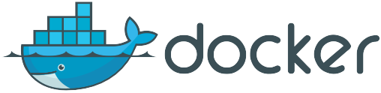
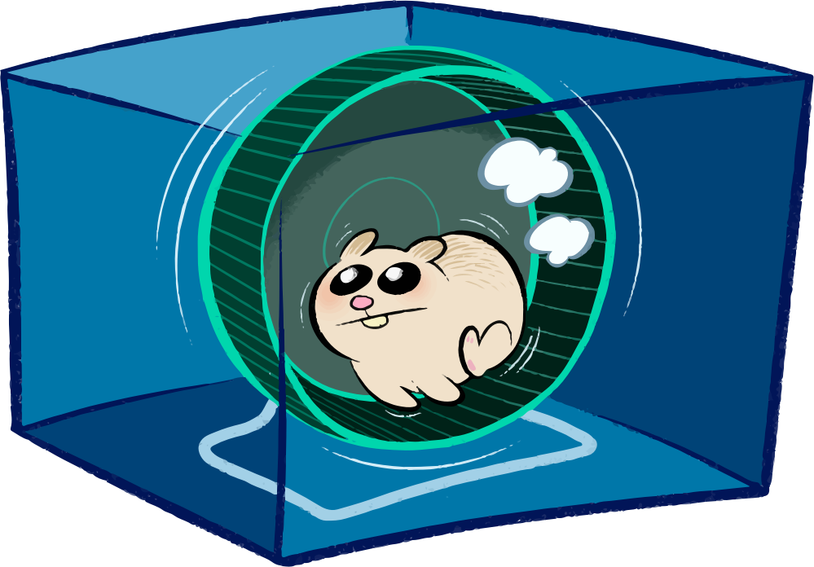
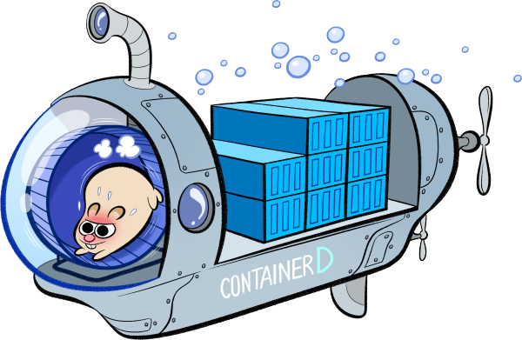
Docker 1.11
Maciej Lasyk
Kraków, devOPS meetup #9
2016-04-14

Slide 2
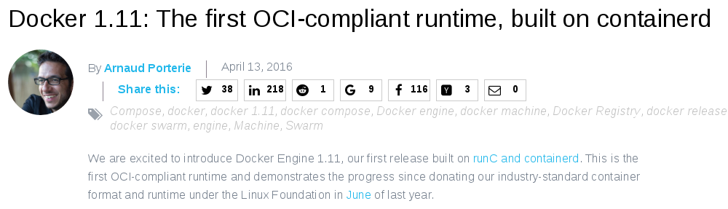
https://blog.docker.com/2016/04/docker-engine-1-11-runc/

Slide 3
This is very important change

Slide 4
→ Docker was created in dotCloud as engine for their PaaS
→ PaaS times were hard in 2013;
→ Decision to open – source Docker
→ LXC based, created for one purpose
→ dotCloud pivot: Docker inc is created
→ Docker is now the main product
→ http://www.trinityventures.com/pivot-worked-docker-story/

Slide 5
→ Docker was created in dotCloud as engine for their PaaS
→ PaaS times were hard in 2013;
→ Decision to open – source Docker
→ LXC based, created for one purpose
→ dotCloud pivot: Docker inc is created
→ Docker is now the main product
→ http://www.trinityventures.com/pivot-worked-docker-story/

Slide 6
→ Docker was created in dotCloud as engine for their PaaS
→ PaaS times were hard in 2013;
→ Decision to open – source Docker
→ LXC based, created for one purpose
→ dotCloud pivot: Docker inc is created
→ Docker is now the main product
→ http://www.trinityventures.com/pivot-worked-docker-story/

Slide 7
→ Docker was created in dotCloud as engine for their PaaS
→ PaaS times were hard in 2013;
→ Decision to open – source Docker
→ LXC based, created for one purpose
→ dotCloud pivot: Docker inc is created
→ Docker is now the main product
→ http://www.trinityventures.com/pivot-worked-docker-story/

Slide 8
→ Docker was created in dotCloud as engine for their PaaS
→ PaaS times were hard in 2013;
→ Decision to open – source Docker
→ LXC based, created for one purpose
→ dotCloud pivot: Docker inc is created
→ Docker is now the main product
→ http://www.trinityventures.com/pivot-worked-docker-story/

Slide 9
→ Docker was created in dotCloud as engine for their PaaS
→ PaaS times were hard in 2013;
→ Decision to open – source Docker
→ LXC based, created for one purpose
→ dotCloud pivot: Docker inc is created
→ Docker is now the main product
→ http://www.trinityventures.com/pivot-worked-docker-story/

Slide 10
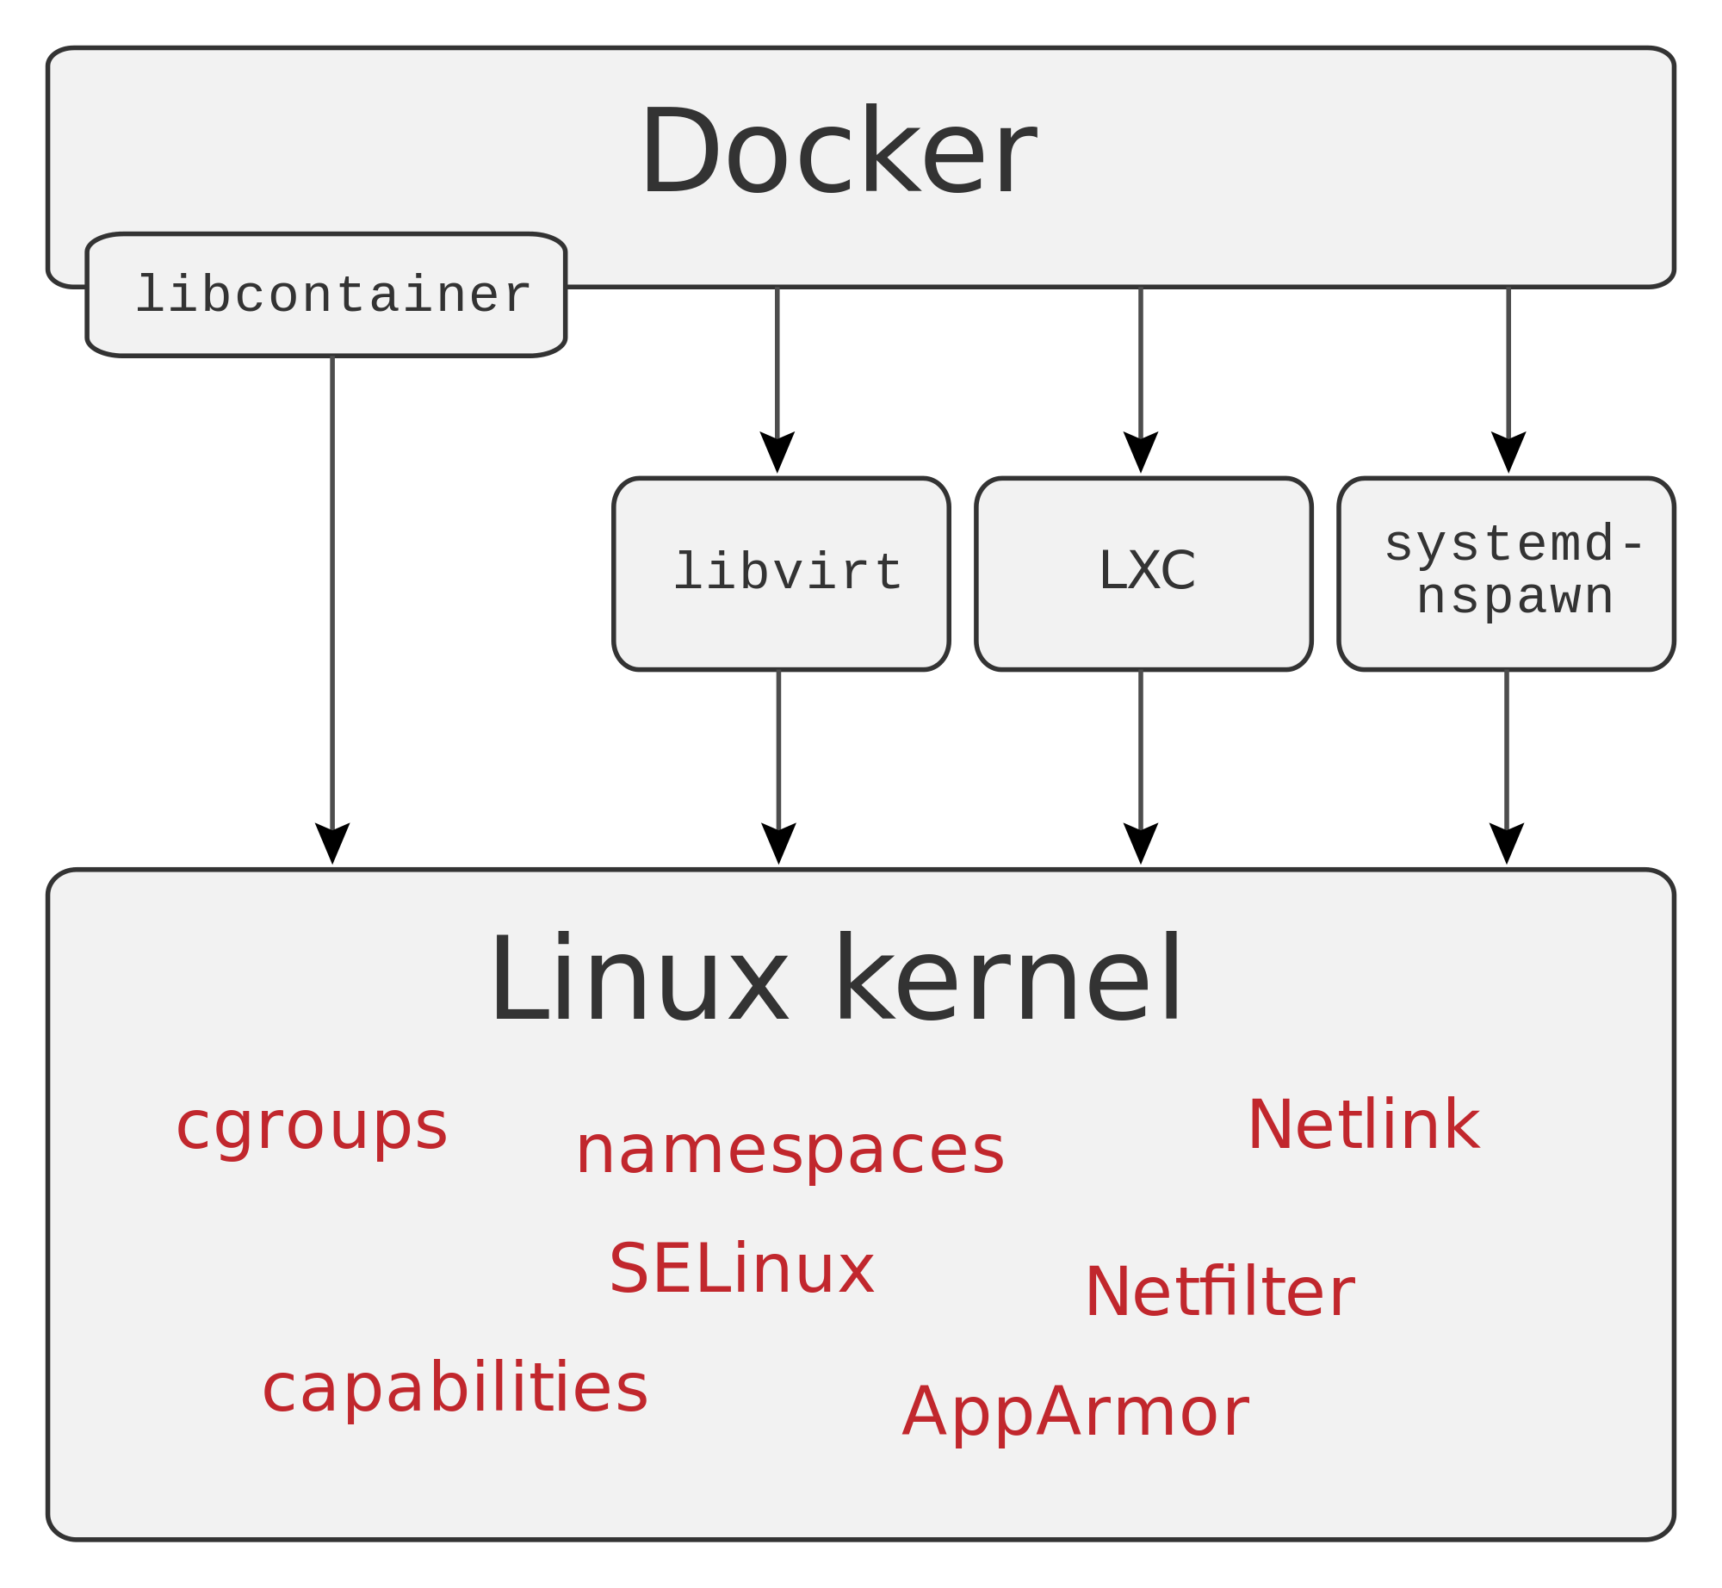

Slide 11
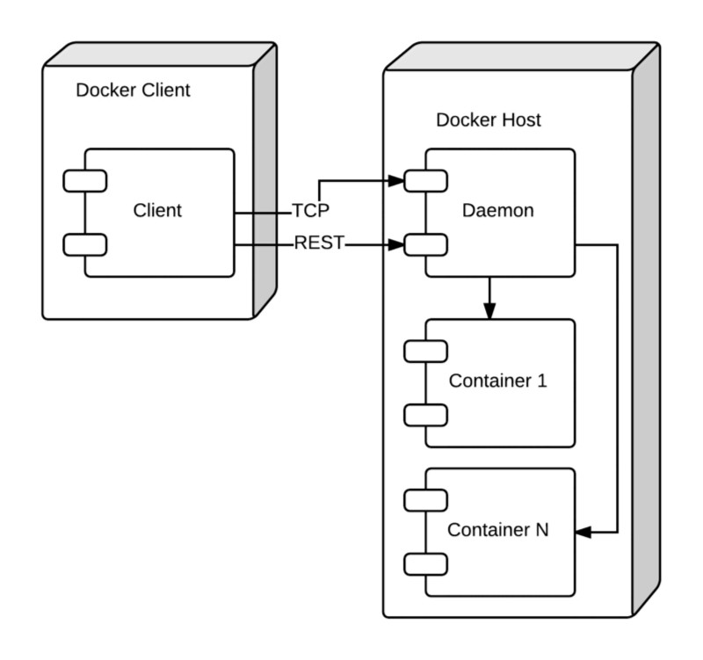
https://medium.com/aws-activate-startup-blog/a-better-dev-test-experience-docker-and-aws-291da5ab1238#.xwmx8063k

Slide 12

https://www.opencontainers.org/
https://github.com/opencontainers/runtime-spec

Slide 13
runC
Implementation of OCF

Slide 14
Daemon (API + cli client) for managing runC containers

Slide 15
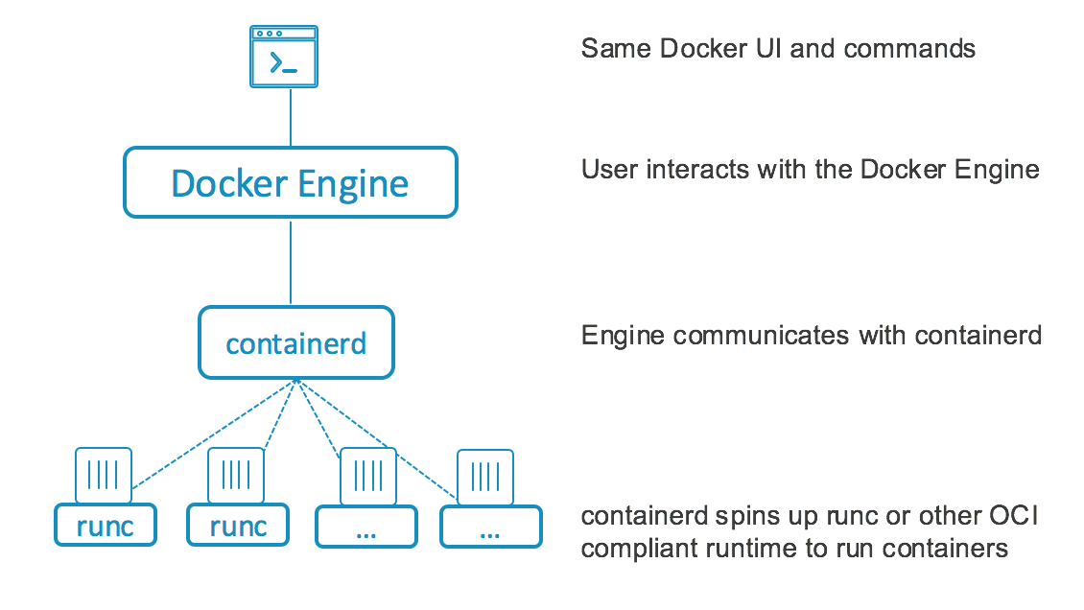

Slide 16
→ integration with systemd (via runC)
→ backwards docker compatibility (hmm not sure)

Slide 17
→ integration with systemd (via runC)
→ backwards docker compatibility (hmm not sure)

Slide 18
Summing up:
→ status changed to “complicated”
→ let's wait and see (after others upgrade)
→ I'm gonna stick for a while w/systemd-nspawn

Slide 19
Summing up:
→ status changed to “complicated”
→ let's wait and see (after others upgrade)
→ I'm gonna stick for a while w/systemd-nspawn

Slide 20
Summing up:
→ status changed to “complicated”
→ let's wait and see (after others upgrade)
→ I'm gonna stick for a while w/systemd-nspawn

Slide 21
Docker 1.11
Maciej Lasyk
Kraków, devOPS meetup #9
2016-04-14

