Slide 1

Devops 101:
Co powinieneś wiedzieć
na temat DevOps?
Maciej Lasyk
2016-01-12

Slide 2

Join Fedora Infrastructure!
- learn Ansible
- learn howto devops
http://fedoraproject.org/en/join-fedora

Slide 3

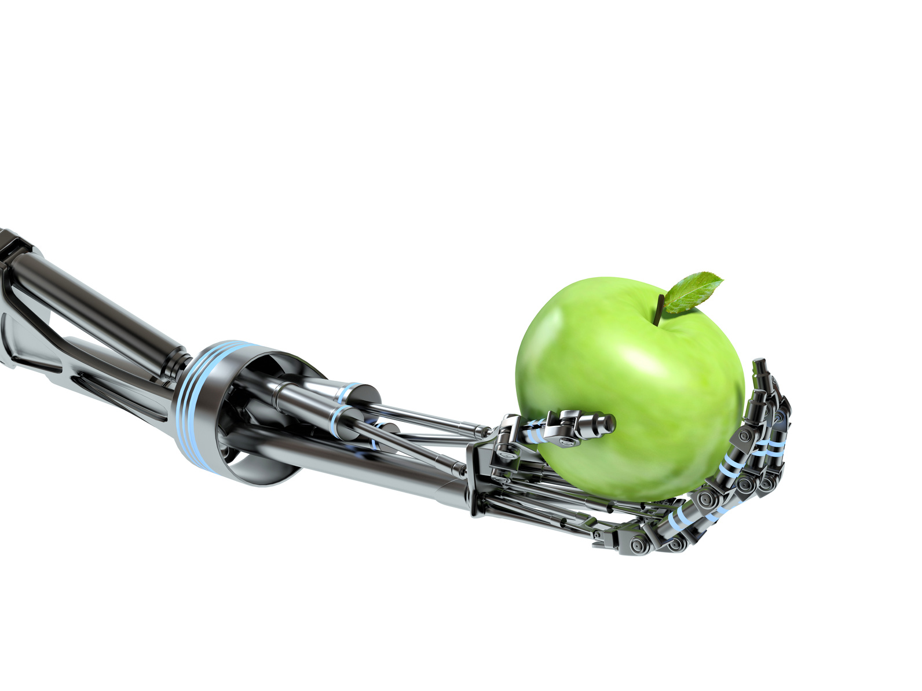
www.ocadotechnology.com/join-us

Slide 4

Notes:
- czym jest devops?
- zapytać ludków czy wiedzą (łapy w górę)
- wybrać kilku I zapytać o odpowiedź

Slide 5
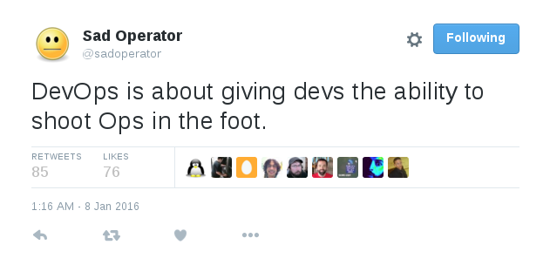

Slide 6
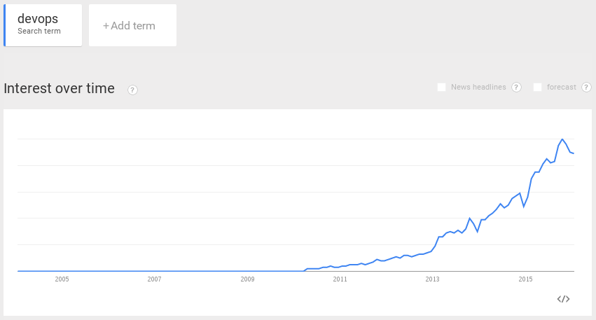

Slide 7
Agile Manifesto
→ Individuals and interactions over processes and tools
→ Working software over comprehensive documentation
→ Customer collaboration over contract negotiation
→ Responding to change over following a plan
Notes:
Opisać przypadek Ganymede I to, dlaczego
my nie nazywaliśmy się agile
- nie byliśmy agile bo nie mieliśmy
kanbana, scruma, spotkań
- liczył się tylko kod

Slide 8

Notes:
- agile potrafia spowalniać
- agile potrafia wymóżdżać – poruszamy się po torach
- show me the code approach – szczególnie u ludzi młodych

Slide 9
Evolution: how we do software?
→ Monoliths
→ SOA
→ Microservices

Slide 10
Evolution: how we do software?
→ Monoliths
→ SOA
→ Microservices

Slide 11
Evolution: how we do software?
→ Monoliths
→ SOA
→ Microservices

Slide 12
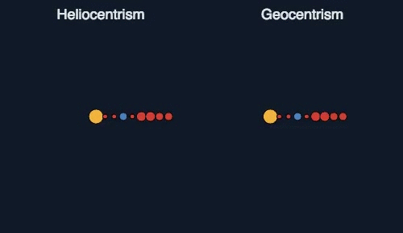
https://de.reddit.com/r/space/comments/404vdc/heliocentrism_vs_geocentrism/
Notes:
Monolith – geocentrism
SOA – heliocentrism
Brakuje czegoś?
Keplera!
Dodajmy keplera I dojdziemy do tego, że jednak SOA jest nie ok, bo mu czegoś brakowało – kierunek → mikroserwisy

Slide 13
So wanna go microservices…?
There's a trap :)

Slide 14
Conway's law (1968)
organizations which design systems ... are constrained to produce designs which are copies of the communication structures of these organizations
http://en.wikipedia.org/wiki/Conway%27s_law
Notes:
- jak komunikować się mają mikroserwisy skoro my nie potrafimy?

Slide 15
Ruth Malan (2008)
if the architecture of the system and the architecture of the organization are at odds, the architecture of the organization wins.
The organizational divides are going to drive the true seams in the system.
http://traceinthesand.com/blog/2008/02/13/conways-law/
Notes:
- jeśli komunikacja międzyludzka nie działa to w taki sam sposób będzie nie działała aplikacja I jej architekrura

Slide 16
Cross – functional, self – organizing teams?
Notes:
zap[ytać czy ktoś w takim rpacuje

Slide 17

@DevopsReactions
Assign it to me
http://devopsreactions.tumblr.com/post/129700187579/assign-it-to-me
Notes:
zap[ytać czy ktoś w takim rpacuje

Slide 18
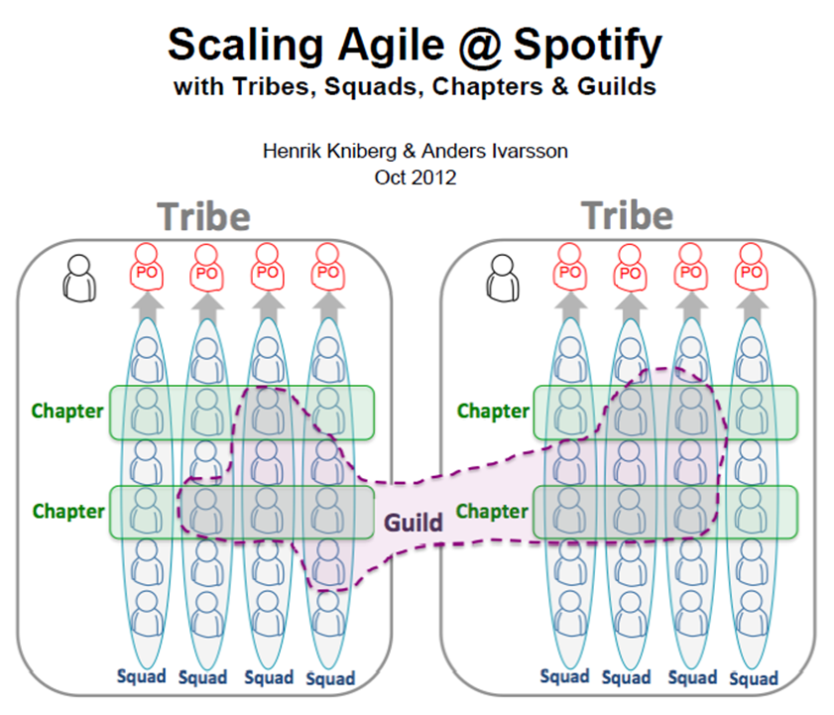

Slide 19
DevOPS ?== CAMS
(culture, automation, measurement, sharing)

Slide 20
DevOPS !== CAMS
DevOPS === people!

Slide 21
culture
automation
People
measurement
sharing

Slide 22
Dead sea effect
→ most talented evaporates
→ the residue
→ maintenance experts & bus factor == 1
http://brucefwebster.com/2008/04/11/the-wetware-crisis-the-dead-sea-effect/

Slide 23

@DevopsReactions
Senior’s reaction when asked to stay late
http://devopsreactions.tumblr.com/post/134976048898/seniors-reaction-when-asked-to-stay-late
Notes:
Potrzebujemy tych ludzi zatrzymać!

Slide 24
Dead sea effect
there is a solution...
Notes:
Odpowiedż jest w psychologii

Slide 25
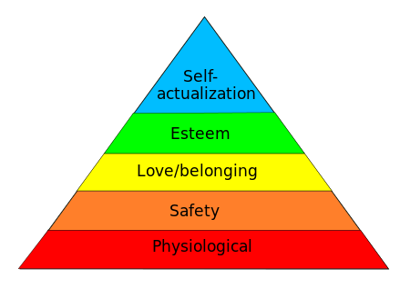
Maslow's hierarchy of needs

Slide 26
Maslow's hierarchy of needs: physiological
Let's say that until it's North Korea than it's ok ;)

Slide 27
Maslow's hierarchy of needs: safety
→ family
→ $$$
→ job security

Slide 28
Maslow's hierarchy of needs: <3 and belonging
→ friendship?
→ is your team your family?
→ do you find yourself in your company?

Slide 29
Maslow's hierarchy of needs: Esteem
→ are you respected?
→ do u need the fame and glory?
→ what about your recognition?

Slide 30
Maslow's hierarchy of needs: self - actualization
→ is your job aligned w/ur interests?
→ do u feel fulfilled?
→ do you find time for self – development?

Slide 31
Maslow's hierarchy of needs

Slide 32
How do you keep good people in company?
people don't leave companies; they leave leaders

Slide 33
How do you keep good people in company?
people don't leave companies; they leave leaders
or just one of the most popular reasons...

Slide 34
most popular reasons.. to leave your company
→ Frustration with the inversion of meritocracy (“organization stupidities”)
→ Simple boredom
→ Perception that current project is futile/destined for failure accompanied by organizational powerlessness to stop it
→ Lack of a mentor or anyone from whom much learning was possible
→ Promotions a matter of time rather than merit
→ No obvious path to advancement
→ Fear of being pigeon-holed into unmarketable technology
→ Red-tape organizational bureaucracy mutes positive impact that anyone can have
→ Lack of creative freedom and creative control (aka “micromanaging”)
http://www.daedtech.com/how-to-keep-your-best-programmers

Slide 35
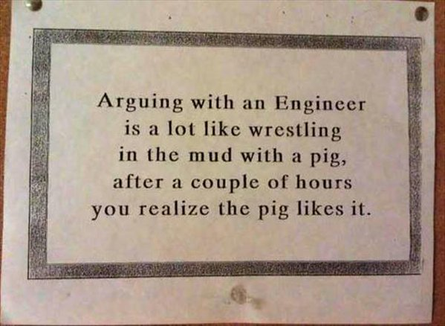
Communication

Slide 36
Communication
→ paraphrase
→ listening, hearing, understanding
→ sarcasm is a passive agression

Slide 37
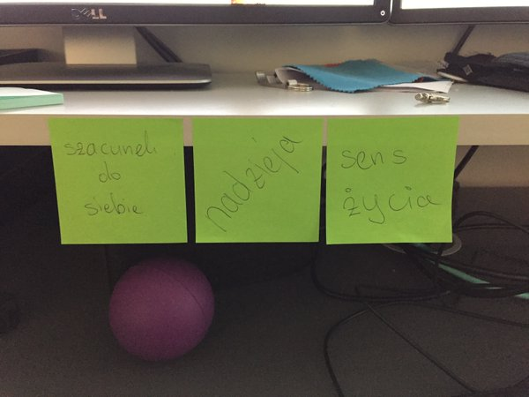

Slide 38
Areas of responsibilities?
Communication patterns?

Slide 39
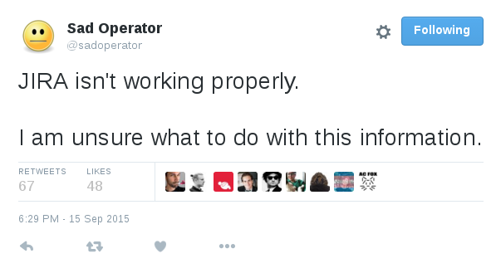
Areas of responsibilities?
Communication patterns?
Notes:
Tha is why Devops should never exists as a team!

Slide 40
DevOps Anti-Types & patterns
This is a copy/paste from http://blog.matthewskelton.net/ w/my comments included
Great job Matthew! Thanks!

Slide 41
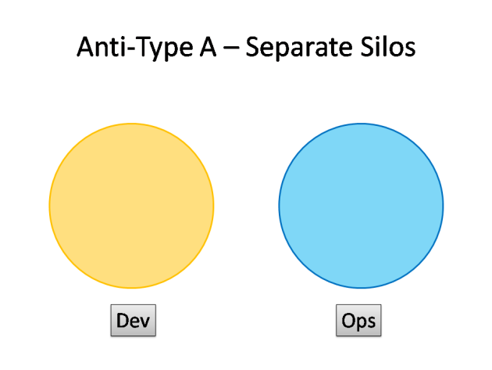
DevOps Anti-Types
http://blog.matthewskelton.net/2013/10/22/what-team-structure-is-right-for-devops-to-flourish/

Slide 42
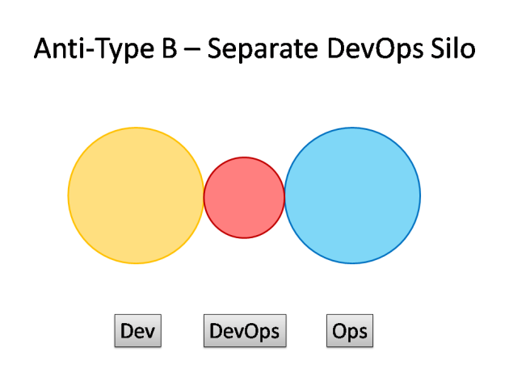
DevOps Anti-Types
http://blog.matthewskelton.net/2013/10/22/what-team-structure-is-right-for-devops-to-flourish/

Slide 43
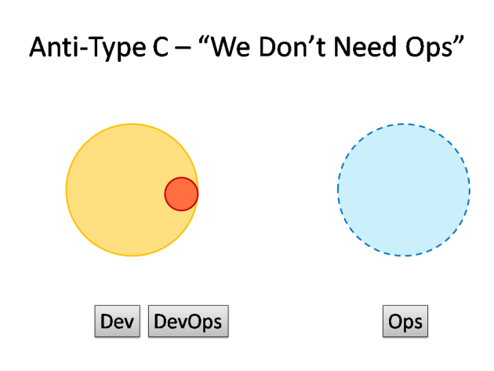
DevOps Anti-Types
http://blog.matthewskelton.net/2013/10/22/what-team-structure-is-right-for-devops-to-flourish/

Slide 44
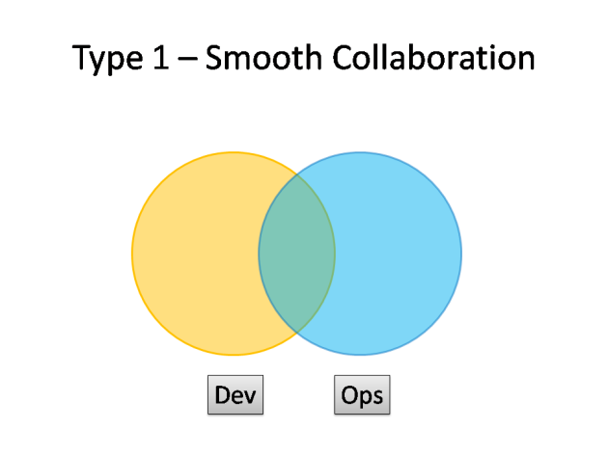
DevOps Patterns
http://blog.matthewskelton.net/2013/10/22/what-team-structure-is-right-for-devops-to-flourish/

Slide 45
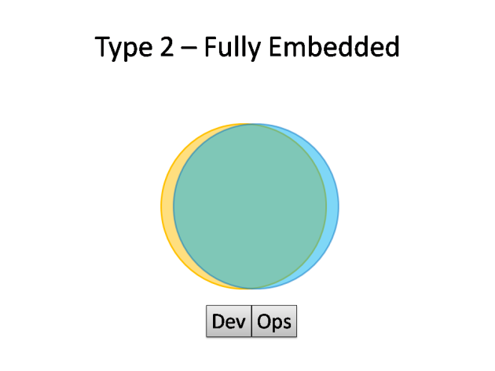
DevOps Patterns
http://blog.matthewskelton.net/2013/10/22/what-team-structure-is-right-for-devops-to-flourish/

Slide 46
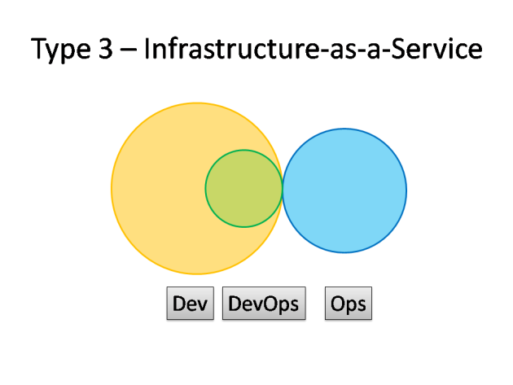
DevOps Patterns
http://blog.matthewskelton.net/2013/10/22/what-team-structure-is-right-for-devops-to-flourish/

Slide 47
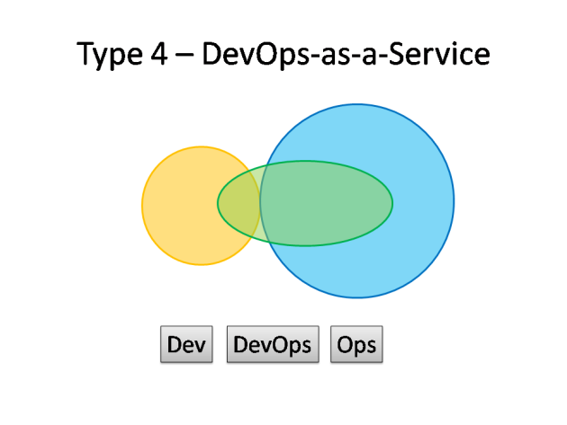
DevOps Patterns
http://blog.matthewskelton.net/2013/10/22/what-team-structure-is-right-for-devops-to-flourish/

Slide 48
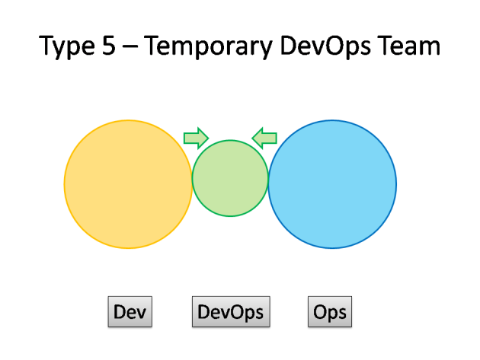
DevOps Patterns
http://blog.matthewskelton.net/2013/10/22/what-team-structure-is-right-for-devops-to-flourish/

Slide 49
Devops myths

Slide 50
Devops myths
You can hire Devops to fix your organisation
Notes:
Nie można o ile to nie jest przemyślane
Devops może szkolić developerów
Devops może im pomagać
Devops nie naprawi samej organizacji – patrz wcześniej
Wandering experts!

Slide 51
Devops myths
Hire Devops to fix monitoring, automation,
configuration etc
Notes:
No nie
Czyć, wspomagać, budować platformę, na bazie której developerzy mogą pracować (ale nie taką grubą platformę)
Pracować bliżej developerów I ich edukować
Devops powinien być seniorem na starcie

Slide 52
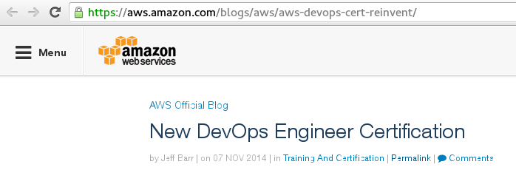
Devops myths
You can certify yourself in Devops

Slide 53
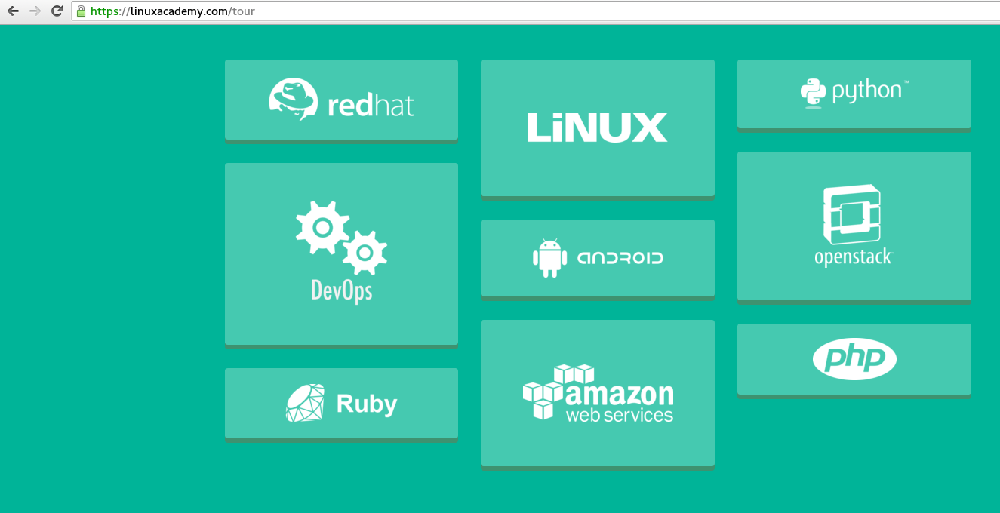

Slide 54
Devops myths
Devops is all about tools

Slide 55
Devops myths
Devops is all about tools
Yup – about “tools” working in company ;)

Slide 56
Devops myths
Devops is only about engineering

Slide 57
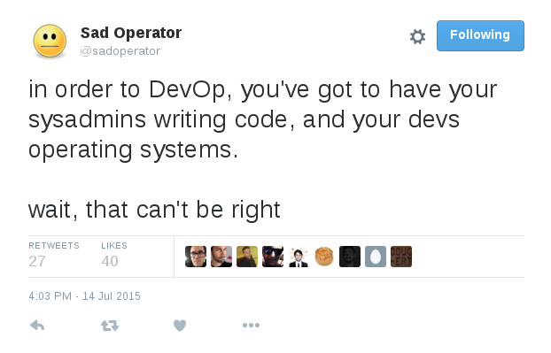
Devops 101: chaos

Slide 58
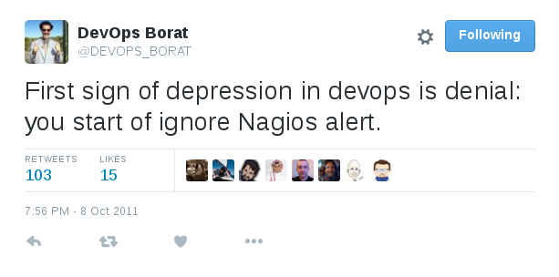
Devops 101: have clever monitoring

Slide 59
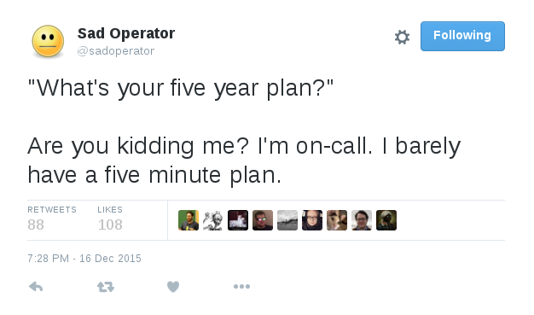
Devops 101: smart oncall

Slide 60
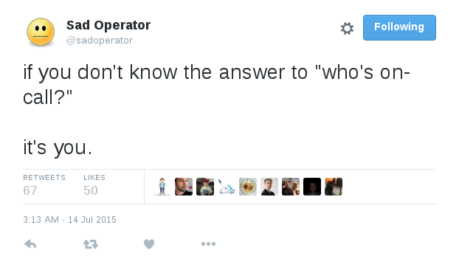
Devops 101: smart oncall

Slide 61
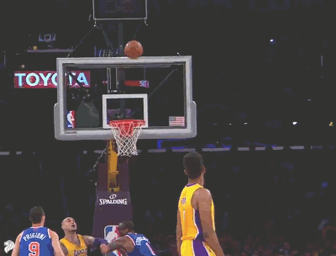
@DevopsReactions
Friday deployments (…and leaving afterwards)
http://devopsreactions.tumblr.com/post/87284390953/friday-deployments-and-leaving-afterwards

Slide 62

@DevopsReactions
Receiving a call after a long day
http://devopsreactions.tumblr.com/post/136805591513/receiving-a-call-after-a-long-day

Slide 63
Devops 101: automate
→ whatever (smart) tools
→ don't reinvent the wheel!
→ test it (approach) during recruitment

Slide 64
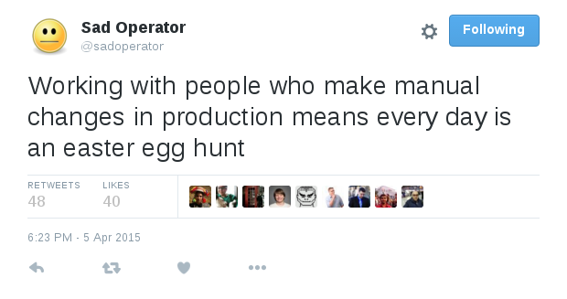
Devops 101: automate

Slide 65
Devops 101: production
→ A/B testing
→ Canary Releases
→ Feature toggles
→ blue / green deployments
→ Chaos Monkey
→ Immutable servers
→ Stress testing
Notes:
historia górników i kanarka

Slide 66
Devops 101: production
→ A/B testing
→ Canary Releases
→ Feature toggles
→ blue / green deployments
→ Chaos Monkey
→ Immutable servers
→ Stress testing

Slide 67
Devops 101: production
→ A/B testing
→ Canary Releases
→ Feature toggles
→ blue / green deployments
→ Chaos Monkey
→ Immutable servers
→ Stress testing

Slide 68
Devops 101: production
→ A/B testing
→ Canary Releases
→ Feature toggles
→ blue / green deployments
→ Chaos Monkey
→ Immutable servers
→ Stress testing
Notes:
Upgrade'owanie baz danych

Slide 69

@DevopsReactions
Cutting over to new service provider
http://devopsreactions.tumblr.com/post/135244622055/cutting-over-to-new-service-provider
Notes:
Upgrade'owanie baz danych

Slide 70
Devops 101: production
→ A/B testing
→ Canary Releases
→ Feature toggles
→ blue / green deployments
→ Chaos Monkey
→ Immutable servers
→ Stress testing

Slide 71
Devops 101: production
→ A/B testing
→ Canary Releases
→ Feature toggles
→ blue / green deployments
→ Chaos Monkey
→ Immutable servers
→ Stress testing
Notes:
apdejtowanie przez rebuildowanie serwerów,
utrzymywanie abse-image'ów
skracanie czasu rollkupowania maszyn
(phoenix server: image + configuracja + data);
stickowanie wersji serwera (wersja obrazu plus konfiguracji) do aplikacj
podkrecanie wraz z aplikacja (trkatowanie serwera jako czesci aplikacji);
odpowiedziec na pytanie w jaki sposob wiec apgerjdowac np security patches?

Slide 72
Devops 101: production
→ A/B testing
→ Canary Releases
→ Feature toggles
→ blue / green deployments
→ Chaos Monkey
→ Immutable servers
→ Stress testing

Slide 73


Devops 101: circuit breakers

Slide 74

Devops 101: wandering experts

Slide 75
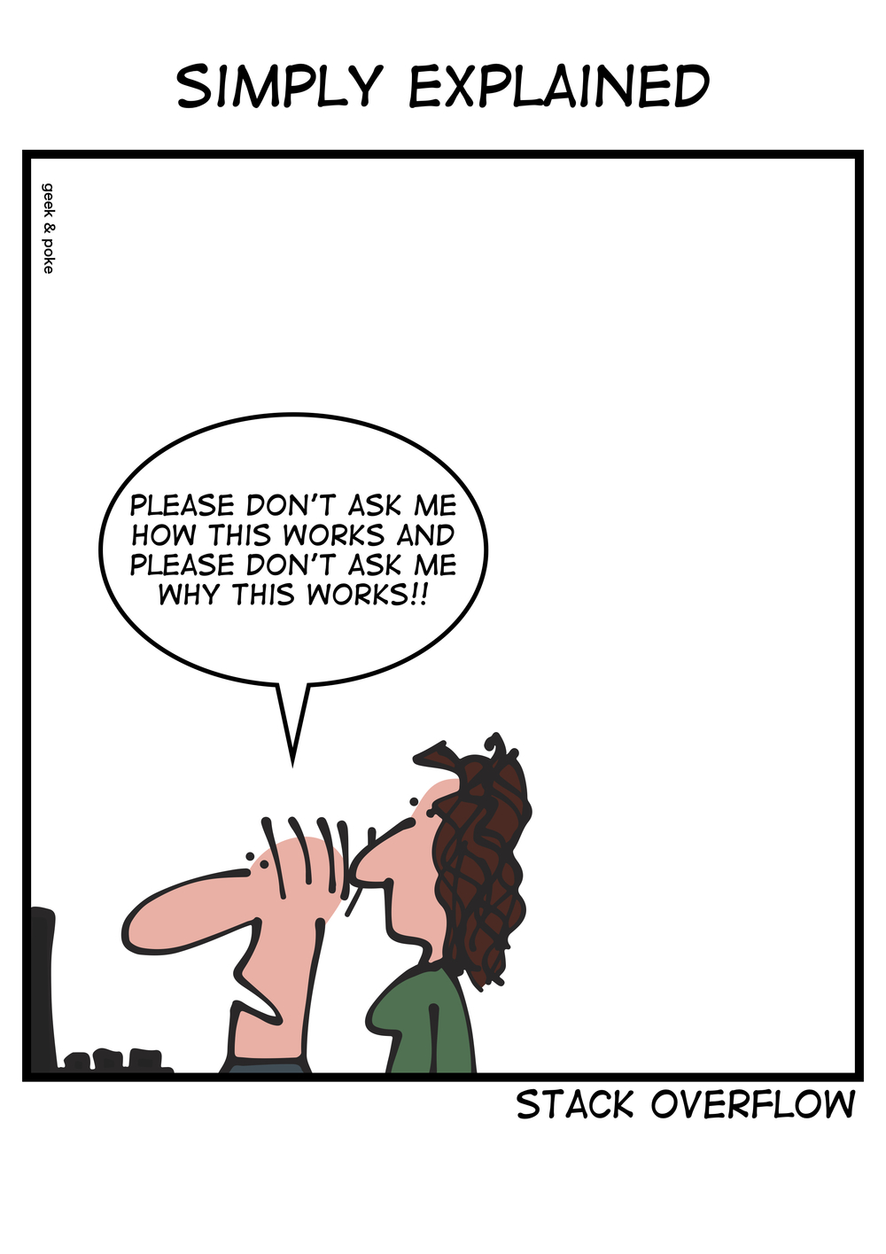
Devops 101: Legacy?

Slide 76
Devops 101: Legacy?
Try Mikado Method

Slide 77
Devops 101: Experiment!
Notes:
How many containerization techniques did u use?

Slide 78
Devops 101: Experiment!
→ Docker
→ systemd-nspawn
→ LX-branded zones
→ runc
→ LXC
→ LXD
→ LMCTFY
…?

Slide 79
Materials
http://devopschecklist.com/
http://www.devopsweekly.com
https://github.com/kilimchoi/engineering-blogs
Books:
→ Phoenix Project
→ Continuous Delivery
→ Continuous Integration
→ Zrozumieć Programowanie :)
https://puppetlabs.com/presentations/why-everything-just-worst

Slide 80
Tools
https://dzone.com/storage/temp/812531-xebialabs-periodic-table-of-devops.png
http://devops.com/business-directory/
https://github.com/charleskorn/devops-101
http://theremotelab.io/blog/updates_about_devops_world/

Slide 81
Devops events?
→ #KrkDevops meetups
→ Devops days
→ Atmosphere Conference
→ Velocity Conference

Slide 82
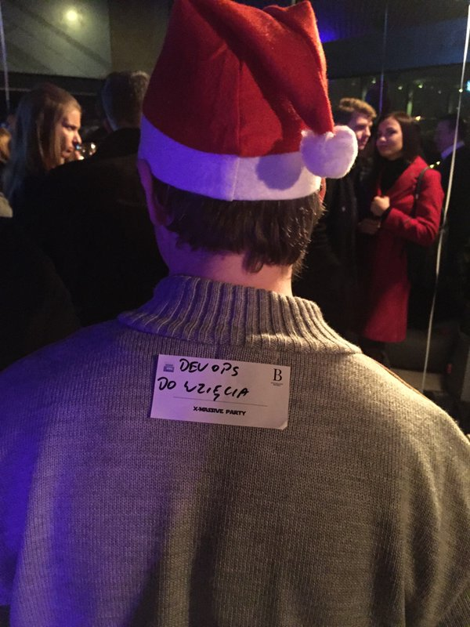

Slide 83
www.ocadotechnology.com/join-us

Slide 84
Devops 101:
Co powinieneś wiedzieć
na temat DevOps?
Maciej Lasyk
2016-01-12

