Slide 1

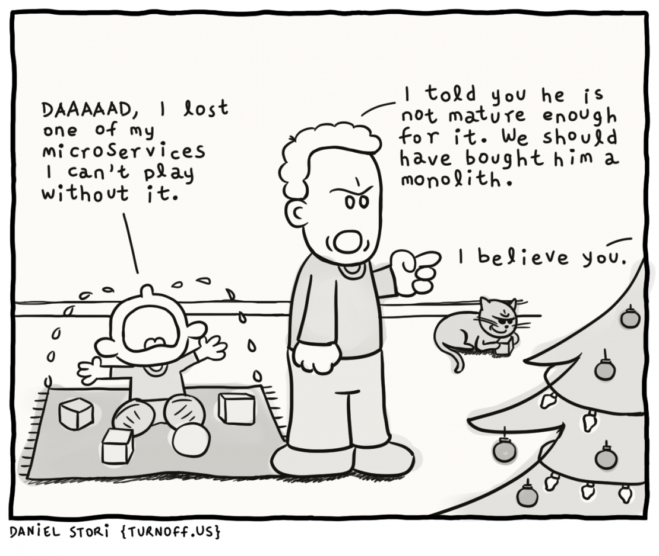
O bezpieczeństwie kontenerów linuksowych
Wrocław, 2019-04-06
Maciej Lasyk

Slide 2
$ whois maciej.lasyk.info
6 raz na Sesji – dzięki!
wspomaga projekt Fedora
@docent-net
github.com/docent-net/
maciej.lasyk.info
dlugodystansowy.pl

Slide 3

Join Fedora Infrastructure!
https://fedoraproject.org/wiki/Infrastructure/GettingStarted

Slide 4
Linux containers?
Used for process containment
Linux namespaces for providing users/FS/others view
Cgroups v1/v2 for resources management
Linux LSMs for sealing security holes
By design not created for providing additional security layer
Some storage copy-on-write magic (not needed btw at all)
Quo-vadis containers: https://www.youtube.com/watch?v=_GSLj-c_LMI

Slide 5
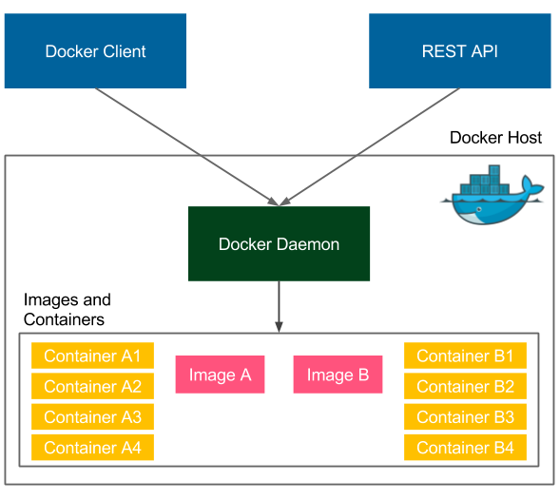
Docker architecture

Slide 6
Docker architecture
Binary client ($ docker)
REST API on docker.sock by default
...booring? Not rly
$ docker run --privileged -v /:/host:rw
(unless SELinux which by default denies socket access)

Slide 7
Docker security considerations
docker run --user foo
  executes the process in the container as non - root
  dockerd, containerd, and runc still running as root

Slide 8
Docker security considerations
docker run --user foo
  executes the process in the container as non - root
  dockerd, containerd, and runc still running as root
USER in Dockerfile
  same as above
  you can't run dnf/yum/apt-get install whatever

Slide 9
Docker security considerations
docker run --user foo
  executes the process in the container as non - root
  dockerd, containerd, and runc still running as root
USER in Dockerfile
  same as above
  you can't run dnf/yum/apt-get install whatever
usermod -aG docker foo
  allows non - root user to connect to docker.sock
  remember docker run --privileged -v /:/host - DON'T

Slide 10
Docker - what are privileged containers?
Basically Linux capabilities unlimited
See man 7 capabilities
Try: --cap-drop=ALL
Read: runtime-privilege-and-linux-capabilities

Slide 11
Docker - rootless considerations
https://docs.docker.com/engine/security/userns-remap/
dockerd --userns-remap
  executes containers as non - root (dockremap) using user namespaces
  most similar to rootless, but still needs dockerd, containerd, runc to run from root

Slide 12
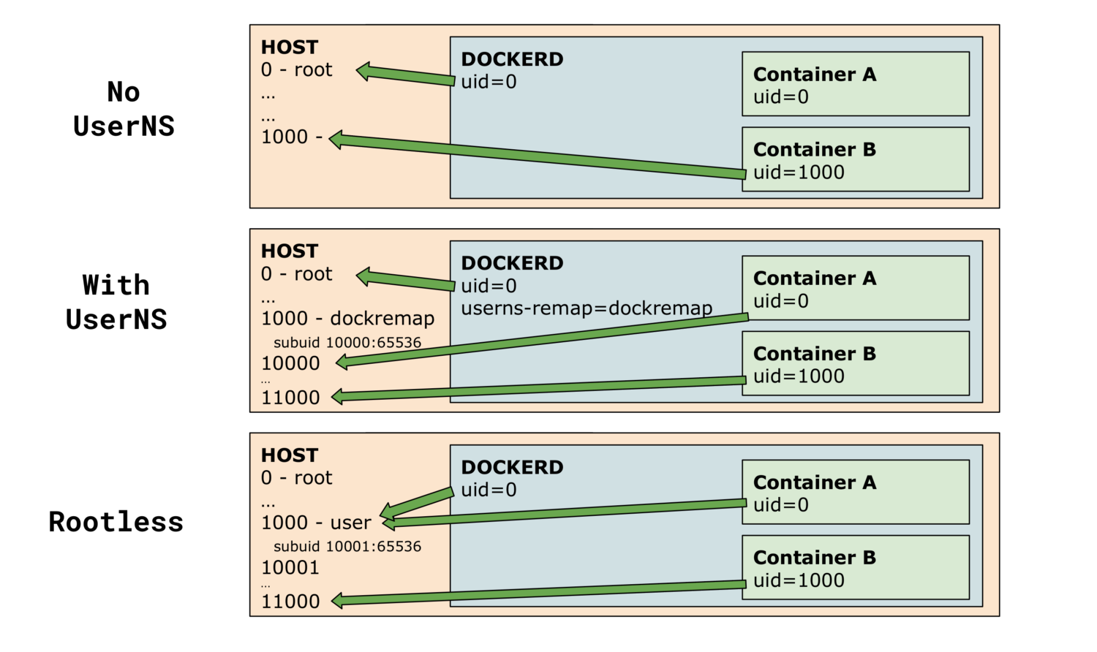

Slide 13
Rootless finally in Docker?
Original issue: https://github.com/moby/moby/pull/38050
https://engineering.docker.com/2019/02/experimenting-with-rootless-docker/
Downsides:
  w/out cgroups (so no resource management)
  w/out apparmor and SELinux
  w/out overlay networks
  w/out ports exposing directly - needs socat
  On Ubuntu overlayFS, rest VFS which is no good for production
So this is an experiment

Slide 14
“Containers do not contain”
Originally said by Dan Walsh: docker-security-selinux
“I have heard people say Docker containers are as secure as running processes in separate VMs/KVM.”
“I know people are downloading random Docker images and then launching them on their host.”
“I have even seen PaaS servers (not OpenShift, yet) allowing users to upload their own images to run on a multi-tenant system.”
“I have a co-worker who said: "Docker is about running random code downloaded from the Internet and running it as root.”

Slide 15
“Containers do not contain”
Containers were not created for/security by design!
Solaris zones were, and have great support directly from FS (see ZFS, Crossbow)
See Containers do not contain

Slide 16
Docker & SELinux
Stop disabling SELinux
“Container security: frustration in the RedHat security team was high because of difficulties to integrate patches into the Docker product [...]” [source]
See: Docker versus Systemd - Can't we just get along?

Slide 17
Docker & SELinux - do you really need LSM?
Major kernel subsystems are not namespaced like:
Cgroups
file systems under /sys
/proc/sys, /proc/sysrq-trigger, /proc/irq, /proc/bus
Devices are not namespaced:
/dev/mem
/dev/sd* file system devices
Kernel Modules are not namespaced
If you can communicate or attack one of these as a privileged process, you can own the system.

Slide 18
Docker seccomp
Kernel w/seccomp
Docker-engine w/seccomp
Read: https://docs.docker.com/engine/security/seccomp/

Slide 19
Docker images
Remember ““I have a co-worker who said: "Docker is about running random code downloaded from the Internet and running it as root.”?
Read most-popular-docker-images-each-contain-at-least-30-vulnerabilities/

Slide 20
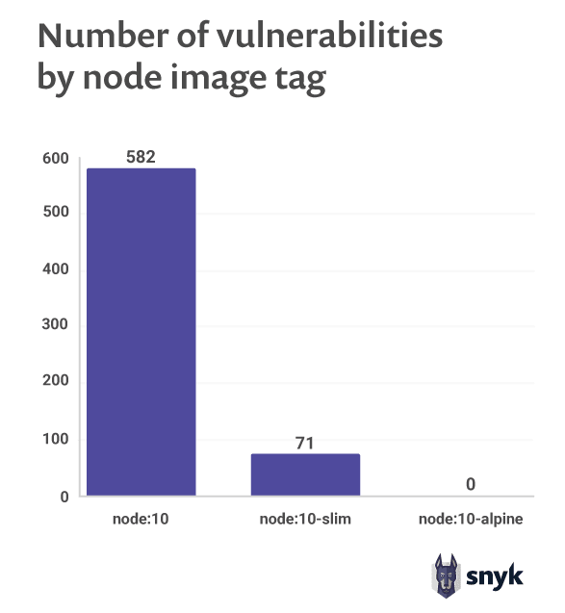
Docker images
Remember ““I have a co-worker who said: "Docker is about running random code downloaded from the Internet and running it as root.”?
Read most-popular-docker-images-each-contain-at-least-30-vulnerabilities/

Slide 21
Docker images
Remember ““I have a co-worker who said: "Docker is about running random code downloaded from the Internet and running it as root.”?
Read most-popular-docker-images-each-contain-at-least-30-vulnerabilities/
[...] Alpine Linux doesn’t maintain a security advisory program, which means that if a system library has vulnerabilities, Alpine Linux will not issue an official advisory about it [...]

Slide 22
Is Alpine images secure as they say?
Alpine Linux is a security-oriented, lightweight Linux distribution based on musl libc and busybox.
Top G results: Alpine so secure, very fast, best, why use anything else?
APK - yet another packaging system
  How much effort needs maintaining packaging system and packages?
  https://news.ycombinator.com/item?id=17981452
  2 pplf for review(!): https://wiki.alpinelinux.org/wiki/Creating_an_Alpine_package#Code_review
  “To successfully have your package pass through code reviewers (as of Feb 18, 2018 are nmeum and jirutka on GitHub) and possible increased acceptance, the following conventions need to be followed:”
  Looks like npm install
  Why not rpm or deb? (because no glibc!)
  Last year no critical security problems with dnf/yum/apt; those are very stable and many, many ppl work on it; and review processes are thorough maintained by number of ppl

Slide 23
Is Alpine images secure as they say?
Alpine has Kernel patched by unofficial grsecurity
Unofficial because grsec is no more free
Can you really maintain Kernel patches for free? NO

Slide 24
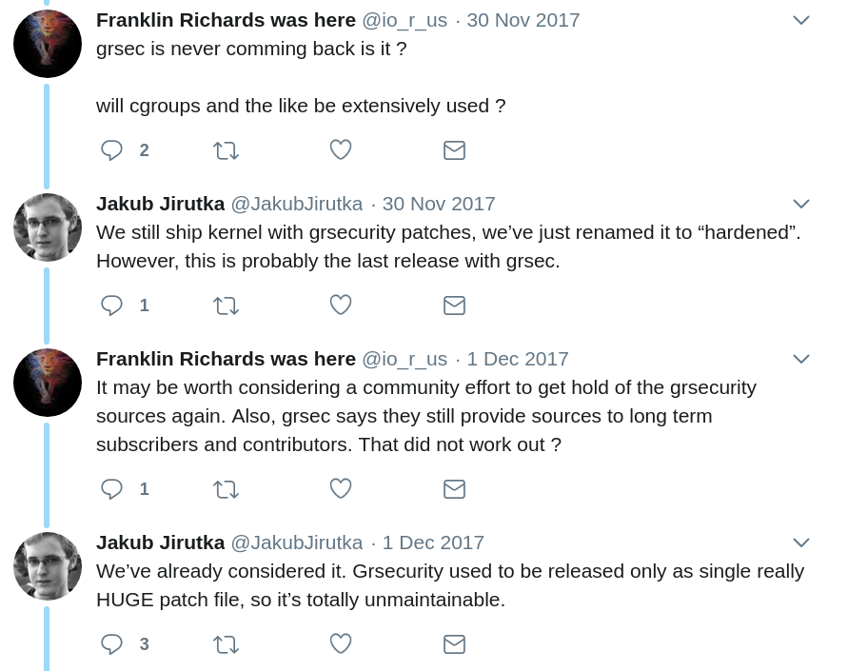
https://twitter.com/grsecurity/status/936422357757022209

Slide 25
Alpine: musl vs glibc
How many of you can compile w/first and the second?
Can u rly strace w/musl?
Operational drama
Glibc is huge as its support & ppl behind it (G, RH, Canonical, IBM, whatever)
Some binaries will crash in corner cases w/musl
Read: what_is_musl_and_glibc
systemd will not work w/musl

Slide 26
Alpine: so why ppl use it?
Because it’s small; few of MBs (6 or smt)
“If it consists of just few libs it must be secure”
Do you have any other ideas?

Slide 27
Alpine: so why ppl use it?
Because it’s small; few of MBs (6 or smt)
  We have currently layered FSes w/copy-on-write
  You can really download 100mb image very fast
  You don’t have to redownload it at all
“If it consists of just few libs it must be secure”
  Yeah, add more and pray that those are secure (remember they don’t have security advisory program!)
Do you have any other ideas?

Slide 28
Alpine: history
Created w/routers, small boxes etc in mind
Why so high adoption in Docker?
  Because Docker hub had gigantic performance problems these times, so little Alpine fixed it
  Because back then storage drivers (aufs /n Debians and devicemapper on RHs) sucked a lot and layers were just too big to handle w/good performance [thx Marcin]

Slide 29
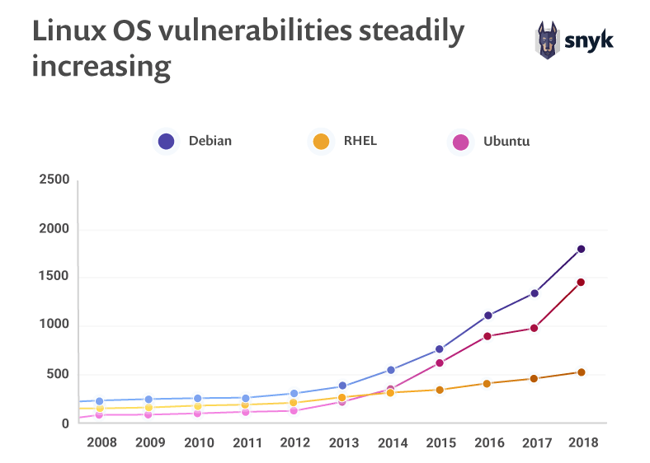
Which image?

Slide 30
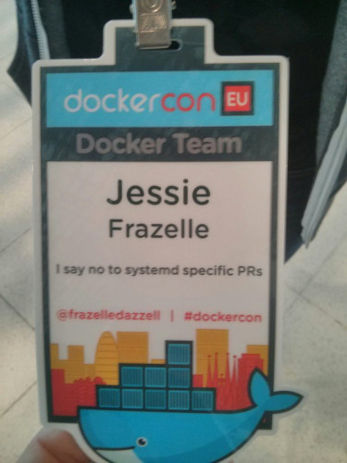
Docker & systemd
"This is Lennart Poettering," said Walsh, showing a picture. "This is Solomon Hykes", showing another. "Neither one of them is willing to compromise much. And I get to be in the middle between them."
[source]

Slide 31
Docker & systemd
"According to Walsh's presentation, the root cause of the conflict is that the Docker daemon is designed to take over a lot of the functions that systemd also performs for Linux. These include initialization, service activation, security, and logging. "In a lot of ways Docker wants to be systemd," he claimed. "It dreams of being systemd.""
[source]

Slide 32
Is there a world without Docker?
Yeah, Podman and CRI-O
“CRI-O owes a great deal of gratitude to the upstream Docker project. As Isaac Newton said “If I have seen further, it is by standing on the shoulders of giants.”

Slide 33
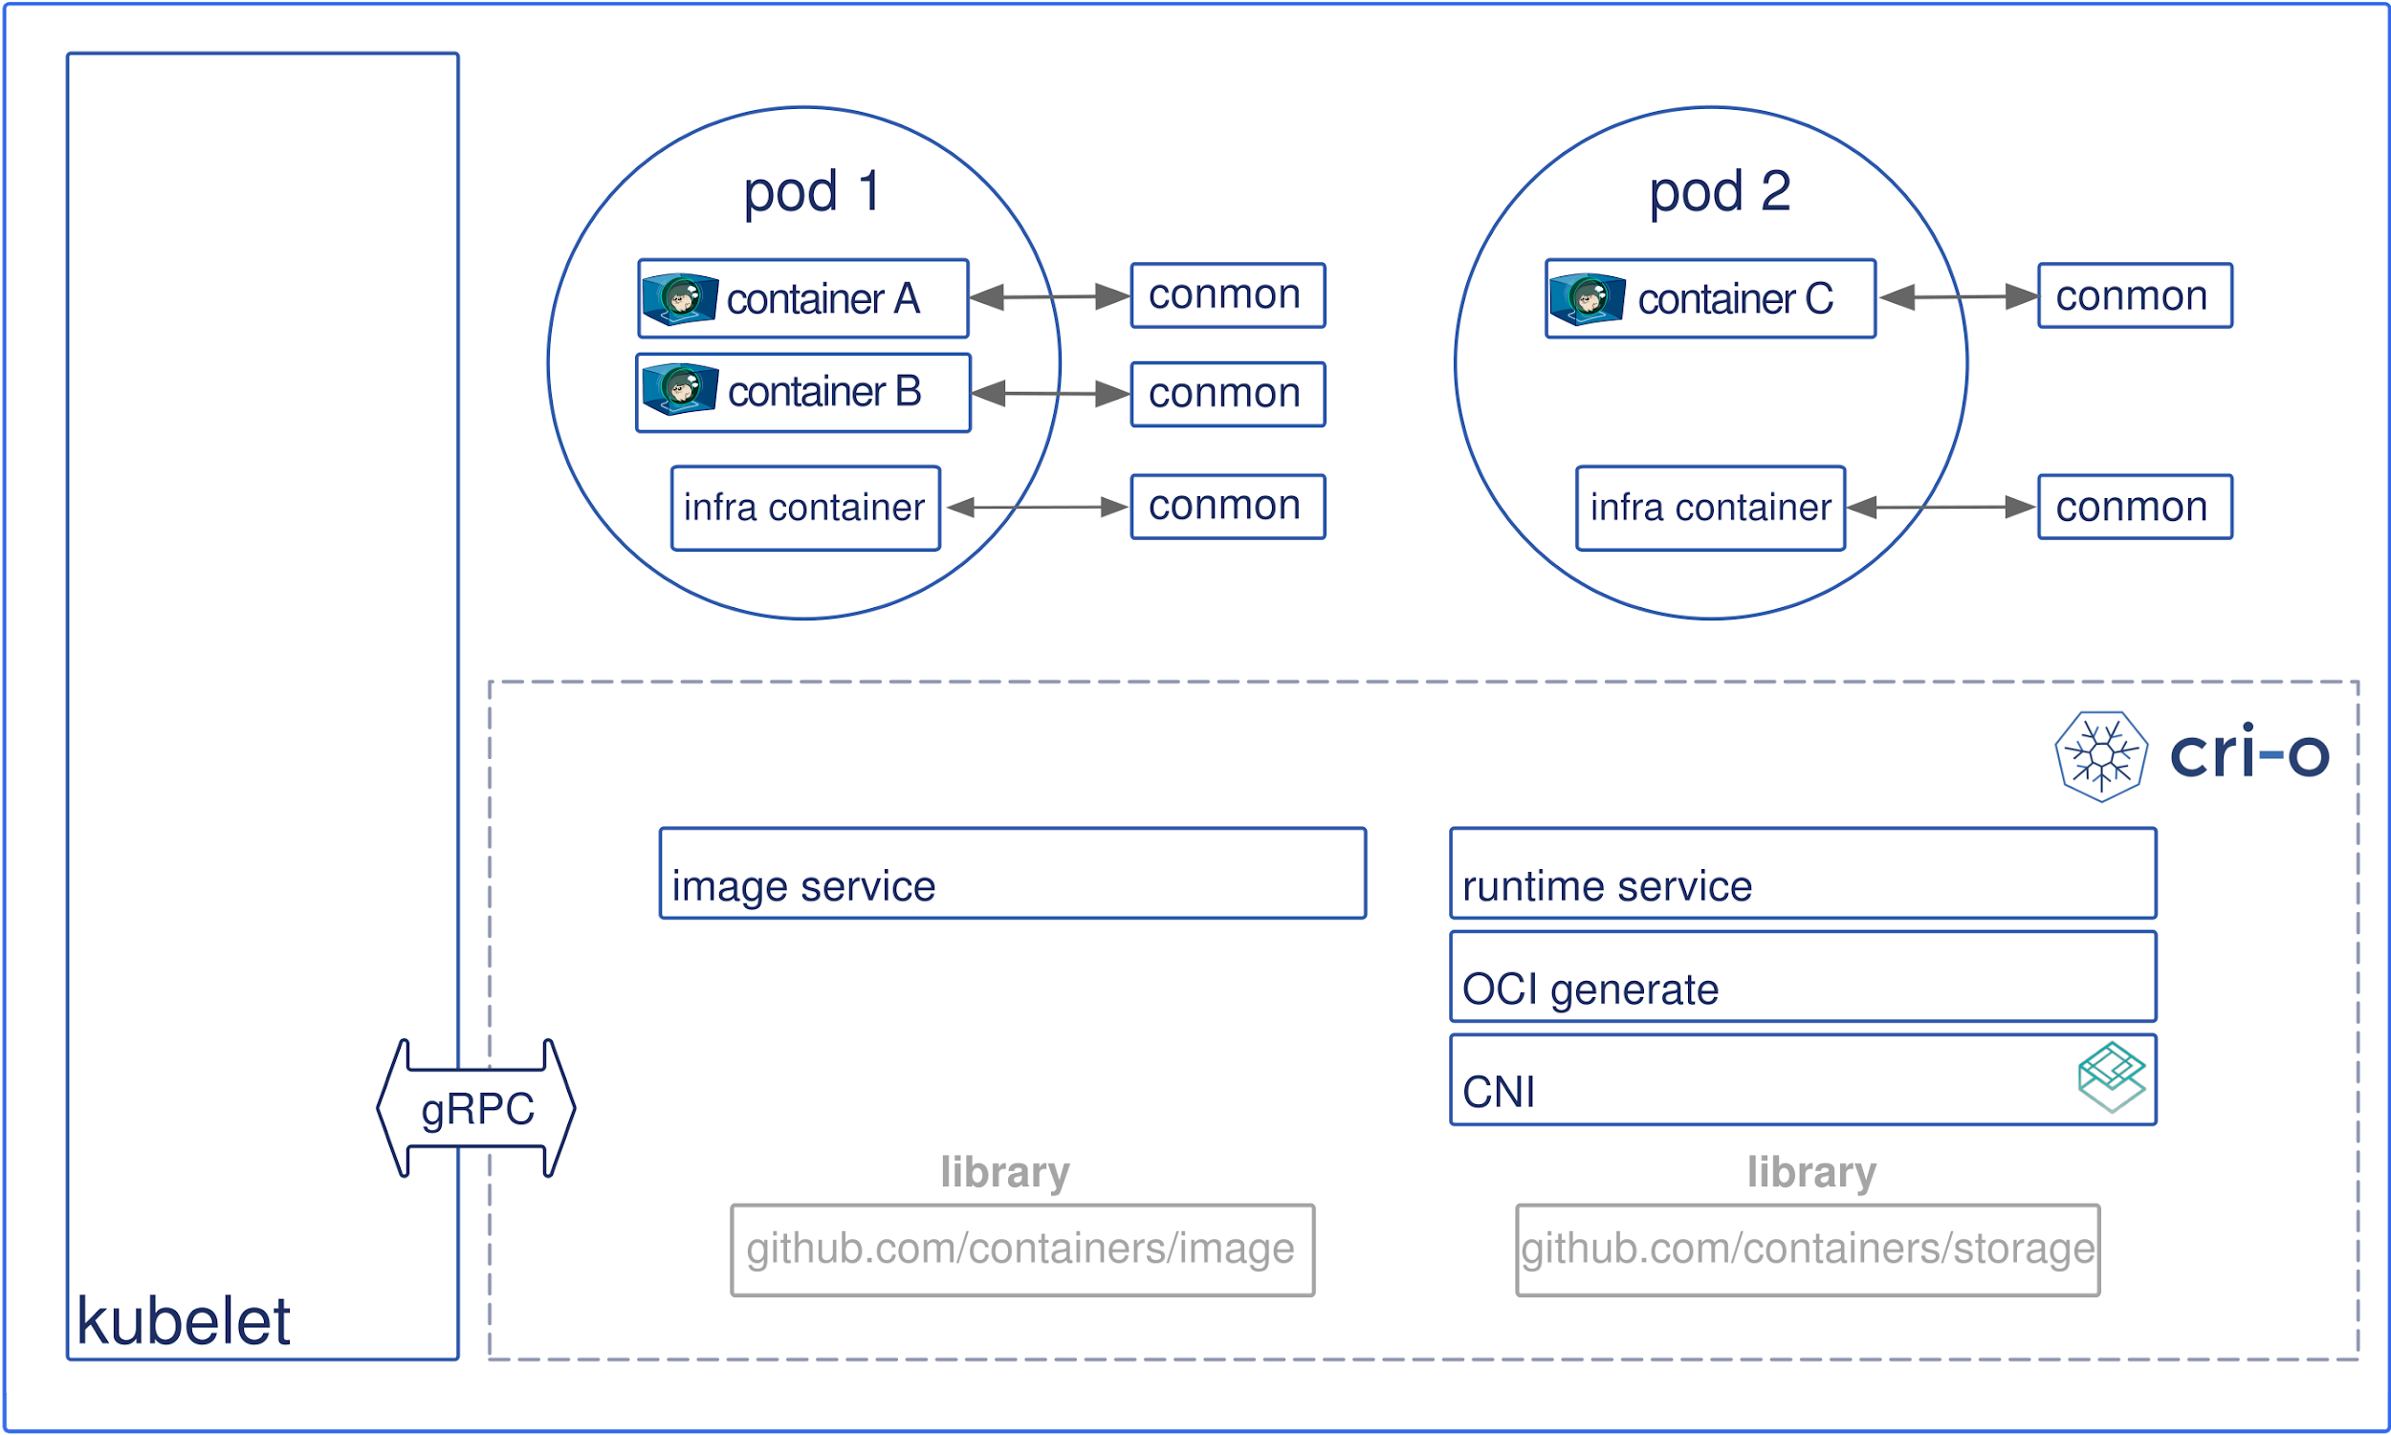

Slide 34
Podman - what is it?
drop-in replacement for docker
#nobigfatdaemons
one process per container (supervised by init, e.g. systemd)
systemd-cgroups: https://asciinema.org/a/182946
user-namespaces
rootless containers (in k8s pod share same user namespace)
support for fuse (on newer Kernels w/out root)/overlays
systemd-features:
  automated start
  dependencies between specified containers and other system services (or even containers)
  socket-activation
  sd-notify

Slide 35
Podman - howto
dnf/yum install -y podman
alias docker=podman

Slide 36
Podman - user namespaces?
Read podman-and-user-namespaces
each container runs in own user namespace
“Since the real UID=0 is not mapped into the container, any file owned by root will be treated as owned by nobody. Even if the process inside the container has CAP_DAC_OVERRIDE, it can't override this protection. DAC_OVERRIDE enables root processes to read/write any file on the system, even if the process was not owned by root or world readable or writable.”
“Podman can use different user namespaces on the same image because of automatic chowning built into containers/storage by a team led by Nalin Dahyabhai. “

Slide 37

Podman - user namespaces?
Read podman-and-user-namespaces
each container runs in own user namespace
“Since the real UID=0 is not mapped into the container, any file owned by root will be treated as owned by nobody. Even if the process inside the container has CAP_DAC_OVERRIDE, it can't override this protection. DAC_OVERRIDE enables root processes to read/write any file on the system, even if the process was not owned by root or world readable or writable.”
“Podman can use different user namespaces on the same image because of automatic chowning built into containers/storage by a team led by Nalin Dahyabhai. “

Slide 38
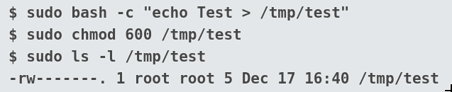
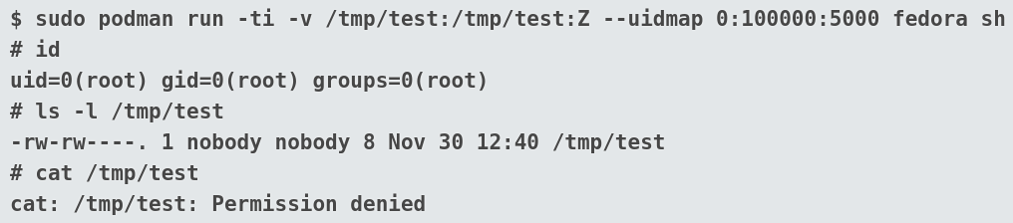
Podman - user namespaces

Slide 39
Docker Podman security considerations
podman run
  executes the process in the container as current user
  dockerd, containerd, and runc not running as #nobigfatdaemons
USER in Dockerfile
  same as above
  you can run dnf/yum/apt-get install whatever
usermod -aG docker foo
  No usermod as no docker.socket

Slide 40
Podman rootless
Read how-does-rootless-podman-work
Watch: replacing_docker_with_podman
Working out-of-the-box
“The Podman tool is enabling people to build and use containers without sacrificing the security of the system; you can give your developers the access they need without giving them root.”

Slide 41
What if no Docker, no Podman - just Linux?

Slide 42
What if no Docker, no Podman - just Linux?
systemd FTW!

Slide 43
What if no Docker, no Podman - just Linux?
systemd FTW!
systemd-run process confinement
systemd portable services
systemd-nspawn

Slide 44
Process confinement w/systemd-run
See my systemd talks here
man systemd.resource-control
  ProtectHome=true, ProtectSystem=Strict, ReadOnlyDirectories, InAccessibleDirectoreis, ReadWriteDirectories, PrivateTmp, TemporaryFileSystem, BindPath, BindReadOnlyPath
  MemoryMax and others
  CPUQuota and others
  IPAddressDeny and others
Read ip-accounting-and-access-lists-with-systemd

Slide 45
Process confinement w/systemd-run
systemd-run -p <param1> -p <param2> -t /bin/sh
  IPAddressDeny=any + IPAddressAllow=8.8.8.8 + IPAddressAllow=127.0.0.0/8
  ProtectSystem=strict
  ProtectHome=true
  PrivateTmp=true
  BindPaths=/mnt/sd-test
  CPUQuota=20%

Slide 46
systemd-nspawn
watch “systemd-nspawn is chroot on steroids” (Lennart Poettering)
created for debugging boot process of Linux OS (by RedHat / Lennart & co)
single process/service w/systemd as init
quite low - level
this was mainly for debugging init process when working on systemd
steeper learning curve
man systemd-nspawn

Slide 47
systemd portable services
Watch: portable_services_are_ready_to_use
Read:
  walkthrough for Portable Services, walkthrough for Portable Services in Go
  portable services
  dynamic-users-with-systemd.html
normal services w/optional chroot and some containment
multiple sandboxing options
leave no artifacts
Own transient user database
Builtin ready security profiles
This is just a wrapper around systemd (portablectl)

Slide 48
systemd portable services - dynamic users
nss-systemd (not using /etc/passwd at all)
man 5 systemd.exec
Setting DynamicUser=yes implies ProtectSystem=strict and ProtectHome=read-only and PrivateTmp=yes
These sand-boxing options turn off write access to pretty much the whole OS directory tree, with a few relevant exceptions, such as the API file systems /proc, /sys and so on, as well as /tmp and /var/tmp.
Setting DynamicUser=yes implies RemoveIPC=yes
allocation of users cheap and ephemeral

Slide 49
Process confinement w/systemd-run
systemd-run -p <param1> -p <param2> -t /bin/sh
  IPAddressDeny=any + IPAddressAllow=8.8.8.8 + IPAddressAllow=127.0.0.0/8
  ProtectSystem=strict
  ProtectHome=true
  PrivateTmp=true
  BindPaths=/mnt/sd-test
  CPUQuota=20%
  DynamicUser=true (see id)
  PrivateUsers=true (see ps, ls)

Slide 50
systemd-analyze security
analyzes the security and sandboxing settings of one or more specified service units
The command checks for various security-related service settings, assigning each a numeric "exposure level" value, depending on how important a setting is
It then calculates an overall exposure level for the whole unit, which is an estimation in the range 0.0…10.0 indicating how exposed a service is security-wise

Slide 51
Sources, urls, ppl
https://rootlesscontaine.rs/
https://snyk.io/blog/top-ten-most-popular-docker-images-each-contain-at-least-30-vulnerabilities/
https://media.ccc.de/v/ASG2018-177-replacing_docker_with_podman
https://opensource.com/article/19/2/how-does-rootless-podman-work
https://opensource.com/article/18/12/podman-and-user-namespaces
https://opensource.com/article/18/10/podman-more-secure-way-run-containers
https://www.youtube.com/watch?v=-MvKe5TFW7g
https://www.projectatomic.io/blog/2018/02/reintroduction-podman/
https://learning.oreilly.com/library/view/continuous-delivery-with/9781787125230/5ef77ae7-ce0c-4f85-92a6-a336bbfe8c29.xhtml
https://www.certdepot.net/death-of-docker/
https://opensource.com/business/14/7/docker-security-selinux
Special thanks to Dan Walsh, Lennart Poettering and Marcin Skarbek <3

Slide 52
O bezpieczeństwie kontenerów linuksowych
Dzięki, pytania?
Wrocław, 2019-04-06
Maciej Lasyk

