Slide 1
Linear congruential method

Slide 2
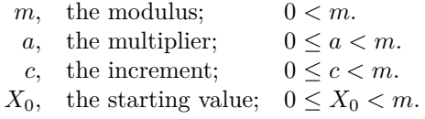



Slide 3
Since we are taking mod m, the range is finite i.e. 0 to m-1. Thus, linear congruential sequences always get into a loop.
The repeating cycle is called the ‘period’.
Longer the period, more useful (random) is the sequence.
D. H. Lehmer originally put c = 0 to make the computation faster, but it makes the period shorter.
Thomson (1958) and Rotenberg (1960), independently, studied that putting c != 0 leads to longer periods.
C = 0 -> multiplicative congruential methods
C != 0 -> mixed congruential methods

Slide 4





The case a = 0
$X_{n}$ = (nc) mod m (even worse)

Slide 5
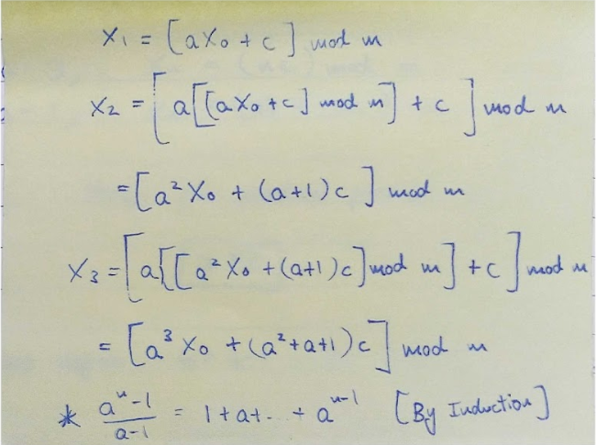
Easily proved by Induction.

Slide 7
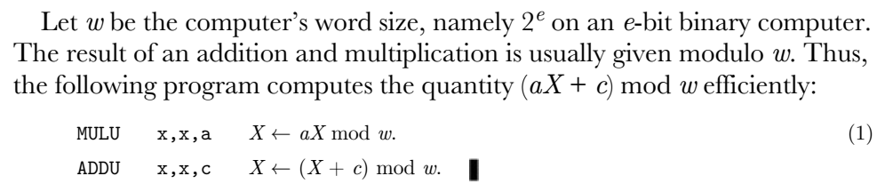
Arithmetic on unsigned integers never causes overflow!

Slide 8







A Clever Way to Calculate modulo (w + 1)
Step1
Step2
Step3
Step4

Slide 9


Proof:
A similar technique can be used to calculate modulo (w – 1).

Slide 10





Which again forms a congruential sequence.

Slide 11



Slide 12

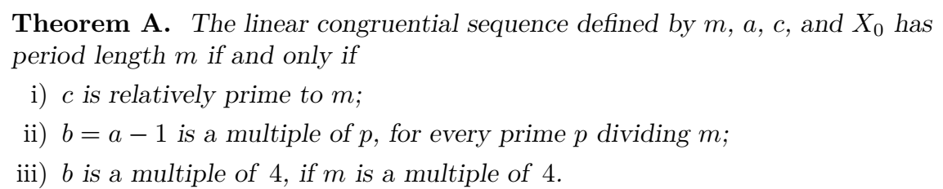

Now, if sequence period is of length m, each possible integer 0 <= x < m occurs in the period once.
Also we are justified in taking Xo = 0 artibtrarily.
If c is not relatively prime to m, 0 will repeat in the sequence.
Second and Third conditions can be proven using 3 lemmas (skip for now).
[ Requires Euler’s Theorem and Primitive Element modulo m ]

Slide 13
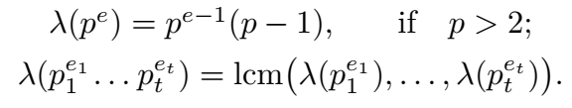
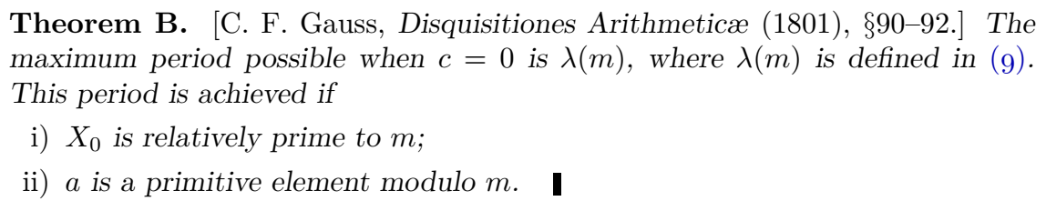
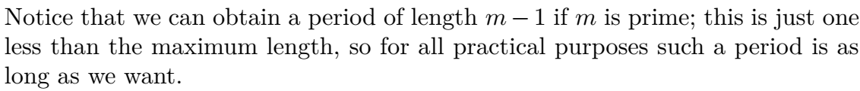
[ Mersenne Primes ]

Slide 14

m is the word size $2^{e}$, then multiplier a = $2^{k}+1$, 2 ≤ k < e satisfies
Also condition (i) of Theorem A $⇒$ we may take c = 1
Now $X_{n+1}=\left[\left(2^{k}+1\right)X_{n}+1\right]mod 2^{k}$
Thus, we can AVOID MULTIPLICATION! Just shifting and adding will suffice.

Slide 15

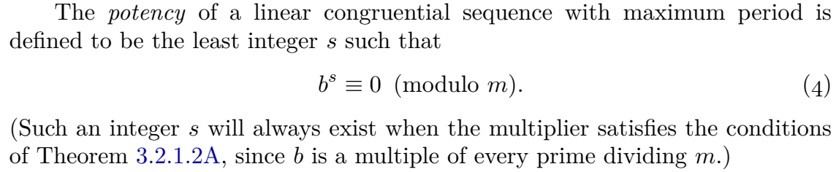

Since 0 must appear somewhere in the sequence, we can take $X_{0}=0$

Slide 16
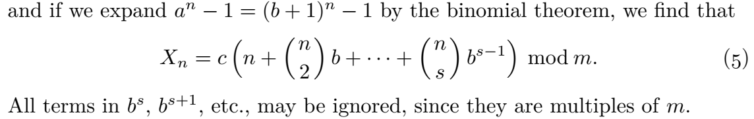

Slide 17



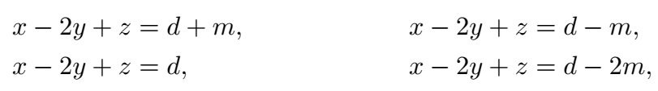
differences between consecutive numbers are in an Arithmetic Progression.

Slide 18
High Potency is necessary but not sufficient for randomness.
LCGs should pass the Spectral Test before they are considered to be acceptably random.

