Slide 1
Bias in a family of quantum rngs

Slide 2
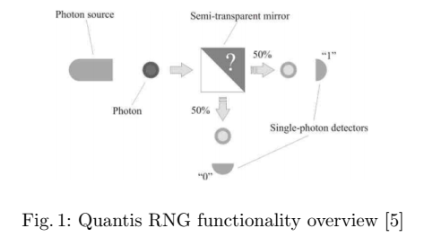
Using deterministic mathematical constructs to generate RN -> PRNG
Using physical (here quantum) phenomena to generate RN -> TRNG

Slide 3
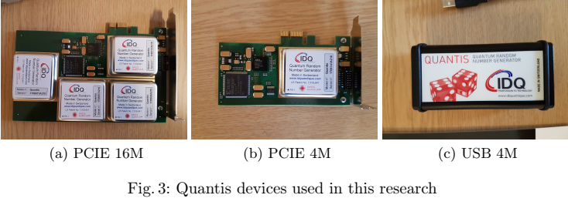
ID Quantique were the first to harness quantum phenomena as an entropy source in a commercial product, in 2001.
This company has commercialized devices that use an optical quantum process as a source of randomness.
This has allowed them to generate random numbers at a speed of 4Mbit/s and 16Mbit/s on PCI-E and USB hardware devices.

Slide 4
3 batteries of tests:
DIEHARDER
NIST STS 2.1.2
ENT
Quantis devices, particularly the PCI-E 16M, PCI-E 4M, and USB 4M, have been certified internally.
External certification by the Swiss Federal Office of Metrology (METAS) has also been awarded, with the Diehard tests forming the basis of their testing strategy.
Indeed the results over the DIEHARDER and NIST batteries confirm acceptable performance on both sets of tests.
However, ENT finds strong evidence of significant biases in the Quantis devices.
Comparative analysis is provided through a study of the Chaos Key TRNG (a hardware RNG in a USB package), and urandom.

Slide 5
On both Windows 10 and Ubuntu 16.04, the Quantis ’Easy Quantis’ application was used to collect 2GB (maximum size allowed) of random data from each module.
Data from Chaos Key and urandom involved the use of the "dd" utility to print random values from each device to a binary file.
Sequences of 128 bytes were extracted 16,406,250 times to achieve a final file size of 2GB for both RNGs.
v3 of the Linux kernel was used for ChaosKey, urandom, and Quantis devices because the latter require so.
The maximum time taken for the USB and 4M modules to provide a 2 GB sample was 1 hour and 7 minutes.
By comparison, the 16M generated 2GB of data in approximately 17 minutes.

Slide 6
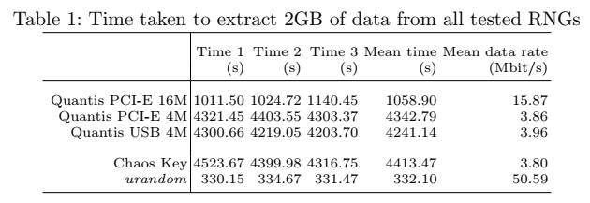
The Chaos Key performs almost as quickly as the 4M modules, while urandom is significantly faster.
The primary issue with urandom is, of course, that it does not wait for its entropy pool to replenish (it is nonblocking).
For larger samples, and in low entropic environments such as virtual machines, it may generate low-quality output.
Though this was not observed during our experiments.

Slide 7
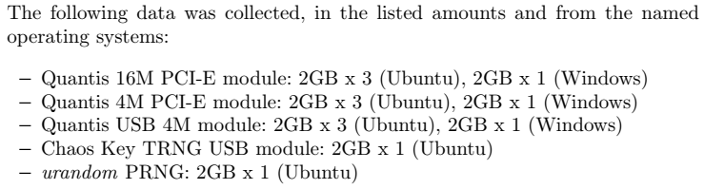

Slide 8
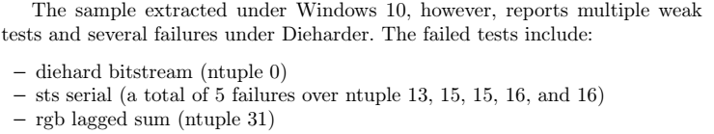
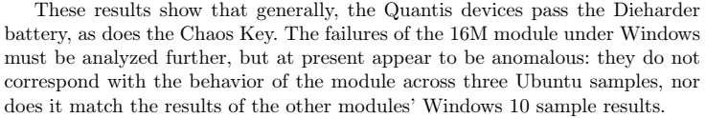
RESULTS
DIEHARDER
Chaos Key and urandom pass the Dieharder battery with good scores.
In general the Quantis Devices perfom well on Dieharder battery.

Slide 9
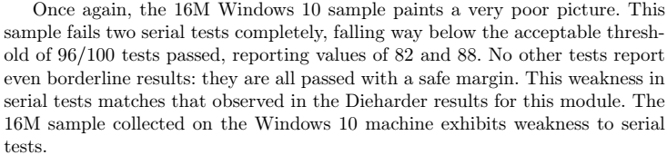
NIST STS 2.1.2

Slide 10
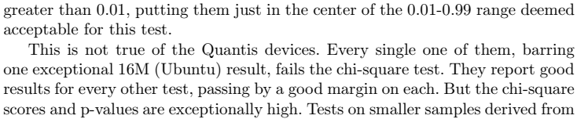
ENT

Slide 11
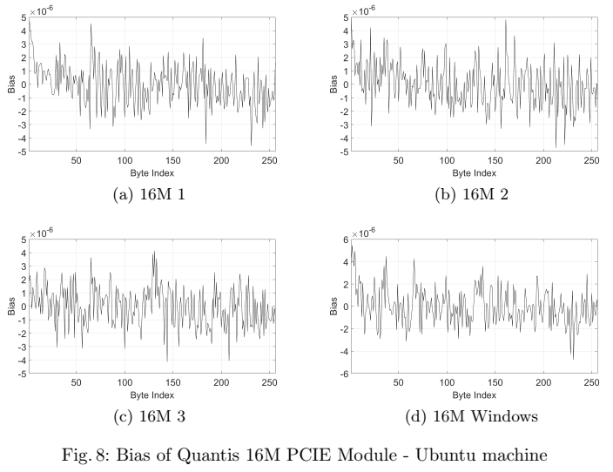

Slide 12
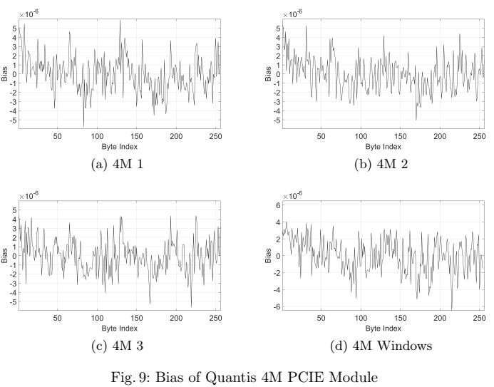

Slide 13
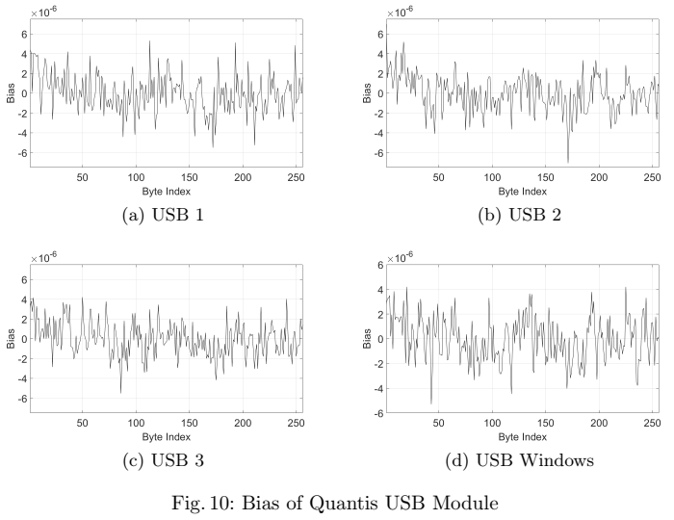

Slide 14
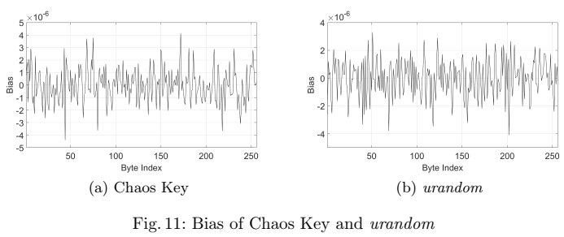

Slide 15
