Slide 1
Novice’s Guide to Docker
Basic Docker terms, concepts & workshop exercises to get you started
Alec Clews
Jan 2019

Slide 2
Agenda
What's Docker?
What are the problems it solves?
What's an image and a container?
Show me it working!
How Can I use it?
This is my personal opinion. Hopefully this will bootstrap you enough to become dangerous
NOTE: I will not be talking about Windows Docker containers

Slide 3
Objective
People understand the reason why Docker is useful, the basics of how to use it by completing the examples, and get enough confidence in the mechanics to want to learn more afterwards
Notes:
Next
People start learning more about Docker
Minimum
Know what docker does
Understand the terms image, container and tag

Slide 4
Are we set for success?
Can everyone run the command
  You will need a working network connection
docker container run hello-world

Slide 5
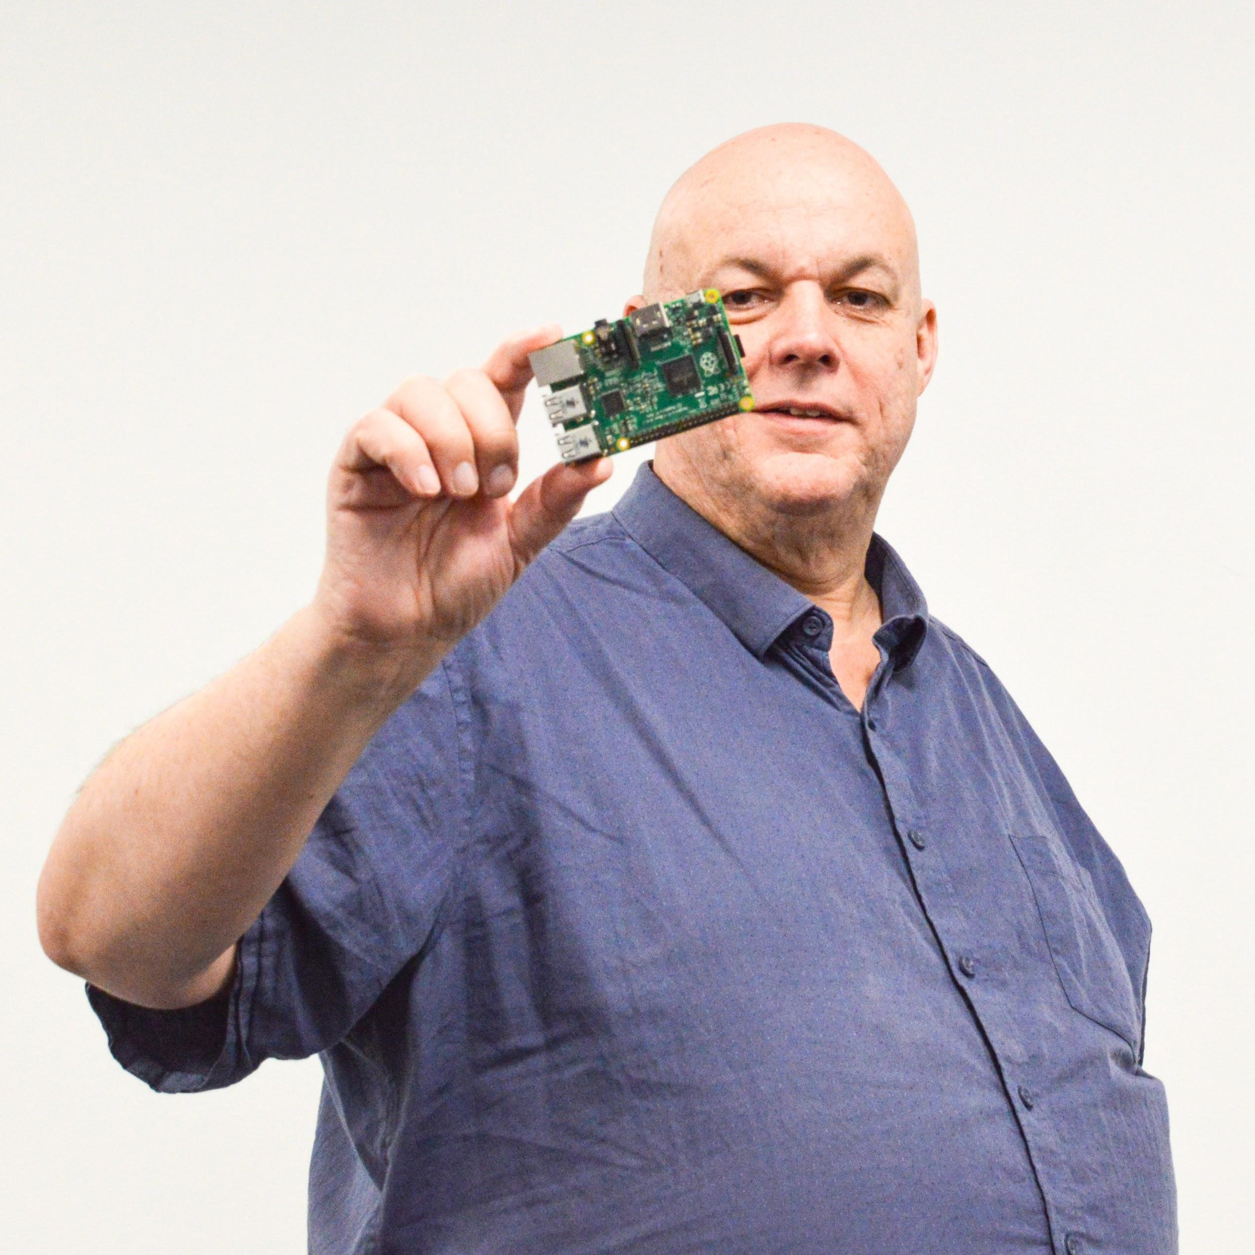



Who is Alec?
Old school software nerd
Using Linux since kernel 0.99
Works as the technical integration manager at PaperCut Software
Loves technology, sometimes too much!
(also beer and coffee)
@alecthegeek alecthgeek https://www.linkedin.com/in/alecclews/

Slide 6
What is Docker?
Process isolation framework
Lightweight virtual machines
Easy way to deploy to dev/test/prod consistently
Great way to set up a developer environment
Which does not really mean much….

Slide 7
We need a Simple Model
A software system is a collection of processes and the resources they need to work to do something useful
A process is code loaded into memory and running on a processor with access to the required resources
Resources are all the different things a process needs. For example: users; network access; security profiles; files (file systems); process space; CPU cycles; …

Slide 8
Look a sample legacy system
Logging & Metrics
Provider
Database server
Application
Server
Processes
Resources
Database
Files
Files

Slide 9
Options to run this workload
One big machine running everything, it works but...
  Performance and scalability
  Wasted CPU resources (so shared amongst multiple IT services)
  Complex to provision and maintain all the running parts
  One process can impact another and can see all resources
  Hard to develop and test on same configuration as production

Slide 10
Process A
Process B
Process C
Operating System

Slide 11
Options to run this workload contd:
Virtual Machines to isolate processes, better but...
  Complex to provision and maintain all the machines
  Hard to develop & test on same configuration
  OS overhead
  Complex to manage VM start up, migration etc

Slide 12
Linux O/S on a VM Manager
Process A
Process B
Process C
Guest O/S
Guest O/S
Guest O/S
Virtual Machine Engine
Host Operating System

Slide 13
Options to run this workload
Containerisation isolates processes running on single machine.
Even better (but nothing is ever perfect of course)

Slide 14
Process Containers running on Linux
Process A
Process B
Process C
Containing Layer
Linux Operating System

Slide 15
Operating-system-level virtualization a.k.a. containerisation
"operating system feature in which the kernel allows the existence of multiple isolated user-space instances. Such instances, called containers, look like real computers from the point of view of programs running in them. A program running on an ordinary operating system can see all resources (connected devices, files and folders, network shares, CPU power, quantifiable hardware capabilities) of that computer. However, programs running inside a container can only see the container's contents and devices assigned to the container." Wikipedia

Slide 16
What problems can we solve?
Scalability -- cheap and quick to provision more workers (& vice versa)
Resilience -- Process are contained. Failures can be restarted
Lower costs -- Fewer resources, easy deployment
Easy to make dev & test look like production
  Repeatable build and deployment process
  Low resource use
  Fast setup & teardown

Slide 17
So Docker eh?
Docker is the world's most popular containerisation platform (?)
Works on the Linux Kernel. Uses Linux specific feature
  But see also Windows Nano Containers
Ecosystem of tools, scaling technology and info
  E.g. Cubby Kittens Kubernetes, Swarm,
Watch Liz Rice's video for insight on how it works under the hood (https://youtu.be/_TsSmSu57Zo)

Slide 18
What is a Docker image?
It's a bunch of files and metadata required to start & run a container
  Think "file system + metadata"
  But no Linux kernel
It contains
  Linux packages your program needs to run. E.g. CUPS
  Your program and static config files
  Metadata about access to OS Level resources (networking, persistent storage, ENV variables,..)
  Default startup command
IT'S NOT RUNNING PROCESSES
  Just the information you need to start and run them
It's small!

Slide 19
So what's a Docker container?
In memory contents of an image that is currently running in Docker
One or more processes using resources
Can only access resources granted to it via Docker
A CONTAINER CANNOT MODIFY THE IMAGE (persistently)
One image can be used to start many containers

Slide 20
Enough Already. SHOW ME!
Let's run an image in a container
There are lots of pre build images ready for us to run
Start with a small lightweight Linux distro -- Alpine
Download an Image
docker image pull alpine
docker image inspect alpine
Run a Container
docker container run -it --name myAlpine \
alpine /bin/sh
docker container inspect myAlpine

Slide 21
Container State
The ls & inspect command displays the container state
Usually running, exited or null (not running)
Try
docker container run -it --name myAlpine alpine sh
In another shell window run
docker container ls
and
docker container inspect myAlpine | less

Slide 22
Going from running to exited
From the Alpine shell prompt hit <Ctrl>-C
Should be returned to host prompt
So
docker container ls
BUT
docker container ls -a
and
docker container inspect --format '{{.State.Status}}' myAlpine
Notes:
Using --format option makes it much easier

Slide 23
A container that is exited can be restarted
Carrying from previous example
docker container restart myAlpine
docker container inspect \
--format '{{.State.Status}}' myAlpine
docker container attach myAlpine

Slide 24
A useful alias
The very useful command
docker container inspect --format '{{.State.Status}}' …
is so tedious to type. So create an alias
alias doccs="docker container inspect --format '{{.State.Status}}'"
Now we can say
doccs myAlpine

Slide 25
Removing a container
Carrying on from previous example
From myAlpine shell prompt hit <Ctrl>-p <Ctrl>-q
Container is now detached, but still running
docker container inspect --format {{.State.Status}} myAlpine
Stop container
docker container stop myAlpine
docker container inspect --format {{.State.Status}} myAlpine
Remove container
docker container rm myAlpine
docker container inspect myAlpine
Notes:
docker container stop myAlpine can take a few minutes if there is an active process

Slide 26
RTFM
More information on different container states in the Docker API docs
https://docs.docker.com/engine/api/v1.37/#operation/ContainerInspect
More about the container commands at
https://docs.docker.com/engine/reference/commandline/container/

Slide 27
Access to container network ports
Container process is isolated Duh!
How to access network services on Container?
Use port mapping
Maps a containers network port (e.g. 80) to a different port on the host interface
For example
docker container run --publish 8089:80 \
--name nginx nginx
then open http://0.0.0.0:8089/

Slide 28
Docker on your workstation
Process A
Process B
Process C
Containing Layer
Volumes
Docker Host (Linux VM)
Mounts
MacOS or Windows

Slide 29
Persistence
When you remove a container you lose any changes to the file system
Images are READ ONLY
SO -- Map storage locations to Data Volumes and Mount Points
Volumes and Mounts exist outside the container file system
They are linked into the container file system when the container starts

Slide 30
Bind mount demo
docker container run --publish 8089:80 \
--volume $PWD:/usr/share/nginx/html \
--name nginx nginx

Slide 31
Custom image!
Building a custom image takes time, so we will start a build 1st and then explain how it works.
docker image build -f jdk.dockerfile -t jdk .

Slide 32
Images -- I need a custom image!
You need an image to run a container
Lots of nice images -- see https://store.docker.com/
Sometimes you need something more or different. E.g. a Java development environment or an application
How?
Write a Dockerfile
Run docker build
For example….

Slide 33
Docker file
FROM debian
LABEL maintainer "Alec Clews <alec.clews@papercut.com>"
LABEL description "Linux with JDK"
RUN apt-get update &&
DEBIAN_FRONTEND=noninteractive \
apt-get install --yes openjdk-8-jdk
ENTRYPOINT ["/bin/bash", "-c", "javac -version"]

Slide 34
Now build it
docker image build -f jdk.dockerfile -t jdk .
What did end up with?
docker image inspect jdk
Name of Dockerfile
Tag of new image
Build context

Slide 35
Now run it
docker container run --name myJDK jdk

Slide 36
The naming of images
Everything in Docker is identified by a sha1 ID. e.g.
$ docker image ls
REPOSITORY TAG IMAGE ID CREATED SIZE
nginx latest 62f816a209e6 3 days ago 109MB
$ docker network ls
NETWORK ID NAME DRIVER SCOPE
9370368d093f bridge bridge local
e532bcce13a6 host host local
acccf8f0c1b6 none null local

Slide 37
Make life easier by giving images a friendly alias
Image aliases have five fields, only one is mandatory
Images aliases are used to:
  Identify images on container registries
  Provide an easier way to identify images locally
  Allow different varients of the same image to co-exist via the tag field
Only the image name is mandatory
<registry-host>:<registry-port>/<user-name>/<image-name>:<tag>
Assign image names with the docker image tag … command
e.g.
docker image tag 2934623

Slide 38
Default values when using the tag command
Registry host defaults to Docker Hub
Port defaults to 5000
User name (on pull) defaults to default user. To push you will need to supply your user name
Tag defaults to latest.
NOTE: latest does not mean “the latest”, it should be correctly reffered to as default tag
But for most official images, latest usually also means “the current production version”

Slide 39
Image registries
Store and serve pre-build docker images
hub.docker.com is the big one
Other public and private options are available
You can host your local registry (via a container image of course)
More on that after we look at the volumes and port mapping
For example.
docker container run -d -p 5000:5000 -v $PWD/registry-data:/var/lib/registry --name registry registry

Slide 40
Docker Compose
The Docker run (& build) tool docker-compose
It's driven from a Compose file
  And of course it's bloody YAML! 😠
A single place to put all the different options for each container e.g.
  publish, mounts, environment variables, dependencies,...
Look at this example & see it in action
docker-compose -f docker-compose.yml up

Slide 41
More information
I learned a lot from this Udemy course
Docker is sooo HOT right now, so loads of blogs, videos etc
Don't forget to RTFM
Examples used in the demos can be found here
https://github.com/PaperCutSoftware/DockerSimpleDemo
Example shell aliases and functions at https://gist.github.com/f3l1x/4c3bb59397d976ac83f0 and https://github.com/tcnksm/docker-alias

Slide 42
Thank
you!

