Slide 1

Kubernetes on CloudStack
Sebastien Goasguen
@sebgoa
Nov 6th 2014
Geneva, Switzerland

Slide 2
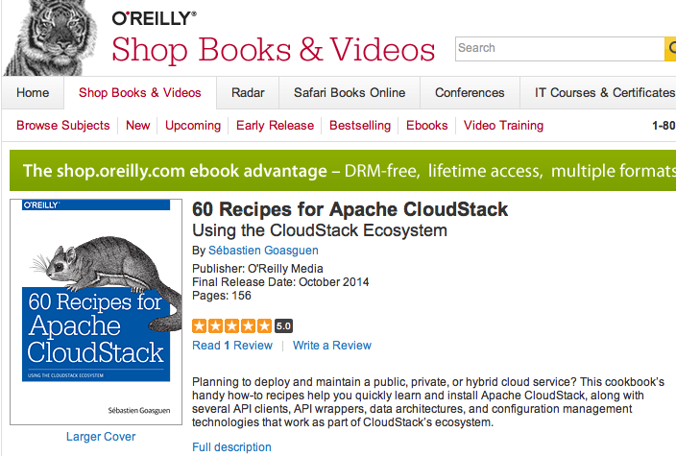
Who am I ?
Apache CloudStack and licloud committer + PMC member
Looking at techs and how they work together
Half dev, half community manager, + half event planner

Slide 3

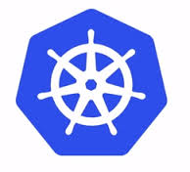


Today’s talk

Slide 4
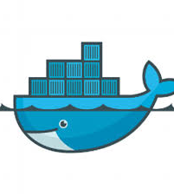
Linux container (LXC and more …)
Application deployment
PaaS
Portability
Image sharing via DockerHub

Slide 5
Linux distribution
Rolling upgrades
Minimal OS
Docker support
etcd and fleet tools to manage distributed applications based on containers.

Slide 6
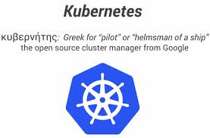
Docker application orchestration
Google GCE, rackspace, Azure providers
Deployable on CoreOS
Container replication
HA services

Slide 7
IaaS Public cloud
Switzerland based
Apache CloudStack
Security groups, ssh key pairs
Offers coreOS templates (+ Debian, ubuntu, CentOS and even Windows)

Slide 8
Docker basics
$ sudo apt-get install docker.io
$ sudo ln -sf /usr/bin/docker.io /usr/local/bin/docker
$ sudo sed -i '$acomplete -F _docker docker' /etc/bash_completion.d/docker.io
Easy to install, easy to start a container:
$ docker run -i -t ubuntu /bin/bash
Use existing container images from docker Hub, or build your own. Expose ports for services running in container, daemonize containers.

Slide 9
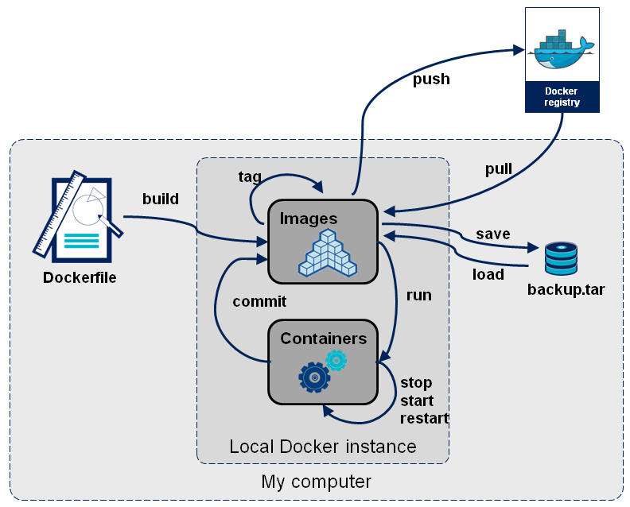
Building docker images
Fair use from http://blog.octo.com/en/docker-registry-first-steps/

Slide 10






+ config mgmt

Slide 11
CoreOS
Linux distribution
Rolling upgrades
Minimal OS
Docker support
etcd and fleet tools to manage distributed applications based on containers.
Cloud-init support
Systemd units

Slide 12
CoreOS clustering
etcd HA key value store
  Raft election algorithm
  Writes when majority in cluster has committed update
  e.g 5 nodes, tolerates 3 node failure
fleet distributed init system (schedules systemd units in a cluster)
  Submits systemd units cluster wide
  Affinity, anti-affinity, global “scheduling”

Slide 13
Try it with Vagrant
git clone https://github.com/coreos/coreos-vagrant.git
vagrant up
vagrant ssh core-01 -- -A
fleetctl list-machines
fleetctl list-units
fleetctl start es.service
fleetctl destroy es.service

Slide 14


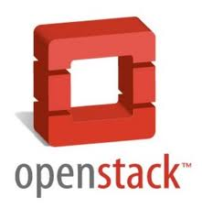



IaaS Landscape

Slide 15








CloudStack clouds

Slide 16
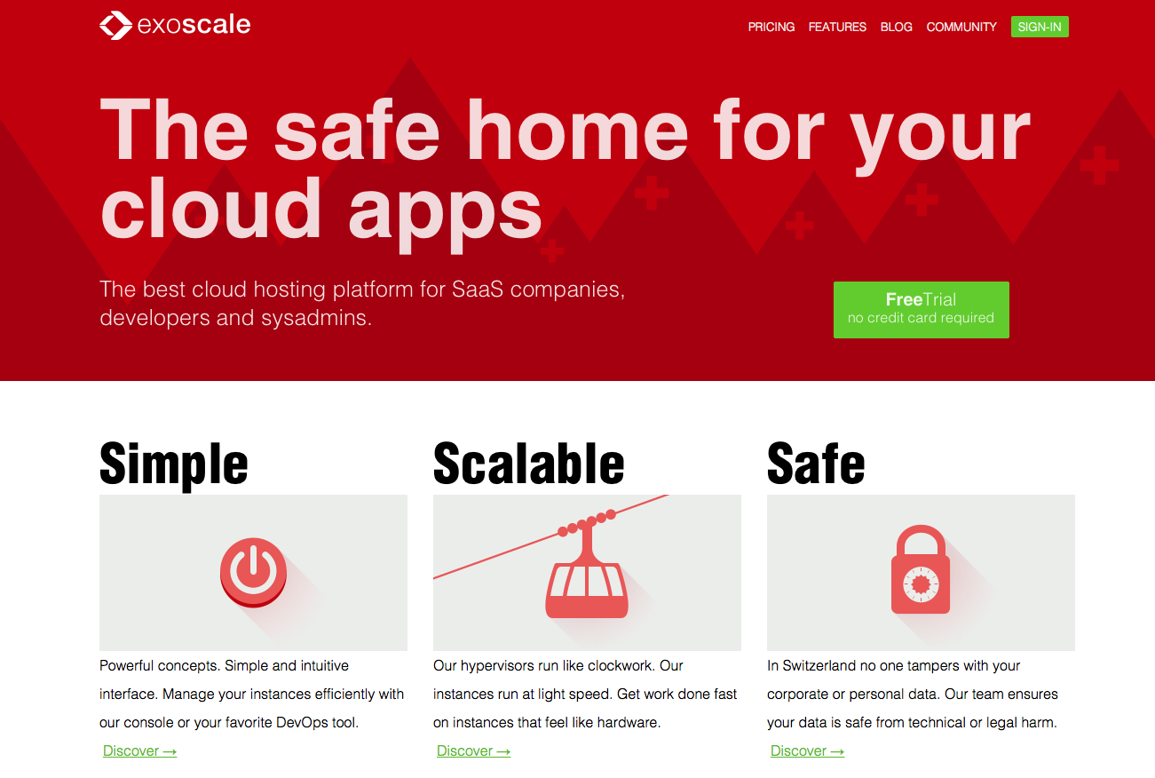
Exoscale

Slide 17
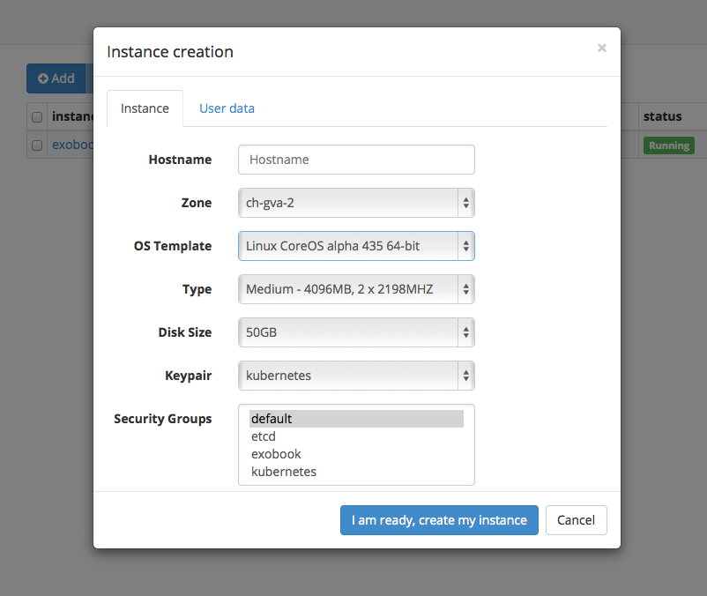
CoreOS on exoscale

Slide 18
Starting containers
#cloud-config
coreos:
units:
- name: docker.service
command: start
- name: es.service
command: start
content: |
[Unit]
After=docker.service
Requires=docker.service
Description=starts ElasticSearch container
[Service]
TimeoutStartSec=0
ExecStartPre=/usr/bin/docker pull dockerfile/elasticsearch
ExecStart=/usr/bin/docker run -d -p 9200:9200 -p 9300:9300 dockerfile/elasticsearch

Slide 19
Kubernetes
Docker application orchestration
Google GCE, rackspace, Azure providers
Deployable on CoreOS
Container replication
HA services

Slide 20
Kubernetes on CloudStack
Find a CloudStack cloud that supports CoreOS
Then use:
https://github.com/runseb/kubernetes-exoscale
Libcloud to start nodes with coreOS template
User data to pass cloud-configs
Then start Kube* Service units with fleet

Slide 21
DEMO ?

Slide 22
Questions and Thanks
Sebastien Goasguen
@sebgoa

