Slide 1

Interview Skills for Employment Success
Mastering key techniques to secure your dream job
Notes:
Interviews are your opportunity to showcase your strengths, experiences, and personality in a way that connects with employers. In this session, we’ll explore what makes a strong interview, learn proven techniques like the S.T.A.R. method, and practice strategies to handle both common and challenging questions. By the end, you’ll feel more confident and prepared to present yourself effectively in any interview setting.

Slide 2
Warm-Up Activity: SELL AN OBJECT
Choose an object in the classroom and work individually or a group to:
Brainstorm creative or unconventional ways the object could be used.
Identify unique features or selling points that make it appealing.
Prepare a quick pitch to share your ideas with the class.
Notes:
The ‘Sell This Object’ activity mirrors the dynamics of an interview because both require quick thinking, clear communication, and persuasive reasoning. In an interview, you often need to present your skills and experiences in a way that makes you stand out—similar to pitching an ordinary object as something valuable or unique. This exercise challenges you to think creatively under time constraints, adapt your message to your audience, and confidently articulate ideas, all of which are essential skills for handling unexpected or unconventional interview questions.”

Slide 3
Understanding Interviews
Notes:
What is an Interview?, Interviewing is a Skill

Slide 4

What is an Interview?
Definition and Purpose
An interview is a structured conversation to assess mutual fit, skills, and readiness for a job role.
Employer Perspective
Employers evaluate if candidates align with company culture and job requirements during interviews.
Candidate Perspective
Candidates showcase qualifications and assess if the organization fits their career goals.
Interview Formats
Interviews can be conducted in-person, by phone, video, or in panel formats.
Notes:
An interview is a structured conversation between a job seeker and an employer, designed to assess mutual fit, skills, and readiness for a role. It is a two-way street where both parties evaluate each other. For the employer, it’s an opportunity to determine if the candidate aligns with the company’s culture and job requirements. For the candidate, it’s a chance to showcase qualifications, ask questions, and assess whether the organization meets their career goals. Interviews can be conducted in various formats including in-person, phone, video, or panel settings. Understanding the purpose and structure of interviews helps candidates prepare effectively and approach the experience with confidence.

Slide 5

Interviewing is a Skill
Practice Enhances Skill
Interviewing skills improve with practice through mock interviews and self-reflection, increasing confidence and effectiveness.
Preparation Reduces Anxiety
Proper preparation helps reduce natural nervousness and anxiety associated with high-stakes interviews.
Learning from Feedback
Using feedback rubrics and peer reviews allows candidates to refine their approach and understand expectations.
Simulating Real Scenarios
Simulated interview environments help build competence and readiness for actual job interviews.
Notes:
Interviewing is a skill that improves with practice, much like riding a bike. The more one engages in mock interviews, prepares responses, and reflects on performance, the more confident and effective they become. Nervousness is natural, especially when the stakes are high, but preparation can significantly reduce anxiety. Candidates should view each interview as a learning opportunity, refining their approach and gaining insights into employer expectations. Practicing with peers, using feedback rubrics, and simulating real interview environments are essential strategies for building interview competence.

Slide 6

The Interview Process
Preparation Phase
Research the employer, review the job description, and practice your responses before the interview.
Beginning of Interview
Start the interview with greetings and introductions to set a positive tone.
Core Interview Discussion
Engage in the main conversation where questions are asked and detailed answers are provided.
Closing and Follow-Up
Conclude with final questions, express interest, and send a thank-you note after the interview.
Notes:
The interview process typically consists of five key segments: preparation, beginning, middle, end, and follow-up. Preparation involves researching the employer, reviewing the job description, and practicing responses. The beginning sets the tone with greetings and introductions. The middle includes the core of the conversation, where questions are asked and answered. The end wraps up with final questions and expressions of interest. Follow-up involves sending a thank-you note and reflecting on the experience. Understanding this structure helps candidates navigate interviews with clarity and purpose.

Slide 7
Preparing for Interviews

Slide 8

Preparation Tips
Researching the Employer
Understanding the employer’s mission, culture, and news shows genuine interest in the role.
Reviewing Job Description
Careful review of job requirements helps candidates align their skills accordingly.
Practicing Interview Questions
Practicing common questions improves confidence and communication during the interview.
Professional Attire and Punctuality
Planning appropriate clothing and arriving early demonstrate professionalism and respect.
Notes:
Effective preparation includes researching the employer’s mission, culture, and recent news; reviewing the job description to understand required skills; practicing common interview questions; planning professional attire; and preparing thoughtful questions to ask the employer. Candidates should also ensure they get adequate rest before the interview and arrive early. These steps demonstrate professionalism and genuine interest in the role, setting a positive tone for the interview.

Slide 9

Researching the Employer
Understand Company Overview
Learn about the company's purpose, goals, products, and services to build a solid knowledge base.
Learn About Company Culture
Familiarize yourself with the organization's culture to align responses during the interview.
Prepare for Job Role and Interviewers
Research the specific job role and interviewers to tailor answers and ask relevant questions.
Demonstrate Initiative
Showing genuine interest through research reflects enthusiasm and impresses potential employers.
Notes:
Researching the employer involves understanding the company’s purpose, goals, products, services, and culture. Candidates should visit the company website, read news articles, and familiarize themselves with the job role and interviewers. This preparation enables candidates to tailor their responses, ask insightful questions, and demonstrate genuine interest. Employers appreciate candidates who take the time to learn about the organization, as it reflects initiative and enthusiasm.

Slide 10
Professional Presentation

Slide 11

Dress for Success
Professionalism Through Attire
Appropriate dressing shows professionalism and respect for the interview opportunity, boosting candidate confidence.
Align with Company Culture
Choosing attire that matches the company culture helps candidates fit in and show understanding of expectations.
Neat Grooming and Minimal Accessories
Clean grooming and minimal accessories contribute to a polished and serious interview appearance.
Use Dress Checklist
Reviewing dress checklists and industry expectations helps candidates make informed outfit choices for interviews.
Notes:
Dressing appropriately for an interview communicates professionalism, confidence, and respect for the opportunity. Candidates should wear attire that aligns with the company’s culture, ensuring cleanliness, neat grooming, and minimal accessories. The goal is to present oneself as a qualified and serious candidate. Reviewing a dress checklist and understanding expectations for different industries can help candidates make informed choices about their interview attire.

Slide 12

DRESS FOR SUCCESS VIDEO

Slide 13
Body Language Matters
Positive Non-Verbal Signals
Smiling, steady eye contact, and confident gestures create a positive impression during interviews.
Posture and Engagement
Sitting upright and leaning slightly forward signals interest and engagement to the interviewer.
Avoiding Negative Habits
Avoiding fidgeting and distracted movements helps maintain a professional and focused demeanor.
Notes:
Non-verbal communication plays a crucial role in interviews. Positive body language includes smiling, maintaining eye contact, sitting up straight, avoiding fidgeting, and using confident gestures. Leaning slightly forward shows engagement, while assertive posture conveys confidence. Candidates should be mindful of their body language throughout the interview, as it complements verbal responses and influences the interviewer’s perception.

Slide 14

Body Language Tips

Slide 15

Basic Interview Tips
Timeliness and Politeness
Arriving early and being polite to everyone helps establish a positive and respectful atmosphere.
Confident Introduction
Introducing yourself confidently with a firm handshake sets a professional tone for the interview.
Preparedness
Bringing copies of your resume demonstrates preparation and professionalism.
Assertive Body Language
Maintaining eye contact and expressing enthusiasm conveys confidence and interest in the position.
Notes:
Basic interview tips include arriving early, being polite to everyone, shaking hands firmly, bringing copies of your resume, and using assertive body language. Candidates should introduce themselves confidently, maintain good eye contact, and express enthusiasm for the opportunity. These behaviors create a positive first impression and set the stage for a successful interview.

Slide 16
Interview Techniques
Notes:
Answering Questions: STAR Method, Questions to Ask Employers, During and Ending the Interview

Slide 17
Answering Questions: STAR Method
Structured Interview Approach
Situation or Task
Describe the situation that you were in or the task that you needed to accomplish. You must describe a specific event or situation, not a generalized description of what you have done in the past. Be sure to give enough detail for the interviewer to understand. This situation can be from a previous job, from a volunteer experience, or any relevant event, but try to steer clear of personal situations that give away too many personal details.
Action you took
Describe the action you took and be sure to keep the focus on you. Even if you are discussing a group project or effort, describe what you did -- not the efforts of the team. Don't tell what you might do. Tell what you did.
Results you achieved
What happened? How did the event end? What did you accomplish? What did you learn?
Why use it? It helps you give clear, focused answers that show problem-solving, decision-making, and impact.
Notes:
Explain that this slide breaks down the structured approach for answering behavioral interview questions using STAR. Emphasize that each step should be specific and detailed:
Situation or Task: Encourage students to set the scene clearly. Stress that they should describe a real event, not a general statement, and avoid overly personal examples.
Action You Took: Highlight that the focus must be on what they did, even in team settings. Remind them to use past tense and avoid hypothetical answers.
Results You Achieved: Point out that this is where they show impact—what happened, what they accomplished, and what they learned.
Why Use It: Reinforce that STAR helps create clear, focused answers that demonstrate problem-solving and decision-making skills.
It is always a good idea to have your result lead to a good outcome. If, for some reason, the outcome was bad, be sure to point out that you learned from what you did and that you know not to do that particular action again.
For example..."What I have learned is in the future __________ is how I will react. I now know how to respond properly".
Invite students to share quick examples for each step to make the concept practical.

Slide 18

EXAMPLE OF AN EXCELLENT ANSWER
TELL ME ABOUT A TIME WHEN YOU WERE FACED WITH A STRESSFUL SITUATION THAT DEMONSTRATED YOUR COPING ABILITY
(S-T) I had worked five 12-hour shifts in a row and was getting ready to clock out when my boss asked me to stay because we had just gotten slammed with exam requests.
I agreed to stay and we worked as a team.
(R) By prioritizing the exams, we were able to turn a stressful situation into a manageable one. As a result, we were able to get caught up and the patients were well taken care of and pleased with our service.

Slide 19
EXAMPLE OF AN EXCELLENT ANSWER
TELL ME ABOUT A SITUATION IN WHICH YOU HAD TO DEAL WITH A VERY UPSET CUSTOMER OR CO-WORKER.
(S-T) I was working in a nursing home when a patient’s very upset family member came up to me and told me the patient’s bathroom and room hadn’t been cleaned in 2 days and that the floors and toilet were sticky.
I reassured the family member that the situation would be taken care of. I made a report to my supervisor evaluating the poor housekeeping. After making my supervisor aware, a housekeeper was assigned to take care of the room immediately.
(R) As a result, the patient’s family was pleased with our quick response and the patient was well taken care of.

Slide 20
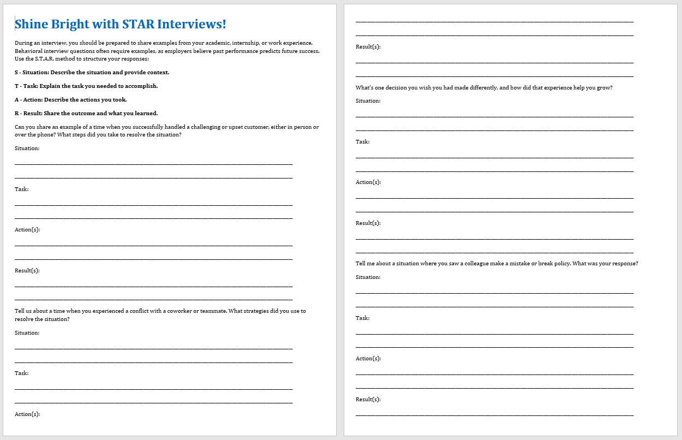
Presentation Activity: STAR Method Practice
Use the STAR method to answer the questions on the “Shine Bright with STAR Interviews!”
Notes:
Guide students to review the previous slides that explain the S.T.A.R. method in detail. Remind them that STAR stands for Situation, Task, Action, Result, and each part helps structure clear, impactful answers. Explain that the worksheet is designed to help them practice applying this technique to real interview questions. Encourage them to take their time, think of specific examples from past experiences, and write responses that follow the STAR format. Walk around to provide support and answer questions as they work.

Slide 21

Questions to Ask Employers
Demonstrate Interest
Asking thoughtful questions shows genuine interest and preparation for the role and company.
Examples of Questions
Effective questions include role success, team culture, and hiring process steps.
Tailor to Role
Questions should be researched and customized based on the specific job and organization.
Notes:
--- This slide references information from the following file: https://wvk12-my.sharepoint.com/personal/jcantrel_wvesc_org/_layouts/15/Doc.aspx?sourcedoc=%7BB746C65F-8720-46E1-82CF-FFB36D583398%7D&file=Interviews%20(2).pptx&action=edit&mobileredirect=true At the end of an interview, candidates are often invited to ask questions. Thoughtful questions demonstrate interest and preparation. Examples include: 'What does success look like in this role?', 'How would you describe the team culture?', and 'What are the next steps in the hiring process?'. These questions should be based on prior research and tailored to the specific role and organization.

Slide 22
Sample Questions to Ask
Will you describe the characteristics of the person best suited for this job?
What advancement opportunities are available with your company?
What type of people tend to do well in this position and who do not?
Are there reservations you have about my fit for the position that I could try to address?
A MUST ASK QUESTION
When will you be making a decision and how will I be notified?

Slide 23

During and Ending the Interview
Effective Interview Behavior
Maintaining good posture and positivity enhances a candidate's presence and confidence during the interview.
Organized Communication
Organizing thoughts before responding and referring to resume helps deliver clear and relevant answers.
Closing the Interview
Asking prepared questions, thanking the interviewer, smiling, and shaking hands create a strong positive impression.
Notes:
--- This slide references information from the following file: https://wvk12-my.sharepoint.com/personal/jcantrel_wvesc_org/_layouts/15/Doc.aspx?sourcedoc=%7BB746C65F-8720-46E1-82CF-FFB36D583398%7D&file=Interviews%20(2).pptx&action=edit&mobileredirect=true During the interview, candidates should maintain good posture, stay positive, organize thoughts before responding, refer to their resume or portfolio, and express a willingness to learn. At the end, they should ask prepared questions, thank the interviewer, smile, and shake hands. These actions leave a lasting impression and reinforce the candidate’s professionalism and enthusiasm.

Slide 24
Practice and Follow-Up
Notes:
--- This slide references information from the following file: https://wvk12-my.sharepoint.com/personal/jcantrel_wvesc_org/_layouts/15/Doc.aspx?sourcedoc=%7BB746C65F-8720-46E1-82CF-FFB36D583398%7D&file=Interviews%20(2).pptx&action=edit&mobileredirect=true Mock Interview Practice, Elevator Pitch Activity, Follow-Up Etiquette

Slide 25

Mock Interview Practice
Why do Mock Interviews help?
Building Confidence and Skills
Mock interviews help candidates build confidence and refine communication skills through practice.
Focused Practice Areas
Candidates focus on tone, clarity, and body language to improve overall interview performance.
Effective Peer Feedback
Peer feedback includes two positives and one suggestion to promote constructive learning.
Simulating Real Interviews
Simulated real interview settings help identify improvement areas and prepare candidates effectively.
Notes:
--- This slide references information from the following file: https://wvk12-my.sharepoint.com/personal/jcantrel_wvesc_org/_layouts/15/Doc.aspx?sourcedoc=%7BB746C65F-8720-46E1-82CF-FFB36D583398%7D&file=Interviews%20(2).pptx&action=edit&mobileredirect=true Mock interviews are valuable for building confidence and refining skills. Candidates can pair up to practice, focusing on tone, clarity, and body language. Peer feedback should include two positives and one suggestion. Using rubrics and rotating partners enhances the learning experience. Simulating real interview settings prepares candidates for actual interviews and helps identify areas for improvement.

Slide 26
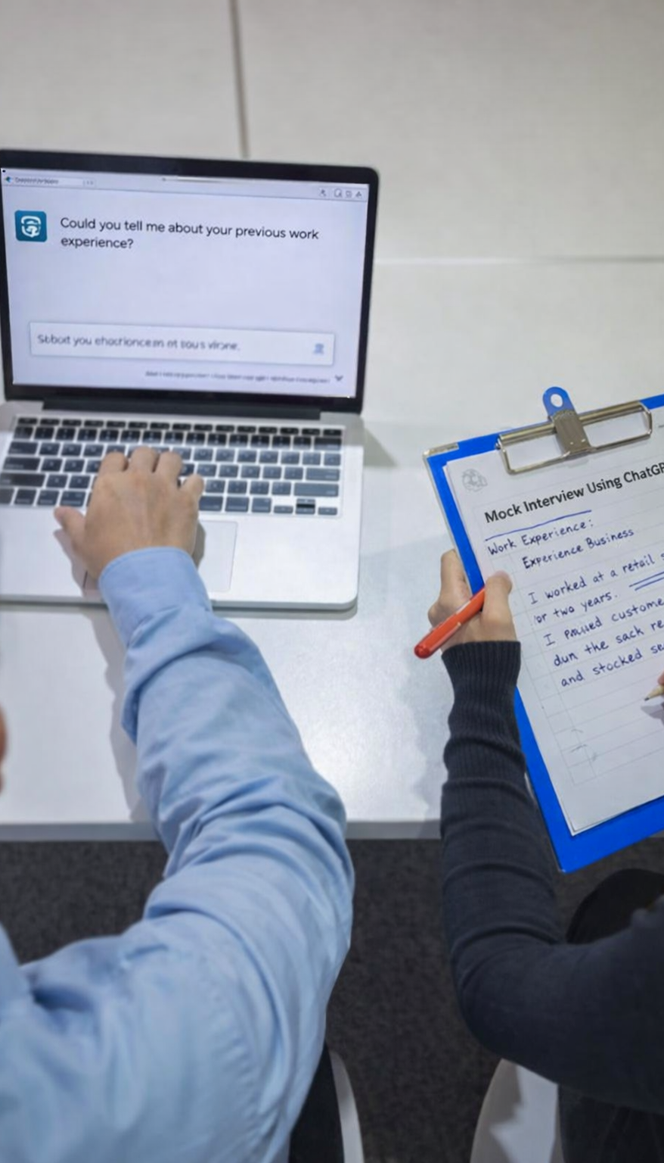
ChatGPT Interview Practice
Step 1: Choose a job you are interested in applying for.
Step 2: Open ChatGPT.
Step 3: Copy and paste the prompt below into ChatGPT.
You are an employer conducting a professional job interview. I am applying for an entry-level position that matches my skills and experience. Please conduct a mock job interview with me. Ask me one interview question at a time and wait for my response before asking the next question. Include common interview questions such as: Work experience, Strengths and skills, Problem-solving, Teamwork, Reliability and professionalism. After the interview is finished, provide clear and constructive feedback on my answers. Tell me: What I did well What I can improve? How I can make my answers stronger for a real interview? Keep the tone professional, supportive, and encouraging.
Step 4: Answer the interview questions as if this were a real interview.
Step 5: When finished, ask ChatGPT for feedback on your answers.

Slide 27

Follow-Up Etiquette
Timely Thank-You Note
Send a personalized thank-you note within 24 hours to express gratitude and reinforce interest.
Reflect on Interview
Review the interview to identify strengths and areas for improvement for future opportunities.
Polite Follow-Up Call
If no response, make a courteous follow-up call after one week to inquire about the decision.
Notes:
--- This slide references information from the following file: https://wvk12-my.sharepoint.com/personal/jcantrel_wvesc_org/_layouts/15/Doc.aspx?sourcedoc=%7BB746C65F-8720-46E1-82CF-FFB36D583398%7D&file=Interviews%20(2).pptx&action=edit&mobileredirect=true Following up after an interview is essential. Candidates should send a thank-you note within 24 hours, expressing appreciation and reiterating interest. The note can be handwritten or emailed and should be tailored to the specific interviewer. Reflecting on the interview helps identify strengths and areas for improvement. If no response is received, a polite follow-up call after a week is appropriate to inquire about the hiring decision.

Slide 28
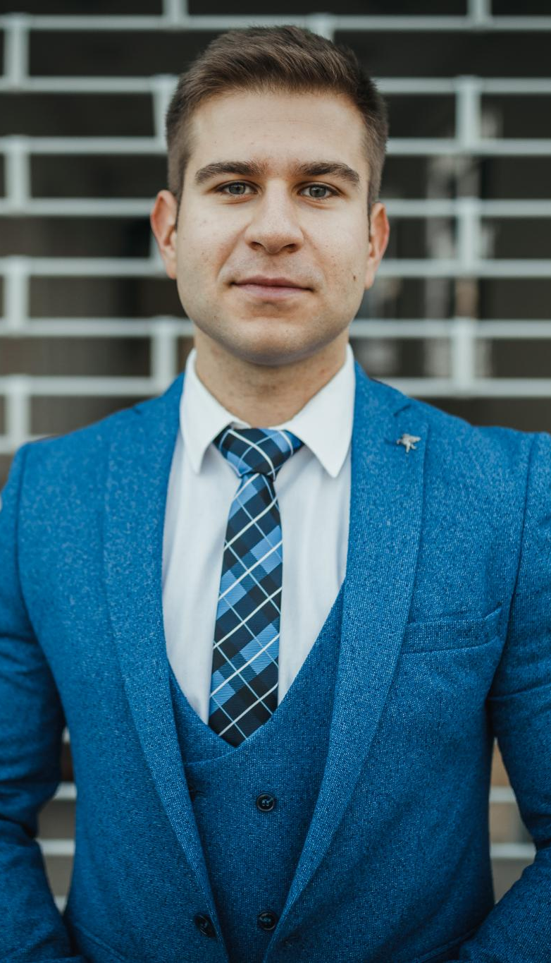
Final Thoughts
Growth Through Interviews
Interviews offer valuable opportunities for personal growth and effective self-presentation.
Preparation Builds Confidence
Thorough preparation and consistent practice significantly boost confidence and competence.
Positive and Persistent Mindset
Maintaining positivity, persistence, and openness to learning enhances interview success.
Interviews as Developable Skills
Viewing interviews as skills to develop empowers candidates to engage with enthusiasm.
Notes:
Interviews are opportunities for growth and self-presentation. Preparation and practice build confidence and competence. Candidates should stay positive, persistent, and open to learning from each experience. Viewing interviews as a skill to be developed empowers job seekers to approach each opportunity with readiness and enthusiasm.

