Slide 1

Time Management
Notes:
Print and/or review the rubric with the learners. The rubric outlines what areas/objectives learners will cover.

Slide 2

Self-Reflection: How Good Is Your Time Management?
Complete the Time Management Self-Reflection Worksheet or complete the self-test at:
https://www.psychologytoday.com/us/tests/career/time-management-skills-test
Notes:
Option 1 (Printable): Give each student a copy of the Time Management Self-Assessment Worksheet to reflect on strengths & weaknesses in their current time management.
Option 2 (Virtual): Click on the link to take the "How Good is Your Time Management“ online test. Have learners use the "calculate my total" button and then read their results taking note of their strengths and weaknesses as each relates to different areas of time management. The five stars next to each area rate how well they did on those time management areas. Encourage learners to share what they found their strengths and weaknesses were as identified by the self-assessment.
*Note - they do not need to log-in to see their results, they can click "no thanks, close this window" at the bottom of the pop-up window to see results.
Self-Test: https://www.psychologytoday.com/us/tests/career/time-management-skills-test

Slide 3




OBJECTIVE of this Module
While we all have 24 hours in our day, we each have different:
Responsibilities
Financial Obligations
Family Sizes
Levels of Support
The main goal of effective time management is to
maximize productivity and achieve goals
by optimizing how you use your time.
Notes:
Set the purpose for the lesson. Time is a resource distributed equally to all people. You will be introduced to the idea that time is a resource to be utilized wisely. You will understand the importance of time in setting goals. The goal of this module is to motivate learners to accomplish day-to-day tasks, using their time wisely, to achieve their long-range goals. At the conclusion of this module, you will understand time management and its importance at home and on the job. You will be able to identify uncontrollable events in their lives and develop coping strategies to deal with those events effectively and efficiently. You will be able to distinguish between urgent and important events and develop strategies to deal with each type of event.

Slide 4

Setting Priorities
Priorities are things that are more important than others and need to be dealt with first, or the ranking of something's importance.
Priorities establish the sequence in which things should be done.
Notes:
Discuss how to identify our personal priorities.

Slide 5
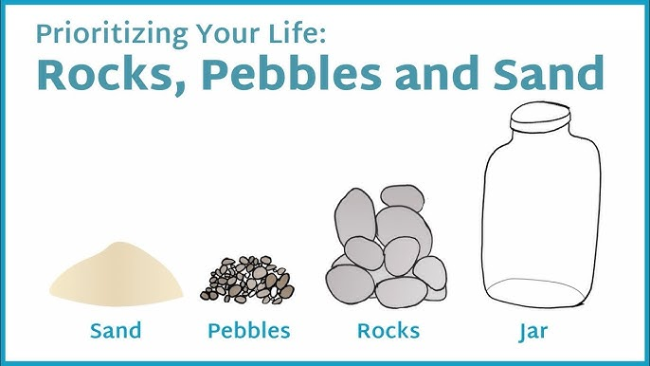
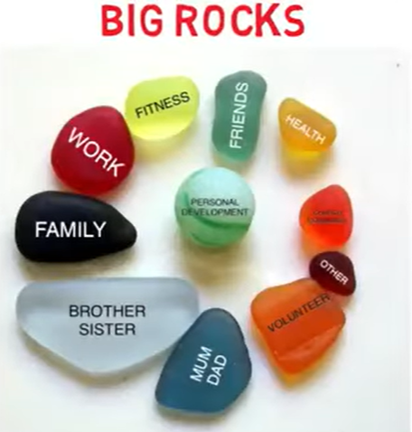

Priorities— “Big Rocks”
Notes:
Watch the video: https://www.youtube.com/watch?v=AtoVhZOWQZU
(Alternatively, learners could read The Big Rocks of Time handout or Instructors could get the materials needed – rocks, gravel, sand, jar - and do the demonstration themselves).
Distribute “Big Rocks Time Management Worksheet” for learners to identify their own “big rocks, marbles, sand, and water”.

Slide 6
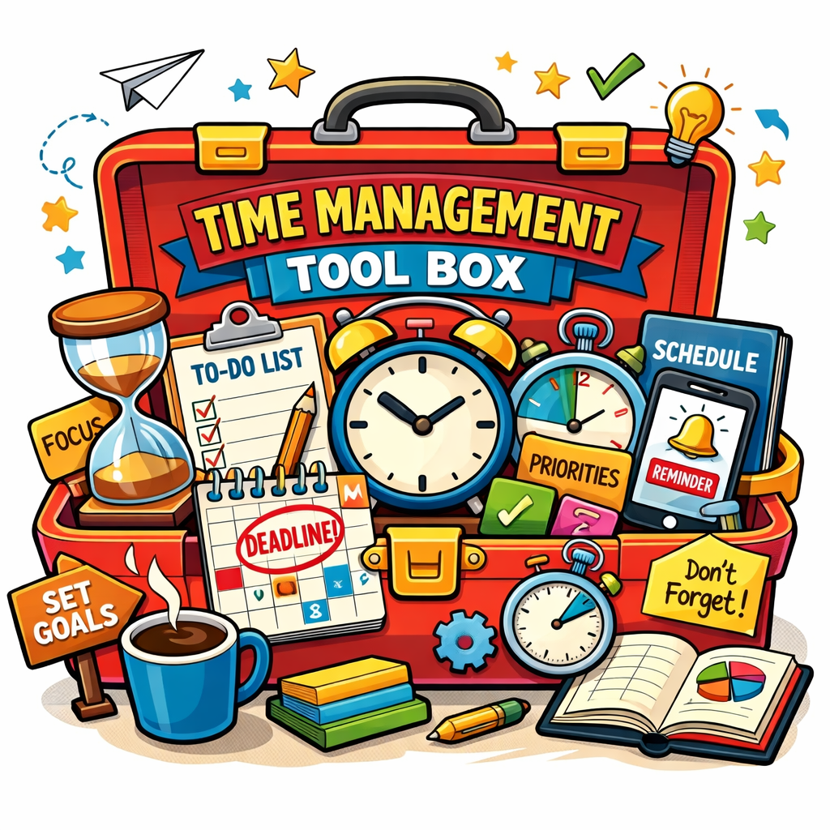
You’ve Identified Your Priorities—Now What?
Now, you’ve got to find a system to dedicate time to each of your priorities. Does that sound intimidating?
Never fear--we’ve got the tools to help!
Notes:
Discuss what follows after identifying priorities.

Slide 7

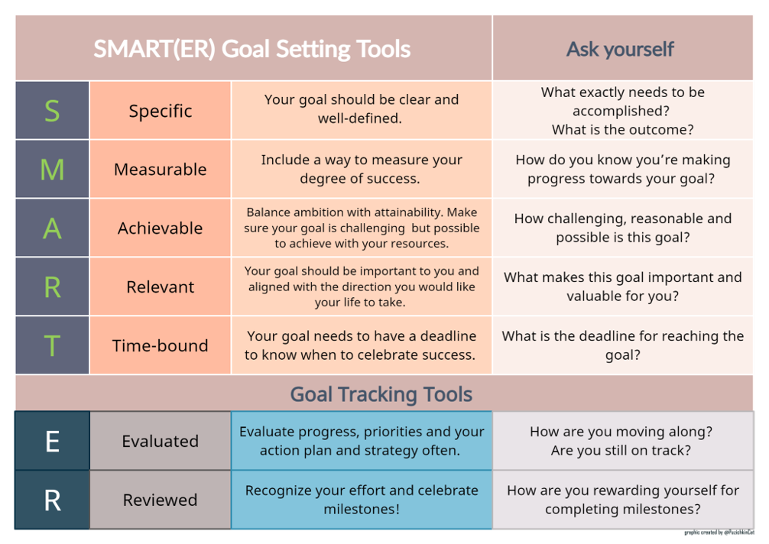
Set Clearly Defined SMART Goals!
Write them down!
Writing down your goals is important because it increases your chances of achieving them, provides a sense of commitment, and improves focus.
Notes:
Review SMART Goal principles.
SMART Goal-setting directly relates to effective time management & setting priorities.

Slide 8
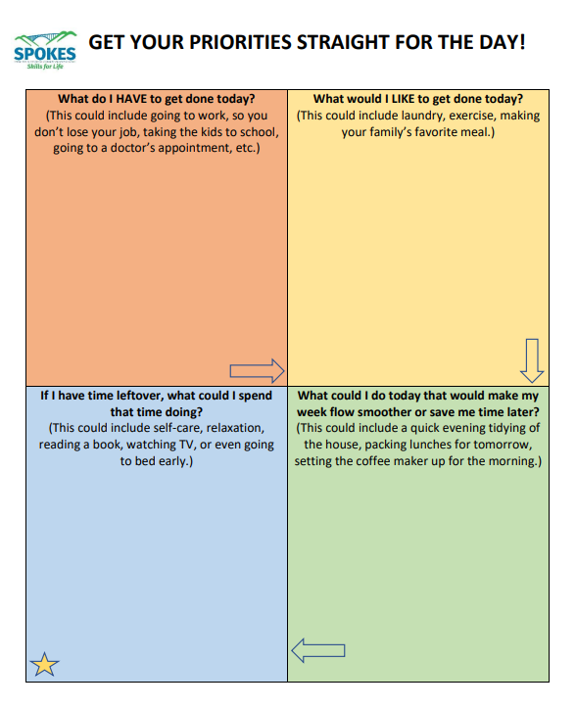
Utilize a Flow-Chart
A flow chart can be used on a daily or weekly basis to ensure that your most important tasks get completed.
Notes:
Distribute a copy of the Get Your Priorities Straight FlowChart to learners. It can be modified or customized for practical daily or weekly use.

Slide 9
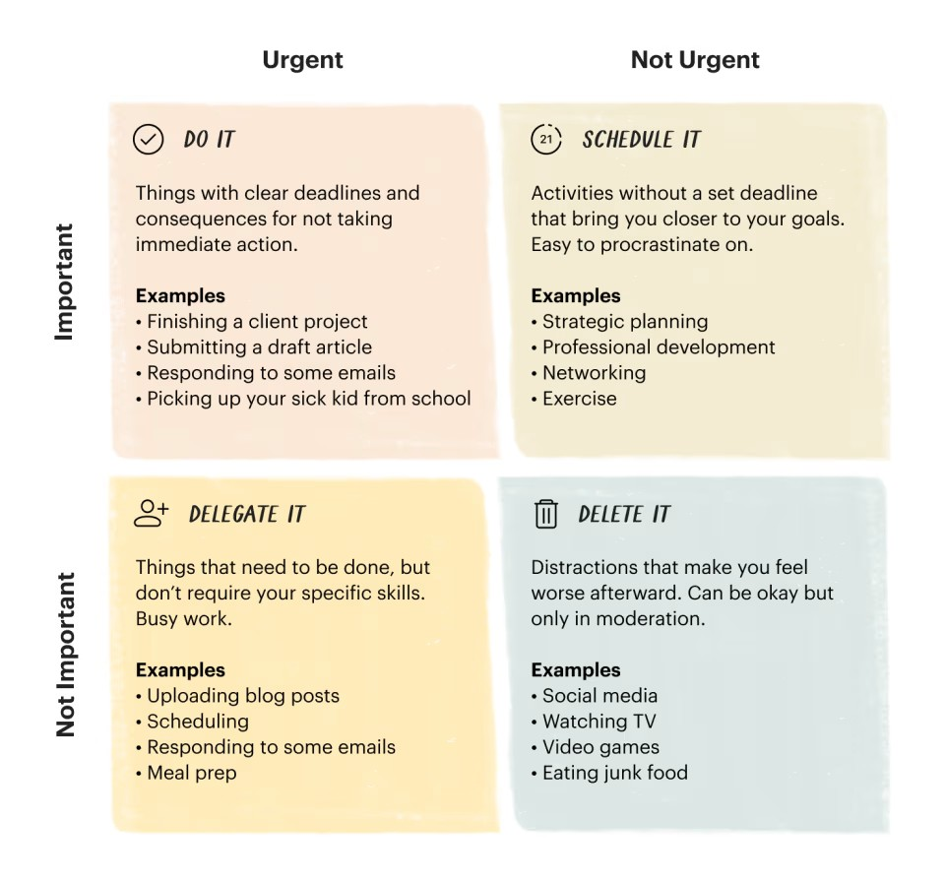
Another Helpful Tool--The Eisenhower Matrix
The Eisenhower Matrix helps you prioritize tasks by urgency and importance to improve productivity.
Notes:
Try the Eisenhower Matrix if you...
Find yourself running around putting out fires all day.
Are busy, but don’t feel like your work has a high impact.
Have long-term goals but no time or energy to make progress on them.
Have a hard time delegating and/or saying no.
Want to be the president of the United States (hey, it worked for Eisenhower!)

Slide 10
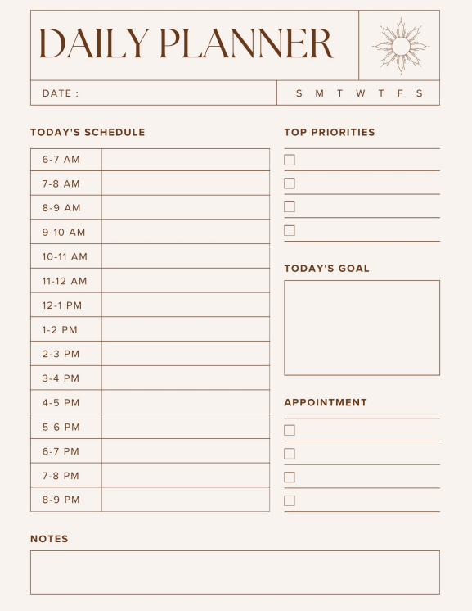
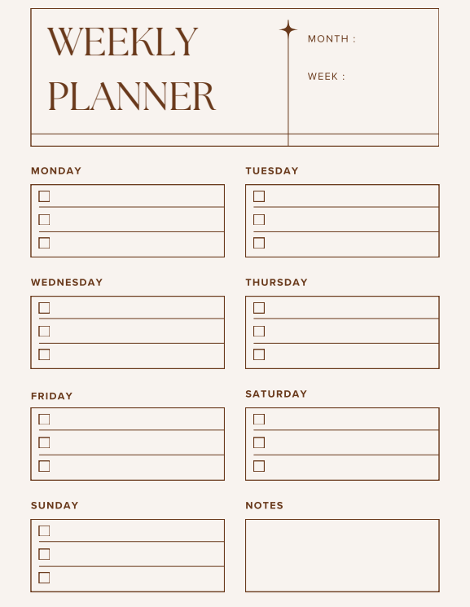
Make Good Use of Daily & Weekly Planners!
Keeping the day’s and week’s activities in view can help ensure that priority tasks get accomplished.
It can also help you find free time!
Notes:
The Daily & Weekly Planner are included as supplemental printable material with this lesson for students to try.

Slide 11
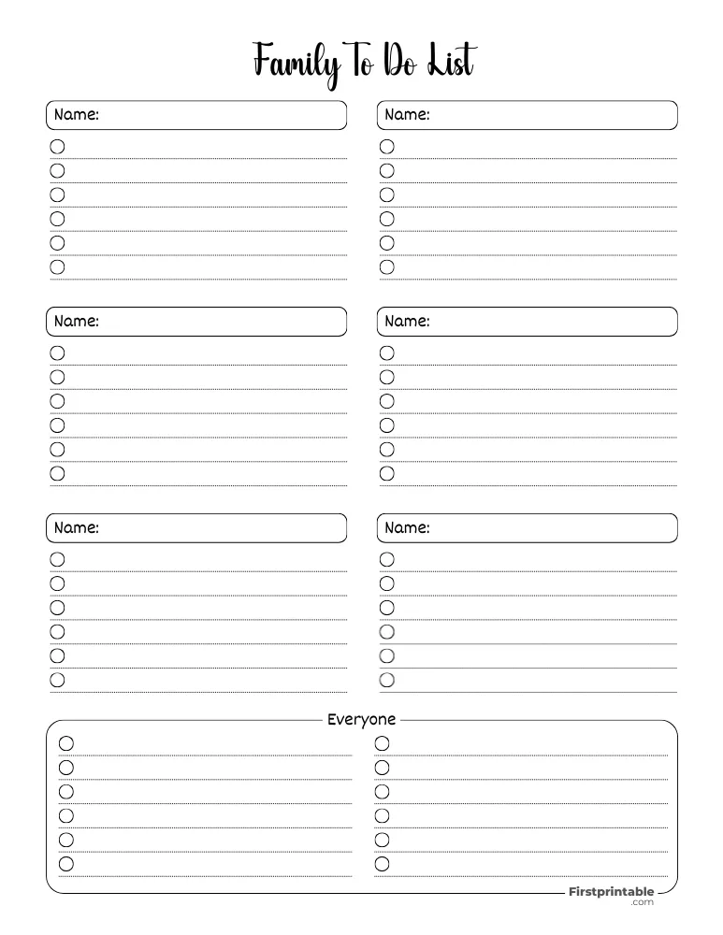
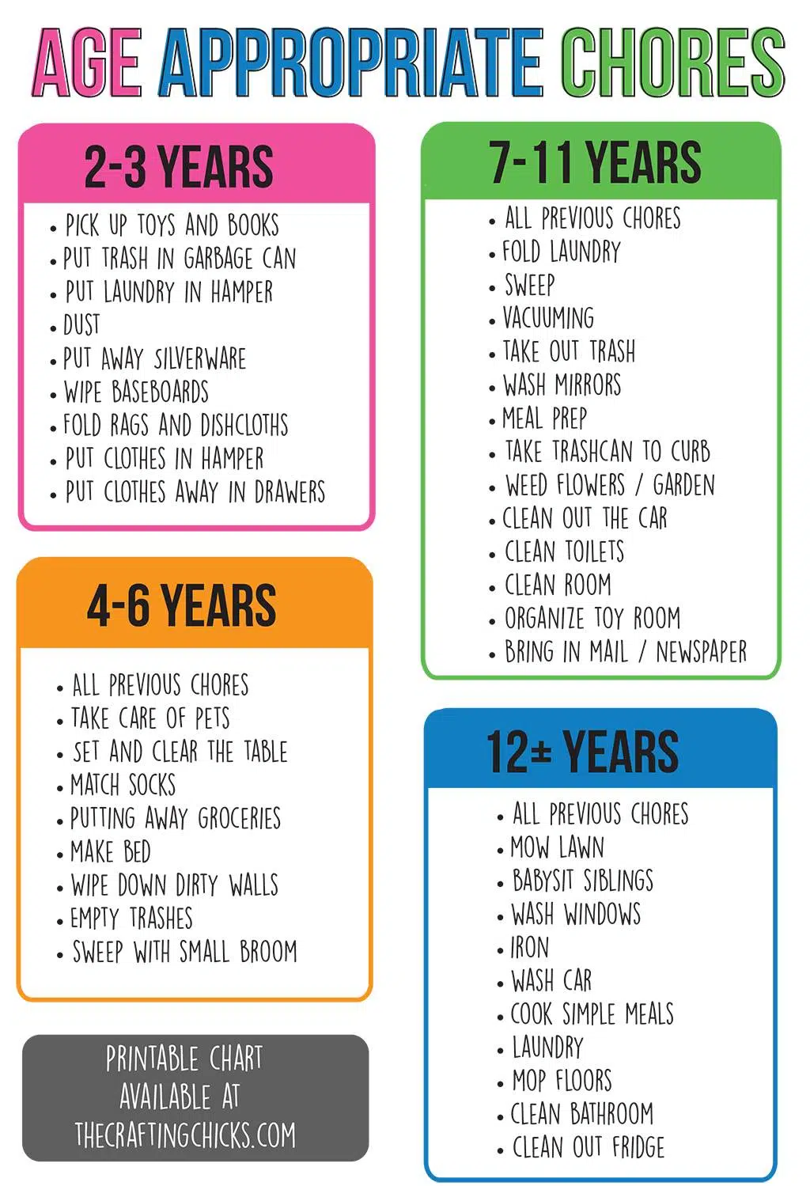
Create Family To-Do Lists & Delegate
It is important for the whole family to help with chores because it:
Builds self esteem.
Teaches vital life skills like responsibility, time management, and work ethic.
Fosters a sense of belonging and teamwork.
Notes:
Creating family to-do lists and delegating age-appropriate chores to children can help create more quality time for everyone.

Slide 12


Be on the Lookout for Time Management Dangers!
Despite our best efforts, there are major challenges to managing time wisely.
These may include:
Distractions
Procrastination
Multitasking
Overcommitment/Inability to say “No”
Lack of Structure and Routine
Notes:
Highlight common challenges to effective time management.

Slide 13


Technology Distractions
Self-Reflection: What strategies do you use (or do you plan to use) to help you stay focused?
Group Activity: Count the notifications you have received on your phone today.
(On iPhone, swipe down from the top left of your screen)
Notes:
Failing to manage distractions.
Group Activity: Each person in class can count the notifications they have received on their phones today.
Watch the video: youtube.com/watch?embeds_referring_euri=https%3A%2F%2Fhubblecontent.osi.office.net%2F&source_ve_path=MTY0OTksMjg2NjQsMTY0NTAz&v=Ig6I3prnlnE&feature=youtu.be
After watching the video, include time for self-reflection on what practical tips learners plan to use.

Slide 14
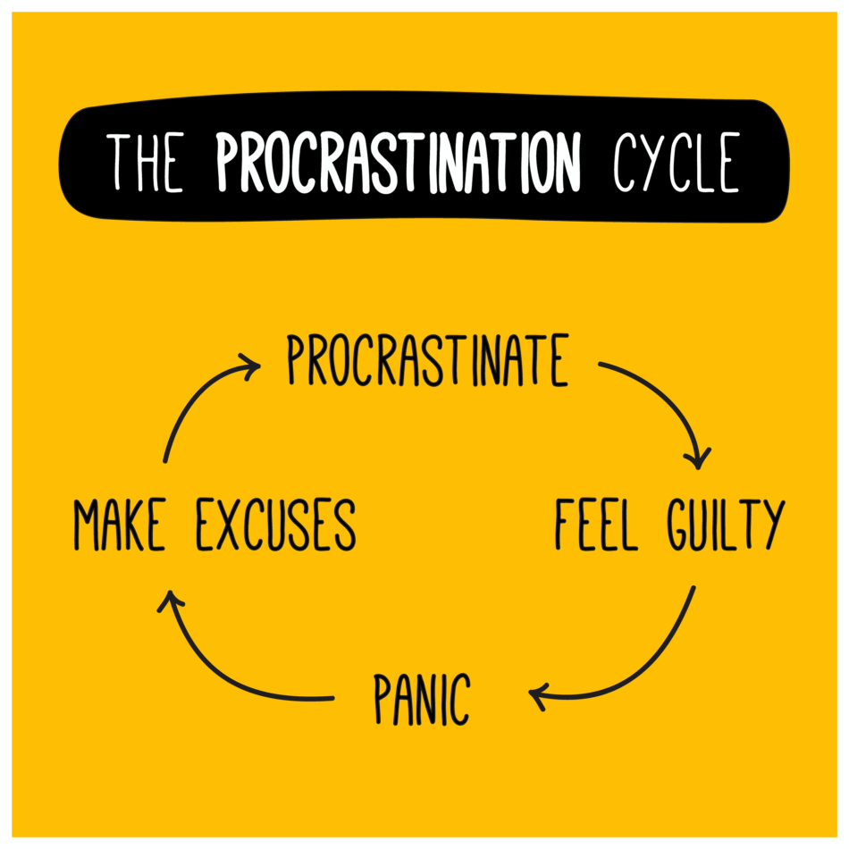

Procrastination
Procrastination is the act of putting off something until a later time.
Procrastination is a habit that can be broken.
Notes:
Help learners realize that procrastination is simply a habit & that the cycle can be broken!
Watch video: https://youtu.be/sB5n6wnT61w

Slide 15
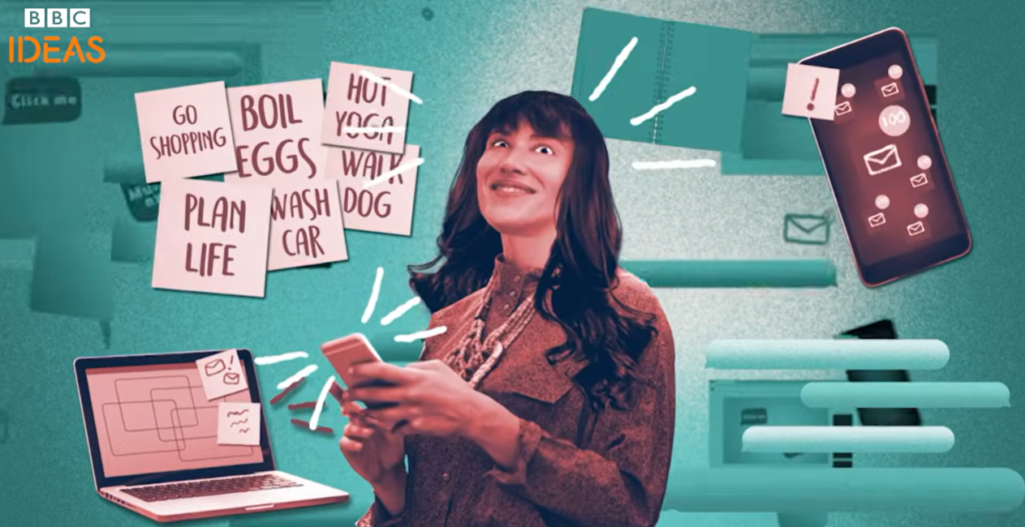
Multitasking
Many see multitasking as a strength, but it can lead to:
Inefficiency
Potential Mistakes
Lack of Creativity & Problem-Solving
Memory Issues
Distractibility
Chronic Stress & Burnout
Notes:
Multitasking is often seen as a strength, but it may actually have a negative impact on our productivity and time management.
https://www.youtube.com/watch?v=tMiyzuO1qMs

Slide 16
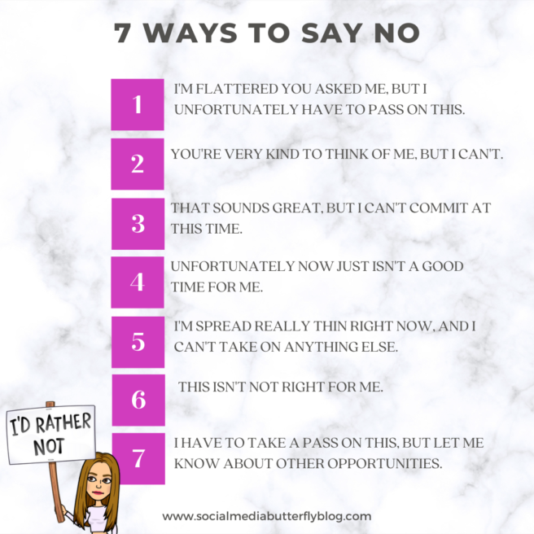
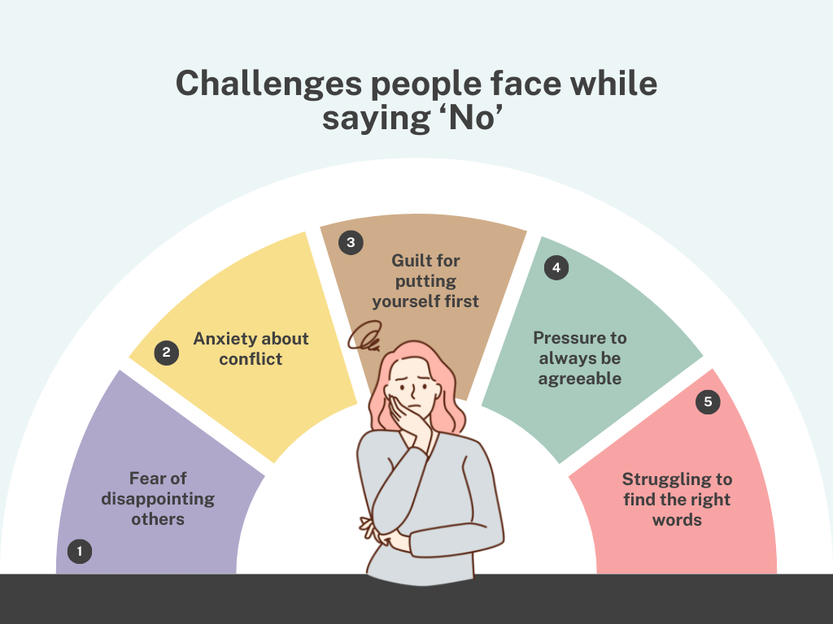
Over-Commitment/Inability to Say “No.”
Notes:
Ask learners to identify situations where they struggle with saying no or over-committing themselves.
Review polite, yet effective, ways to say “No.”

Slide 17
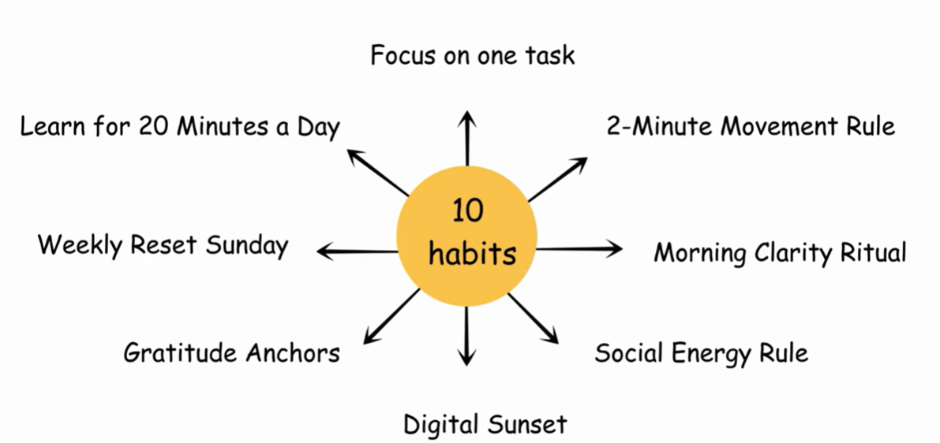
Lack of Structure and Routine
Notes:
Watch the video excerpt from Atomic Habits.
Another great resource to share with students is the free audiobook Make Your Bed by ADMIRAL WILLIAM H. McRAVEN: https://www.youtube.com/watch?v=l3e3tfxqejE&t=504s

Slide 18

Exit Ticket Time!
What did you learn?
What tips do you plan to use to better manage your time?
Notes:
Distribute The Exit Ticket to learners and ask them to complete it. Provide learners the opportunity to share their answers to the questions on the slide.

Slide 19
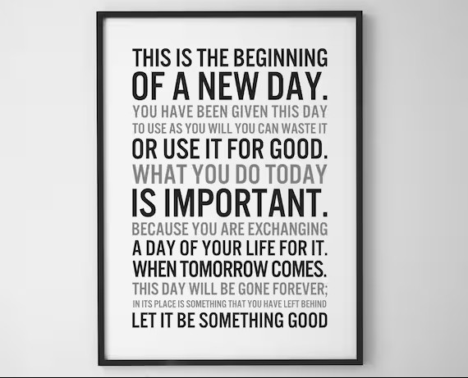
How will you put your TIME to use today?
Notes:
Do a Round Robin - Post the Stand and Deliver questions. Each learner will print one of the questions on a blank sheet of paper. (If you have more than 5 learners, put them in groups. Adjust however you see fit, so it works with your class). Each group member must choose a different question. Learners pass their papers to the right. The next member writes his/her response to the question. They again pass their papers to the right. The next person writes his/her response. Repeat until the learners receive their original paper. They read all the responses and write summaries of what they have learned. Facilitate a whole-class discussion in which learners read some of their summaries.
Stand and Deliver Questions:
What are the most important concepts you learned from this module?
How will you use this information?
What other steps can you take to learn more about this topic?
With whom can you share what you’ve learned and what would you tell him or her?
What is one question you still have about this topic?

