Slide 1



Journey of Integrating Docling intoAskIBM
Jose Moises Romo, Abby Tse
Notes:
Enhanced structure of extracted data - Images, text, and markdown
Through the ability to read attachment in as embeddings, we've been able to expand the scope of what we can ingest, in terms of the different file extensions: pdf, images, csv, xl, etc. - allowing us to support multiple file types

Slide 2

Mission of the CIO Creating AI experiences to make IBM the most productive company in the world
Notes:
Generative AI has dominated the technology conversation since the emergence of Chat GPT in late 2022, with its implications discussed not only in the business world but in society at large.
AI will impact every industry and every role in an organization, creating new opportunities to increase productivity and enabling new ways to use data for competitive advantage. Every client we speak with is looking to boost productivity with AI.
A Boston Consulting Group study (as reported in Fortune), revealed the 85% of business leaders plan to boost AI and GenAI spending in 2024.
However, for many large enterprises – and the shared services organizations responsible for leading this technology adoption – it is still relatively early days. They are beginning to move from experimentation to scaling across business functions.
IBM knows that AI for Enterprise has unique requirements. We have years of experience in technology-led business transformation, and lessons we can share about how we did it.
We understand that business transformation at enterprise scale with Generative AI requires:
A Hybrid cloud infrastructure to support it
A data architecture to train the models
governance structure to ensure your AI is compliant, ethical & secure
A growth mindset, where your employees embrace new ways of working and a commitment to continual skills enhancement
However, successful implementation of AI requires more than a technology transformation.
It requires a cultural and behavioral transformation with a commitment to continuous skills enhancement and a full embrace of new ways of working.
For leaders in shared Shared Services organizations, it is a game-changing opportunity to create a new future as growth enablers, removing mundane tasks and bureaucracy from the enterprise to create a more fulfilling work environment focused on innovation and growth.

Slide 3
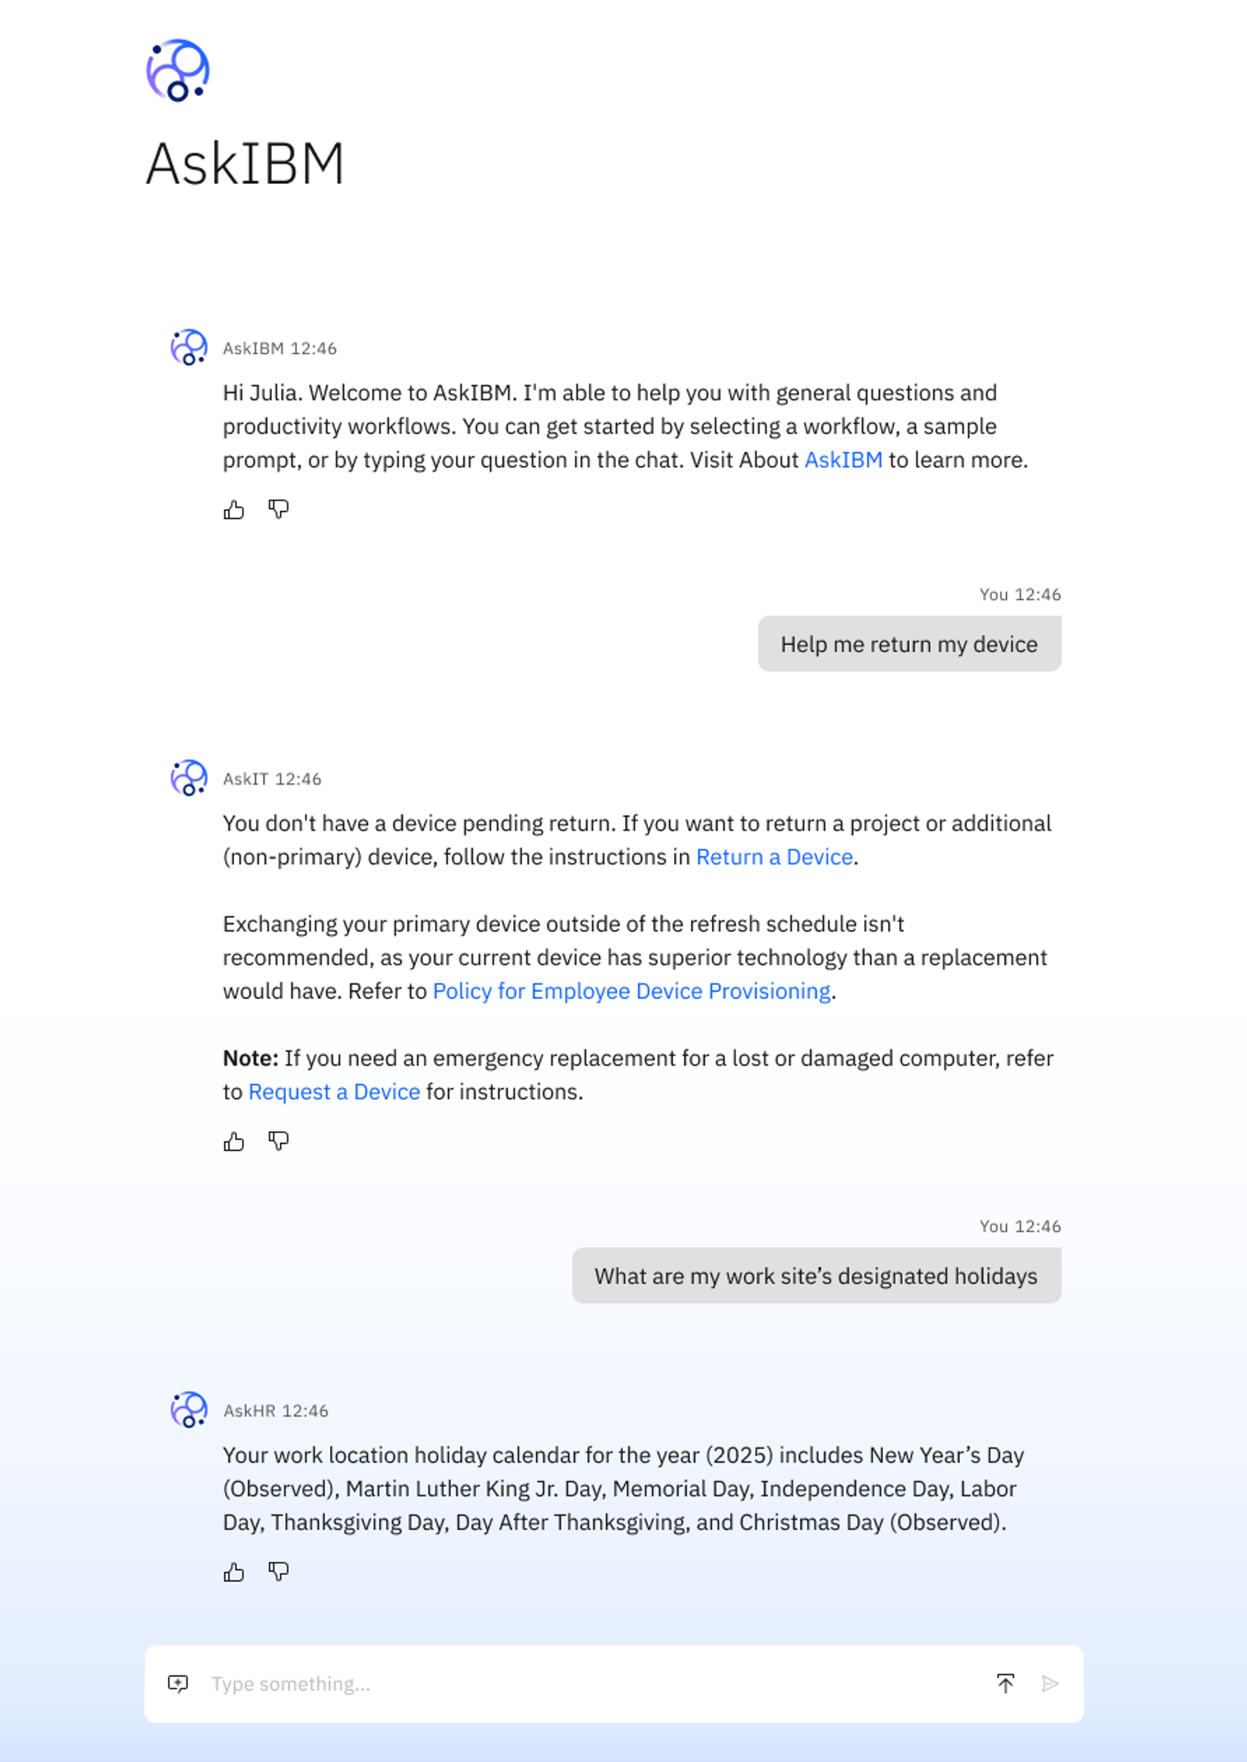
Introducing AskIBM
AskIBM is the one-stop destination for IBMers everyday AI needs, providing seamless access to digital agents and enterprise knowledge to help drive greater productivity across IBM.
IBM | CIO
Notes:
Users – 270k+ employees

Slide 4

AskIBM Creating AI experiences to make IBM the most productive company in the world
AskIBM is the one-stop destination for IBMers everyday AI needs, providing seamless access to digital agents and enterprise knowledge to help drive greater productivity across IBM.​
Notes:
Enhanced structure of extracted data - Images, text, and markdown
Through the ability to read attachment in as embeddings, we've been able to expand the scope of what we can ingest, in terms of the different file extensions: pdf, images, csv, xl, etc. - allowing us to support multiple file types

Slide 5
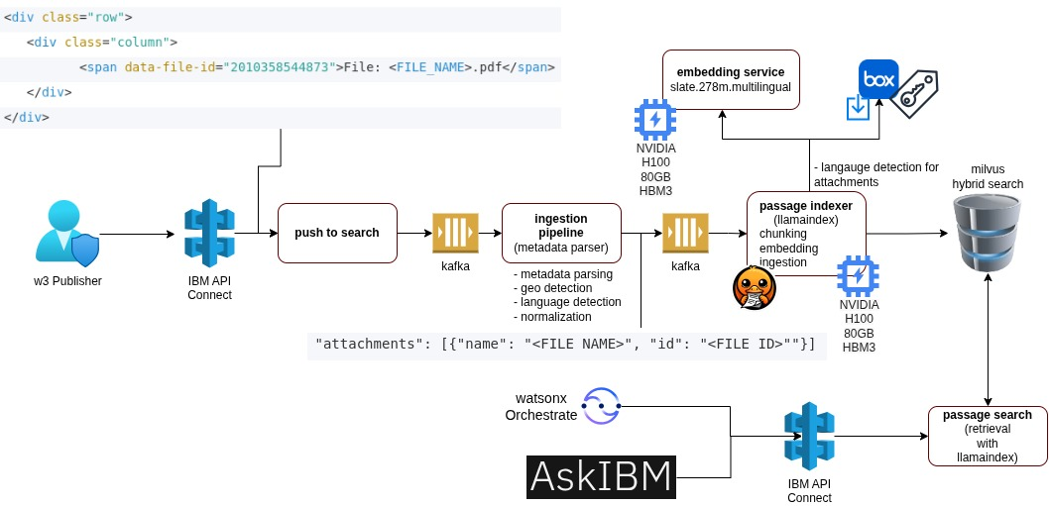
Architectural Diagram
IBM | CIO
Notes:
Supporting attachments from publisher
Pdf, images (different extensions), csv, xl, etc.
Adopters via tools + AskIBM + w3Search
Milvus has entitlement field – public/private, nothing private in the results
Attachments documents traffic is higher than web based documents (previously in milvus outdated data, github pages, 404, crawler with duplicates -> data is cleaned up)
2 mil documents now, performance is better
Passage search with two regions, one with doc with attachments, other with everything else
OCR on for all pdf types

Slide 6

Metrics on Documents
250K
10%
Pages of documents (PDF, DOCX, PPTX, images)
Of vectors in entire collection are from attachments
5%
16K
Of daily total search results having attachments used for RAG by AskIBM
Attachment results retrieved per day
IBM | CIO
Notes:
Total number of calls/requests from adopters (maybe from BlueAPI)
# of pdf attachments
Highlight additional attachment numbers 0 -> 116k

Slide 7
Demo
IBM | CIO

