Slide 1
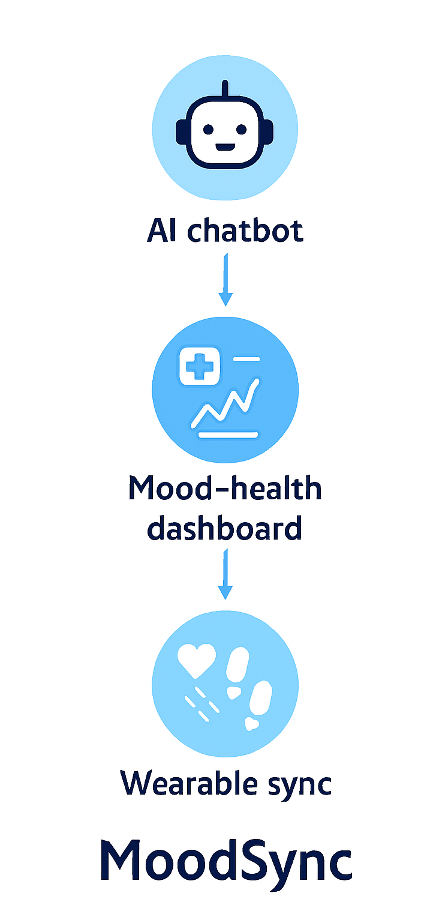
Idea 1 – MoodSync
Concept: An AI chatbot that syncs with wearables to track sleep, activity, and mood, offering personalized nudges and emotional support.
Key Features:
Wearable sync (HR, sleep, steps)
Sentiment-aware chatbot
Mood–health dashboard
Value Proposition: Real-time, personalized wellness companion that adapts to user’s emotional and physical state.

Slide 2
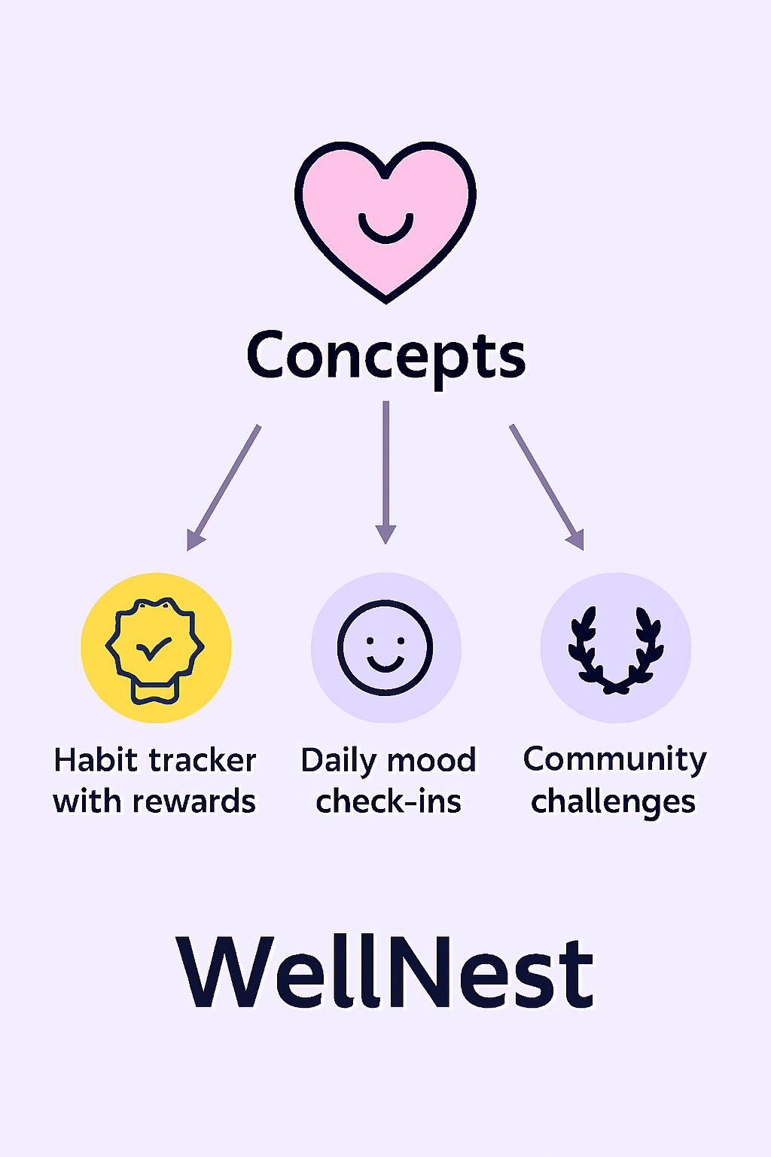
Idea 2 – WellNest
Concept: A gamified wellness app that rewards users for healthy habits and emotional check-ins.
Key Features:
Daily mood check-ins
Habit tracker with rewards
Community challenges
Value Proposition: Boosts motivation and engagement through gamification and peer support

Slide 3
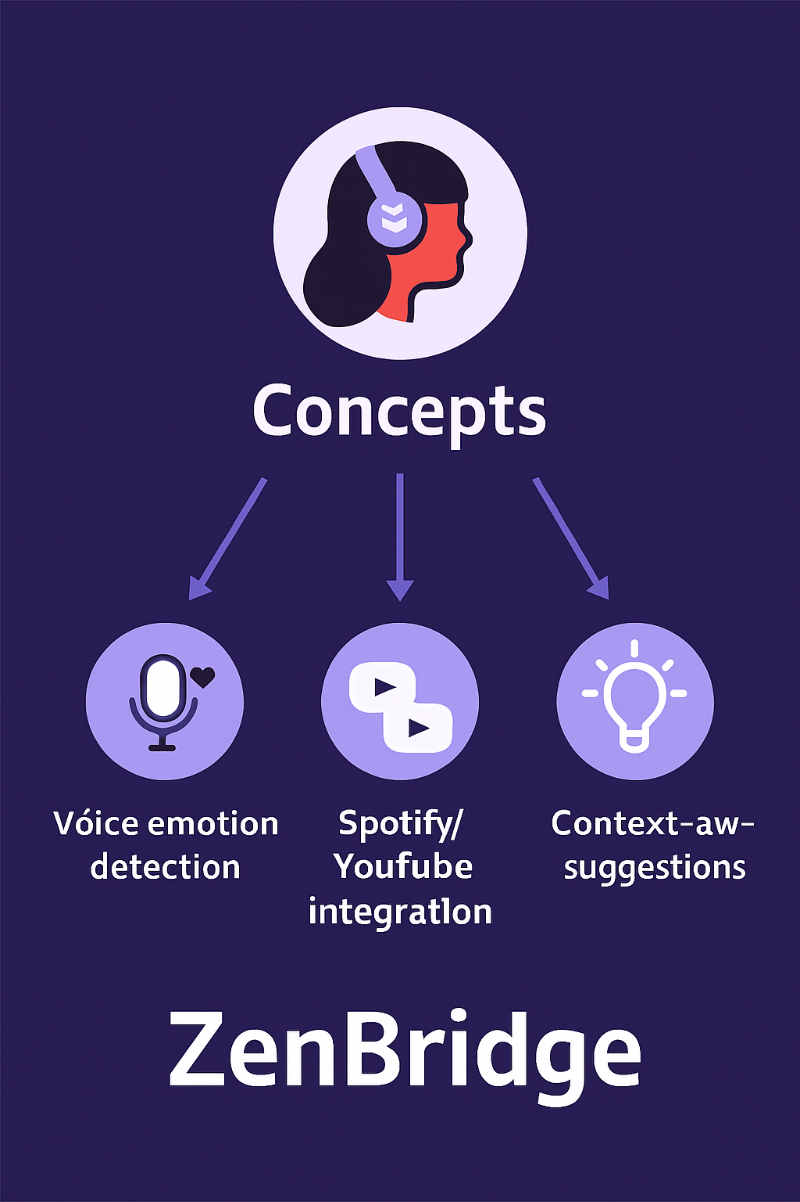
Idea 3 – ZenBridge
Concept: A voice-based AI assistant that detects emotional tone and offers mindfulness, music, or health tips.
Key Features:
Voice emotion detection
Spotify/YouTube integration
Context-aware suggestions
Value Proposition: Hands-free, empathetic support that feels natural and intuitive.

