Slide 1

Project I Need A Budget
CodeClan
Ruby – Sinatra – SQL – HTML & CSS

Slide 2
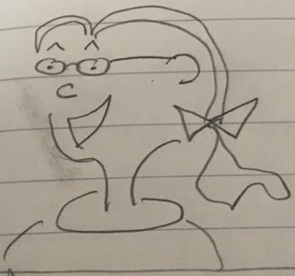
ProtoPersona: Nicole
Demographic
At college (age 17)
Living with parents in Edinburgh
Weekend waitressing job
Still gets an allowance
Behaviours
Just passed driving test
Likes to spend time at shops and movies
Generous, but friends don’t always pay back
User Needs
As a generous friend I keep track of loans so that I’m not taken advantage of.
As a weekend waitress I pay for petrol so that I can borrow mum’s car
As a person who loves celebrating I budget for gifts so that I can treat my friends

Slide 3
It’s Friday night, and Nicole has just finished a four-hour shift at Nandos. She’s tired, and her dad is late picking her up, so she pops into the 24-hour CostCutter for crisps and a drink. Time to record her spending...

Slide 4
User Journey
User
  opens the website on her phone
System
  displays landing page with current budgets and navigation
User
  clicks on add transaction
System
  displays form with required fields, save and cancel buttons
User
  notices that ‘food’ is getting low and decides to bring snacks next time
System
  waits for user input
User
  choses options and clicks save
System
  adds record to database, displays budget summary and transactions

Slide 5
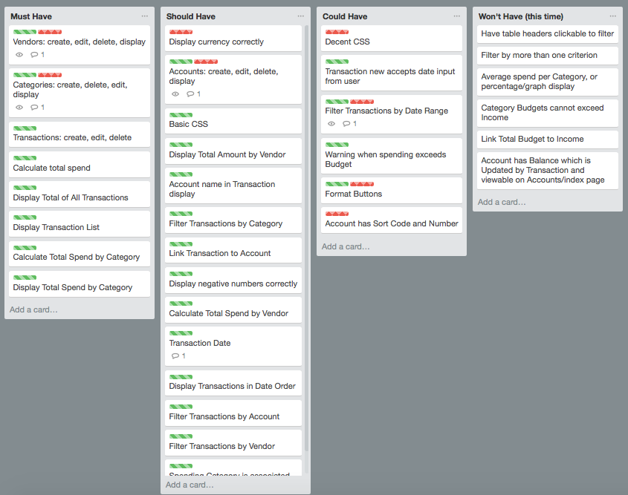
Planning

Slide 6
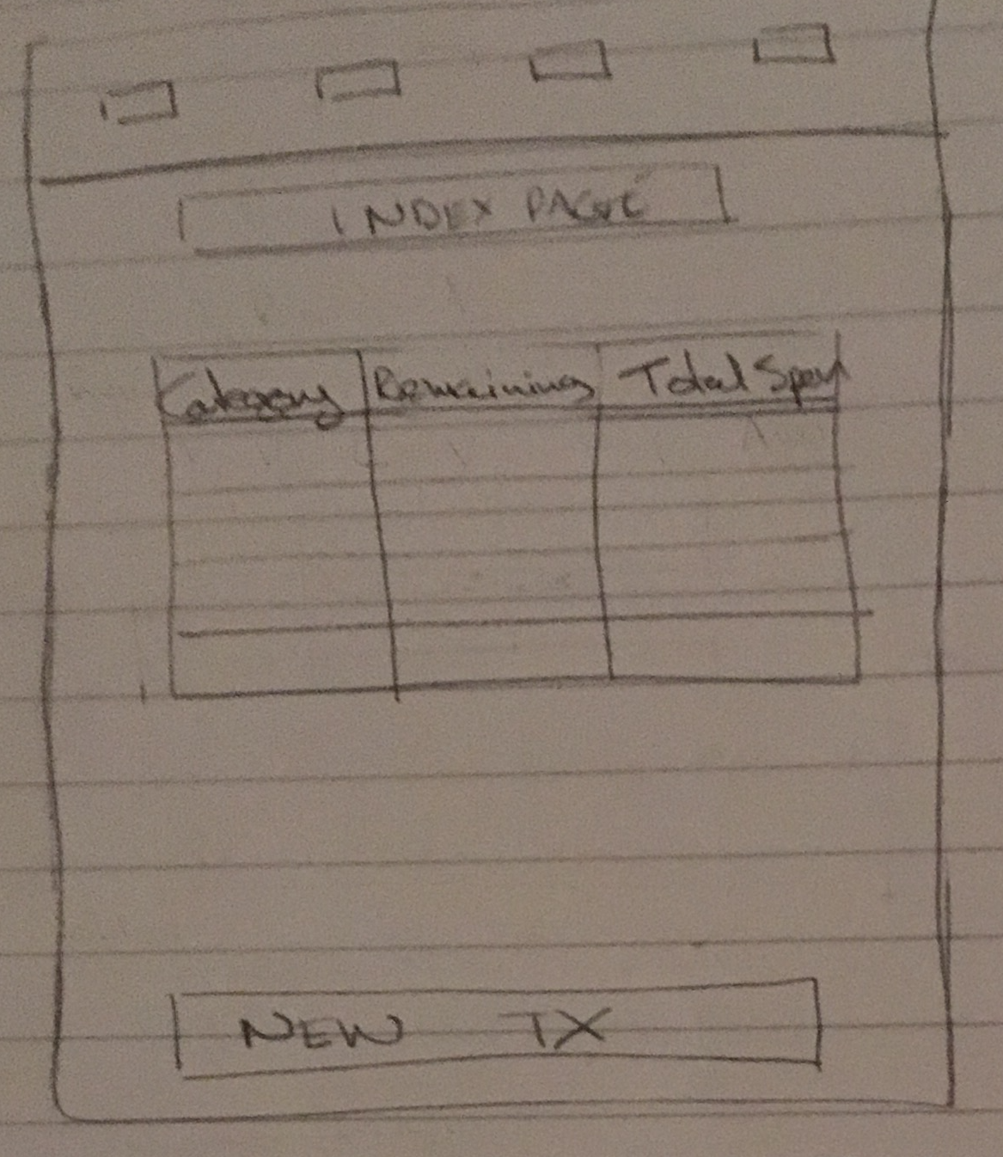
MockUp: Landing Page

Slide 7
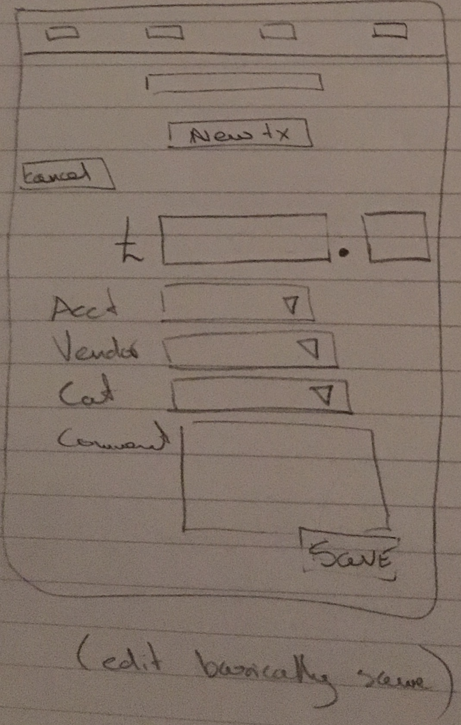
MockUp: New Transaction

Slide 8
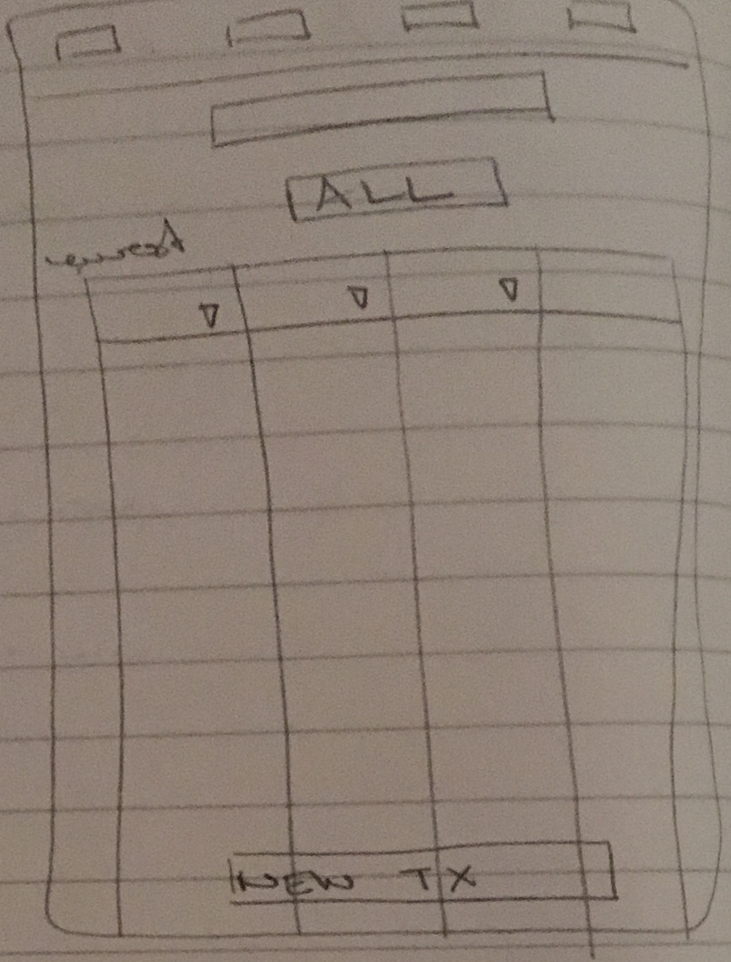
MockUp: All Transactions

Slide 9
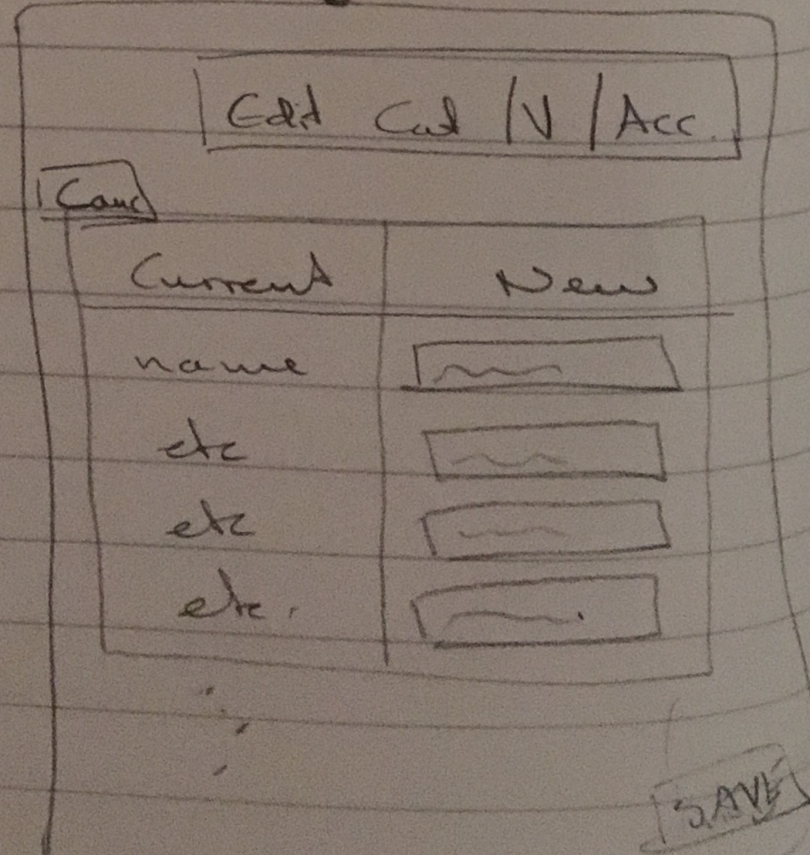
MockUp: Edit Category / Vendor

Slide 10
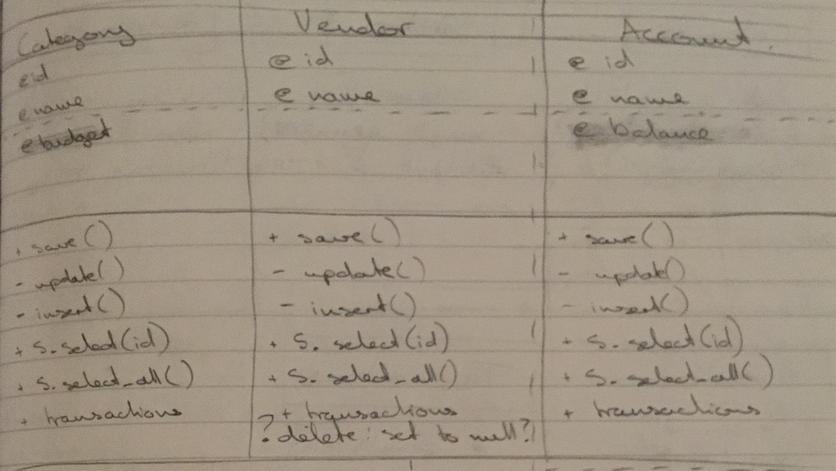
Models: Account, Category, Vendor

Slide 11
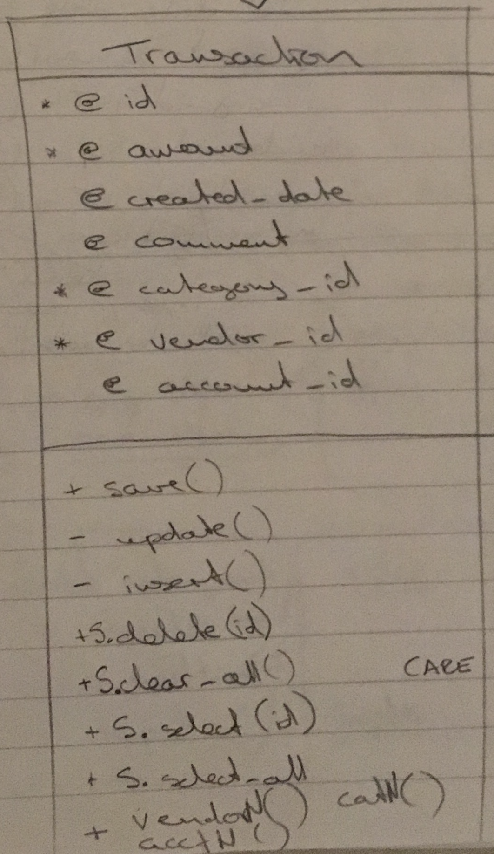
Model: Transaction

Slide 12
Database: Table Categories
Column | Type | Modifiers
--------+------------------------+---------------------------------------------------------
id | integer | not null default nextval('categories_id_seq'::regclass)
name | character varying(255) | not null
budget | numeric(8,2) |
Indexes:
"categories_pkey" PRIMARY KEY, btree (id)
Referenced by:
TABLE "transactions" CONSTRAINT "transactions_category_id_fkey" FOREIGN KEY (category_id) REFERENCES categories(id)

Slide 13
Database: Table Vendors
Column | Type | Modifiers
--------+------------------------+------------------------------------------------------
id | integer | not null default nextval('vendors_id_seq'::regclass)
name | character varying(255) | not null
Indexes:
"vendors_pkey" PRIMARY KEY, btree (id)
Referenced by:
TABLE "transactions" CONSTRAINT "transactions_vendor_id_fkey" FOREIGN KEY (vendor_id) REFERENCES vendors(id)

Slide 14
Database: Table Accounts
Column | Type | Modifiers
--------+------------------------+-------------------------------------------------------
id | integer | not null default nextval('accounts_id_seq'::regclass)
name | character varying(255) | not null
Indexes:
"accounts_pkey" PRIMARY KEY, btree (id)
Referenced by:
TABLE "transactions" CONSTRAINT "transactions_account_id_fkey" FOREIGN KEY (account_id) REFERENCES accounts(id)

Slide 15
Database: Table Transactions
Column | Type | Modifiers
------------------+------------------------+-----------------------------------------------------------
id | integer | not null default nextval('transactions_id_seq'::regclass)
amount | numeric(8,2) |
comment | character varying(255) |
transaction_date | date |
category_id | integer |
vendor_id | integer |
account_id | integer |
Indexes:
"transactions_pkey" PRIMARY KEY, btree (id)
Foreign-key constraints:
"transactions_account_id_fkey" FOREIGN KEY (account_id) REFERENCES accounts(id)
"transactions_category_id_fkey" FOREIGN KEY (category_id) REFERENCES categories(id)
"transactions_vendor_id_fkey" FOREIGN KEY (vendor_id) REFERENCES vendors(id)

Slide 16
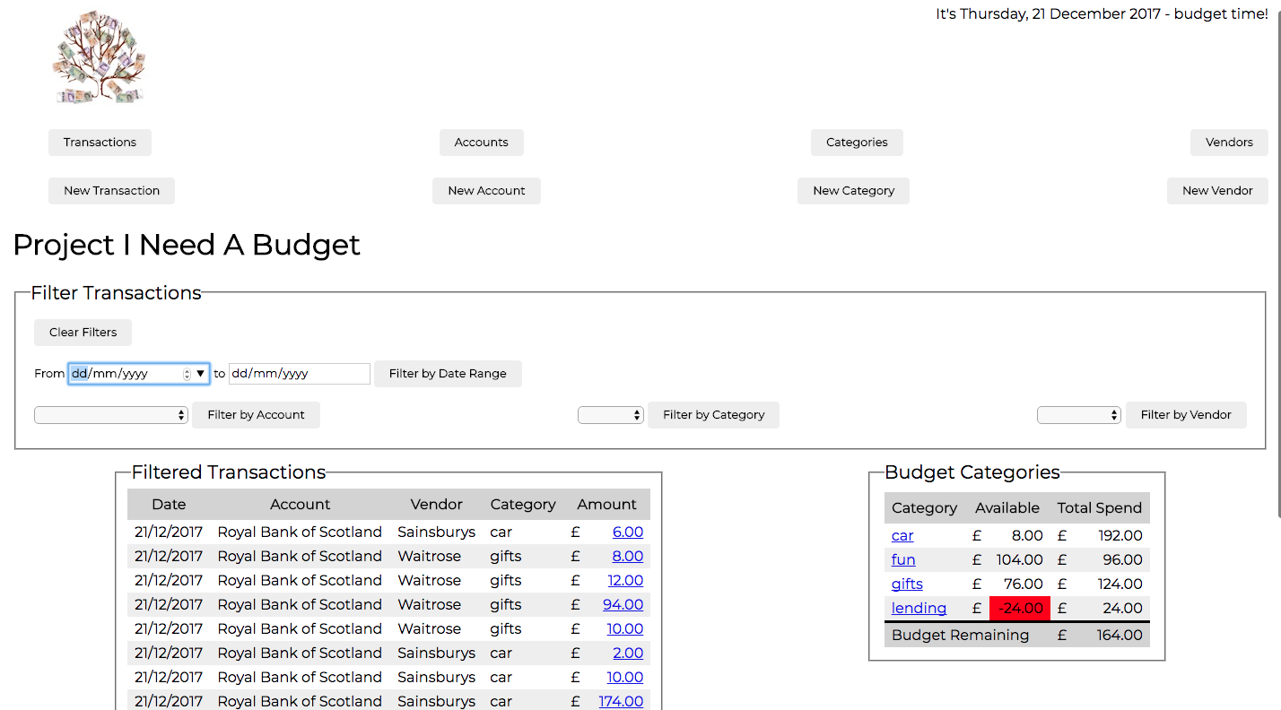
Walkthrough

Slide 17
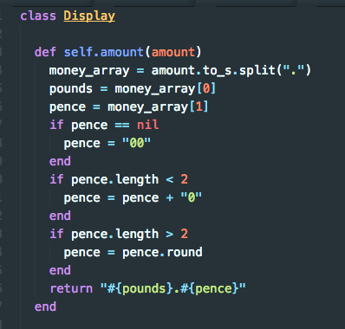
I thought I was being so clever...

Slide 18

Then I googled

Slide 19
I probably should have...
Controllers
  Found a way to hide the ‘delete’ function for anything with a foreign key constraint
Browser
  Worked out how to get consistent display
  Looked at mobile layout
Accounts
  Stored a sort-code and account number

Slide 20
I would have liked to...
Filtering
  More than one criterion
Budgets
  Link to income so you can’t budget what you don’t have
Accounts
  Balance is updated with every transaction
Testing
  Learn how to test functions which call a database

Slide 21
I learned
If you don’t set a timer, your day disappears
Flexbox is almost as unpredictable as CSS
Knowing what to google is a real skill
Cut and paste does not save time
You are never finished

Slide 22
Credits
YNAB
  http://youneedabudget.com
Graham Shaw | TEDxHull
  https://youtu.be/7TXEZ4tP06c

Slide 23
Next?

