Slide 1
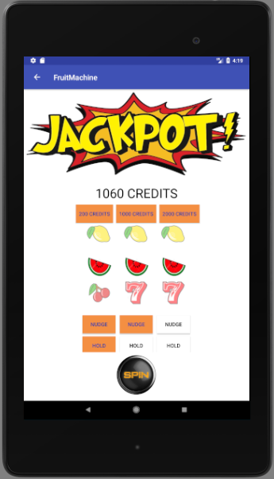
Project Fruit Machine
CodeClan
Java and Android

Slide 2
ProtoPersona: Ricky
Demographic
45 years old
Married
Long-distance HGV driver
£28,000 annual income
Behaviours
Left school at 14: reading is hard
Spends at least 3 nights a week on the road
Enjoys playing the puggies if he can get parked up near a pub
User Needs
As a long-distance truck driver I need a pastime that doesn’t require space so I can fill my downtime
As someone with a drink-driving conviction, I need a way to play the puggies that keeps me away from the pub
As a poor reader, I want an app that allows me to sign up with just a few clicks

Slide 3
ProtoPersona: Jackie
Demographic
30 years old
Single-ish
Pub Franchisee
£15,000 annual income
Behaviours
Loves being behind the bar
Hates admin
Willing to try anything to make money
User Needs
As an ambitious entrepreneur I want a low-contact, scalable, second income stream to boost my earning potential so I can retire at 45
As an admin-hater I want to automate as much as possible so that I can spend time having fun

Slide 4
Ricky has found free WiFi at the truck stop, and has downloaded a new Fruit Machine app...

Slide 5
User Journey
Ricky
  Clicks on the new icon
System
  Displays “Allow in-app purchases ☑”
Ricky
  Clicks on the ☑
System
  Displays app splashscreen with choice of games: 3 or 5 reels, and various image sets
Ricky
  Selects a game, and clicks “play”
System
  Loads main app page with selected reels and images, and starter credits
Ricky
  Clicks spin button
System
  Displays random results on reels, along with nudge/hold options
  Updates credits, winnings etc as play continues

Slide 6
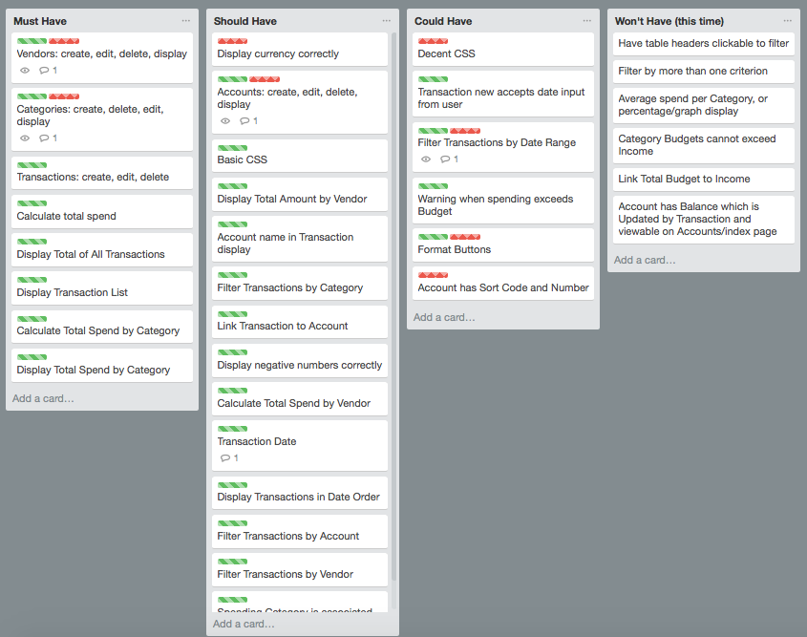
Planning

Slide 7
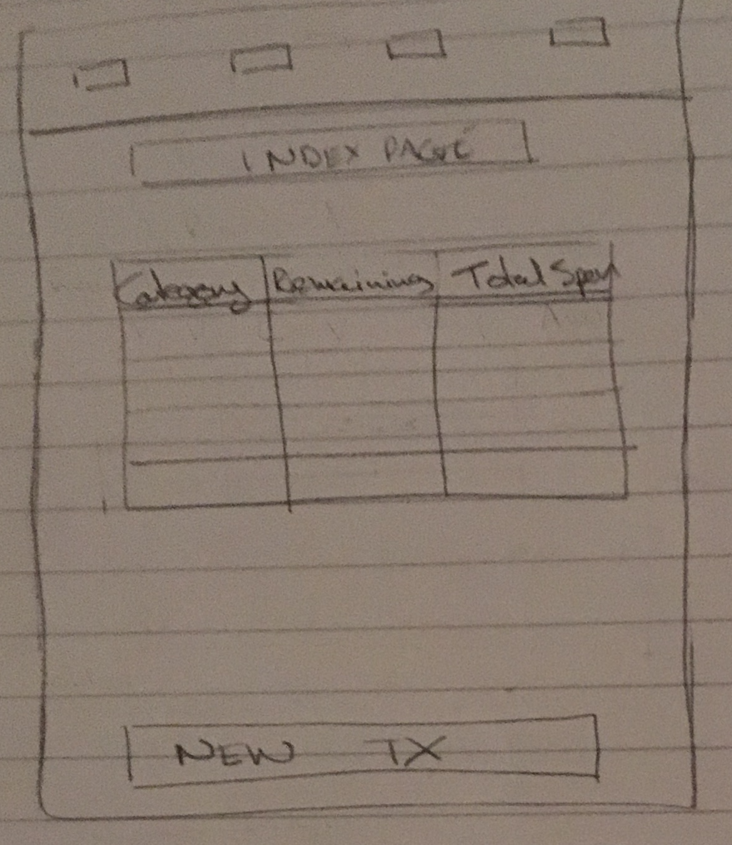
MockUp: Landing Page

Slide 8
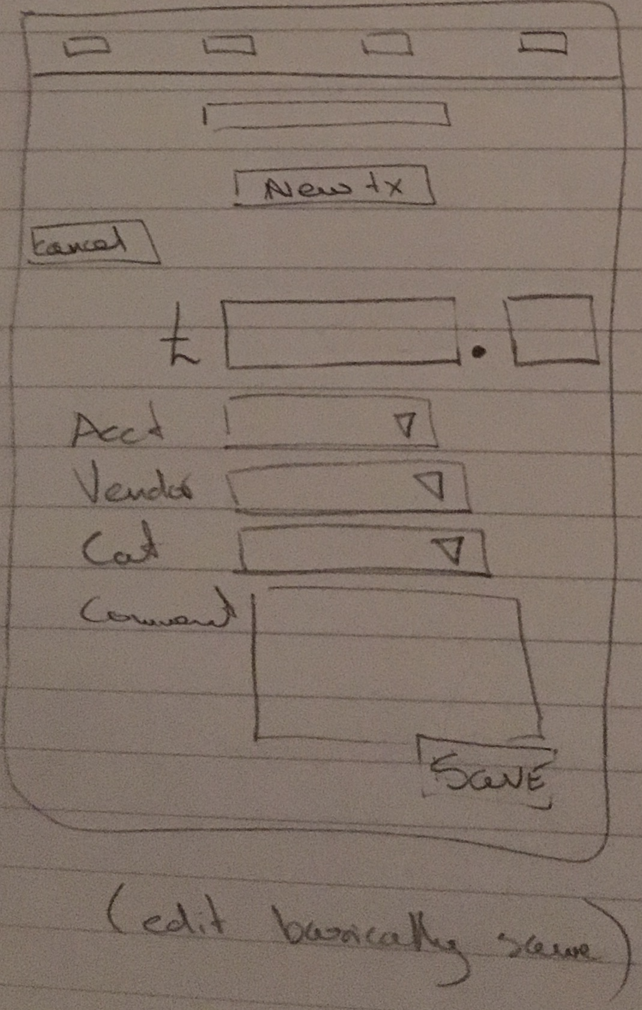
MockUp: New Transaction

Slide 9
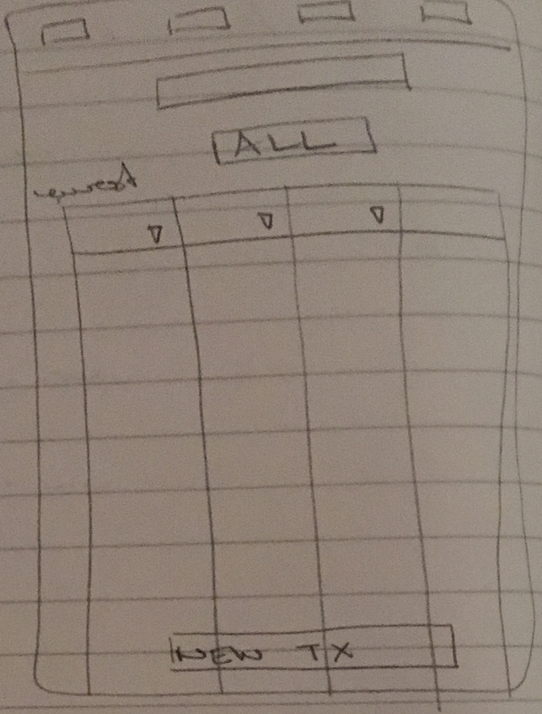
MockUp: All Transactions

Slide 10
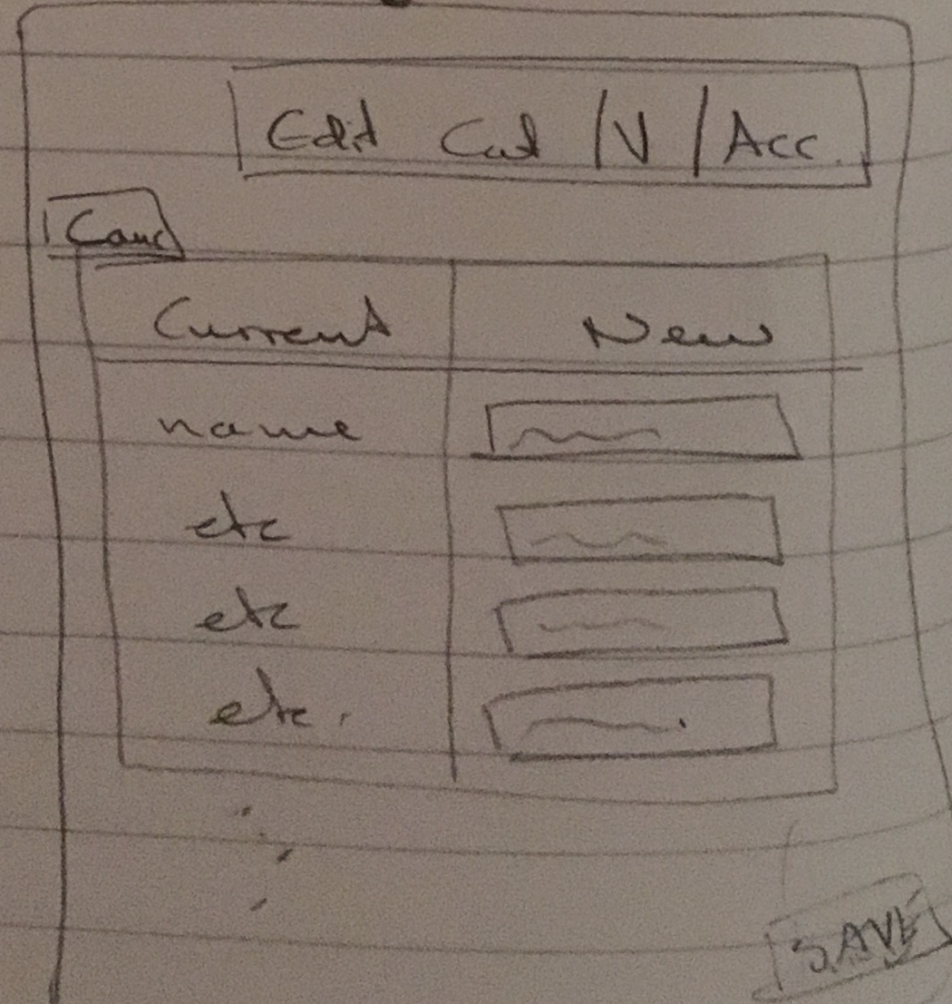
MockUp: Edit Category / Vendor

Slide 11
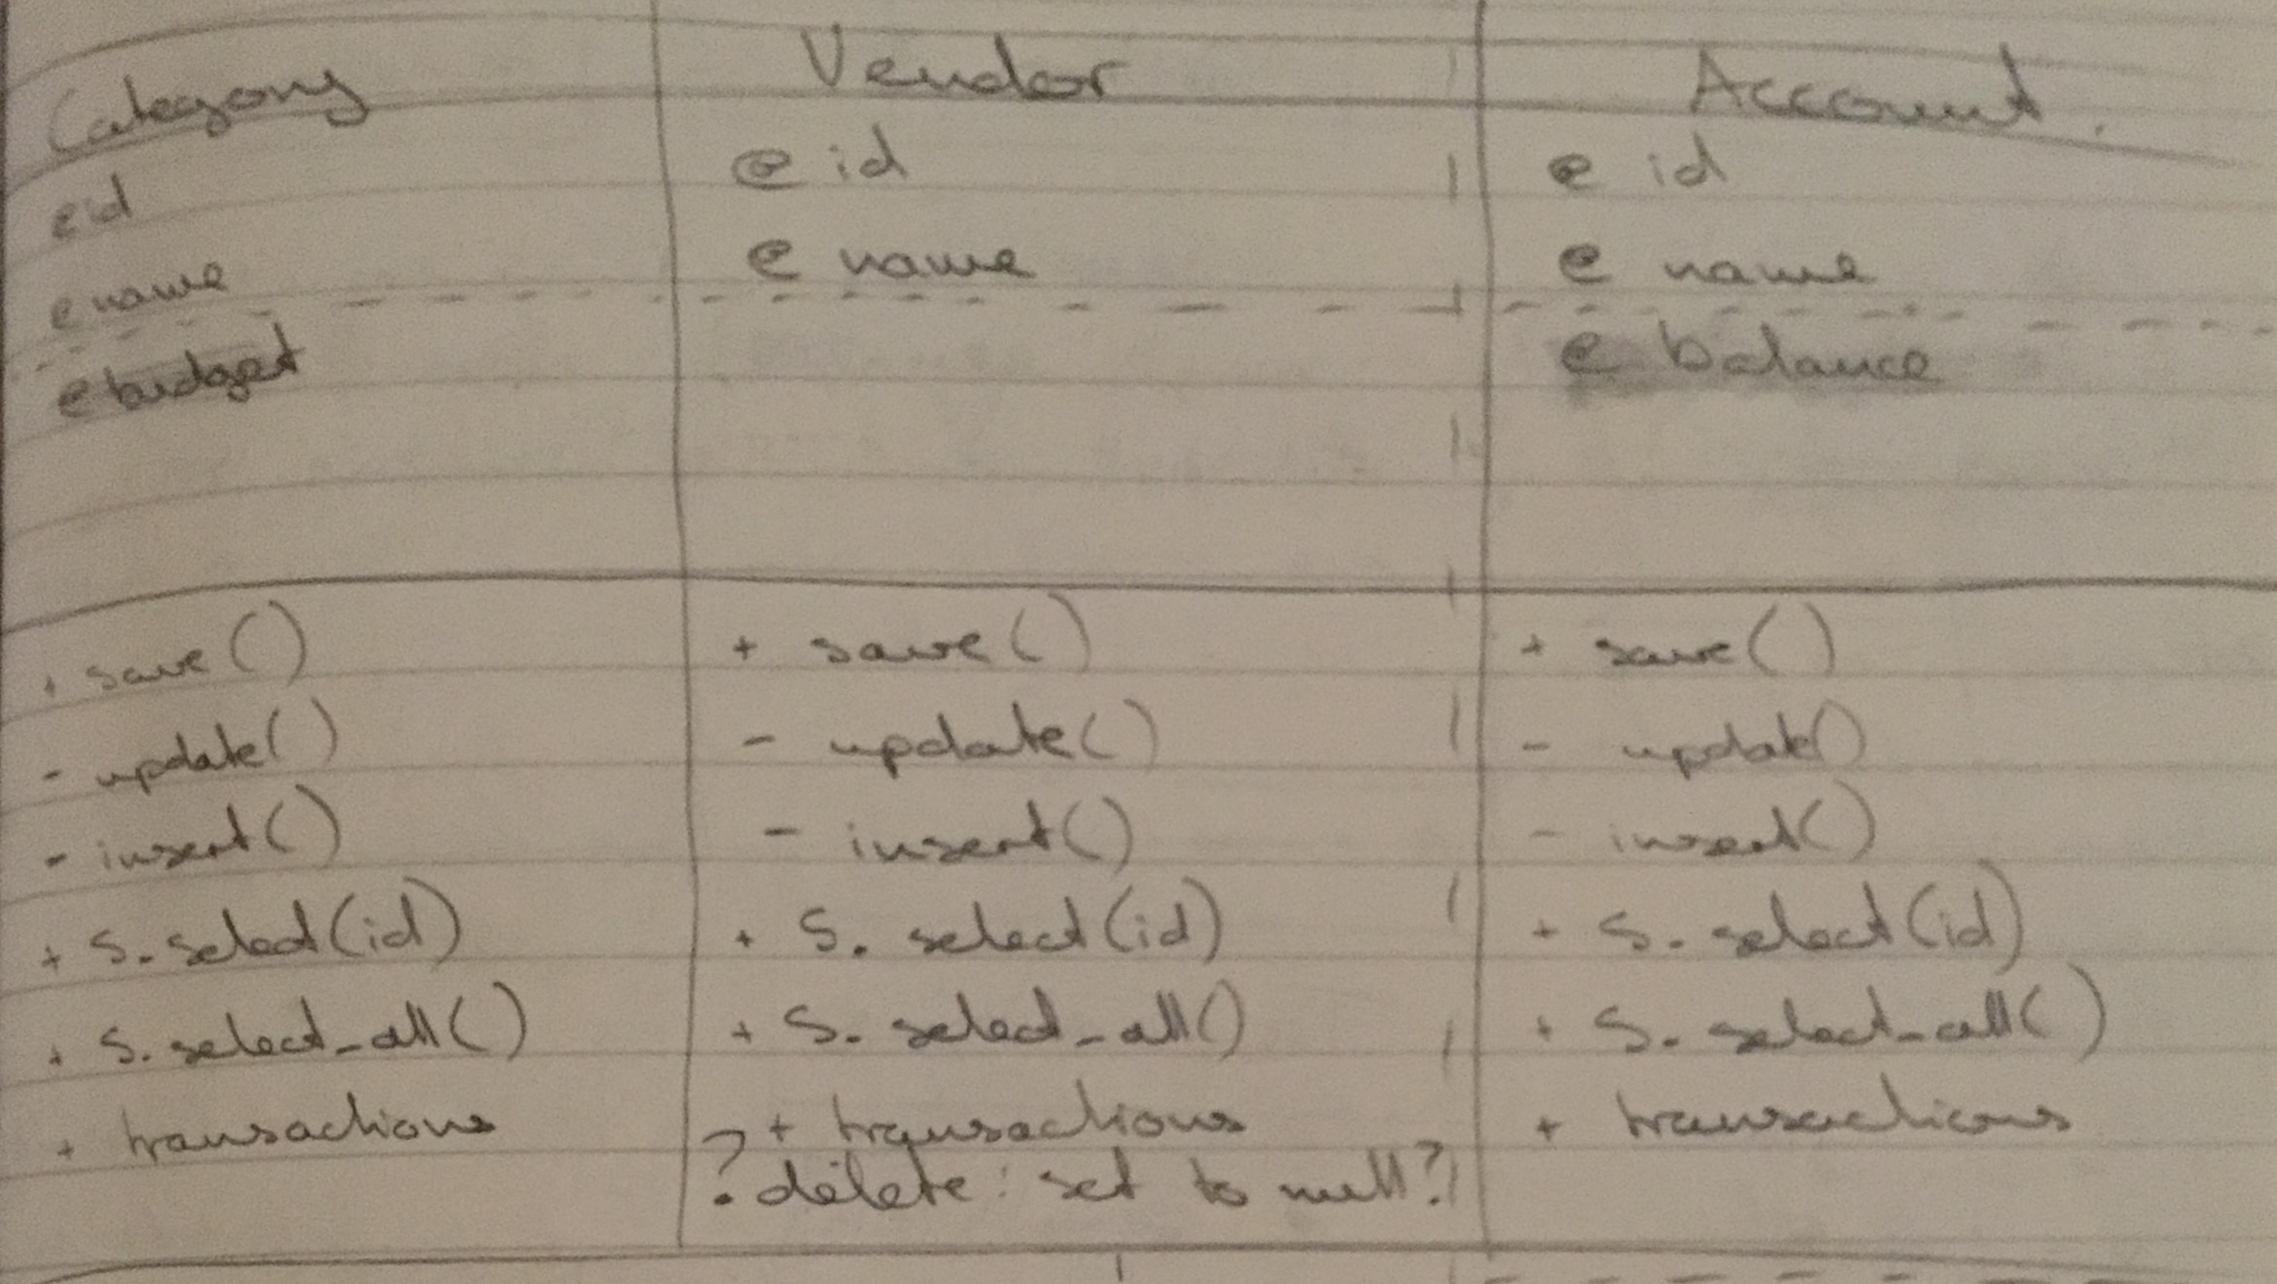
Models: Account, Category, Vendor

Slide 12
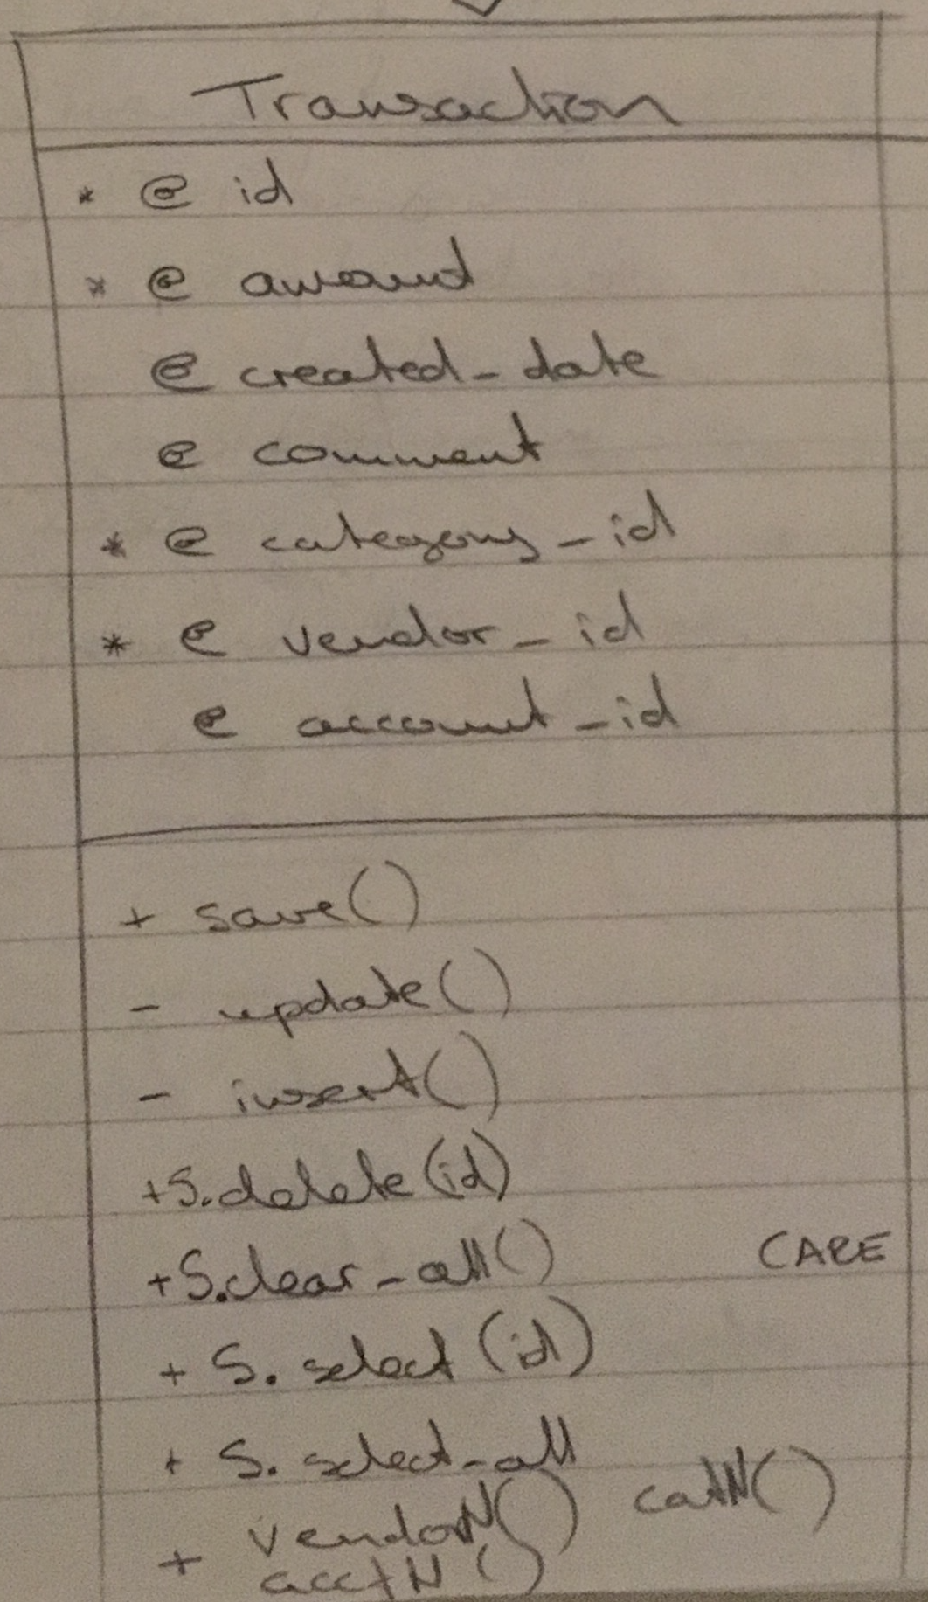
Model: Transaction

Slide 13
Database: Table Categories
Column | Type | Modifiers
--------+------------------------+---------------------------------------------------------
id | integer | not null default nextval('categories_id_seq'::regclass)
name | character varying(255) | not null
budget | numeric(8,2) |
Indexes:
"categories_pkey" PRIMARY KEY, btree (id)
Referenced by:
TABLE "transactions" CONSTRAINT "transactions_category_id_fkey" FOREIGN KEY (category_id) REFERENCES categories(id)

Slide 14
Database: Table Vendors
Column | Type | Modifiers
--------+------------------------+------------------------------------------------------
id | integer | not null default nextval('vendors_id_seq'::regclass)
name | character varying(255) | not null
Indexes:
"vendors_pkey" PRIMARY KEY, btree (id)
Referenced by:
TABLE "transactions" CONSTRAINT "transactions_vendor_id_fkey" FOREIGN KEY (vendor_id) REFERENCES vendors(id)

Slide 15
Database: Table Accounts
Column | Type | Modifiers
--------+------------------------+-------------------------------------------------------
id | integer | not null default nextval('accounts_id_seq'::regclass)
name | character varying(255) | not null
Indexes:
"accounts_pkey" PRIMARY KEY, btree (id)
Referenced by:
TABLE "transactions" CONSTRAINT "transactions_account_id_fkey" FOREIGN KEY (account_id) REFERENCES accounts(id)

Slide 16
Database: Table Transactions
Column | Type | Modifiers
------------------+------------------------+-----------------------------------------------------------
id | integer | not null default nextval('transactions_id_seq'::regclass)
amount | numeric(8,2) |
comment | character varying(255) |
transaction_date | date |
category_id | integer |
vendor_id | integer |
account_id | integer |
Indexes:
"transactions_pkey" PRIMARY KEY, btree (id)
Foreign-key constraints:
"transactions_account_id_fkey" FOREIGN KEY (account_id) REFERENCES accounts(id)
"transactions_category_id_fkey" FOREIGN KEY (category_id) REFERENCES categories(id)
"transactions_vendor_id_fkey" FOREIGN KEY (vendor_id) REFERENCES vendors(id)

Slide 17
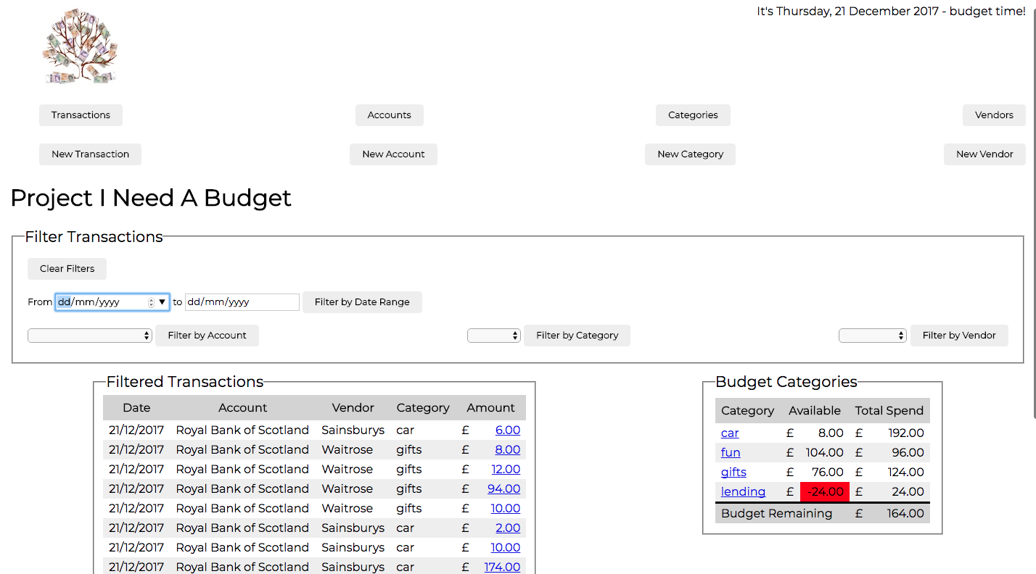
Walkthrough

Slide 18
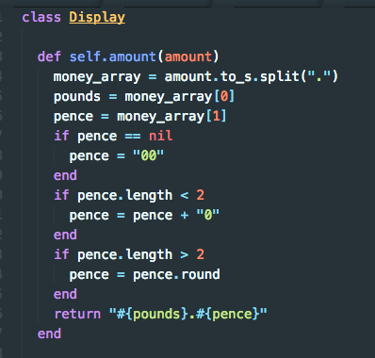
I thought I was being so clever...

Slide 19

Then I googled

Slide 20
I probably should have...
Controllers
  Found a way to hide the ‘delete’ function for anything with a foreign key constraint
Browser
  Worked out how to get consistent display
  Looked at mobile layout
Accounts
  Stored a sort-code and account number

Slide 21
I would have liked to...
Filtering
  More than one criterion
Budgets
  Link to income so you can’t budget what you don’t have
Accounts
  Balance is updated with every transaction
Testing
  Learn how to test functions which call a database

Slide 22
I learned
If you don’t set a timer, your day disappears
Flexbox is almost as unpredictable as CSS
Knowing what to google is a real skill
Cut and paste does not save time
You are never finished

Slide 23
Credits
YNAB
  http://youneedabudget.com
Graham Shaw | TEDxHull
  https://youtu.be/7TXEZ4tP06c

Slide 24
Next?

