Slide 1
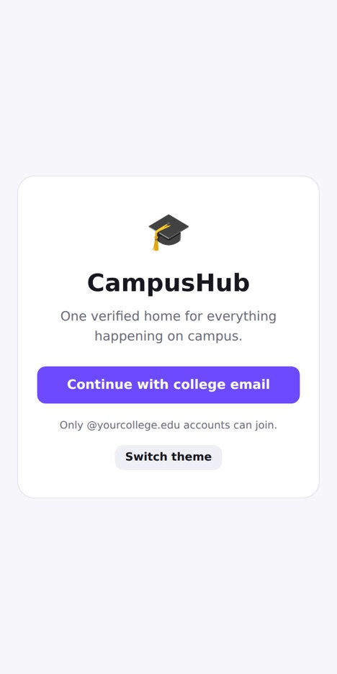
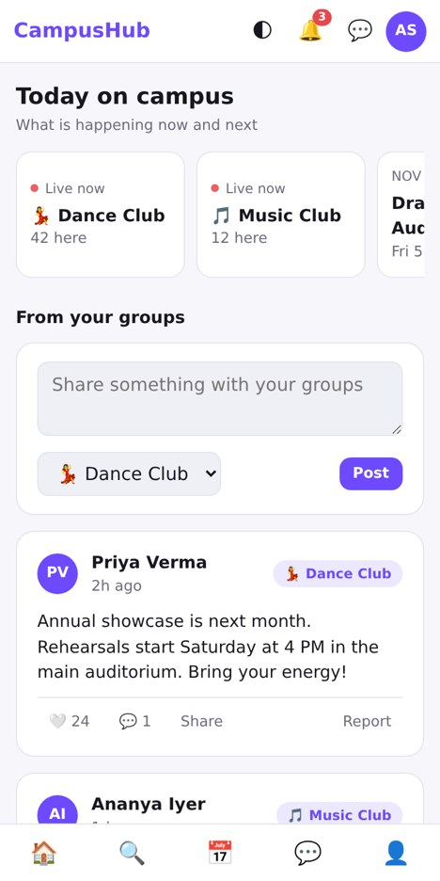
SRI ESHWAR COLLEGE OF ENGINEERING | COIMBATORE
CampusHub
One verified home for everything happening on campus.
Verified students only
Join in one tap
PRESENTED BY CRAZY RHINOS🇳🇵
Rakesh | Anshu | Raj | Ghanshyam | Kamlesh | Priyankaa

Slide 2




Students miss campus opportunities because information is scattered, unverified and hard to act on in time
01 THE PROBLEM
"
Scattered updates
Unverifiable links
Students hear about events after they are over.
Spread across many WhatsApp groups, DMs and notice boards.
Fake or unclear links get forwarded with no way to check them.
Buried files
Missed deadlines
Posters and important documents sink deep in chat history.
Students hesitate to approach clubs and miss sign-ups.
The everyday campus experience

Slide 3
Existing solutions and their gaps
02 EXISTING SOLUTIONS
Channel | How it is used | The gap
WhatsApp groups | Fast announcements inside each club | Hundreds of groups, no search, messages and files get buried
Instagram pages | Posters and reels for public reach | Easy to miss, anyone can post, no club rooms or RSVP
Notice boards | Physical posters across campus | Only seen if you walk past, no reminders or updates
Forwarded links | Forms and sign-ups shared by chat | Unverified and often fake, nobody can tell what is real
No single, verified place to see what is happening on campus today.

Slide 4





One verified home for campus life
03 PROPOSED SOLUTION
Verify
Discover
Join
Sign in with a verified college email, so only real students get in.
The home page shows what is live today and what is happening next.
Join any club in one tap, no forms and no forwarded links.
Public Stage
Members-only Backstage
Open to every verified student: club posts, showcases and upcoming events.
Tasks, planning and chat for members, kept out of public view.

Slide 5




Everything a club needs, in one place
04 KEY FEATURES
Verified login
Today on campus
One-tap join
College-email sign-in keeps the community students-only.
Live-now and up-next events front and centre on Home.
Join a club instantly from Explore, with member counts visible.
Events and RSVP
Stage and Backstage
Trust and safety
See dates, venues and who is going, then RSVP in a tap.
Public feed for everyone, private tasks and chat for members.
Report button, moderator review and instant notifications.

Slide 6
A simple three-layer design
05 SYSTEM ARCHITECTURE
1 Client
2 Services
3 Data
Home and Today feed
Verified email login
Browser storage
Explore and Events
Clubs and membership
Cloud database
Club rooms and Messages
Events and RSVP
Profile and alerts
Posts and club chat
Live notifications
Built in prototype
Planned for the pilot

Slide 7

From sign-in to the club room in five taps
06 WORKFLOW
1
2
3
4
5
Verified login
Discover clubs
Join in one tap
Events and RSVP
Post and chat
Sign in with your college email
Browse Explore and see who is live now
Become a member instantly
See what is next and save your spot
Take part in the club room
No links to forward and nothing to hunt for: every step starts on the Home screen.

Slide 8





Technology stack and implementation
07 TECHNOLOGY
Built in the prototype
Planned for the pilot
HTML5 and CSS3
College-email auth
Mobile-first layout with light and dark themes
Domain-restricted, verified sign-in
Vanilla JavaScript
Cloud database
Single-page navigation, state and rendering
Shared data for clubs and members
Browser storage
Live notifications
Keeps joins, RSVPs and posts between visits
Real-time push for new posts and events
In-app alerts
Roles and moderation
Notification panel and unread badges
Club admins and reviewed reports

Slide 9
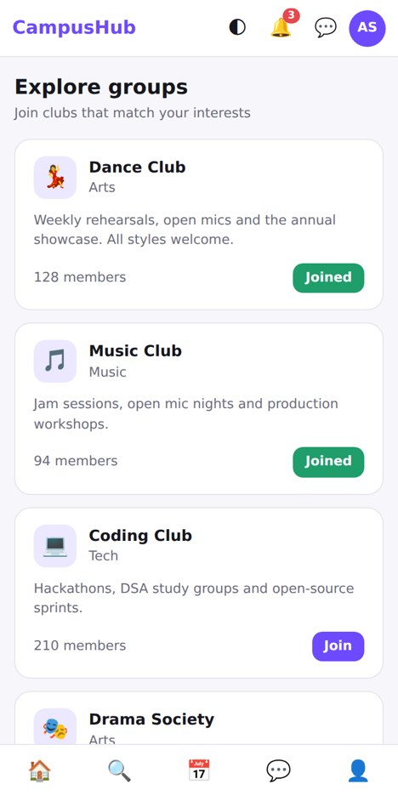
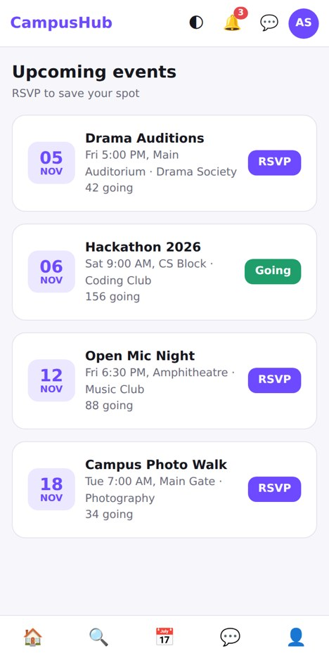
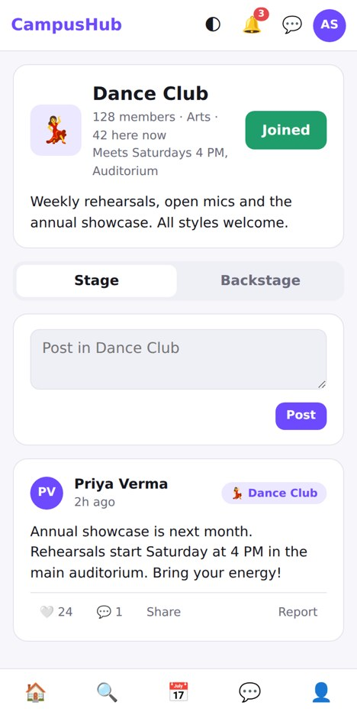
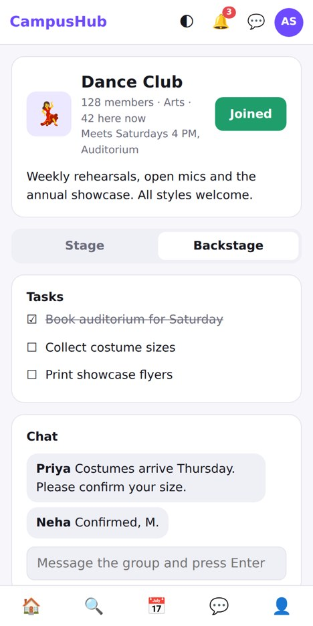
A working prototype you can click through
08 PROTOTYPE
Home
Explore
Events
Stage
Backstage
Today on campus
Join in one tap
RSVP with one tap
Public club feed
Tasks and member chat

Slide 10
Why CampusHub is different
09 INNOVATION
 | CampusHub | WhatsApp | Instagram
Verified students only | Yes | No | No
Event discovery in one place | Yes | No | Partial
Club rooms with public and private areas | Yes | Partial | No
Fake links reduced | Yes | No | No
Not another chat group: a verified layer built for how clubs actually work.

Slide 11



Feasible now, valuable to everyone
10 FEASIBILITY, IMPACT, SCALE
Feasible
Impact
Scalable
A working prototype already exists. Real login and a database are the main build, and the pilot starts small with 5 clubs.
Students stop missing events, clubs reach members in one place, and the college gets one trusted channel.
The verified-domain model repeats for any club, department or college, with no redesign needed.
5 clubs at SECE
All SECE clubs
Other colleges

Slide 12

Where we are and what comes next
11 STATUS AND ROADMAP
Working today
Build
1
Real database, email login and live notifications.
Login, Home, Explore, Events, Messages, Profile
Join clubs and RSVP in one tap
Pilot
2
Launch with 5 clubs at SECE.
Stage and Backstage club rooms
Learn and grow
3
Posts, likes, comments, reports, alerts
Collect feedback from 50 students, then open to more clubs.

Slide 13
THANK YOU
"Students shouldn't have to hunt for their own campus."
THE ASK
Pilot with 5 clubs at SECE and gather feedback from 50 students.
Rakesh | Anshu | Raj | Ghanshyam | Kamlesh | Priyankaa

