Slide 1

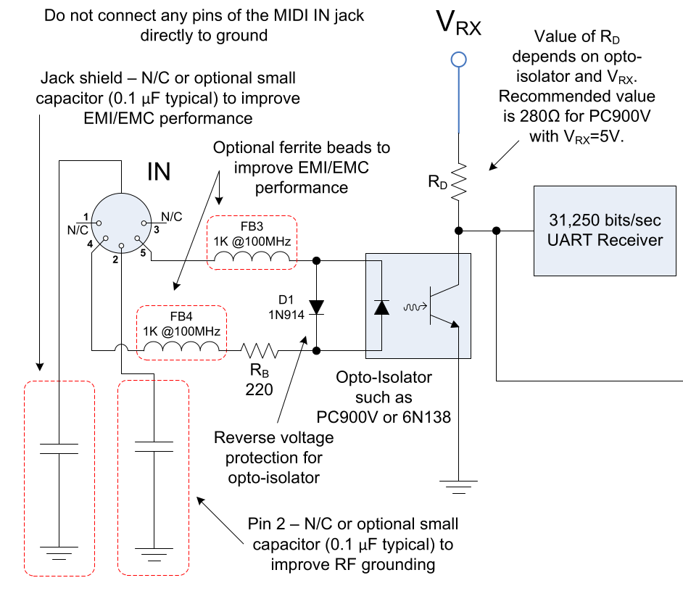
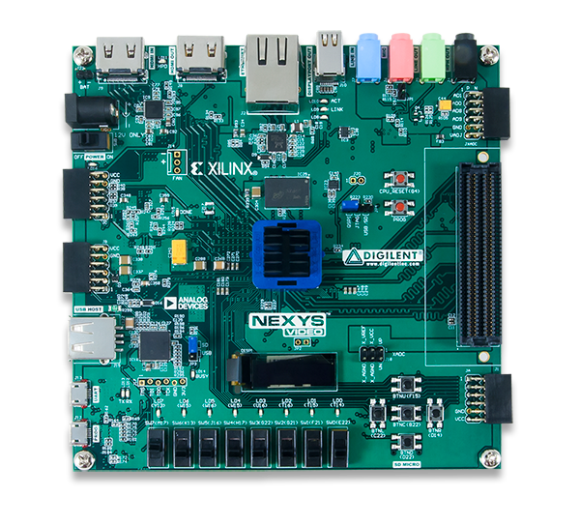
Audio to headphones or speaker
PMOD into board which implements the UART Receiver
Computer Control

