Slide 1


DeathRay: A hardware test platform Preliminary Design Review
Vanderbilt University, March 15th 2012

Slide 2
Group Members: Nadiah Zainol Abidin Anas Alfuntukh Jack Minardi Customer/Sponsor: Institute of Space and Defense Electronics (ISDE) Advisor: Prof. Daniel Loveless, Research/Develop Engineer

Slide 3
Agenda
Overview
Graphical User Interface Design
Hardware Control
Modularity
API
Robustness
Testing
Challenges

Slide 4
Statement of Work
The goal of this project is to design a graphical user interface to control and visualize integrated circuits radiation experiments in real time
Why does it have to be in real time?
Detect any kind of error at early stage
Device under testing
Equipment malfunction
What are the advantages of using this software?
Save time
Save $$$$

Slide 5
Graphical User Interface Goals
Be able to set up new experiments
Be able to save experiment configurations
Be able to poll active hardware [DONE]
Be able to plot in real time while accessing data [~DONE]
Be able to load in configuration of previous experiments
Be able to access data from previous experiments [DONE]
Be able to integrate GPIB control with FPGA scripts
Fully implement power supply, digital multimeter, oscilloscope [~DONE]

Slide 6
Draft of GUI design
Welcome Window
Data
Experiments
List of experiments
New Experiment
Load Experiment
Configure settings
Saved configurations
Data of experiment
(read only)
confirm
Edit/confirm
Run analysis window

Slide 7
Flow of the GUI (aim)

Slide 8
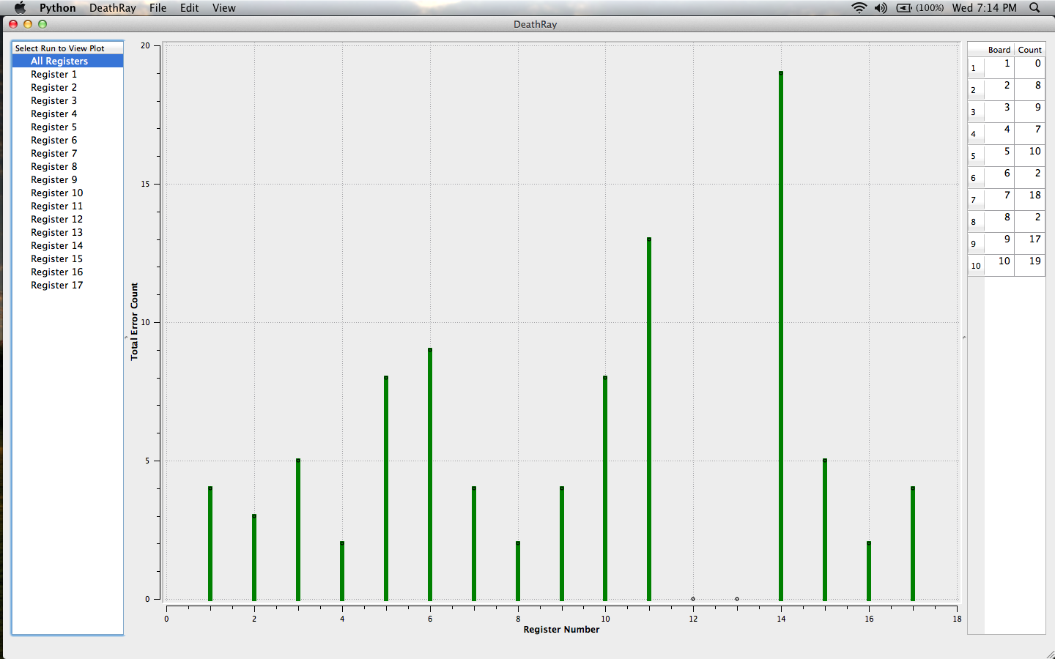
Current GUI progress

Slide 9
Hardware Control
So how does the software communicate with the hardware?
Series of commands using the GPIB
Series of tools using the FPGA

Slide 10
FPGA control
3.3 V
SE Test System (made of several components)
I/O
FPGA
GND
USB/serial
Computer
DUT

Slide 11
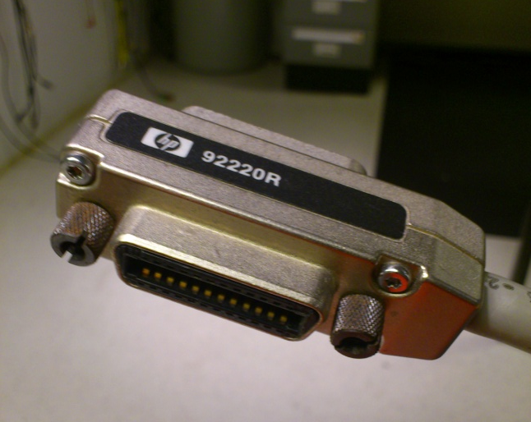
GPIB Control
‘General Purpose Interface Bus’
The de facto standard of controlling hardware using a PC
A bus system for Test and Measurement applications
This networked system has all features that are required to create a measurement system.
Remote control of instruments, real-time response capability, data handshake for reliable operation are few of the features of the GPIB.

Slide 12
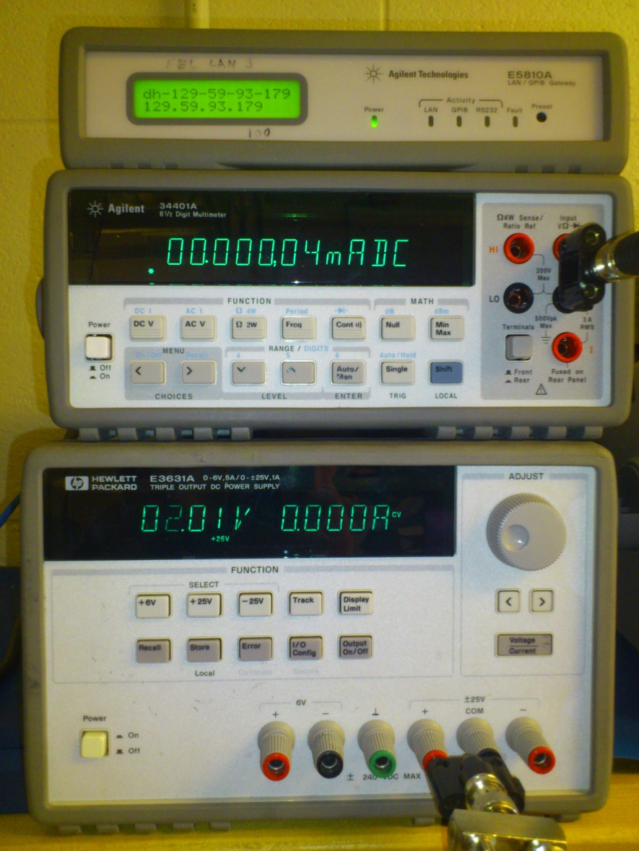
Hardware
GPIB gateway
Digital multimeter
hp34401a
DC power supply
hpe3631a

Slide 13
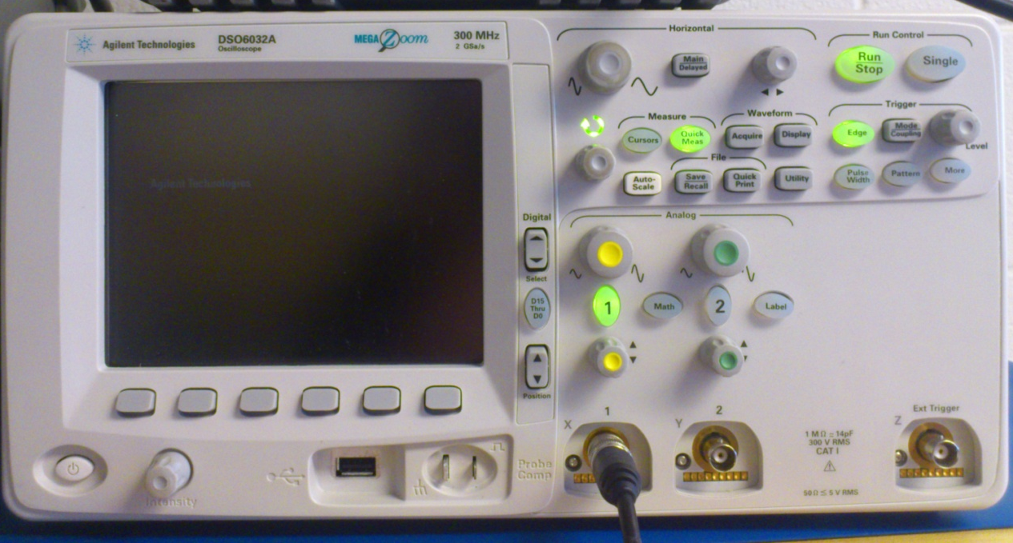
Hardware
Oscilloscope
dso6032a

Slide 14
GPIB: SCPI commands
Standard Commands for Programmable Instruments
standard for syntax and commands to use in controlling programmable test and measurement devices
SCPI commands to an instrument may either perform a set operation (e.g. switching a power supply on) or a query operation (e.g. reading a voltage)
Example:
Set operation on oscilloscope
TRIGger:MODE <mode>
the type of mode can be selected from the following option:
<mode> ::= {EDGE | GLITch | PATTern | CAN | DURation | I2S |IIC | EBURst | LIN | M1553| SEQuence | SPI | TV | UART| USB | FLEXray}
query operation on oscilloscope
TRIG:MODE?

Slide 15
Modularity
What is modularity?
Subdivide the modules by commands because one command can work with multiple device
should be easy for user to write new commands for new device
Easy for extending the software in the future

Slide 16
API
class FileProcessor:
def init(self, filesList):
self.filesList = filesList
#Fill in the following
self.processedData = [{}]
self.displayData = []
self.tableData = []

Slide 17
API
Have access to 4 plot windows
Uses PyQwt plotting library
Easy to modify
View is based off of the tree list
Documentation and sample code

Slide 18
Robustness
Software has to be robust from:
People who are not familiar with the program
People who wants to hack the program
People who might try to break the program on purpose
How?
Checking method
Documentation (user manual, developer manual)
Hide implementation details (such as GPIB)
Sanitizing inputs
Notes:
Specified choices of the users

Slide 19
Assumptions
User sets up physical GPIB devices
Will not be used for publication quality plots
User will process FPGA data (in python)
Access to FGPA output files

Slide 20
Challenges
Device SCPI (data_acquisition)
- Return ‘15’ error: does not help us detect error if ‘junk’ was written
Inconsistency in the user manual
-Time Scale issue for oscilloscope (starts at 2ns instead of 500ps)
Testing
-unit testing
-user testing
Building software with dumb user expectation
Security
Dealing with failing hardware

Slide 21
Testing
Unit testing: need to figure out how to do this
User Testing: Trial period for candidates to use it for 2 weeks (Date: 22 March → 5 April)
- Receive feedback from candidates
- user manual (after GUI is fully completed, use feedback)
- developers manual for adding new device (ongoing)
- Use feedback for improvising the program in the future

Slide 22
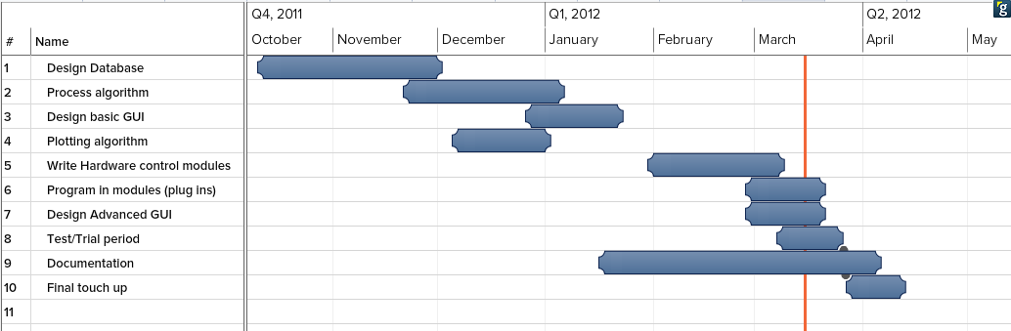
Timeline of Work
Are we on track? Yes!

Slide 23
Questions?

