Slide 1
Deathray: A hardware test platform Preliminary Design Review
Vanderbilt University, March 15th 2012

Slide 2
Group Members: Nadiah Zainol Abidin Anas Alfuntukh Jack Minardi Customer/Sponsor: Institute of Space and Defense Electronics (ISDE) Advisor: Prof. Daniel Loveless, Research/Develop Engineer

Slide 3
Agenda
Overview
Graphical User Interface Design
Hardware Control
Software Design
Robustness
Testing

Slide 4
Statement of Work
The goal of this project is to design a graphical user interface to control and visualize integrated circuits radiation experiments in real time
Why does it have to be in real time?
What are the advantages of using this software?

Slide 5
Graphical User Interface Goals
Be able to set up new experiments
Be able to save experiment configurations
Be able to access data from hardware testing done in real time and plot in real time
Be able to load in configuration of experiments done in the past
Be able to access data from experiments done

Slide 6
Draft of GUI design
Welcome Window
Data
Experiments
List of experiments
New Experiment
Load Experiment
Configure settings
Saved configurations
Data of experiment
(read only)
confirm
Edit/confirm
Run analysis window

Slide 7
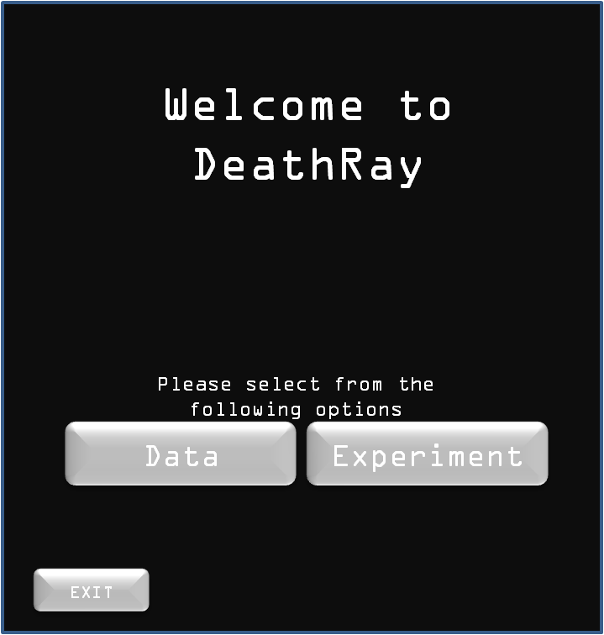
GUI Design-11 slides or how do we display this?

Slide 8
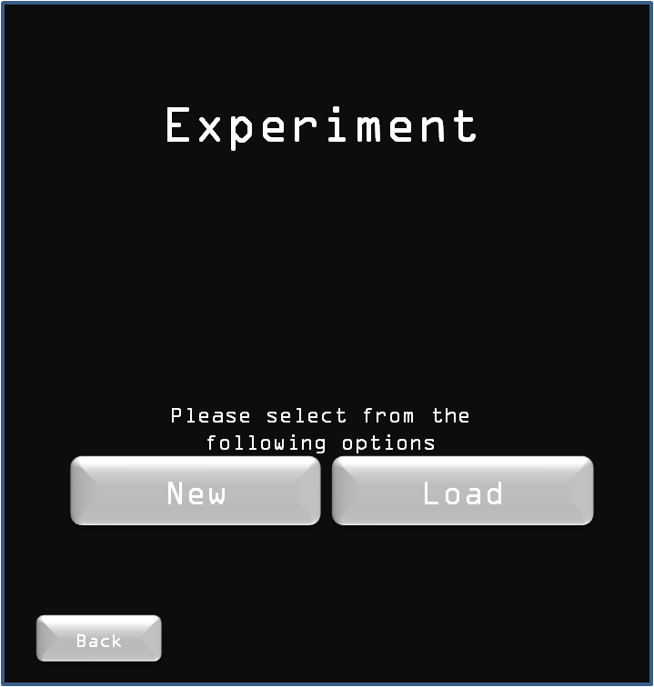
GUI Design

Slide 9
Current GUI progress

Slide 10
Hardware Control
So how does the software communicate with the hardware?
Series of commands using the GPIB
Series of tools using the FPGA

Slide 11
FPGA control
3.3 V
SE Test System (made of several components)
I/O
FPGA
GND
USB/serial
Computer
DUT

Slide 12
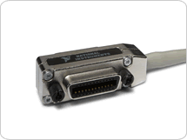
GPIB Control
The de facto standard of controlling hardware using a PC

Slide 13
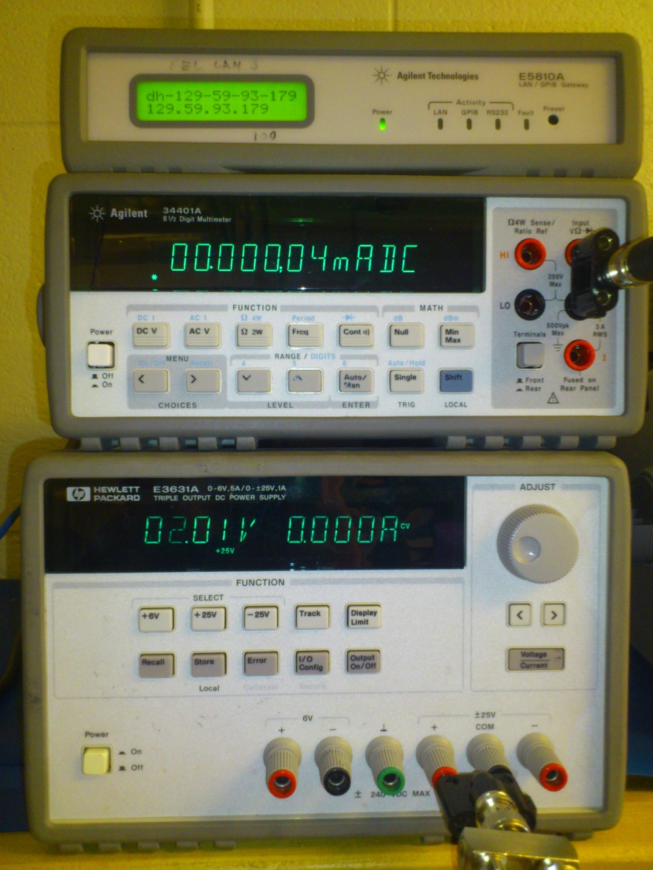
Hardware
Gpib
Digital multimeter
hp34401a
DC power supply
hpe3631a

Slide 14
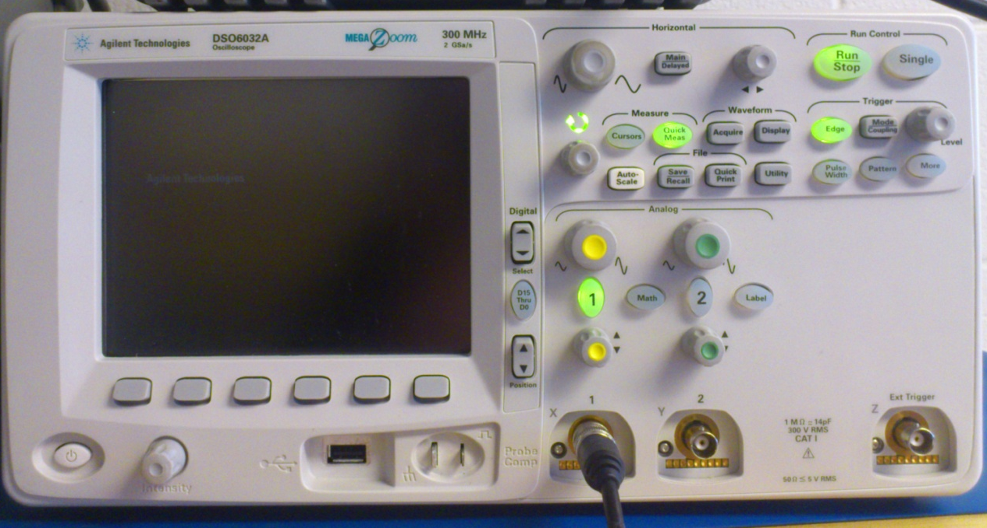
Hardware
- Oscilloscope
dso6032a

Slide 15
GPIB: SCPI commands
What is it
Why we use it
Examples

Slide 16
Software Design
How to make it modular?
Modules for each device
-documentation so everything is standardized

Slide 17
Robustness
Software has to be robust from people:
who are not familiar with the program
who wants to hack the program
who might try to break the program on purpose
How?
Checking method
Documentation (user manual, developer manual)
Expectation for dummy users

Slide 18
Testing
Trial period for candidates to use it for two weeks
- user manual (after GUI is complete)
- developers manual (ongoing)
Receive feedback from candidates
Use feedback for improvising the program in the future

