Slide 1

DOCTOR APPOINTMENT SYSTEM
Presented By
Yogesh Chandwani(171500402)
Sumit Singh(171500347)
Saurabh Kumar(171500301)

Slide 2
CONTENTS
Introduction to project
What is MEAN ?
Why MEAN ?
Packages used in Node
Project Structure
Data Flow
Working of Project

Slide 3
Introduction to Project
Sometimes the task becomes very tedious for the compounder or doctor himself in manually allotting appointments for the customer as per their availability.
The patients faces many problem while requesting a appointment.
This project offers an effective solution where customers can view many booking slots available and select preferred date and time. Therefore we came with this project

Slide 4

What is MEAN ?
MEAN is the acronym of four softwares
MongoDB for storing data
Express js for connecting Front End and Back End
Angular for Fast manipulation of DOM.
Node js for Back End

Slide 5
Why MEAN ?
MEAN is open source .
MEAN allows the developers to write code in only one language which is JavaScript for both client and server side which makes it a simple and fast language.
Angular provides for fast DOM (Document Object Model ) manipulation.
Node js allows us to write API’s in javascript which executes on server side.
MEAN uses common JSON format of data everywhere.
Developing applications using Mean saves your lot of time and this it does because it has an infinite set of module libraries for Node.js

Slide 6
Packages used in Node
Cors (cross origin request server)
Body Parser for converting the data in JSON format.
Sha1 for password Encryption.
Multer for uploading an image.
Nodemailer for automatically sending an email.
Mongoose for connectivity of database
Nodemon for automatically restart your node application after several changes made in API’s file.
Express provides small, robust tooling for HTTP servers,

Slide 7
Project Structure
Our project is mainly divided into three panels
1)ADMIN PANEL: Admin can login and manipulate patient’s and doctor’s details.
2)DOCTOR PANEL: Doctor can login and can accept or reject appointments.
3)PATIENT PANEL: Patient can login and can book appointment.

Slide 8
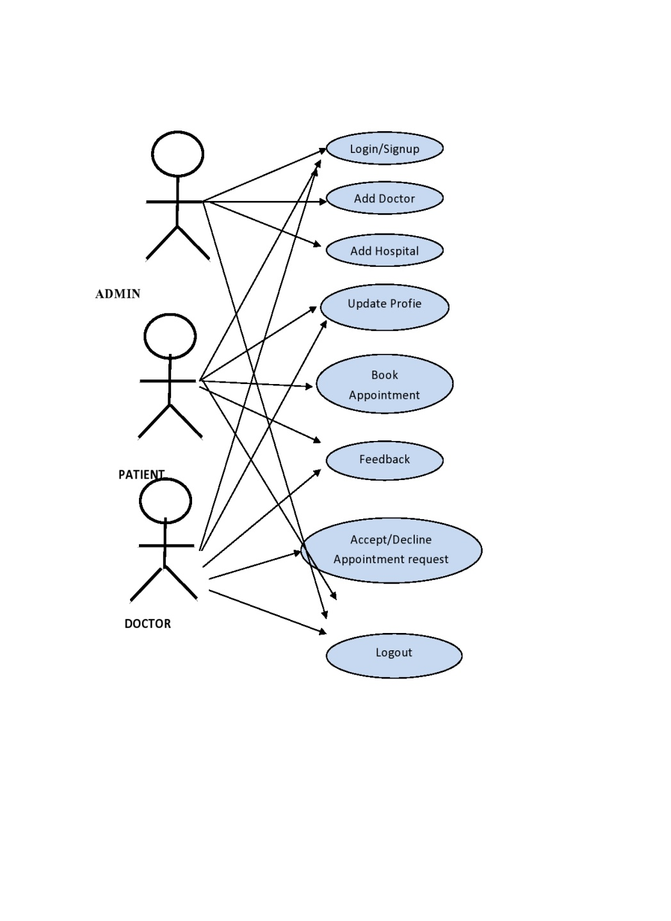
Data Flow use case Diagram

Slide 9
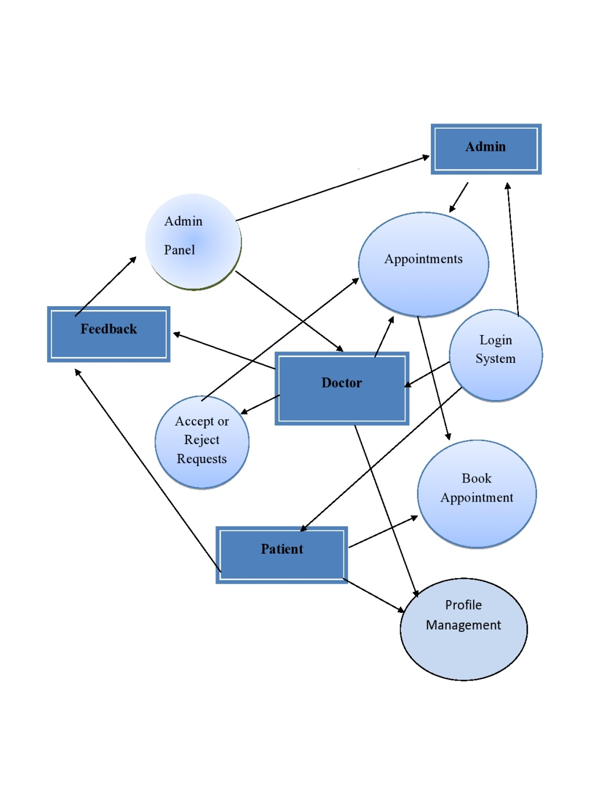
Level One DFD

Slide 10
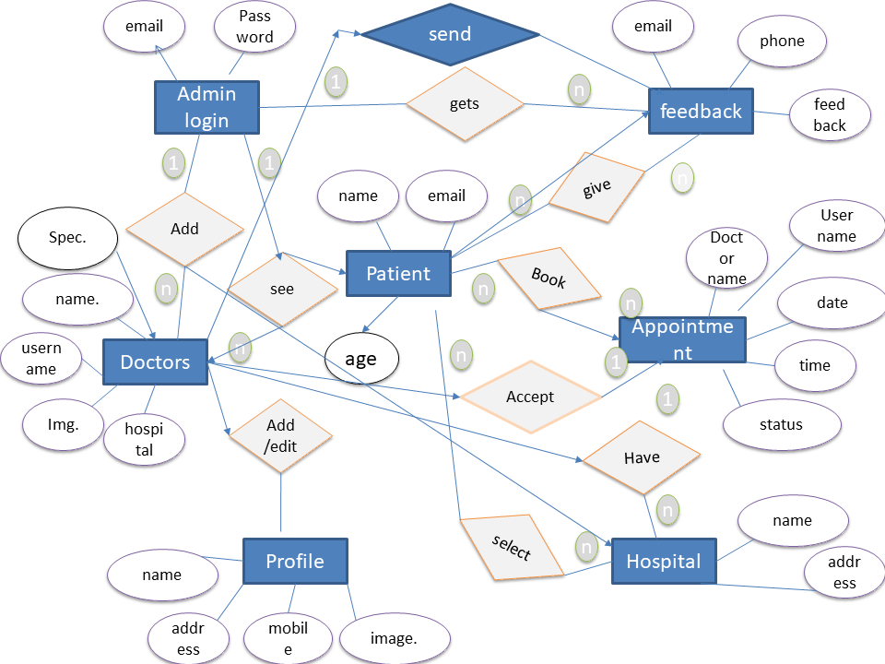
ER diagram

Slide 11
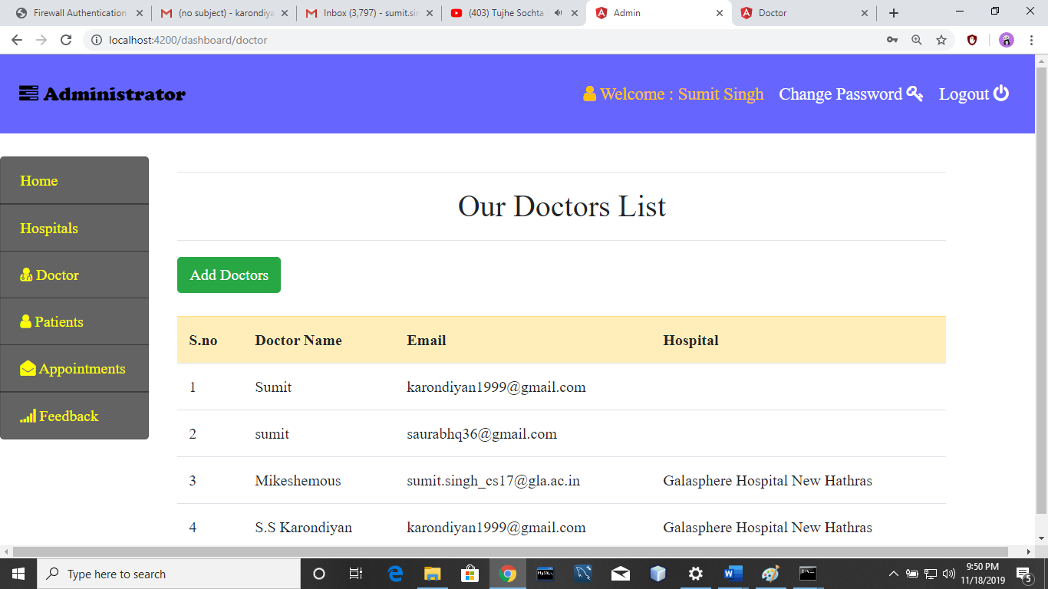
Working of Project
First Admin add doctors after successfully login which will be displayed to the patients.

Slide 12
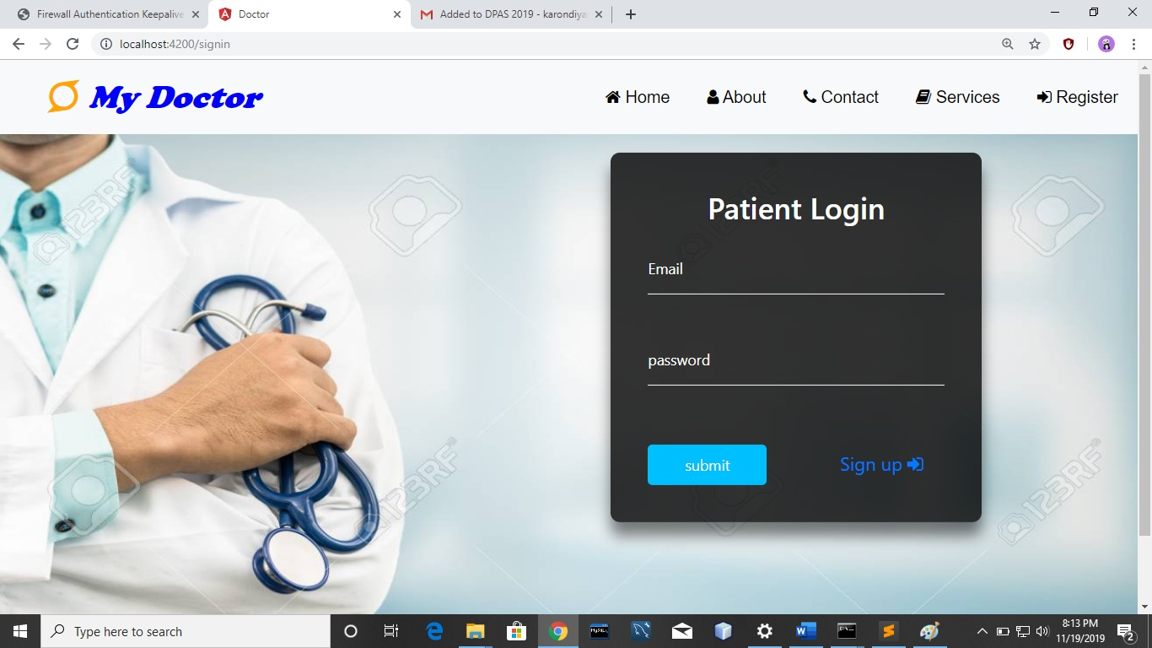
Working of Project
Patient can login through this portal.

Slide 13
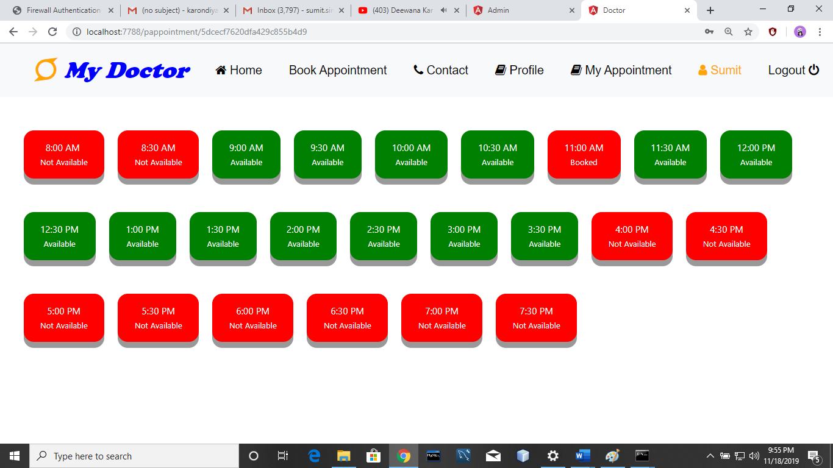
Working of Project
After successfully login patient book an appointment by selecting available slots.

Slide 14
THANK YOU

