Slide 1














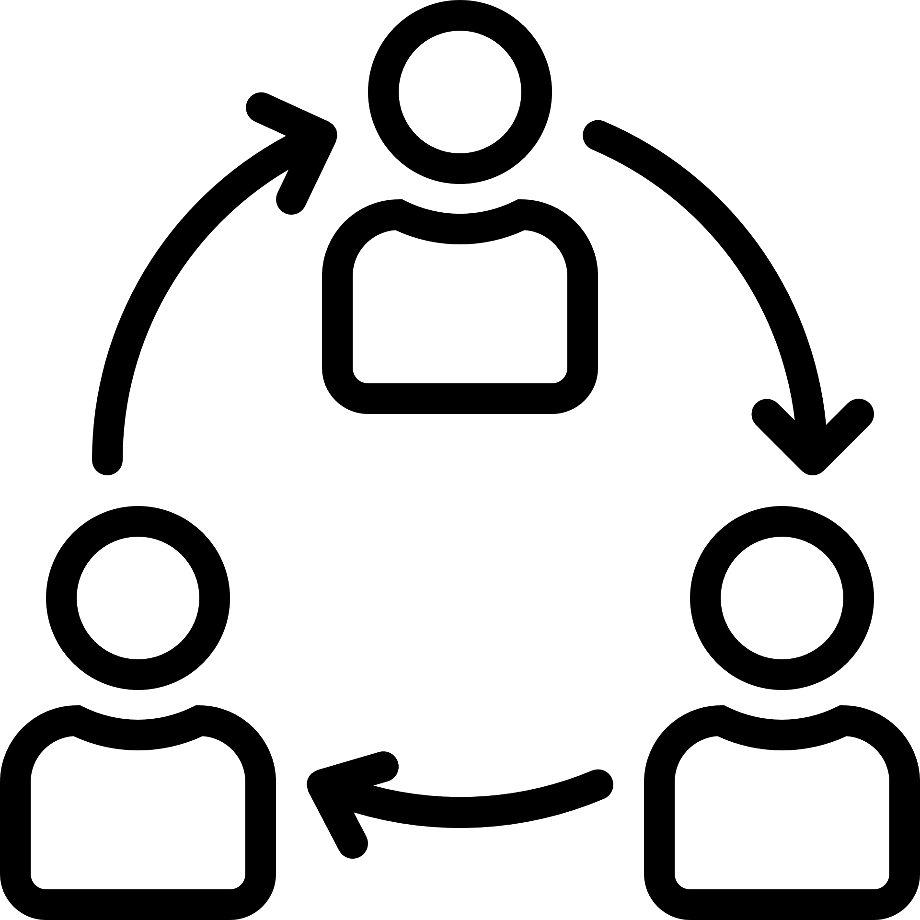


The Scrum Team
Consist of a Product Owner, the Development Team, and a Scrum Master
Self-organizing and cross-functional
Designed to optimize flexibility, creativity, and productivity
Deliver products iteratively and incrementally, maximizing opportunities for feedback
Product Owner
Development Team
Scrum Master
Creativity
Incrementally &
Maximizing
Feedback
Self-Organizing & Cross-Functional
Productivity
Ref : Icon made by mynamepong from www.flaticon.com

Slide 2



The Scrum Team : The Product Owner
One person, not a committee
Maximizing the value of the product
Managing the Product Backlog
Clearly expressing Product Backlog items
Ordering & Prioritizing the items
Optimizing the value of the work the Development Team performs
Visible, transparent, and clear to all
Ensuring the Development Team understands items
The entire organization must respect his or her decisions
No one can force the Development Team to work from a different set of requirements, Except the product owner
Product Owner
Product Owner Team

Slide 3
The Scrum Team : The Development Team
Create the Increment
Delivering a potentially releasable Increment of “Done” product at the end of each Sprint
Self-Organizing & Cross-Functional
Overall efficiency and effectiveness
No titles & No sub-teams
Specialized skills and areas of focus, but accountability belongs to the Development Team as a whole
Development Team

Slide 4


The Scrum Team : The Development Team : Development Team Size
Small enough to remain nimble and large enough to complete significant work within a Sprint
Development Team
Scrum Master
Product Owner
Development Team
3 – 9 team members
The Product Owner and Scrum Master roles are not included

Slide 5
The Scrum Team : The Scrum Master
Servant-leader for the Scrum Team
Promoting and supporting Scrum as defined in the Scrum Guide
Helping everyone understand Scrum theory, practices, rules, and values
Helps everyone change these interactions to maximize the value
Scrum Master

Slide 6
The Scrum Team : The Scrum Master : Service to the Product Owner
Ensuring that goals, scope, and product domain are understood
Finding techniques for effective Product Backlog management
Helping the Scrum Team understand the need for clear and concise Product Backlog items
Ensuring the Product Owner knows how to arrange the Product Backlog to maximize value
Understanding and practicing agility
Facilitating Scrum events as requested or needed
Product Owner
Scrum Master
Product Owner Team

Slide 7
The Scrum Team : The Scrum Master : Service to the Development Team
Helping the Development Team to create high-value products
Removing impediments
Coaching the Team in organizational environments in which Scrum is not yet fully adopted and understood
Scrum Master
Development Team

Slide 8



The Scrum Team : The Scrum Master : Service to the Organization
Leading and coaching
Planning Scrum implementations
Helping employees and stakeholders understand and enact Scrum
Causing change that increases the productivity of the Scrum Team
Working with other Scrum Masters
Scrum Master
Organization

