Slide 1
TROPISM
Plants generally react to the changes that occur in their environment. There are some environmental factors that cause clearly visible changes in plants. Two of these environmental factors are:
light
Gravity
These environmental factors are referred to as external stimuli.

Slide 2
A common effect of light and gravity on plants is an alteration of the direction of plant growth.
Such alteration in the direction of growth often results in a bending or curving of part of the plant either away from or towards the source of the particular environmental factor.

Slide 3
Tropism is a growth movement whose direction is determined by the direction from which the stimulus strikes the plant.
Positive = the plant, or a part of it, grows in the direction from which the stimulus originates.
Negative = growth away from the stimulus.
Plants respond to:
Light = phototropism
Stems are positively phototropic.
Roots are negatively phototropic.
Gravity = gravitropism
Stems are negatively gravitropic.
roots are positively gravitropic.

Slide 4
The adaptive value of these tropisms is obvious.
Roots growing down and/or away from light are more likely to find soil, water, and the minerals they need.
Stems growing up into the atmosphere will be able to expose the leaves to light, so that photosynthesis can occur.

Slide 5
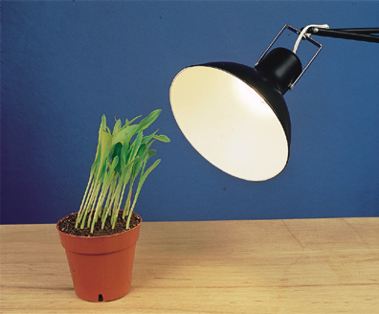
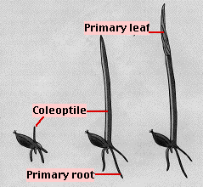
PHOTOTROPISM
The phenomenon of bending or curvature of plant or parts of plant in response to unilateral light is known as phototropism.
The initial discovery of phototropism was by Charles Darwin and his son Francis in 1880.
They used grass seedlings for their experiments.

Slide 6
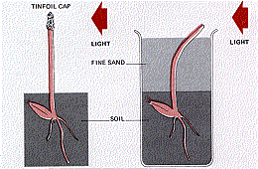
The Darwins studied only the responses of the coleoptile to the light stimulus. In their experiments they found that the tip of the coleoptile was necessary for phototropism but that the bending takes place in the region below the tip.
When they placed an opaque cover over the tip, phototropism failed to occur even though the rest of the coleoptile was illuminated from one side.
However, when they buried the plant in fine black sand so that only its tip was exposed to unilateral, there was no interference with tropism — the buried coleoptile bent in the direction of the light.

Slide 7
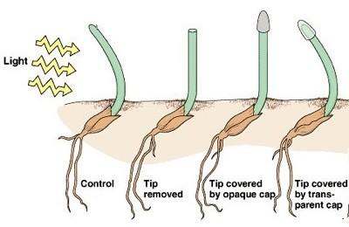
In further experiments with the reed canary grass and oat it was observed that curvature did not occur in reed canary grass when the tip of the coleoptiles was cut off.
Secondly when the tip was covered with an opaque cap no curvature was seen but
when the tip was covered with a transparent cover however some curvature was observed.

Slide 8
From these experiments, it seemed clear that
the stimulus i.e. light was detected at one location (the tip)
the response i.e. bending, was carried out at another location (the region of elongation).
This implied that the tip was, in some way, communicating with the cells below in the region of elongation.

Slide 9
These observations generated several question :
How are plant able to tell the direction of the external stimulus ????.....
Which parts of the plant perceives the stimulus ???.....
What the process of perception is ???.....
How the cells perceiving the stimulus transmits the message to the parts of the plant that responds to the stimulus ???.....
What actually happens within the cells that respond to the stimulus ???.....
Partial answers have been obtained for some of these questions but we are still in the dark about others.

Slide 10
Cholodny-Went theory – 1920
The early experiments conducted on coleoptiles also showed that something was being transmitted from the coleoptiles tip down the coleoptiles that cause the bending.
In 1920 a hypothesis was put forth by Cholodny and Went to explain the bending which was known as Cholodny-Went theory. This theory proposed that the curvature observed as a result of unilateral lighting was due to an uneven distribution of a plant hormone – auxin.

Slide 11
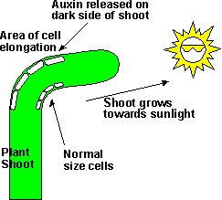
When light is shone on a coleoptile from one direction the bend which occurs is due to an unequal elongation of cells on the side towards and on the side away from light. Elongation of the cells on the lighted side of the coleoptiles is slowed down compared to elongation of cells on the shaded side.
This results in an unequal extension of the lighted and shaded sides of the coleoptiles. To accommodate these elongation inequalities, the coleoptile bends towards the light.

Slide 12
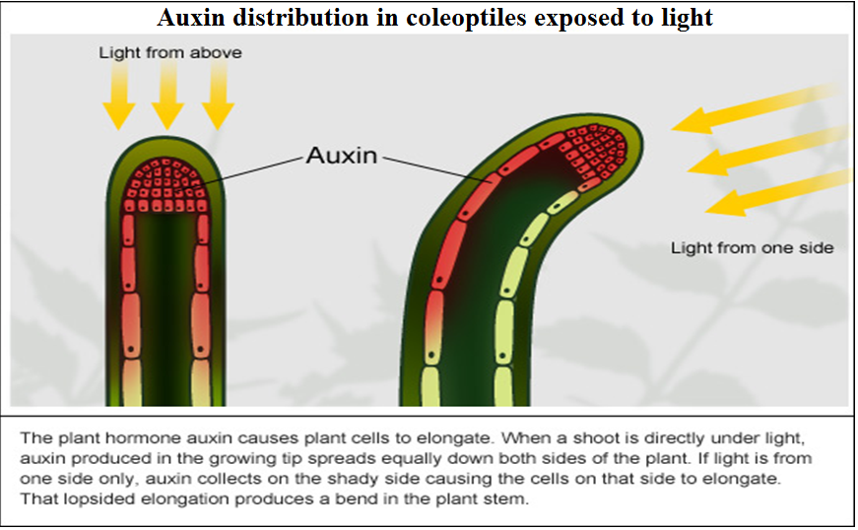
The Cholodny-Went theory explains that the unequal growth was due to lateral transport of auxins away from the lighted to the shaded sides of the plant when tip was exposed to unilateral light.

Slide 13
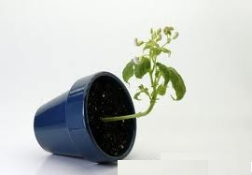
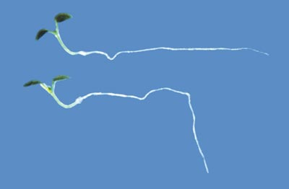
GRAVITROPISM
This is the directional growth of a plant part towards or away from the source of gravity.
Root generally grow towards the source of gravity – positively gravitropic.
Shoot grow away from the source of gravity – negatively gravitropic.

Slide 14
GRAVITROPISM – ROOTS
Primary roots are generally more sensitive to gravity than the lateral roots. Thus primary roots grow vertically downwards while lateral roots grow horizontally.
In higher plants gravity sensing by primary root is the function of the root cap.
The cells in the central cylinder of the root cap region – columella, contain gravity sensitive inclusions.
These cells are known as Statocytes and the gravity sensitive inclusions, probably starch grains, are referred to as statoliths.

Slide 15
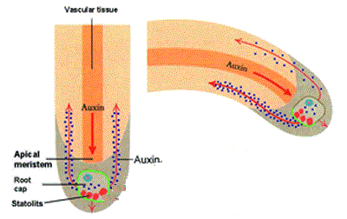
Curvature of the root occurs in the elongation zone of the root and is downward towards the source of gravity. It results from faster growth of cells on the upper than on the lower sides of a horizontal root.
In horizontally placed seedling, auxin accumulates under gravity on the lower side. This leads to a higher concentration of auxin on the lower than the upper side. High concentration of auxin inhibits cell elongation in roots.
The cells on the upper side which have a lower concentration of auxin would elongate more compared to the cells on the lower side which have higher auxin concentration.
THUS THE ROOT BENDS DOWNWARDS IN THE DIRECTION OF GRAVITY

Slide 16
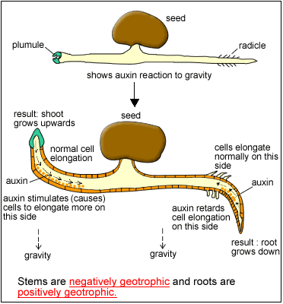
GRAVITROPISM – SHOOTS
Coleoptiles that have been placed horizontally bend and grow vertically upwards. This is because cells on the lower side elongate much more than those on the upper side of the horizontal coleoptiles. Relatively higher concentration of auxin stimulates elongation of cells in the shoot

